Slide 1
David Hanauer, MD, MS
University of Michigan
hanauer@umich.edu
Twitter: @DavidHanauer2
MARCH Informatics Committee Mtg
July 7, 2020
http://project-emerse.org/presentations.html

Slide 2
If you’re thinking of taking notes
these slides can be found at:
link will be on
most slides
http://project-emerse.org/presentations.html

Slide 3
slides
1
live demo
2
roadmap for
today’s
presentation
Q&A
3
http://project-emerse.org/presentations.html

Slide 4
What is EMERSE?
A search engine, kind of like Google, for free text medical record documents
(technically, it’s an information retrieval system)
Simple to use
Designed to be self-serve*
*Once access is approved
http://project-emerse.org/presentations.html

Slide 5
What is EMERSE?
A research tool, available at no cost
Open source, Apache 2.0 licensing
Picking the right tool for your research is important
multiple tools are often needed
http://project-emerse.org/presentations.html

Slide 6
Unstructured vs Structured Data
EMERSE is for this… | i2b2 is for this…
Unstructured Data (free text) | Structured Data
Mrs. Jones is a 56 year old female with a h/o HTN, T2DM, and, and high cholesterol who comes to the clinic today with a 3 day h/o coughing, fever, and severe headache. | WBC: 5.6 Total cholesterol: 182 Weight: 67.4 AST: 30 ALT: 52
http://project-emerse.org/presentations.html

Slide 7
80% of EHR data are in unstructured free text
structured data
unstructured data/free text
http://project-emerse.org/presentations.html

Slide 8
80% of EHR data are in unstructured free text
"potential cases may be missed or wrongly dated when coded data alone are used..” (PMID: 23964710)
"structured data is best used for first pass filtering of EHR data…prior to a more nuanced second pass using unstructured data" (PCMID: PMC4333685)
"...urinary incontinence, an important patient-centered outcome following prostate cancer treatment, was reported almost exclusively in the free text of EHRs and was rarely coded as an ICD 9 diagnosis code.” (PMCID: PMC4899050)
"Claims and structured EHR data give an incomplete picture of burden related to geriatric syndromes. Geriatric syndromes are likely to be missed if unstructured data are not analyzed."
(PMID: 29972595)
http://project-emerse.org/presentations.html

Slide 9
What isn’t EMERSE?
It is not: natural language processing (NLP)
but full NLP may not always be needed
and NLP can be hard to use or customize
http://project-emerse.org/presentations.html

Slide 10
EMERSE vs NLP
EMERSE: augmented intelligence
NLP: artificial intelligence
http://project-emerse.org/presentations.html

Slide 11
EMERSE vs NLP
NLP
EMERSE
http://project-emerse.org/presentations.html

Slide 12
With EMERSE: find cohorts
EMERSE allows you to find cohorts based on things mentioned in the notes
diseases
drugs
symptoms
more!
http://project-emerse.org/presentations.html

Slide 13
Find cohorts
It’s perfect for finding diagnoses that don’t have a specific ICD-10 code… like leiomyosarcoma…
https://www.icd10data.com/search?s=leiomyosarcoma
http://project-emerse.org/presentations.html

Slide 14
Highlight documents for chart review
A chest x-ray was obtained and revealed the presence of patchy consolidations in bilateral lower lobes. CT chest/abdomen/pelvis (Fig. 1 ) was notable for diffuse ground-glass opacities in the periphery of bilateral lungs as well as splenomegaly with a splenic hypodensity measuring 8.6 × 0.7 cm and surrounding peri-splenic edema, consistent with a splenic infarct. Hydroxychloroquine and a one-time dose of Tocilizumab were administered along with supportive measures. A continuous heparin infusion was also initiated and patient was admitted to the general medical ward for further workup.
https://www.ncbi.nlm.nih.gov/pmc/articles/PMC7256550/
http://project-emerse.org/presentations.html

Slide 15
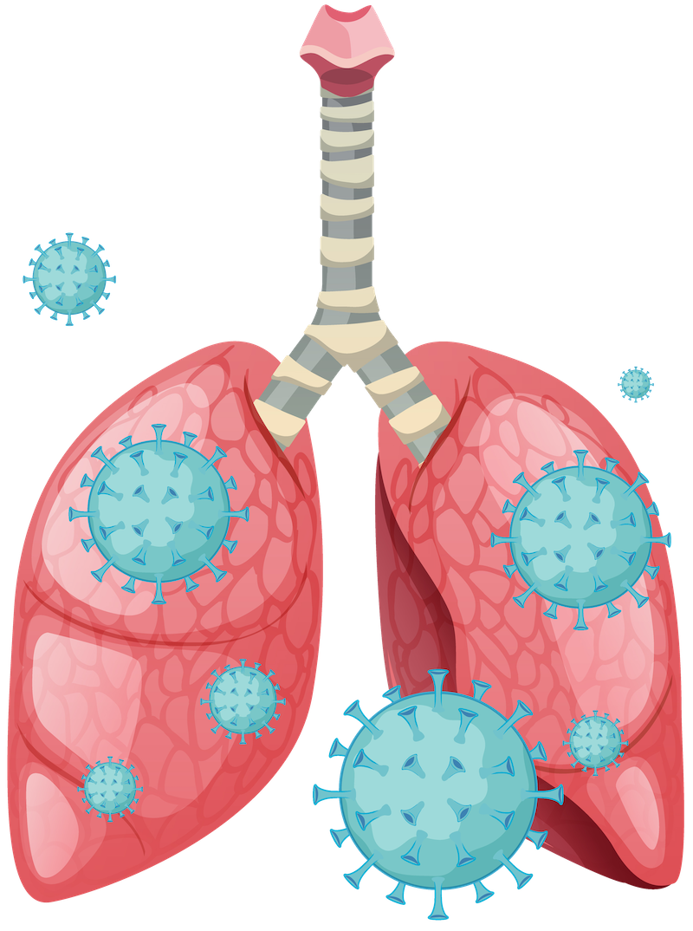
Chart review
Research team at Michigan Medicine used
EMERSE to identify presenting symptoms for
COVID-19, including:
dyspnea | rhinorrhea or congestion | vomiting
wheezing | myalgia or arthralgia | abdominal pain
cough | fatigue or malaise | chest pain or tightness
sputum production | headache | loss of smell or taste
blood in sputum | loss of appetite | altered mental status
sore throat | diarrhea | weakness
fever or chills | nausea | lightheadedness or syncope
http://project-emerse.org/presentations.html

Slide 16
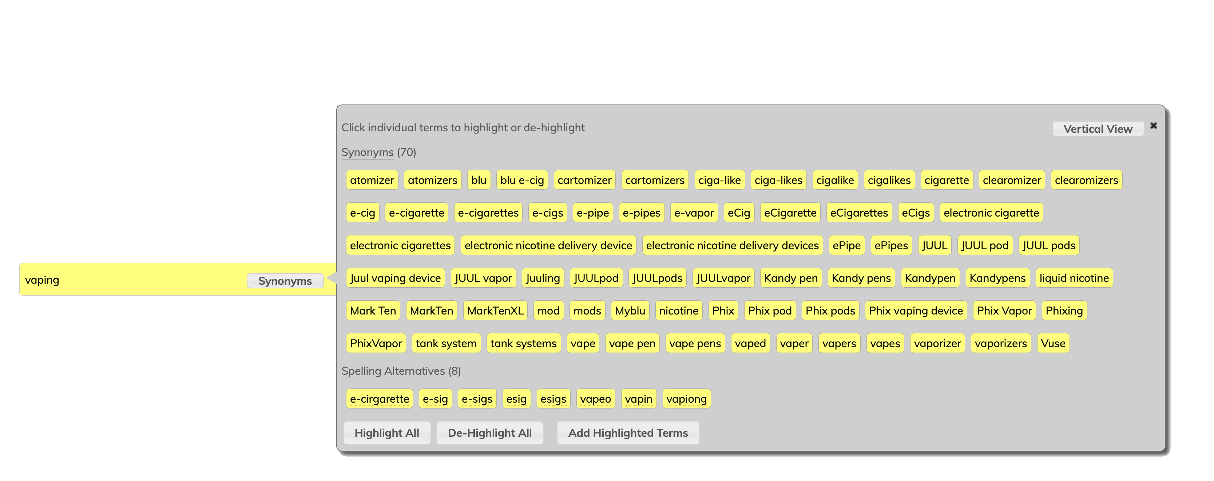
EMERSE query expansion
http://project-emerse.org/presentations.html

Slide 17
EMERSE query expansion
Can use “EMERSE Synonyms” or upload your own dataset (e.g., ICD-10, human phenotype ontology, MeSH terms)
Simple file format
http://project-emerse.org/documentation/administrator_guide.html#truepreparing-a-synonyms-file
http://project-emerse.org/presentations.html

Slide 18
EMERSE Synonyms
Manually curated over past 12+ years
Terms/phrases not found in standard vocabularies, taxonomies, ontologies (but found in clinical notes)
Academic and non-academic licensing available*
> 1.1 million unique rows
Details are at:
http://project-emerse.org/synonyms.html
To explore a subset, visit:
http://www.davidhanauer.com/EMERSE_synonyms_T_Terms/
*David Hanauer is entitled
to a portion of the license fees
http://project-emerse.org/presentations.html

Slide 19
EMERSE Synonyms
Category | Example
Acronyms | CXR chest x-ray
Abbreviations | chemotherapy chemo
Professional and consumer terms | emesis puking
Misspellings | diarriea diahhrea
Trade and generic drug names | Tylenol acetaminophen
Chemotherapy regimens | FOLFOX, folinic acid, fluorouracil, oxaliplatin
Word Stems | sleep, sleeping, sleepy
Category | Example
True synonyms | frigid cold
Phrasing variations | lido w/ epi epi-lidocaine
Malapropisms/ usage errors | beast mass prostrate cancer
Root word variations | adenotonsillectomy tonsilloadenoidectomy
Hyphenations | pseudosarcomatous pseudo-sarcomatous
Idioms | under the knife under the weather
Neologisms | trabecularity (vs trabeculation)
http://project-emerse.org/presentations.html

Slide 20
EMERSE Bundles
Saved sets of search terms
Shared among users
Helps standardize searches
Supports reproducibility
- Some teams publish Bundles
in their publication’s appendix
(example: https://www.ncbi.nlm.nih.gov/pmc/articles/PMC3860174/)
http://project-emerse.org/presentations.html

Slide 21
What’s in EMERSE?
Free text notes
admission notes
history and physical
progress notes
pathology reports
radiology reports
more!
@ Michigan: 2.5 million patients
170 million notes
1995-present
http://project-emerse.org/presentations.html

Slide 22
What’s not in EMERSE?
Structured data
discrete lab values
vital signs
billing codes
Other tools such as i2b2 exist for structured data
http://project-emerse.org/presentations.html

Slide 23
Typical workflow
initial cohort identified
with a cohort discovery
tool (i2b2) using structured data (or via EMERSE
‘Find Patients’)
http://project-emerse.org/presentations.html

Slide 24
Typical workflow
additional details abstracted from the free text using EMERSE
http://project-emerse.org/presentations.html

Slide 25
Typical workflow
Data recorded in an electronic data capture system (REDCap)
http://project-emerse.org/presentations.html

Slide 26
Publications using EMERSE
354 papers
54 abstracts
Full list can be found at:
http://project-emerse.org/publications.html
http://project-emerse.org/presentations.html

Slide 27
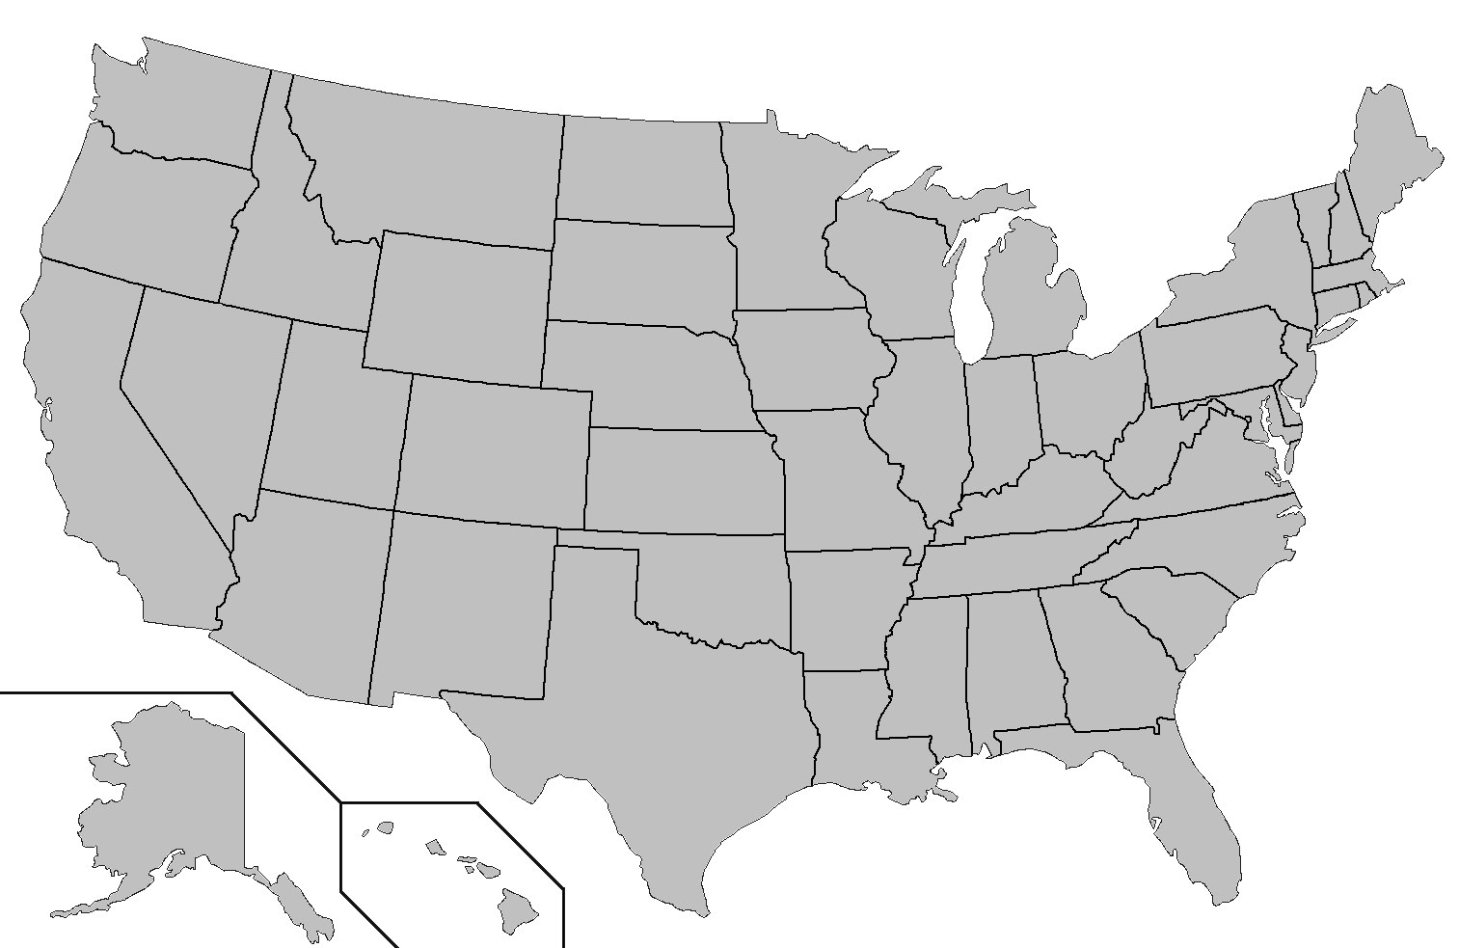
Where is EMERSE?
installed
Case Western Reserve
installing
U of Michigan
Columbia
UCSF
U of Cincinnati
U of Virginia
U of Kentucky
UNC-Chapel Hill
http://project-emerse.org/presentations.html

Slide 28
Getting EMERSE
local installation required
need support of IT team
similar to i2b2
EHR-agnostic
runs independent of EHR
need a way to extract documents to send to EMERSE
http://project-emerse.org/presentations.html

Slide 29
Test driving EMERSE
online demo
videos on website
virtual machine
- could be used for
individual projects
http://project-emerse.org/presentations.html

Slide 30
project-emerse.org
http://project-emerse.org/presentations.html

Slide 31
hanauer@umich.edu
http://project-emerse.org/presentations.html

Slide 32
Acknowledgements
Michigan Institute
for Clinical and
Health Research
(MICHR)
[UL1TR000433]
NCI Information
Technology for
Cancer Research
(ITCR)
[U24CA204863]
U of Michigan
Rogel Cancer Center
[P30CA046592]
U of Michigan
Health Information
and Technology
Services (HITS)
http://project-emerse.org/presentations.html

