Slide 1
Hem/Onc Clinical Trials Course
David Hanauer
hanauer@umich.edu
July 21, 2020
http://project-emerse.org/presentations.html
slides: http://bit.ly/emerse-november-2019

Slide 2
If you’re thinking of taking notes
these slides can be found at:
link will be on
most slides
http://project-emerse.org/presentations.html

Slide 3
slides
1
live demo
2
roadmap for
today’s
presentation
Q&A
3
http://project-emerse.org/presentations.html

Slide 4
Goals
• Describes tools for research
• Discuss free text vs structured data
• Describe use cases for EMERSE
• Introduce capabilities of EMERSE
• Explain how access is obtained
• Show a live demo of EMERSE
http://project-emerse.org/presentations.html

Slide 5
What is EMERSE?
A search engine, kind of like Google, for free text medical record documents
(technically, it’s an information retrieval system)
Simple to use
http://project-emerse.org/presentations.html

Slide 6
What is EMERSE?
A research tool, available at no cost
requires local implementation
picking the right tool for your research is important; multiple tools are often needed
http://project-emerse.org/presentations.html

Slide 7
Unstructured vs Structured Data
EMERSE is for this… | …not this
Unstructured Data (free text) | Structured Data
Mrs. Jones is a 56 year old female with a history of HTN, hypercholesterolemia, and T2DM who comes to the clinic today with a 3 day h/o dizziness and severe headache on the left side. | WBC: 5.6 Total cholesterol: 182 Weight: 67.4 AST: 30 ALT: 52
http://project-emerse.org/presentations.html

Slide 8
80% of EHR data are in unstructured free text
structured data
unstructured data/free text
http://project-emerse.org/presentations.html

Slide 9
80% of EHR data are in unstructured free text
"potential cases may be missed or wrongly dated when coded data alone are used..” (PMID: 23964710)
"structured data is best used for first pass filtering of EHR data…prior to a more nuanced second pass using unstructured data" (PCMID: PMC4333685)
"...urinary incontinence, an important patient-centered outcome following prostate cancer treatment, was reported almost exclusively in the free text of EHRs and was rarely coded as an ICD 9 diagnosis code.” (PMCID: PMC4899050)
"Claims and structured EHR data give an incomplete picture of burden related to geriatric syndromes. Geriatric syndromes are likely to be missed if unstructured data are not analyzed."
(PMID: 29972595)
http://project-emerse.org/presentations.html

Slide 10
What isn’t EMERSE?
It is not: natural language processing (NLP)
but full NLP may not always be needed
and NLP can be hard to use or customize
http://project-emerse.org/presentations.html

Slide 11
EMERSE vs NLP
EMERSE: augmented intelligence
NLP: artificial intelligence
http://project-emerse.org/presentations.html

Slide 12
EMERSE vs NLP
NLP
EMERSE
http://project-emerse.org/presentations.html

Slide 13
Find cohorts
EMERSE allows you to find cohorts based on things mentioned in the notes
diseases
drugs
symptoms
anything!
http://project-emerse.org/presentations.html

Slide 14
Find cohorts
It’s perfect for finding rare things…
…like rare cancers
http://project-emerse.org/presentations.html

Slide 15
Find cohorts
It’s perfect for finding diagnoses that don’t have a specific ICD-10 code… like leiomyosarcoma
https://www.icd10data.com/search?s=leiomyosarcoma
http://project-emerse.org/presentations.html

Slide 16
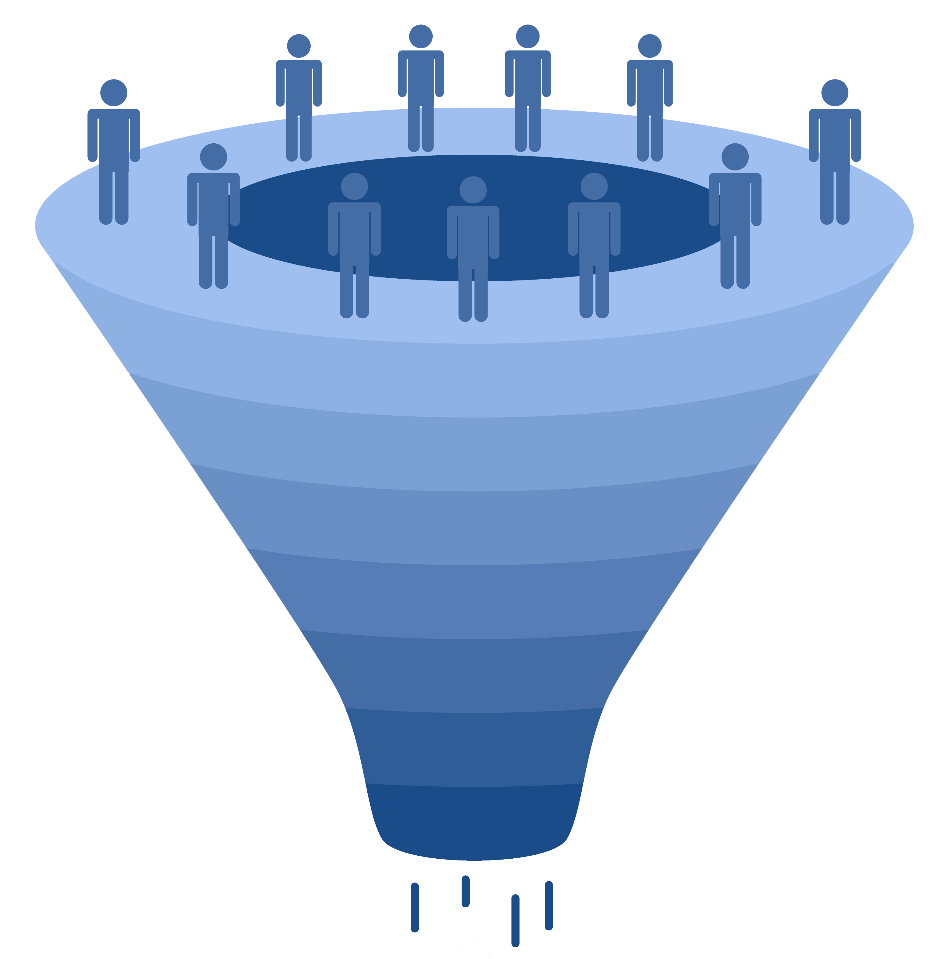
Working with cohorts
upload a list
of patients
find a cohort
from within
EMERSE
import list
from another
system
EMERSE patient lists
(up to 100,000 per list)
http://project-emerse.org/presentations.html

Slide 17
Highlight documents for chart review
Thoracocentesis confirmed the recurrence of mantle cell lymphoma. Disease restaging work-up revealed multicompartment lymphadenopathy in the neck, mediastinal, retrocrural, retroperitoneal and pelvic regions. Bone marrow was also involved. The patient was treated with a total of six cycles of rituximab, cyclophosphamide, vincristine, doxorubicin and dexamethasone (R-HyperCVAD) completed in January 2007. That treatment led to complete remission that lasted until October 2008, when the disease was found to have recurred in the left pleural space and retroperitoneum without bone marrow involvement.
https://jmedicalcasereports.biomedcentral.com/articles/10.1186/1752-1947-4-329
http://project-emerse.org/presentations.html

Slide 18
What’s in EMERSE?
Free text notes
admission notes
history and physical
progress notes
pathology reports
radiology reports
more!
@ Michigan: 2.5 million patients
170 million notes
1995-present
http://project-emerse.org/presentations.html

Slide 19
What’s not in EMERSE?
Structured data
discrete lab values
vital signs
billing codes
Other tools exist for
structured data (DataDirect, i2b2, etc)
http://project-emerse.org/presentations.html

Slide 20
Typical workflow
initial cohort identified
with a cohort discovery
tool using structured data (or via EMERSE
‘Find Patients’)
Cohort discovery tools:
DataDirect @ Michigan
i2b2, LEAF, others elsewhere
http://project-emerse.org/presentations.html

Slide 21
Typical workflow
additional details abstracted from the free text using EMERSE
http://project-emerse.org/presentations.html

Slide 22
Typical workflow
Data recorded in an electronic data capture system (e.g., REDCap)
http://project-emerse.org/presentations.html

Slide 23
Publications using EMERSE
346 papers
52 abstracts
Full list at:
http://project-emerse.org/publications.html
http://project-emerse.org/presentations.html

Slide 24
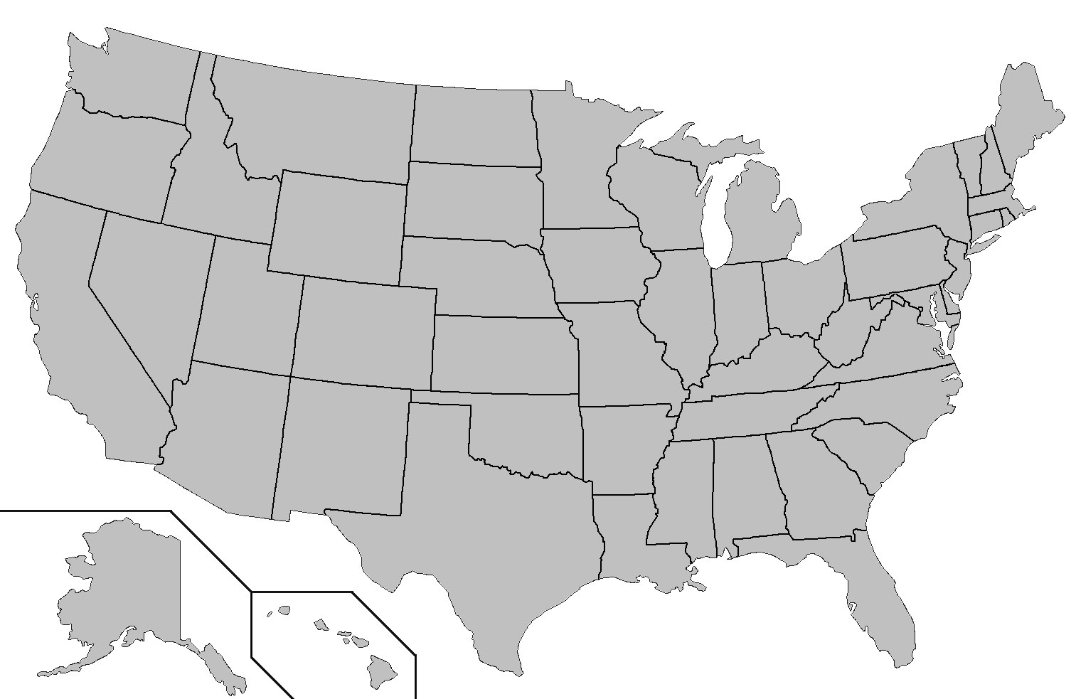
Where is EMERSE?
installed
installing
http://project-emerse.org/presentations.html

Slide 25
The future…
installed
installing
http://project-emerse.org/presentations.html

Slide 26
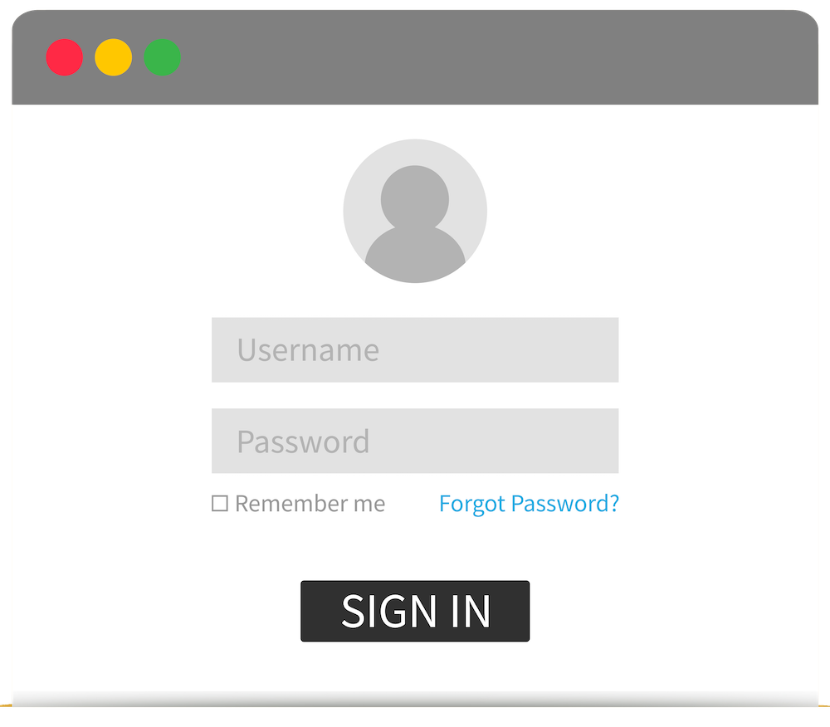
Getting access to EMERSE
@ Michigan
• Research: Data Office
(need IRB approval)
• Non-research: Through Michart (contact David Hanauer for details)
http://project-emerse.org/presentations.html

Slide 27
Who can obtain access?
@ Michigan
Anyone with EHR access, BUT:
• you need a valid reason such as research, operations, quality
• “curiosity” is not a valid reason
• all usage is tracked
http://project-emerse.org/presentations.html

Slide 28
project-emerse.org
http://project-emerse.org/presentations.html

Slide 29
hanauer@umich.edu
http://project-emerse.org/presentations.html

Slide 30
Acknowledgements
U of Michigan
Michigan Institute
for Clinical and
Health Research
(MICHR)
U of Michigan
Rogel Cancer Center
U of Michigan
Health Information
and Technology
Services (HITS)
NCI Information
Technology for
Cancer Research
(ITCR)
http://project-emerse.org/presentations.html

