Slide 1
Introduction to EMERSE:
EMERSE 101
David Hanauer, MD, MS
University of Michigan
hanauer@umich.edu
Twitter: @informaticsGeek
@projectEMERSE
August 18, 2021
http://project-emerse.org/presentations.html

Slide 2
If you’re thinking of taking notes
these slides can be found at:
link will be on
most slides
http://project-emerse.org/presentations.html

Slide 3
Disclosure
EMERSE is available at no cost under the
Apache 2.0 open source license
An optional addition to EMERSE is the
“Synonyms Collection”, for which
David Hanauer is entitled to a portion of the
license fees
LICENSE
http://project-emerse.org/presentations.html

Slide 4
slides
1
live demo
2
roadmap for
today’s
presentation
Q&A
3
http://project-emerse.org/presentations.html

Slide 5
Goals
• Describes tools for research
• Discuss free text vs structured data
• Describe use cases for EMERSE
• Introduce capabilities of EMERSE
• Show a live demo of EMERSE
http://project-emerse.org/presentations.html

Slide 6
What is EMERSE?
A search engine, kind of like Google, for free text medical record documents
(technically, it’s an information retrieval system)
Simple to use
http://project-emerse.org/presentations.html

Slide 7
What is EMERSE?
A research tool, available at no cost
requires local implementation
picking the right tool for your research is important; multiple tools are often needed
http://project-emerse.org/presentations.html

Slide 8
Unstructured vs Structured Data
EMERSE is for this… | …not this
Unstructured Data (free text) | Structured Data
Mrs. Jones is a 56 year old female with a history of HTN, hypercholesterolemia, and T2DM who comes to the clinic today with a 3 day h/o dizziness and severe headache on the left side. | WBC: 5.6 Total cholesterol: 182 Weight: 67.4 AST: 30 ALT: 52
http://project-emerse.org/presentations.html

Slide 9
80% of EHR data are in unstructured free text
structured data
unstructured data/free text
http://project-emerse.org/presentations.html

Slide 10
80% of EHR data are in unstructured free text
"potential cases may be missed or wrongly dated when coded data alone are used..” (PMID: 23964710)
"structured data is best used for first pass filtering of EHR data…prior to a more nuanced second pass using unstructured data" (PCMID: PMC4333685)
"...urinary incontinence, an important patient-centered outcome following prostate cancer treatment, was reported almost exclusively in the free text of EHRs and was rarely coded as an ICD 9 diagnosis code.” (PMCID: PMC4899050)
"Claims and structured EHR data give an incomplete picture of burden related to geriatric syndromes. Geriatric syndromes are likely to be missed if unstructured data are not analyzed."
(PMID: 29972595)
http://project-emerse.org/presentations.html

Slide 11
What isn’t EMERSE?
It is not: natural language processing (NLP)
but full NLP may not always be needed
and NLP can be hard to use or customize
http://project-emerse.org/presentations.html

Slide 12
EMERSE vs NLP
EMERSE: augmented intelligence
NLP: artificial intelligence
http://project-emerse.org/presentations.html

Slide 13
EMERSE vs NLP
NLP
EMERSE
http://project-emerse.org/presentations.html

Slide 14
Find cohorts
EMERSE allows you to find cohorts based on things mentioned in the notes
diseases
drugs
symptoms
anything*
*if it is mentioned
http://project-emerse.org/presentations.html

Slide 15
Find cohorts
It’s perfect for finding rare things…
…like rare cancers
http://project-emerse.org/presentations.html

Slide 16
Find cohorts
It’s perfect for finding diagnoses that don’t have a specific ICD-10 code… like leiomyosarcoma…
https://www.icd10data.com/search?s=leiomyosarcoma
http://project-emerse.org/presentations.html

Slide 17
Find cohorts
…or Bainbridge-Ropers Syndrome
…or hundreds of other disorders with no specific code
https://www.icd10data.com/search?s=leiomyosarcoma
http://project-emerse.org/presentations.html

Slide 18
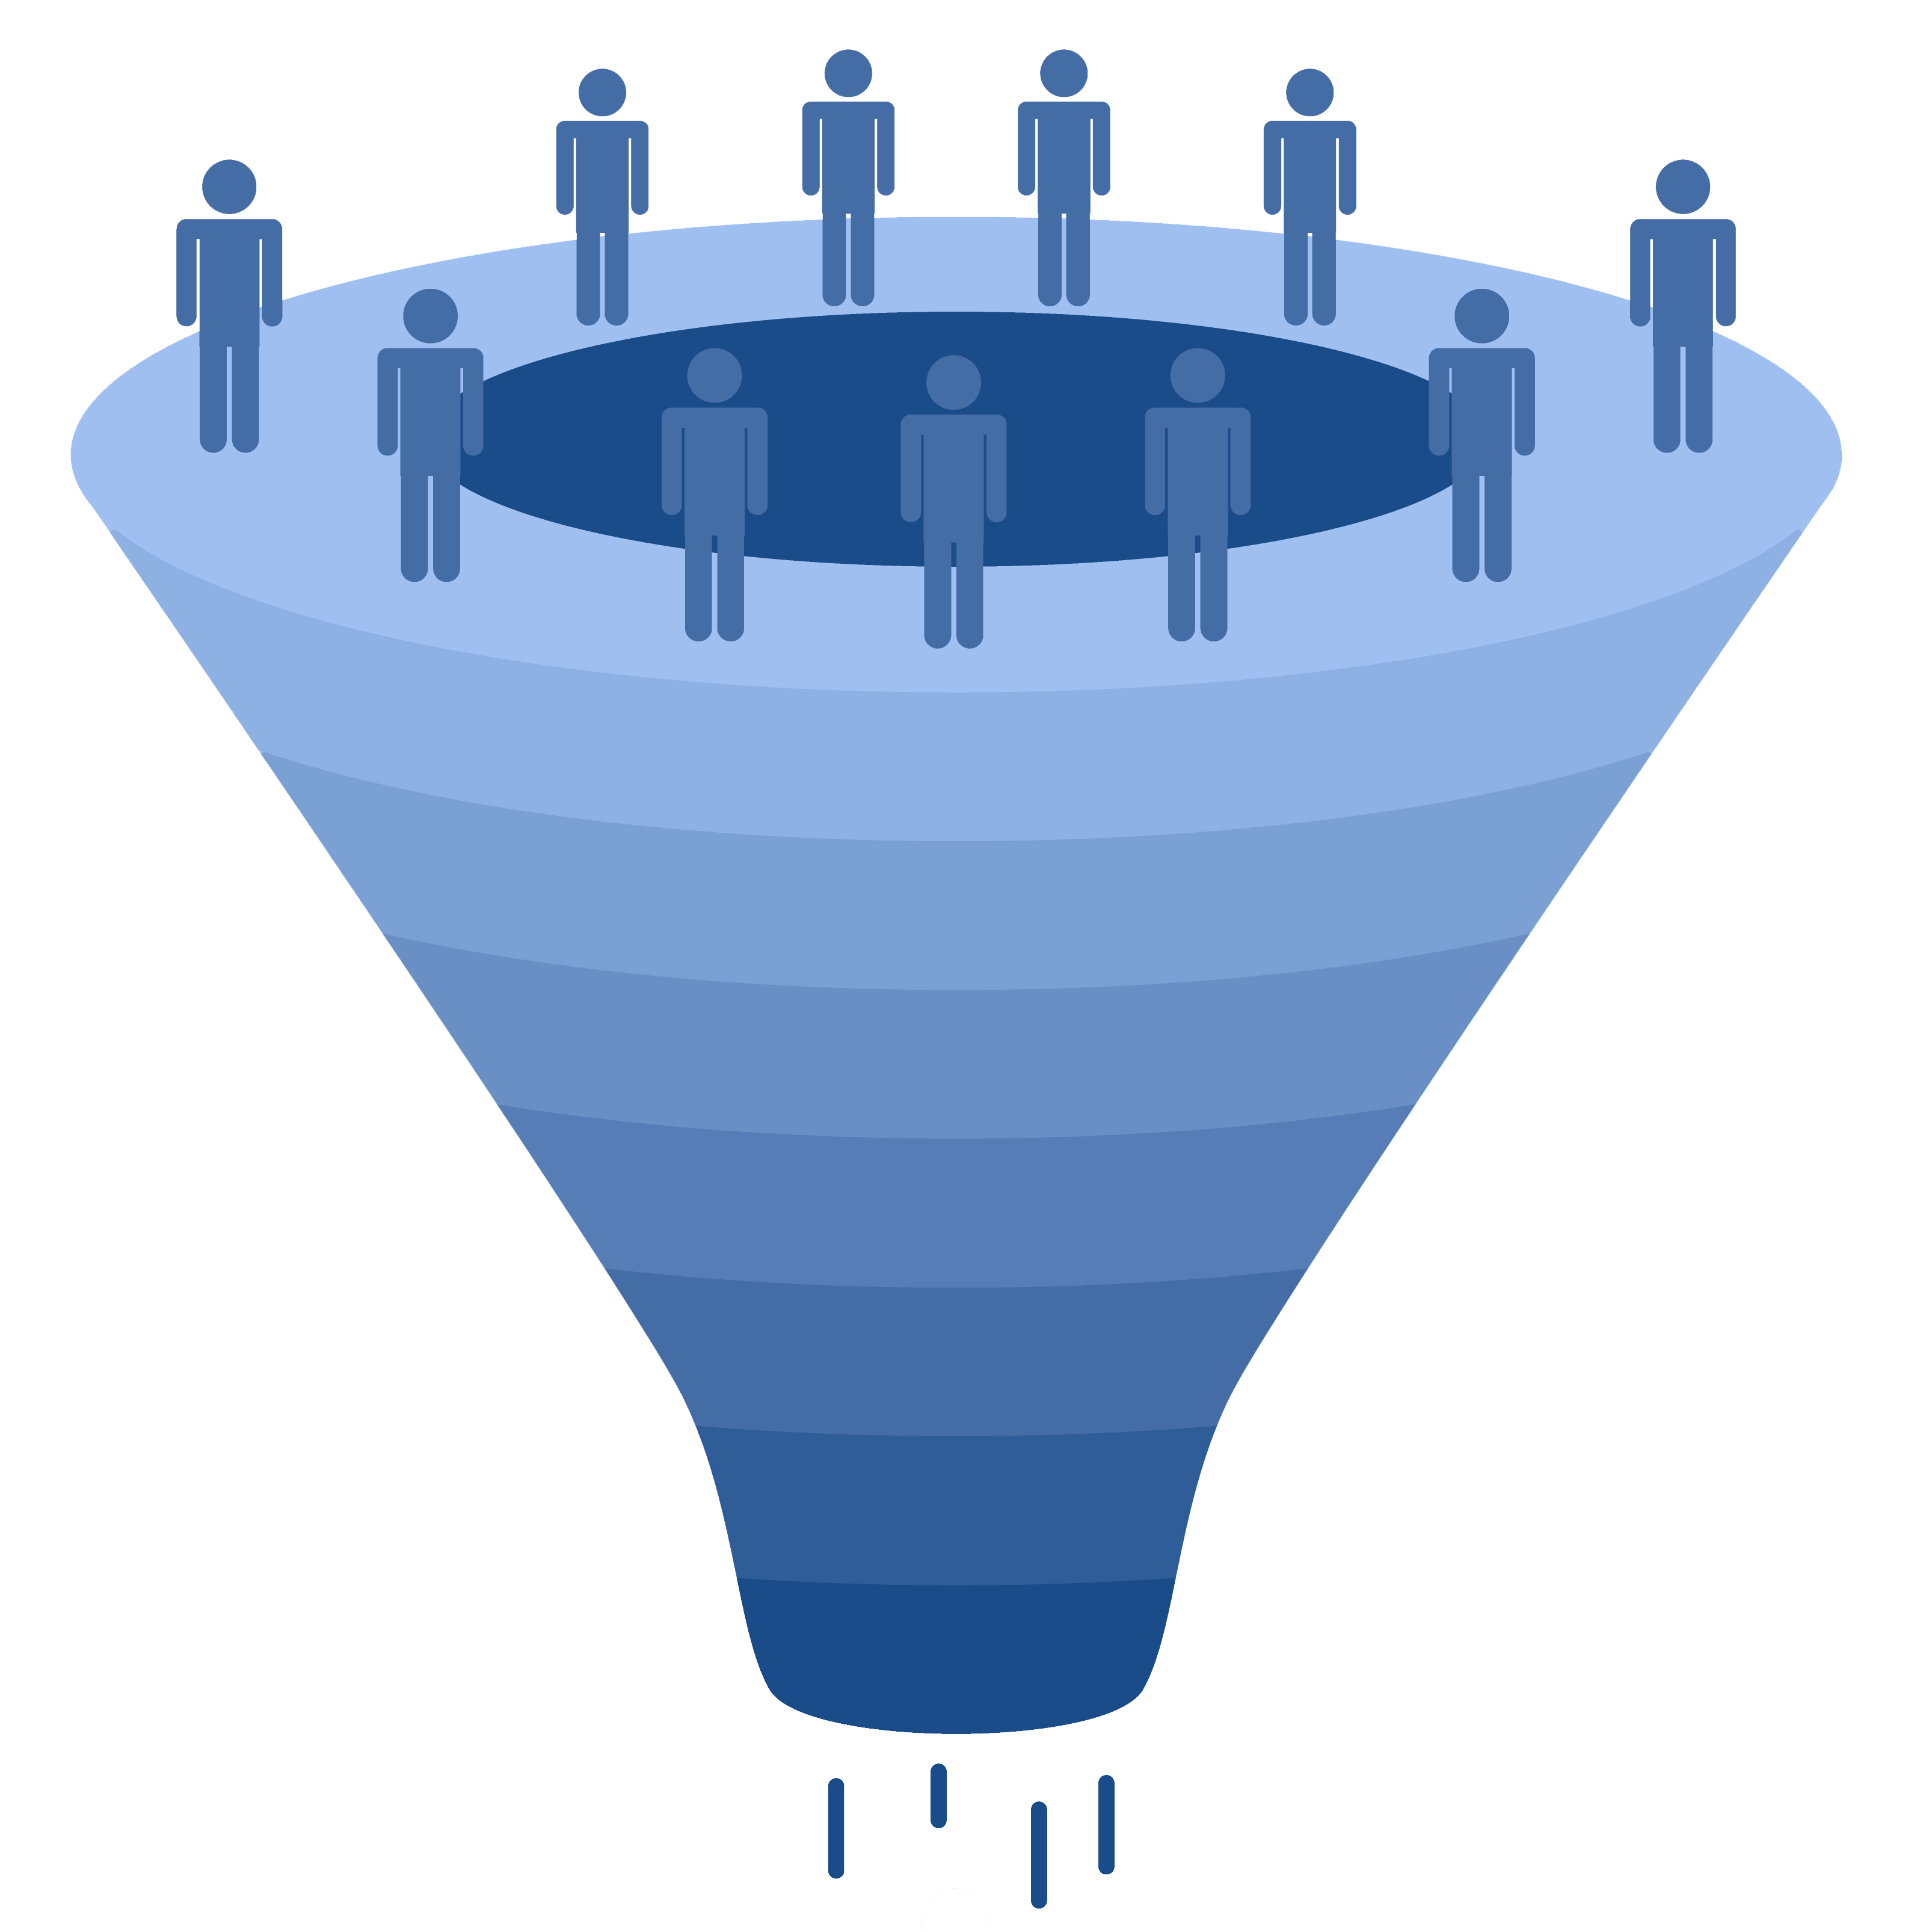
Working with cohorts
upload a list
of patients
find a cohort
from within
EMERSE
import list
from another
system
EMERSE patient lists
(from 1 to 100,000 patients per list)
http://project-emerse.org/presentations.html

Slide 19
Highlight documents for chart review
Thoracocentesis confirmed the recurrence of mantle cell lymphoma. Disease restaging work-up revealed multicompartment lymphadenopathy in the neck, mediastinal, retrocrural, retroperitoneal and pelvic regions. Bone marrow was also involved. The patient was treated with a total of six cycles of rituximab, cyclophosphamide, vincristine, doxorubicin and dexamethasone (R-HyperCVAD) completed in January 2007. That treatment led to complete remission that lasted until October 2008, when the disease was found to have recurred in the left pleural space and retroperitoneum without bone marrow involvement.
https://jmedicalcasereports.biomedcentral.com/articles/10.1186/1752-1947-4-329
http://project-emerse.org/presentations.html

Slide 20
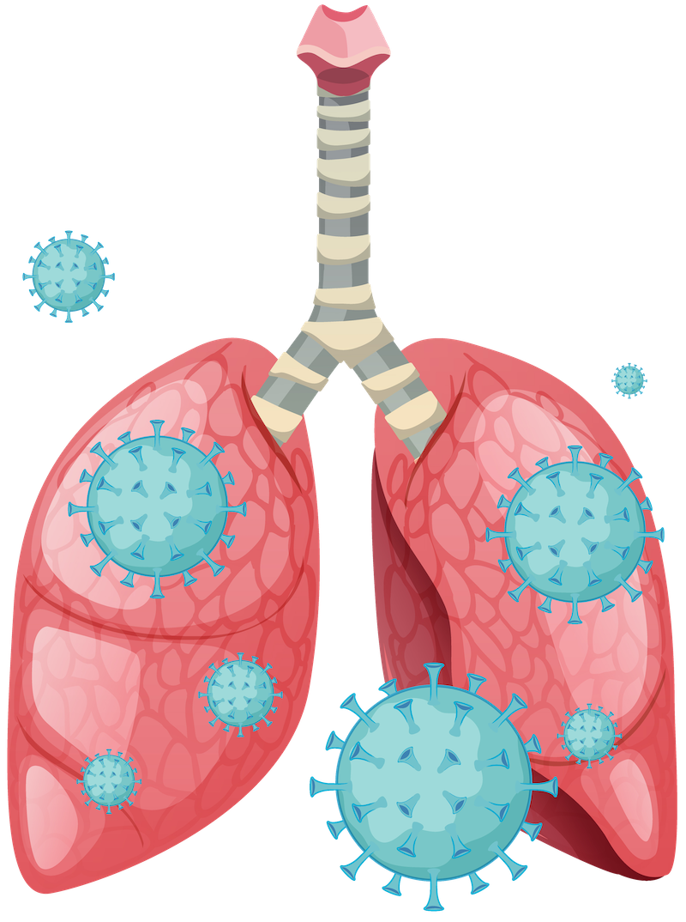
Chart review
Research team at Michigan Medicine used
EMERSE to identify presenting symptoms for
COVID-19, including:
dyspnea | rhinorrhea or congestion | vomiting
wheezing | myalgia or arthralgia | abdominal pain
cough | fatigue or malaise | chest pain or tightness
sputum production | headache | loss of smell or taste
blood in sputum | loss of appetite | altered mental status
sore throat | diarrhea | weakness
fever or chills | nausea | lightheadedness or syncope
https://pubmed.ncbi.nlm.nih.gov/33046294/
http://project-emerse.org/presentations.html

Slide 21
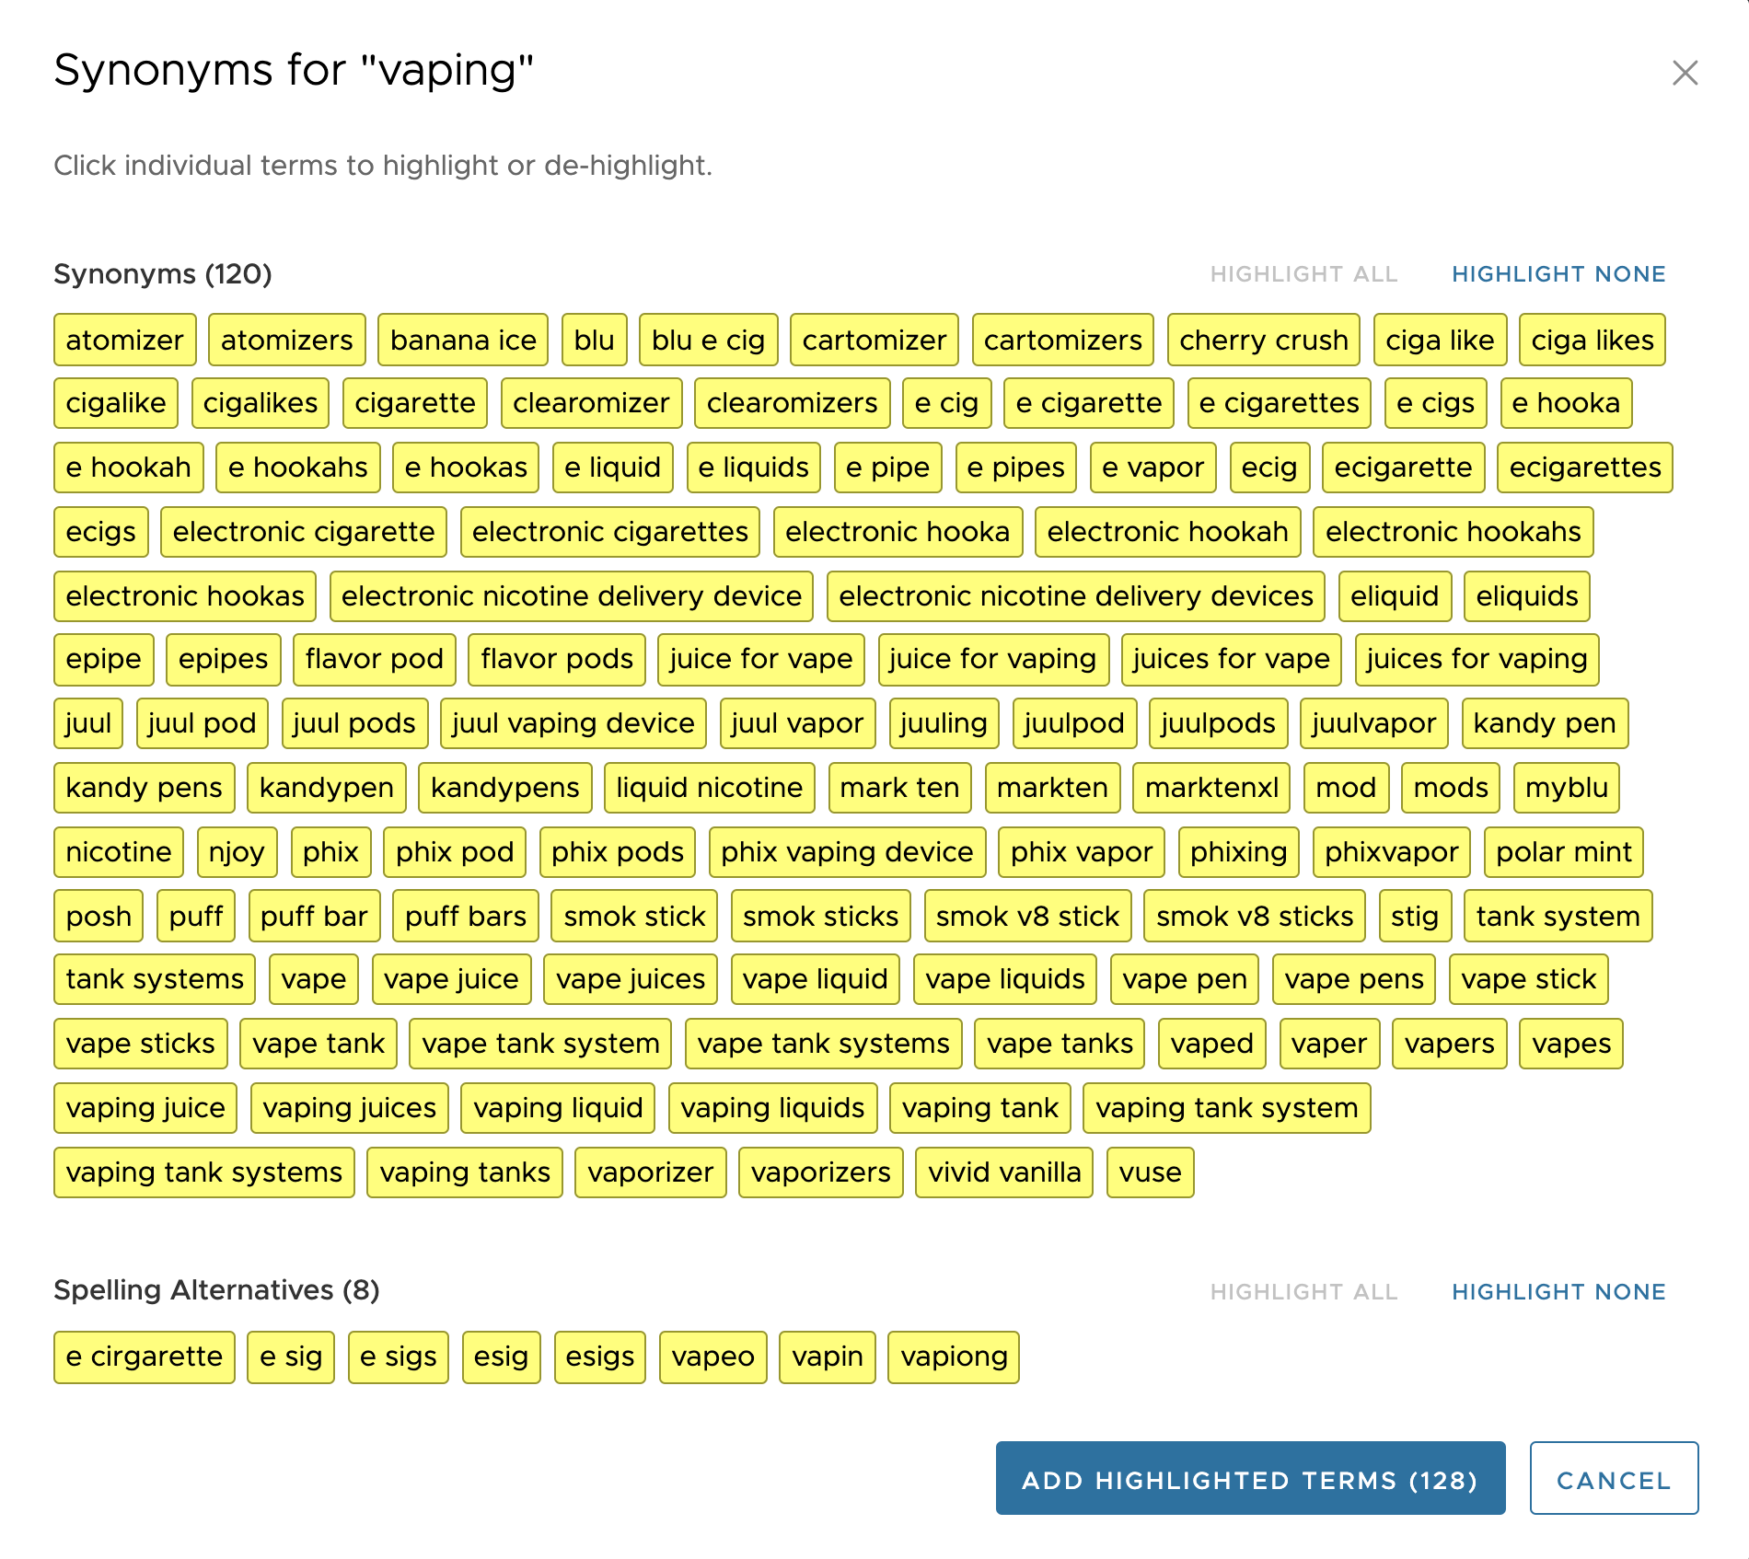
EMERSE query expansion
http://project-emerse.org/presentations.html

Slide 22
EMERSE query expansion
Can use “EMERSE Synonyms Collection” or administrators can upload additional datasets (e.g., ICD-10, human phenotype ontology, MeSH terms)
http://project-emerse.org/presentations.html

Slide 23
EMERSE Synonyms Collection
Manually curated over past 14+ years
Terms/phrases not found in standard vocabularies, taxonomies, ontologies (but found in clinical notes)
Academic and non-academic licensing available
> 1.2 million unique rows
Details are at:
http://project-emerse.org/synonyms.html
To explore a subset, visit:
http://www.davidhanauer.com/EMERSE_synonyms_T_Terms/
http://project-emerse.org/presentations.html

Slide 24
EMERSE Synonyms
Category | Example
Acronyms | CXR chest x-ray
Abbreviations | chemotherapy chemo
Professional and consumer terms | emesis puking
Misspellings | diarriea diahhrea
Trade and generic drug names | Tylenol acetaminophen
Chemotherapy regimens | FOLFOX, folinic acid, fluorouracil, oxaliplatin
Word Stems | sleep, sleeping, sleepy
Category | Example
True synonyms | frigid cold
Phrasing variations | lido w/ epi epi-lidocaine
Malapropisms/ usage errors | beast mass prostrate cancer
Root word variations | adenotonsillectomy tonsilloadenoidectomy
Hyphenations | pseudosarcomatous pseudo-sarcomatous
Idioms | under the knife under the weather
Neologisms | trabecularity (vs trabeculation)
http://project-emerse.org/presentations.html

Slide 25
EMERSE Bundles
Saved sets of search terms
Shared among users
Helps standardize searches
Supports reproducibility
- Some teams publish Bundles
in their publication’s appendix
(example: https://www.ncbi.nlm.nih.gov/pmc/articles/PMC3860174/)
http://project-emerse.org/presentations.html

Slide 26
EMERSE is fast
Query to identify all patients with the following | Epic Clarity time (s) | EMERSE time (s) | EMERSE advantage
cavernous hemangioma | 14,652 | 2 | 7,320x
gray platelet syndrome | 14,940 | 2 | 7,470x
inferior lingular segment of the left upper lobe | 17,784 | 9 | 1,980x
…enabling real-time querying
http://project-emerse.org/presentations.html

Slide 27
What’s in EMERSE?
Free text notes*
admission notes
history and physical
progress notes
pathology reports
radiology reports
*depends on local configuration
@ Michigan: 2.6+ million patients
210+ million notes
1995-present
http://project-emerse.org/presentations.html

Slide 28
What’s not in EMERSE?
Structured data
discrete lab values
vital signs
billing codes
Other tools exist for structured data (DataDirect, i2b2, Leaf, etc.)
http://project-emerse.org/presentations.html

Slide 29
Typical workflow
initial cohort identified
with a cohort discovery
tool using structured data (or via EMERSE
‘Find Patients’)
Cohort discovery tools:
DataDirect @ Michigan
i2b2, LEAF, others elsewhere
http://project-emerse.org/presentations.html

Slide 30
Typical workflow
additional details abstracted from the free text using EMERSE
http://project-emerse.org/presentations.html

Slide 31
Typical workflow
Data recorded in an electronic data capture system (e.g., REDCap)
http://project-emerse.org/presentations.html

Slide 32
Publications using EMERSE
446 papers
81 abstracts
Full list at:
http://project-emerse.org/publications.html
http://project-emerse.org/presentations.html

Slide 33
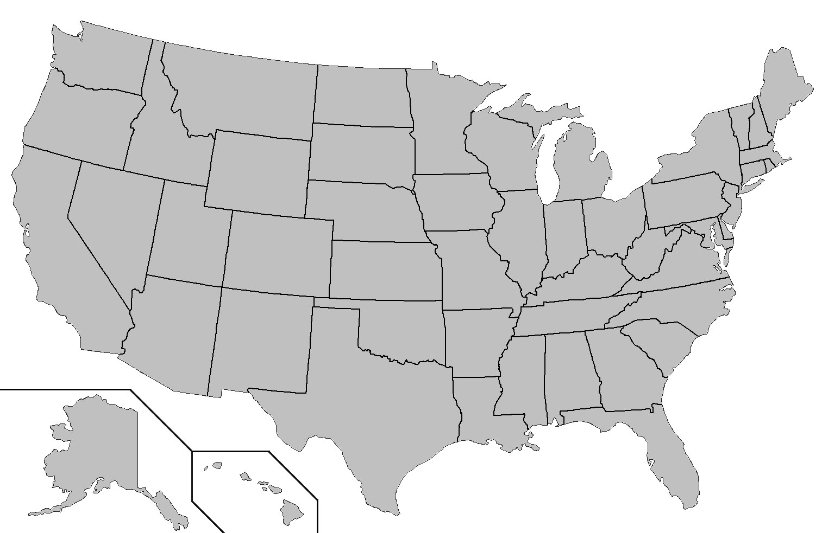
Where is EMERSE?
installed
installing
http://project-emerse.org/presentations.html

Slide 34
The future…
installed
installing
http://project-emerse.org/presentations.html

Slide 35
Who can obtain access?
@ Michigan
Anyone with EHR access, BUT:
• you need a valid reason such as research, operations, quality
• “curiosity” is not a valid reason*
• all usage is tracked
@ elsewhere
Will depend on each site’s local rules
*but we do have a demo site for curious users
http://project-emerse.org/presentations.html

Slide 36
Getting EMERSE
local installation required
need support of IT team
http://project-emerse.org/presentations.html

Slide 37
Under the Hood
EMERSE application
(Java, Javascript)
Apache Solr
Database
http://project-emerse.org/presentations.html

Slide 38
Test driving EMERSE
online demo (contact us)
videos on website
http://project-emerse.org/presentations.html

Slide 39
project-emerse.org
http://project-emerse.org/presentations.html

Slide 40
Twitter: @projectEMERSE
publications
software releases
announcements
webinars
http://project-emerse.org/presentations.html

Slide 41
EMERSE-team@umich.edu
Lisa Ferguson
David Hanauer
Kellen McClain
Guan Wang
http://project-emerse.org/presentations.html

Slide 42
Acknowledgements
U of Michigan
Institute
for Clinical and
Health Research
(MICHR)
U of Michigan
Health Information
and Technology
Services (HITS)
U of Michigan
Department of
Learning Health
Sciences
U of Michigan
Rogel Cancer
Center
NCI Information
Technology for
Cancer Research
(ITCR)
U of Michigan
Office of
Research
Our
Partner
Institutions
Our
Users
http://project-emerse.org/presentations.html

Slide 43
slides
1
live demo
2
roadmap for
today’s
presentation
Q&A
3
http://project-emerse.org/presentations.html

Slide 44
Live demonstration
10,000 simulated patients
500,000 simulated documents
Look and options will differ depending on version and local setup (some components may not be available to all users/sites)
http://project-emerse.org/presentations.html

