Slide 1
EMERSE Networking
Connecting for Prep to Research
9/21/21

Slide 2
Welcome
Session will be recorded
Feel free to use the zoom CHAT feature to submit questions
Program overview:
EMERSE Background, Networking Functional Overview & Demo - David Hanauer, Director of MICHR Informatics Program, Associate Professor - 25 min.
Q&A - 5 min.
EMERSE Network Terms of Use Document - Rebecca Hulea, Compliance Director, Michigan Medicine Compliance - 15 min.
Q&A - 15 min.

Slide 3
EMERSE Background, Networking Functional Overview & Demo

Slide 4
EMERSE – system background
Search engine for clinical documents in the electronic health record (EHR)
Originally built for local use only to query for details in clinical notes (diagnoses, symptoms, medications, complications, and much more)
These notes contain protected health information
Access to the data is limited based on a variety of factors (e.g., IRB approval for research).
Audit logs are maintained
EMERSE is being deployed at multiple institutions nationwide
Each site manages their own: system, data, users, security, access privileges, etc.

Slide 5
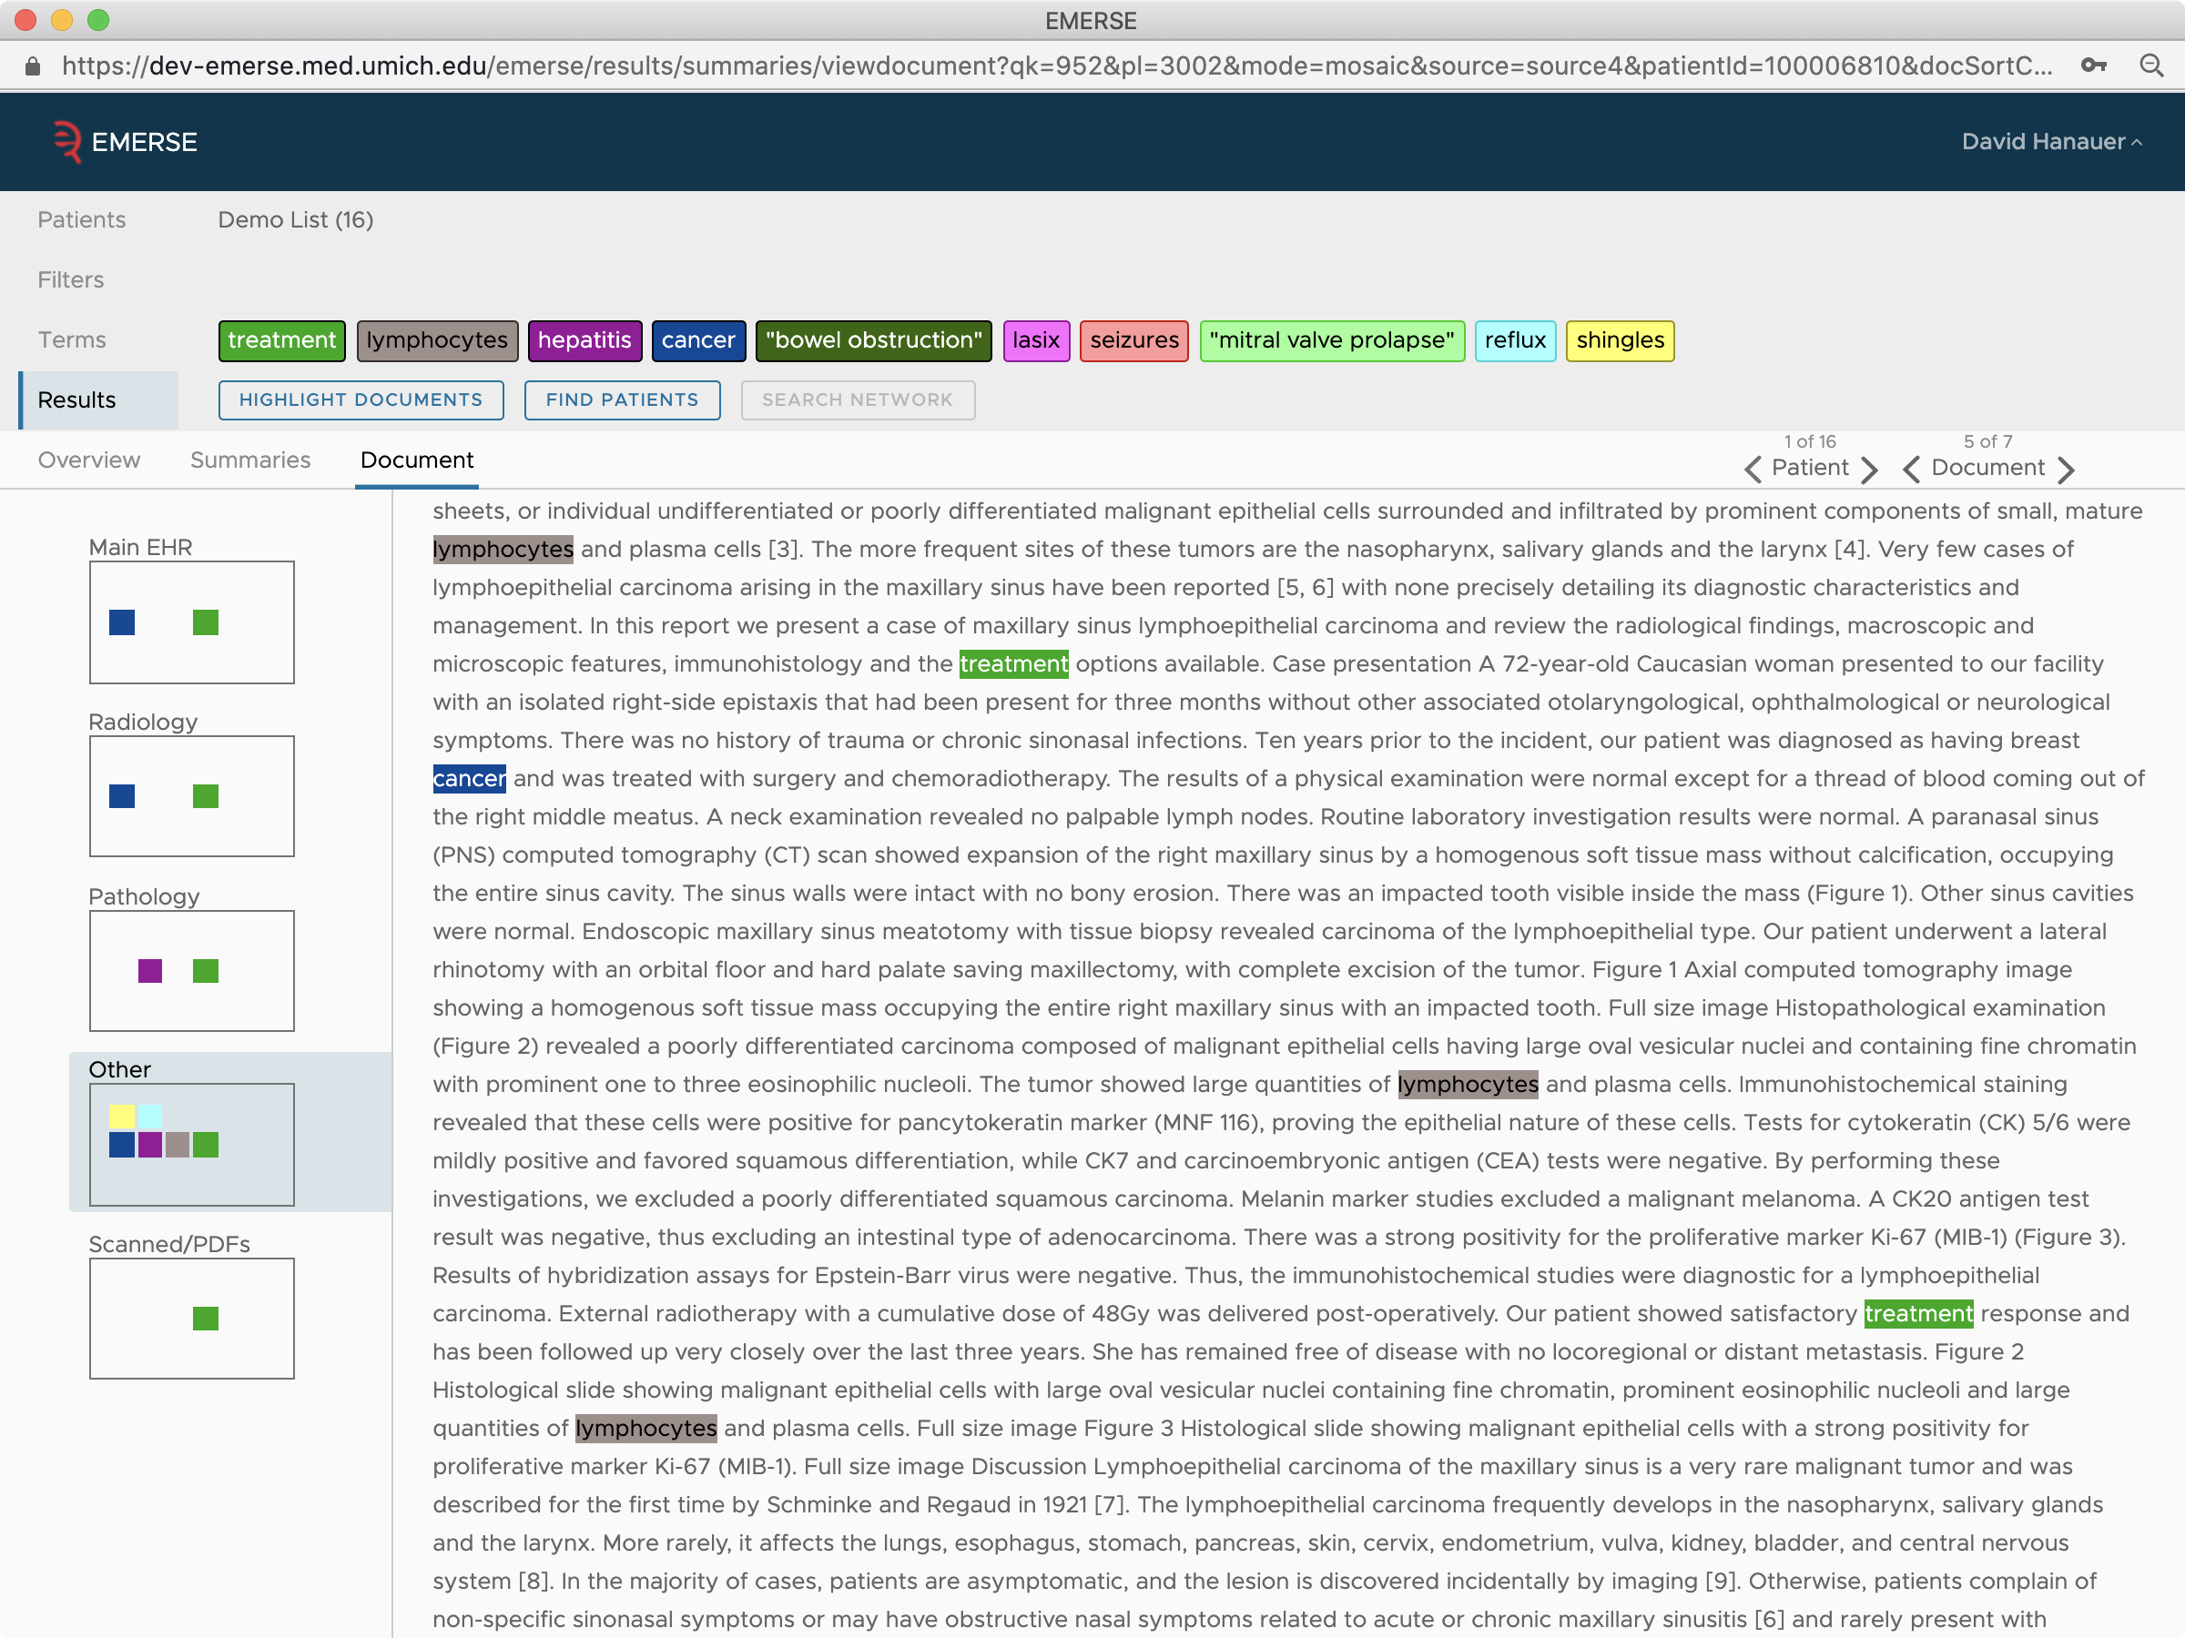
EMERSE standard view (non-network view)

Slide 6
EMERSE – network background
Is there any way to link these sites together in a secure manner to allow limited querying at other sites?
Nothing like this has been done for free text
Could be useful for developing a study, estimating cohorts (preparatory to research), finding collaborating institutions
For structured data, there is a precedent for this type of network: i2b2 SHRINE/ACT
ACT–Accrual to Clinical Trials–allows users to use structured data (e.g., diagnosis codes) to query other sites for obfuscated counts
SHRINE–Shared Health Research Information Network
EMERSE network is inspired by, but independent from, i2b2/ACT

Slide 7
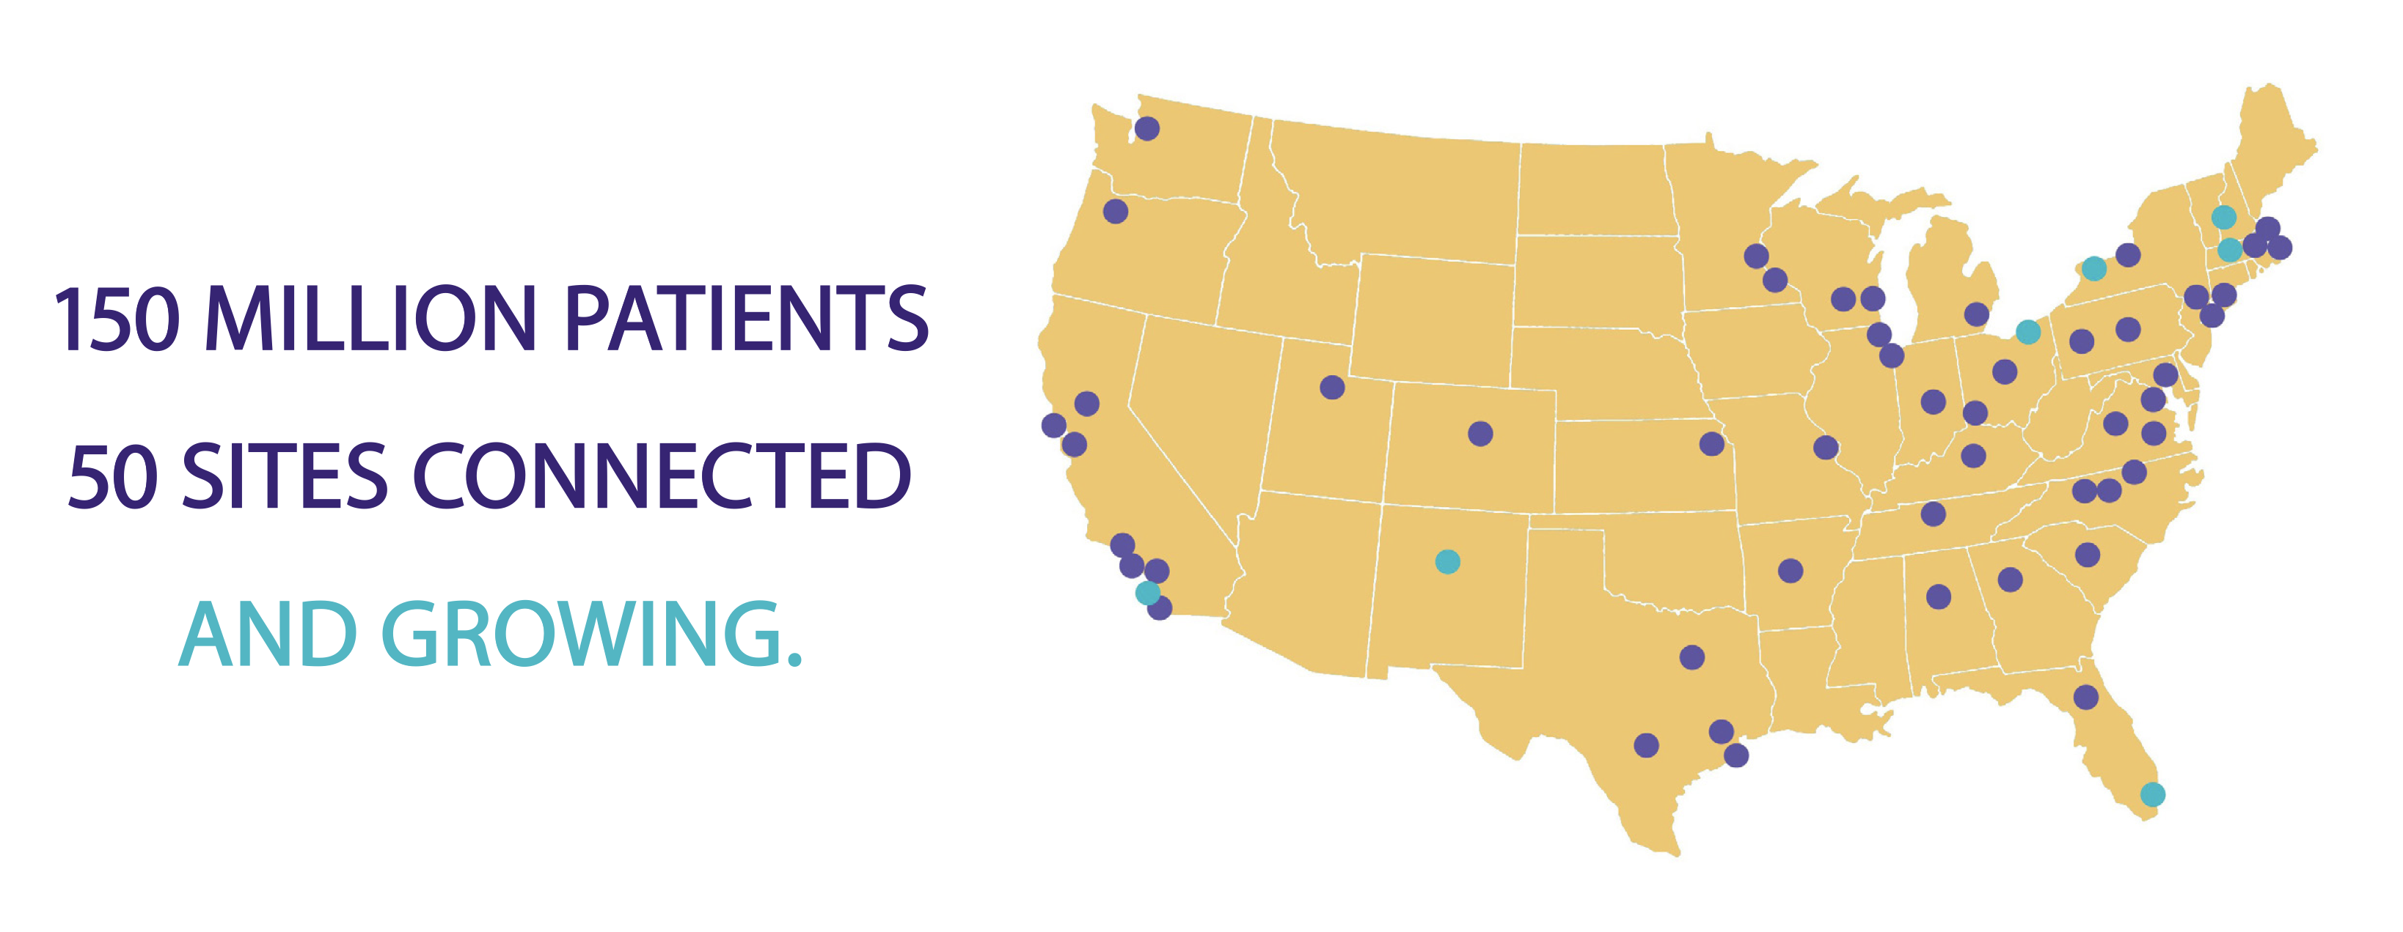
i2b2 SHRINE/ACT

Slide 8
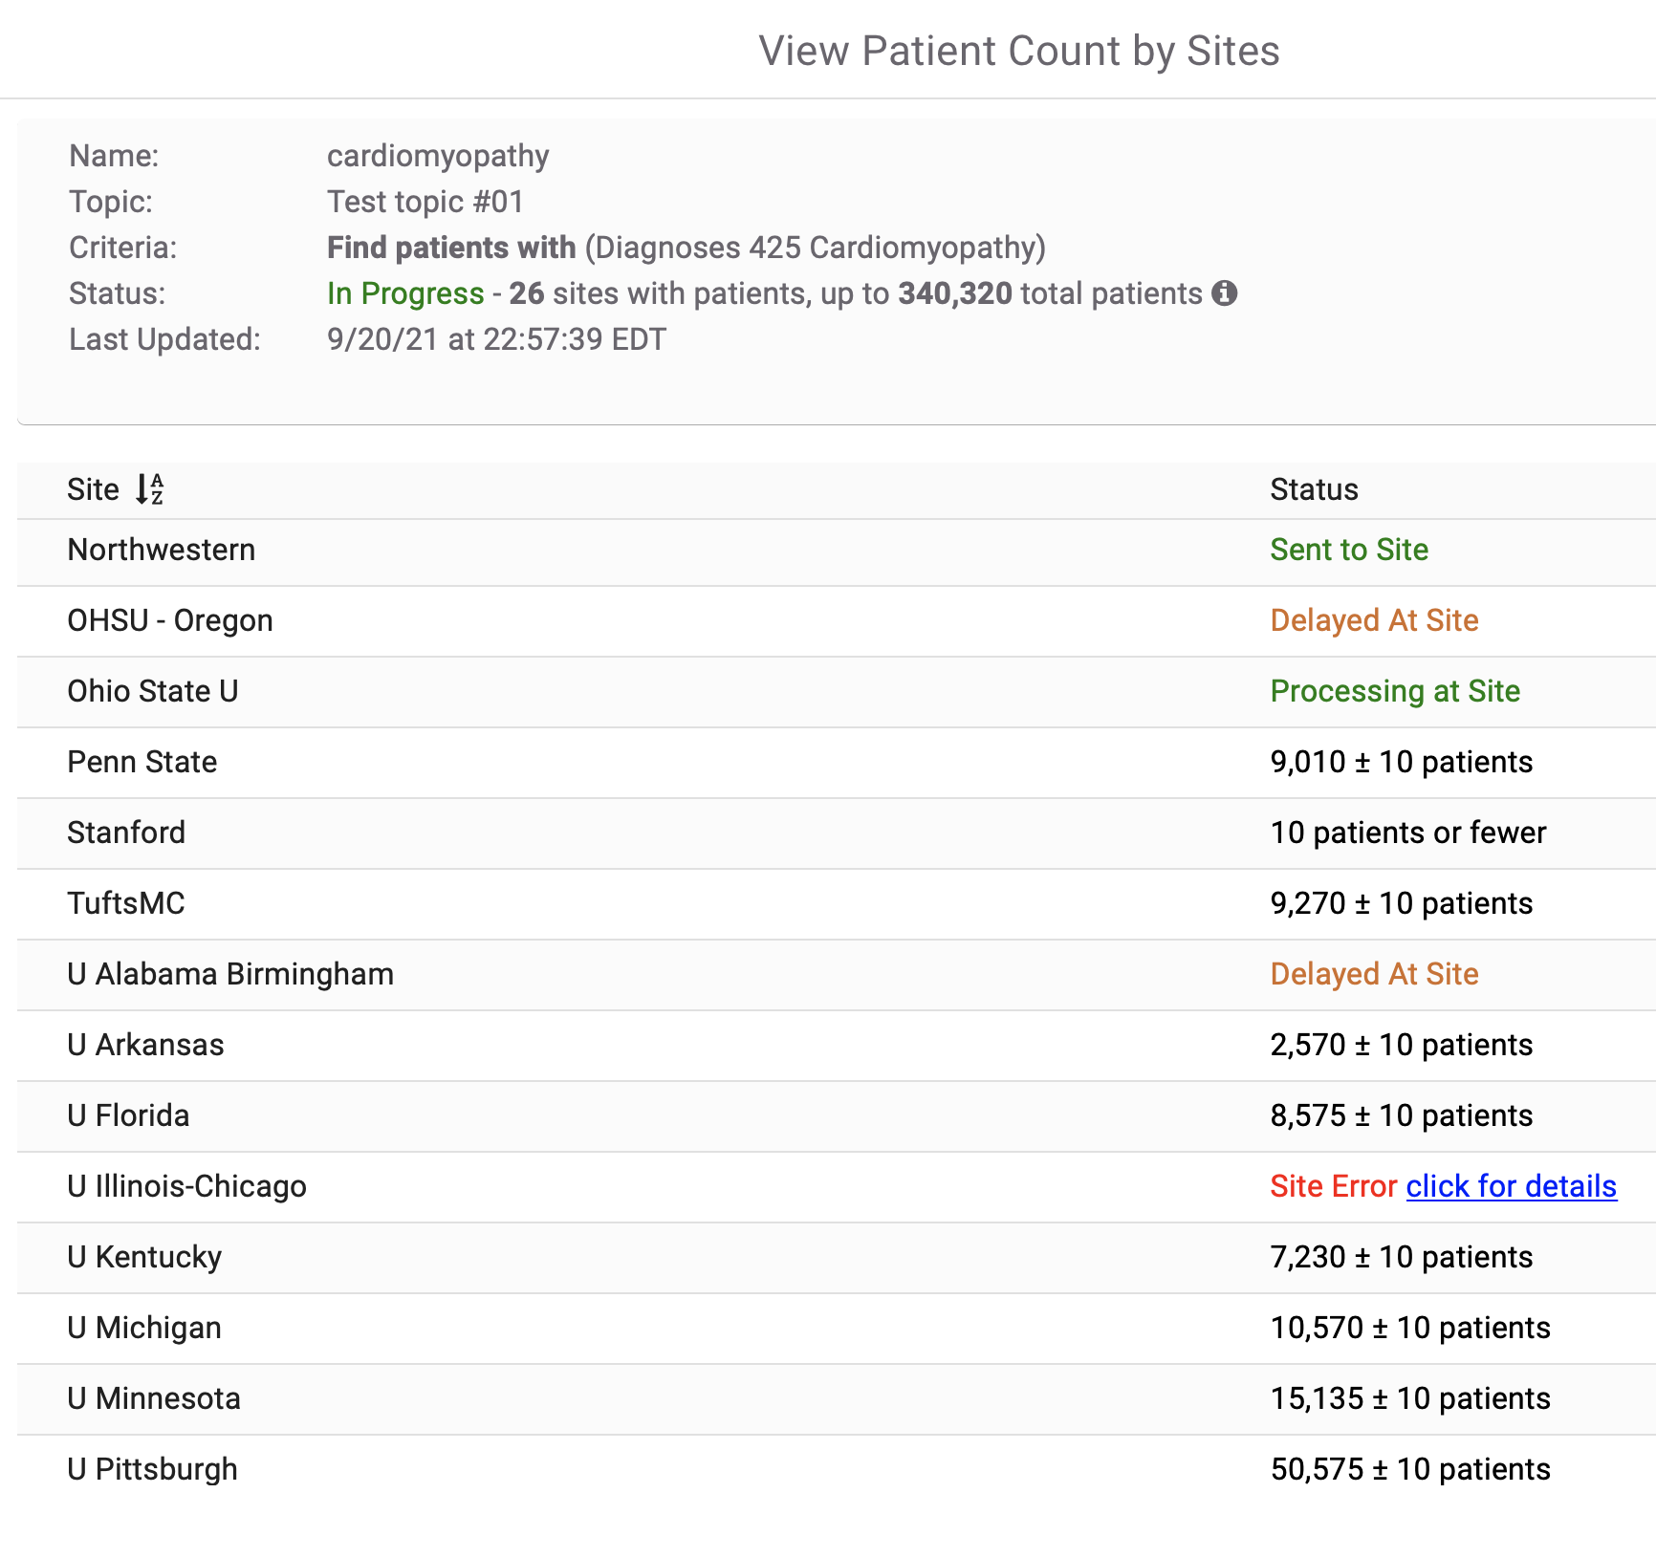
i2b2 SHRINE/ACT

Slide 9
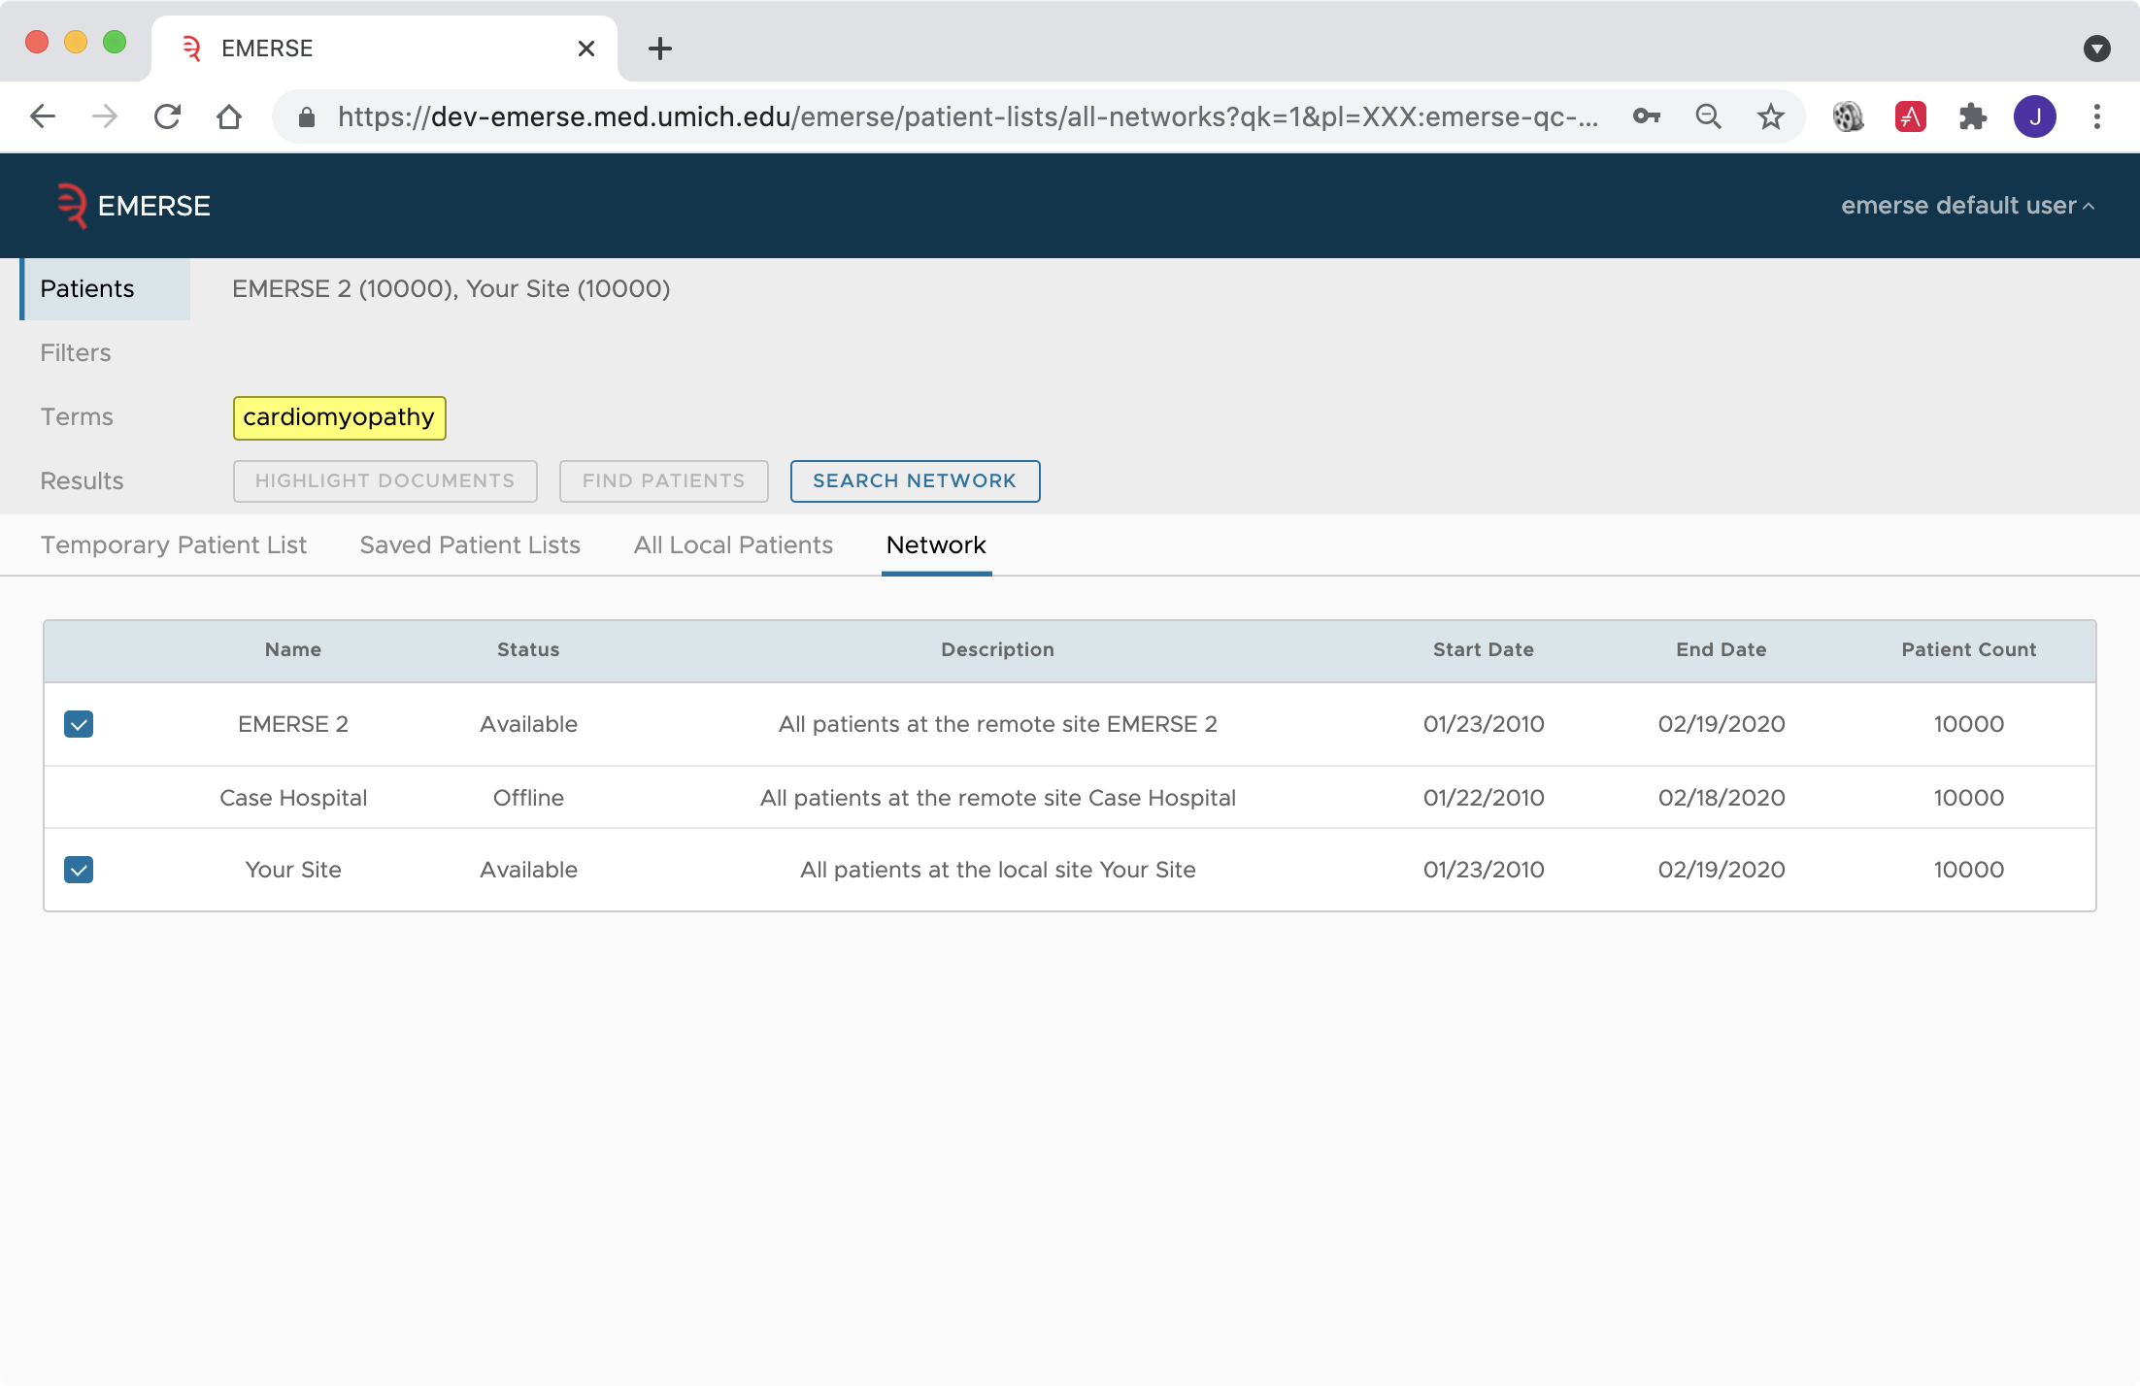
EMERSE

Slide 10
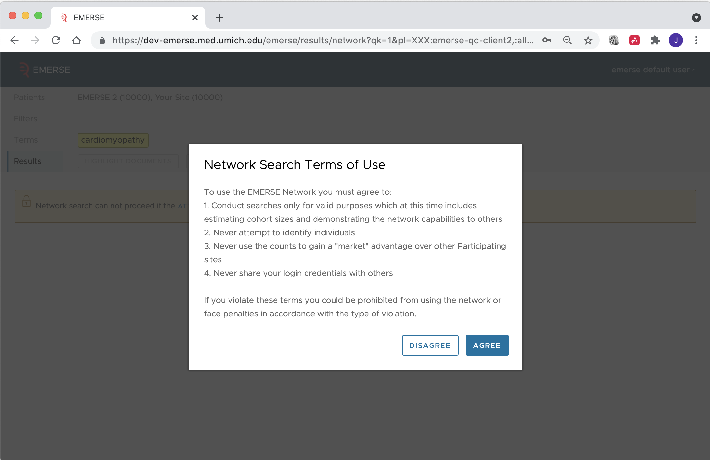
EMERSE

Slide 11
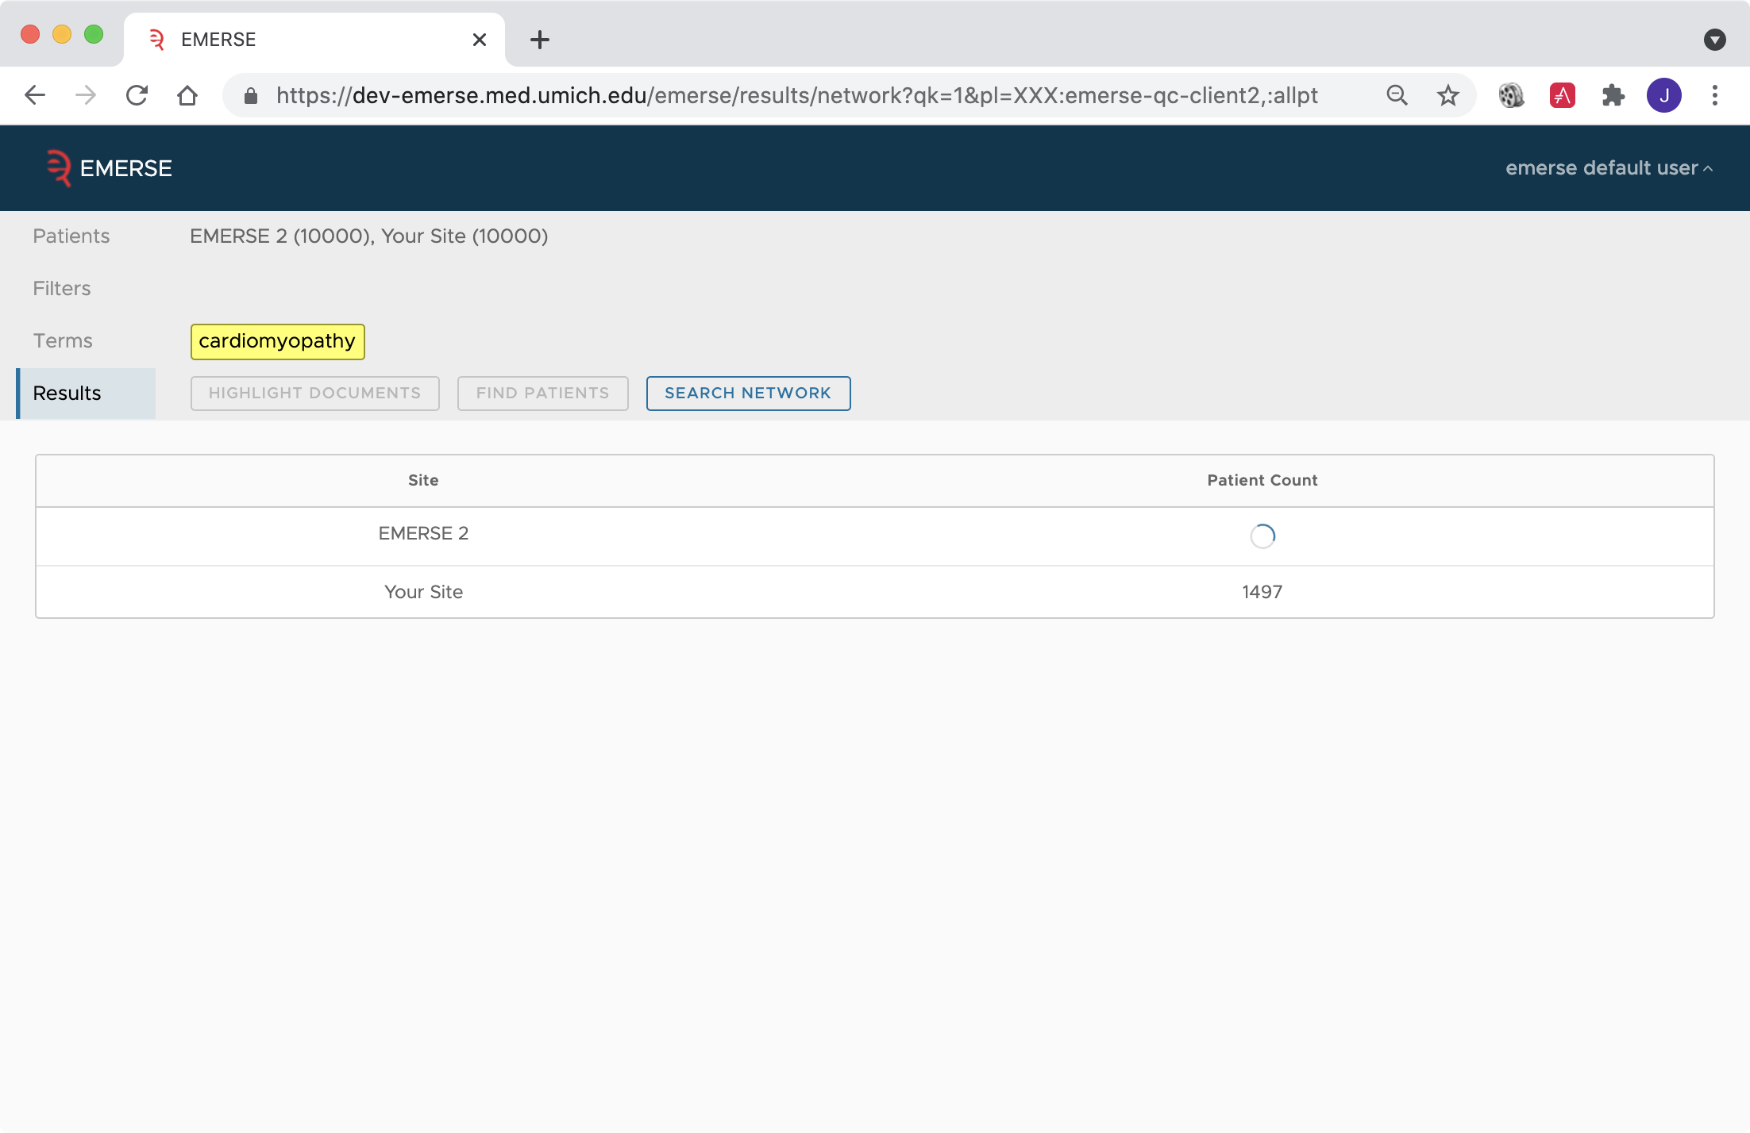
EMERSE

Slide 12
EMERSE

Slide 13
EMERSE – network: practical questions
What can a user do with the counts?
Hope is that it can encourage research collaborations among sites
This still needs to be explored
Similar issues to use of i2b2/ACT
Why should a site bother?
No additional software needs to be installed or maintained
Everything is already built into EMERSE
The network component just needs to be turned on and configured
Sites have to feel “comfortable” with this setup, but we have made great efforts to enable this in a secure and trustworthy manner

Slide 14
EMERSE – network: two phases
Phase 1: Obfuscated counts
Technical work is complete
Goal now is to get sites to agree to participate
Phase 2: Shared Search Term “Bundles”
Sharing of saved search terms across sites
Users can already share Bundles internally to all users
This can promote re-use of search knowledge
Have already had a request for this feature from a multi-site study involving EMERSE sites
Technical work still required, but will leverage existing network components

Slide 15
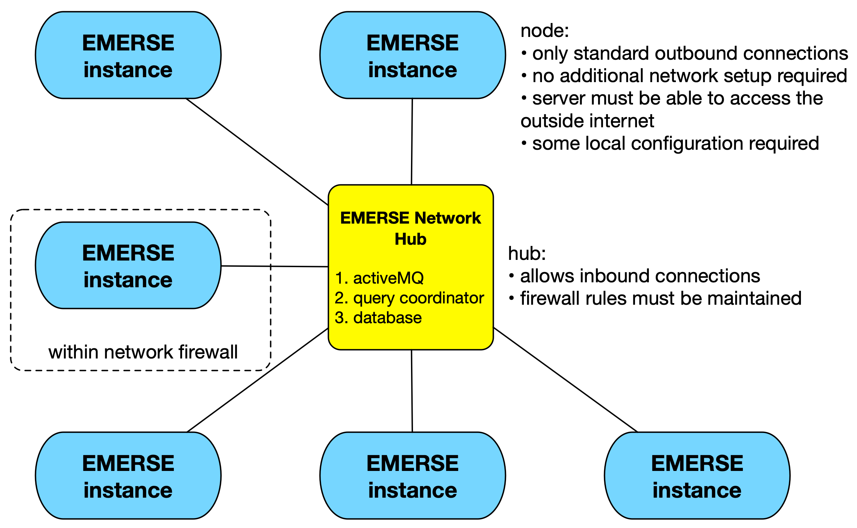
EMERSE – network architecture

Slide 16
EMERSE – network security
Built with security in mind
Developed with input from the Michigan Medicine Information Assurance (IA; aka IT security) team
Has undergone external (from the EMERSE team) code reviews, penetration testing, vulnerability scans, architectural reviews
Has received the approval of IA
Requires ongoing reviews

Slide 17
EMERSE – network security feature #1
No “data” are transmitted
No data/text/no protected health information ever leaves a local EMERSE instance.
No data/text/no protected health information ever travels across the network
Only obfuscated counts are sent out by each EMERSE instance – this is not even considered to be clinical data (no data use agreement is needed)

Slide 18
EMERSE – network security feature #2
Obfuscation
Obfuscation is determined locally by each site
Each site has control over the approach for obfuscation

Slide 19
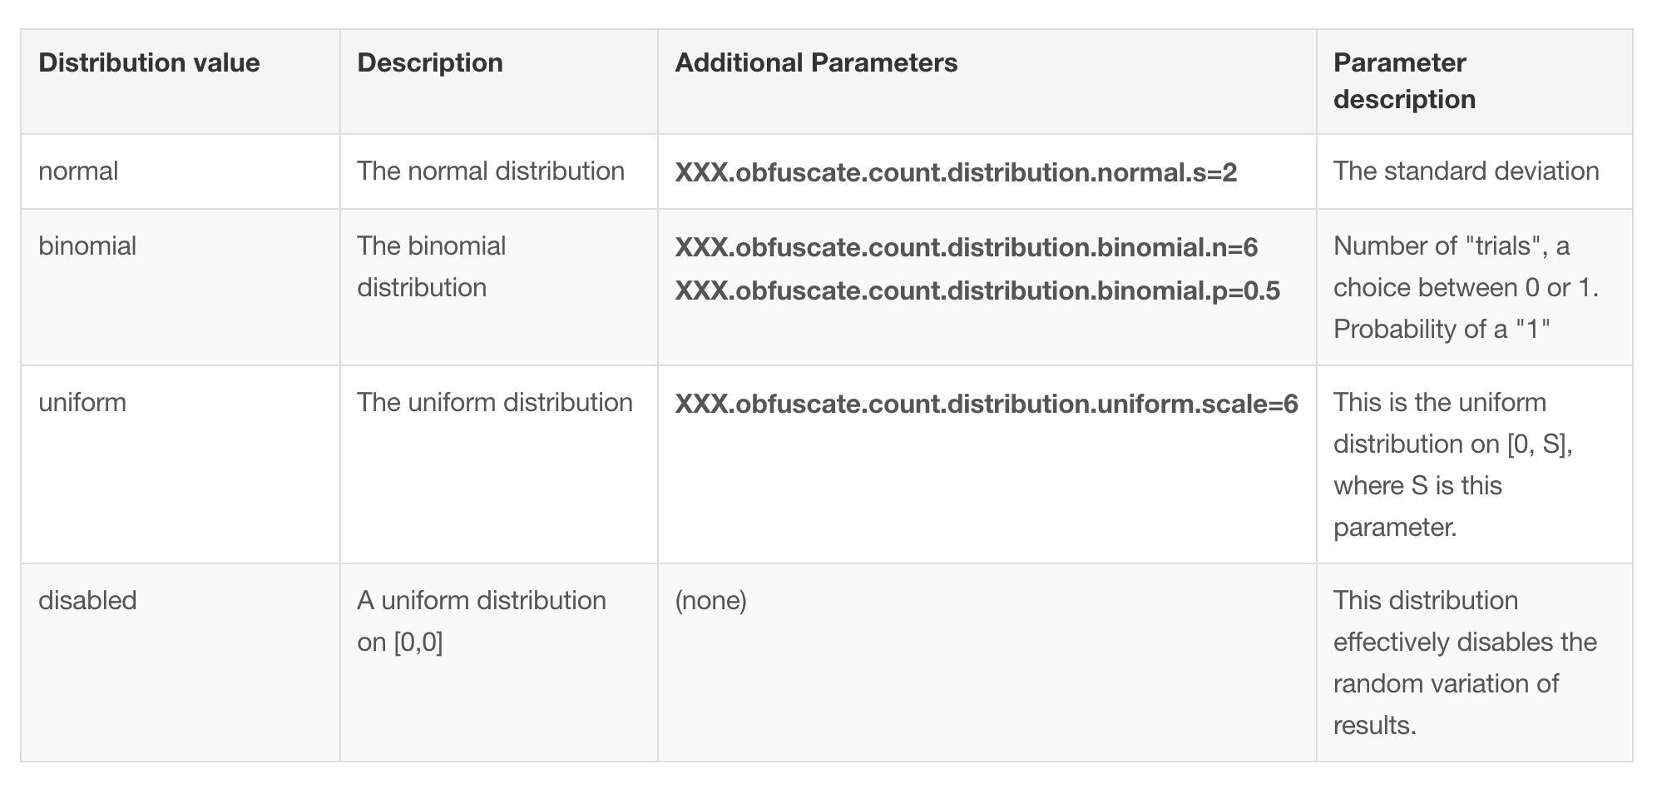
EMERSE – network security feature #2

Slide 20
EMERSE – network security feature #3
Thresholds
Thresholds are controlled by each site
Thresholds are important to prevent a user from narrowing a query down to extremely small samples sizes, which could potentially identify and individual.

Slide 21
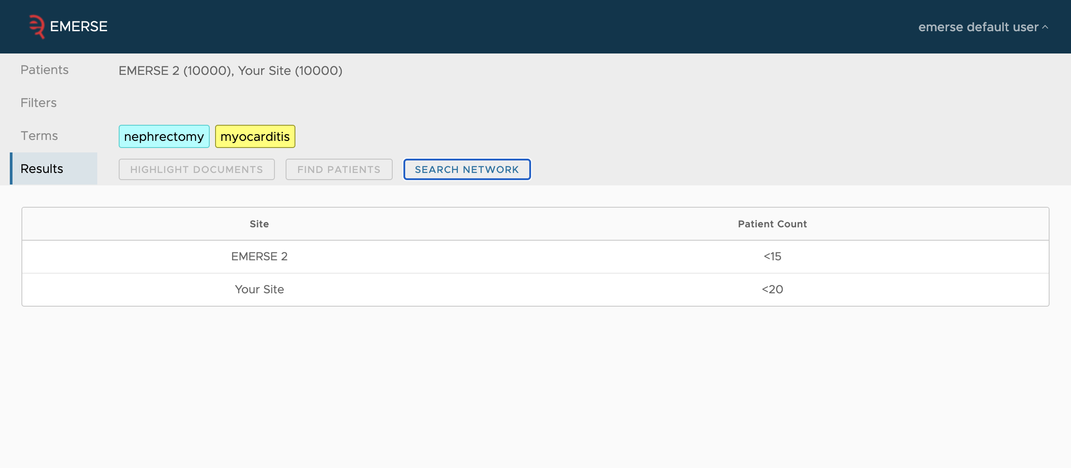
EMERSE – network security feature #3

Slide 22
EMERSE – network security feature #4
Encryption
Connections between sites are encrypted

Slide 23
EMERSE – network security feature #5
Authentication
Each site authenticates to the broker by a username and password, over a secure TLS connection
This helps ensure attackers don’t try to directly connect to the message broker, or that one site doesn’t attempt to impersonate another

Slide 24
EMERSE – network security feature #6
Query limits
Sites can set a limit for how many queries a user can submit in a given time
This can help prevent a user from running the same query over-and-over to try to “guess” the real count

Slide 25
EMERSE – network security feature #7
Randomized response times
In general, smaller counts can be returned faster, especially 0 counts.
Random amounts of delays are added to each response time
This helps prevent a malicious person from trying to estimate the count based on the response time

Slide 26
EMERSE – network security feature #8
Detailed audit logs
All sites maintain their own audit logs and track details about both incoming and outgoing queries

Slide 27
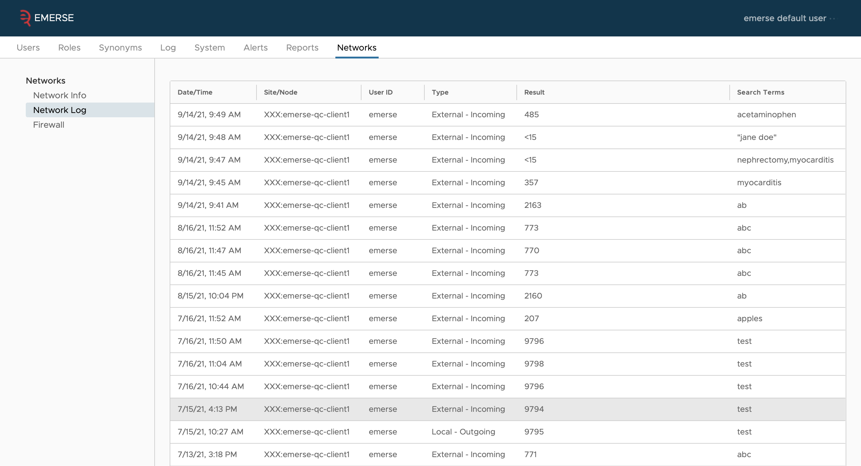
EMERSE – network security feature #8

Slide 28
EMERSE – network security feature #9
Built-in firewall
Each site has its own firewall which allows them to:
Block a specific site on the network (all users from that site)
Block a specific user from a specific site on the network (including local/internal users as well as external users)

Slide 29
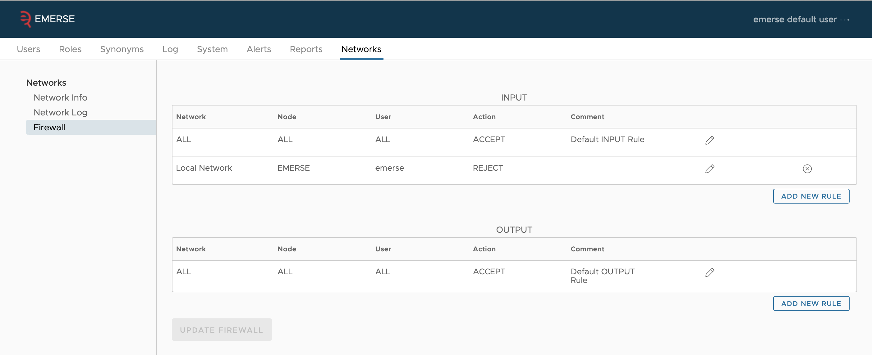
EMERSE – network security feature #9

Slide 30
EMERSE – network security feature #10
Outbound connections only
All sites only need to make an outbound connection to the query coordinator
No inbound connections are needed
No network security firewall exceptions need to be made
The EMERSE server can be maintained behind the secure firewalls of each institution
The server simply has to be able to make an outbound connection, but most server configurations should be capable of doing that while keeping the system secure

Slide 31
EMERSE – network security feature #11
Terms of Use
For every EMERSE session, the network Terms of use will be shown to the user and they will have to agree to the Terms
The Terms are brief and written in easily understandable language

Slide 32
EMERSE

Slide 33
Network Terms of Use Document

Slide 34
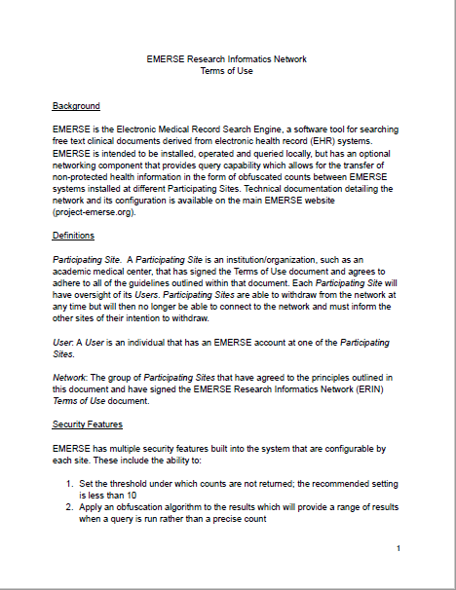
Approach to Understanding – Terms of Use
Network Agreement describes terms of use for network participants
Network sites are responsible for its users and setting up security / privacy features
Network sites may withdraw participation at anytime
Network Terms of Use requires acknowledgement of understanding (institutional signature on the document)

Slide 35
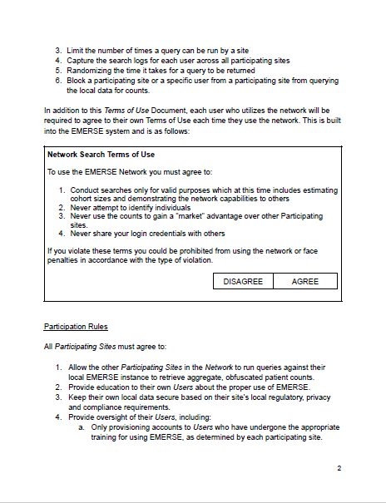
Data Privacy Features
Obfuscated Counts only – no PHI
Limits the number of queries:
By site
By individuals
Monitor / track search logs for users across all sites
Randomizes returned search time
Block users and sites
Users agree to Privacy Terms of use

Slide 36
Participation Rules
Allow Network sites to run queries
Educate Users
Provide oversight of users
Monitor access / terminate when no longer needed by a user
Investigate concerns of other Network sites when raised

Slide 37
Finalizing the Network Terms of Use
Ready to implement networking phase | Acknowledge use terms are in place and will abide by use terms by Signing Agreement
Not ready to implement networking phase | Don’t sign until all use terms are in place and agree to be bound by use terms.

Slide 38
Thank you for attending!
Hold the date
10/19/21
12-1:30 p.m. ET
Making Sense of Unstructured Data

