Slide 1




Unlocking Real World Data Buried in the EHR:
The EMERSE Experience at Case Western Reserve University
and University Hospitals of Cleveland
Mark Beno, MSM
Executive Director - Cleveland Institute for Computational Biology
School of Medicine, Case Western Reserve University

Slide 2
Disclosure
I have no relevant relationships with commercial interests to disclose.
Funding for this work comes from:
UL1TR002548, Clinical and Translational Science Award, Grace McComsey (PI), NIH/NCATS, 5/1/2018-4/30/2023
U24 CA204863, Advanced Development and Dissemination of EMERSE for Cancer Phenotyping from Medical Records, David Hanauer (PI), NIH/NCI, 8/17/17-7/31/2022
Cleveland Institute for Computational Biology internal funding (Case Western Reserve University and University Hospitals Health System of Cleveland)

Slide 3

EMERSE – What is it?
A human-augmented search engine for anything contained in medical notes – not NLP, but another tool in the informatics toolbox – however NLP is coming in the next version (stay tuned!)
Created in 2005 by David Hanauer, MD, MS, FACMI, FAMIA and maintained/enhanced at the University of Michigan and tested/deployed by partners/collaborators
Used to perform rapid searches against the 80% of clinical data stored in notes – for an entire patient population, defined lists of patients, and at the individual patient level
All source notes are indexed and stored in a document repository – EHR never touched directly
Powered by a collection of over 2 million clinically curated terms and phrases
Searches can be done on 100’s (1000’s) of terms simultaneously
Live at 6 academic medical centers covering ~10 million patients and > 442 million documents

Slide 4
The Open-Source EMERSE (Electronic Medical Record Search Engine) Tool
Easy to understand user-interface with a ~30-minute learning curve – A “system for the people”
Software is free from the University of Michigan, however, there is an initial cost to implement
Relatively low maintenance requirements – (0.15 FTE) – no ongoing vendor fees
Other tools require customizations for each medical specialty and require ongoing license fees
Rapid querying compared to EMR – e.g., gray platelet syndrome: 14,940 seconds vs. 2 seconds
EMERSE excels at finding diagnoses that do not have a specific ICD-10 code – e.g., leiomyosarcoma
    Michigan Case Study - Cutaneous Leiomyosarcoma (cLMS) – Incidence of 0.2 per 100,000 per year – Cancer Registry found 101 patients, EMERSE found 311 potential that was narrowed down to 128 positive after manual chart review= 21% additional patients; 183 false positives due to standardized language in genetics consultation notes stating risk for “cutaneous leiomyosarcoma”*

Slide 5
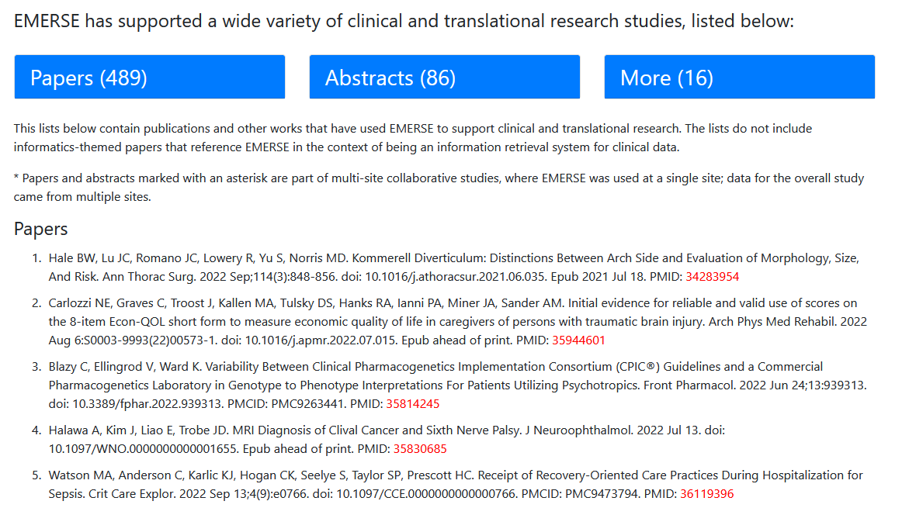
The Open-Source EMERSE (Electronic Medical Record Search Engine) Tool
Used for research and clinical operations (billing/coding, quality, infection control)
University of Michigan is tracking research where EMERSE has been referenced (project-emerse.org/publications.html)

Slide 6
Cleveland Institute for Computational Biology
University Hospitals Health System of Cleveland, Ohio, ~ 2 million patients
Case Western Reserve University, Cleveland, Ohio, Jonathan L. Haines, PhD, Faculty Director
Translating big data to better understand disease mechanism, improve clinical care,
and inform population health

Slide 7

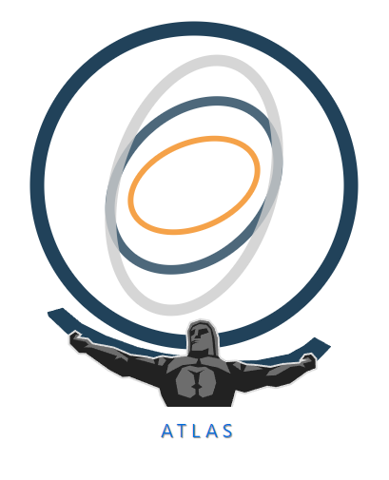


CICB Infrastructure Overview
University Hospitals
Ambulatory and In-patient
Unstructured/notes
Structured/coded
>1.7 million patients
>45 million notes
2018-present
Clinical, pathology, radiology, nurses' notes, etc.
Structured/coded
>1.9 million patients
2016-present
Present state: CICB facilitated utilization
Self-service tools in late 2022
Clinical characterizations/descriptions
Longitudinal/temporal analyses
Population-level Estimation
Patient-level Prediction
Rapid searching across all patients
>2 million synonyms and phrases
Rapid cohort selection
Rapid chart review
Import and export patient lists
Comparison of patient lists
Sharing of patient lists internally
Filtering by EHR source, dates, demographics
CICB facilitated
data exchange
OMOP

Slide 8
CICB Infrastructure Overview and Example
University Hospitals
Ambulatory and In-patient
Unstructured/notes
Structured/coded
>1.7 million patients
>45 million notes
2018-present
Clinical, pathology, radiology, nurses' notes, etc.
Structured/coded
>1.9 million patients
2016-present
Present state: CICB facilitated utilization
Self-service tools in late 2022
Clinical characterizations/descriptions
Longitudinal/temporal analyses
Population-level Estimation
Patient-level Prediction
Rapid searching across all patients
>2 million synonyms and phrases
Rapid cohort selection
Rapid chart review
Import and export patient lists
Comparison of patient lists
Sharing of patient lists internally
Filtering by EHR source, dates, demographics
CICB facilitated
data exchange
OMOP

Slide 9
CICB EMERSE Implementation Timeline and Experience To Date
NIH/NCI 5-year grant starts (Jill Barnholtz-Sloan, PhD, years 1-4, and Satya Sahoo, PhD, year 5; local PIs)
18 months spent obtaining institutional buy-in
  Meetings with researchers – many
  Meetings with C-suite hospital representatives
  At least 2 visits from David Hanauer to drum up support
  Meetings with CQOs and system CMIO, leading to capital funding from University Hospitals Cleveland Medical Center, Daniel Simon, MD (President, Academic & External Affairs and Chief Scientific Officer)
Implementation started at the beginning of COVID – all remote work (2/2020-11/30/2020)
Pilot phase in late 2020 through October 2021 – Validation of EMERSE via source systems
Official launch in November 2021
Currently over 200 EMERSE user accounts (research and ops), > 70 IRB protocols
Picking up new users every week

Slide 10
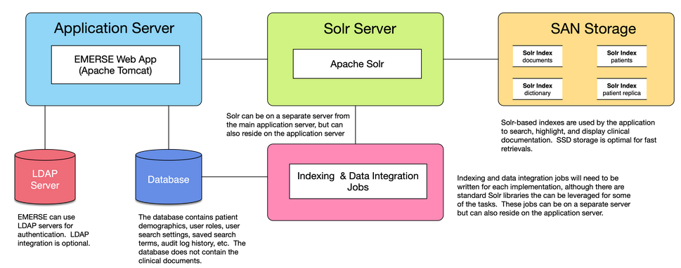
EMERSE Architecture – Deployment View

Slide 11
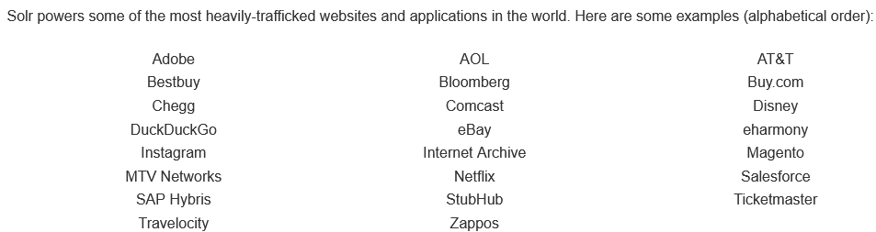
Apache Solr – the open-source software under the hood
Open-source enterprise search platform built on Apache Lucene
Highly reliable, scalable, fault tolerant
Distributed indexing, replication, and load-balanced querying

Slide 12
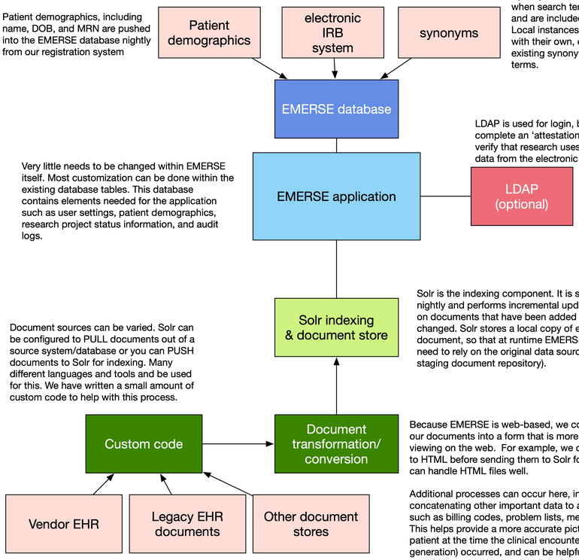
EMERSE Architecture – Process View
Synonyms are suggested to users when search terms are entered and are included with the system. Local instance can replace the list with their own, or augment existing synonyms with additional terms.
Patient demographics, including name, DOB, and MRN are pushed into the EMERSE database nightly from the patient registration system.
The EMERSE database contains elements need for the application, such as user settings, patient demographics and other meta-data, research project status information, and audit logs.
Very little needs to be changed within EMERSE itself. Most customization can be done within the existing database tables.
LDAP is used for login, but users must still complete an “attestation” for each EMERSE session.
Solr is the indexing component, set to run each morning and performing incremental updates only on documents that have been added or changed. It stores a local copy of each document to allow for rapid runtime functionality.
Additional processes can occur here, including concatenating other important data to a clinical note such as billing codes, problem lists, and medication lists. This helps provide a more accurate picture about a patient at the time the clinical encounter (and note generation), occurred, and can be helpful for those searching and reviewing clinical documents within EMERSE.
Apache Camel, an open-source integration framework, is used to extract documents from the Enterprise Data Warehouse and into Solr for indexing

Slide 13


University Hospitals EMERSE Implementation
App, Solr, storage = one server
Allscripts Touchworks and Sunrise, Sorian Registration
Enterprise Data Warehouse
MS SQL
Notes views
New notes added from prior day at 6 a.m. for near real-time updates
Emergent MRN errors corrected from the prior day via Health Identity Management

Slide 14
EMERSE Demonstration Simulation – Why?
“Live Demos” = Extra stress of a technical issue arising
Demo system is limited to 10,000 synthetic patients; live = ~ 2 million
Live system contains full PHI and we need to redact
Allows us to look at real world scenarios
Allows us to look at performance across >1.7 million patients and >45 million documents
However, return counts will also be obfuscated

Slide 15
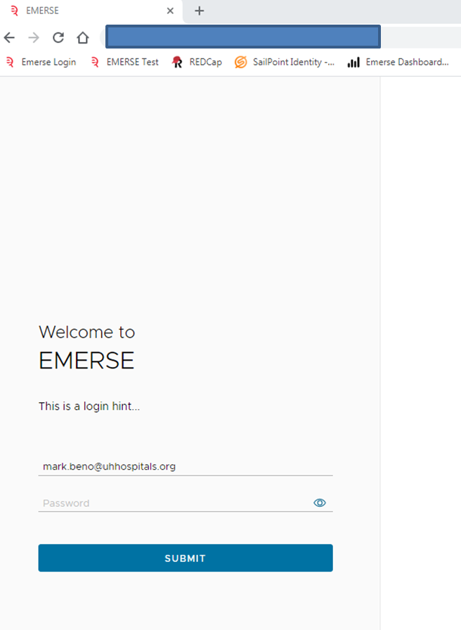
Accessed via Chrome Browser

Slide 16
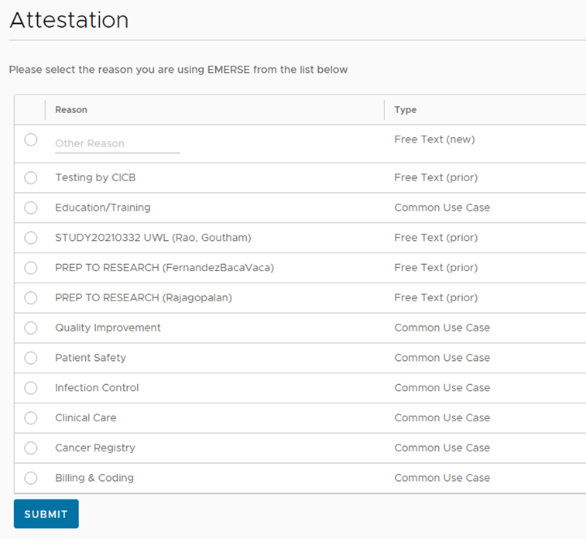
EMERSE – Attestation Screen
Records why are you using EMERSE for each session
Some categories are for operations (e.g, Quality Improvement, Patient Safety, Billing and Coding)
Research identified as either PREP or by the IRB number
All activity is logged for the session

Slide 17
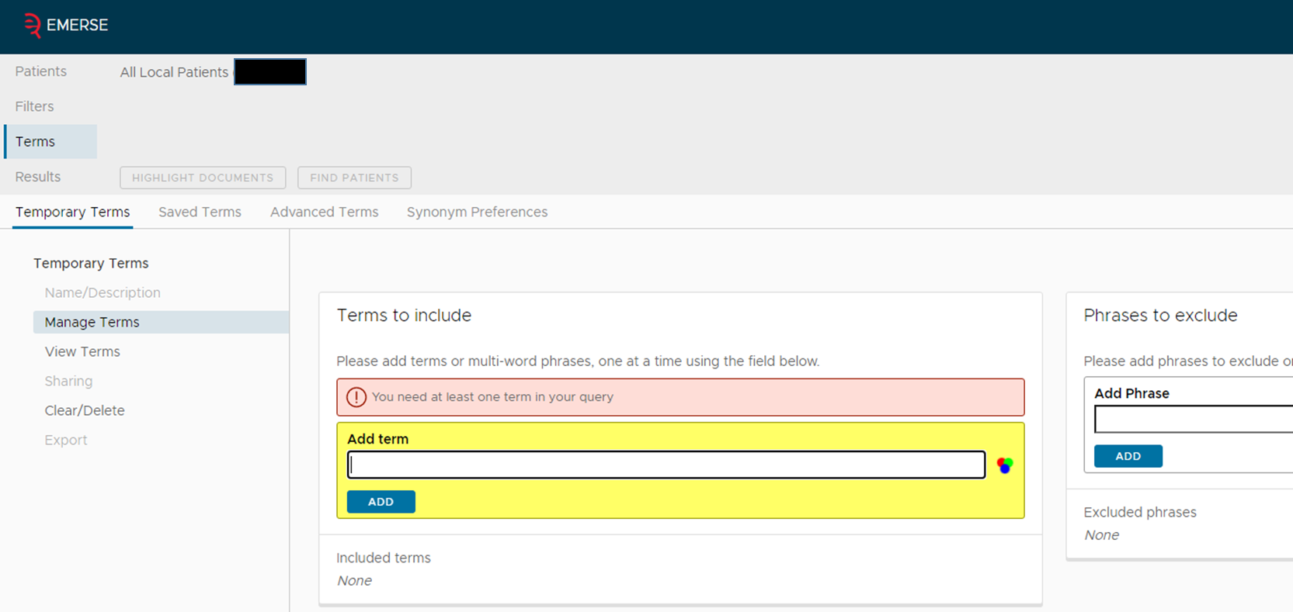
EMERSE – Main Interface

Slide 18
EMERSE – Main Interface

Slide 19
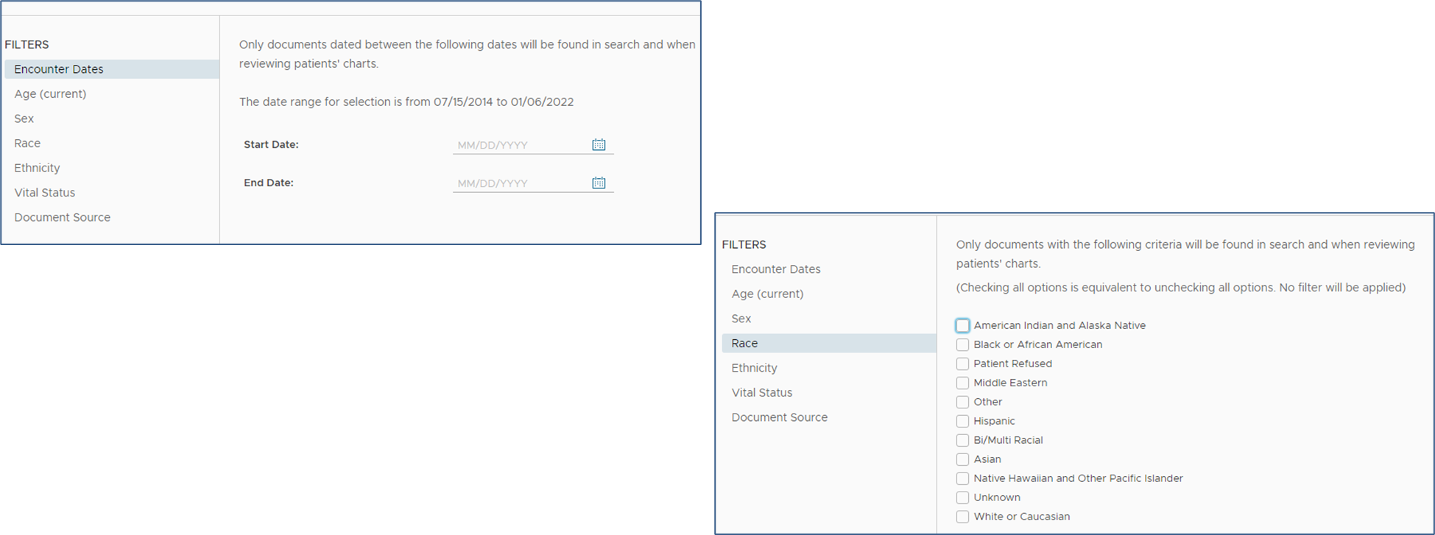
EMERSE – Filters

Slide 20
EMERSE – Main Interface

Slide 21
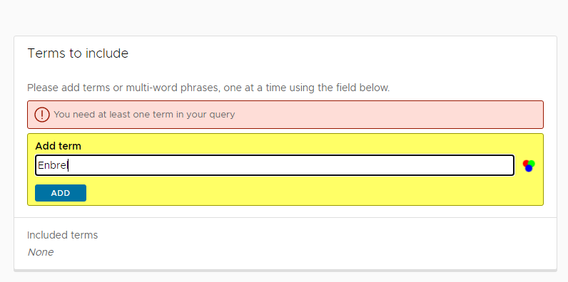
EMERSE – Simple search

Slide 22
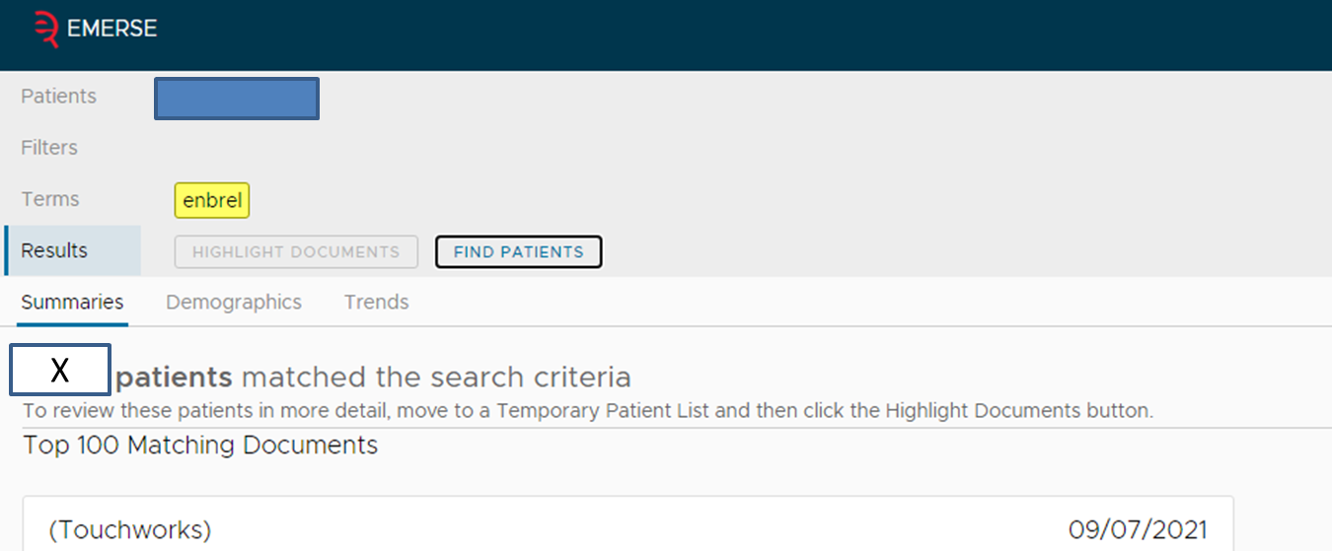
EMERSE – Simple Search
Results returned
in less than 1 second

Slide 23
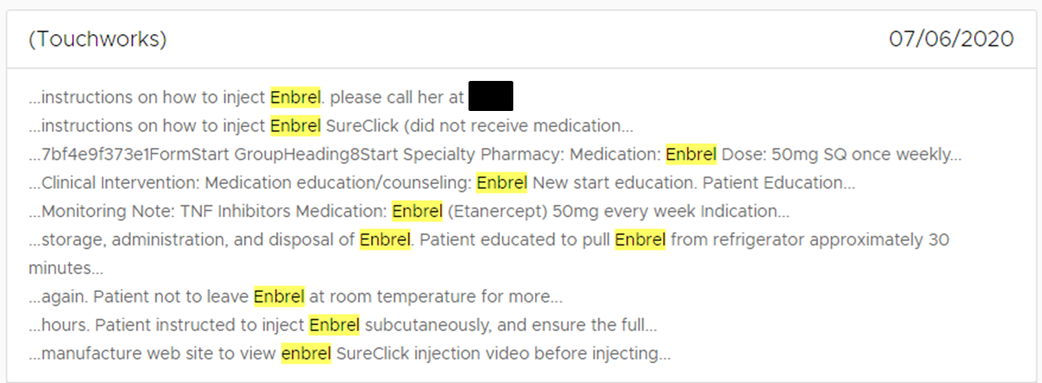
EMERSE – Simple Search

Slide 24
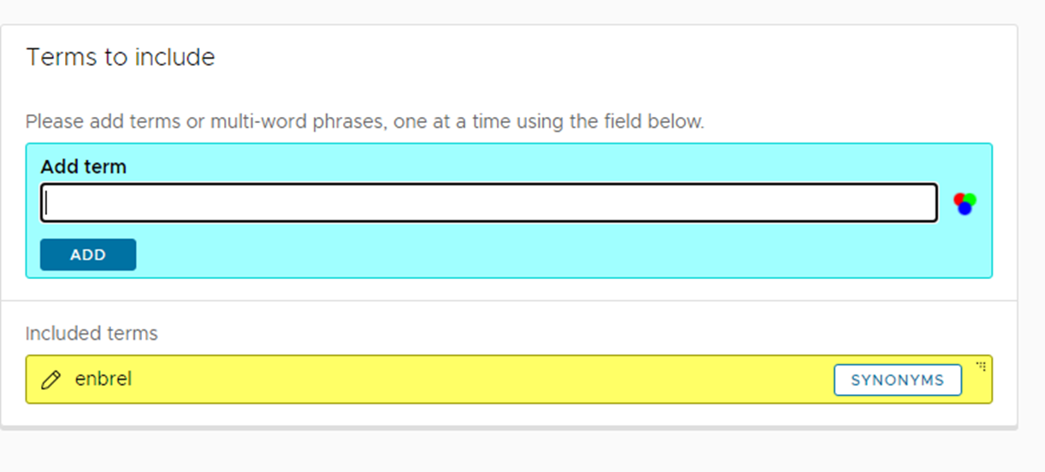
EMERSE – Adding synonyms

Slide 25
Adding synonyms – previous version of EMERSE
These are all of the synonyms built-in to EMERSE for Enbrel

Slide 26
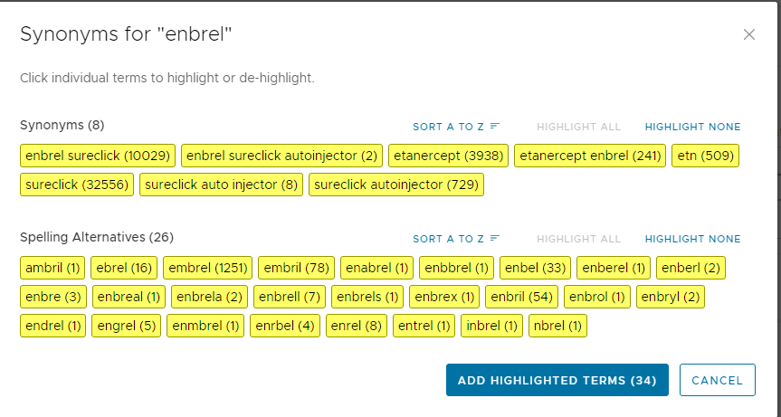
Adding synonyms – upgraded version of EMERSE
The counts are an indication of how many notes contain these variations of Enbrel

Slide 27
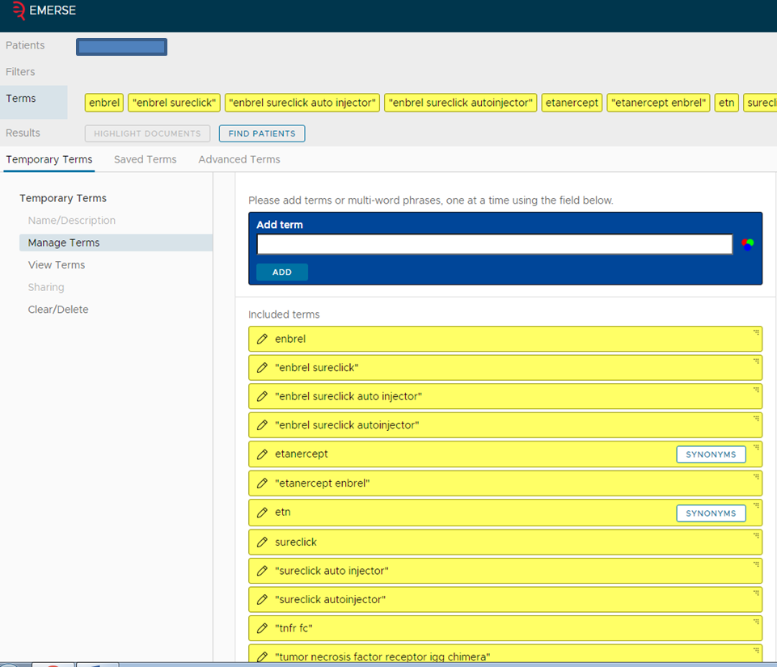
EMERSE – Adding synonyms

Slide 28
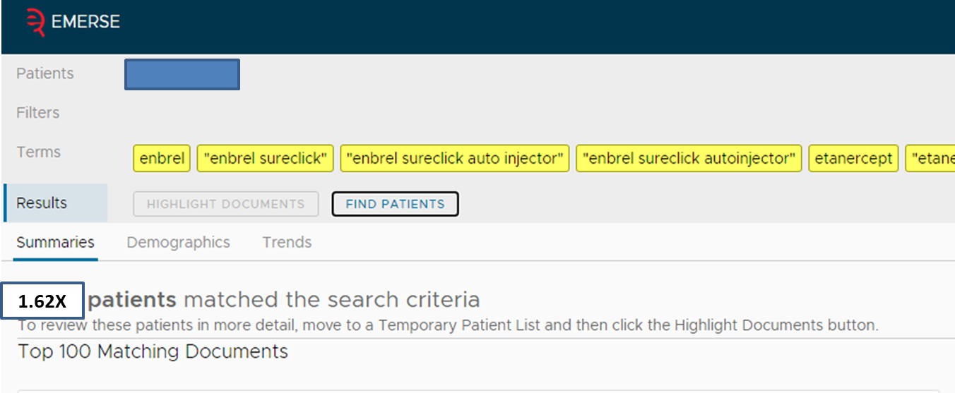
EMERSE – Adding synonyms to search
Results returned
in less than 4 seconds

Slide 29
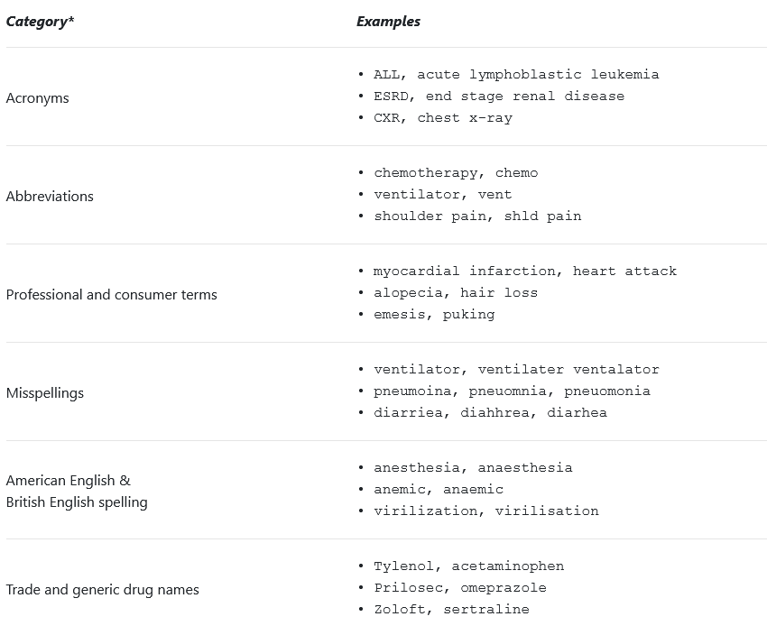
EMERSE – Synonyms discussion
Synonyms and phrases collection
>2 million built into EMERSE and are updated through U. of Michigan
Allows rapid searching across 100s of terms simultaneously
Drugs and brand names, diagnoses and procedures, non-clinical words, etc.
Common phrases in written notes
Users can supplement with additional search terms
Think about the variety of styles used in writing medical notes – all of this can be searched as well as combined in a single search

Slide 30
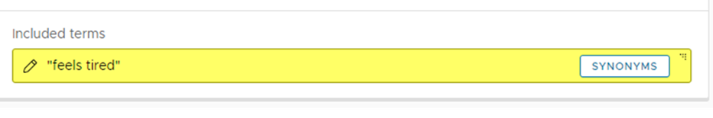
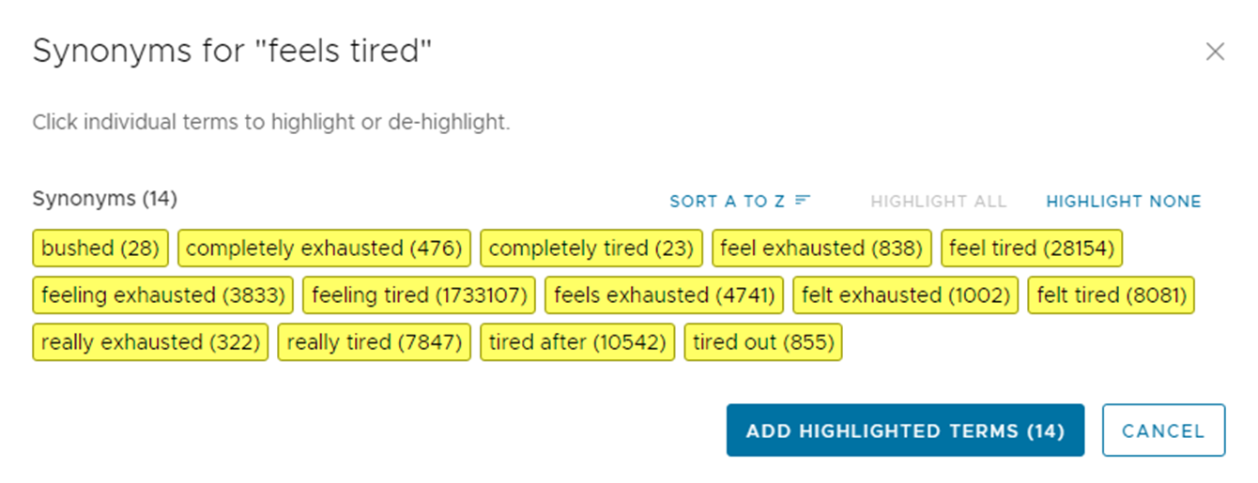
EMERSE – Synonyms for common phrases

Slide 31
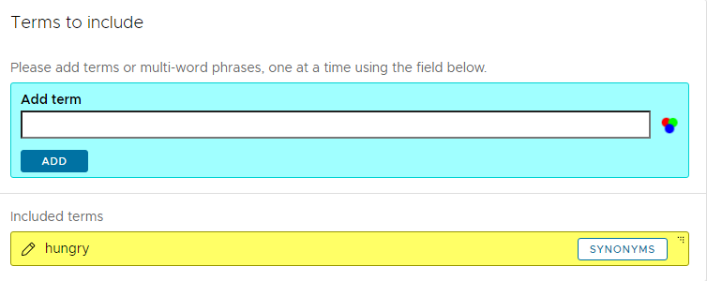
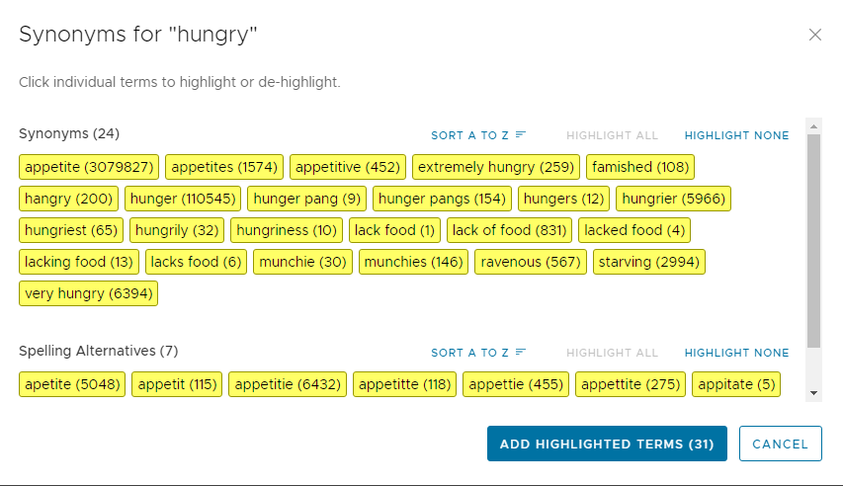
Synonyms that allow rapid discovery of Social Determinants of Health in Notes

Slide 32
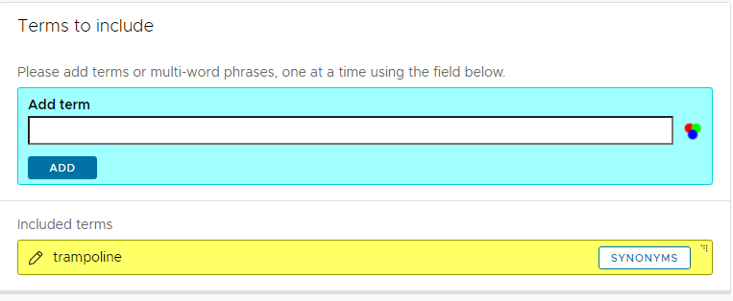
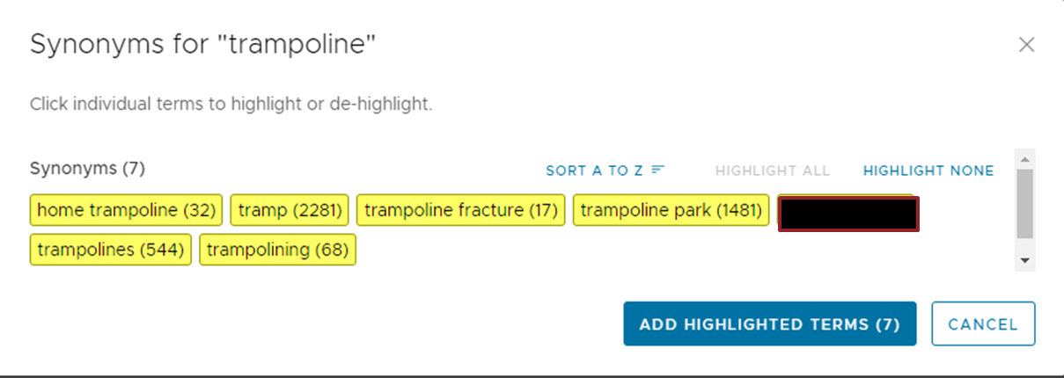
Synonyms that reflect injuries that are discussed in notes

Slide 33
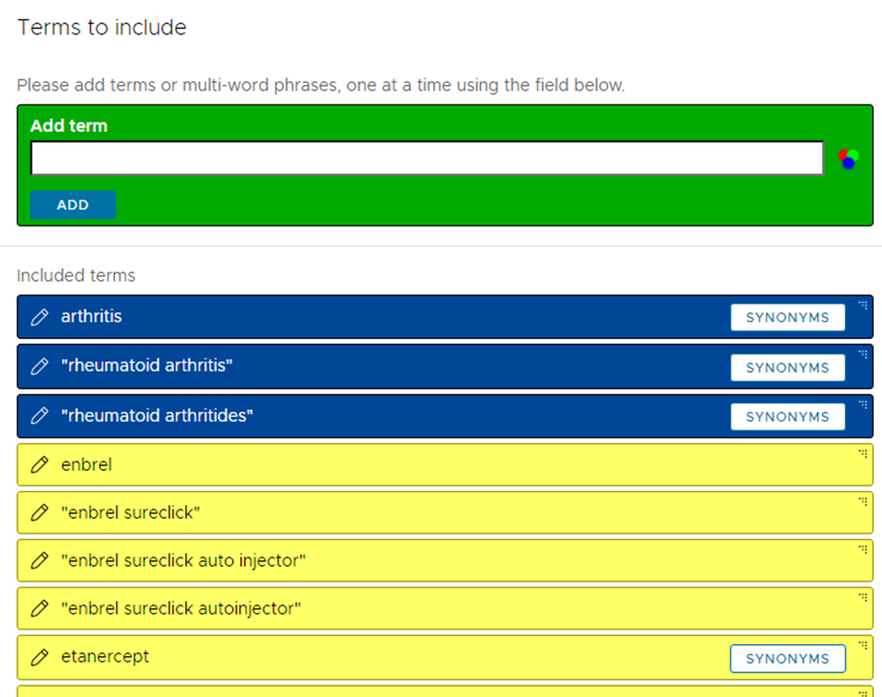
Searching with synonyms contained with the same note

Slide 34
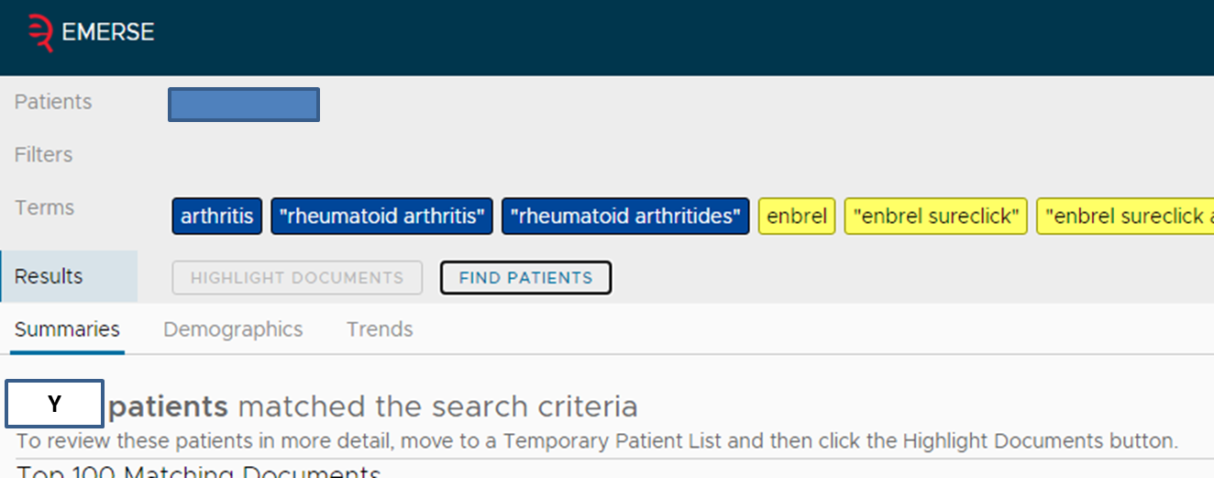
EMERSE – Searching for any blue AND any yellow within the same note
Results returned
in less than 3 seconds

Slide 35
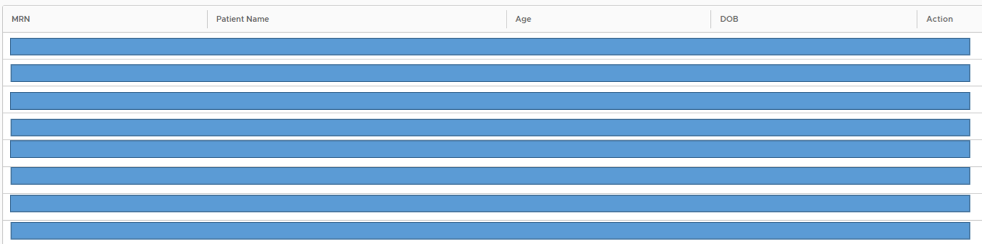
EMERSE – Moving discovered cohort to a temporary list

Slide 36
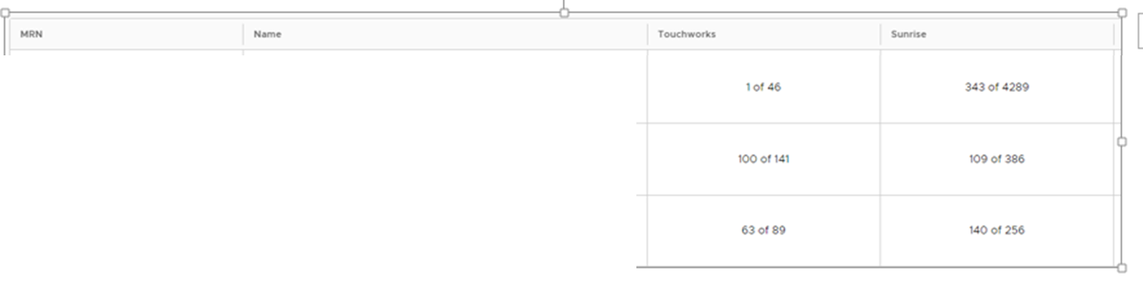
EMERSE – Selecting highlight documents numeric view

Slide 37
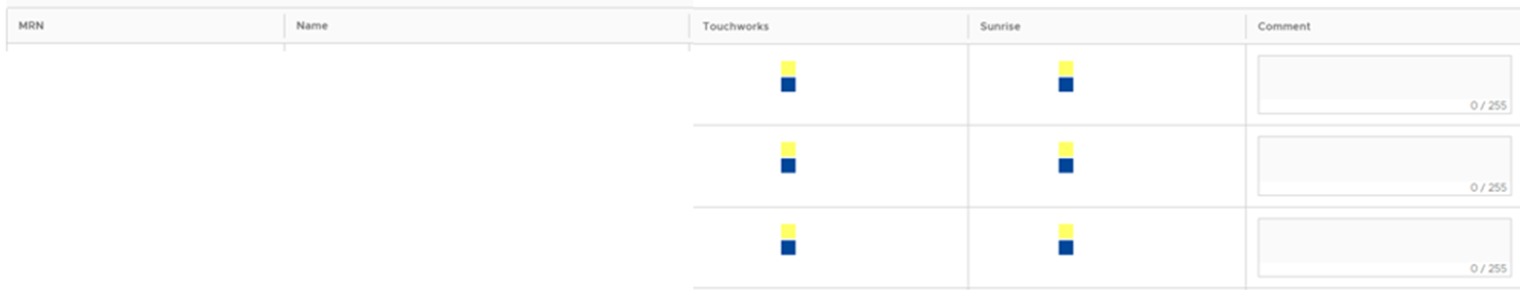
EMERSE – Switching to mosaic view for highlighting

Slide 38
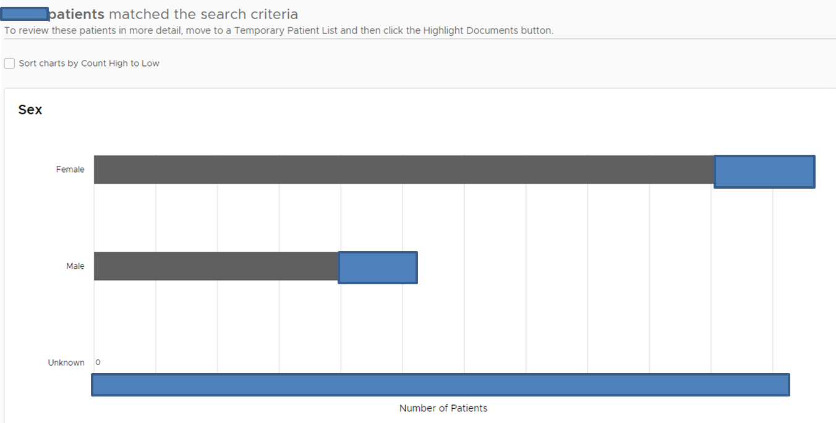
EMERSE – Temporary list demographics

Slide 39
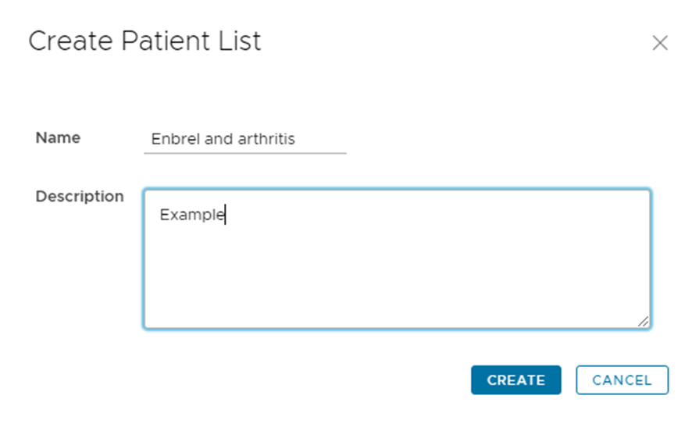
EMERSE – Saving patients to a permanent list
Patient lists
Created using EMERSE searches
Entered manually
Imported from an Excel file
Shared with other EMERSE users
Can be compared to other patient lists

Slide 40
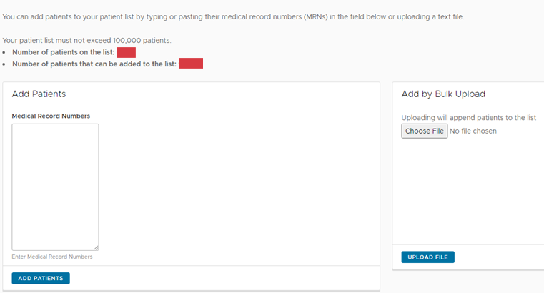
EMERSE – Saving patients to a permanent list
Patient lists
Created using EMERSE searches
Entered manually
Imported from an Excel file
Shared with other EMERSE users
Can be compared to other patient lists

Slide 41
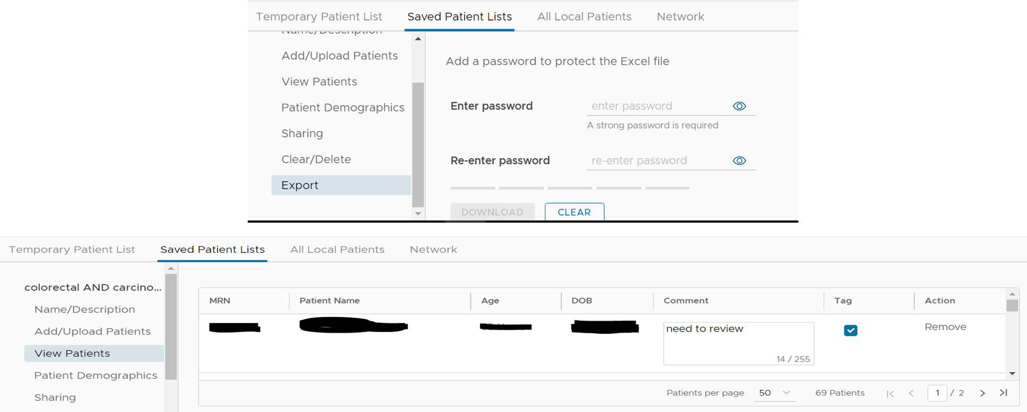
EMERSE – Tagging, annotating, and exporting patient lists

Slide 42
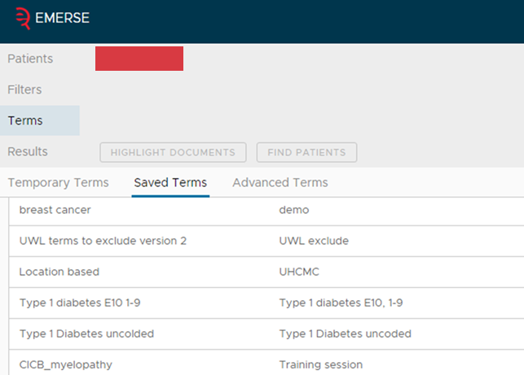
EMERSE – Term collections
Term collections
The building blocks of effective searching with EMERSE
User-created and shared with other users locally (and with other institutions using EMERSE if the feature is turn on)
Allows for reusable tools to use with EMERSE
Potential to create catalogs of terms based on discipline or specialty
Potential to create catalogs based on providers in a department by creating a term list of provider names

Slide 43
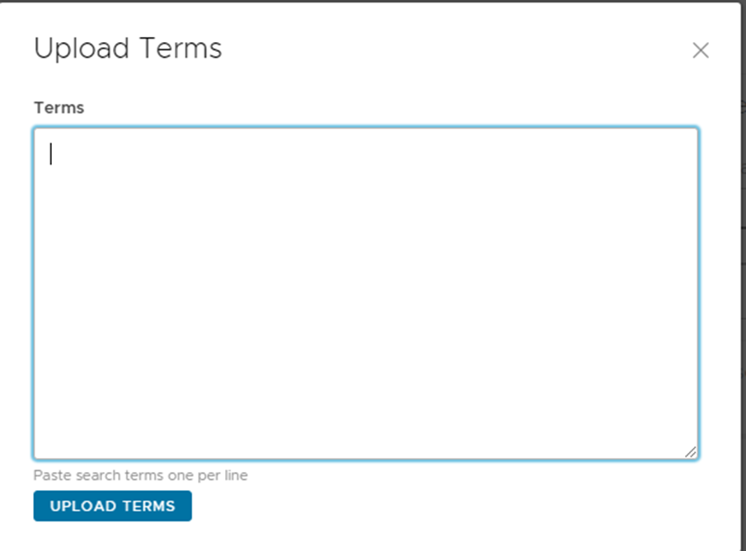
EMERSE – Term collections
Term collections upload feature
Allows common term collections to be shared with other research teams at other institutions who also have EMERSE installed
Potential for many multi-institutional collaborative studies with the EMERSE consortium

Slide 44

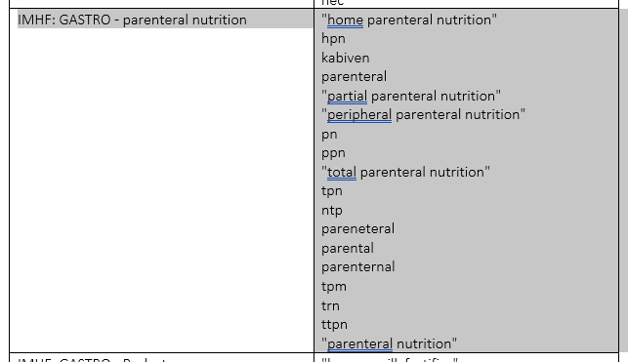




EMERSE – Sharing Terms Across Sites
PediaTracTM a multi-disciplinary project dedicated to creating a comprehensive,
user-friendly tool for tracking infant development across key domains

Slide 45
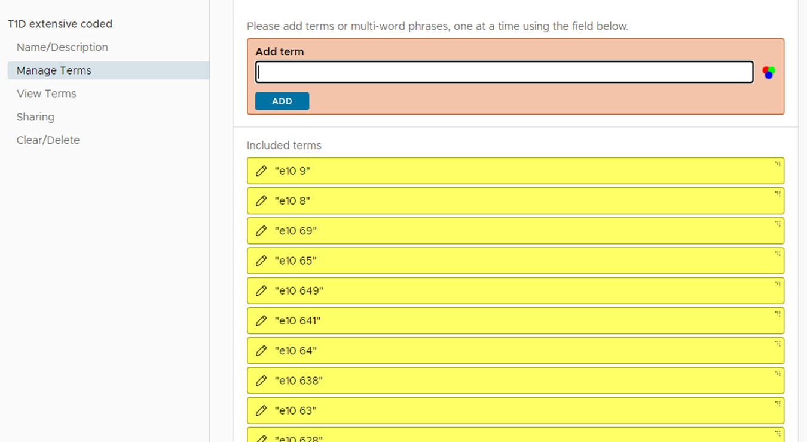
EMERSE – Finding patients w/o coded T1D diagnosis
Step 1: Search for all with coded T1D in notes or other structured data source

Slide 46
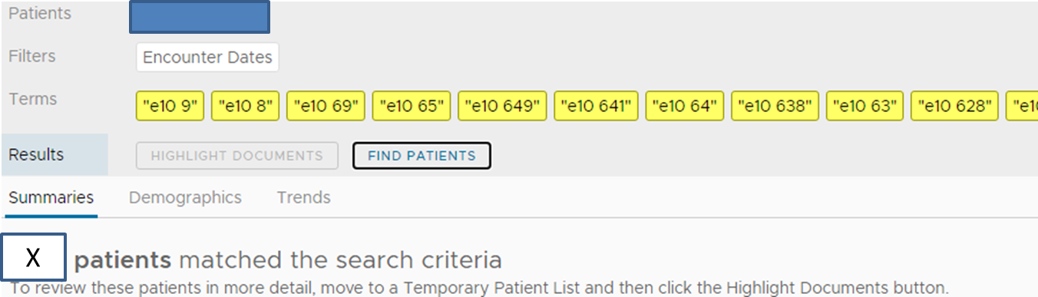
EMERSE – Finding patients w/o coded T1D diagnosis
Results returned
in less than 9 seconds
Step 2: Move these patients to a permanent list called T1D coded

Slide 47
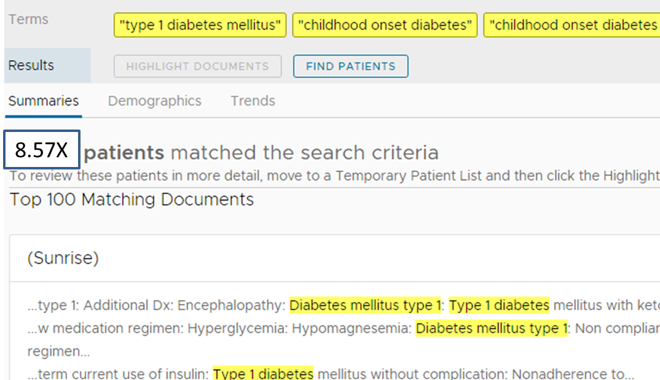
EMERSE – Finding patients w/o coded T1D diagnosis
Step 3: Search for patients where T1D is mentioned in the notes, with synonyms
Unstructured search for T1D - Assumptions
Patients in this list should be in the coded list in the prior example
We have not entered any exclusion criteria such as “do not suspect T1D”
Resulting list would have patients who have T1D but have not been coded for it
Results returned
in less than 9 seconds
Step 4: Save list of found patients as permanent list called T1D uncoded

Slide 48
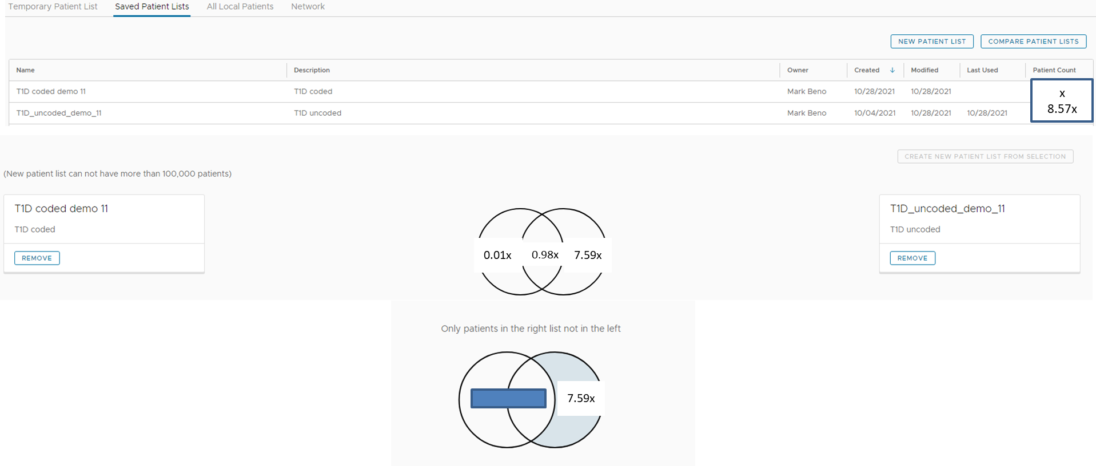
EMERSE – Finding patients w/o coded T1D diagnosis
Step 5: Compare coded T1D with uncoded T1D search
The patient list on the right mentions type 1 diabetes but none of those patients have any of the T1D ICD-10 codes in their charts
Use this cohort to refine actual T1D Dx

Slide 49
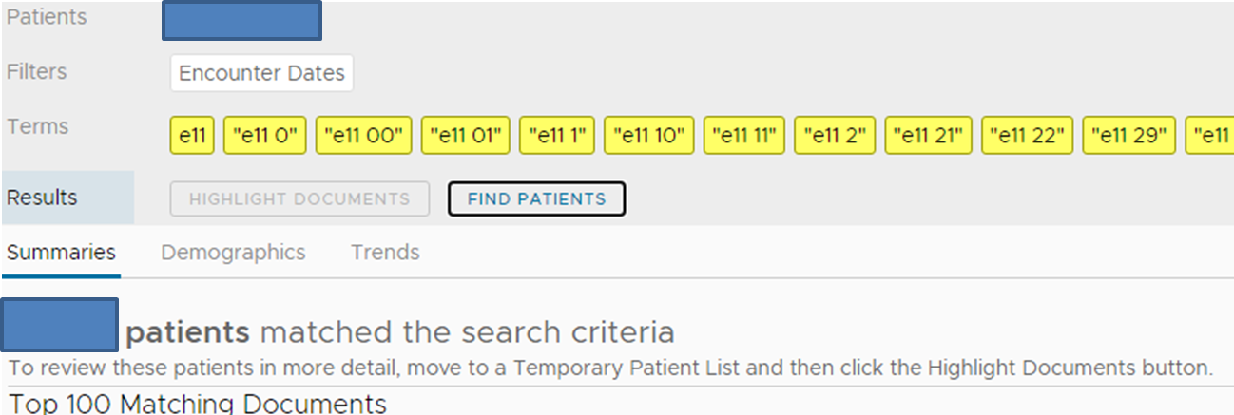
EMERSE – Searching within a patient list
These patients have a coded type 2 diabetes

Slide 50
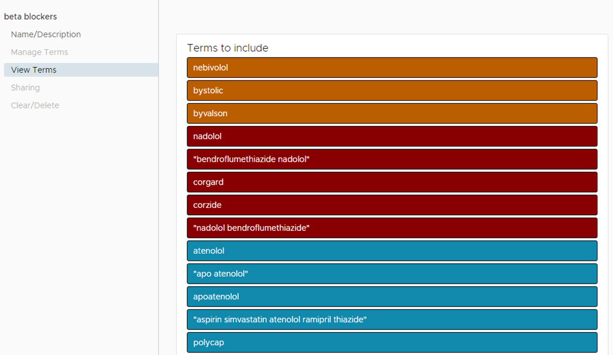
EMERSE – Searching within a patient list
Who is taking specific drugs to control T2D?
We want to visually see who in this list of T2D patients has a mention of 3 different drugs, all beta-blockers, somewhere in their notes
When searching in a saved patient list, the search is done using logical OR

Slide 51
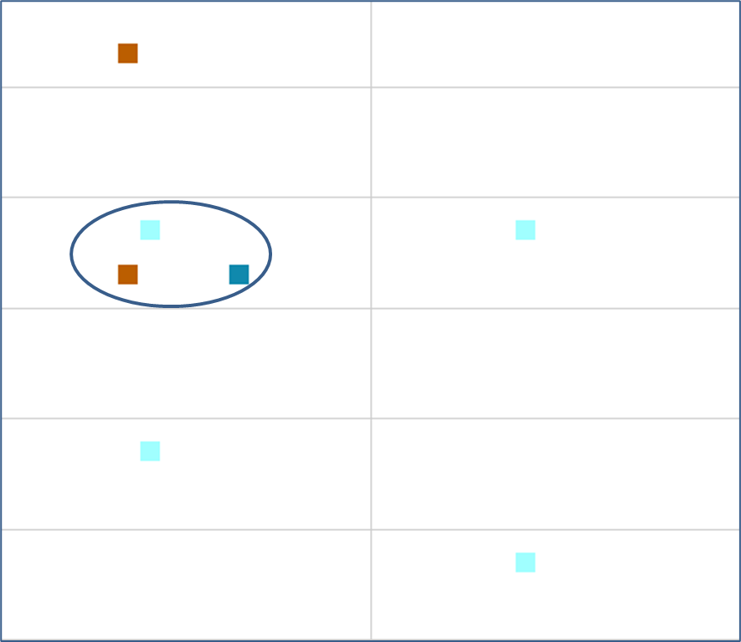
EMERSE – Searching within a patient list
Highlighting documents with mosaic view
Allows view of T2D patients who have these drugs mentioned in their notes
Can quickly narrow down someone who might has more than one drug brand mentioned in their notes

Slide 52
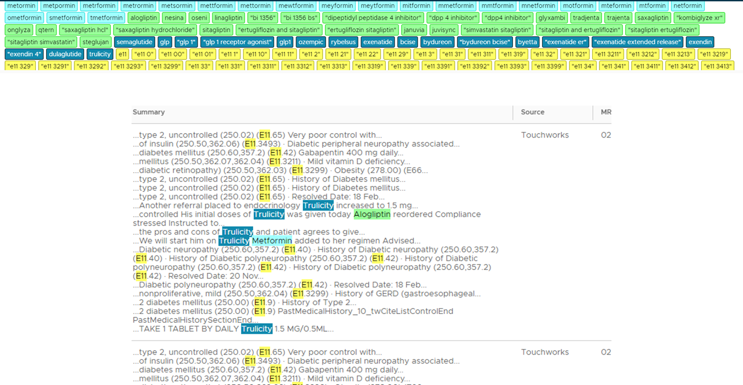
EMERSE – Searching all patients for Dx and Rx classes
Who is taking different classes of drugs to control T2D?
We want to visually see who in this list of T2D patients has a mention of 3 different drug classes mentioned in their same note
Results returned
in less than 3 seconds
345 terms searched simultaneously

Slide 53
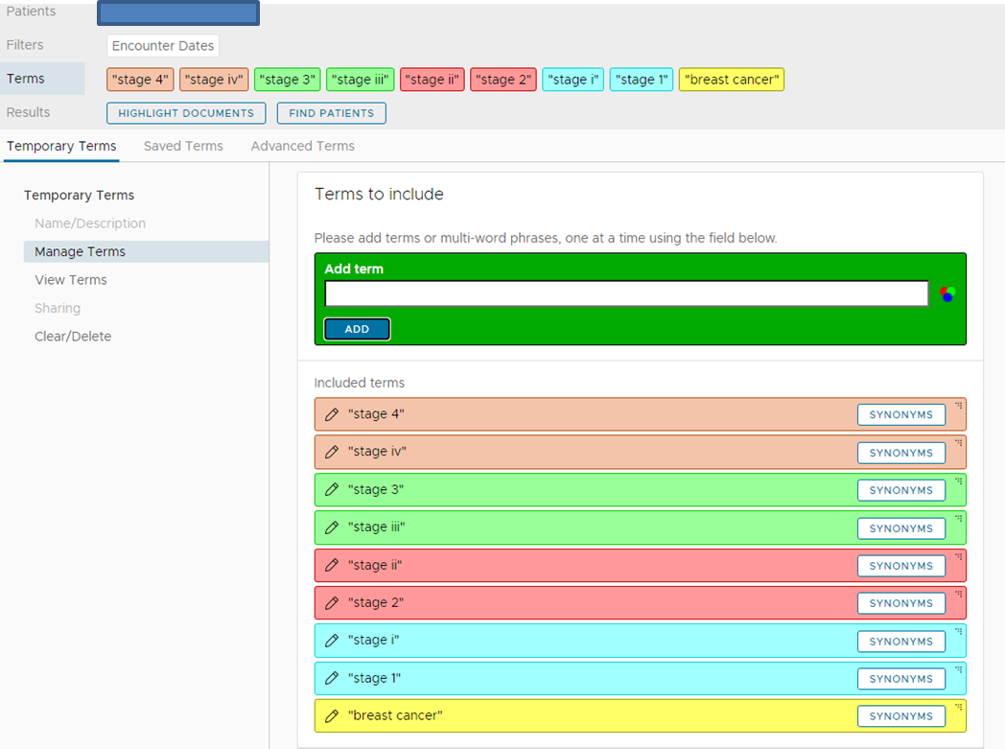
EMERSE – Searching within a patient list
Breast Cancer
This example shows visually how many patients had a mention of breast cancer and the various stages in their notes
The search quickly shows which patients match all 5 of the search criteria in our existing list the initial search was simply “breast cancer”

Slide 54
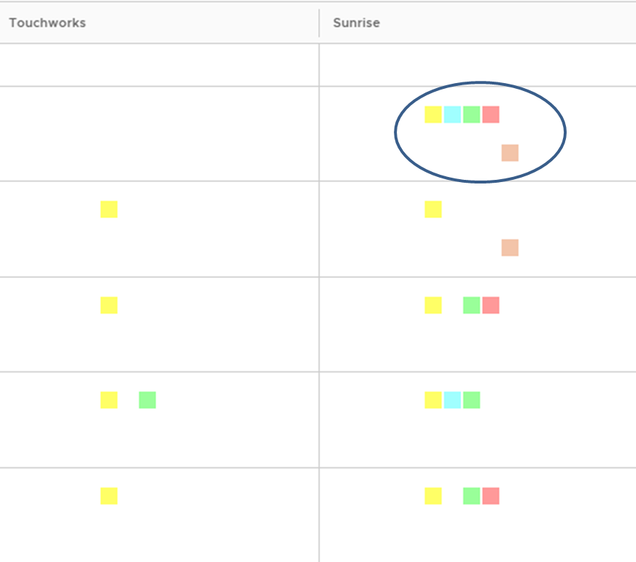
EMERSE – Searching within a patient list
Breast Cancer
We implicitly know that this patient has a mention of stages 1 through 4 mentioned in his/her notes
Now we can look to see if it was related to cancer or some other disease
Can add terms to exclude and do another search within this list
We can tag matches and save as a new list

Slide 55
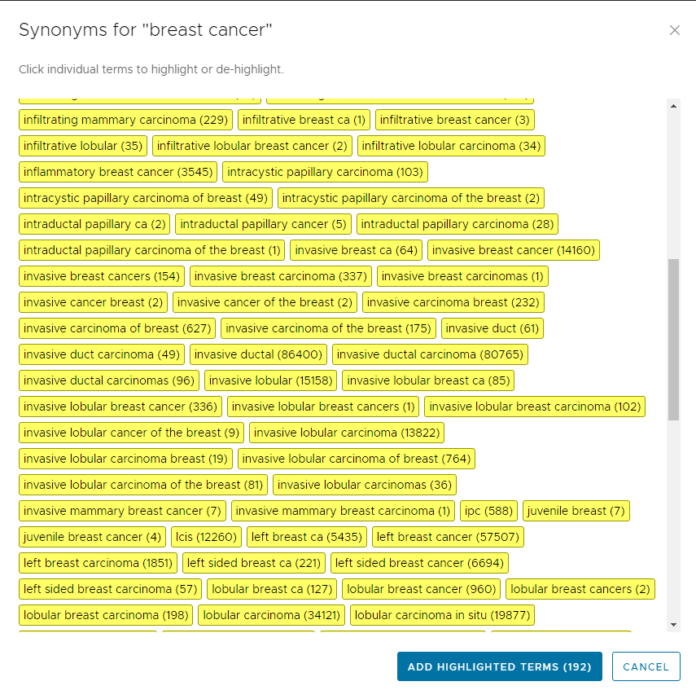

Slide 56
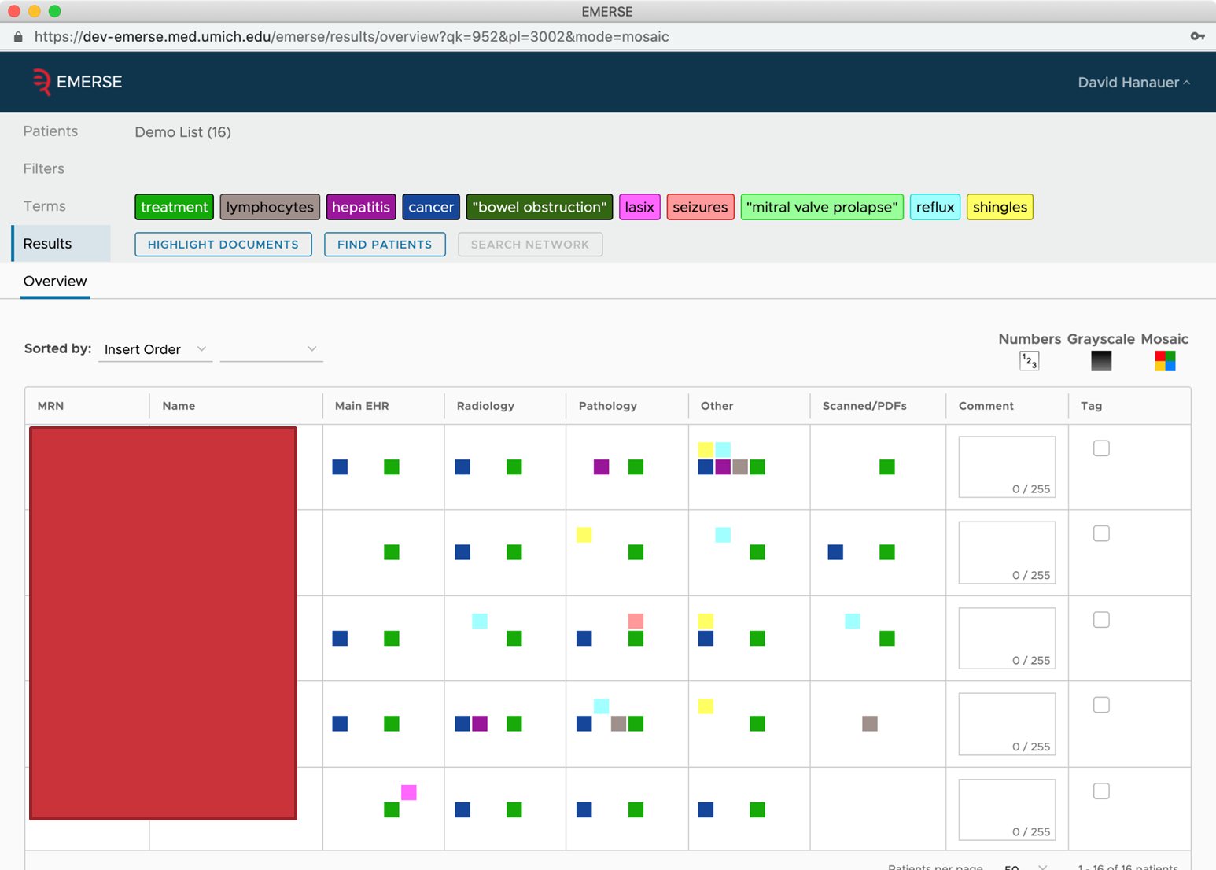

Slide 57
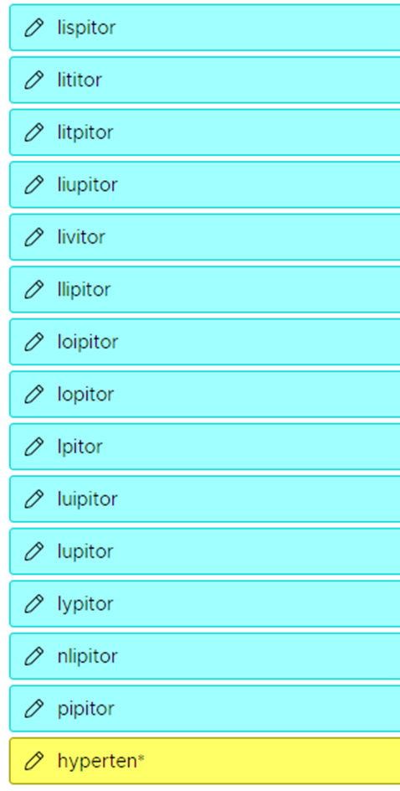
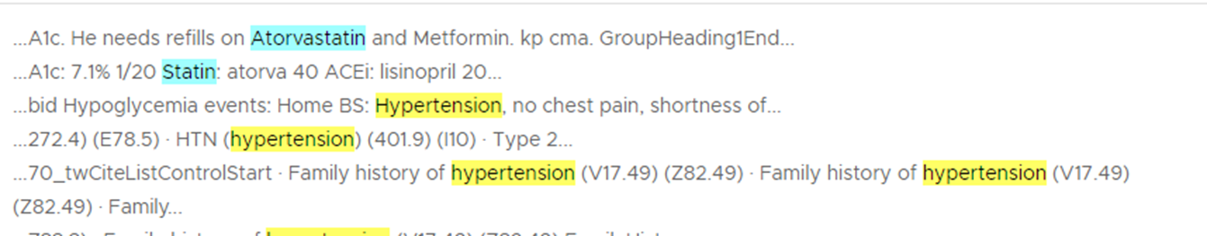
EMERSE – Searching with wild cards
Using the * character allows for the expansion of the word-stem
In this example, hyperten is expanded

Slide 58
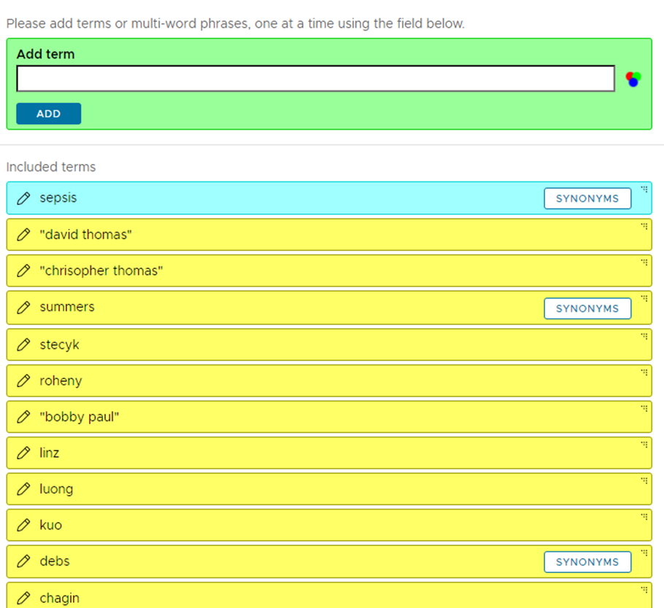

EMERSE – Temporal searching
Notes – Temporal searching
Updated every morning at 6 a.m.
Allows for near real-time searches
Potential use for differential Dx follow-up for ED patients post-discharge
In-patient tracking (e.g., DVT, sepsis)

Slide 59

EMERSE – Temporal searching
Clinician Names
The names of all signing clinicians are searchable and can become part of search strategies
Search for both last name first name and first name last name to catch all instances of common names

Slide 60

EMERSE – Enhancing notes content
Meta-data added to note headers is fully searchable
EMR Note Types
Over 2000 found during implementation
Can search for many of these by name as part of a search strategy (e.g. Triage ED Peds and some condition of interest)
Adding additional meta-data may be useful for research and ops (e.g., GIS data)

Slide 61

EMERSE – Advanced Searches

Slide 62

EMERSE – Proximity Search

Slide 63


EMERSE – Excluding terms from a search
EMERSE cannot do math, but if you search for lab values, such as LDL, and include a term for each possible value of LDL, then all patients with lab results in their notes that are in that lab value “range” will be found
However, we do not want to find anything related to an “optimal” value for LDL

Slide 64

EMERSE – Excluding terms from a search
Excluding “optimal LDL” from the search eliminates 20 patients from the search results of this time bound search

Slide 65



Synonym Sets that Can Be Added to EMERSE

Slide 66

Synonym Preferences

Slide 67

Synonym Preferences – ICD10 Codes

Slide 68



Synonym Preferences – Occupations

Slide 69


Synonym Preferences – Human Phenotype Ontology (HPO)

Slide 70
Examples of how EMERSE is being used
at University Hospitals and Case Western Reserve University

Slide 71
How EMERSE being used at University Hospitals and Case Western Reserve University

Slide 72
EMERSE – Sampling of Current Uses for Cancer Research
Understanding racial and gender disparities in bladder cancer
Exploring treatment delays in metastatic spinal cord disease
Management of head and neck malignancies involving the lateral skull base
Retrospective study of resistance and response to immunotherapy in patients with urothelial cancer
Unintentional weight loss (UWL) identification, evaluation and management

Slide 73

EMERSE – Sampling of Current Uses for Research
Digestive Health Institute

Slide 74


EMERSE – Sampling of Current Uses for Research
Digestive Health Institute

Slide 75

Center for Child Health and Policy, UH Rainbow Babies and Children’s Hospital

Slide 76

ROSE Project was used to validate EMERSE utility
Internal validation study submitted to D & I conference for 12/2021
Nora Lee, MD, Suzanne Lo, MPH, Mark Beno, MSM, Sarah Ronis, MD, MPH

Slide 77



Identification of unintentional weight loss from electronic health records data
Society to Improve Diagnosis in Medicine Annual Conference, October 16-18, 2022
Mark Beno, Harry Menegay, Goutham Rao, Paola Saroufim, and Kelsey Ufholz
University Hospitals OMOP Data Mart
Data temporally queried from OMOP according to inclusion and exclusion criteria defined in UWL study protocol
2. Resulting cohort list exported to an encrypted Excel file and then imported
into EMERSE for further analysis
Notes on >1.7 million UH patients
3. EMERSE used to determine whether weight loss was unintentional and, if so,
was it recognized clinically
4. Iterative cohort refinement via
clinical- research-technical team
dialogue and feedback
Extracted EHR data on >1.8 million UH patients
Development of a phenotype for unintentional weight loss to improve missed diagnoses

Slide 78

Unintentional Weight Loss and Cancer
Review found cancer was the underlying cause of 6 to 36% of cases of UWL
  All but one study reported cancer as UWLs at least 15%
UWL may often be the only symptom of underlying cancer
  Among 328 patients with UWL and no other symptoms, cancer was found in 35%
UWL may be the most common cancer symptom
  1/3 cancer patients have UWL at diagnosis
Estimated that 1 out of 2 Americans will get cancer in their lifetime
1 in 4 will die from cancer

Slide 79
Center to Improve Clinical Diagnosis
AHRQ R18HS029358
Goutham Rao, MD (PI); Marlene Miller, MD; Peter Pronovost, MD, PhD (MPIs)
Mission: “To identify best practices for diagnostic evaluation of common conditions prone to diagnostic error.” Classic examples include dizziness in older patients, undifferentiated abdominal pain, sepsis in children, hypertension in children, and unintentional weight loss in the elderly.
Will employ a four-step strategy developed by Dr. Rao and his team over the past ten years.
Advisory committee and diagnosticians’ panel will include > 30 clinicians from many institutions.
Focal point for improving diagnosis nationwide. Significant dissemination through weekly seminars and workshops to begin late this fall.
Central component of health services research efforts at UH.
Total budget: $3,993,301.00 over four years.

Slide 80


Slide 81
Tracking EMERSE Utilization
for Stakeholders and Compliance

Slide 82

EMERSE – Power BI Dashboard – Patient Demographics

Slide 83

EMERSE – Power BI Dashboard – Accounts Provisioned to Date

Slide 84


EMERSE – Power BI Dashboard – Unique Sessions to Date
Many introductions to the system occurred just prior to when COVID was swamping hospitals again

Slide 85

EMERSE – Power BI Dashboard – Sessions by User
But we clearly have
some power users

Slide 86


EMERSE – Power BI Dashboard – Sessions Details

Slide 87


Lessons Learned During the EMERSE System-wide Rollout
Cannot simply train and go away – generic examples do not translate to actual user engagement nor success, and users initially want to believe that EMERSE can do everything
Listening to potential end user stories is key – what will make their lives easier?
Every medical specialty has unique potential uses for EMERSE – we have needed to guide each group, and then sometimes be added to the IRB as study members to facilitate the research
Searching effectively and getting to the information desired requires a degree of strategy as well as practice and patience – this is difficult when bandwidth is limited
Clinicians are busy and will look to their research teams to use EMERSE
EMERSE can serve as a powerful research resource for medical fellowships, MD students, MPH students, Nursing, Social Workers – pretty much anything that requires chart reviews
New 12 consecutive weeks for research for University Program medical students in summer between 1st and 2nd years

Slide 88
Lessons Learned During the EMERSE System-wide Rollout
Social Determinants of Health Research – tons of potential here – the notes provide a window to the clinician/patient relationship and the patient environment that is never captured through structured data
Utilization of EMERSE beyond research is currently untapped potential – need clearer messaging on how EMERSE can create greater efficiencies and to set up meetings with operational leadership
There is some confusion about what tool can and cannot do even after showing it to users in a live setting
CICB coordination with department/division and central UH research coordinators will be key in moving forward
Using EMERSE with OMOP structured data allows for integrative innovation

Slide 89

Synonyms that allow rapid discovery of Social Determinants of Health in notes

Slide 90

Synonyms that allow rapid discovery of Social Determinants of Health in notes

Slide 91
EMERSE Next Steps
Upgrade to latest version of EMERSE (6.3) – completed October 2022
We will loop back with the power users and learn from them as well as loop back with those who have accounts but have not used the tool (or used it only a few times)
Complete the implementation of EMERSE dashboard in Power BI to track utilization and provide functions for audit and compliance (winter 2022)
Populate the studies tables to allow for the auto-population of end user attestation options (winter 2022-2023)
Conduct a meta-analysis of the publications, abstracts and theses that have used EMERSE that can serve as a resource for researchers (BHI M.S. student completed and will be transitioned to an R Shiny dashboard)
Conduct an EMERSE end-user experience survey at all active EMERSE sites (winter 2022-2023)
  How is EMERSE being used? Are users sufficiently aware of how to use EMERSE? Can learning materials be developed to enhance EMERSE?
Plan for the University Hospitals go-live with Epic in 2023

Slide 92
EMERSE and CICB Teams
CICB Team
Sunah Song, PhD
Harry Menegay, PhD
Paola Saroufim, PharmD, MPH
Devin Tian, PhD
Bob Lanese, MS
Veronica Sheng, MS candidate
Beverly Kalasky
CWRU and UH IT support
Mike Warfe (CWRU)
Carl Langdon (UH)
Cal Frye (CWRU)
Brian Christian (CWRU)
Ryan Jaskolka (UH)
Craig Schwabl (UH)
EMERSE Team at University of Michigan
David Hanauer, MD, MS
Kellen McClain
Guan Wang, MS
Lisa Ferguson, MS
Kathie Karagiannis
www.icompbio.net
www.project-emerse.org
CICB Faculty Leadership
Jonathan Haines, PhD
Daniel Simon, MD (UH)
Dana Crawford, PhD
William Bush, PhD
Satya Sahoo, PhD
Scott Williams, PhD
Jessica Cooke Bailey, PhD
Ricky Chan, PhD
Jill Barnholtz-Sloan, PhD (5/21)
www.case.edu/utech
www.uhhospitals.com

Slide 93
Thank you and Questions!
  Email me at: mark.beno@cwru.edu

