Slide 1
Using the self-service EMERSE tool to search for terms embedded in the clinical notes – now expanded for use by Internal Medicine
May 26, 2022
David Hanauer, MD, MS
Dept of Learning Health Sciences
University of Michigan
hanauer@umich.edu
Twitter: @informaticsGeek
@projectEMERSE
Web: project-emerse.org
http://project-emerse.org/presentations.html

Slide 2
If you’re thinking of taking notes
or want to visit links
these slides can be found at:
this link will be
on most slides
http://project-emerse.org/presentations.html

Slide 3
Disclosures
Funding: NIH (NCI, NCATS); PCORI
Licenses/Royalties: EMERSE “Synonyms” (used for query expansion) which is licensed by the U of Michigan
Disclosures
http://project-emerse.org/presentations.html

Slide 4
http://project-emerse.org/presentations.html

Slide 5
2021 study out of UC Irvine: Design, Implementation, and Usability of the Electronic Medical Record Search Engine (EMERSE) Tool https://escholarship.org/uc/item/44p23878
“Users unanimously responded that they would recommend the system to others, and…for a tool they found so useful, they believed that far too few people both within and outside of their network knew about the tool’s existence.”
http://project-emerse.org/presentations.html

Slide 6
Unstructured vs Structured Data
EMERSE is for this… | …not this
Unstructured Data (free text) | Structured Data
Mrs. Jones is a 56 year old female with a history of HTN, hypercholesterolemia, and T2DM who comes to the clinic today with a 3 day h/o dizziness and severe headache on the left side. | WBC: 5.6 Total cholesterol: 182 Weight: 67.4 AST: 30 ALT: 52
http://project-emerse.org/presentations.html

Slide 7
80% of EHR data are in unstructured free text
structured data
unstructured data/free text
http://project-emerse.org/presentations.html

Slide 8
The Problem(s)
Free text is: complex
it’s a representation of the mind
http://project-emerse.org/presentations.html

Slide 9
The Problem(s)
Free text is: a mess
“domino pain”
http://project-emerse.org/presentations.html

Slide 10
The Problem(s)
Free text is: difficult to access
http://project-emerse.org/presentations.html

Slide 11
The Problem(s)
Many free text tools are hard to use
"The average ratings provided by the end user evaluators on ease of use and ease of interpreting output... indicat[e] that this group of users generally deemed the systems extremely difficult to work with"
https://pubmed.ncbi.nlm.nih.gov/26210361/
http://project-emerse.org/presentations.html

Slide 12
The EMERSE solution
A system “for the people”
Users search the EHR on their own
No need to wait in a queue for an analyst or a data scientist
Data are kept secure within a centralized, audited system
No need to download/store the data elsewhere
Easy-to-use for non-technical researchers
http://project-emerse.org/presentations.html

Slide 13
The EMERSE is the…
Electronic Medical Record Search Engine
Supports Google-like searching to find patients
Supports chart reviews by highlighting terms within notes
http://project-emerse.org/presentations.html

Slide 14
EMERSE is mature
Software we’ve been developing and refining for 17 years
2022
2005
http://project-emerse.org/presentations.html

Slide 15
EMERSE is a tool for free text
picking the right tool for your research is important; multiple tools are often needed
http://project-emerse.org/presentations.html

Slide 16
Find cohorts
EMERSE allows you to find cohorts based on things mentioned in the notes
diseases
drugs
symptoms
anything*
*if it is mentioned
http://project-emerse.org/presentations.html

Slide 17
Find cohorts
It’s perfect for finding rare things…
…like rare cancers
See this talk for more details:
https://vimeo.com/677482835
“Using EMERSE to Improve Research Involving Rare Cancers”
http://project-emerse.org/presentations.html

Slide 18
Highlight documents for chart review
Thoracocentesis confirmed the recurrence of mantle cell lymphoma. Disease restaging work-up revealed multicompartment lymphadenopathy in the neck, mediastinal, retrocrural, retroperitoneal and pelvic regions. Bone marrow was also involved. The patient was treated with a total of six cycles of rituximab, cyclophosphamide, vincristine, doxorubicin and dexamethasone (R-HyperCVAD) completed in January 2007. That treatment led to complete remission that lasted until October 2008, when the disease was found to have recurred in the left pleural space and retroperitoneum without bone marrow involvement.
https://jmedicalcasereports.biomedcentral.com/articles/10.1186/1752-1947-4-329
http://project-emerse.org/presentations.html

Slide 19
EMERSE Bundles
Saved sets of search terms
Shared among users
Helps standardize searches
Supports reproducibility
- Some teams publish Bundles
in their publication’s appendix
(example: https://www.ncbi.nlm.nih.gov/pmc/articles/PMC3860174/)
http://project-emerse.org/presentations.html

Slide 20
EMERSE is fast
Query to identify all patients with the following | Reporting DB time (s) | EMERSE time (s) | EMERSE advantage
cavernous hemangioma | 14,652 | 2 | 7,320x
gray platelet syndrome | 14,940 | 2 | 7,470x
inferior lingular segment of the left upper lobe | 17,784 | 9 | 1,980x
…enabling real-time querying
http://project-emerse.org/presentations.html

Slide 21
Typical workflow
initial cohort identified
with a cohort discovery
tool using structured data (or via EMERSE
‘Find Patients’)
Cohort discovery tools:
i2b2, TriNetX, LEAF, etc.
http://project-emerse.org/presentations.html

Slide 22
Typical workflow
additional details abstracted from the free text using EMERSE
http://project-emerse.org/presentations.html

Slide 23
Typical workflow
Data recorded in an electronic data capture system (e.g., REDCap)
http://project-emerse.org/presentations.html

Slide 24
Cincinnati specifics
EMERSE stats at Cincinnati:
Available since 2018
Data from 2017-present, refreshed quarterly
750k patients
45M documents
http://project-emerse.org/presentations.html

Slide 25
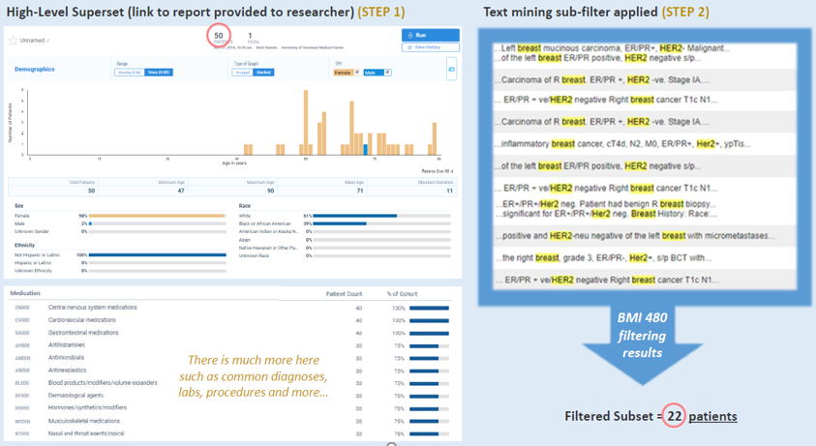
Cincinnati specifics
Potential workflow:
Identify patients with
TriNetX → contact BMI for
MRNs → import MRNs
into EMERSE
To request access: https://chi.uc.edu/research
http://project-emerse.org/presentations.html

Slide 26
Publications using EMERSE
553
papers and abstracts
Full list at:
http://project-emerse.org/publications.html
http://project-emerse.org/presentations.html

Slide 27
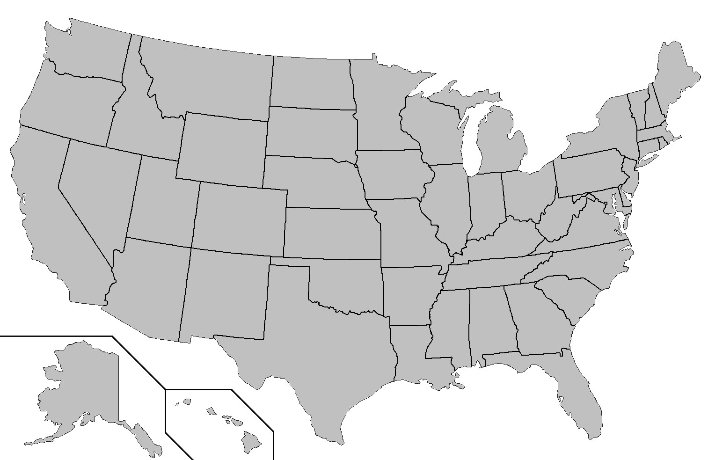
Where is EMERSE?
installed
installing
http://project-emerse.org/presentations.html

Slide 28
Now available…
EMERSE Research Informatics Network
real-time, secure
cross-site queries
http://project-emerse.org/presentations.html

Slide 29
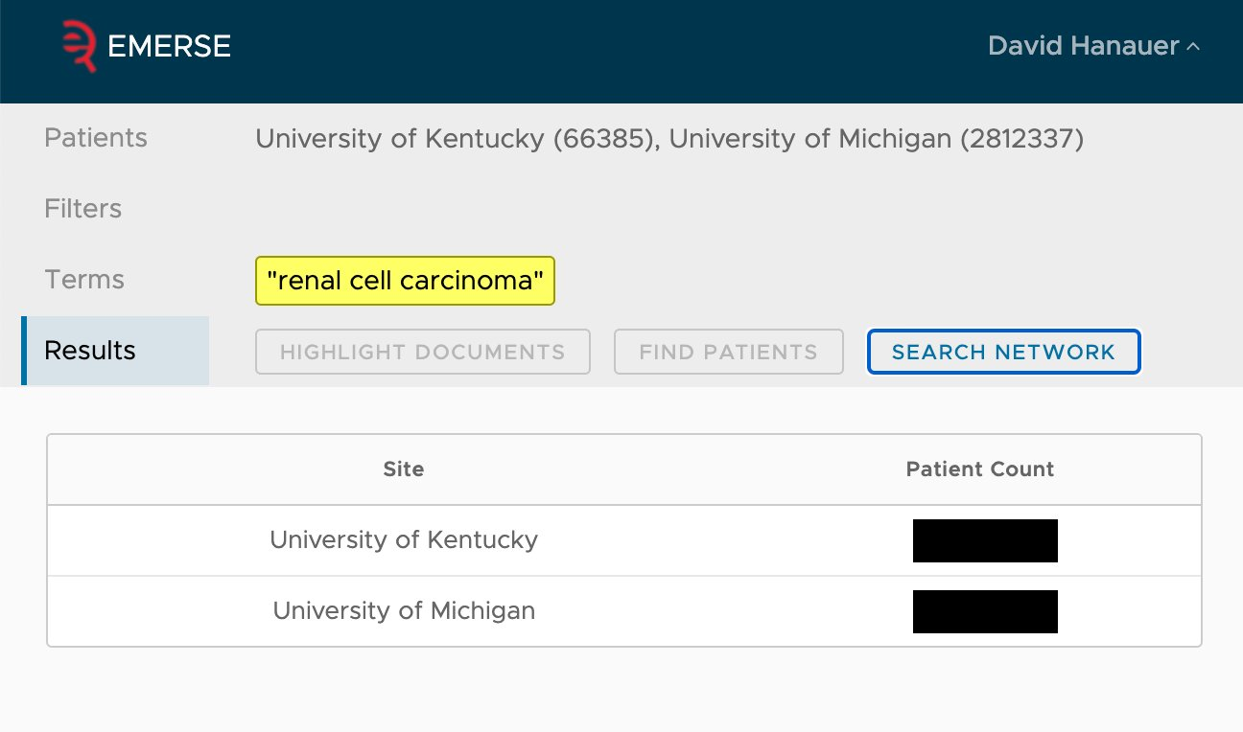
EMERSE Research Informatics Network
http://project-emerse.org/presentations.html

Slide 30
The future…
Incorporation of NLP features
- negation
- uncertainty
- subject (patient vs other)
- named entity recognition/mapping to ontologies
Data extraction from templated notes
http://project-emerse.org/presentations.html

Slide 31
project-emerse.org
http://project-emerse.org/presentations.html

Slide 32
Twitter: @projectEMERSE
publications
software releases
announcements
webinars
http://project-emerse.org/presentations.html

Slide 33
Interested in learning more?
Contact us to schedule a time with your team for:
Discussions about research strategies
Training
Live demonstrations
http://project-emerse.org/presentations.html

Slide 34
EMERSE-team@umich.edu
Lisa Ferguson
David Hanauer
Kellen McClain
Guan Wang
http://project-emerse.org/presentations.html

