Slide 1
An overview of EMERSE, an easy-to-use, self-service search engine and chart review tool for free text electronic health record documents
February 17, 2022
David Hanauer, MD, MS
Dept of Learning Health Sciences
University of Michigan
hanauer@umich.edu
Twitter: @informaticsGeek
@projectEMERSE
Web: project-emerse.org
http://project-emerse.org/presentations.html

Slide 2
If you’re thinking of taking notes
or want to visit links
these slides can be found at:
this link will be
on most slides
http://project-emerse.org/presentations.html

Slide 3
Disclosures
Funding: NIH (NCI, NCATS); PCORI
Licenses/Royalties: EMERSE “Synonyms” (used for query expansion) which is licensed by the U of Michigan
Disclosures
http://project-emerse.org/presentations.html

Slide 4
The Problem(s)
Free text is: complex
it’s a representation of the mind
http://project-emerse.org/presentations.html

Slide 5
The Problem(s)
Free text is: a mess
“domino pain”
http://project-emerse.org/presentations.html

Slide 6
The Problem(s)
Free text is: difficult to access
http://project-emerse.org/presentations.html

Slide 7
The Problem(s)
Many free text tools are hard to use
"The average ratings provided by the end user evaluators on ease of use and ease of interpreting output... indicat[e] that this group of users generally deemed the systems extremely difficult to work with"
https://pubmed.ncbi.nlm.nih.gov/26210361/
http://project-emerse.org/presentations.html

Slide 8
A solution
A system “for the people”
Users search the EHR on their own
No need to wait in a queue for an analyst or a data scientist
Data are kept secure within a centralized, audited system
No need to download/store the data elsewhere
Easy-to-use for non-technical researchers
http://project-emerse.org/presentations.html

Slide 9
What is EMERSE?
A search engine, kind of like Google, for free text medical record documents
(technically, it’s an information retrieval system)
Simple to use
http://project-emerse.org/presentations.html

Slide 10
What is EMERSE?
Software we’ve been developing and refining for 17 years
2021
2005
http://project-emerse.org/presentations.html

Slide 11
What is EMERSE?
A research tool, open-source licensing
picking the right tool for your research is important; multiple tools are often needed
http://project-emerse.org/presentations.html

Slide 12
What isn’t EMERSE?
It is not: natural language processing (NLP)
but full NLP may not always be needed
and NLP can be hard to use or customize
(and we have plans to build in some NLP)
http://project-emerse.org/presentations.html

Slide 13
EMERSE vs NLP
EMERSE: human-in-the-loop augmented intelligence
NLP: artificial intelligence
http://project-emerse.org/presentations.html

Slide 14
EMERSE vs NLP
NLP
EMERSE
http://project-emerse.org/presentations.html

Slide 15
Find cohorts
EMERSE allows you to find cohorts based on things mentioned in the notes
diseases
drugs
symptoms
anything*
*if it is mentioned
http://project-emerse.org/presentations.html

Slide 16
Find cohorts
It’s perfect for finding rare things…
…like rare cancers
See this talk for more details:
https://vimeo.com/677482835
“Using EMERSE to Improve Research Involving Rare Cancers”
http://project-emerse.org/presentations.html

Slide 17
Highlight documents for chart review
Thoracocentesis confirmed the recurrence of mantle cell lymphoma. Disease restaging work-up revealed multicompartment lymphadenopathy in the neck, mediastinal, retrocrural, retroperitoneal and pelvic regions. Bone marrow was also involved. The patient was treated with a total of six cycles of rituximab, cyclophosphamide, vincristine, doxorubicin and dexamethasone (R-HyperCVAD) completed in January 2007. That treatment led to complete remission that lasted until October 2008, when the disease was found to have recurred in the left pleural space and retroperitoneum without bone marrow involvement.
https://jmedicalcasereports.biomedcentral.com/articles/10.1186/1752-1947-4-329
http://project-emerse.org/presentations.html

Slide 18
EMERSE Bundles
Saved sets of search terms
Shared among users
Helps standardize searches
Supports reproducibility
- Some teams publish Bundles
in their publication’s appendix
(example: https://www.ncbi.nlm.nih.gov/pmc/articles/PMC3860174/)
http://project-emerse.org/presentations.html

Slide 19
EMERSE is fast
Query to identify all patients with the following | Reporting DB time (s) | EMERSE time (s) | EMERSE advantage
cavernous hemangioma | 14,652 | 2 | 7,320x
gray platelet syndrome | 14,940 | 2 | 7,470x
inferior lingular segment of the left upper lobe | 17,784 | 9 | 1,980x
…enabling real-time querying
http://project-emerse.org/presentations.html

Slide 20
Typical workflow
initial cohort identified
with a cohort discovery
tool using structured data (or via EMERSE
‘Find Patients’)
Cohort discovery tools:
DataDirect @ Michigan
i2b2, LEAF, others elsewhere
http://project-emerse.org/presentations.html

Slide 21
Typical workflow
additional details abstracted from the free text using EMERSE
http://project-emerse.org/presentations.html

Slide 22
Typical workflow
Data recorded in an electronic data capture system (e.g., REDCap)
http://project-emerse.org/presentations.html

Slide 23
Publications using EMERSE
463 papers
84 abstracts
Full list at:
http://project-emerse.org/publications.html
http://project-emerse.org/presentations.html

Slide 24
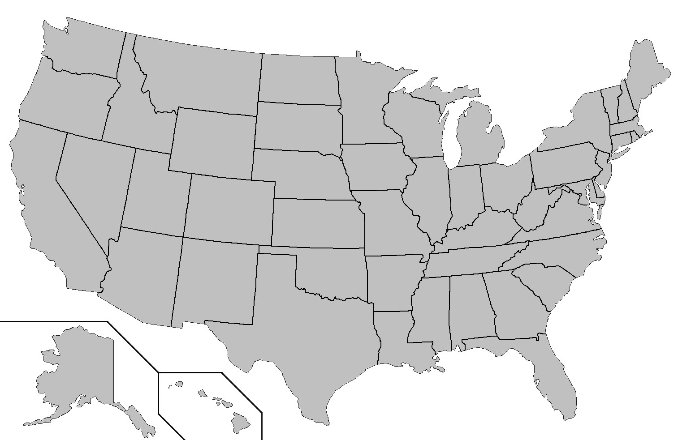
Where is EMERSE?
installed
installing
http://project-emerse.org/presentations.html

Slide 25
The future…
EMERSE Research Informatics Network
real-time, secure
cross-site queries
http://project-emerse.org/presentations.html

Slide 26
The future…
Incorporation of NLP features
- negation
- uncertainty
- patient vs other
- named entity recognition/mapping to ontologies
Data extraction from templated notes
http://project-emerse.org/presentations.html

Slide 27
Upcoming presentations about EMERSE
March 3, 2022, 2:00 – 3:00 PM ET
EMERSE Meeting Series: - Machine-Redacted Clinical Text, EMERSE, and Solr API: a data scientist-friendly environment for utilizing clinical notes for research (Presentation by UCSF)
Register here: https://bit.ly/emerse-march-2022
March 24, 2022, 10:30 – 12:00 PM CDT
AMIA Informatics Summit (Chicago); https://bit.ly/emerse-amia-2022
Session 36: Systems Demonstrations - Improving Workflow: Informatics Tools No Researcher Should Be Without
"The Open-Source EMERSE (Electronic Medical Record Search Engine) Tool”
(presentation by Case Western Reserve U)
http://project-emerse.org/presentations.html

Slide 28
project-emerse.org
http://project-emerse.org/presentations.html

Slide 29
Twitter: @projectEMERSE
publications
software releases
announcements
webinars
http://project-emerse.org/presentations.html

Slide 30
EMERSE-team@umich.edu
Lisa Ferguson
David Hanauer
Kellen McClain
Guan Wang
http://project-emerse.org/presentations.html

Slide 31
Acknowledgements
U of Michigan
Institute
for Clinical and
Health Research
(MICHR)
U of Michigan
Health Information
and Technology
Services (HITS)
U of Michigan
Department of
Learning Health
Sciences
U of Michigan
Rogel Cancer
Center
NCI Informatics
Technology for
Cancer Research
(ITCR)
U of Michigan
Office of
Research
Our
Partner
Institutions
Our
Users
http://project-emerse.org/presentations.html

