Slide 1
EMERSE Community Meeting
2023-Oct-10
https://project-emerse.org
https://project-emerse.org

Slide 2
Plan for today
Welcome and Housekeeping
Announcements and Updates
Publication updates
EMERSE and NLP: David Hanauer
Discussion: Administration, Architecture and Technology
Open Forum
Adjourn

Slide 3
Housekeeping
Zoom Meeting
More opportunities for interaction
Please stay muted, unless you would like to ask a question or make a comment
Feel free to use the chat function to type questions or provide comments
We will answer questions throughout
We will record this meeting, available where prior recordings are located: https://project-emerse.org/presentations.html

Slide 4
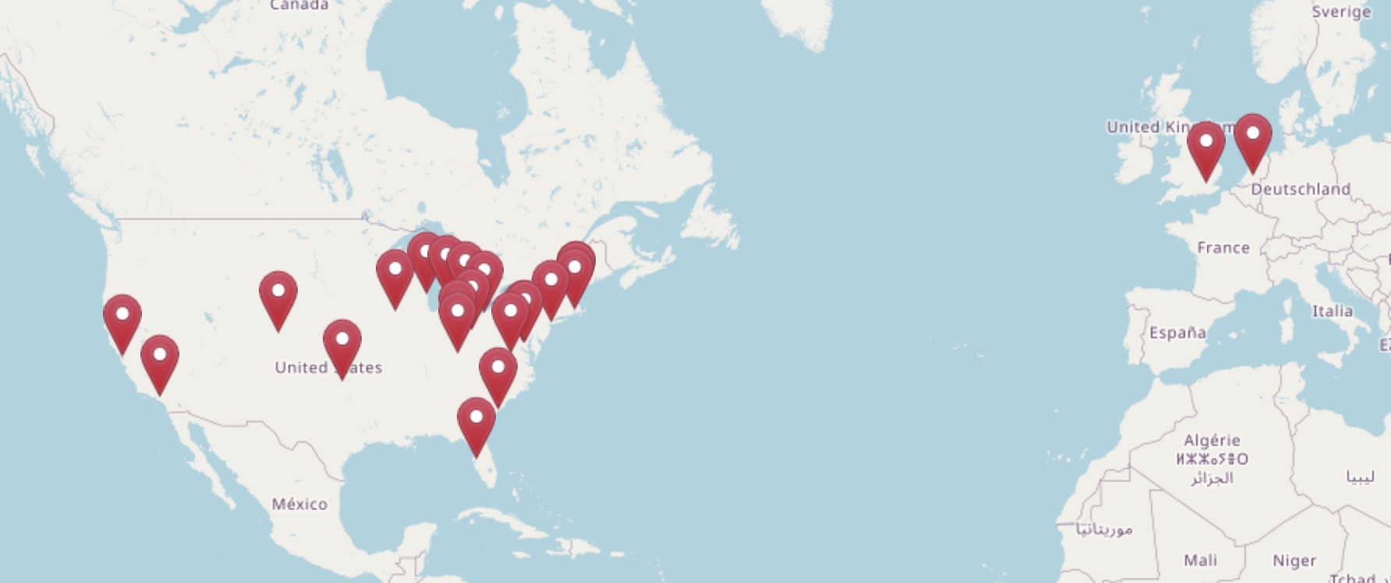
Our Community
Location of registrants for today’s meeting
https://project-emerse.org/community.html

Slide 5
Acknowledgements
EMERSE has been supported by:
NCI ITCR program
NCATS via MICHR CTSA
Michigan Medicine
Department of Learning Health Sciences
Office of Research
Health Information Technology & Services

Slide 6
Updates and Announcements
New NCI ITCR U24 Grant Awarded!
5 years (October 2023 – September 2028)
Overview of Aims at next Community Meeting (TBD ~Jan/Feb 2024)
EMERSE Research Collaborative
Kick-off – May 23, 2023
Next meeting: Oct 26, 2023

Slide 7
Publications

Slide 8
Publications
University of Michigan
Impact of Metagenomic Next-Generation Sequencing of Plasma Cell-free DNA Testing in the Management of Patients With Suspected Infectious Diseases
Low-parameter supervised learning models can discriminate pseudoprogression and true progression in non-perfusion-based MRI
Margin status in vulvovaginal melanoma: Management and oncologic outcomes of 50 cases
Presenting Symptoms and Imaging Features of Posterior Cerebral Artery Stroke Causing Homonymous Hemianopia
Subcutaneous Leiomyosarcoma: An Aggressive Malignancy Portending a Significant Risk of Metastasis and Death

Slide 9
Publications
University of California – San Francisco
Demographic and clinical characteristics of patients with metastatic breast cancer and leptomeningeal disease: A single center retrospective cohort study
Social Determinants of Health Documentation in Structured and Unstructured Clinical Data of Patients With Diabetes: Comparative Analysis
University of North Carolina – Chapel Hill
Transition of care from the emergency department to skilled nursing facility: Retrospective case-control study

Slide 10
Publications
Case Western Reserve University
Social Determinants of Health and Racial Disparities in Cardiac Events in Breast Cancer
Social Determinants of Health Data Improve the Prediction of Cardiac Outcomes in Females with Breast Cancer
Thirty-Day Unplanned Hospital Readmissions in Patients With Cancer and the Impact of Social Determinants of Health: A Machine Learning Approach
The Development of Head and Neck Cancer in Patients with the Isolated Complaint of Globus Pharyngeus

Slide 11
Publications – “The largest”
“…this is the largest series to date that examines the importance of preinvasive disease [of vulvovaginal melanoma] at the margins and its clinical implications.” [PMID 37711973]
“…this represents the largest series of subcutaneous LMS [leiomyosarcoma] thus far reported in the literature.” [PMID 37727934]
“This is the largest multi-institutional series in the literature to date focused on evaluating the incidence of a HN [head and neck] cancer diagnosis after initial GP [globus pharyngeus] presentation.” [PMID 37737553]

Slide 12
EMERSE and NLP
Goals
Incorporate more information in the index including negation, uncertainty, subject, name entity recognition/concept identification
Expose more of the underlying search capabilities to users
Improve the user interface for term management
Approach
Substantial improvements to the user interface
Layered index

Slide 13
EMERSE and NLP
Layered index example

Slide 14
EMERSE and NLP
Layered index example

Slide 15
EMERSE and NLP – Three “Fs” of NLP
Fast, Good, Cheap Rule → Fast, Flawless, Free
Fast
Desired NLP
solution
Flawless
Free

Slide 16
EMERSE and NLP
Work completed to-date
Functional prototype (including plain text and HTML formatted notes)
Work still to do
Indexing speed tests when scaled up
Saving terms with new options
Incorporating local/custom NLP (BYON model: Bring Your Own NLP)
Enabling across network
Data extraction
Demo

Slide 17
EMERSE and NLP
Interested in testing the demo and providing feedback?
Email EMERSE-team@umich.edu for an account

Slide 18
Administration, Architecture and Technology
Other work in progress
Admin filters to limit access to certain users
Seems simple, but very challenging
Saving/sharing filters
Filters across the network (not yet begun)
API with audit trails

Slide 19
Administration, Architecture and Technology
Open discussion
Questions?
Comments?

Slide 20
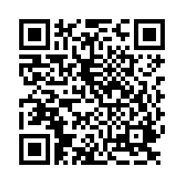
Wrap up
THANK YOU
Next Meeting: TBD (Jan/Feb 2024)
Please complete meeting survey:

