Slide 1
EMERSE: an easy-to-use, self-service search engine and chart review tool for EHR notes
January 11, 2023
David Hanauer, MD, MS
Dept of Learning Health Sciences
University of Michigan
hanauer@umich.edu
Twitter: @informaticsGeek
@projectEMERSE
Web: project-emerse.org
http://project-emerse.org/presentations.html

Slide 2
If you’re thinking of taking notes
or want to visit links
these slides can be found at:
this link will be
on most slides
http://project-emerse.org/presentations.html

Slide 3
Disclosures
Funding: NIH (NCI, NCATS); PCORI
Licenses/Royalties: EMERSE “Synonyms” (used for query expansion) which is licensed by the U of Michigan
Disclosures
Free for academic use
within EMERSE
http://project-emerse.org/presentations.html

Slide 4
http://project-emerse.org/presentations.html

Slide 5
2021 study out of UC Irvine: Design, Implementation, and Usability of the Electronic Medical Record Search Engine (EMERSE) Tool https://escholarship.org/uc/item/44p23878
“Users unanimously responded that they would recommend the system to others, and…for a tool they found so useful, they believed that far too few people both within and outside of their network knew about the tool’s existence.”
http://project-emerse.org/presentations.html

Slide 6
Unstructured vs Structured Data
EMERSE is for this… | …not this
Unstructured Data (free text) | Structured Data
Mrs. Jones is a 56 year old female with a history of HTN, hypercholesterolemia, and T2DM who comes to the clinic today with a 3 day h/o dizziness and severe headache on the left side. | WBC: 5.6 Total cholesterol: 182 Weight: 67.4 AST: 30 ALT: 52
http://project-emerse.org/presentations.html

Slide 7
80% of EHR data are in unstructured free text
structured data
unstructured data/free text
http://project-emerse.org/presentations.html

Slide 8
The EMERSE solution
A system “for the people”
Users search the notes on their own
No need to wait in a queue for an analyst or a data scientist
Easy-to-use for non-technical researchers
It just works
http://project-emerse.org/presentations.html

Slide 9
The EMERSE solution
A system “for the admins”
Enterprise grade, easy to support
Configurable with roles/privileges to control access
Data are kept secure within a centralized, audited system
No need to download/store the data elsewhere
http://project-emerse.org/presentations.html

Slide 10
Find cohorts
EMERSE allows you to find cohorts based on things mentioned in the notes
diseases
drugs
symptoms
anything*
*if it is mentioned
http://project-emerse.org/presentations.html

Slide 11
Find cohorts
It’s perfect for finding rare things…
…like rare cancers
See this talk for more details:
https://vimeo.com/677482835
“Using EMERSE to Improve Research Involving Rare Cancers”
http://project-emerse.org/presentations.html

Slide 12
Highlight documents for chart review
Thoracocentesis confirmed the recurrence of mantle cell lymphoma. Disease restaging work-up revealed multicompartment lymphadenopathy in the neck, mediastinal, retrocrural, retroperitoneal and pelvic regions. Bone marrow was also involved. The patient was treated with a total of six cycles of rituximab, cyclophosphamide, vincristine, doxorubicin and dexamethasone (R-HyperCVAD) completed in January 2007. That treatment led to complete remission that lasted until October 2008, when the disease was found to have recurred in the left pleural space and retroperitoneum without bone marrow involvement.
https://jmedicalcasereports.biomedcentral.com/articles/10.1186/1752-1947-4-329
http://project-emerse.org/presentations.html

Slide 13
Our philosophy
It’s important to see the terms/concepts in the context of the original text to truly understand the clinical meaning.
http://project-emerse.org/presentations.html

Slide 14
Phrase: A 31-year old Caucasian British woman with a history of long-term zopiclone use
>>>>> Phrase
a 31 year old caucasian british woman with a history of long term zopiclone use
<<<<< Phrase
>>>>> Mappings
Meta Mapping (696):
567 31 [Quantitative Concept]
567 YEAR (year) [Temporal Concept]
567 Old [Temporal Concept]
579 Caucasian British (White British) [Population Group]
733 WOMAN (Woman) [Population Group]
567 History [Occupation or Discipline]
579 Long Term (Long-term) [Temporal Concept]
567 ZOPICLONE (zopiclone) [Organic Chemical,Pharmacologic Substance]
578 Use of [Functional Concept]
567 history (Historical aspects qualifier) [Functional Concept]
567 history (History of present illness (finding)) [Finding]
567 History (Medical History) [Finding]
567 History (Concept History) [Conceptual Entity]
567 History (History of previous events) [Finding]
567 History, NOS (History of (present illness) (contextual qualifier) (situation)) [Intellectual Product]
733 Woman (Human, Female adult) [Human]
567 /Year (per year) [Temporal Concept]
<<<<< Mappings
Phrase: and
Phrase: anorexia nervosa
anorexia nervosa
Meta Mapping (1000):
1000 ANOREXIA NERVOSA (Anorexia Nervosa) [Mental or Behavioral Dysfunction]
Phrase: was
Phrase: admitted as an inpatient
admitted as an inpatient
1000 Admitted as an inpatient (Admitted as an inpatient:Find:Pt:^Patient:Ord) [Clinical Attribute]
1000 Admitted as an inpatient [Finding]
Phrase: for a ten-day alcohol detoxification.
ten day alcohol detoxification
Meta Mapping (888):
694 TEN-DAY (Ten-Day Report) [Intellectual Product]
861 Alcohol detoxification (Detoxication psychiatric therapy for alcoholism) [Therapeutic or Preventive Procedure]
861 Alcohol detoxification [Therapeutic or Preventive Procedure]
Processing inter_12192022_20:07:23_27484_hanauer@umich.edu_609965139.tmp.tx.2: Her weekly (four days out of seven) intake of alcohol was 180 units and her daily intake of zopiclone, 30 mg.
Phrase: Her weekly
weekly
1000 Weekly [Temporal Concept]
1000 Weekly (Chief Complaint is Present Weekly) [Finding]
Phrase: (four days out of seven
four days out of seven
Meta Mapping (752):
593 Four [Quantitative Concept]
593 Out (Out (direction)) [Spatial Concept]
781 SEVEN-DAY (Seven-Day Report) [Intellectual Product]
593 Out (Removed) [Qualitative Concept]
Phrase: )
Phrase: intake of alcohol
intake of alcohol
Meta Mapping (858):
858 intake alcohol (Alcohol consumption) [Individual Behavior]
Phrase: 180 units
180 units
Meta Mapping (861):
861 Units (Unit) [Quantitative Concept]
861 Units (Unit of Measure) [Quantitative Concept]
861 UNITS (Enzyme Unit) [Quantitative Concept]
861 Units (Unit - NCI Thesaurus Property) [Quantitative Concept]
Phrase: her daily intake of zopiclone,
her daily intake of zopiclone
Meta Mapping (733):
593 HER (Herero language) [Language]
760 Daily [Temporal Concept]
760 Intake [Functional Concept]
593 ZOPICLONE (zopiclone) [Organic Chemical,Pharmacologic Substance]
760 Daily (Chief Complaint is Present Daily) [Finding]
Phrase: 30 mg.
30 mg
694 30% [Quantitative Concept]
861 MG (Mammography) [Diagnostic Procedure]
861 mg% (mg/dL) [Quantitative Concept]
861 Mg (Mg antigen) [Amino Acid, Peptide, or Protein,Immunologic Factor]
861 mg % (Milligram percent) [Quantitative Concept]
861 Mg++ (magnesium cation) [Element, Ion, or Isotope,Pharmacologic Substance]
861 MG (US Military Commissioned Officer O8) [Classification]
861 MG (Mongol Chinese) [Population Group]
Processing inter_12192022_20:07:23_27484_hanauer@umich.edu_609965139.tmp.tx.3: Apart from a short period five years ago, she had been taking zopiclone for 13 years at daily doses of up to 90 mg.
Phrase: Apart from a short period five years ago,
short period five years ago
Meta Mapping (798):
673 short period (Short menstrual periods) [Finding]
637 Five [Quantitative Concept]
804 YEARS (year) [Temporal Concept]
Phrase: she
Phrase: had
Phrase: been
Phrase: taking
taking
Meta Mapping (966):
966 Take [Health Care Activity]
Phrase: zopiclone for 13 years
zopiclone for 13 years
Meta Mapping (708):
770 ZOPICLONE (zopiclone) [Organic Chemical,Pharmacologic Substance]
604 YEARS (year) [Temporal Concept]
Phrase: at daily doses of
at daily doses of
Meta Mapping (794):
604 At [Spatial Concept]
799 Daily Dose [Quantitative Concept]
604 AT (GATM wt Allele) [Gene or Genome]
604 AT (AT genotype) [Finding]
604 AT (Apnea Time) [Quantitative Concept]
Phrase: up to 90 mg.
90 mg
694 >90 [Quantitative Concept]
694 <90 [Quantitative Concept]
694 90% [Quantitative Concept]
Processing inter_12192022_20:07:23_27484_hanauer@umich.edu_609965139.tmp.tx.4: She admitted to using 'on top' of her prescribed medication, purchasing extra tablets from friends or receiving them gratis from her partner.
Phrase: admitted to using '
admitted to using
Meta Mapping (746):
790 admitted (Hospital admission) [Health Care Activity]
790 Using (Use of) [Functional Concept]
790 Admitted (Admission activity) [Health Care Activity]
Phrase: on top' of her prescribed medication,
prescribed medication
694 Prescribed [Health Care Activity]
861 Medication (Pharmaceutical Preparations) [Pharmacologic Substance]
861 MEDICATION (Concomitant Agent) [Idea or Concept]
861 medication (medication - HL7 publishing domain) [Intellectual Product]
861 Medication (Medications) [Intellectual Product]
Phrase: purchasing
purchasing
1000 Purchasing (Purchase) [Activity]
Phrase: extra tablets from friends
extra tablets from friends
604 Extra (Supernumerary) [Quantitative Concept]
770 Tablets (Tablet Dosage Form) [Biomedical or Dental Material]
604 Friends (friend) [Population Group]
604 Friends (Friends - (Religious Affiliation)) [Population Group]
Phrase: or
Phrase: receiving
receiving
1000 RECEIVING (Receive) [Qualitative Concept]
Phrase: them gratis from her partner.
them gratis from her partner
Meta Mapping (528):
593 Partner (Partner in relationship) [Family Group]
593 Partner [Population Group]
Processing inter_12192022_20:07:23_27484_hanauer@umich.edu_609965139.tmp.tx.5: After detoxification from alcohol and zopiclone, she was prescribed diazepam which she found ineffectual and voiced her intention of returning to zopiclone on leaving the hospital.
Phrase: After detoxification from alcohol
after detoxification from alcohol
Meta Mapping (783):
604 After (Status post) [Temporal Concept]
819 Alcohol detoxification (Detoxication psychiatric therapy for alcoholism) [Therapeutic or Preventive Procedure]
819 detoxification alcohol (Alcohol detoxification) [Therapeutic or Preventive Procedure]
604 AFTER (Post) [Temporal Concept]
Phrase: zopiclone,
zopiclone
1000 ZOPICLONE (zopiclone) [Organic Chemical,Pharmacologic Substance]
Phrase: prescribed
prescribed
1000 Prescribed [Health Care Activity]
Phrase: diazepam
diazepam
1000 DIAZEPAM (diazepam) [Organic Chemical,Pharmacologic Substance]
1000 Diazepam (Diazepam measurement) [Laboratory Procedure]
Phrase: which she
Phrase: found
found
1000 Found (Present) [Finding]
Phrase: ineffectual
ineffectual
Phrase: voiced
voiced
966 VOICE (Voice) [Organism Function]
966 voice (TelecommunicationCapabilities <voice>) [Qualitative Concept]
966 Voice (Voice G-code) [Intellectual Product]
Phrase: her intention of
her intention of
Meta Mapping (771):
623 HER (Herero language) [Language]
790 Intention (Intention - mental process) [Mental Process]
790 Intention (intent) [Qualitative Concept]
Phrase: returning to zopiclone
returning to zopiclone
Meta Mapping (730):
756 Return (Return to (contextual qualifier) (qualifier value)) [Qualitative Concept]
790 ZOPICLONE (zopiclone) [Organic Chemical,Pharmacologic Substance]
Phrase: on leaving
leaving
1000 Leaving (Departure - action) [Activity]
Phrase: the hospital.
hospital
1000 HOSPITAL (Hospitals) [Health Care Related Organization,Manufactured Object]
1000 Hospital (Hospital environment) [Qualitative Concept]
MetaMap output
http://project-emerse.org/presentations.html

Slide 15
Location_Start | Location_End | Semantic | Entity
56 | 79 | problem | long-term zopiclone use
84 | 100 | problem | anorexia nervosa
244 | 249 | frequency | daily
260 | 269 | drug | zopiclone
271 | 276 | strength | 30 mg
340 | 349 | drug | zopiclone
350 | 362 | duration | for 13 years
354 | 362 | temporal | 13 years
366 | 371 | frequency | daily
387 | 392 | strength | 90 mg
428 | 453 | treatment | her prescribed medication
574 | 583 | drug | zopiclone
604 | 612 | drug | diazepam
http://project-emerse.org/presentations.html

Slide 16
https://jmedicalcasereports.biomedcentral.com/articles/10.1186/1752-1947-4-403
http://project-emerse.org/presentations.html

Slide 17
EMERSE is fast
Query to identify all patients with the following | Reporting DB time (s) | EMERSE time (s) | EMERSE advantage
cavernous hemangioma | 14,652 | 2 | 7,320x
gray platelet syndrome | 14,940 | 2 | 7,470x
inferior lingular segment of the left upper lobe | 17,784 | 9 | 1,980x
…enabling real-time querying
http://project-emerse.org/presentations.html

Slide 18
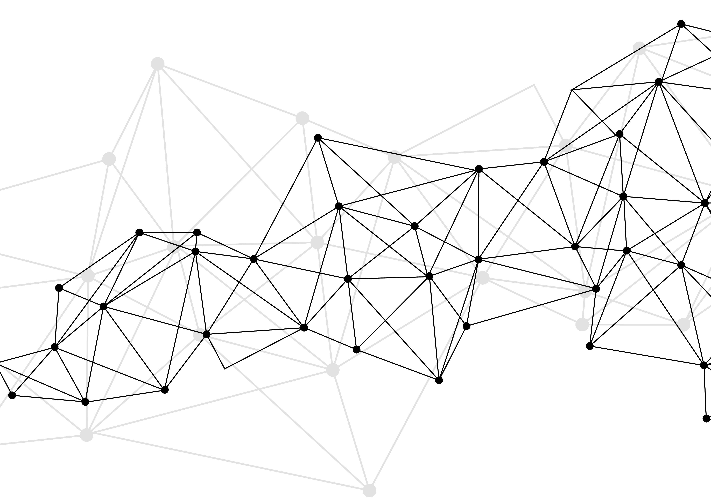
Synonyms
Used for query expansions
User-controlled
Multiple datasets can be included
EMERSE Synonyms
acronyms, abbreviations, professional/consumer terms, misspellings, trade/generic drug names, species, chemo regimens, phrase variations, malapropisms, idioms, neologisms, organizations, companies, & more
1.6 million unique entries (85% not within UMLS)
http://project-emerse.org/presentations.html

Slide 19
Typical workflow
initial cohort identified
with a cohort discovery
tool using structured data (or via EMERSE
‘Find Patients’)
Cohort discovery tools:
i2b2/ENACT, Leaf, etc.
http://project-emerse.org/presentations.html

Slide 20
Typical workflow
additional details abstracted from the free text using EMERSE
http://project-emerse.org/presentations.html

Slide 21
Typical workflow
Data recorded in an electronic data capture system (e.g., REDCap)
http://project-emerse.org/presentations.html

Slide 22
Publications using EMERSE
590
papers and abstracts
Full list at:
http://project-emerse.org/publications.html
http://project-emerse.org/presentations.html

Slide 23
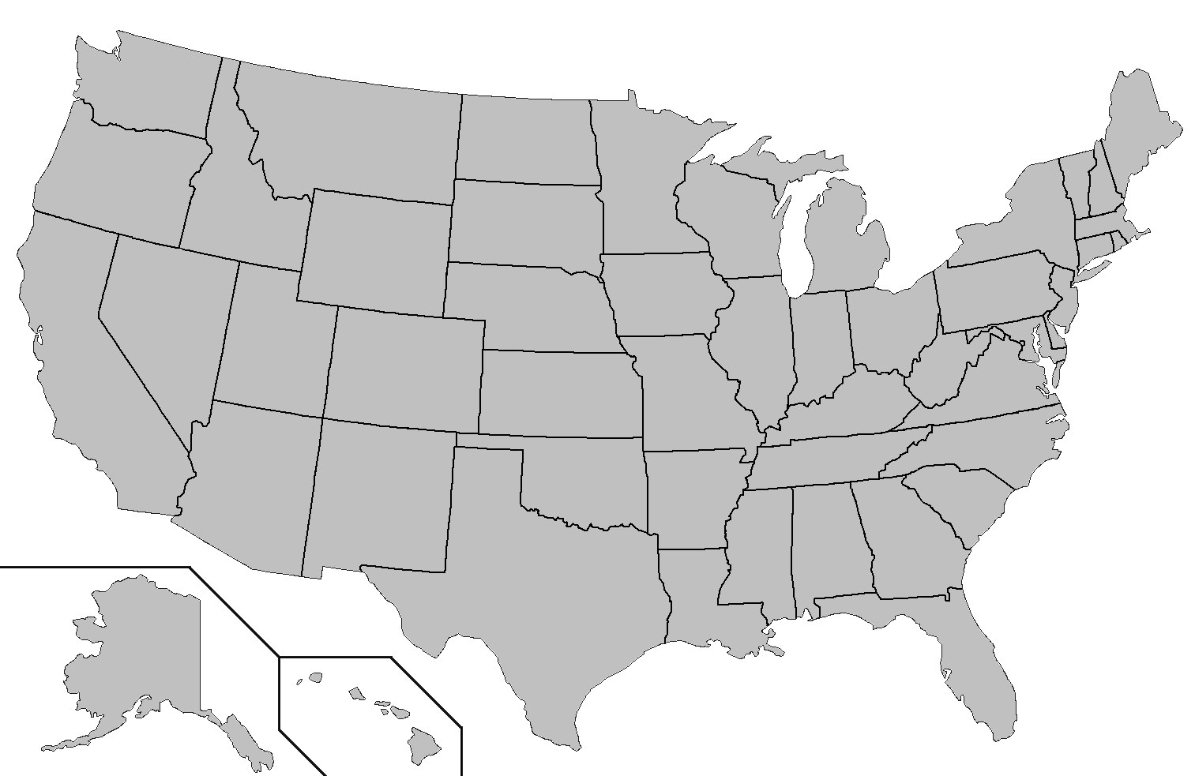
Where is EMERSE?
installed
installing
http://project-emerse.org/presentations.html

Slide 24
Where is EMERSE?
installed
installing
http://project-emerse.org/presentations.html

Slide 25
Now available…
EMERSE Research Informatics Network
real-time, secure
cross-site queries
http://project-emerse.org/presentations.html

Slide 26
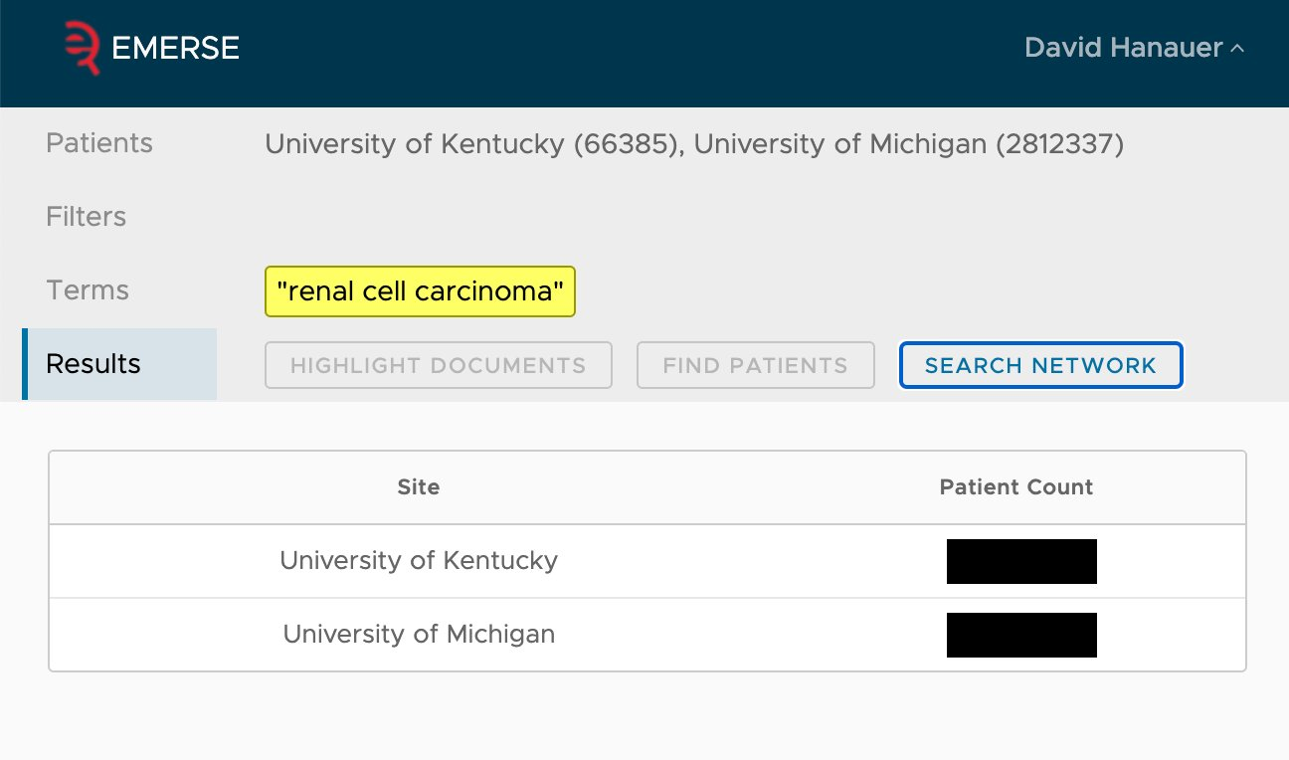
EMERSE Research Informatics Network
http://project-emerse.org/presentations.html

Slide 27
The future…
Incorporation of NLP features
- negation
- uncertainty
- subject (patient vs other)
- named entity recognition/mapping to ontologies
Data extraction from templated notes
http://project-emerse.org/presentations.html

Slide 28
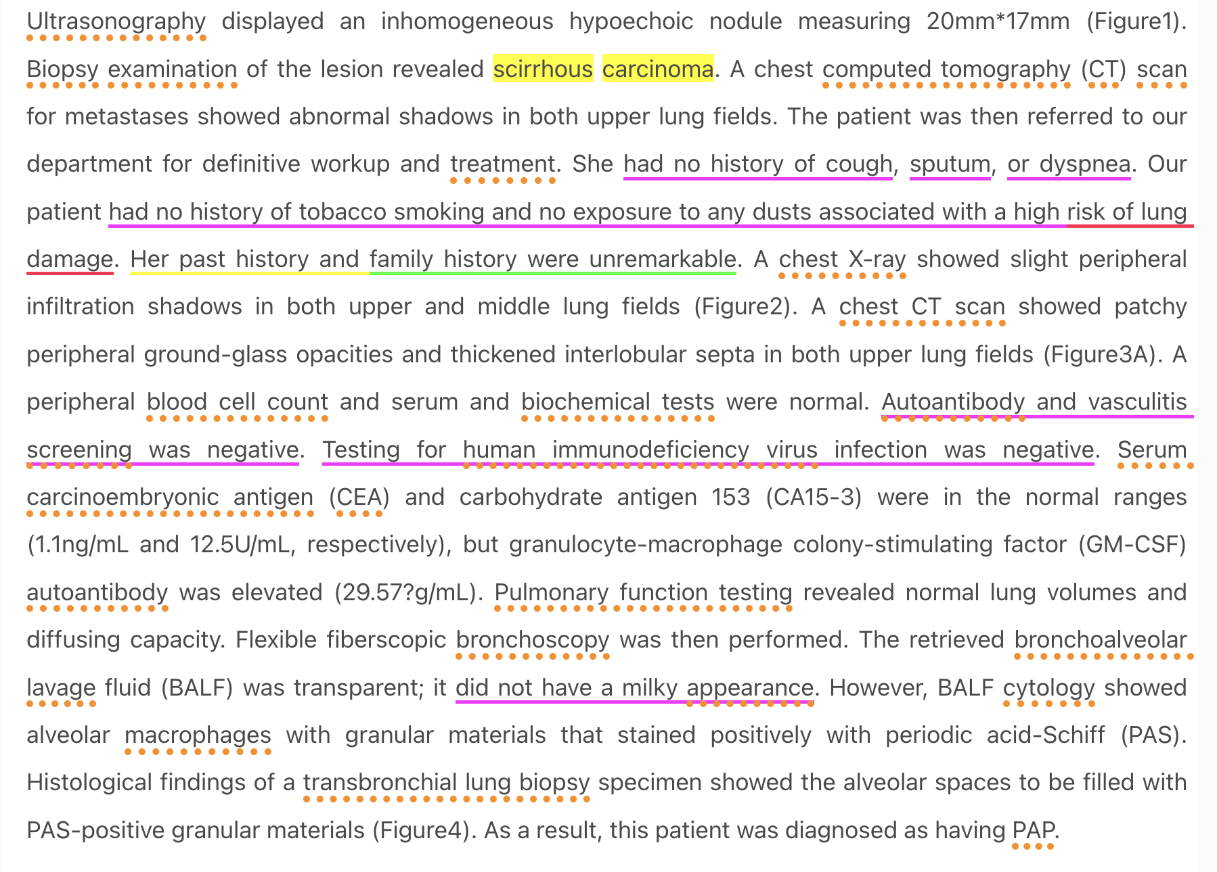
From our NLP proof-of-concept system
https://www.ncbi.nlm.nih.gov/pmc/articles/PMC4140142/
http://project-emerse.org/presentations.html

Slide 29
project-emerse.org
http://project-emerse.org/presentations.html

Slide 30
Twitter: @projectEMERSE
publications
software releases
announcements
webinars
http://project-emerse.org/presentations.html

Slide 31
Interested in learning more?
Contact us to schedule a time with your team for:
Discussions about research strategies
Training
Live demonstrations
http://project-emerse.org/presentations.html

Slide 32
Upcoming presentations
EMERSE Community Meeting Series
Date: Tuesday, February 7, 2023, 12:00 – 1:00 PM ET
Register: https://bit.ly/emerse-february-2023-register
NCI Emerging Technologies Seminar Series
Date: Tuesday, February 21, 2023, 2:00 – 3:00 PM ET
Register: https://events.cancer.gov/cssi/technology-seminar/registration
http://project-emerse.org/presentations.html

Slide 33
EMERSE-team@umich.edu
Lisa Ferguson
David Hanauer
Kellen McClain
Guan Wang
http://project-emerse.org/presentations.html

