Slide 1
Extending the capabilities and reach of EMERSE in support of cancer research
David Hanauer
University of Michigan
November 3, 2023

Slide 2
THANK YOU to ITCR for the generous support!

Slide 3
And thank you on behalf of our users
Thanks so much, EMERSE is SOOOO important in our daily work!
To say “it is the most useful tool I use in my job” would be an understatement
We are truly thankful for a tool like Emerse
It's impossible for me to express how much time EMERSE has saved me.

Slide 4
What is EMERSE
Information retrieval tool to support clinical research using clinical notes from electronic health records (EHRs)
Enterprise-level software (one installation per site)
Designed for non-technical researchers to easily access and utilize the notes
Designed for system administrators with security in mind
Supports tasks important to clinical research
Cohort identification
Data abstraction
Patient Lists

Slide 5
Why is EMERSE needed?
~80% of clinical data are in free text form
NLP tools remain difficult to use
Data security can no longer be an afterthought

Slide 6
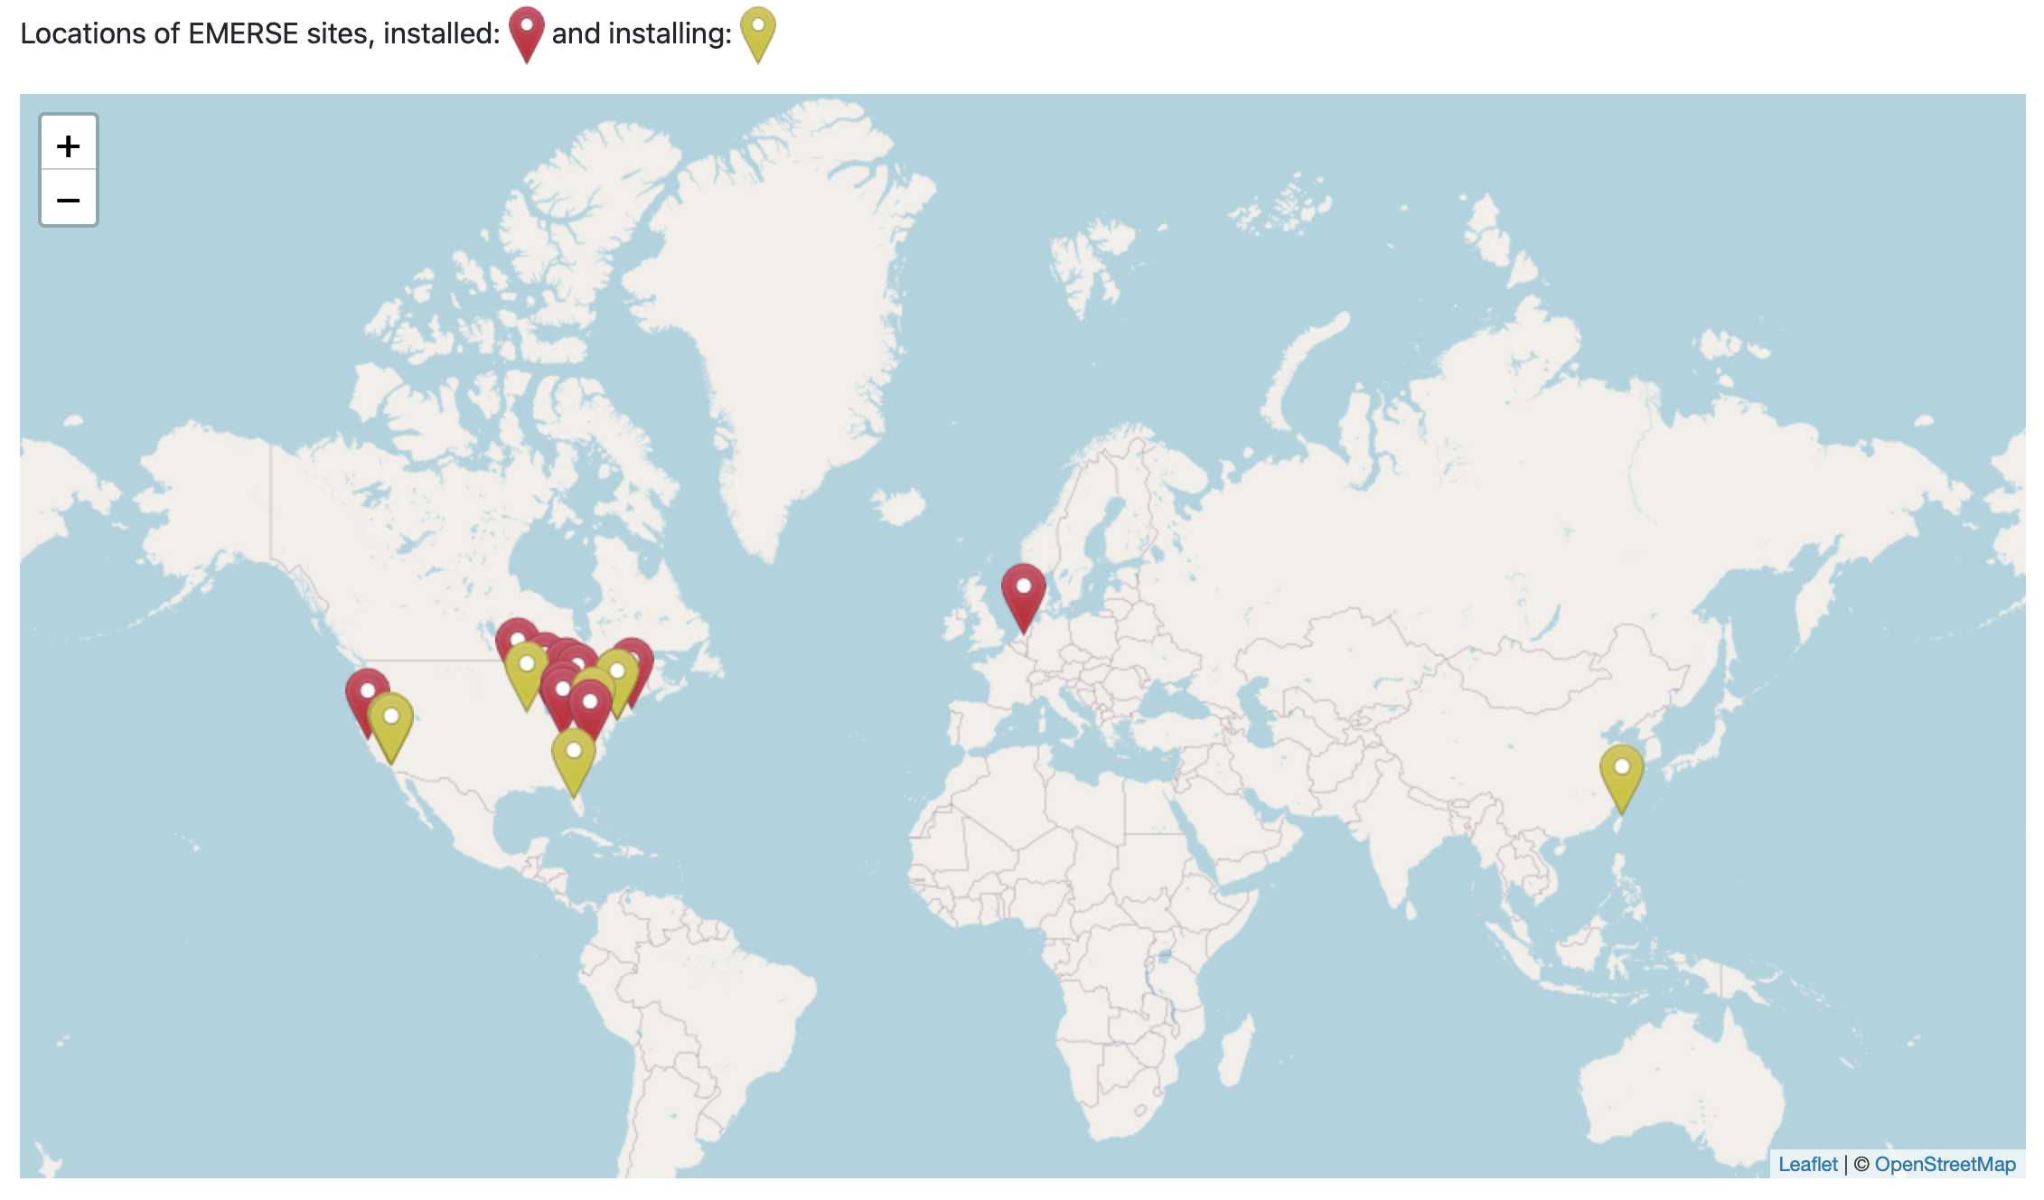
Where is EMERSE – a growing community

Slide 7
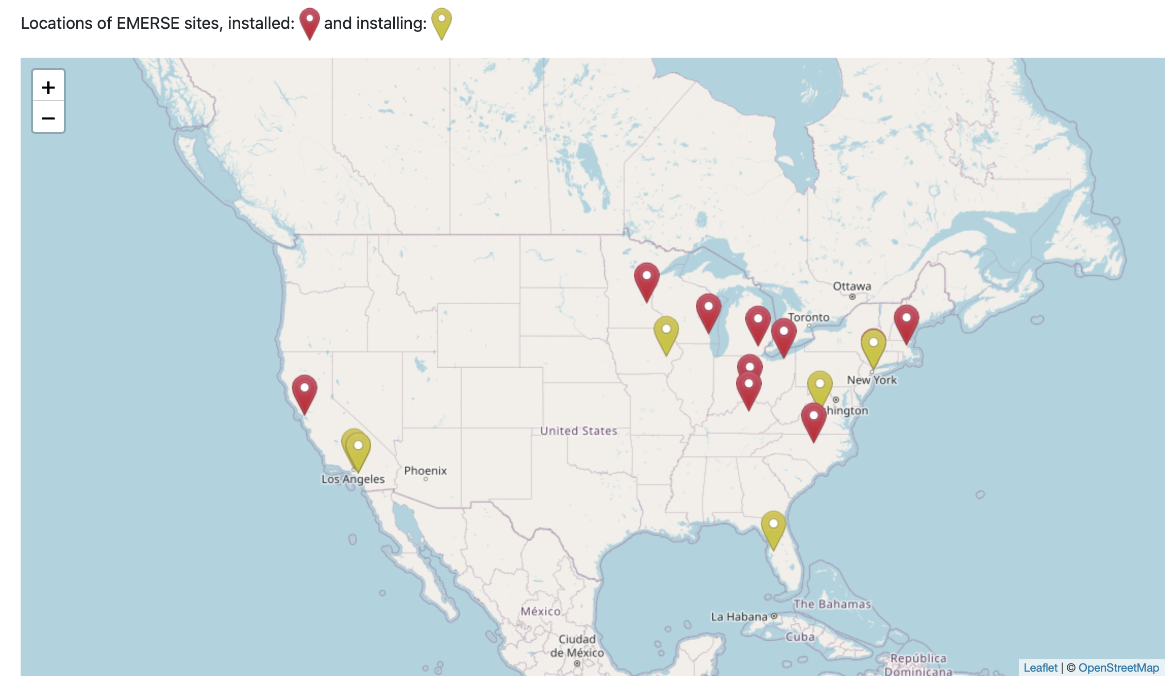
Where is EMERSE – a growing community

Slide 8
Recent publications using EMERSE
Impact of Metagenomic Next-Generation Sequencing of Plasma Cell-free DNA Testing in the Management of Patients With Suspected Infectious Diseases
Low-parameter supervised learning models can discriminate pseudoprogression and true progression in non-perfusion-based MRI
Margin status in vulvovaginal melanoma: Management and oncologic outcomes of 50 cases
Subcutaneous Leiomyosarcoma: An Aggressive Malignancy Portending a Significant Risk of Metastasis and Death
Demographic and clinical characteristics of patients with metastatic breast cancer and leptomeningeal disease: A single center retrospective cohort study
Social Determinants of Health and Racial Disparities in Cardiac Events in Breast Cancer
Social Determinants of Health Data Improve the Prediction of Cardiac Outcomes in Females with Breast Cancer
Thirty-Day Unplanned Hospital Readmissions in Patients With Cancer and the Impact of Social Determinants of Health: A Machine Learning Approach
The Development of Head and Neck Cancer in Patients with the Isolated Complaint of Globus Pharyngeus

Slide 9
Proposed work in 4 themes
New Features
Natural Language Processing (NLP) integration
Network
Evaluation

Slide 10
New Features
Standards-Compliant API
Needs to respect roles/privileges from the application
Detailed audit logs
Support technical use cases (finding documents, cohorts, patient lists, etc)
Test with ITCR DeepPhe (Cancer Deep Phenotyping) integration

Slide 11
New Features
Timeline data visualizations

Slide 12
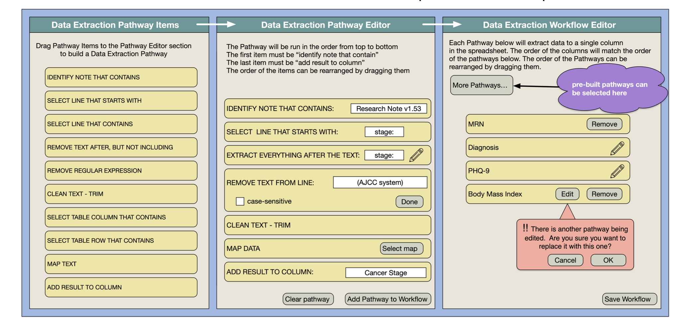
New Features
Data Extraction Workflow Editor

Slide 13
New Features
Data Extraction Workflow Editor

Slide 14
New Features
OCR Pipeline

Slide 15
NLP
Incorporate Natural Language Processing (NLP) into EMERSE
“Out-of-the-Box” capabilities
Named Entity Recognition (mapped to UMLS CUIs & semantic types)
Negation (*** most requested feature by users)
Uncertainty
Subject
History of

Slide 16
NLP
Build generalizable/extensible NLP import to accommodate external solutions, test with 3 partner institutions
UCSF
Moffitt
City of Hope
Assumption is that others may want to replace or augment our “out-of-the-box” NLP
Will help sites keep up with latest technologies/capabilities
In later years, partner with 2 NLP expert teams to make sure EMERSE is keeping up with latest advancements: cTAKES & MedTagger teams

Slide 17
NLP – layer aligned tokens

Slide 18
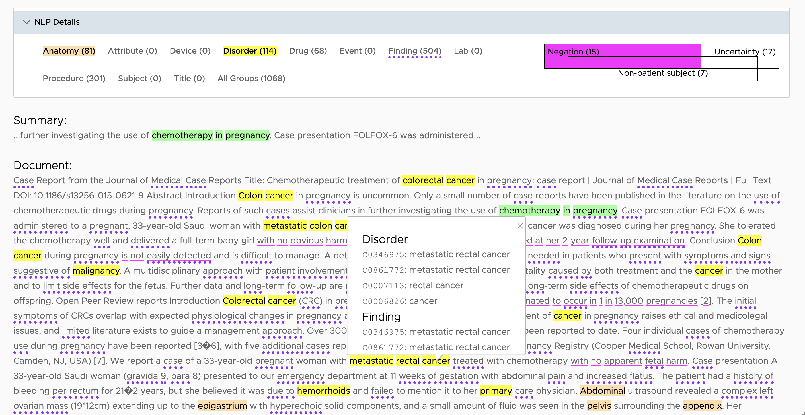

Slide 19
Anticipated future side project: LLMs
Already exploring possibilities for integration and use cases
Will be testing accuracy, effectiveness, usefulness, cost, etc.
Consider security, privacy of protected health information
Local versus external/commercial models
Grant deadline for our submission cycle: November 17, 2022
Release date of OpenAI ChatGPT 3.5: November 30, 2022

Slide 20
Network
EMERSE has a built-in network capability to obtain obfuscated patient counts across sites
Useful for cohort estimation, especially for rare disorders
Sites have been reluctant to turn it on, due to security concerns
Despite multiple safeguards built-in
Security was baked into the design
Plan to work with 4 sites to develop a generalizable network participation framework, involving: security, regulatory, and other groups to understand and address all concerns

Slide 21
Network
Incorporate data standards to enable better network search filtering
Few standards exist for unstructured data
We can start with “simple” mapping for demographics
Will consider various standards including OMOP CDM
Develop advanced auditing to ensure queries are not attempting to re-identify individual patients
Add ability to exclude “special status” patients from local or networked searched.

Slide 22
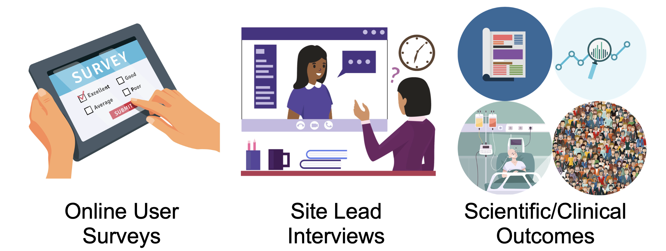
Evaluation

Slide 23
Miscellaneous
Many details can be found at: https://project-emerse.org
Contact us at: EMERSE-team@umich.edu
Thoughts on set-aside collaborations? Contact us!
EMERSE Community Meetings 3-4 times/year, next in Jan/Feb 2024
EMERSE Research Collaborative, meeting ~monthly
Video recordings of prior presentations at https://project-emerse.org/presentations.html
Sneak preview of NLP integration: https://vimeo.com/873431543

