Slide 1
EMERSE: electronic medical record search engine
Panel – The National Cancer Institute’s Informatics Technology for Cancer Research Program: Building A Community of Practice in Cancer Informatics
S34
David Hanauer, MD, MS
University of Michigan
Twitter: @davidhanauer2
#AMIA2019

Slide 2
Disclosure
I and my spouse/partner have no relevant relationships with commercial interests to disclose.

Slide 3
What is EMERSE?
Self-service search tool for the medical record free text notes
→ the 80% not captured in structured data
Helps people abstract the phenotype, for non-coded data
→ e.g., metastatic ductal vs. metastatic lobular breast cancer
Easy to use for typical research staff
→ finds cohorts or highlights notes within a cohort
Scales well
Secure and regulatory compliant (audit logs, etc)
Simple—it’s not full NLP, but often NLP isn’t needed: “augmented intelligence”
structured
unstructured

Slide 4
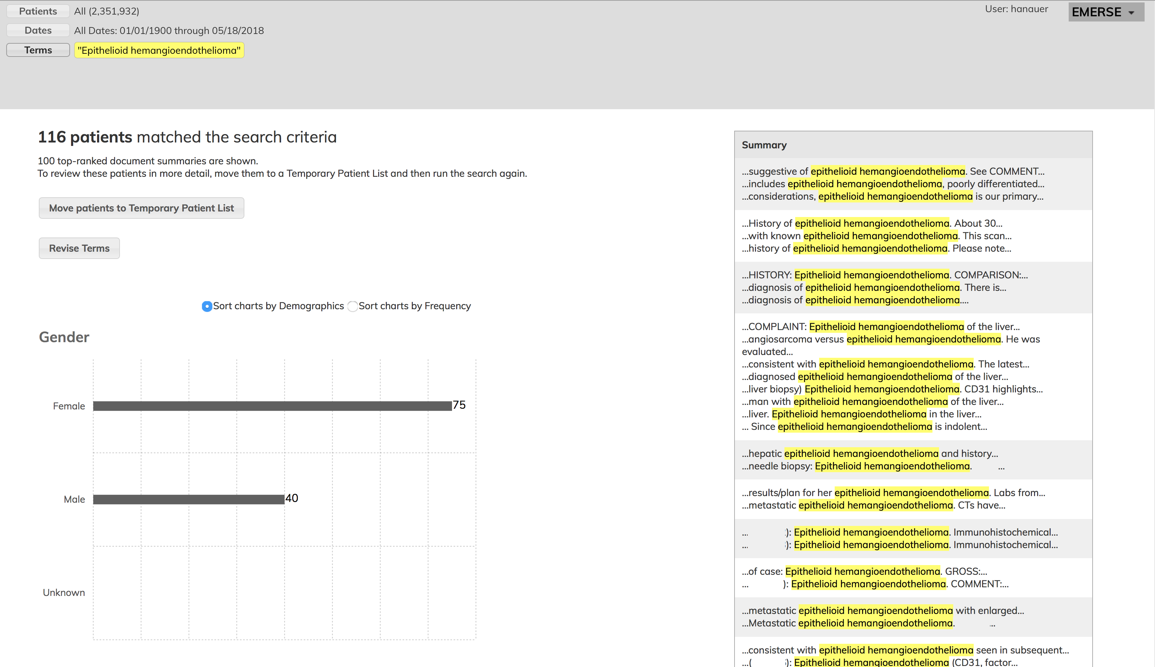

Slide 5
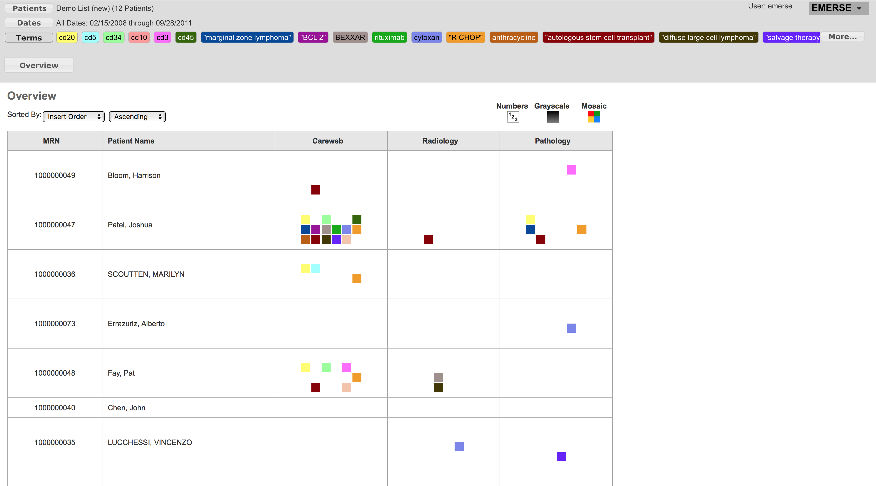

Slide 6
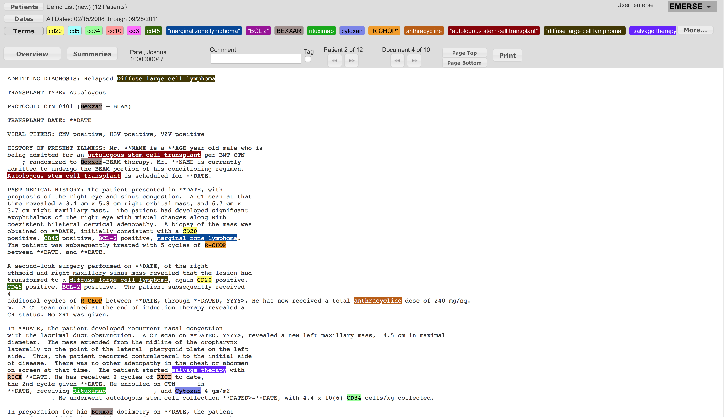

Slide 7
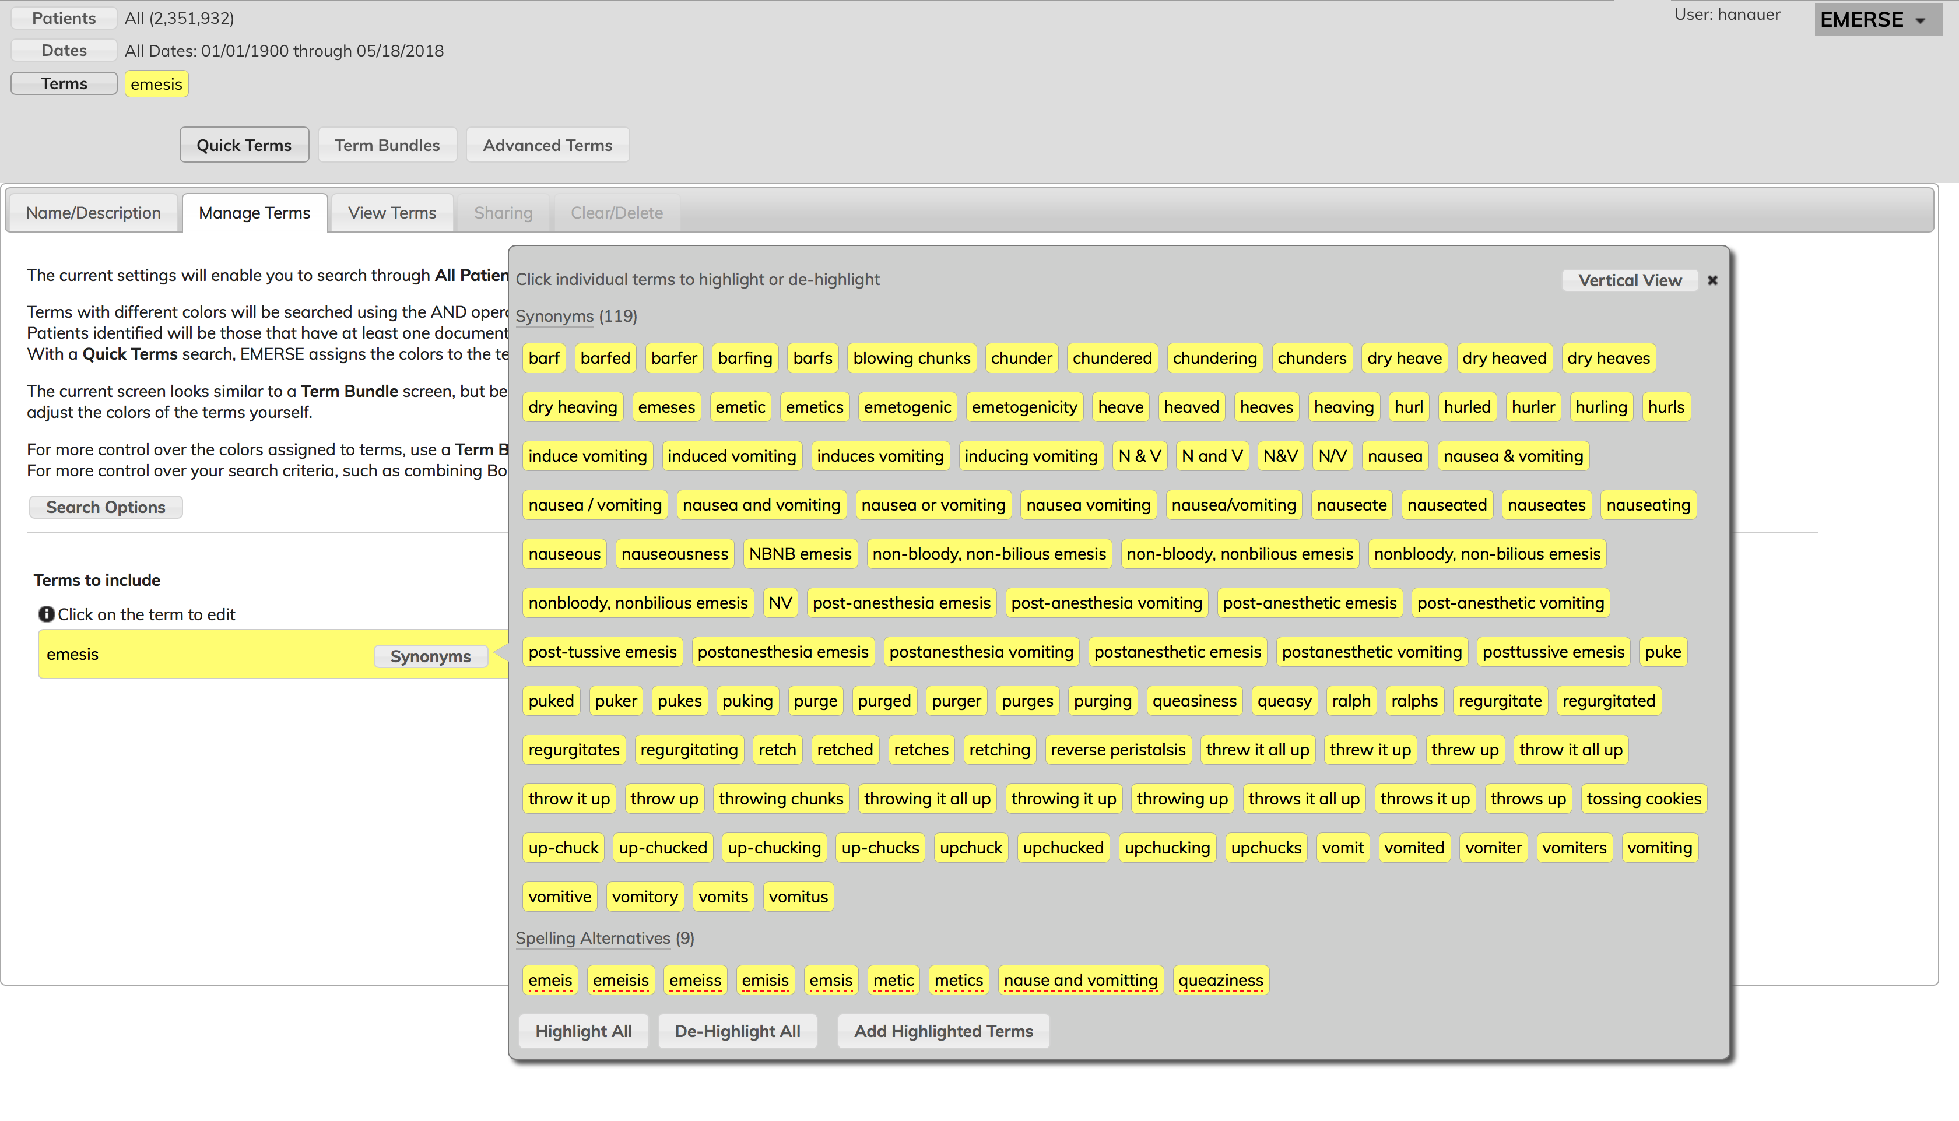

Slide 8
Goals of the EMERSE project
Develop new functionality for the software
• Improved query suggestion
• Networking across sites (“SHRINE-like”)
Create the infrastructure for dissemination of an enterprise-level search tool
• Build the community
• Documentation for end-users and implementers
• Training materials

Slide 9
Engaging with users
Two kinds of “users”:
System implementers (who have many local challenges)
engagement with ITCR support
building the community
2. Standard users
engagement through training sessions (group and 1:1)
usability interviews
users often approach us with requests for features

Slide 10
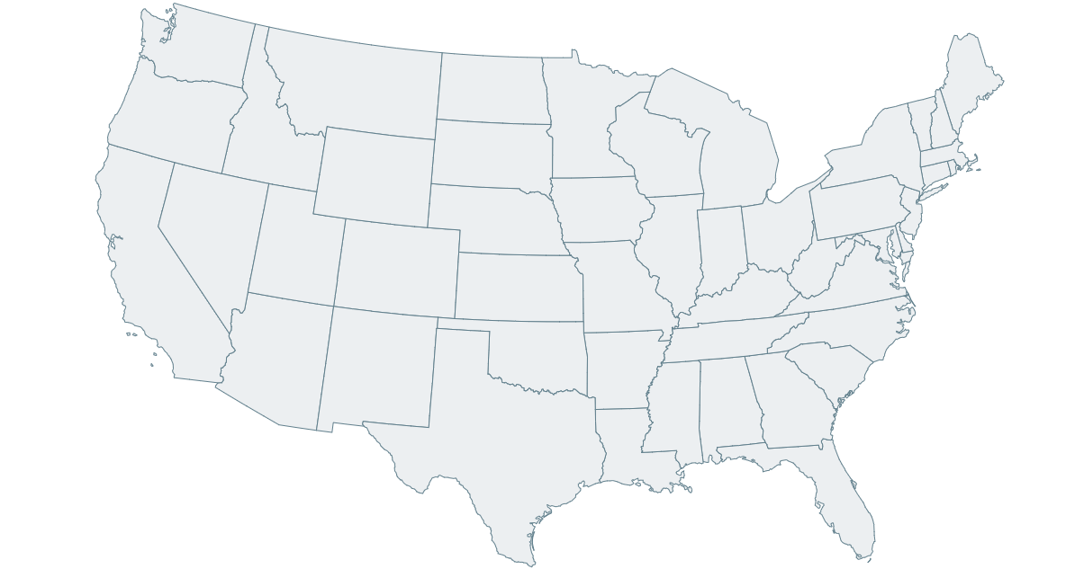
EMERSE Sites
live
implementing

Slide 11
What ITCR support means
The ability to scale up from a local effort to a national one
The ability to build the infrastructure needed for broad dissemination
Protected time to engage with other sites, provide demos, etc
Protected time to engage with uses
Developer effort
A peer/mentoring network of ITCR software developers

Slide 12
Developing software in academic setting
Pros:
understand the challenging environment in which the software must exist
access to the data
regulatory concerns
prioritization of projects with limited resources
security
Cons:
shifting between local work vs national focus based on dual funding streams
other academic demands (teaching, publishing, etc)
security

Slide 13
Security
Quickly becoming a major concern and priority of medical centers
The days of installing any software in the clinical environment are gone
Rigorous security reviews are required before allowed to operate
Adds a major amount of time/effort/expense
Can never fall behind – otherwise, the plug gets pulled
Reviews designed for vendor software, doesn’t work as well for open source

Slide 14
Security
cybersecurity
technical design
risk assessment
information system contingency plan
stakeholders document
firewall change request
vulnerability
scans
interconnect document
penetration
testing
shared responsibility agreement
software security code review
vendor security assessment
This is a
lot of work!

Slide 15
Acknowledgements
ITCR (NIH NCI): U24CA204863
MICHR (NIH CTSA): UL1TR000433 and UL1TR002240
U of Michigan Rogel Cancer Center (NIH NCI): P30CA046592
EMERSE Development Team: James Law, Ritu Khanna, Kellen McClain, Raghu Tadi, Rachael Hodder, Doran Steele, Long Zhang
EMERSE Partners: Jill Barnholtz-Sloan, Mark Beno, James Champion, Bront Davis, Guilherme Del Fiol, Eric Durbin, Oksana Gologorskaya, Daniel Harris, Brett Harnett, Kensaku Kawamoto, Benjamin May, Eric Meeks, Emily Pfaff, Janie Weiss, Kai Zheng

Slide 16
Learn more about EMERSE
hanauer@umich.edu
project-emerse.org

