Slide 1
EMERSE: the Electronic Medical Record Search Engine
David Hanauer
University of Michigan
ITCR Annual Meeting
May 29, 2019

Slide 2
80% OF EHR DATA UNSTRUCTURED
Unstructured text = Free text
“free” means clinicians are free
to write anything they want, any
way they want.
But the text is hardly “free” to use
Free text
Difficult to use
http://www-07.ibm.com/hk/watson/health/

Slide 3
STRUCTURED VS UNSTRUCTURED
Structured Data
Unstructured Data
Lab results
Radiology reports
Prescribed
medications
Pathology reports
Billing codes
Clinical notes
Problem lists

Slide 4
FREE TEXT USES
cohort identification
eligibility determination
adverse event
detection
data abstraction
much more!

Slide 5
NEED FOR FREE TEXT
eligibility determination
Free text needed for resolving…
…59% of eligibility criteria for a chronic lymphocytic
leukemia (CLL) clinical trial
…77% of eligibility criteria for a prostate cancer clinical trial
PMCID: PMC4333685

Slide 6
RESEARCHERS NEED TOOLS

Slide 7
EMERSE – INFORMATION RETRIEVAL
• Electronic Medical Record Search Engine
Information Retrieval (IR) tool
– Users familiar with Google, Bing, etc.
– Flexible for many information needs
• Similar to, but still different from, Natural Language Processing (NLP)
– NLP can be powerful, but generally requires expertise (in short
supply)
– EMERSE meant for real-time, self-service data interactions
** EMERSE (IR) and NLP are not mutually exclusive

Slide 8
EMERSE
• Developed at U of Michigan
• In use at Michigan since 2005
• 113,000 user sessions since 2012 (2,085 in last 30 days)
• 1,738 studies supported
• 209 (known) peer-reviewed publications (~12% citation rate)
• Now also available at: University of North Carolina, University of Cincinnati.
• Planning stages: Columbia Univ, Case Western Reserve Univ, Univ of Kentucky, UCSF, Dana Farber, Memorial Sloan Kettering

Slide 9
RECENT PUBLICATIOS
Tsao PA et al. Cardiovascular and Metabolic Toxicity of Abiraterone in Castration-Resistant Prostate Cancer: Post-Marketing Experience. Clinical Genitourinary Cancer. March 2019.
Chappell G et al. Maintenance sorafenib in FLT3-ITD AML following allogeneic HCT favorably impacts relapse and overall survival. Bone Marrow Transplant. 2019 Feb 26.
Manohar PM et al. Prognostic Value of FDG-PET/CT Metabolic Parameters in Metastatic Radioiodine-Refractory Differentiated Thyroid Cancer. Clin Nucl Med. 2018 Sep;43(9):641-647.
Siontis BL et al. Primary Cardiac Sarcoma: A Rare, Aggressive Malignancy with a High Propensity for Brain Metastases. Sarcoma, vol. 2019, Article ID 1960593, 6 pages, 2019.

Slide 10
WHAT WAS SEARCHED? (yesterday)
"no sign cancer"; recurrence; remission; "disease free"; lvef; "phosphaturic mesenchymal tumor"; trandolapril; azilsartan; cozaar; irbesartan; normodyne; nadolol; enema; oncotype; proctitis; ruxolitinib; laxative; risk; and; pulmozyme; "no cancer"; flutter; edema; "ace inhibitor"; olmesartan; candesartan; carvedilol; bystolic; zebeta; monocor; bisoprolol; metoprolol; "breast cancer"; sma; bleeding; initiative; jakafi; preterm; transsphenoidal; cushing's; coagu*; "9520 like"; thromb*; nyha; glucose; breath; "coronary angiography"; photosensitivity; pentasa; fai; fibrillation; "lv ef"; "ventricular ejection fraction"; moexipril; enalapril; accupril; quinapril; teveten; pindolol; timolol; betoptic; fracture; coagulopathy; mycobacterium; diarrhea; sts; "source radiology"; "gastric leiomyoma"; tibial; "congenital hypertrophy of the retinal pigment epithelium"; sweats; gender; doxorubicin; mets; bundle; ef; nexium; "low grade spindle cell neoplasm"; lotensin; diovan; betapace; lobeta; penbutolol; coreg; trandate; betaxolol; tenormin; propranolol; corgard;; hla; dulera; advair; shock; hemorrhage; bleed; "sinonasal melanoma"; "rectal inflammation"; immunocompromised; des; abscess; chf; pe; femoral; metas*; ned; canasa; "beta blocker"; vasotec; zestril; perindopril; carteolol; labetalol; nebivolol; atenolol; lopressor; cmv; tacrolimus; injured; "superior mesenteric"; "blood loss"; arthritis; ana; flovent; qvar; "stomach leiomyoma"; stent; hydrogen; conjunctivitis; adriamycin; manometry; "no residual"; "cancer free"; failure; arb; benazepril; altace; ramipril; valsartan; eprosartan; cilexetil; brevibloc; inderal; toprol; cardiogenic; injury; anticoag*; complicate*; hemperitoneum; pituitary; smith; asmanex; metal; dvt; fluid; test; coronary; angiography; flail; paraplegia; embol*; "lynch syndrome"; mitoxantrone; afib; "left ventricular ejection fraction"; 2004; claudication; mavik; aceon; hyzaar; avapro; ocupress; visken; sotalol; acebutolol; pmt; hematoma; "distal colitis"; genomics; lumpectomy; pulmicort; score; echo; dvu; endocarditis; epirubicin; "no evidence"; "no tumor recurrence"; respiratory; mgi; branch; "ejection fraction"; "ventricular ejection"; pantoprazole; omeprazole; "sts score"; imuran; lisinopril; fosinopril; captopril; telmisartan; benicar; losartan; esmolol; sectral; donor; symbicort; 6mp; "chest pain"; daunorubicin; idarubicin;

Slide 11
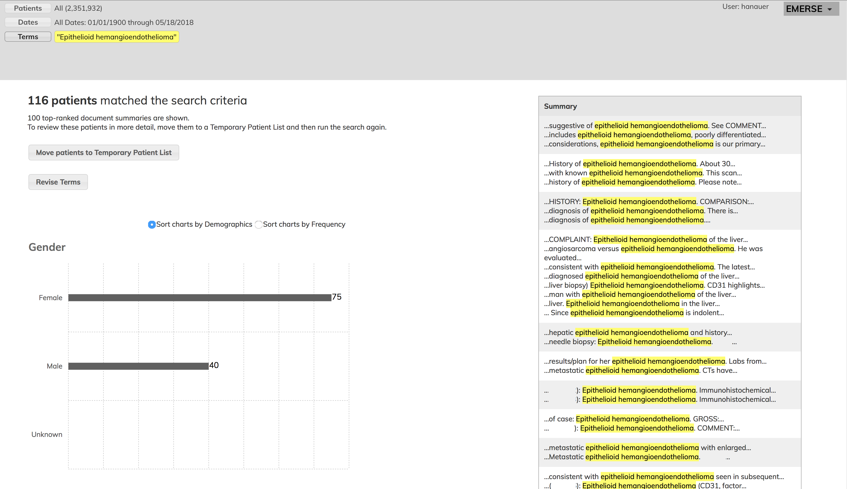

Slide 12
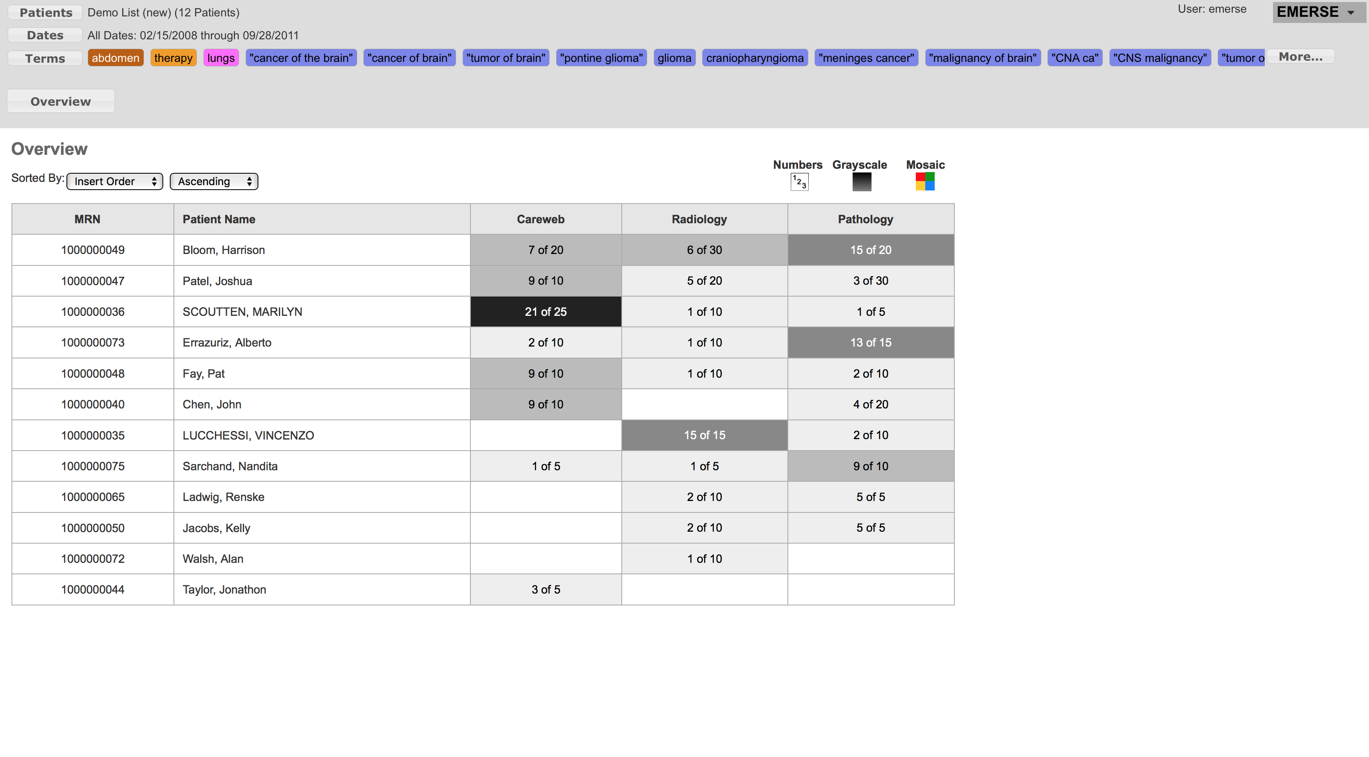
(fake names)

Slide 13
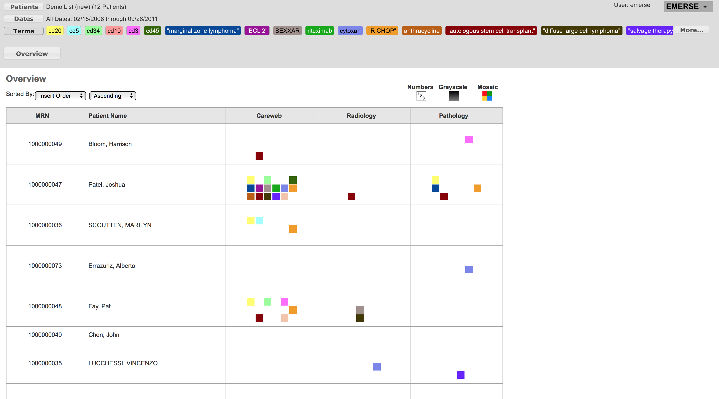

Slide 14
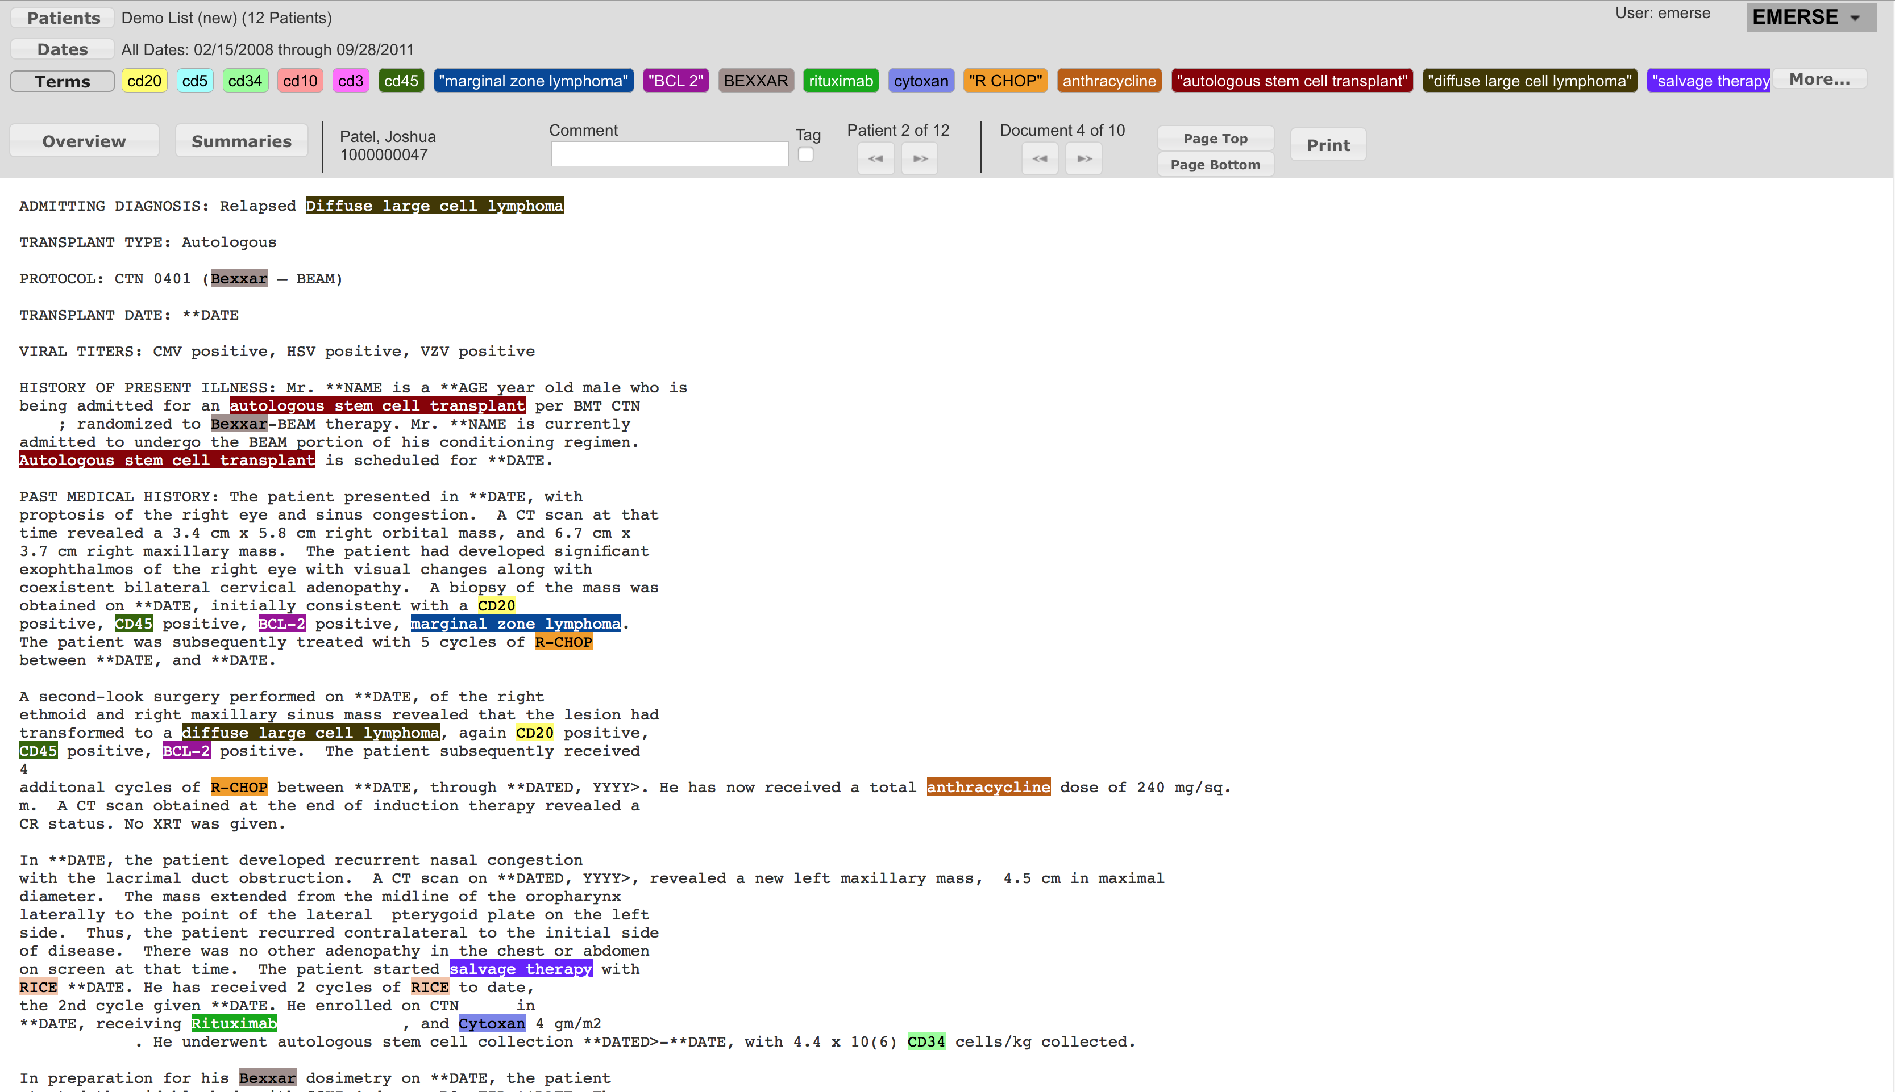

Slide 15
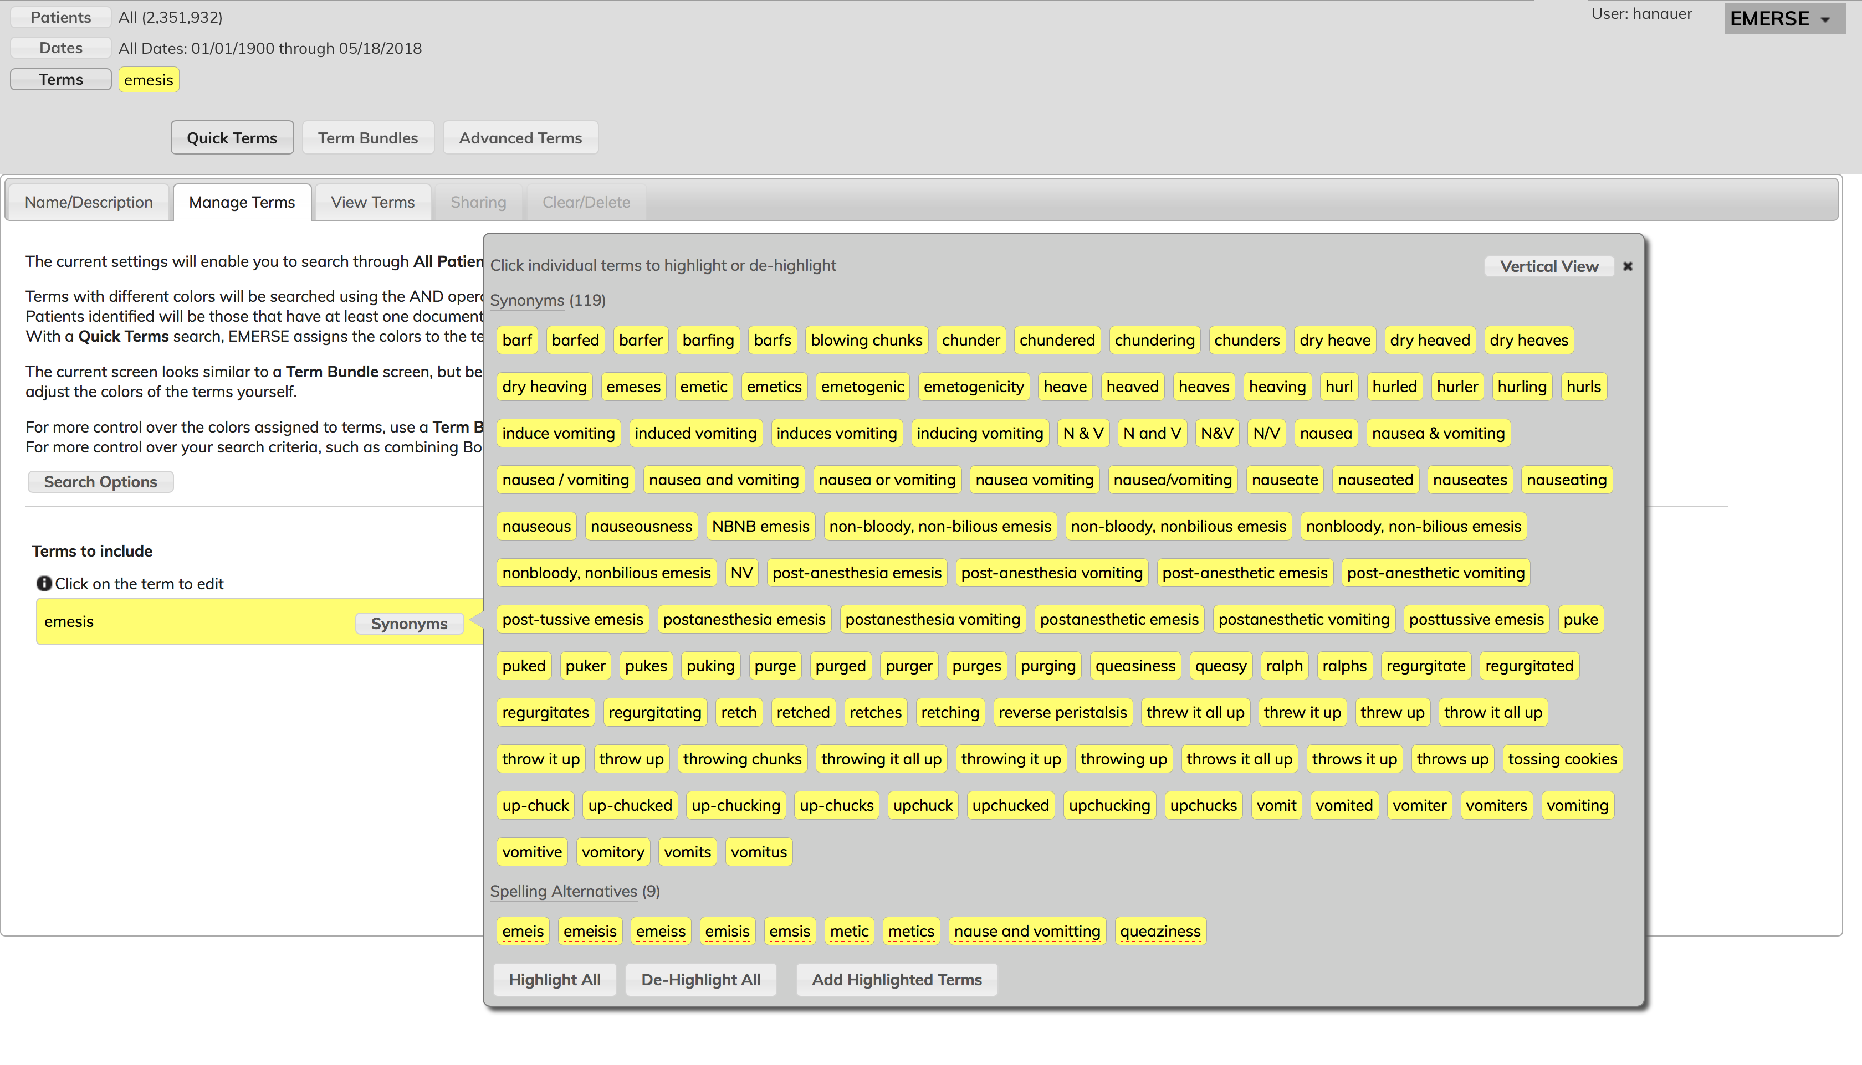

Slide 16
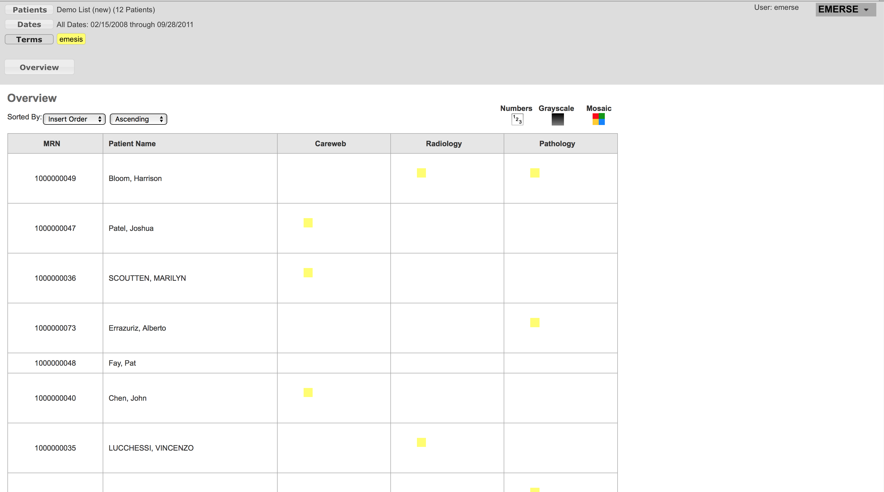

Slide 17
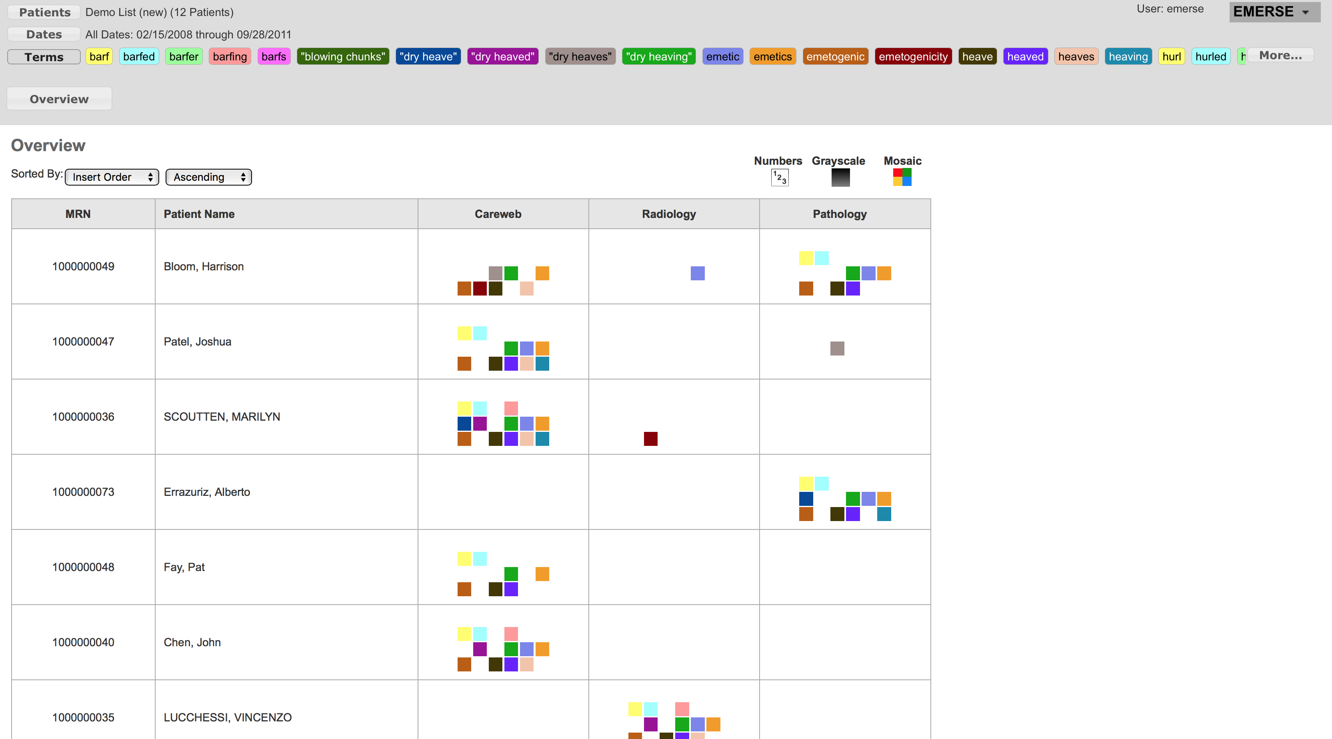

Slide 18
NETWORKING
• Search across sites for counts
• Similar concept to other networks for structured data
(PCORnet, i2b2)
• Many security considerations
• Architecture designed for simplicity at other sites

Slide 19
NETWORKING ARCHITECTURE
One hub runs query
coordinator for network
Other sites only need to make an
outbound https connection,
simplifying security requirements
(no firewall rules needed for
outbound connections)
Hub site will create
firewall rules to allow
inbound connections
All queries run through
the coordinator

Slide 20
NETWORKING - SECURITY
• Obfuscated counts only – obfuscation customizable
• Customizable thresholds (e.g., < 20) to prevent
pinpointing exact count of individual
• Throttle/randomize return time for queries
• Throttle # queries per user per time
• Audit logs of all users/queries across the network
• Meet all requirements by our Information Assurance
team (the “internal hackers”)

Slide 21
EMERSE TRENDS
Similar idea to Google Trends
Google Trends – search terms over time
EMERSE Trends – patients over time
A good way to explore data for patterns over time

Slide 22
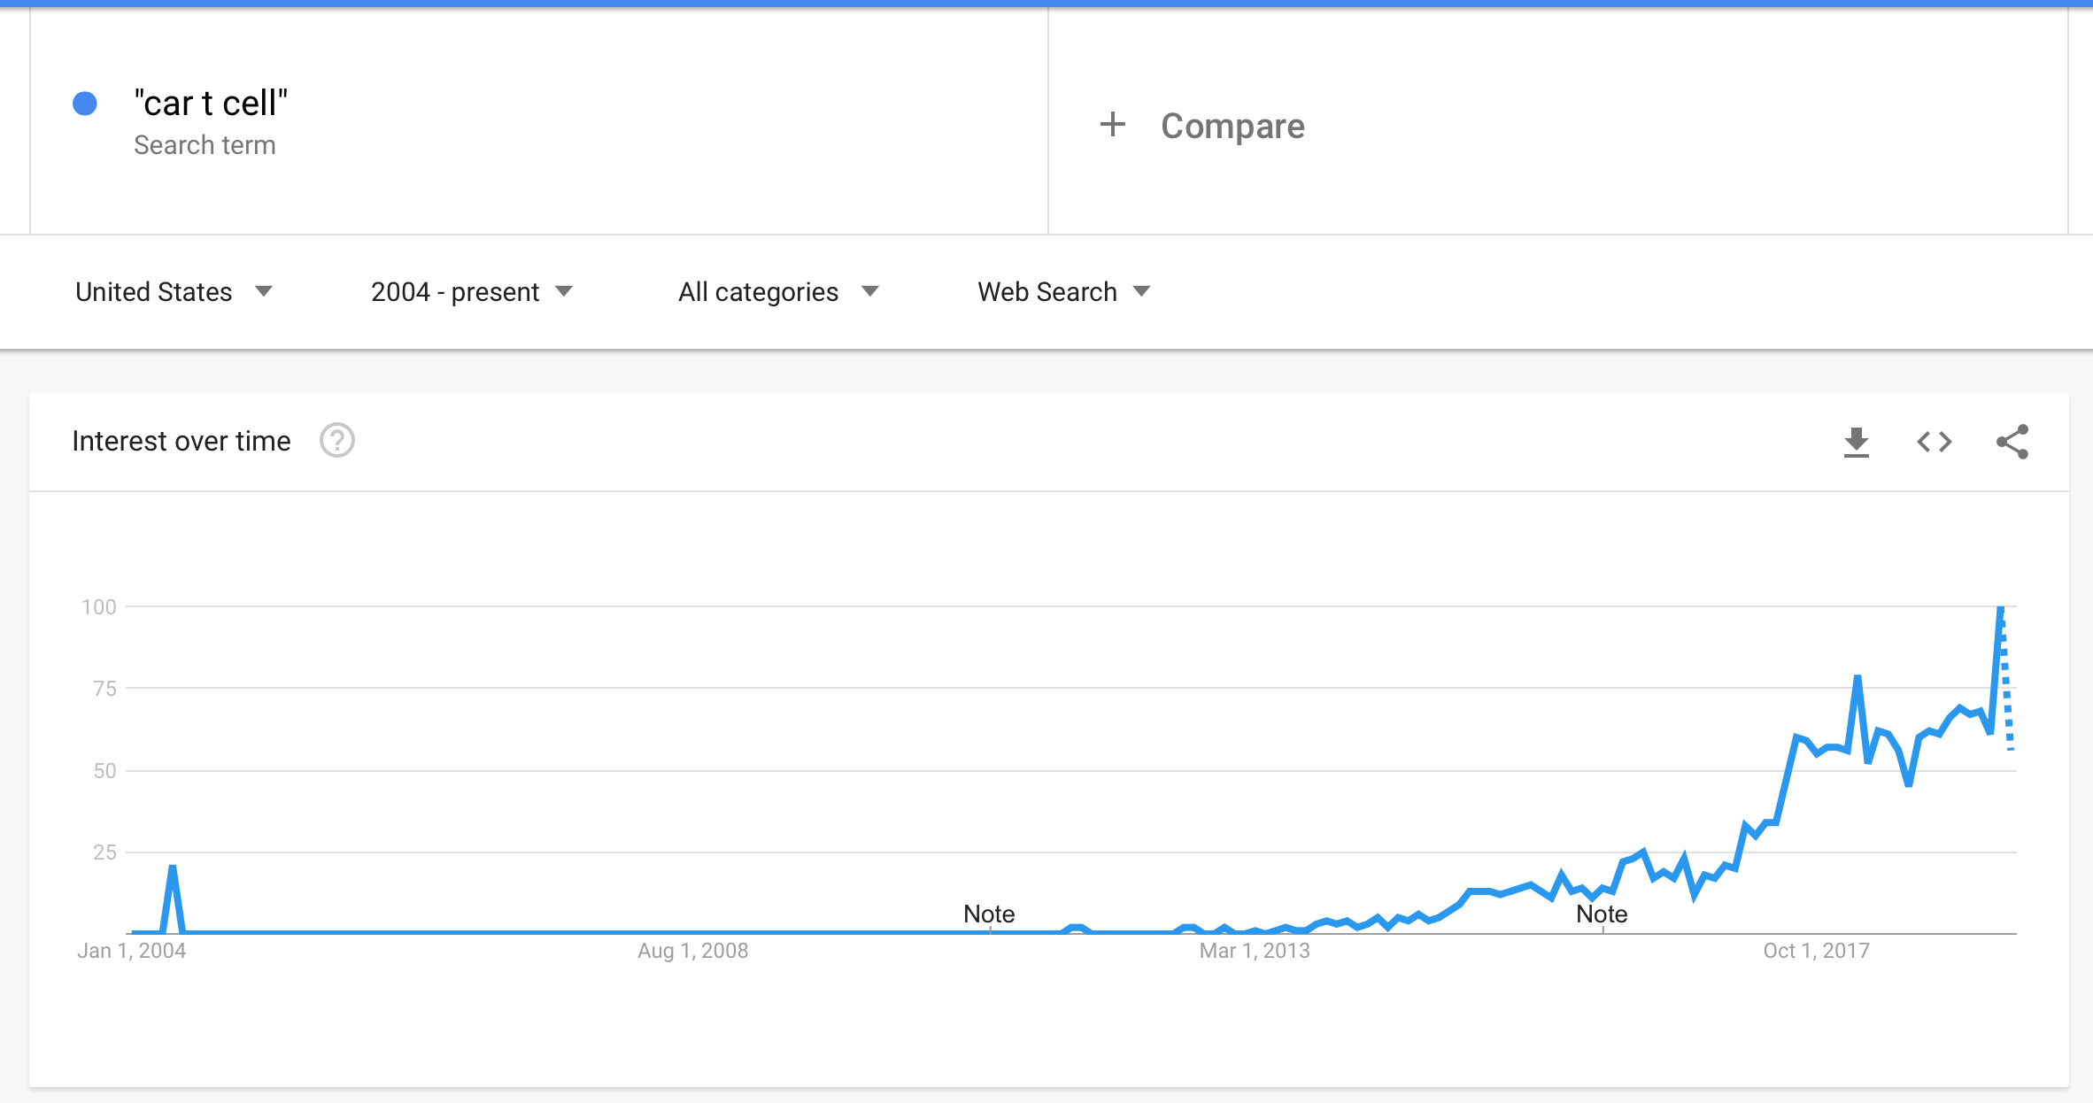
GOOGLE TRENDS
“CAR T cell”

Slide 23
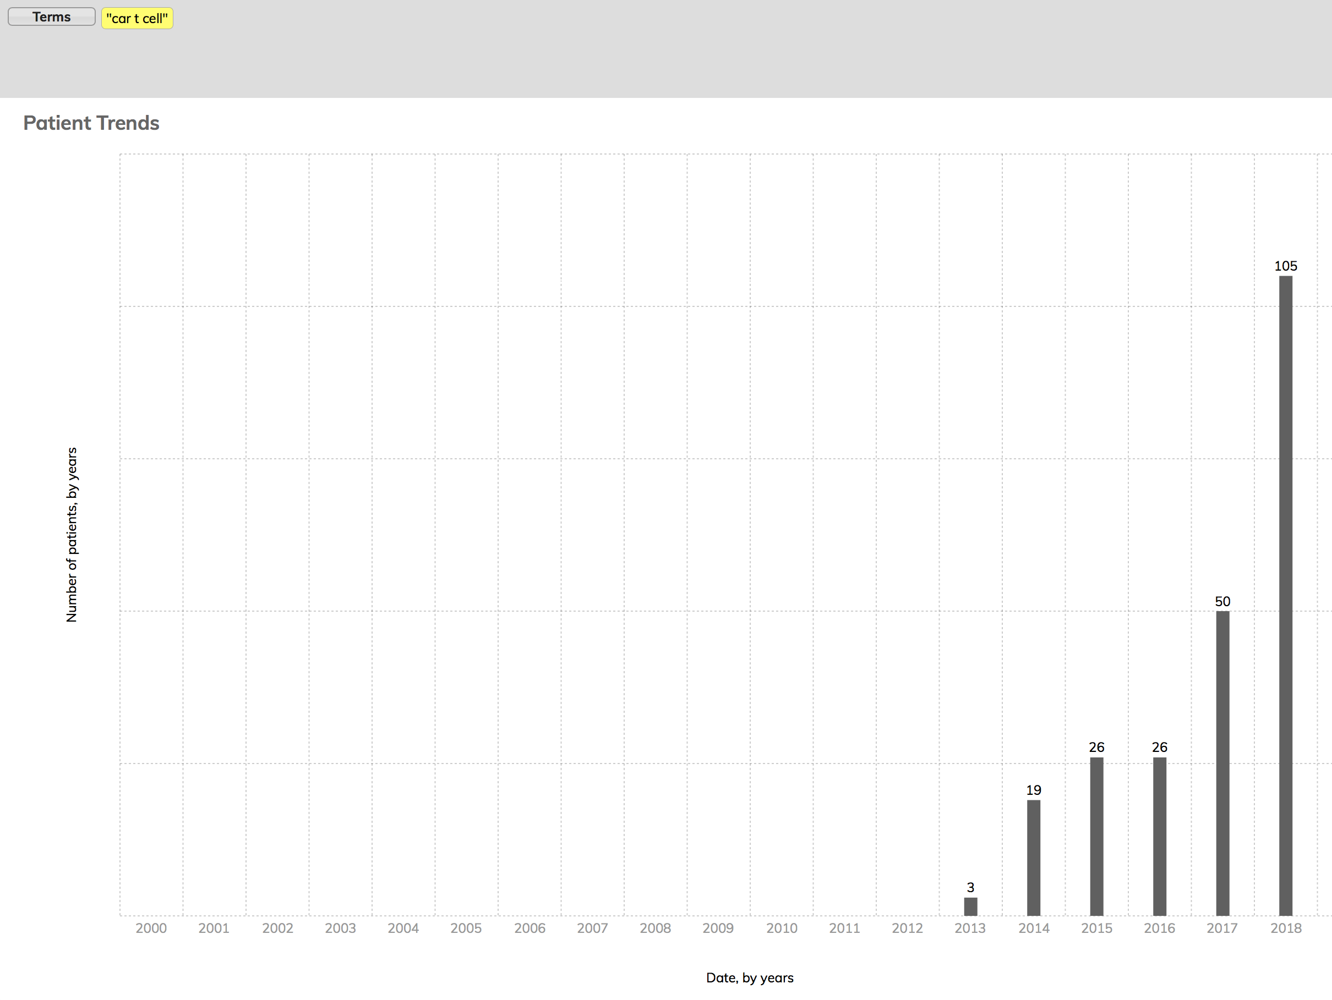
“CAR T cell”

Slide 24
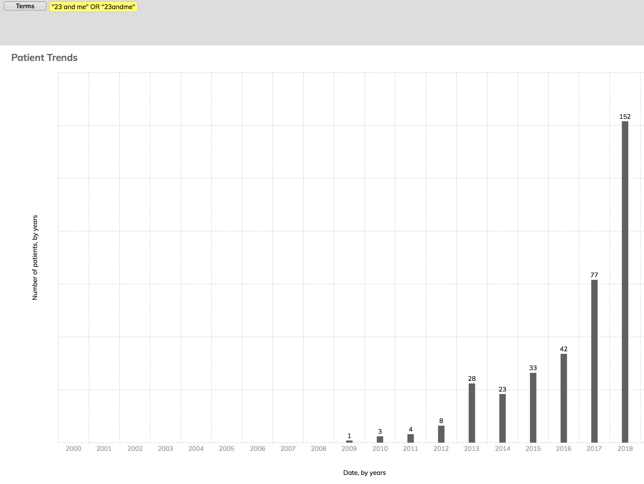
“23 and me” or “23andme”

Slide 25
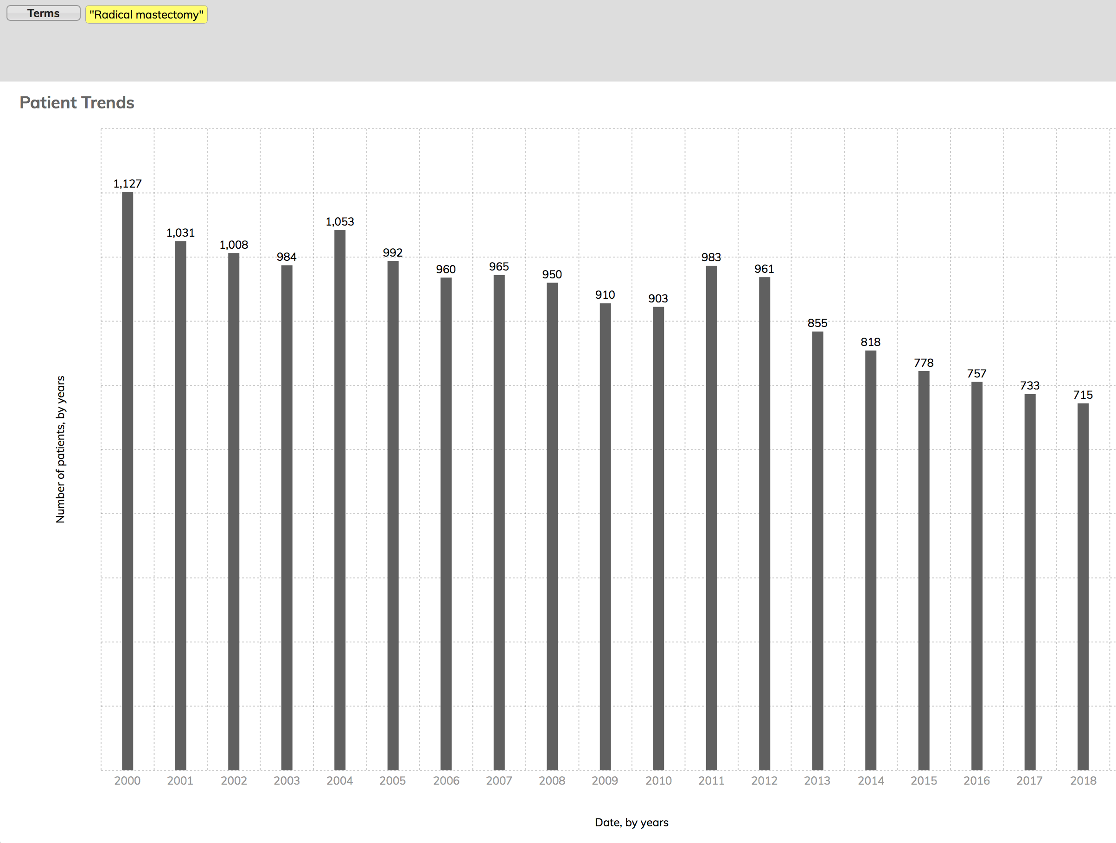
“radical mastectomy”

Slide 26
PROJECT PLANS
• Securely network sites for cross-institution searches
• Continue work on detailed documentation
• Improve handling of synonyms
• Incorporate de-identified documents
• Feature and usability enhancements
• User evaluation
• Dissemination

Slide 27
PROJECT PLANS
Deploy at site
Examine what didn’t work well
Update code/documentation
Repeat
cycle
at next
site

Slide 28
LEARNING ABOUT VARIABILITY
• Variable database needs
• Variable local support structures
– Self-service vs pay-per-use
• Variable levels of experience with the technologies
• Variable understandings of local infrastructures
• Variable security requirements

Slide 29
COLLABORATION WITH UTAH
• Understand how sites obtain documents to index
• Develop a reproducible process for extracting documents in bulk from an EHR
• Explore the current use of/potential for formatted notes
-- Formatting can contain useful information

Slide 30
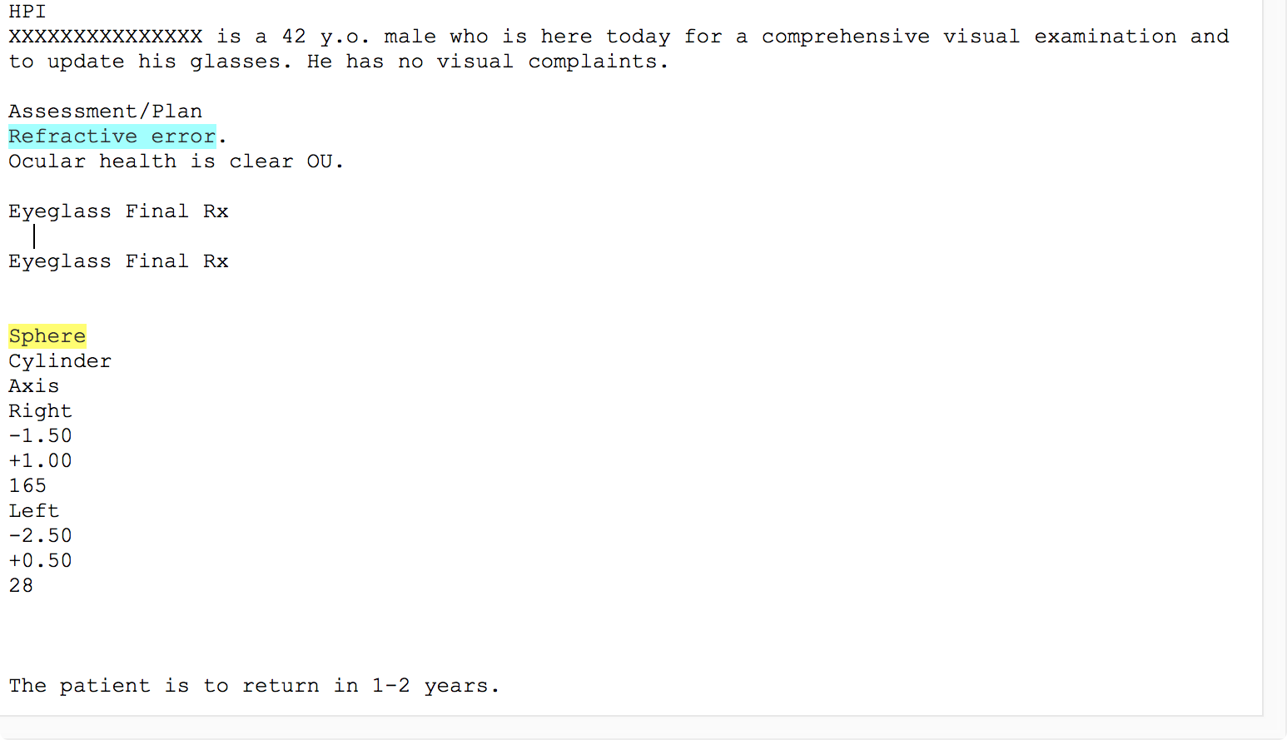
Formatted
Unformatted

Slide 31
COLLABORATORS

Slide 32
ACKNOWLEDGEMENTS
ITCR
ITCR (NCI): U24CA204863
U of Michigan Rogel Cancer Center (NCI): P30CA046592
MICHR (CTSA): UL1TR000433 and UL1TR002240

Slide 33
WEBSITE
http://project-emerse.org

