Slide 1
David Hanauer, MD, MS
University of Michigan
hanauer@umich.edu
March 17, 2020
http://project-emerse.org/presentations.html

Slide 2
If you’re thinking of taking notes
these slides can be found at:
link will be on
most slides
http://project-emerse.org/presentations.html

Slide 3
slides
1
live demo
2
roadmap for
today’s
presentation
Q&A
3
http://project-emerse.org/presentations.html

Slide 4
What is EMERSE?
A search engine, kind of like Google, for free text medical record documents
(technically, it’s an information retrieval system)
Simple to use
Designed to be self-serve
http://project-emerse.org/presentations.html

Slide 5
What is EMERSE?
A research tool, available at no cost
Apache 2.0 licensing
Requires local implementation
Picking the right tool for your research is important
multiple tools are often needed
http://project-emerse.org/presentations.html

Slide 6
Unstructured vs Structured Data
EMERSE is for this… | i2b2/ACT is for this…
Unstructured Data (free text) | Structured Data
Mrs. Jones is a 56 year old female with a history of HTN, hypercholesterolemia, and T2DM who comes to the clinic today with a 3 day h/o dizziness and severe headache on the left side. | WBC: 5.6 Total cholesterol: 182 Weight: 67.4 AST: 30 ALT: 52
http://project-emerse.org/presentations.html

Slide 7
80% of EHR data are in unstructured free text
structured data
unstructured data/free text
http://project-emerse.org/presentations.html

Slide 8
80% of EHR data are in unstructured free text
"potential cases may be missed or wrongly dated when coded data alone are used..” (PMID: 23964710)
"structured data is best used for first pass filtering of EHR data…prior to a more nuanced second pass using unstructured data" (PCMID: PMC4333685)
"...urinary incontinence, an important patient-centered outcome following prostate cancer treatment, was reported almost exclusively in the free text of EHRs and was rarely coded as an ICD 9 diagnosis code.” (PMCID: PMC4899050)
"Claims and structured EHR data give an incomplete picture of burden related to geriatric syndromes. Geriatric syndromes are likely to be missed if unstructured data are not analyzed."
(PMID: 29972595)
http://project-emerse.org/presentations.html

Slide 9
What isn’t EMERSE?
It is not: natural language processing (NLP)
but full NLP may not always be needed
and NLP can be hard to use or customize
http://project-emerse.org/presentations.html

Slide 10
EMERSE vs NLP
EMERSE: augmented intelligence
NLP: artificial intelligence
http://project-emerse.org/presentations.html

Slide 11
EMERSE vs NLP
NLP
EMERSE
http://project-emerse.org/presentations.html

Slide 12
Find cohorts
EMERSE allows you to find cohorts based on things mentioned in the notes
diseases
drugs
symptoms
anything!
http://project-emerse.org/presentations.html

Slide 13
Find cohorts
It’s perfect for finding diagnoses that don’t have a specific ICD-10 code… like leiomyosarcoma…
https://www.icd10data.com/search?s=leiomyosarcoma
http://project-emerse.org/presentations.html

Slide 14
Find cohorts
…or Bainbridge-Ropers Syndrome
…or hundreds of other disorders with no specific code
https://www.icd10data.com/search?s=leiomyosarcoma
http://project-emerse.org/presentations.html

Slide 15
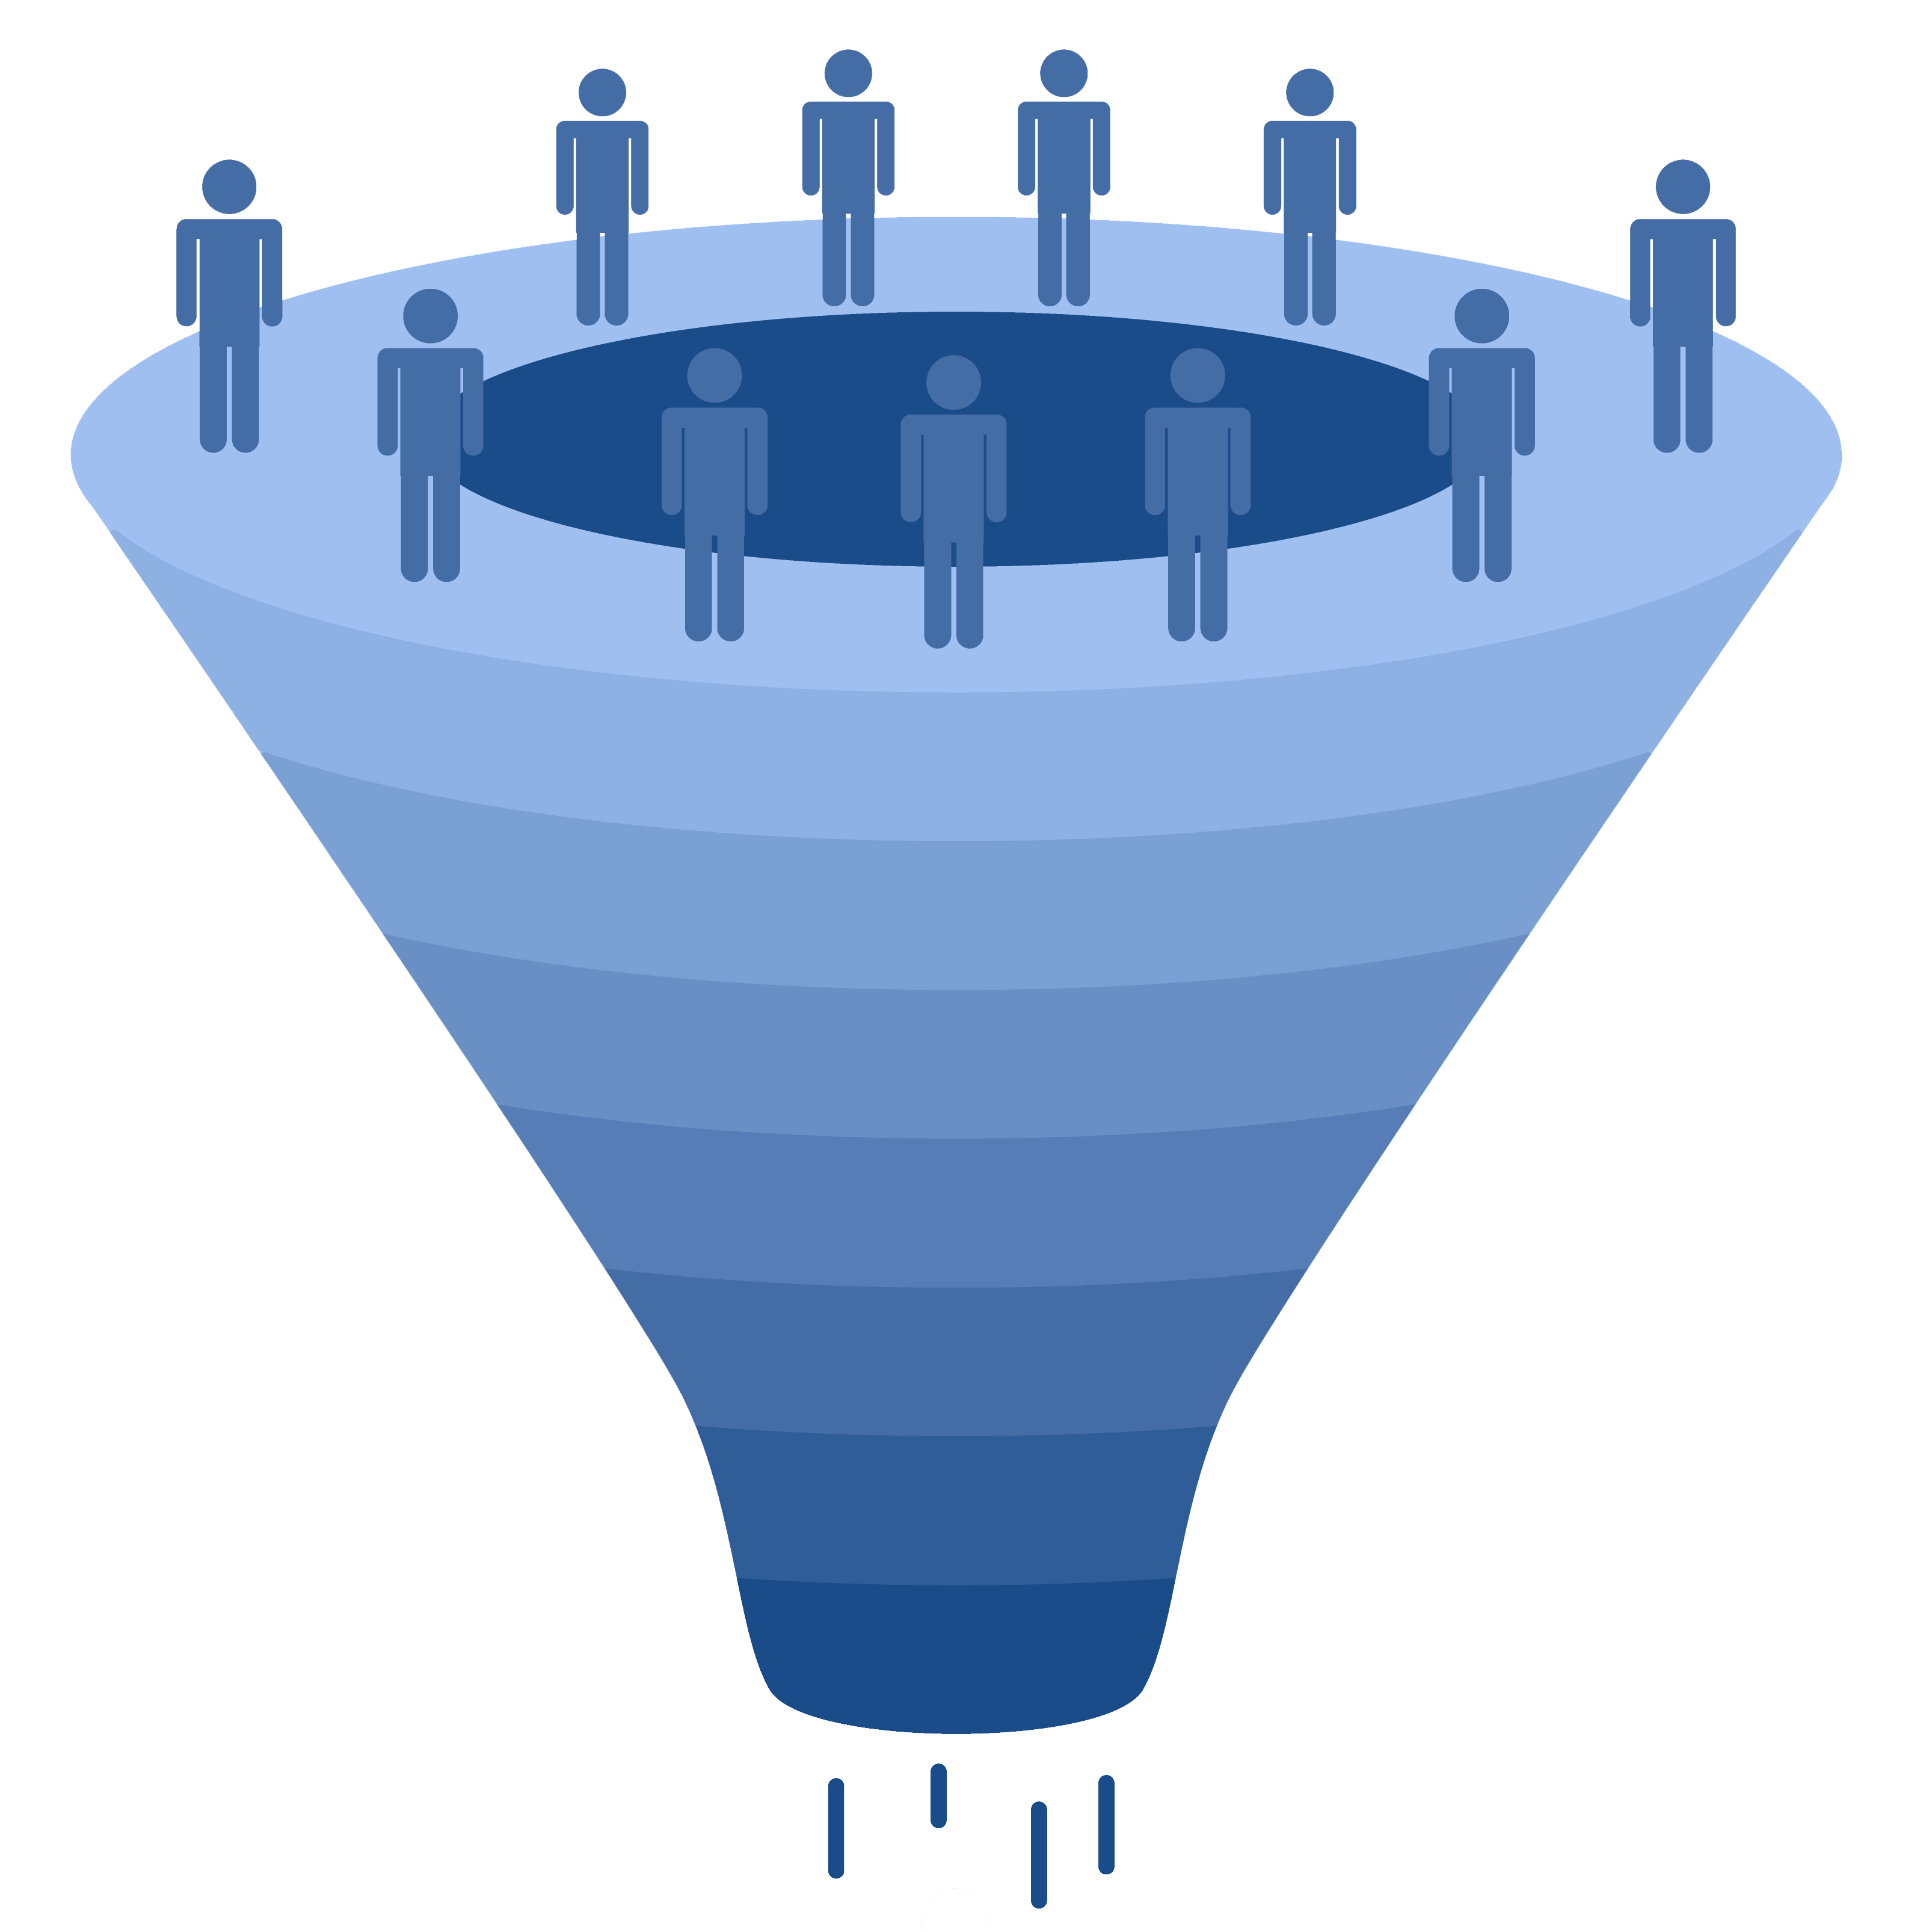
Working with cohorts
upload a list
of patients
find a cohort
from within
EMERSE
import list
from another
system (such as i2b2)
EMERSE patient lists
(up to 100,000 per list)
http://project-emerse.org/presentations.html

Slide 16
Highlight documents for chart review
Thoracocentesis confirmed the recurrence of mantle cell lymphoma. Disease restaging work-up revealed multicompartment lymphadenopathy in the neck, mediastinal, retrocrural, retroperitoneal and pelvic regions. Bone marrow was also involved. The patient was treated with a total of six cycles of rituximab, cyclophosphamide, vincristine, doxorubicin and dexamethasone (R-HyperCVAD) completed in January 2007. That treatment led to complete remission that lasted until October 2008, when the disease was found to have recurred in the left pleural space and retroperitoneum without bone marrow involvement.
https://jmedicalcasereports.biomedcentral.com/articles/10.1186/1752-1947-4-329
http://project-emerse.org/presentations.html

Slide 17
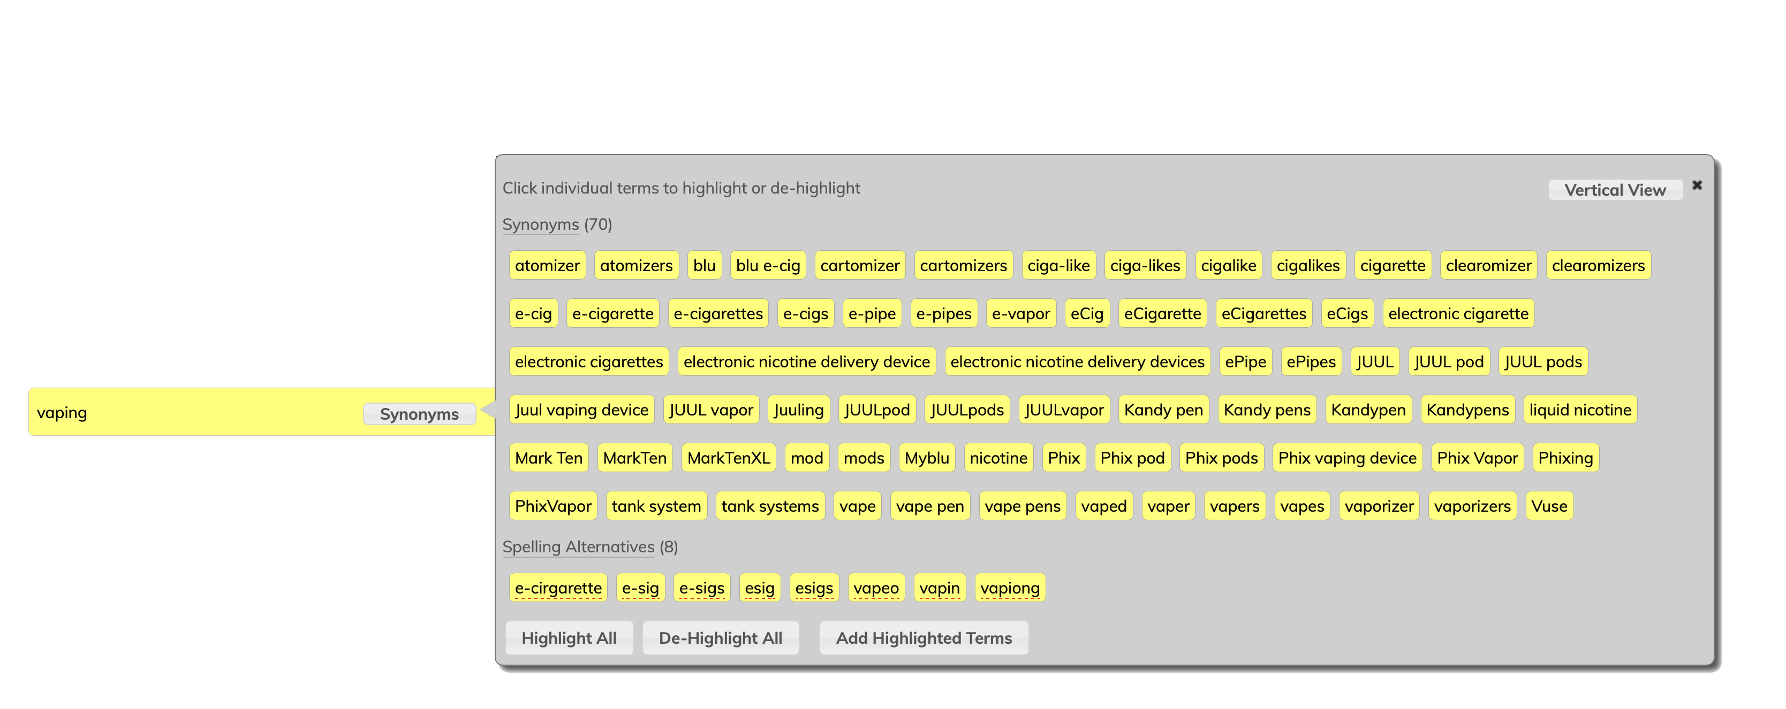
Query expansion
http://project-emerse.org/presentations.html

Slide 18
Query expansion
Can use “EMERSE Synonyms” or upload your own dataset (e.g., ICD-10, human phenotype ontology, MeSH terms)
Simple file format
http://project-emerse.org/documentation/administrator_guide.html#truepreparing-a-synonyms-file
http://project-emerse.org/presentations.html

Slide 19
EMERSE Synonyms
Manually curated over past 12+ years
Has many terms/phrases not found in standard vocabularies, taxonomies, ontologies (but are found in clinical notes)
Reasonable licensing terms for academic centers
> 1 million unique rows
Details are at:
http://project-emerse.org/synonyms.html
To explore a subset, visit:
http://www.davidhanauer.com/EMERSE_synonyms_T_Terms/
http://project-emerse.org/presentations.html

Slide 20
What’s in the Synonyms?
Category | Example
Acronyms | CXR chest x-ray
Abbreviations | chemotherapy chemo
Professional and consumer terms | emesis puking
Misspellings | diarriea diahhrea
Trade and generic drug names | Tylenol acetaminophen
Chemotherapy regimens | FOLFOX, folinic acid, fluorouracil, oxaliplatin
Word Stems | sleep, sleeping, sleepy
Category | Example
True synonyms | frigid cold
Phrasing variations | lido w/ epi epi-lidocaine
Malapropisms/ usage errors | beast mass prostrate cancer
Root word variations | adenotonsillectomy tonsilloadenoidectomy
Hyphenations | pseudosarcomatous pseudo-sarcomatous
Idioms | under the knife under the weather
Neologisms | trabecularity (vs trabeculation)
http://project-emerse.org/presentations.html

Slide 21
What’s in EMERSE?
Free text notes
admission notes
history and physical
progress notes
pathology reports
radiology reports
more!
@ Michigan: 2.5 million patients
170 million notes
1995-present
http://project-emerse.org/presentations.html

Slide 22
What’s not in EMERSE?
Structured data
discrete lab values
vital signs
billing codes
Other tools such as i2b2 exist for structured data
http://project-emerse.org/presentations.html

Slide 23
Typical workflow
initial cohort identified
with a cohort discovery
tool (i2b2) using structured data (or via EMERSE
‘Find Patients’)
http://project-emerse.org/presentations.html

Slide 24
Typical workflow
additional details abstracted from the free text using EMERSE
http://project-emerse.org/presentations.html

Slide 25
Typical workflow
Data recorded in an electronic data capture system (REDCap)
http://project-emerse.org/presentations.html

Slide 26
EMERSE and i2b2 could go together like…
http://project-emerse.org/presentations.html

Slide 27
EMERSE and i2b2 could go together like…
i2b2 queries EMERSE/Solr API for list of patients as additional criteria
e.g.: structured data &
note contains phrase: _______
i2b2 sends patient cohort to EMERSE
(this has been done before)
EMERSE queries i2b2 to narrow cohort using structured data
http://project-emerse.org/presentations.html
http://project-emerse.org/presentations.html

Slide 28
EMERSE and i2b2 have been connected in the past
i2b2 plugin
http://project-emerse.org/presentations.html
http://project-emerse.org/presentations.html

Slide 29
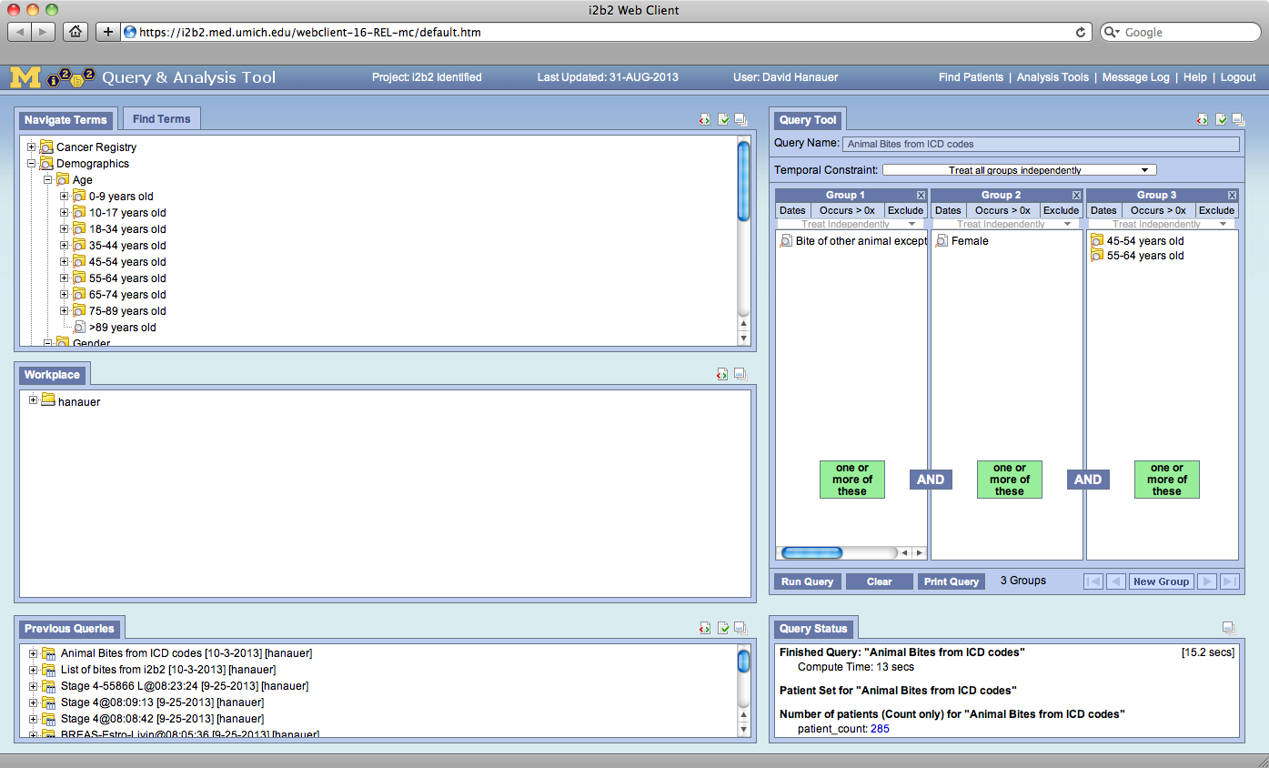

Slide 30
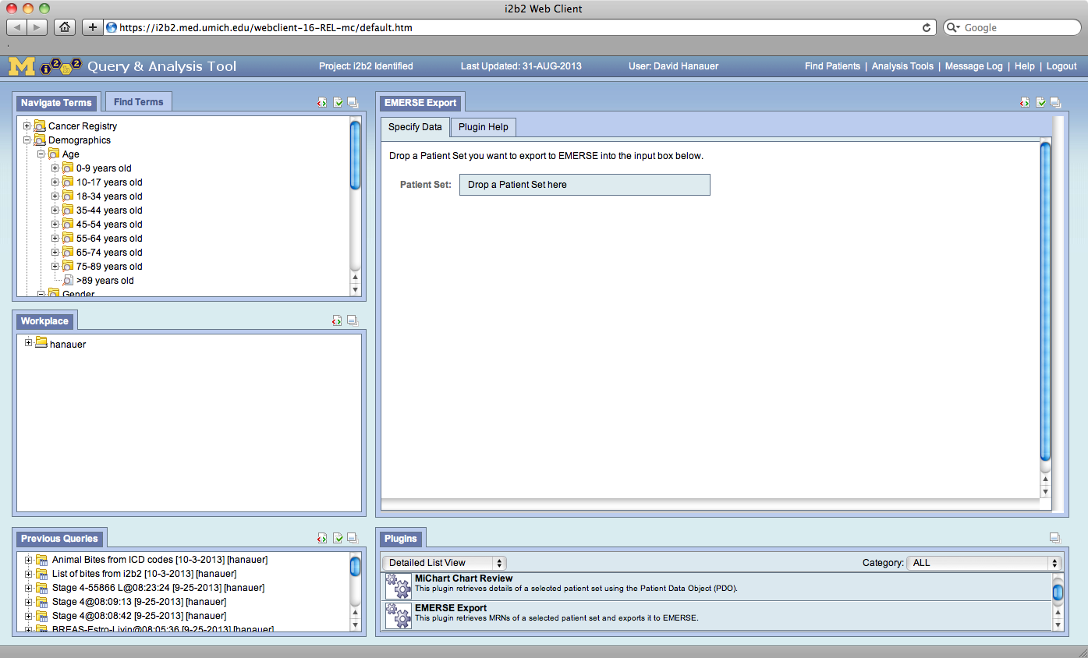

Slide 31
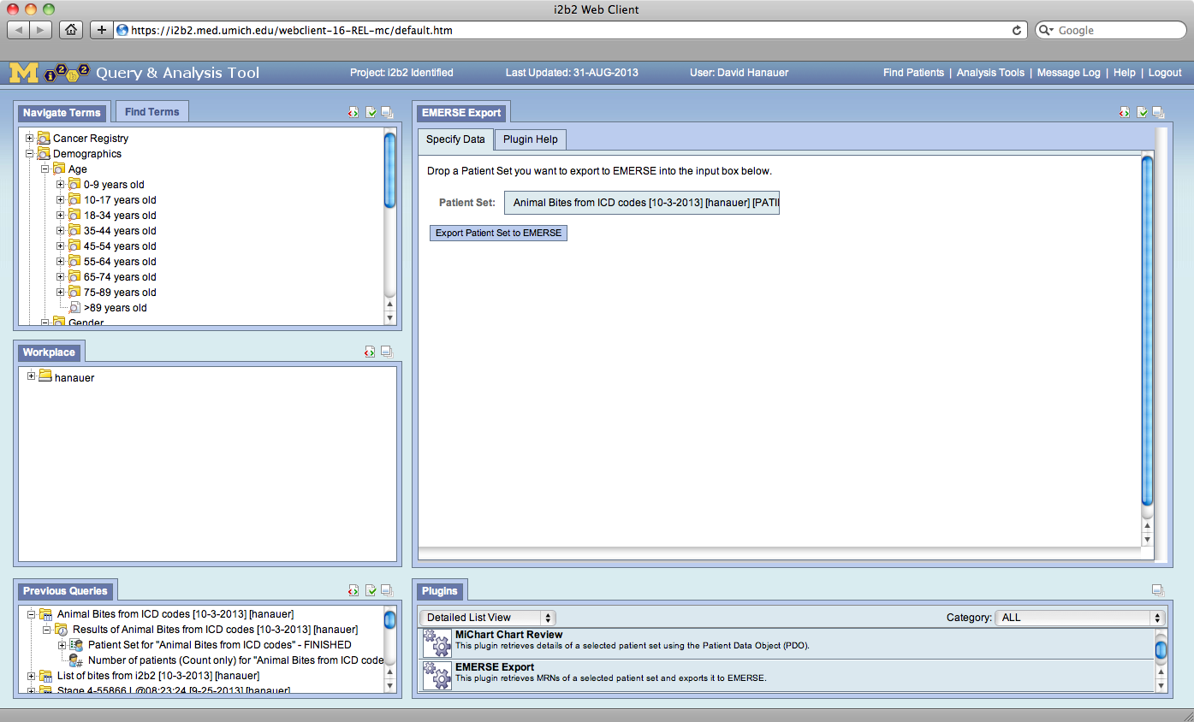

Slide 32
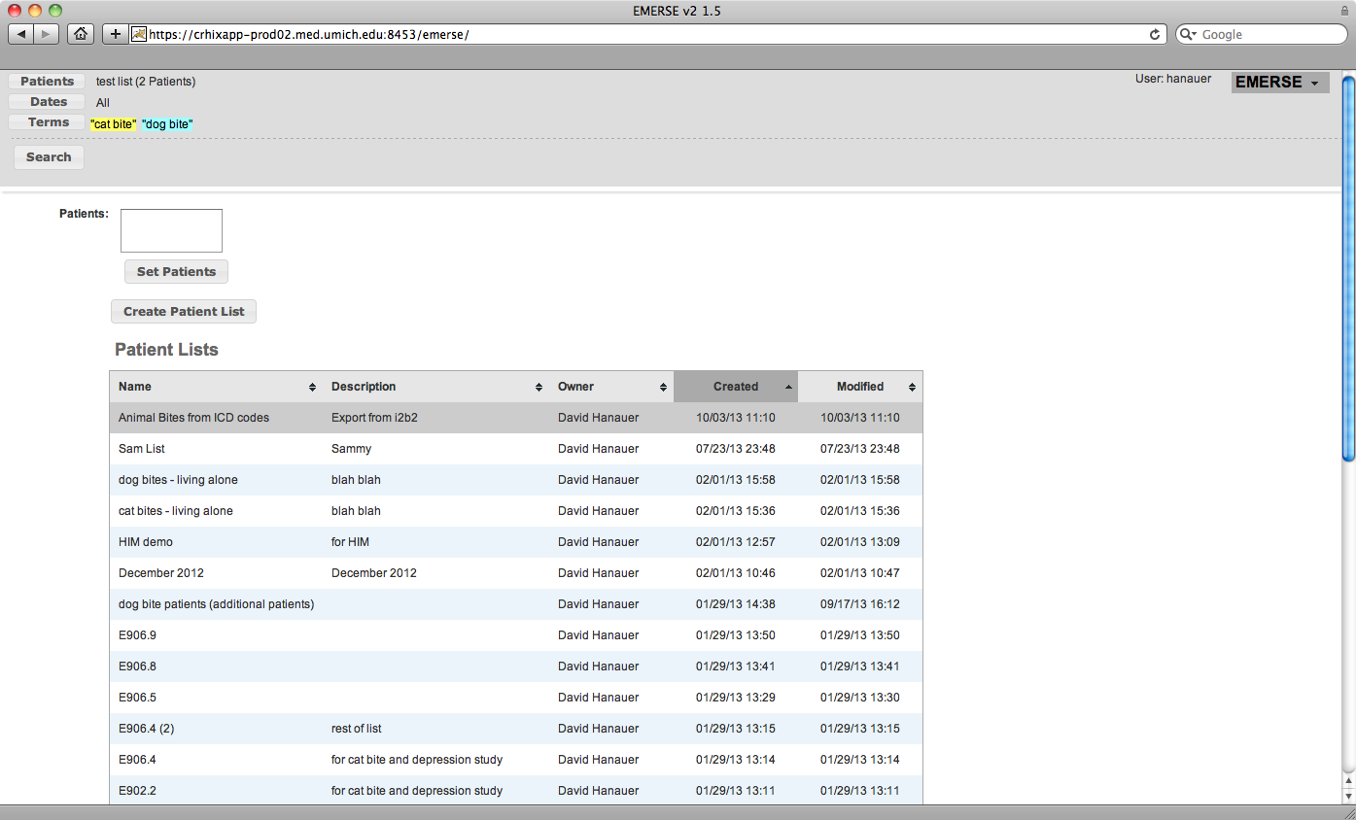

Slide 33
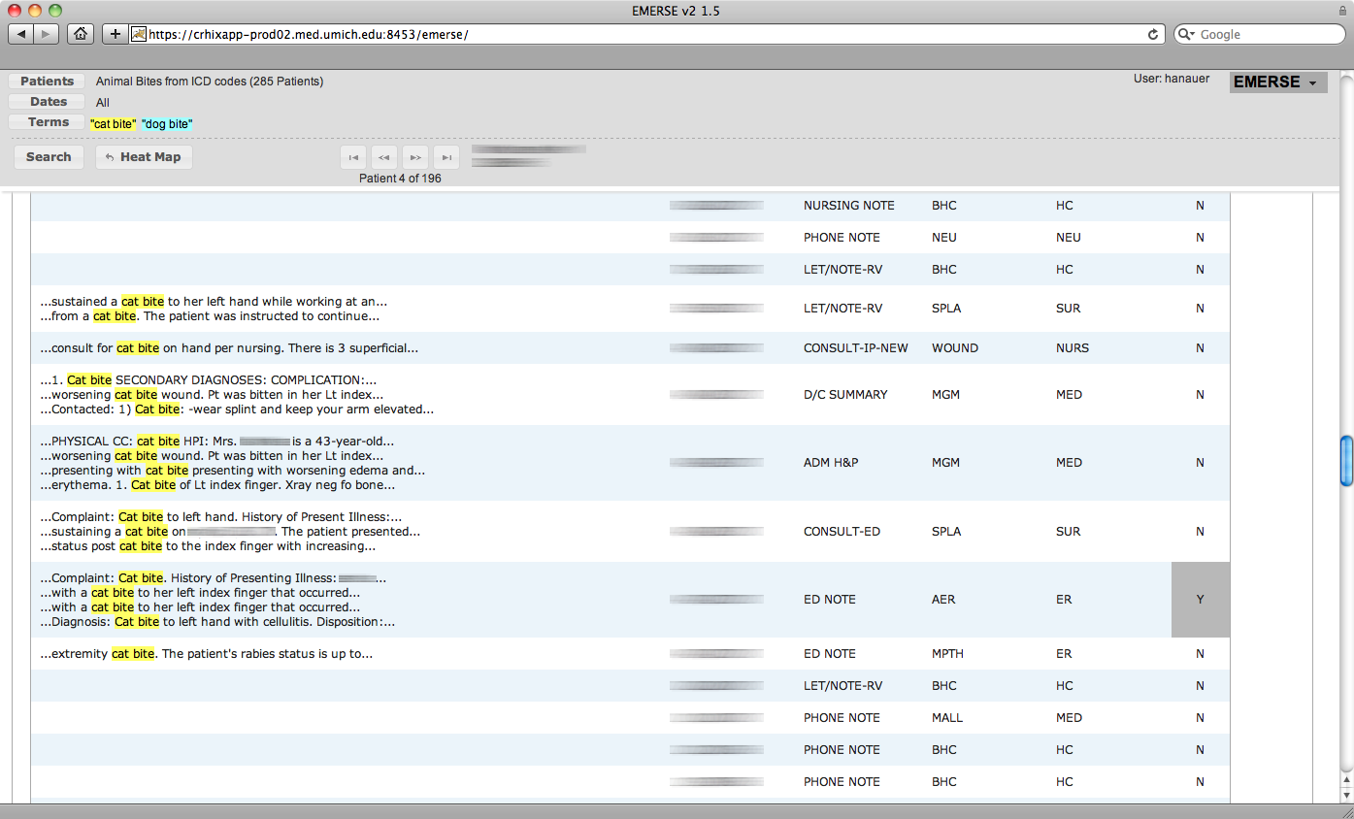

Slide 34
EMERSE is fast
Query to identify all patients with the following | Epic Clarity time (s) | EMERSE time (s) | EMERSE advantage
cavernous hemangioma | 14,652 | 2 | 7,320x
gray platelet syndrome | 14,940 | 2 | 7,470x
inferior lingular segment of the left upper lobe | 17,784 | 9 | 1,980x
…enabling real-time querying
http://project-emerse.org/presentations.html

Slide 35
Publications using EMERSE
348 papers
52 abstracts
Full list can be found at:
http://project-emerse.org/publications.html
http://project-emerse.org/presentations.html

Slide 36
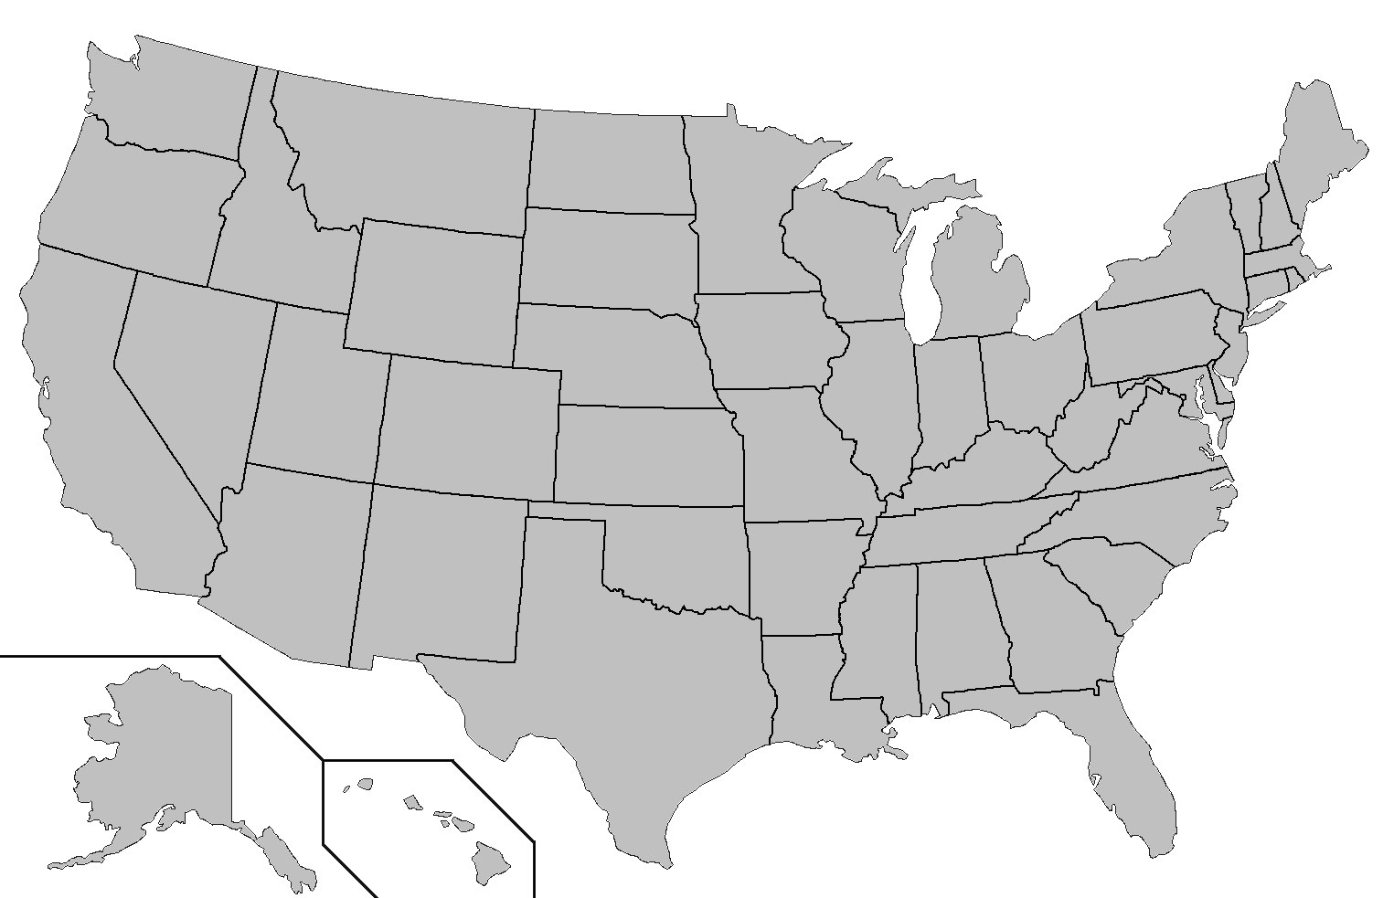
Where is EMERSE?
installed
installing
http://project-emerse.org/presentations.html

Slide 37
The future…
installed
installing
http://project-emerse.org/presentations.html

Slide 38
Getting EMERSE
local installation required
need support of IT team
EHR-agnostic
runs independent of EHR
need a way to extract documents to send to EMERSE
http://project-emerse.org/presentations.html

Slide 39
Under the Hood
EMERSE application
(Java, Javascript)
Apache Solr
Apache ActiveMQ
Oracle
http://project-emerse.org/presentations.html

Slide 40
Test driving EMERSE
online demo
videos on website
virtual machine
- could be used for
individual projects
http://project-emerse.org/presentations.html

Slide 41
project-emerse.org
http://project-emerse.org/presentations.html

Slide 42
hanauer@umich.edu
http://project-emerse.org/presentations.html

Slide 43
Acknowledgements
U of Michigan
Michigan Institute
for Clinical and
Health Research
(MICHR)
U of Michigan
Rogel Cancer Center
U of Michigan
Health Information
and Technology
Services (HITS)
NCI Information
Technology for
Cancer Research
(ITCR)
http://project-emerse.org/presentations.html

