Slide 1
EMERSE: an easy-to-use, self-service search engine and chart review tool for EHR notes
May 6, 2022
David Hanauer, MD, MS
Dept of Learning Health Sciences
University of Michigan
hanauer@umich.edu
Twitter: @informaticsGeek
@projectEMERSE
Web: project-emerse.org
http://project-emerse.org/presentations.html

Slide 2
If you’re thinking of taking notes
or want to visit links
these slides can be found at:
this link will be
on most slides
http://project-emerse.org/presentations.html

Slide 3
Disclosures
Funding: NIH (NCI, NCATS); PCORI
Licenses/Royalties: EMERSE “Synonyms” (used for query expansion) which is licensed by the U of Michigan
Disclosures
http://project-emerse.org/presentations.html

Slide 4
http://project-emerse.org/presentations.html

Slide 5
2021 study out of UC Irvine: Design, Implementation, and Usability of the Electronic Medical Record Search Engine (EMERSE) Tool https://escholarship.org/uc/item/44p23878
“Users unanimously responded that they would recommend the system to others, and…for a tool they found so useful, they believed that far too few people both within and outside of their network knew about the tool’s existence.”
http://project-emerse.org/presentations.html

Slide 6
Unstructured vs Structured Data
EMERSE is for this… | …not this
Unstructured Data (free text) | Structured Data
Mrs. Jones is a 56 year old female with a history of HTN, hypercholesterolemia, and T2DM who comes to the clinic today with a 3 day h/o dizziness and severe headache on the left side. | WBC: 5.6 Total cholesterol: 182 Weight: 67.4 AST: 30 ALT: 52
http://project-emerse.org/presentations.html

Slide 7
80% of EHR data are in unstructured free text
structured data
unstructured data/free text
http://project-emerse.org/presentations.html

Slide 8
The EMERSE solution
A system “for the people”
Users search the EHR on their own
No need to wait in a queue for an analyst or a data scientist
Data are kept secure within a centralized, audited system
No need to download/store the data elsewhere
Easy-to-use for non-technical researchers
http://project-emerse.org/presentations.html

Slide 9
Find cohorts
EMERSE allows you to find cohorts based on things mentioned in the notes
diseases
drugs
symptoms
anything*
*if it is mentioned
http://project-emerse.org/presentations.html

Slide 10
Find cohorts
It’s perfect for finding rare things…
…like rare cancers
See this talk for more details:
https://vimeo.com/677482835
“Using EMERSE to Improve Research Involving Rare Cancers”
http://project-emerse.org/presentations.html

Slide 11
Highlight documents for chart review
Thoracocentesis confirmed the recurrence of mantle cell lymphoma. Disease restaging work-up revealed multicompartment lymphadenopathy in the neck, mediastinal, retrocrural, retroperitoneal and pelvic regions. Bone marrow was also involved. The patient was treated with a total of six cycles of rituximab, cyclophosphamide, vincristine, doxorubicin and dexamethasone (R-HyperCVAD) completed in January 2007. That treatment led to complete remission that lasted until October 2008, when the disease was found to have recurred in the left pleural space and retroperitoneum without bone marrow involvement.
https://jmedicalcasereports.biomedcentral.com/articles/10.1186/1752-1947-4-329
http://project-emerse.org/presentations.html

Slide 12
EMERSE is fast
Query to identify all patients with the following | Reporting DB time (s) | EMERSE time (s) | EMERSE advantage
cavernous hemangioma | 14,652 | 2 | 7,320x
gray platelet syndrome | 14,940 | 2 | 7,470x
inferior lingular segment of the left upper lobe | 17,784 | 9 | 1,980x
…enabling real-time querying
http://project-emerse.org/presentations.html

Slide 13
Typical workflow
initial cohort identified
with a cohort discovery
tool using structured data (or via EMERSE
‘Find Patients’)
Cohort discovery tools:
i2b2, LEAF, etc.
http://project-emerse.org/presentations.html

Slide 14
Typical workflow
additional details abstracted from the free text using EMERSE
http://project-emerse.org/presentations.html

Slide 15
Typical workflow
Data recorded in an electronic data capture system (e.g., REDCap)
http://project-emerse.org/presentations.html

Slide 16
Statistics at Michigan
Sept 2018 – Sept 2021
31,800 research logins
926 studies
525 PIs
http://project-emerse.org/presentations.html

Slide 17
Publications using EMERSE
553
papers and abstracts
Full list at:
http://project-emerse.org/publications.html
http://project-emerse.org/presentations.html

Slide 18
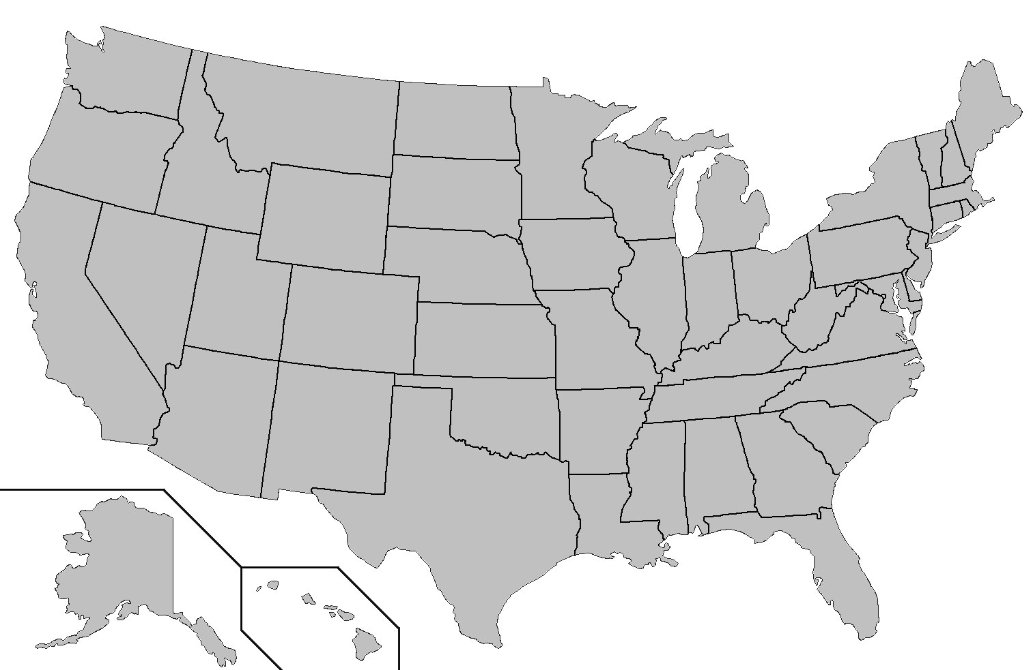
Where is EMERSE?
installed
installing
http://project-emerse.org/presentations.html

Slide 19
Now available…
EMERSE Research Informatics Network
real-time, secure
cross-site queries
http://project-emerse.org/presentations.html

Slide 20
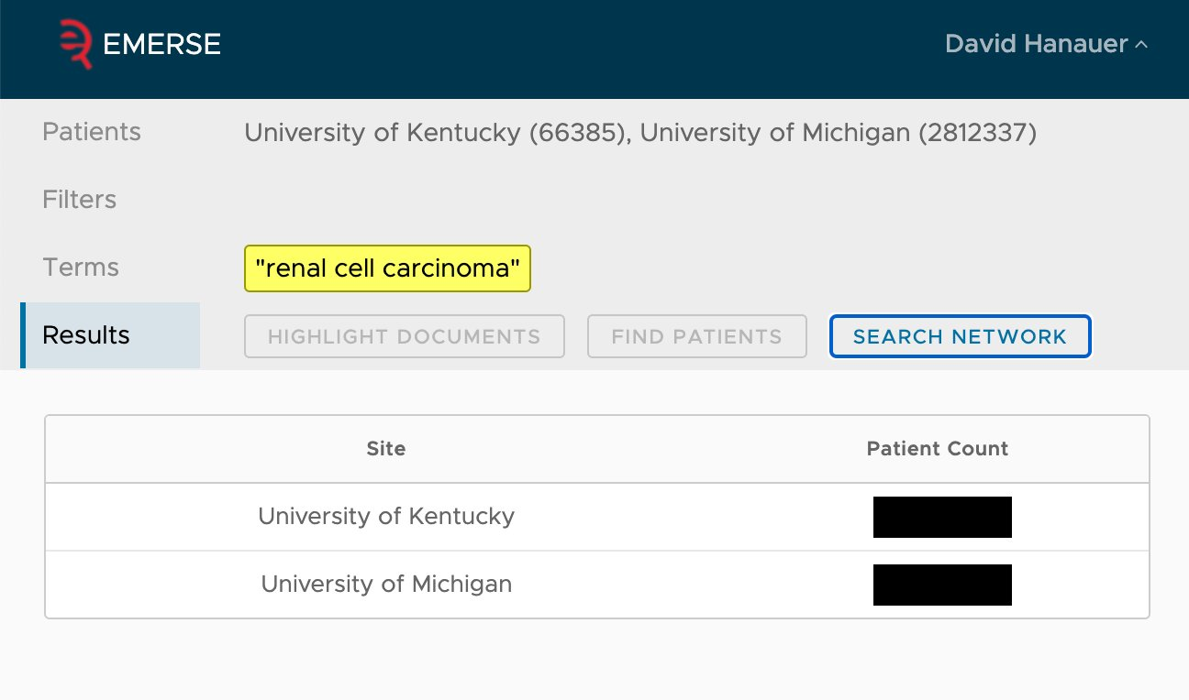
EMERSE Research Informatics Network
http://project-emerse.org/presentations.html

Slide 21
The future…
Incorporation of NLP features
- negation
- uncertainty
- subject (patient vs other)
- named entity recognition/mapping to ontologies
Data extraction from templated notes
http://project-emerse.org/presentations.html

Slide 22
project-emerse.org
http://project-emerse.org/presentations.html

Slide 23
Twitter: @projectEMERSE
publications
software releases
announcements
webinars
http://project-emerse.org/presentations.html

Slide 24
Interested in learning more?
Contact us to schedule a time with your team for:
Discussions about research strategies
Training
Live demonstrations
http://project-emerse.org/presentations.html

Slide 25
EMERSE-team@umich.edu
Lisa Ferguson
David Hanauer
Kellen McClain
Guan Wang
http://project-emerse.org/presentations.html

