Slide 1
EMERSE Community Meeting
2023-May-23
https://project-emerse.org
https://project-emerse.org

Slide 2
Plan for today
Welcome and Housekeeping
Announcements and Updates
EMERSE Evaluation Study: Kai Zheng, PhD, FACMI
Discussion: Administration, Architecture and Technology
Open Forum
Adjourn

Slide 3
Housekeeping
Zoom Meeting
More opportunities for interaction
Please stay muted, unless you would like to ask a question or make a comment
Feel free to use the chat function to type questions or provide comments
We will answer questions throughout
We will record this meeting, available where prior recordings are location: https://project-emerse.org/presentations.html

Slide 4
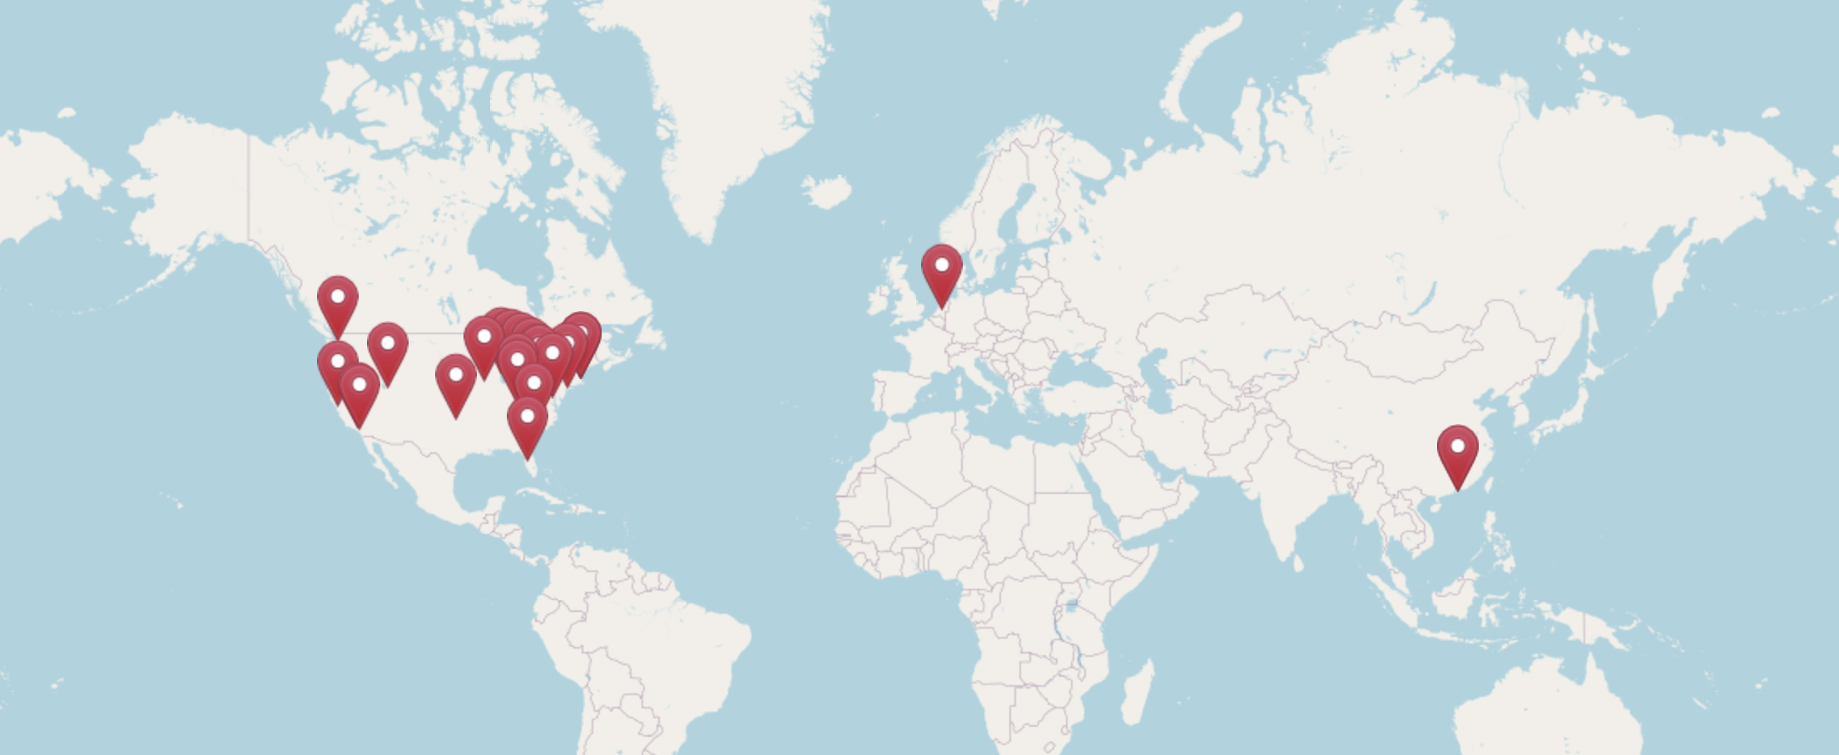
A Growing Community
Registrants from 25 organizations and institutions
https://project-emerse.org/community.html

Slide 5
Acknowledgements
EMERSE has been supported by:
NCI ITCR program
NCATS/CTSA/MICHR
Michigan Medicine
Department of Learning Health Sciences
Office of Research
Health Information Technology & Services

Slide 6
Updates and Announcements
ChatGPT (and other LLMs)
EMERSE Research Collaborative
First meeting: May 9, 2023
Next meeting: TBD
New EMERSE Release (More later……)

Slide 7
Publications
University of Michigan
Gunchick V, et al. Survival Analysis of 1140 Patients with Biliary Cancer and Benefit from Concurrent Renin-Angiotensin Antagonists, Statins, or Aspirin with Systemic Therapy. Oncologist. 2023 Apr 10:oyad063. PMID: 37036699
→ "largest retrospective advanced BTC cohort in the literature with both OS and PFS data reported"
Case Western Reserve University
Rao G, et al. Recognition, diagnostic practices, and cancer outcomes among patients with unintentional weight loss (UWL) in primary care. Diagnosis (Berl). 2023 Apr 21. PMID: 37080911
University of North Carolina-Chapel Hill
Powell C, Lancaster K. Natural medical history study of patients with STAC3 disorder from a single center. Genetics in Medicine Open. Volume 1, Issue 1 Supplement, 2023. 2023 ACMG Annual Clinical Genetics Meeting, 14 March 2023 - 18 March 2023.
→ "largest case series to date of patients with a clinical or molecular diagnosis of STAC3 disorder."

Slide 8
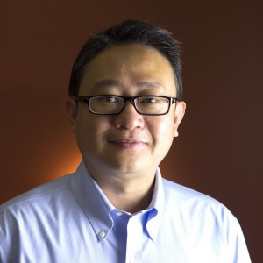
EMERSE Evaluation
Kai Zheng, PhD, FACMI Professor in Informatics and Emergency Medicine Chief Research Information Officer, Office of Data and Information Technology Director of Biomedical Informatics, Institute for Clinical and Translational Science Director, Public Health Informatics & Technology Workforce Development Program University of California, Irvine

Slide 9
Administration, Architecture and Technology
Recent release
Enhancements - Demo/discussion of filters
Bug fixes

Slide 10
Administration, Architecture and Technology
Synonyms – used for query expansion
Free license if used within EMERSE, and for research only
2.4M total rows
1.8M unique rows
July 4 weekend a good time to update counts (contact David if you want update)

Slide 11
Wrap up
THANK YOU
Next Meeting: TBD (Sep/Oct 2023)
Please complete meeting survey
https://bit.ly/emerse-may-2023

