Slide 1
EMERSE Community Meeting
2024-May-15
https://project-emerse.org
https://project-emerse.org

Slide 2
Plan for today
Welcome and Housekeeping
Announcements and Updates
Guest speaker: Jackie Gravitt, “Implementing EMERSE at UVA: Lessons Learned”
Discussion: Considerations for implementing and supporting EMERSE
Open Forum
Adjourn

Slide 3
Housekeeping
Zoom Meeting
More opportunities for interaction
Please stay muted, unless you would like to ask a question or make a comment
Feel free to use the chat function to type questions or provide comments
We will answer questions throughout
We will record this meeting; it will be available where prior recordings are located:
https://project-emerse.org/presentations.html
https://project-emerse.org/community.html

Slide 4
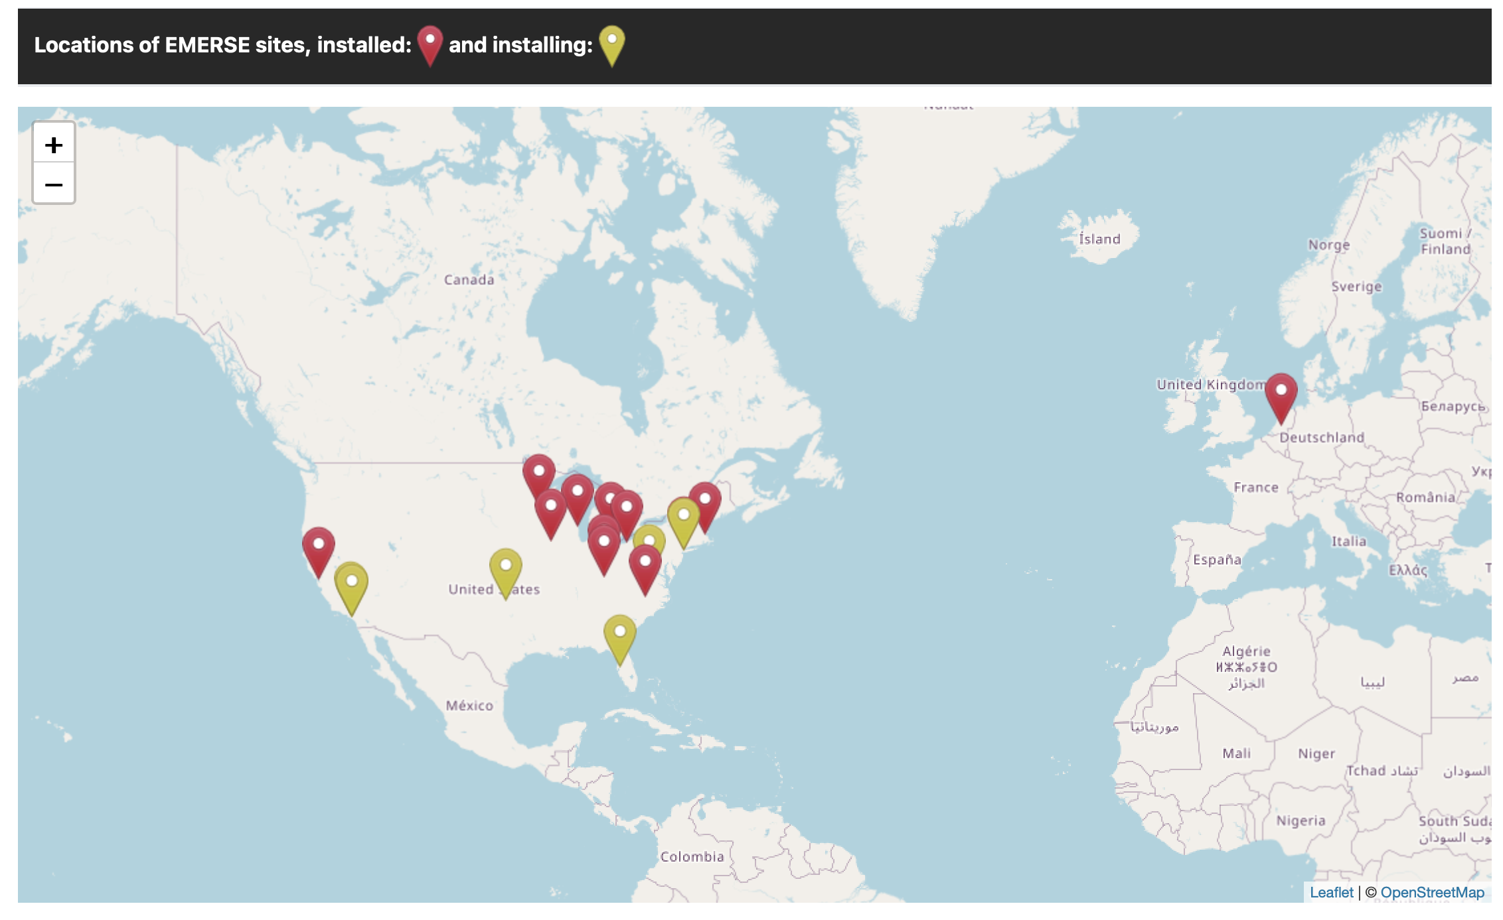
Community
Updated page for EMERSE Community
https://project-emerse.org/community.html

Slide 5
Acknowledgements
EMERSE has been supported by:
NCI ITCR program
NCATS via MICHR CTSA
Michigan Medicine
Department of Learning Health Sciences
Office of Research
Health Information Technology & Services

Slide 6
Research Collaborative
Last meeting was April 29, 2024; next meting TBD
Initial research focus: pronoun usage in the EHR over time
Contributions from U Michigan, UCSF, U Virginia, U Cincinnati, U Iowa
If interested in participating, please contact EMERSE-team@umich.edu

Slide 7
Publications
https://project-emerse.org/publications.html

Slide 8
Publications (new since last meeting)
DeCamillo D, Herrel LA, Haymart B, Latfolla A, Barnes GD. Unexplained hematuria in direct oral anticoagulant use: a single-center retrospective case series. Res Pract Thromb Haemost. 2024;8:e102404 www.rpthjournal.org. PMID: Pending.
Kang Y, Chao S, Battles A, Firn J. Clinical Ethics Consultation for Patients Impacted by Incarceration: A Single Center Retrospective Review. J Correct Health Care. 2024 Apr 9. doi: 10.1089/jchc.23.10.0083. Epub ahead of print. PMID: 38597931
Drake VE, Smith C, Watkins MO, Rudy SF, Joseph AW, Stucken CL, Brenner MJ, Kim JC, Moyer JS. Outcomes of Autologous Versus Irradiated Homologous Costal Cartilage Graft in Rhinoplasty. Facial Plast Surg Aesthet Med. 2024 Mar 19. doi: 10.1089/fpsam.2023.0334. Epub ahead of print. PMID: 38502836
Pradhan S, Strohacker C, Schachtner S, Palm K, Trauth A, Gao Z, Marcuccio E. Management of Hematochezia in Infants with Congenital Heart Disease Admitted to the Acute Care Cardiology Unit: A Multicenter Retrospective Pilot Study. J Pediatr. 2024 Feb 27;269:113992. doi: 10.1016/j.jpeds.2024.113992. Epub ahead of print. PMID: 38417782
Lopez-Medina AI, Campos-Staffico AM, A Chahal CA, Volkers I, Jacoby JP, Berenfeld O, Luzum JA. Genetic risk factors for drug-induced long QT syndrome: findings from a large real-world case-control study. Pharmacogenomics. 2024 Feb;25(3):117-131. doi: 10.2217/pgs-2023-0229. Epub 2024 Mar 20. PMCID: PMC10964839. PMID: 38506312
Harake ES, Linzey JR, Jiang C, Joshi RS, Zaki MM, Jones JC, Khalsa SSS, Lee JH, Wilseck Z, Joseph JR, Hollon TC, Park P. Development and validation of an artificial intelligence model to accurately predict spinopelvic parameters. J Neurosurg Spine. 2024 Mar 29:1-9. doi: 10.3171/2024.1.SPINE231252. Epub ahead of print. PMID: 38552236
Haring CT, Heft Neal ME, Jaffe CA, Shuman AG, Rosko AJ, Spector ME. Association of preoperative thyroid hormone replacement with perioperative complications after major abdominal surgery. Am J Surg. 2024 Jan 23:S0002-9610(24)00020-5. doi: 10.1016/j.amjsurg.2024.01.018. Epub ahead of print. PMID: 38311517
Holste KG, Makar KG, Ulma RM, et al. Advantages of an Image-Guided Subcranial Technique for Le Fort III Osteotomies for Midface Advancement: A Case Series. FACE. 2024;0(0). doi:10.1177/27325016241227446. PMID: Pending
Ahmad RA, Orelaru F, Arora A, Ling C, Kim KM, Fukuhara S, Patel H, Deeb GM, Yang B. Acute type A intramural hematoma: The less-deadly acute aortic syndrome? J Thorac Cardiovasc Surg. 2024 Jan 25:S0022-5223(24)00090-4. doi: 10.1016/j.jtcvs.2024.01.032. Epub ahead of print. PMID: 38280668
Roseland ME, Ma T, Shampain KL, Stein EB, Wasnik AP, Curci NE, Sciallis AP, Uppal S, Johnson TD, Maturen KE. Neoadjuvant chemotherapy for high-grade serous ovarian cancer: radiologic-pathologic correlation of response assessment and predictors of progression. Abdom Radiol (NY). 2024 Mar 13. doi: 10.1007/s00261-024-04215-w. Epub ahead of print. PMID: 38478037

Slide 9
Publications (“The largest”)
“Our report describes the successful technical advantages of using Stealth navigation for subcranial Le Fort III osteotomies and presents, to our knowledge, the largest case series of patients with long-term follow-up.” [doi:10.1177/27325016241227446]
“…this is the largest study that investigated the association of candidate genetic variants with the risk of diLQTS.” [PMID 38506312]

Slide 10
Upcoming software release
Version 7.x
Release date: unknown, but we’re getting close!
Lots of complex changes under the hood
So many changes, it will be challenging to cover them all
Many are discussed in our GitHub issues (https://github.com/project-emerse/emerse/issues)
More powerful
Many UI improvements
Undergoing lots of testing, bug fixes
Will have basic NLP capabilities baked in
Negation, named entity recognition, mapping to UMLS concepts
UMLS license will be required (one per site; free)
Will require upgrading, re-indexing, re-uploading synonyms

Slide 11
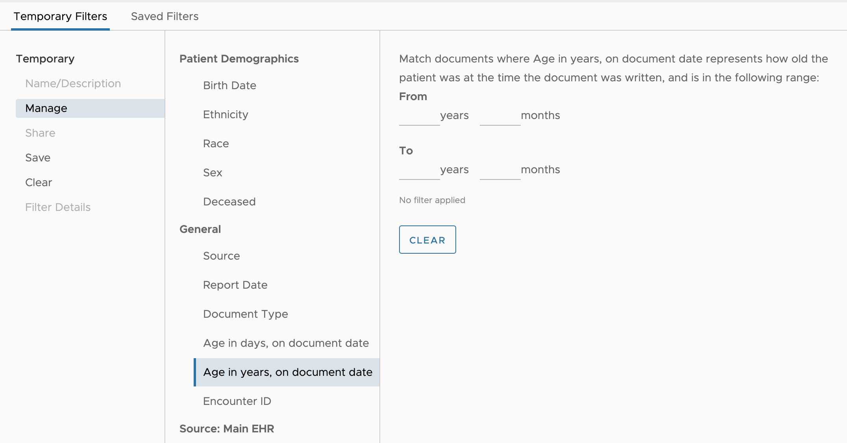
Upcoming software release

Slide 12
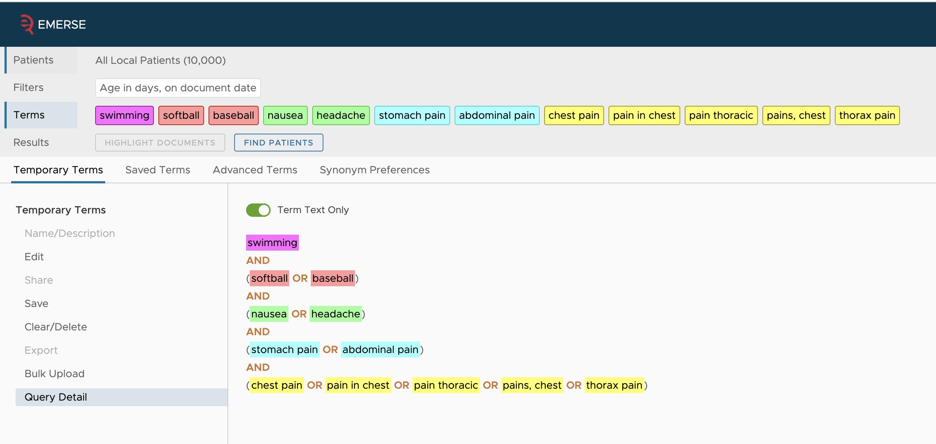
Upcoming software release

Slide 13
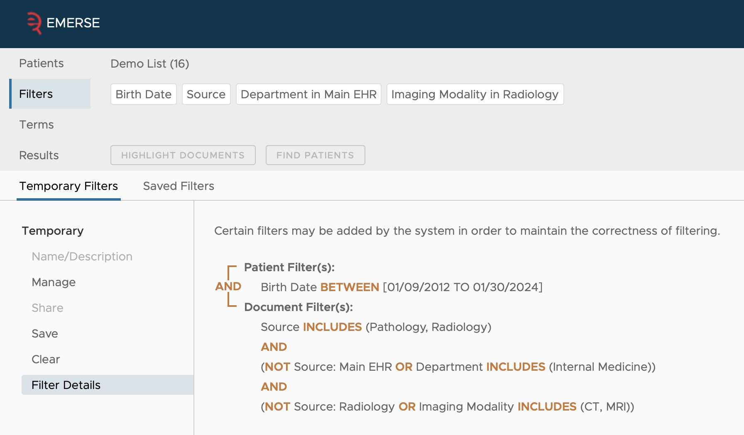
Upcoming software release
Upcoming

Slide 14
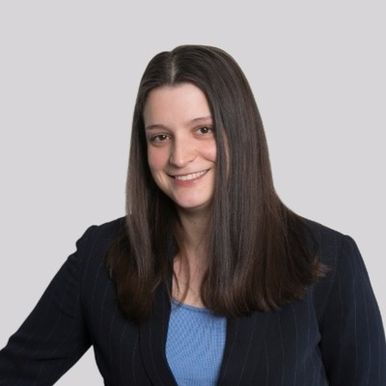
Guest speaker
“Implementing EMERSE at UVA: Lessons Learned”
Jackie Gravitt
Health Data Engineer
Analytics and Reporting Team (ART) Data Operations
University of Virginia (UVA) Health

Slide 15
Implementing EMERSE at the University of Virginia
Lessons Learned

Slide 16
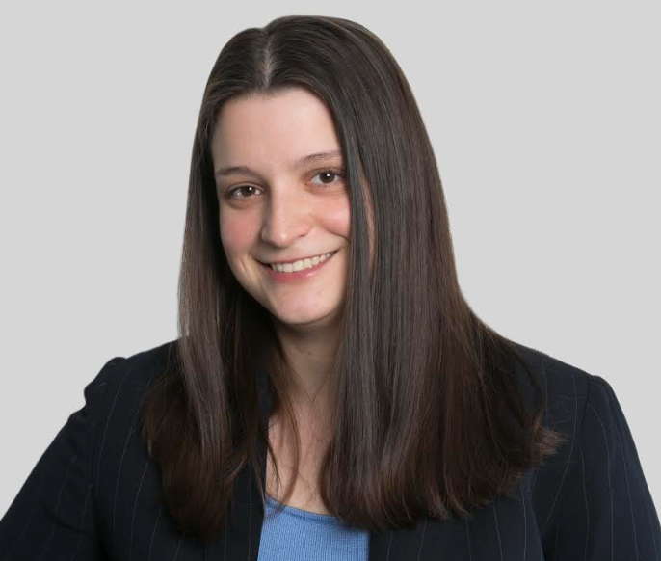
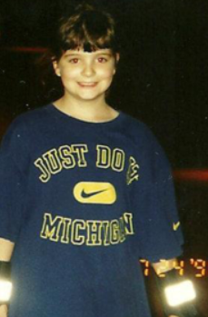
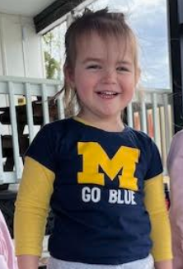
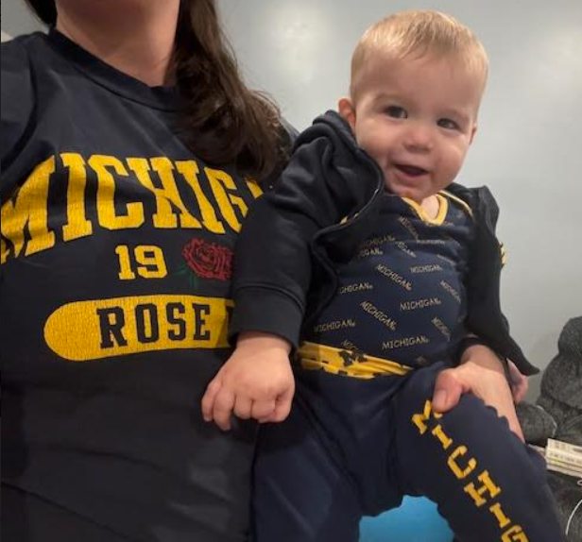
About Me
Jackie Gravitt
Engineering Staff Specialist, Health Data
Started with UVA Health in May 2023
UVA Alumna – Systems Engineering and Psychology
Longtime Michigan fan
Notes:
Data Operations
Prior – 10 years working on a reporting tool for community banks

Slide 17
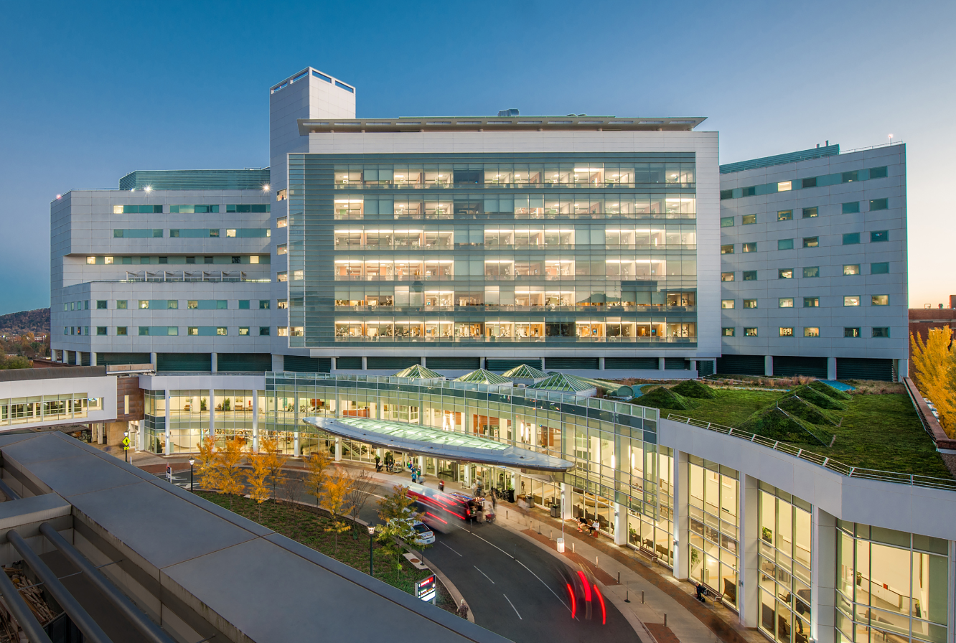
UVA Health
About Us
Academic Medical Center in Charlottesville, Virginia
Also encompasses 3 community hospitals
1000+ Beds Across 4 Hospitals
Level 1 Trauma Center, Transplant Center, Comprehensive Cancer Center
#1 Children’s Hospital in Virginia
Notes:
City of Charlottesville population – 50,000
Metropolitan Area – 250,000

Slide 18
EMERSE Team at UVA
Team | Leaders | Work Team
Analytics & Performance Evaluation | Christine Kelly-Fisher
Data Operations | Kapil Parkhi | Jackie Gravitt
RCTA – Research & Clinical Trial Analytics | Deb Green | Dave Guan, Fauzia Khan, Misha Zemmel, Rob Pates
HIT – Heath IT | Ron Clarke | Shayla Gustafson
Notes:
Multi disciplinary approach

Slide 19
UVA Strategy
Background
2020 POC – desktop machine - completed
Prototype with data science institute partners Don Brown and Saurav Sengupta
Completed install on Windows machine with EMERSE dummy data and then with an export of UVA data
Project Plan
Install on desktop with dummy data
Install on test server with dummy data
Populate test server with limited set of real data
ED Notes – Notes, Provider Notes, Triage Notes for last x many days
Weekly updates
Install on production with all notes
Weekly updates
Backfill on production with historical notes
Notes:
POC – prior to me
Windows – impressive – at that point, EMERSE was not supporting all databases – built for Oracle
Able to benefit from a lot of work they did
Note_Typ_IC_C – 6, 8, 19

Slide 20
EMERSE Components
University of Michigan
University of Virginia
Database
Oracle (prod)
Maria DB (test)
Server
Linux
Indexing Code
Java application that pushes to Solr via SolrJ API
Database
SQL Server
Server
Windows
Indexing Code
Python script using pysolr run via JAMS job
Notes:
Michigan had Java code/application they used, but we had more python experience on our team
Use JAMS to automate the load
Talk through 3 components

Slide 21
Database - SQL
Database install – straight forward, Michigan provides scripts
Need to download SQL drivers
Patients – weekly load
Loaded from Clarity via SSIS Package/SQL stored procedure
Research Studies and Members – daily load
Python script pulls information from API and lands in staging table
SQL stored procedure moves from staging into EMERSE research tables
Notes:
Patients updated weekly with notes
In the beginning, weekly access sufficient – easy to change
Research studies drive access, so wanted daily runs
Make sure no one has been removed from studies, new studies added

Slide 22
Server/Desktop - Windows
Set system variables
JAVA_HOME, JRE_HOME, CATALINA_HOME, SOLR_HOME
Tomcat
Set to run on port 8090
Change default credentials
Change allowed IPs
Configure Tomcat to run as a Windows service and to logon using local system account
Change initial and memory pools for Java From 128MB and 256MB to 1536 and 2048 MB, respectively
Change default settings for non-existent resources to not show report or server information
Configure Tomcat to enable HTTP Script Transport Security (HSTS)
Include SQL drivers in lib folder
NOTE: After SSL is configured, you will have to access the host via port 443
Notes:
Shayla – IT – most of the heavy lifting here – able to benefit from when Don and Saurav did in 2020 as they had some notes
HTTP Strict Transport Security (HSTS) is a web security policy mechanism, which helps protect web application users against some passive (eavesdropping) and active network attacks.

Slide 23
Server/Desktop – Windows (cont)
Solr
Configure to run as a Windows service
Enable basic security, create user accounts, and enable roles
Configure audit logging
Set Up SSL
Generate keystore file and certificates
Configure Solr to use it once set up
Notes:
Might be the only Windows users but got it working

Slide 24
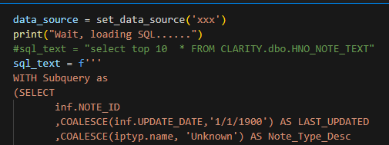
Indexing – Python
SQL query loads data from Clarity
Goes against week old copy of Clarity
Puts notes into data frame
Notes:
I wrote SQL, Dave from research wrote Python
Weekly was sufficient for researcher – can be changed later
Minimize traffic to real Clarity

Slide 25
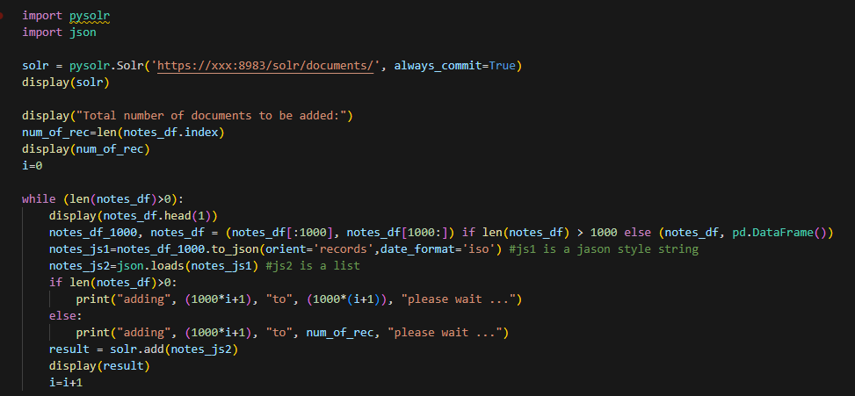
Indexing – Python (cont)
Pushes to Solr using pysolr in chunks of 1000

Slide 26
Indexing – Python (cont)
Code worked!
…but load times were growing with each run – time to load 100k rows:
10 minutes → 17 minutes → 25 minutes
Sufficient for weekly loads, but we wanted to load years worth of older data
Asked ChatGPT for some help
Rewrote with threads and queues
Was able to load 7 million documents in the time it had taken to do 744k the with the old script

Slide 27
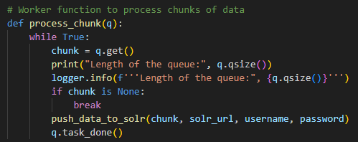
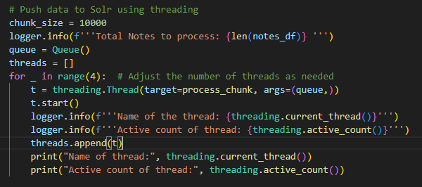
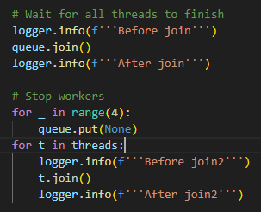
Indexing – Python (cont)
Notes:
Chunks, queues, joins, threads
Run both test and prod – less than 15 minutes
Where clause - backfill, took in a start date and end date
Weekly, days to run
Last 15 days of data - overkill
Prod loads all notes, test – space constraints – didn’t backfill history, load 10,000 notes a week

Slide 28
Beyond the Basics
Access
Access will be granted to those with IRB approval for a particular study
Using REDCap to request/approve
Auditing Views
Created views to see who is accessing, attesting, searching
Search History
Attestations – Last 30 Days
Notes:
Blurred out
Attestation Code – changes based on what you put in
– for research studies, code goes in attestation code and description is name of the study
For free text, the code is blank and the free text goes into the description
one tied to a TFS task, so that was entered in the description

Slide 29
Pilot Projects
Pronouns in EHR with EMERSE partners
Christine and Deb searched according to study protocol
Manually updated aggregate data on study spreadsheet, validated results, submitted to the researcher
Psoriasis study where needed information was in patient notes
Researcher submitted request to Data Request team; decided EMERSE might be a good fit
Researcher included diagnosis codes as a starting point, then required study team to manually review patient notes for specific phrases to meet inclusion
Deb and Harrison (on her team) did searches, exported patient lists, validated results, submitted to the researcher
Notes:
In this study, using EMERSE allowed us to search for the "specific phrases", saving resources, time, and costs for the researcher.
EMERSE had very positive feedback for it

Slide 31
Open Discussion: Implementation & Support

Slide 32
Wrap up
THANK YOU
Next Meeting: TBD (Sep/Oct 2024)
Please complete meeting survey:

