Slide 1
EMERSE Community Meeting
2024-Oct-01
https://project-emerse.org
https://project-emerse.org

Slide 2
Plan for today
Welcome and Housekeeping
Announcements and Updates
Brief System Demo
Open Forum
Adjourn

Slide 3
Housekeeping
Zoom Meeting
More opportunities for interaction
Please stay muted, unless you would like to ask a question or make a comment
Feel free to use the chat function to type questions or provide comments
We will answer questions throughout
We will record this meeting; it will be available where prior recordings are located:
https://project-emerse.org/presentations.html
https://project-emerse.org/community.html

Slide 4
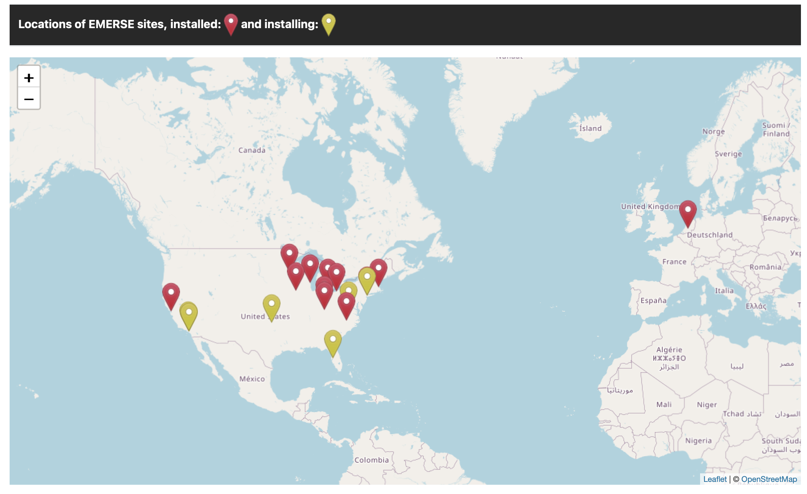
Community
https://project-emerse.org/community.html

Slide 5
Acknowledgements
EMERSE has been supported by:
NCI ITCR program
NCATS via MICHR CTSA
Michigan Medicine
Department of Learning Health Sciences
Office of Research
Health Information Technology & Services

Slide 6
Research Collaborative
Initial research focus: pronoun usage in the EHR over time
Contributions from U Michigan, UCSF, U Virginia, U Cincinnati, U Iowa
Abstract will be presented at November 2024 AMIA Symposium in SF
Next steps: poster, paper, and new projects
If interested in participating, please contact EMERSE-team@umich.edu

Slide 7
Publications
https://project-emerse.org/publications.html

Slide 8
Publications (new since last meeting)
Derstine BA, Holcombe SA, Wang NC, Ross BE, Sullivan JA, Wang SC, Su GL. Relative muscle indices and healthy reference values for sarcopenia assessment using T10 through L5 computed tomography skeletal muscle area. Sci Rep. 2024 Sep 18;14(1):21799. doi: 10.1038/s41598-024-71613-x. PMCID: PMC11410951. PMID: 39294201
Stabellini N, Cullen J, Bittencourt MS, Moore JX, Sutton A, Nain P, Hamerschlak N, Weintraub NL, Dent S, Tsai MH, Banerjee A, Ghosh AK, Sadler D, Coughlin SS, Barac A, Shanahan J, Montero AJ, Guha A. Allostatic Load/Chronic Stress and Cardiovascular Outcomes in Patients Diagnosed With Breast, Lung, or Colorectal Cancer. J Am Heart Assoc. 2024 Jul 16;13(14):e033295. doi: 10.1161/JAHA.123.033295. Epub 2024 Jul 9. PMCID: PMC11292743. PMID: 38979791
Mohan A, Quingalahua E, Gunchick V, Paul S, Kumar-Sinha C, Crysler O, Zalupski MM, Sahai V. PARP inhibitor therapy in patients with IDH1 mutated cholangiocarcinoma. Oncologist. 2024 Aug 5;29(8):725-730. doi: 10.1093/oncolo/oyae163. PMCID: PMC11299928. PMID: 39036962
Ahmed M, Pu A, Jencks K, Bishu S, Higgins P, Chey WD, Rao K, Lee A. Predictors of irritable bowel syndrome-like symptoms in quiescent inflammatory bowel disease. Neurogastroenterol Motil. 2024 Jun;36(6):e14809. doi: 10.1111/nmo.14809. Epub 2024 Apr 23. PMID: 38651743
Owlett LD, Zapanta B, Sandkuhler SE, Ames EG, Hickey SE, Mackenzie SJ, Meisner JK. Multicenter appraisal of comorbid TANGO2 deficiency disorder in patients with 22q11.2 deletion syndrome. Am J Med Genet A. 2024 Jun 3:e63778. doi: 10.1002/ajmg.a.63778. Epub ahead of print. PMID: 38829177
Huppert LA, Fisch S, Tsopurashvili E, Somepalle SS, Salans M, Vasudevan HN, Jo Chien A, Majure M, Rugo HS, Balassanian R, Boreta L, Melisko ME. Demographic and clinical characteristics of patients with metastatic breast cancer and leptomeningeal disease: a single center retrospective cohort study. Breast Cancer Res Treat. 2024 Jun 18. doi: 10.1007/s10549-024-07339-1. Epub ahead of print. PMID: 38888796
Shabet C, Kattapuram M, Burton A, Thoeny R, Nielsen H, Accardo ML, Smith EH, Koeppe E, Else T, Cha KB. A retrospective cohort study of genetic referral and diagnosis of Birt-Hogg-Dubé Syndrome in patients with Trichodiscoma and Fibrofolliculoma skin lesions. Fam Cancer. 2024 Jun 1. doi: 10.1007/s10689-024-00402-2. Epub ahead of print. PMID: 38822938
Sabharwal B, Lawal NO, Smith MA. Rotating Palliative Care Patients From Full Agonist Opioids to Low Dose Milligram Buprenorphine. J Pain Symptom Manage. 2024 May 21:S0885-3924(24)00786-3. doi: 10.1016/j.jpainsymman.2024.05.018. Epub ahead of print. PMID: 38777074
Carrasco M, Estiphan T, McCaffery H, McNamara N. "Is it a seizure?" Prediction tool for seizure likelihood in children aged 1-24 months admitted for electroencephalographic monitoring of paroxysmal, rhythmic, and repetitive events. Epilepsia. 2024 May 29. doi: 10.1111/epi.18018. Epub ahead of print. PMID: 38808646
Ahn AB, Kulhari S, Rhee J, Cooper G. Inappropriate Ordering of Multitarget Stool DNA Tests for Colon Cancer Screening. J Am Board Fam Med. 2024 Mar-Apr;37(2):328-331. doi: 10.3122/jabfm.2023.230164R2. PMID: 38740492

Slide 9
Publications - quotation
“A retrospective cohort was obtained through use of...EMERSE...Cohort 1 contained one previously diagnosed patient with comorbid 22q11.2DS and TDD, and this patient was identified as high risk using this screening system and demonstrated the efficacy of the screening methodology.” [PMID 38829177]

Slide 10
Imminent software release
Version 7
Has been in production at U of Michigan ~1 month
External Release date: We’re getting really, really close!
Mostly documentation updates and minor bug fixes
Some documentation components have been re-written and re-organized to make them more clear

Slide 11
Updating to version 7
Moderate complexity
But less than install, since not dealing with DB compatibility, etc.
We will work with sites individually on the upgrade
Must upgrade from version-to-version, don’t skip steps
contact us when you are ready or want to discuss logistics
Reindexing is necessary – index is restructured to handle NLP
Multiple new components, new DB tables, etc

Slide 12
Updating to version 7
Someone at your site will need an active UMLS license
https://www.nlm.nih.gov/databases/umls.html
Not required or expected of standard users
We will provide a UMLS extract
We will provide a new synonyms file to map terms to UMLS CUIs
Need to update user search terms
Prior systems lacked robust validation
We will provide scripts – looks for things that cannot be automatically fixed

Slide 13
Updating to version 7
NLP is built-in
Named entity recognition (NER) – diagnoses, procedures, drugs, etc.
Attributes – negation, uncertainty, subject, history of
Negation, Uncertainty, etc, based on sets of regular expressions/patterns
Everything possible is tagged with attributes, not just UMLS concepts
“possible rain showers for the Michigan game”
Sentence/phrase detection is challenging in notes
If you don’t like the built-in NLP you can use your own system and add annotations at the time of indexing
We have documentation on how to do this
We can meet to discuss/plan

Slide 14
Example custom NLP header
RU1FUlNFX0g=2|5|XHRcdEVNRVJTRSoqKioqKioqRVNSRU1FXHRcdA==
800 810 CUI_0015392 R
800 810 SMG_ANATOMY R
1169 1173 CUI_0023317 R
1169 1173 SMG_ANATOMY R
1580 1590 CUI_0015392 R
1580 1590 SMG_ANATOMY R
1672 1675 CUI_0015392 R
...
1971 1983 POL_NEG T
1971 1983 CUI_0025952 R
1971 1983 SMG_TITLE R
5528 5535 POL_NEG T
5528 5535 CUI_0020405 R
5528 5535 SMG_TITLE R
XHRcdEVNRVJTRSoqKioqKioqRVNSRU1FXHRcdA==
Case Report from the Journal of Medical Case Reports
Title: Reactive arthritis developing after pneumococcal conjunctivitis: a case report | Journal of Medical Case Reports | Full Text
DOI: 10.1186/1752-1947-1-2
Abstract
Background
S. pneumoniae is a known cause of bacterial conjunctivitis and can be transmitted through contact with infected carriers.
Case presentation
A 38-year-old ophthalmologist developing reactive arthritis following clinic-acquired pneumococcal conjunctivitis.

Slide 15
For Users
No changes required if you don’t want to use new features
User interface is updated, so will take some learning
We think it should be easier to use
Many more features previously “hidden” are now exposed
No more using ^ to denote case sensitive searches
Proximity searches
Exclude phrase is now better integrated
Exclude notes is now easily available
Better checking of terms for potential problems
Search terms shown in original form, making it easier to interpret (although some characters are ignored)
“s p and” is now “s/p AND”
Additional interface enhancements for more clarity (moving some buttons to more logical locations)
Upcoming

Slide 16
For Users
Can now search by terms (words) or concept unique identifiers (CUIs), or a mix of both
NLP enables searching with additional annotations such as negation
Our most requested feature over the years
Example, search for headache, but exclude “denies headache”
When reviewing notes:
highlight based on some NLP “semantic groups” – drugs, anatomy, disorders, procedures, etc.
Underline based on annotations – negation, uncertainty, history of, etc.
With filters, can search based on document date and/or age of patient at the time the document was created
Query Details show logical AND/OR relationship which previously was not obvious to users
Upcoming

Slide 17
For Users
One Implication of the change: Standard term entry is now more powerful/capable than “Advanced Terms”.
Only exception (for now) is better control over Boolean searching when using Advanced Terms
Upcoming

Slide 18
Brief Demo
Demo system is online and available for anyone to test
Contact us for an account
Upcoming

Slide 19
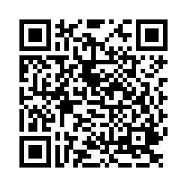
Open Forum
Questions/Comments/Discussion
Next Meeting: TBD (Jan/Feb 2025)
Please complete meeting survey:
Upcoming

Slide 20
Wrap up
THANK YOU
Next Meeting: TBD (Jan/Feb 2025)
Please complete meeting survey:

