Slide 1
EMERSE: an easy-to-use, self-service search engine and chart review tool for EHR notes
Presentation for UM Quality
October 10, 2024
Twitter/X: @projectEMERSE
Web: project-emerse.org
Email: hanauer@umich.edu
emerse-team@umich.edu
David Hanauer, MD, MS
Dept of Learning Health Sciences
University of Michigan
http://project-emerse.org/presentations.html

Slide 2
If you want to take notes or visit links
these slides can be found at:
this link will be
on most slides
http://project-emerse.org/presentations.html

Slide 3
http://project-emerse.org/presentations.html

Slide 4
2021 study out of UC Irvine: Design, Implementation, and Usability of the Electronic Medical Record Search Engine (EMERSE) Tool https://escholarship.org/uc/item/44p23878
“Users unanimously responded that they would recommend the system to others, and…for a tool they found so useful, they believed that far too few people both within and outside of their network knew about the tool’s existence.”
http://project-emerse.org/presentations.html

Slide 5
Unstructured vs Structured Data
EMERSE is for this… | …not this
Unstructured Data (free-text) | Structured Data
Mrs. Jones is a 56 year old female with a history of HTN, hypercholesterolemia, and T2DM who comes to the clinic today with a 3 day h/o dizziness and severe headache on the left side. | WBC: 5.6 Total cholesterol: 182 Weight: 67.4 AST: 30 ALT: 52
http://project-emerse.org/presentations.html

Slide 6
80% of EHR data are in unstructured free-text
structured data
unstructured data/free text
http://project-emerse.org/presentations.html

Slide 7
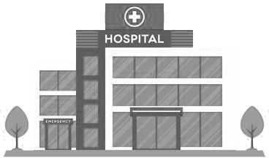
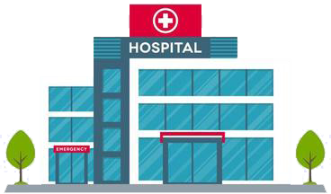
Most medical centers lack tools for free-text
http://project-emerse.org/presentations.html

Slide 8
The EMERSE solution
A system “for the people”
Users search the notes on their own
No need to wait in a queue for an analyst or a data scientist
Easy-to-use for non-technical users
Unlike with some EHRs, EMERSE can search across all notes and all patients at once
Continuous refinements for almost 19 years
http://project-emerse.org/presentations.html

Slide 9
EMERSE is a useful tool
It will be one of many you need to build/support your project
http://project-emerse.org/presentations.html

Slide 10
We think EMERSE is really good
We’re proud of what we created
We think it’s better than other software tools that cost $$$
http://project-emerse.org/presentations.html

Slide 11
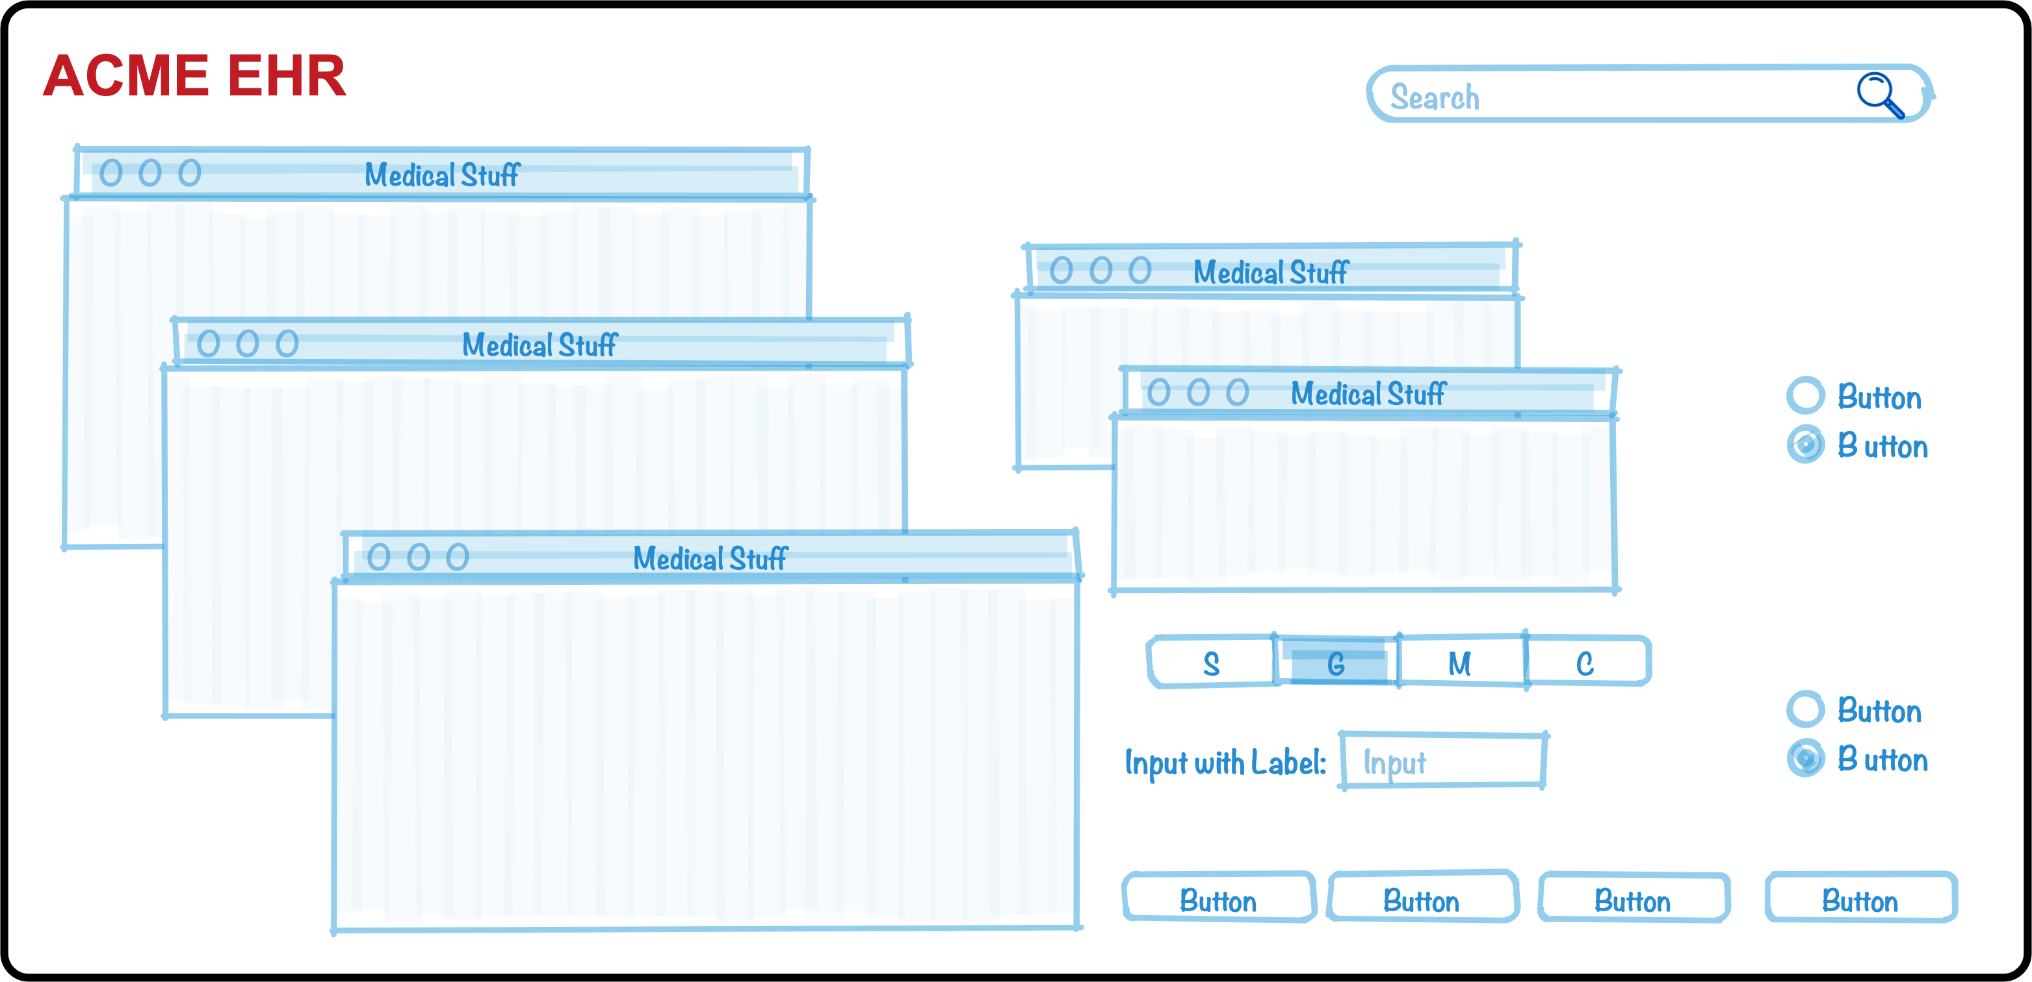
How do we know it’s better?
We’ve been laser-focused on it
EHRs have a bazillion features
The EMERSE team has invested $millions and 18 years on just this one feature (search) because it’s so important
http://project-emerse.org/presentations.html

Slide 12
How do we know it’s better?
We’ve studied it
“new users of the EMERSE system are able to complete basic but critical workflow tasks in the system with a high rate of success…are highly satisfied with the interface, and have highly positive perceptions of its expected utility in their work.”
“survey results indicate very high ratings of usability and satisfaction with the EMERSE system by new users after only one session of use.”
https://project-emerse.org/documents/reyes_masters_thesis_2021.pdf
http://project-emerse.org/presentations.html

Slide 13
How do we know it’s better?
Our users tell us
Thank you for…this important tool which is proving extremely valuable in enhancing patient safety and quality of care delivered at Michigan Medicine.
EMERSE is working out great for casefinding...have found quite a bit of cases that we would have missed otherwise. Thank you and everyone on your team!
..continued gratitude for the availability of this powerful research tool. As always, thank you for this innovation!
EMERSE is an absolute gem
@umichmedicine. The functionality is very friendly and it saved hours of time during the data collection process. Thank you to the team that created this powerful research tool!
To say “it is the most useful tool I use in my job” would be an understatement, so thank you for creating and sharing it with others!!
http://project-emerse.org/presentations.html

Slide 14
How do we know it’s better?
Top-tier medical centers trust it
Installed | Installing
U of Michigan | Weill Cornell Medical Center
Harvard U – Dana Farber Cancer Center | U of Virginia
Columbia U Cancer Center | Moffitt Cancer Center, Tampa, FL
U of North Carolina – Chapel Hill | U of California – Irvine
U of California – San Francisco | Children’s Health Orange County, Calif.
U of Kentucky
U of Cincinnati
Case Western Reserve U
U of Minnesota – Minneapolis
Utrecht University, Netherlands
U of Iowa
http://project-emerse.org/presentations.html

Slide 15
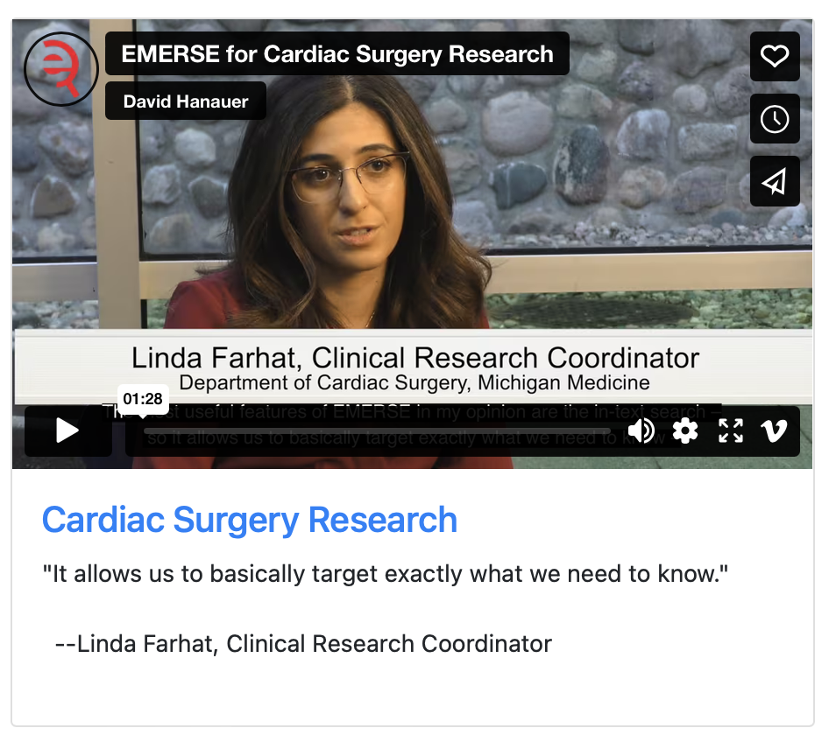
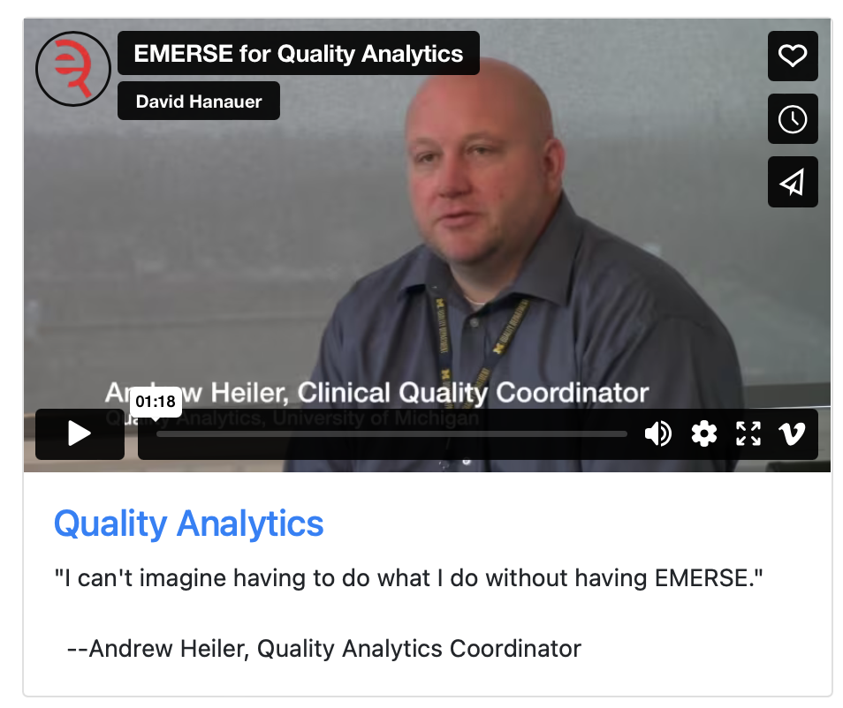
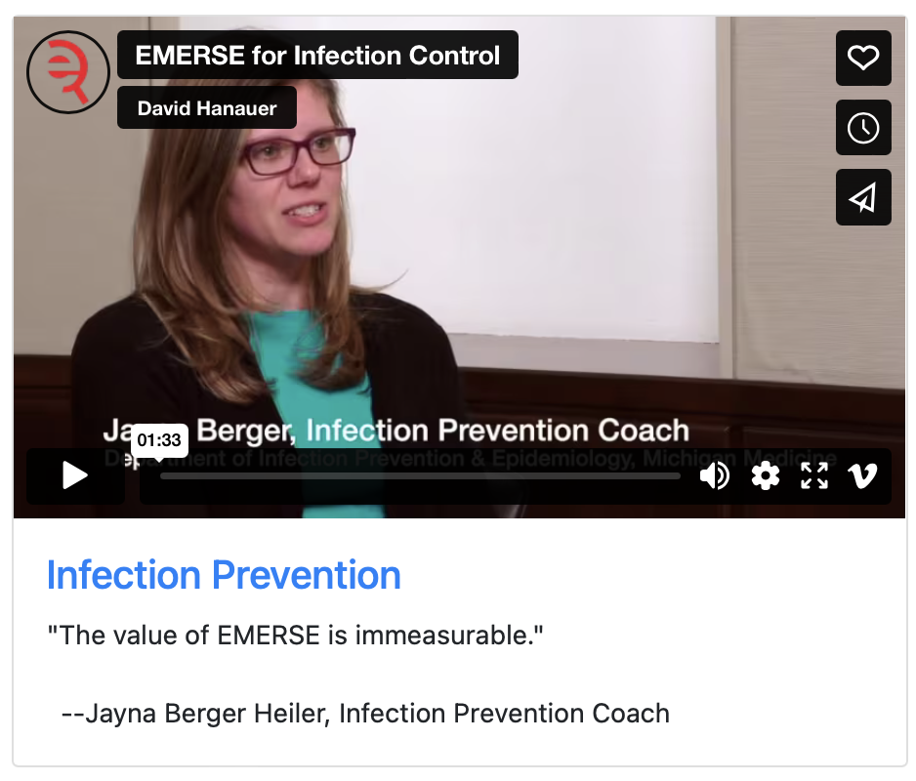
What can EMERSE do?
Lots of things!
Watch our videos: https://project-emerse.org/use_cases.html

Slide 16
Find cohorts
EMERSE allows you to find cohorts based on things mentioned in the notes
diseases
drugs
symptoms
anything*
*if it is mentioned
http://project-emerse.org/presentations.html

Slide 17
Find cohorts
It’s perfect for finding rare things…
…like rare cancers such as
cutaneous leiomyosarcoma
See this talk for more details:
https://vimeo.com/677482835
“Using EMERSE to Improve Research Involving Rare Cancers”
http://project-emerse.org/presentations.html

Slide 18
Highlight documents for chart review
Thoracocentesis confirmed the recurrence of mantle cell lymphoma. Disease restaging work-up revealed multicompartment lymphadenopathy in the neck, mediastinal, retrocrural, retroperitoneal and pelvic regions. Bone marrow was also involved. The patient was treated with a total of six cycles of rituximab, cyclophosphamide, vincristine, doxorubicin and dexamethasone (R-HyperCVAD) completed in January 2007. That treatment led to complete remission that lasted until October 2008, when the disease was found to have recurred in the left pleural space and retroperitoneum without bone marrow involvement.
https://jmedicalcasereports.biomedcentral.com/articles/10.1186/1752-1947-4-329
http://project-emerse.org/presentations.html

Slide 19
EMERSE is fast
Query to identify all patients with the following | Reporting DB time (s) | EMERSE time (s) | EMERSE advantage
cavernous hemangioma | 14,652 | 2 | 7,320x
gray platelet syndrome | 14,940 | 2 | 7,470x
inferior lingular segment of the left upper lobe | 17,784 | 9 | 1,980x
…enabling real-time querying
http://project-emerse.org/presentations.html

Slide 20
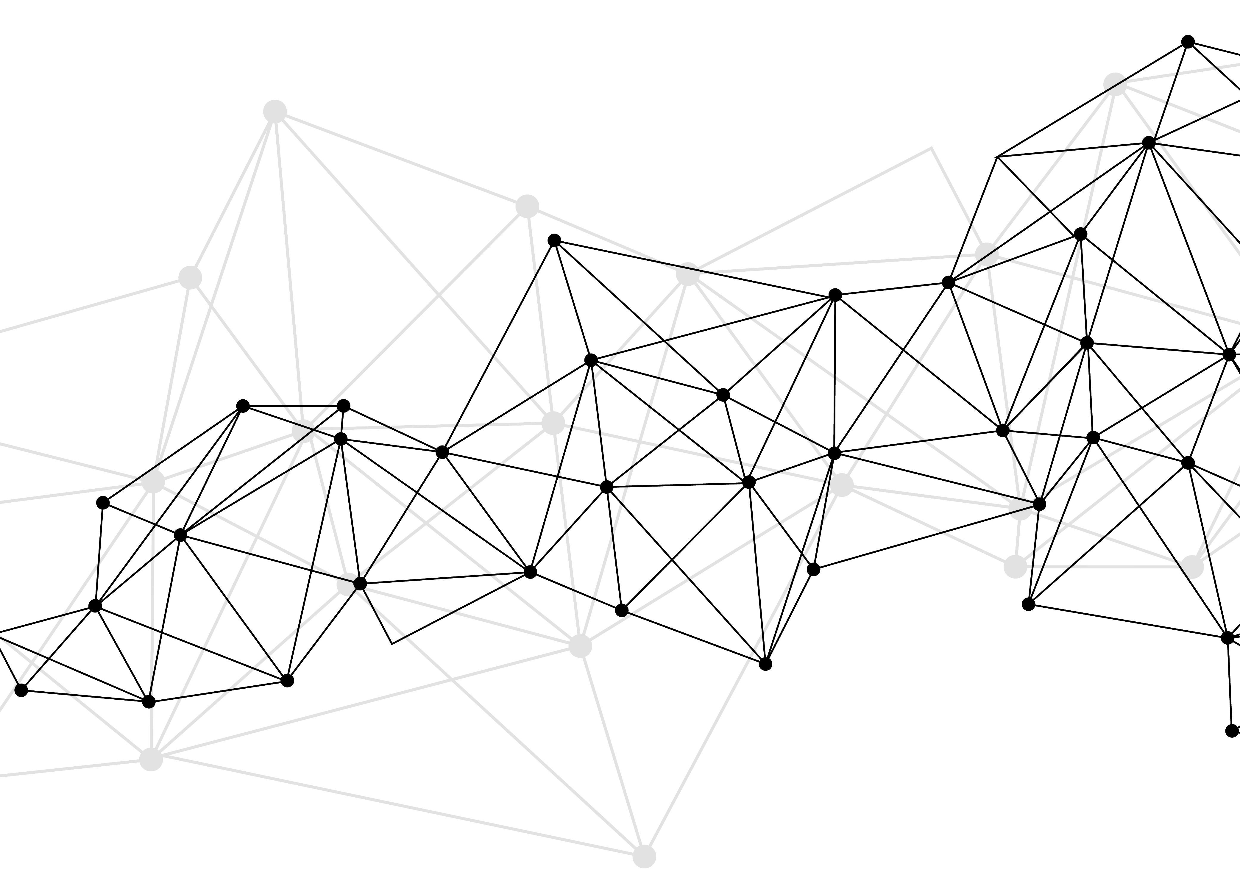
Synonyms
Used for query expansions
User-controlled
Multiple datasets can be included
EMERSE Synonyms
acronyms, abbreviations, professional/consumer terms, misspellings, trade/generic drug names, species, chemo regimens, phrase variations, malapropisms, idioms, neologisms, organizations, companies, & more
2.6 million unique entries
http://project-emerse.org/presentations.html

Slide 21
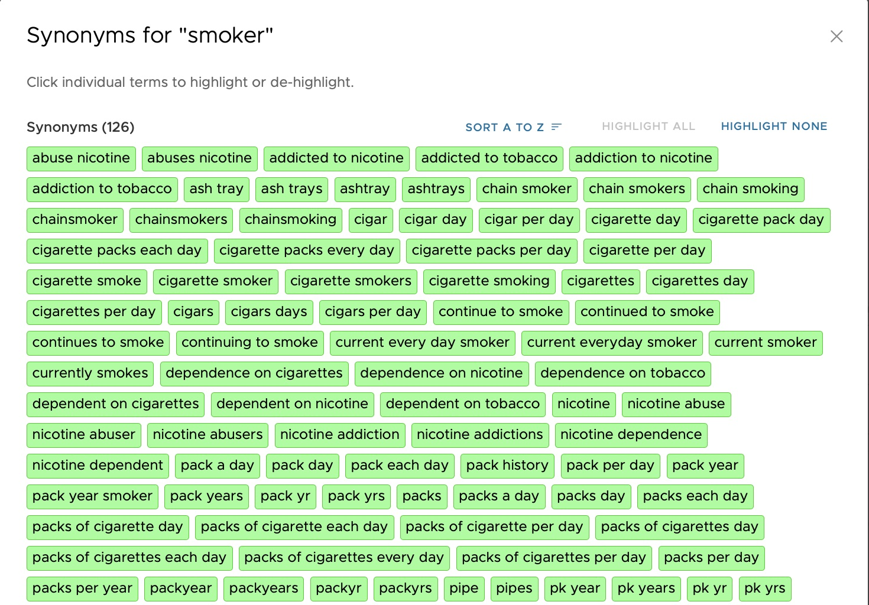

Slide 22
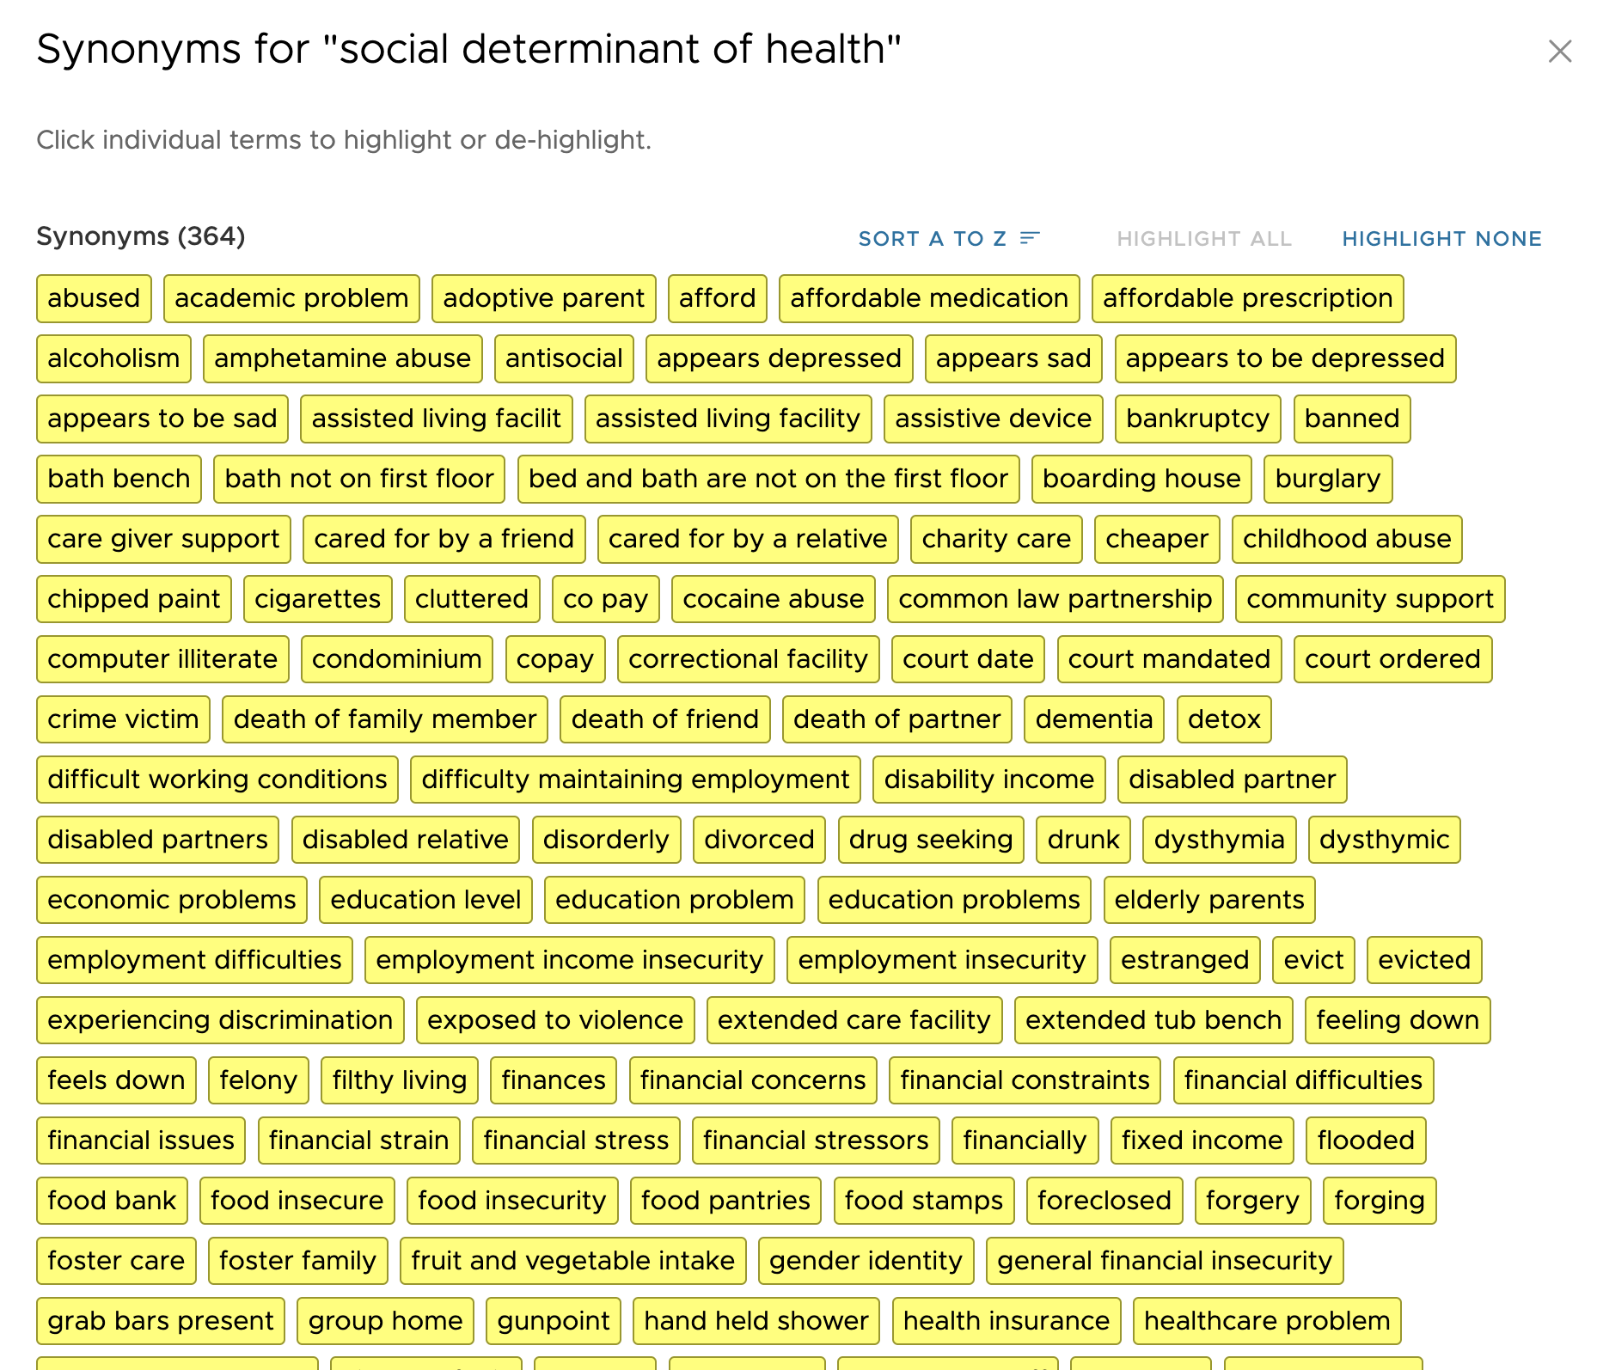
http://project-emerse.org/presentations.html

Slide 23
Application Programming Interface (API)
For technical teams
Can pull notes based
on keywords, CSNs, etc
Contact us for details
http://project-emerse.org/presentations.html

Slide 24
Future Work
Data extraction from templated notes
Integration with ChatGPT or similar tools
& more…
http://project-emerse.org/presentations.html

Slide 25
project-emerse.org
http://project-emerse.org/presentations.html

Slide 26
Interested in EMERSE?
Contact us to schedule a time with your team for:
Discussions about usage strategies
Training
Live demonstrations (abstractors, IT teams, etc)
http://project-emerse.org/presentations.html

Slide 27
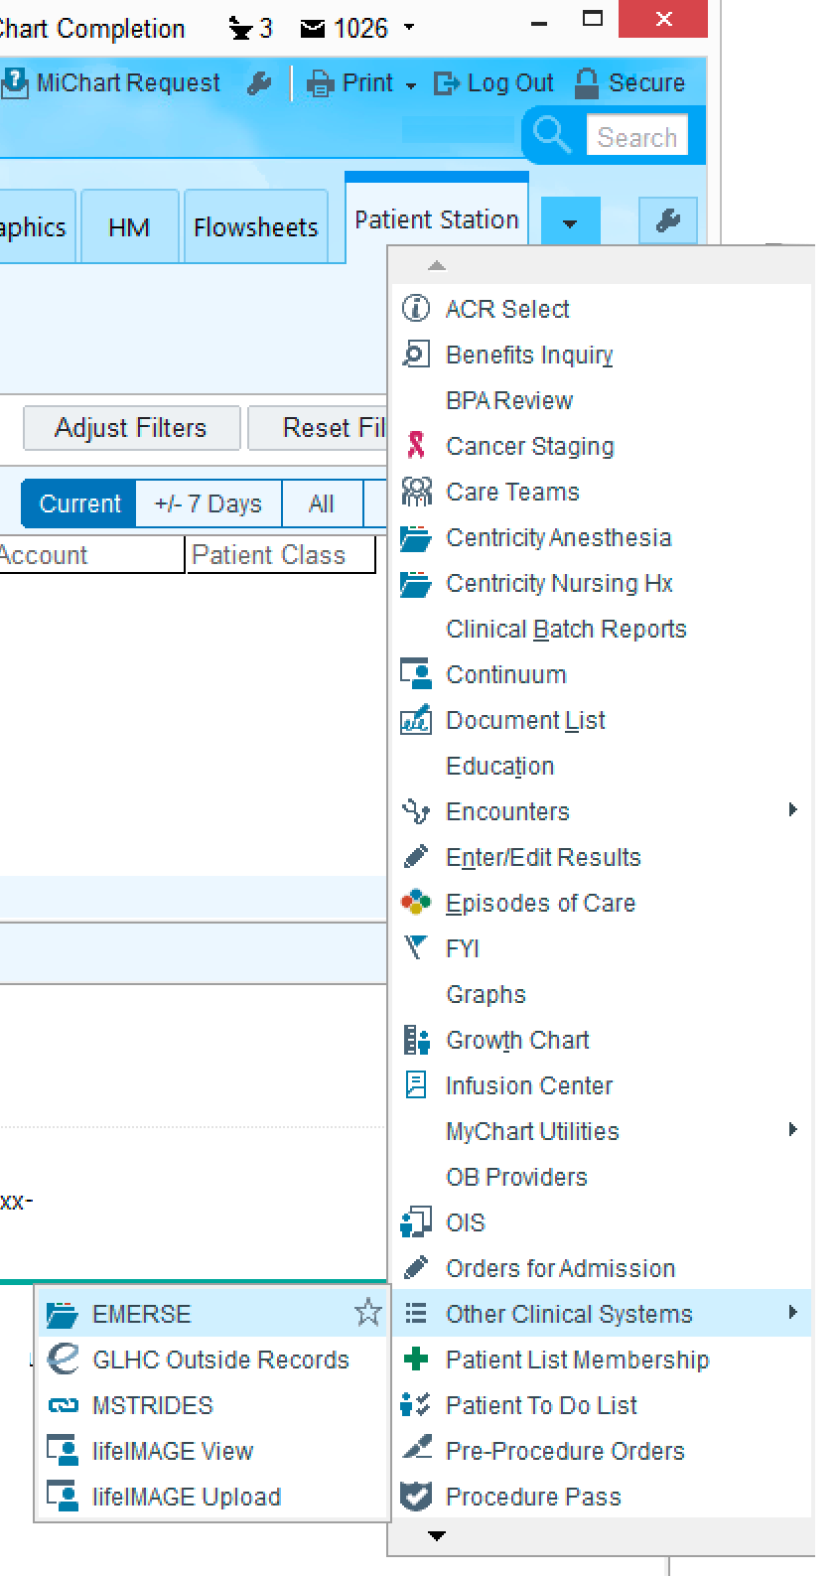
Getting an account
If you already have access to MiChart, you have access to EMERSE
Contact us if you have questions/problems
http://project-emerse.org/presentations.html

Slide 28
EMERSE-team@umich.edu
Lisa Ferguson
David Hanauer
Kellen McClain
Guan Wang
http://project-emerse.org/presentations.html

Slide 29
Live Demo (if we have time)
No real names
No PHI
Publicly available
Abstracts & case reports
http://project-emerse.org/presentations.html

