Slide 1
Data Tools for Research
Presentation for UM Psychiatry
October 22, 2024
Twitter/X: @projectEMERSE
Web: project-emerse.org
Email: hanauer@umich.edu
emerse-team@umich.edu
David Hanauer, MD, MS
Dept of Learning Health Sciences
University of Michigan
http://project-emerse.org/presentations.html

Slide 2
If you want to take notes or visit links
these slides can be found at:
this link will be
on most slides
http://project-emerse.org/presentations.html

Slide 3
http://project-emerse.org/presentations.html

Slide 4
2021 study out of UC Irvine: Design, Implementation, and Usability of the Electronic Medical Record Search Engine (EMERSE) Tool https://escholarship.org/uc/item/44p23878
“Users unanimously responded that they would recommend the system to others, and…for a tool they found so useful, they believed that far too few people both within and outside of their network knew about the tool’s existence.”
http://project-emerse.org/presentations.html

Slide 5
Unstructured vs Structured Data
EMERSE is for this… | …not this
Unstructured Data (free-text) | Structured Data
Mrs. Jones is a 56 year old female with a history of HTN, hypercholesterolemia, and T2DM who comes to the clinic today with a 3 day h/o dizziness and severe headache on the left side. | WBC: 5.6 Total cholesterol: 182 Weight: 67.4 AST: 30 ALT: 52
http://project-emerse.org/presentations.html

Slide 6
80% of EHR data are in unstructured free-text
structured data
unstructured data/free text
http://project-emerse.org/presentations.html

Slide 7
The EMERSE solution
A system “for the people”
Users search the notes on their own
No need to wait in a queue for an analyst or a data scientist
Easy-to-use for non-technical users
Unlike with some EHRs, EMERSE can search across all notes and all patients at once
Continuous refinements for almost 19 years
http://project-emerse.org/presentations.html

Slide 8
EMERSE is a useful tool
It will be one of many you need to build/support your project(s)
http://project-emerse.org/presentations.html

Slide 9
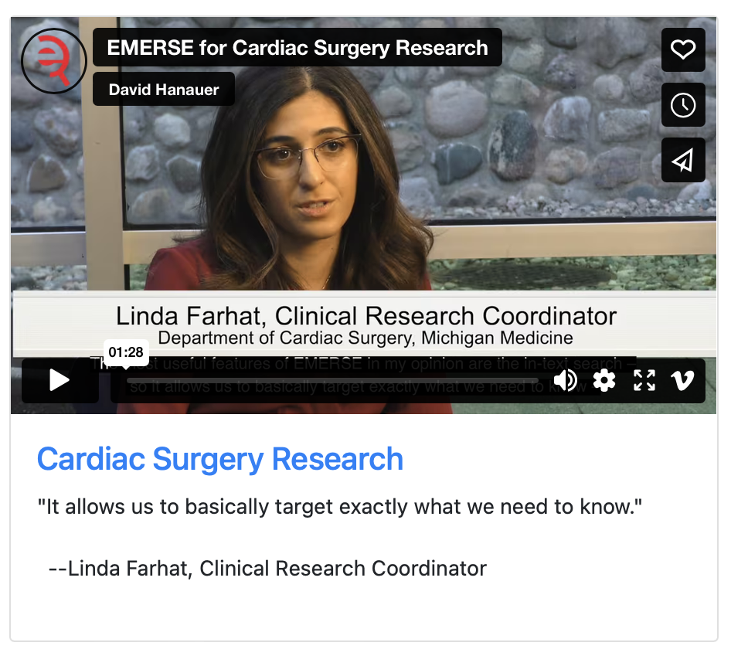
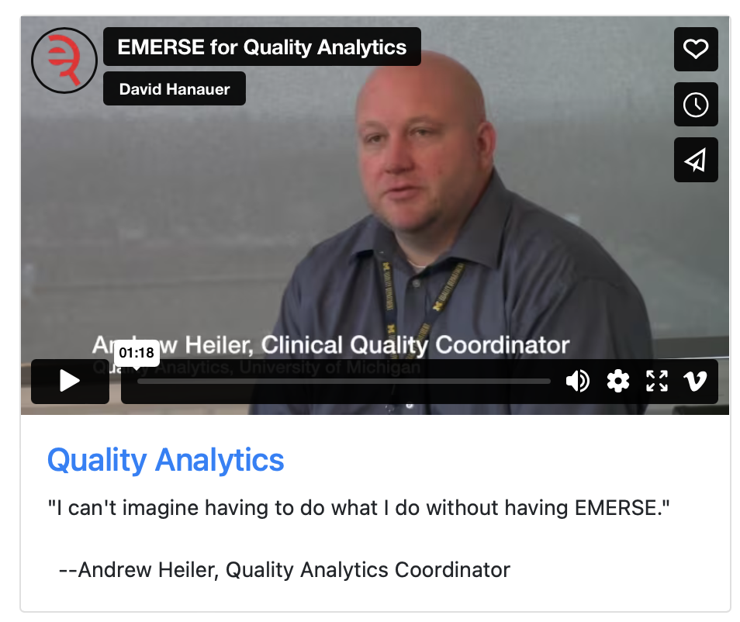
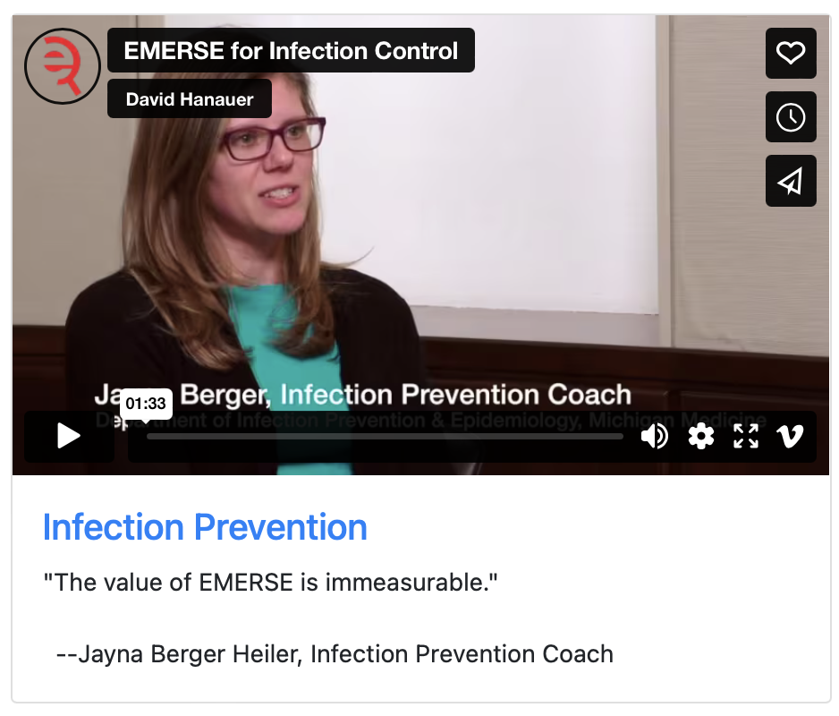
What can EMERSE do?
Lots of things!
Watch our videos: https://project-emerse.org/use_cases.html

Slide 10
Find cohorts
EMERSE allows you to find cohorts based on things mentioned in the notes
diseases
drugs
symptoms
anything*
*if it is mentioned
http://project-emerse.org/presentations.html

Slide 11
Find cohorts
It’s perfect for finding rare things…
…like rare cancers such as
cutaneous leiomyosarcoma
See this talk for more details:
https://vimeo.com/677482835
“Using EMERSE to Improve Research Involving Rare Cancers”
http://project-emerse.org/presentations.html

Slide 12
Highlight documents for chart review
Thoracocentesis confirmed the recurrence of mantle cell lymphoma. Disease restaging work-up revealed multicompartment lymphadenopathy in the neck, mediastinal, retrocrural, retroperitoneal and pelvic regions. Bone marrow was also involved. The patient was treated with a total of six cycles of rituximab, cyclophosphamide, vincristine, doxorubicin and dexamethasone (R-HyperCVAD) completed in January 2007. That treatment led to complete remission that lasted until October 2008, when the disease was found to have recurred in the left pleural space and retroperitoneum without bone marrow involvement.
https://jmedicalcasereports.biomedcentral.com/articles/10.1186/1752-1947-4-329
http://project-emerse.org/presentations.html

Slide 13
EMERSE is fast
Query to identify all patients with the following | Reporting DB time (s) | EMERSE time (s) | EMERSE advantage
cavernous hemangioma | 14,652 | 2 | 7,320x
gray platelet syndrome | 14,940 | 2 | 7,470x
inferior lingular segment of the left upper lobe | 17,784 | 9 | 1,980x
…enabling real-time querying
http://project-emerse.org/presentations.html

Slide 14
Synonyms
Used for query expansions
User-controlled
Multiple datasets can be included
EMERSE Synonyms
acronyms, abbreviations, professional/consumer terms, misspellings, trade/generic drug names, species, chemo regimens, phrase variations, malapropisms, idioms, neologisms, organizations, companies, & more
2.6 million unique entries
http://project-emerse.org/presentations.html

Slide 15
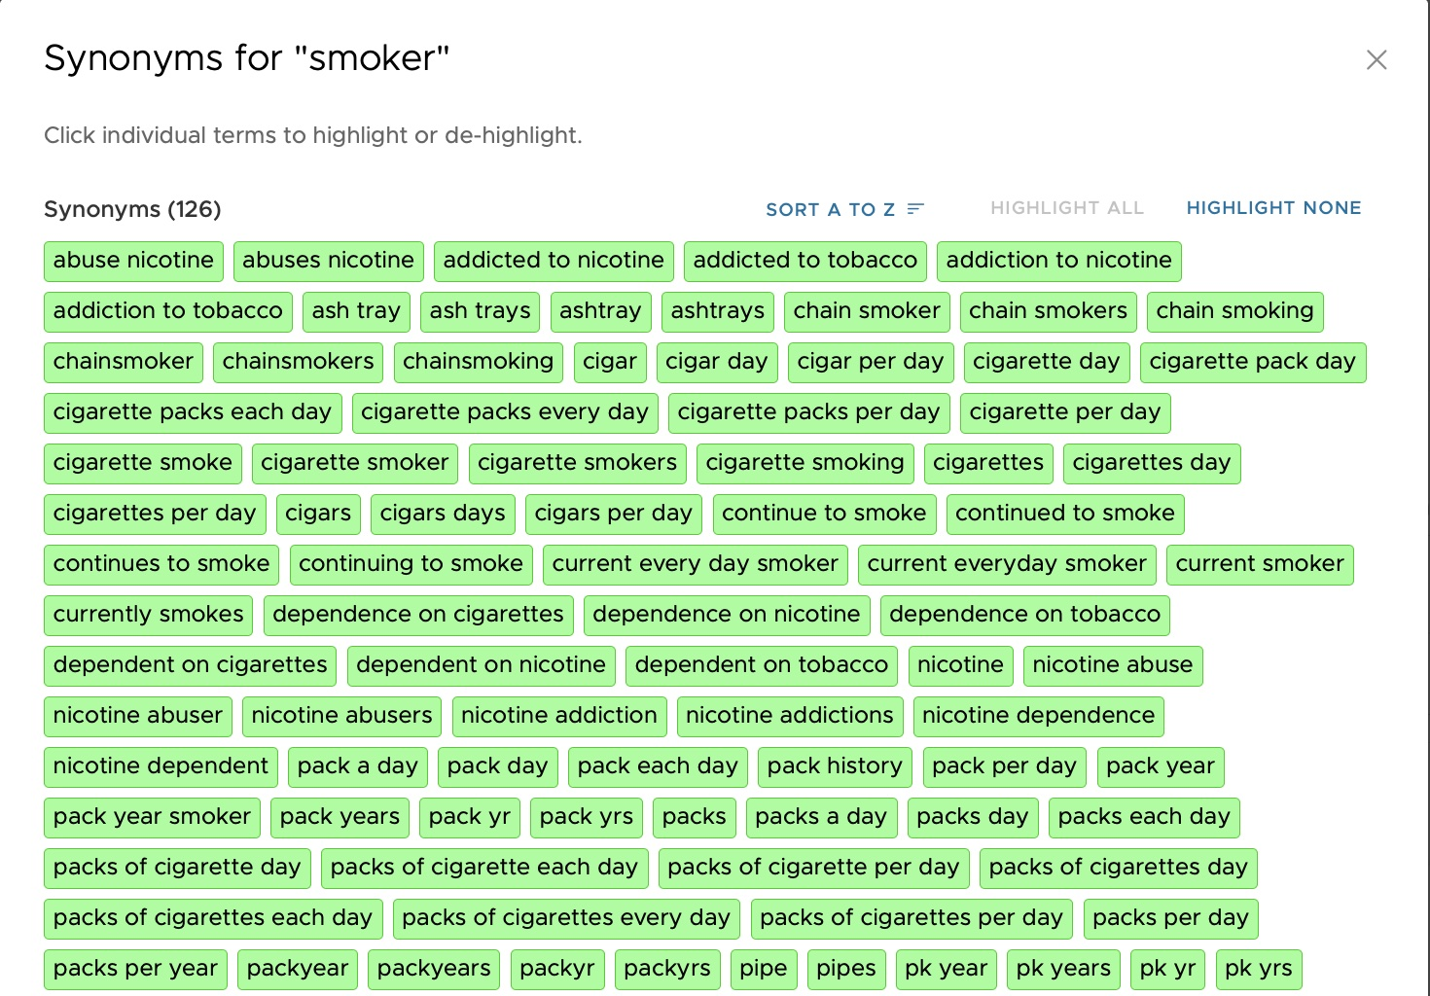

Slide 16
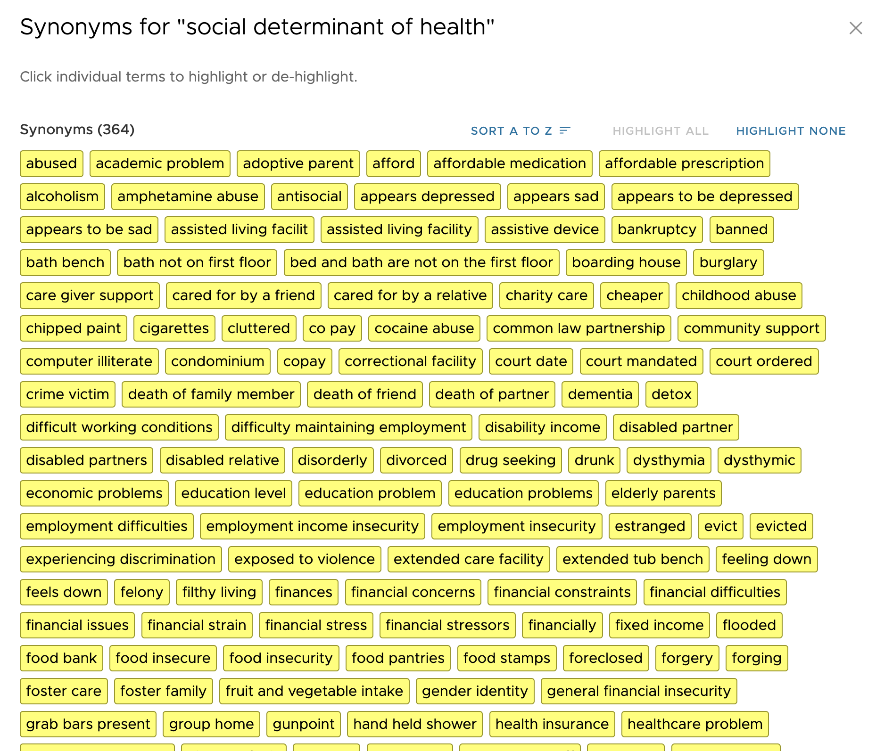
http://project-emerse.org/presentations.html

Slide 17
Typical workflow
initial cohort identified
with a cohort discovery
tool using structured data (or via EMERSE
‘Find Patients’)
Cohort discovery tools:
Data Direct, ENACT
http://project-emerse.org/presentations.html

Slide 18
Typical workflow
additional details abstracted from the free text using EMERSE
http://project-emerse.org/presentations.html

Slide 19
Typical workflow
Data recorded in an electronic data capture system (e.g., REDCap)
http://project-emerse.org/presentations.html

Slide 20
Just released…
Incorporation of NLP features
negation
uncertainty
subject (patient vs other)
named entity recognition/mapping to ontologies
http://project-emerse.org/presentations.html

Slide 21
Future Work
Data extraction from templated notes
Integration with ChatGPT or similar tools
& more…
http://project-emerse.org/presentations.html

Slide 22
project-emerse.org
http://project-emerse.org/presentations.html

Slide 23
Interested in EMERSE?
Contact us to schedule a time with your team for:
Discussions about usage strategies
Training
Live demonstrations
http://project-emerse.org/presentations.html

Slide 24
Getting access (for research)
Apply through the Data Office on the Self Service Tools Page:
https://medresearch.umich.edu/office-research/about-office-research/our-units/data-office-clinical-translational-research/self-serve-data-tools
http://project-emerse.org/presentations.html

Slide 25
EMERSE-team@umich.edu
Lisa Ferguson
David Hanauer
Kellen McClain
Guan Wang
http://project-emerse.org/presentations.html

Slide 26
Live Demo
No real names
No PHI
Publicly available
Abstracts & case reports
http://project-emerse.org/presentations.html

