Slide 1

EMERSE Community Meeting
2025-Feb-10
https://project-emerse.org
https://project-emerse.org

Slide 2
Plan for today
Welcome and Housekeeping
Announcements and Updates
Brief Demo of upcoming changes
Open Forum
Adjourn

Slide 3
Housekeeping
Zoom Meeting
  More opportunities for interaction
Please stay muted, unless you would like to ask a question or make a comment
Feel free to use the chat function to type questions or provide comments
We will answer questions throughout
We will record this meeting; it will be available where prior recordings are located:
  https://project-emerse.org/presentations.html
  https://project-emerse.org/community.html

Slide 4
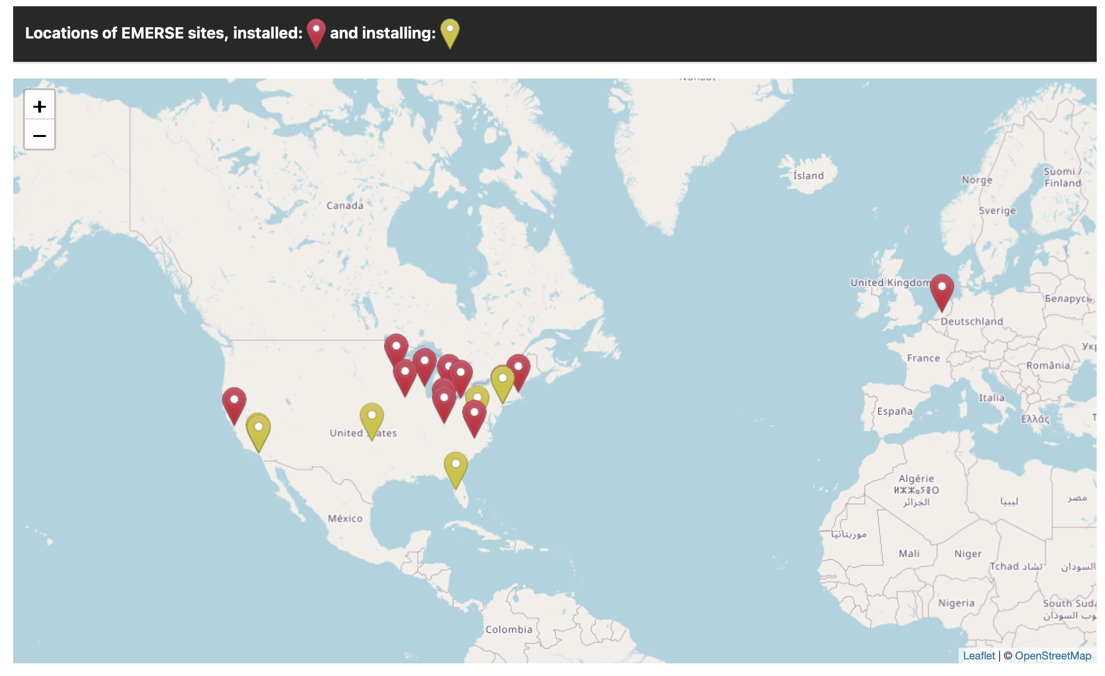
Community
https://project-emerse.org/community.html

Slide 5
Acknowledgements
EMERSE has been supported by:
  NCI ITCR program
  NCATS via MICHR CTSA
  Michigan Medicine
    Department of Learning Health Sciences
    Office of Research
    Health Information Technology & Services

Slide 6
Research Collaborative
Initial research focus: pronoun usage in the EHR over time
  Contributions from U Michigan, UCSF, U Virginia, U Cincinnati, U Iowa
  Presented at the Nov 2024 AMIA Symposium in San Francisco
Will likely move on to a new effort in the spring/summer
  Stay tuned, David or Lisa will reach out
If interested in participating, please contact EMERSE-team@umich.edu

Slide 7

Publications
https://project-emerse.org/publications.html

Slide 8
Publications (new since last meeting)
Smith JD, Darr OAF, Haring CT, Rosko AJ, Spector ME, Heft-Neal ME. Nerve dissection technique for excision of parotid tumors: Outcomes controlling for tumor size and location. Am J Otolaryngol. 2024 Dec 21;46(1):104582. doi: 10.1016/j.amjoto.2024.104582. Epub ahead of print. PMID: 39731964
Lopez-Medina AI, Campos-Staffico AM, Chahal CAA, Jacoby JP, Volkers I, Berenfeld O, Luzum JA. Polygenic risk score for drug-induced long QT syndrome: independent validation in a real-world patient cohort. Pharmacogenet Genomics. 2025 Jan 1;35(1):45-56. doi: 10.1097/FPC.0000000000000548. Epub 2024 Oct 8. PMCID: PMC11543509; PMID: 39470415
Kochhar K, Priesand S, Yosef M, Schmidt BM. Diabetic foot infection severity as a predictor of re-ulceration following partial forefoot amputation. J Foot Ankle Surg. 2024 Oct 30:S1067-2516(24)00277-1. doi: 10.1053/j.jfas.2024.10.012. Epub ahead of print. PMID: 39486786
Vielot NA, Ballard CAP, St Jean DT, Page S, Hammond K, Thompson P, Butler AM, Ranney LM. Documenting human papillomavirus vaccine refusal among adolescents in electronic health records: A mixed methods study. Vaccine. 2024 Dec 2;42(26):126467. doi: 10.1016/j.vaccine.2024.126467. Epub 2024 Oct 29. PMID: 39467411
Co A, Kazaglis C, DeCamillo D, Haymart B, Rajakumar B, Barnes GD. Prevalence of discussions around left atrial appendage occlusion as a treatment option in patients on oral anticoagulation experiencing a major bleeding event. Thromb Res. 2025 Jan;245:109239. doi: 10.1016/j.thromres.2024.109239. Epub 2024 Dec 4. PMID: 39644619
Noll A, Kawamoto KR, Dassanayake MT, Leuenberger L, Spehar SM, Wu J, Langen E, Davis MB. Breastfeeding in patients with peripartum cardiomyopathy: clinical outcomes and physician counseling. Int Breastfeed J. 2024 Oct 29;19(1):73. doi: 10.1186/s13006-024-00673-6. PMCID: PMC11523573. PMID: 39472928
Stack TJ, McCain MN, Benaim EH, Dickerson TA, Mohammad I, Senior BA, Kimple AJ, DeMason C. Beyond Tobacco: Bridging Gaps in Social History Records for Tobacco-Free Nicotine Pouch Consumers. OTO Open. 2024 Nov 12;8(4):e70034. doi: 10.1002/oto2.70034. PMCID: PMC11555441. PMID: 39534855
Mills JN, Gunchick V, Mcgue J, Qin Z, Kumar-Sinha C, Bednar F, Brown N, Shi J, Udager AM, Frankel T, Zalupski MM, Sahai V. Characterization of undifferentiated carcinomas of the pancreas with and without osteoclast-like giant cells. JNCI Cancer Spectr. 2024 Oct 3:pkae097. doi: 10.1093/jncics/pkae097. Epub ahead of print. PMID: 39363498
Lotakis DM, Rubalcava NS, Lopyan NM, Heider A, Rabah R, Elizabeth Speck K, Jarboe MD, Ehrlich PF, Ralls MW. Clinical relevance of inflammation on rectal biopsy for Hirschsprung disease: An outcomes analysis. J Pediatr Gastroenterol Nutr. 2024 Jan;78(1):36-42. doi: 10.1002/jpn3.12047. Epub 2023 Dec 11. PMID: 38291694
Koek AY, Darpel KA, Mihaylova T, Kerr WT. Myoclonus After Cardiac Arrest did not Correlate with Cortical Response on Somatosensory Evoked Potentials. J Intensive Care Med. 2024 Sep 30:8850666241287154. doi: 10.1177/08850666241287154. Epub ahead of print. PMID: 39344464

Slide 9
Publications (new since last meeting)
Barlowe TS, Saxena-Beem S, Ishizawar RC, Herfarth H, Moon AM. Multiple gastrointestinal immune related adverse events from immune checkpoint inhibitor therapy. Clin Transl Gastroenterol. 2024 Sep 12. doi: 10.14309/ctg.0000000000000768. Epub ahead of print. PMID: 39264061
Burgess HJ, Rizvydeen M, Huizenga B, Prasad M, Bahl S, Duval ER, Kim HM, Phan KL, Liberzon I, Abelson J, Klumpp H, Horwitz A, Mooney A, Raglan GB, Zalta AK. A 4-week morning light treatment reduces amygdala reactivity and clinical symptoms in adults with traumatic stress. Psychiatry Res. 2024 Sep 21;342:116209. doi: 10.1016/j.psychres.2024.116209. Epub ahead of print. PMID: 39316998

Slide 10
EMERSE version 7
Version 7
  Released Oct 2024
  Positive feedback from users so far
  NLP-enabled (negation, named entity recognition, and more)
  Unclear if any other sites have completed an upgrade
    Contact us for questions, help
    Let us know if you have installed it or are working on it
    Let us know if you have concerns about upgrading

Slide 11
Work in progress: Collapsible Nav Panel
Navigation Panel will be collapsible
  Save space on smaller screens
  Reduce distractions
  Allow for more of the screen to show the note itself

Slide 12
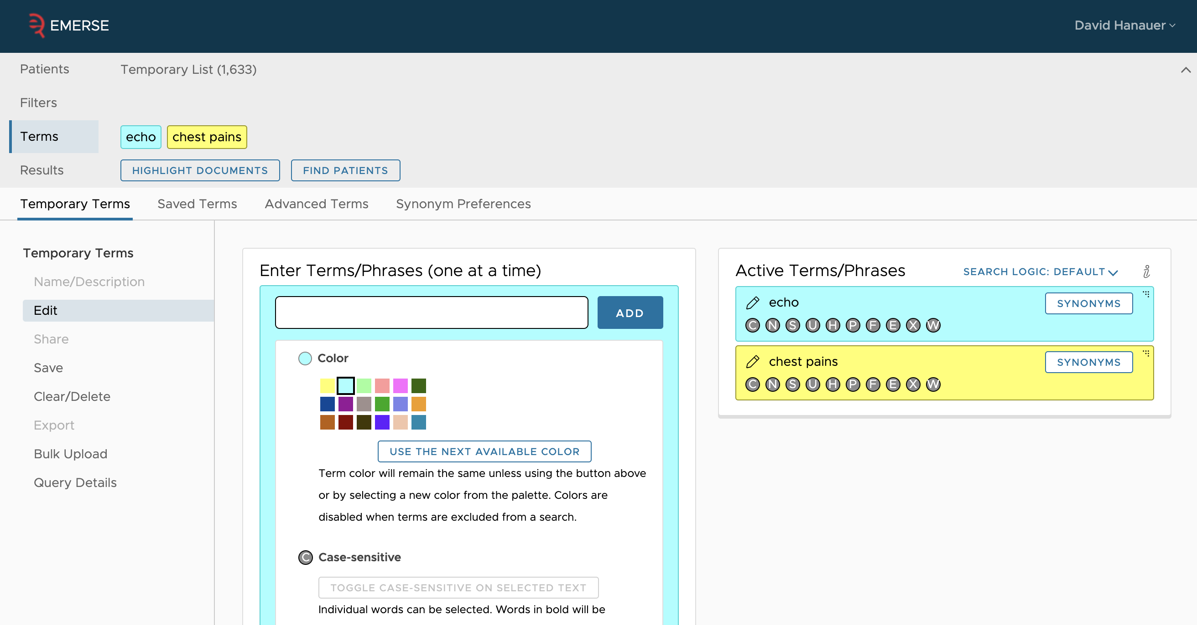
Work in progress: Collapsible Nav Panel
some useful info is shown, but not always needed
toggle is here
Current:
options
displayed
vertically
wasted spaced

Slide 13
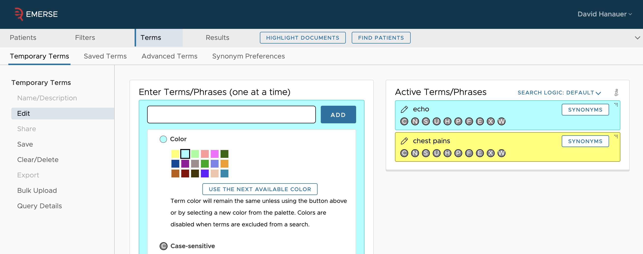
Work in progress: Collapsible Nav Panel
toggle is here
New:
options
displayed
horizontally

Slide 14
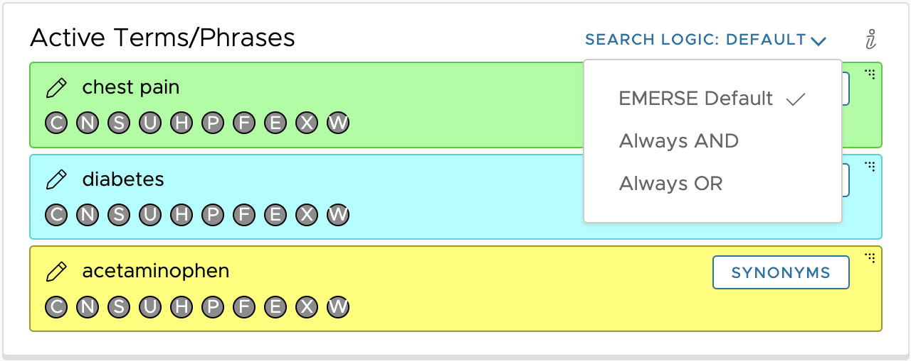
Work in progress: Boolean settings
Change to Boolean search options
Current:
  Search across all patients: same color = OR, different color = AND
  Search across patient list: all terms are OR, regardless of color
New (options)
  Default: Same as above
  Always AND
  Always OR
Saved along with terms

Slide 15
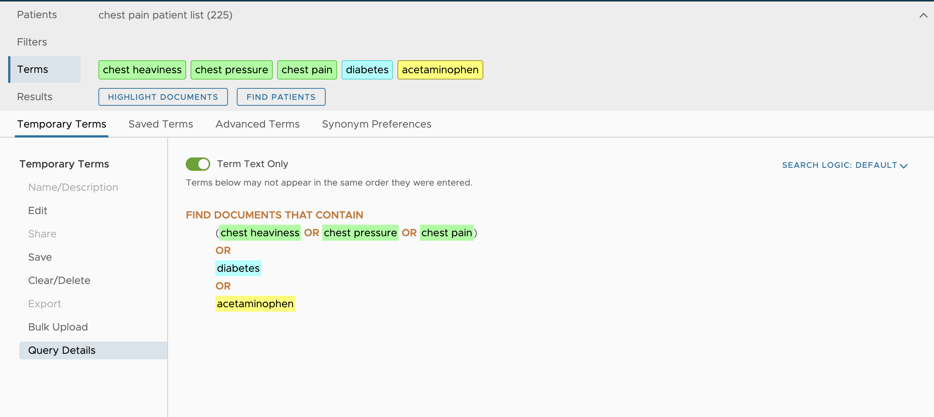
Work in progress: Boolean settings
Also available on the Query Details Page

Slide 16
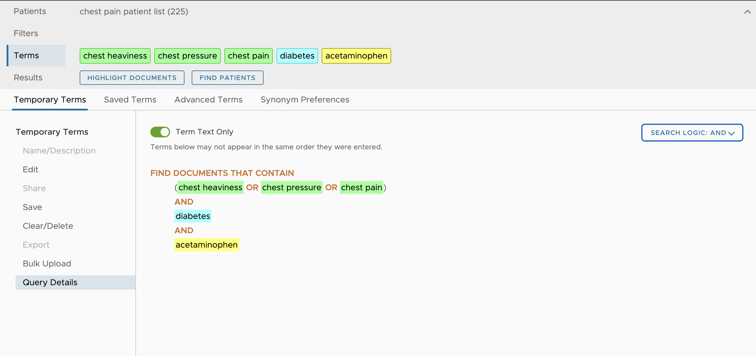
Work in progress: Boolean settings
Also available on the Query Details Page

Slide 17
Work in progress: Boolean settings
Implications of this feature
  Almost no need anymore for the Advanced Terms
  Advanced Terms cannot take advantage of the NLP components
  Main thing still possible with Advanced Terms, not possible elsewhere, is nested Booleans, for example:
  (a AND b) or (b AND (c OR d))
  Still possible to get similar behavior by running several searches in a row
  We might consider removing Advanced Terms at some point

Slide 18
Work in progress: OCR
Optical character recognition (OCR)
  Recognition of text within scanned documents
  Want it to be fully integrated into rest of system
  Should support NLP components, UI features,
  Working on things like misspellings due to misidentification of characters
  Seems to be working well so far
  Images (pages) will be stored in the document index, so the index will get much larger

Slide 19
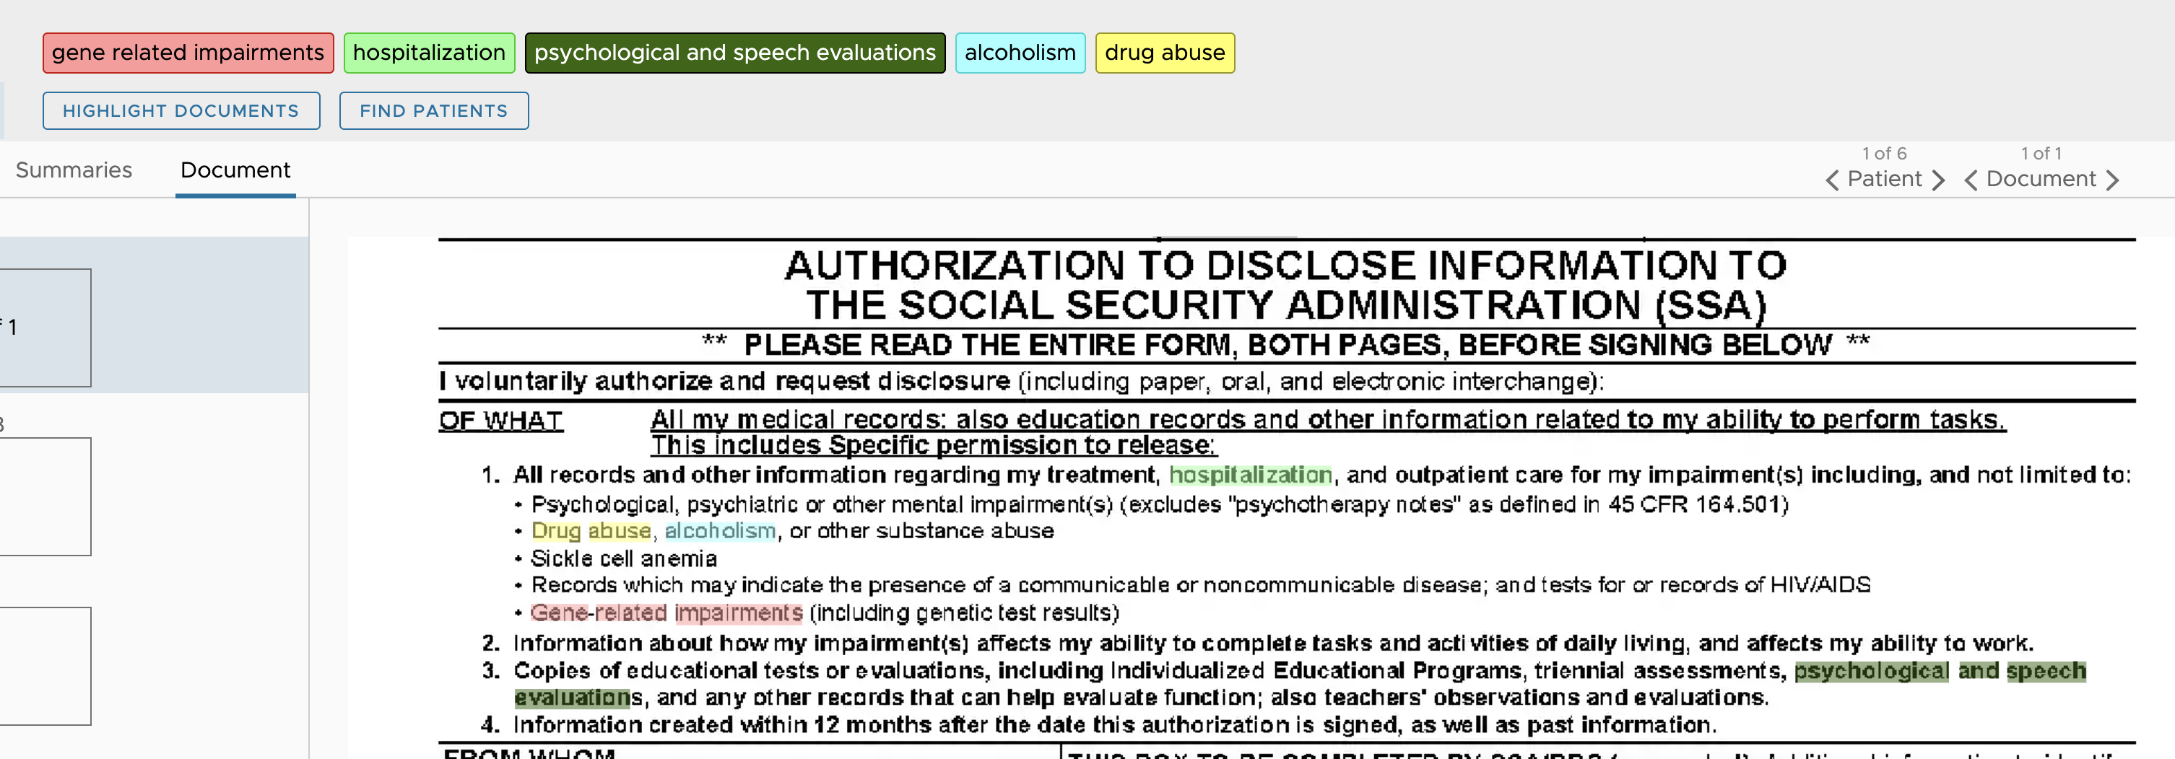
Work in progress: OCR

Slide 20
Work in progress: Query Writer
Inspired from the work done with the EMERSE Research collaborative
  Table of data, each cell in the table required manually updating the search criteria, running the search, and copying down the result
  Time intensive
Query Writer
  Simple interface to build a table of results based on overall counts
  Similar to a SQL editor
  Technical complexity: medium

Slide 21
Work in progress: Query Writer
Format example:
Location = 1,1
Text = Acetaminophen use 2014
Location = 2,1
query = acetaminophen
noteFilter = ENCOUNTER_DATE: [2014-01-01T00:00:00Z TO 2014-12-31T00:00:00Z]
patientFilter = SEX_CD: "F"
Output:
location in the output table is defined as row, column
label text can be added to a cell to make the output easier to interpret
the text query goes here
filters based on the patient go here
filters based on notes go here
Acetaminophen use 2014
4056

Slide 22
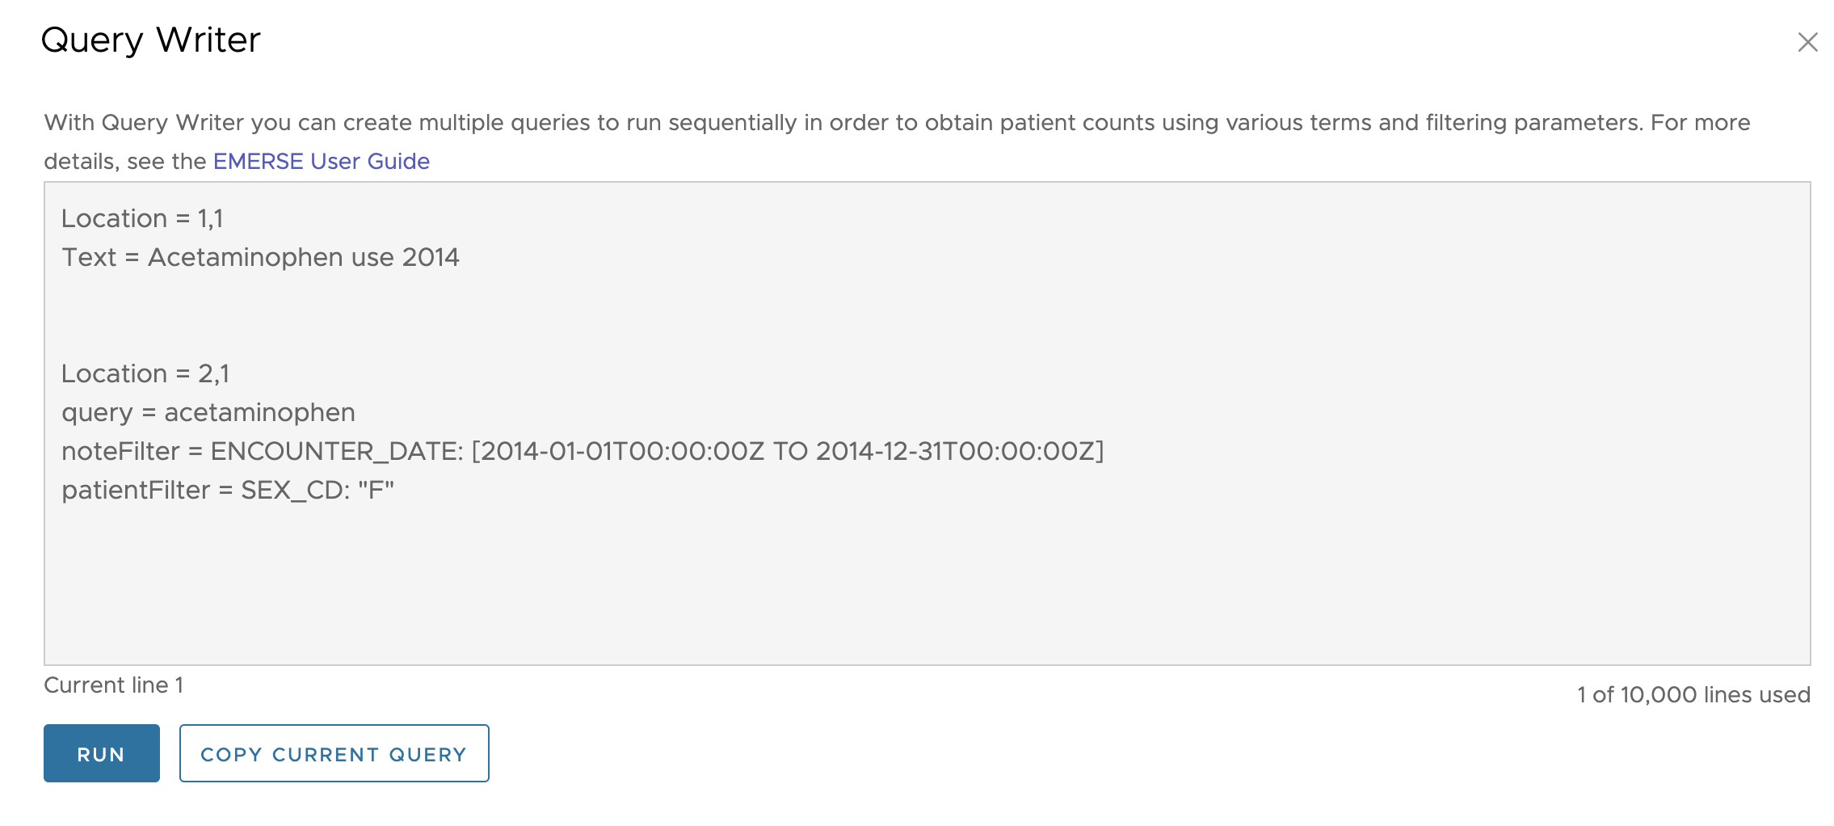
Work in progress: Query Writer

Slide 23
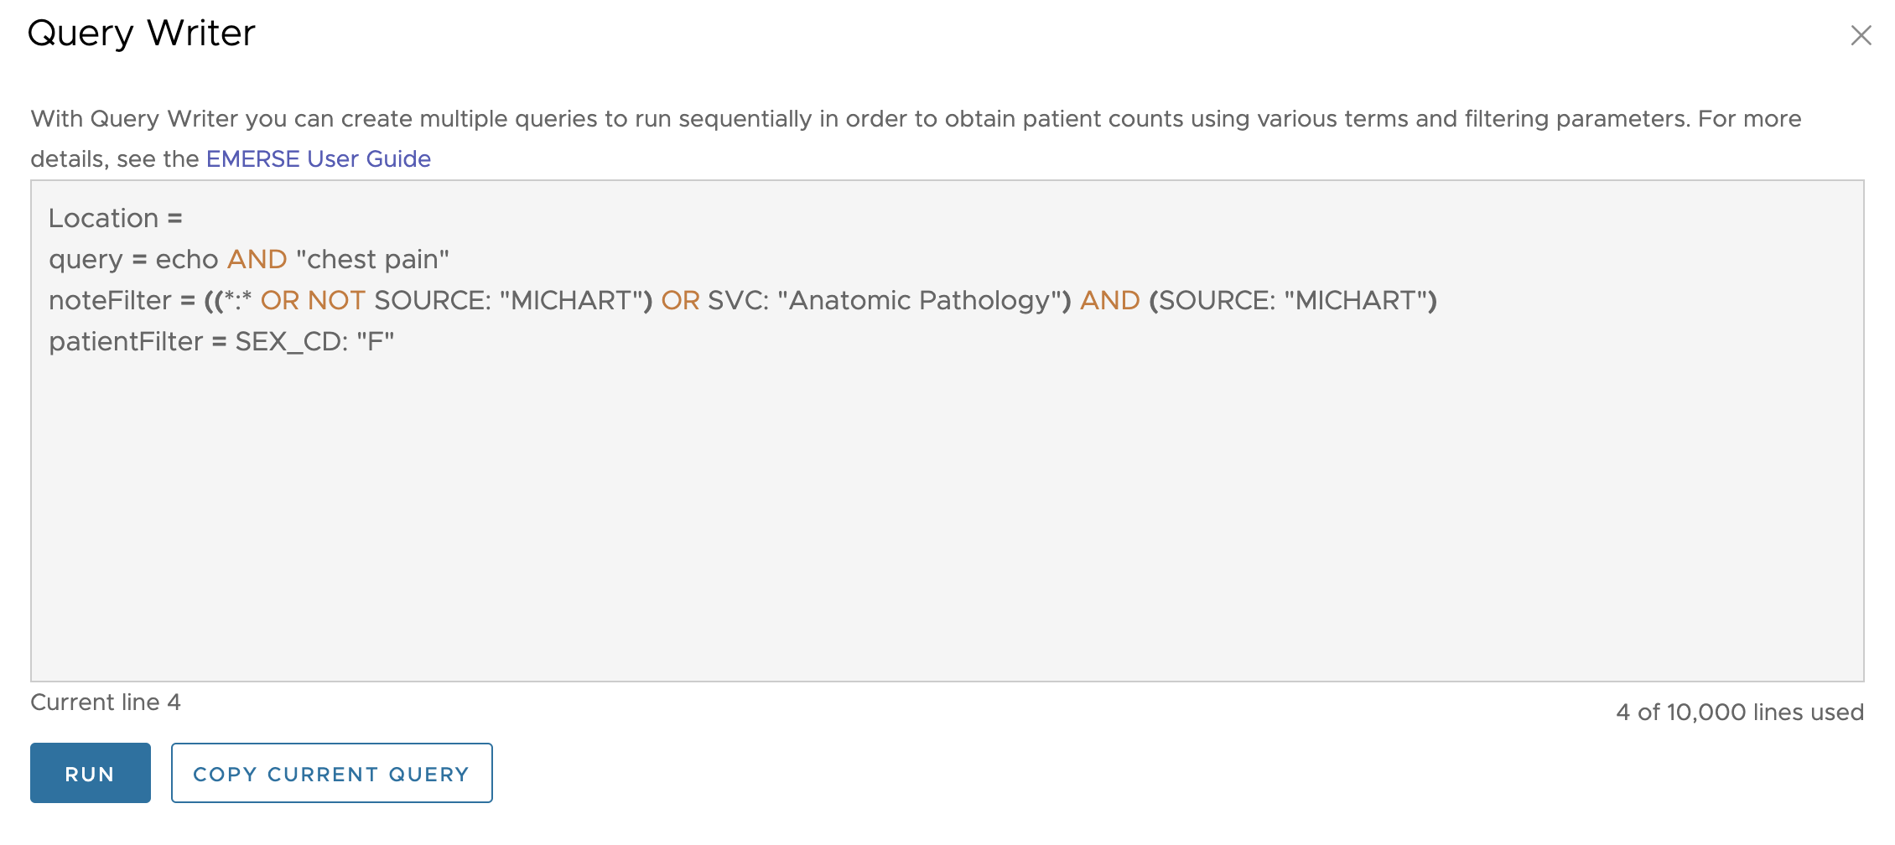
Work in progress: Query Writer
Click the ‘Copy Current Query’ button to pull in the query from the
main user interface. It can then be further edited if needed.

Slide 24
Work in progress: Query Writer
Brief Demo of Query Writer

Slide 25
Demo System
Demo system is online and available for anyone to test
Contact us for an account
These new features in progress are not yet on the demo system
Upcoming

Slide 26
Further out: LLMs
Large Language Models (LLMs) like ChatGPT
We hope to start exploring some options soon
If you are interested in providing your thoughts, or if you think you would like to help us survey the users at your site, please contact us.
Upcoming

Slide 27
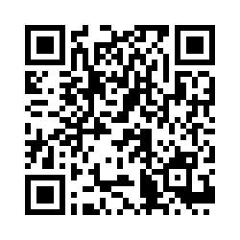
Open Forum & Wrap-up
Questions/Comments/Discussion
Thanks for attending!
Next Meeting: TBD (May/June 2025)
Please complete meeting survey:
Upcoming

