Slide 1

EMERSE Community Meeting
2025-Nov-05
https://project-emerse.org
https://project-emerse.org

Slide 2
Plan for today
Welcome and Housekeeping
Announcements and Updates
Open Forum
Adjourn

Slide 3
Housekeeping
Zoom Meeting
More opportunities for interaction
Please stay muted, unless you would like to ask a question or make a comment
Feel free to use the chat function to type questions or provide comments
We will answer questions throughout
We will record this meeting; it will be available where prior recordings are located:
https://project-emerse.org/presentations.html
https://project-emerse.org/community.html

Slide 4
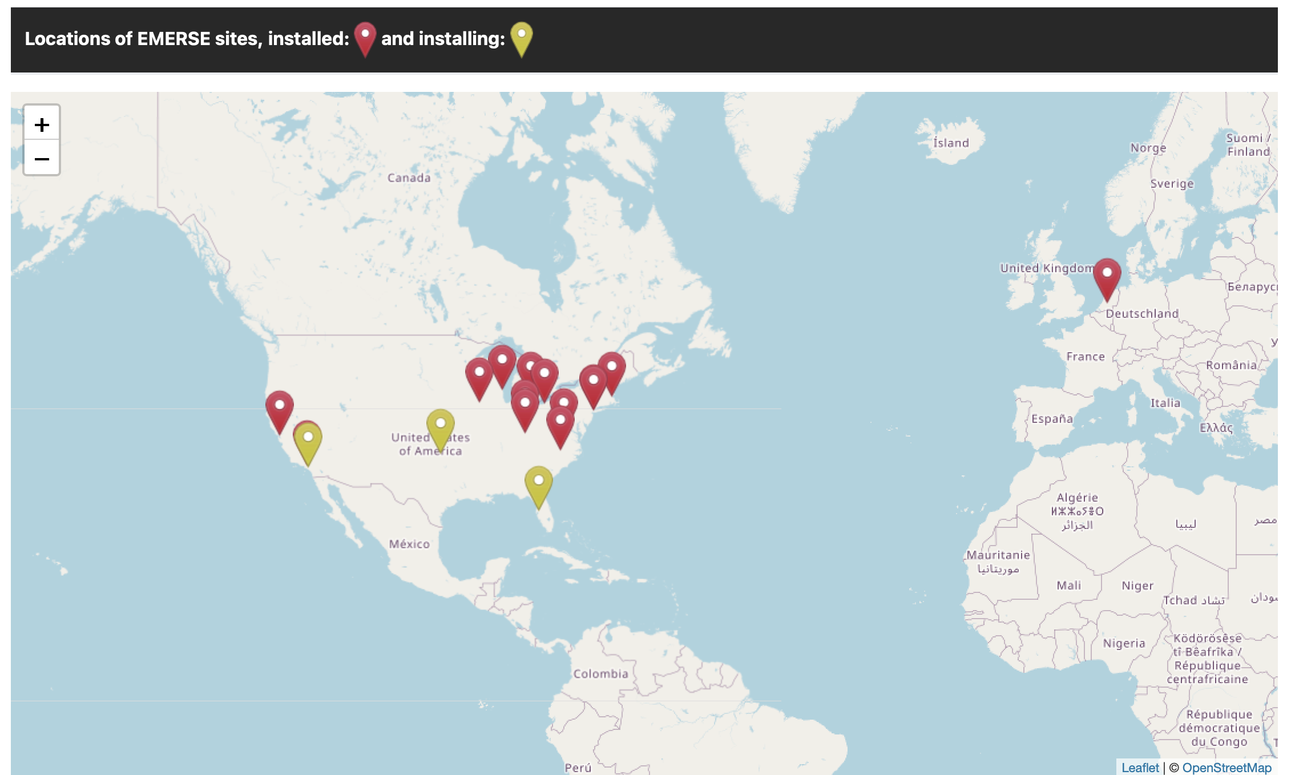
Community
https://project-emerse.org/community.html

Slide 5
Acknowledgements
EMERSE has been supported by:
NCI ITCR program
NCATS via MICHR CTSA
Michigan Medicine
Department of Learning Health Sciences
Office of Research
Health Information Technology & Services
Rogel Cancer Center

Slide 6

Publications using EMERSE
Mattingly AS, et al. Hypocalcemia After Cervical Procedures in Patients with a History of Nonbariatric Gastrojejunostomy. Ann Surg Oncol. 2025 Sep 5. doi: 10.1245/s10434-025-18197-6. PMID: 40911241
Brdar NM, et al. Clinical and demographic characteristics of adolescents, emerging adults, and young adults presenting to an emergency department following a suicide attempt. JCPP Advances, August 2025.
Tabarani E, et al. Enhancing Accurate Delirium Detection in Older Patients With Heart Failure: Integrating Education and an Electronic Health Record Tool for Nurses. J Dr Nurs Pract. 2025 Feb 18:JDNP-2024-0020.R1. doi: 10.1891/JDNP-2024-0020. Epub ahead of print. PMID: 39965801
Jha SA, et al. Fracture Characteristics Among Adults With Intellectual Disabilities and Autism Spectrum Disorders to Inform Fracture Prevention Strategies: A Descriptive Study. J Intellect Disabil Res. 2025 May 21. doi: 10.1111/jir.13255. Epub ahead of print. PMID: 40399135
Durgin JS, et al. Role of single-nucleotide polymorphism microarray in the classification of BAP1-inactivated melanocytic tumours. Histopathology. 2025 Jul;87(1):110-129. doi: 10.1111/his.15434. Epub 2025 Feb 20. PMCID: PMC12129603. PMID: 39976080

Slide 7


Publications using EMERSE
Whitney DG. Prognostic comparison between GMFCS and WCI for 5-year risks of 22 relevant health outcomes for adults with cerebral palsy: Expanding the methodological menu for prognostic model research. Disabil Health J. 2025 Jul;18(3):101783. doi: 10.1016/j.dhjo.2025.101783. Epub 2025 Feb 11. PMID: 39955248
Nugent KI, et al. Pharmacogenetic associations of GATA4 and KCNQ1 with ibrutinib cardiovascular toxicity. Pharmacogenet Genomics. 2025 Apr 1;35(3):101-109. doi: 10.1097/FPC.0000000000000558. Epub 2025 Jan 21. PMID: 39832190
Shaikh H, et al. Outcomes and Prognostic Assessment of Post-Transplant Lymphoproliferative Disorder: 20-Year Experience. Lymphatics 2025, 3, 5. https://doi.org/10.3390/lymphatics3010005. PMID: Pending
Carlozzi NE, et al. Improving Outcomes for Care Partners of Individuals With Traumatic Brain Injury: Results for a mHealth Randomized Control Trial of the CareQOL App. Arch Phys Med Rehabil. 2025 Apr;106(4):548-561. doi: 10.1016/j.apmr.2024.12.022. Epub 2025 Jan 9. PMCID: PMC11968231. PMID: 39798892
Diehl JN, et al. Serious mental illness prolongs hospital admission following lung cancer resection. J Thorac Dis. 2024 Dec 31;16(12):8450-8460. doi: 10.21037/jtd-24-762. Epub 2024 Dec 28. PMCID: PMC11740033. PMID: 39831237

Slide 8

Publications using EMERSE
Gupta S, et al. Simulation-Based Training Improves Developmental Hip Dysplasia Examination and Diagnosis Skills on Newborns. Acad Pediatr. 2025 May-Jun;25(4):102782. doi: 10.1016/j.acap.2025.102782. Epub 2025 Jan 23. PMID: 39855392
Hazle MS, et al. Documenting Pediatric Delirium During Transitions of Care: A Single Site Observational Study. J Intensive Care Med. 2025 May 13:8850666251339457. doi: 10.1177/08850666251339457. Epub ahead of print. PMID: 40356555
Kukora SK, et al. Development and acceptability testing of a tracheostomy decision support video for parents. PEC Innovation, Volume 7, 2025, 100412, ISSN 2772-6282, https://doi.org/10.1016/j.pecinn.2025.100412. PMID: Pending.
Lu R, et al. Clinical Delivery of Whole Systems Traditional Chinese Medicine and Impacts Upon Patient Reported Outcomes During IVF. Glob Adv Integr Med Health. 2025 Jun 4;14:27536130251349116. doi: 10.1177/27536130251349116. PMCID: PMC12138210. PMID: 40475372
Shapiro JN, et al. Brain MRI Lesions in Alexia Without Agraphia: A Case-Control Study. J Neuroophthalmol. 2024 Nov 25. doi: 10.1097/WNO.0000000000002263. Epub ahead of print. PMID: 39582117

Slide 9
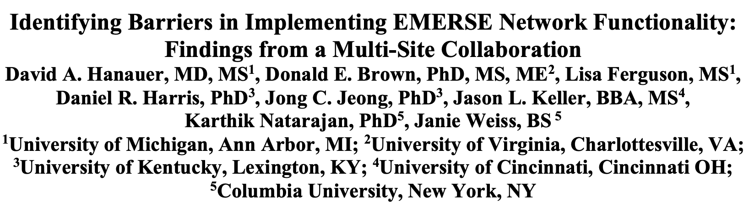
AMIA Meeting November 2025

Slide 10
EMERSE version 7.1
Current version
New features in 7.1:
A few bug fixes
Synonyms counting in background
Collapsible navigation panel
Query Writer
Control over Boolean (AND/OR) options
Searches without terms

Slide 11
Work in progress: UI Framework
Updating backend UI framework
Removing Clarity UI (not Epic Clarity)
Will allow us to update Angular, reduce potential security issues
May speed up the interface
Lots of work, but will be mostly invisible to the users

Slide 12
Work in progress: Solr Cloud
Exploring this as a way to scale up resources for improved performance

Slide 13
Work in progress: OCR
Optical character recognition (OCR)
We are building in general capabilities, but local implementations may vary
At Michigan we are settling for now on Apple Vision
Cost of hardware, no per page costs
Other cloud options exist (AWS, Google), but pay per page
Converting scanned documents, including PDFs into images, which will be stored in the index
At a minimum, a site would need the extract text and the X,Y coordinate of the text on the image
Will support highlighting terms within documents
Pros/cons of spelling correction is still unclear

Slide 14
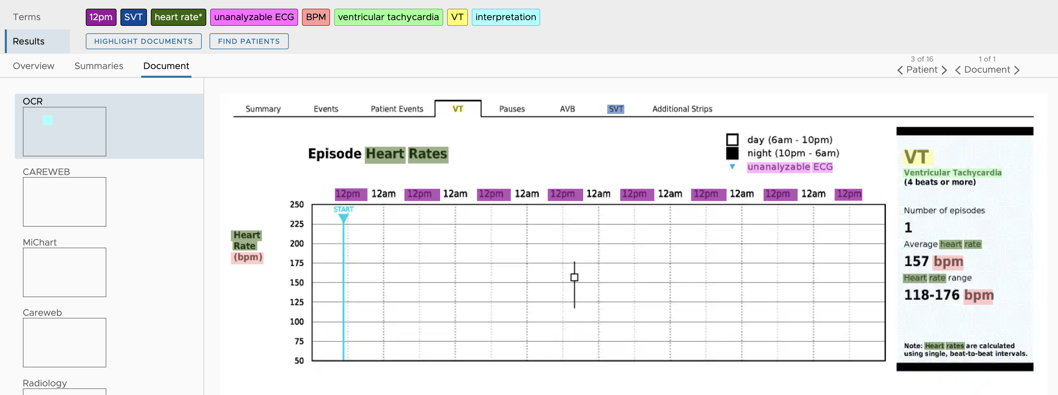
Work in progress: OCR

Slide 15
Work in progress: Download Data
Request from UCSF
Offers authorized users ability to download large dataset of notes for use in downstream applications
Would be off by default, controlled through privileges

Slide 16
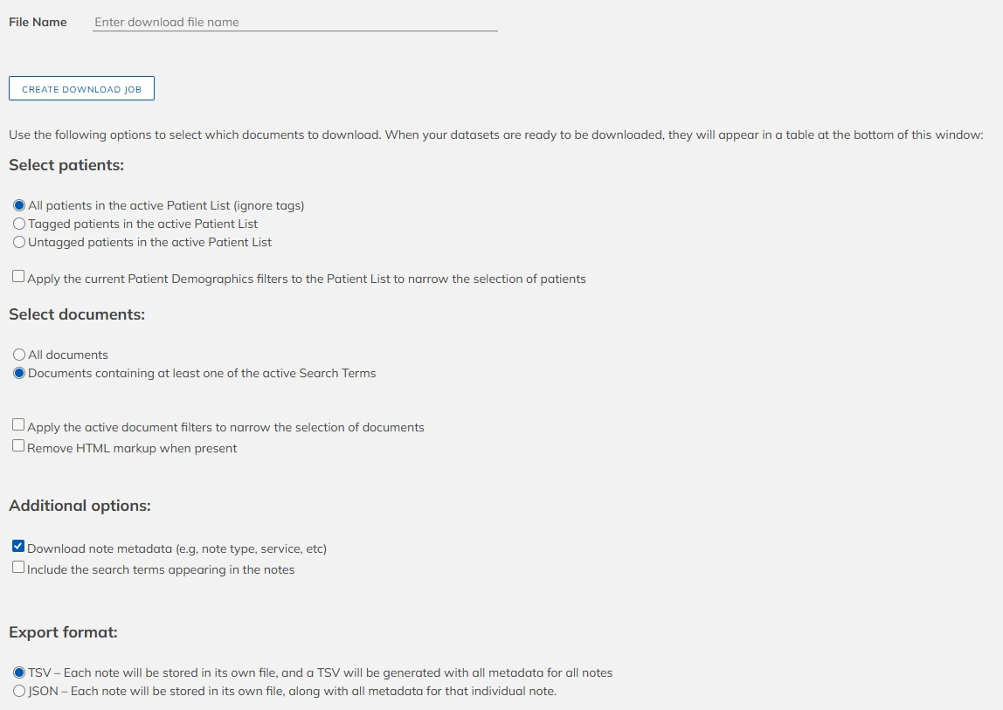
Work in progress: Download Data

Slide 17
Work in progress: Flowsheets
Enabled by an updated indexing pipeline that allows for both standard and custom annotations/NLP indexing simultaneously
This would have to be customized by each site as part of data loading pipeline
Take structured flowsheet data and create a table
Label certain components using custom NLP pipeline
Would allow user to search only within a flowsheet, or certain parts of a flowsheet

Slide 18
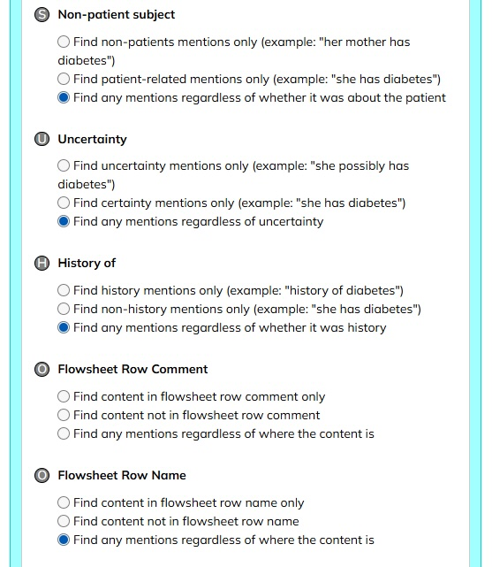
Work in progress: Flowsheets

Slide 19
Work in progress: Flowsheets
This capability raises new possibilities
If a site can label document sections (history, exam, assessment, plan, etc) those can become elements to limit searches to those specific sections

Slide 20
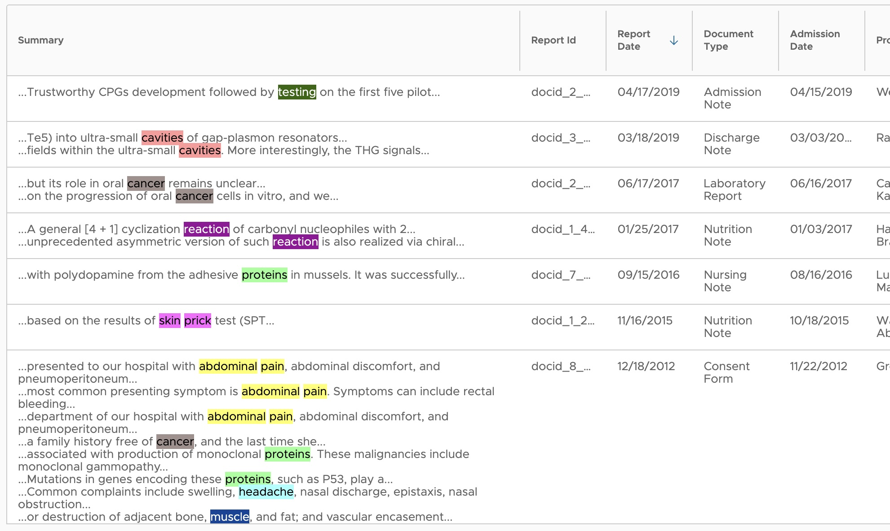
Work in progress: Timelines

Slide 21
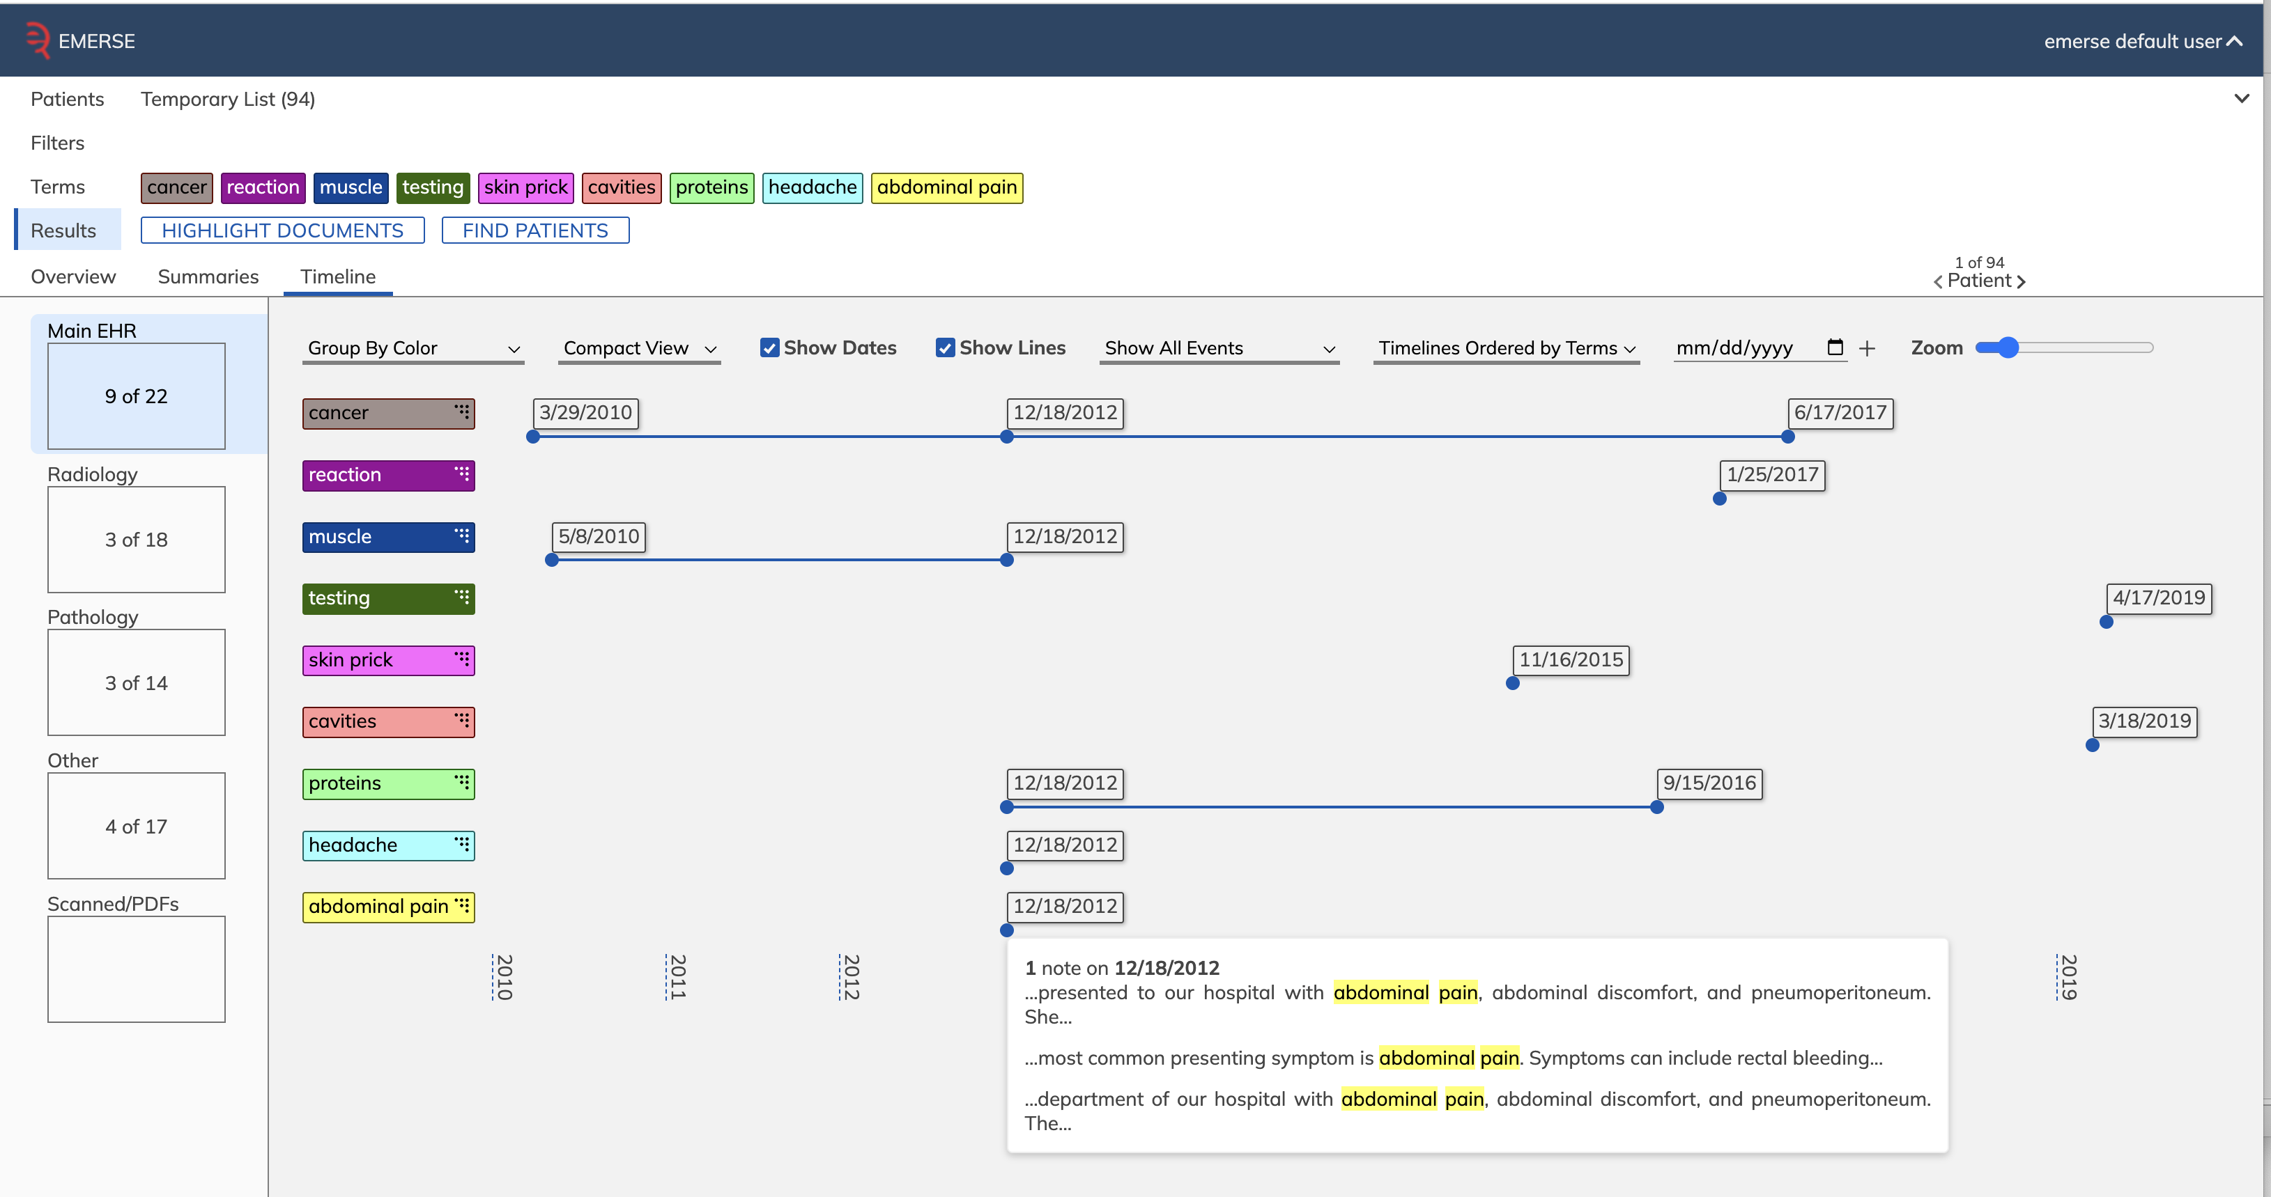
Work in progress: Timelines

Slide 22
Work in progress: AI Integration
Integrating ChatGPT or similar tools
Much work to be done
Will reach out to site leads soon
Will try to survey users at sites
If you have ideas on use cases, or specific functions in EMERSE, let us know

Slide 23
Questions/Comments
Any thoughts about work in progress?

Slide 24
Discussion topics
Any sites using EMERSE for non-research work (e.g., quality?)
Large language model integration

Slide 25

Wrap-up
Thanks for attending!
Next Meeting: TBD (Spring 2026)
Please complete meeting survey:
https://bit.ly/emerse-nov-2025
Upcoming

