Slide 1
EMERSE Community Meeting
2025-May-14
https://project-emerse.org
https://project-emerse.org

Slide 2
Plan for today
Welcome and Housekeeping
Guest Speaker
Announcements and Updates
Brief Demo of upcoming changes
Open Forum
Adjourn

Slide 3
Housekeeping
Zoom Meeting
More opportunities for interaction
Please stay muted, unless you would like to ask a question or make a comment
Feel free to use the chat function to type questions or provide comments
We will answer questions throughout
We will record this meeting; it will be available where prior recordings are located:
https://project-emerse.org/presentations.html
https://project-emerse.org/community.html

Slide 4
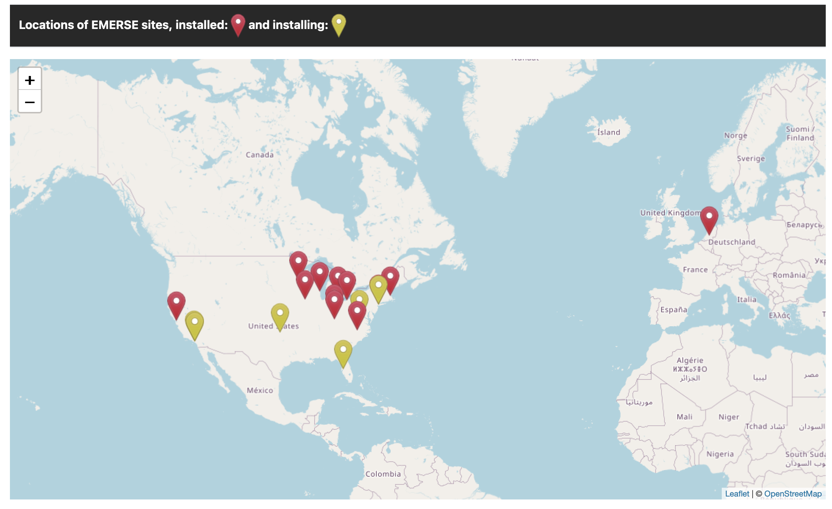
Community
https://project-emerse.org/community.html

Slide 5
Acknowledgements
EMERSE has been supported by:
NCI ITCR program
NCATS via MICHR CTSA
Michigan Medicine
Department of Learning Health Sciences
Office of Research
Health Information Technology & Services
Rogel Cancer Center

Slide 6
Guest Speaker
Erik Harden, BA, MA
DrPH candidate, GWU Milken Institute School of Public Health
Administrator and Senior Clinical Research Manager, Columbia University Irving Medical Center

Slide 7
Using EMERSE to Find patients for a Colorectal Cancer prevention study
Erik Harden, MA, DrPH Student

Slide 8
FORTE: Five- or Ten-Year Colonoscopy for 1-2 Non-Advanced Adenomatous Polyps
About FORTE
A national colorectal cancer prevention study sponsored by the National Cancer Institute (NCI)
Focuses on patients with 1-2 small, non-advanced adenomas (polyps) found during colonoscopy
Study hopes to answer if people who had one 1 or 2 polyps removed during colonoscopy, should repeat colonoscopy exam at 10 years or should they have their repeat exams at both 5 years and at 10 years?
Who qualifies for FORTE
Adults 45-70
Had a screening colonoscopy in the last 4 years.
Found to have 1 or 2 small, non-advanced polyps

Slide 9
FORTE at Columbia University Medical Center (CUMC)
In 2021 CUMC chose to open the FORTE trial – currently there are 500 other hospitals participating in FORTE
FORTE is classified as a cancer control trial (a clinical trial focused on improving cancer prevention, early detection, and management, with a particular emphasis on reaching underserved populations)
CUMC has a strong history of successful enrollment for cancer controls studies
CUMC enrollments to NCI Cancer Control vs NCI Treatment trials

Slide 10
Pre-EMERSE Workflow
FORTE-Columbia team initially wanted to query their electronic medical record (EMR) around FORTE eligibility to produce a patient report, however the Principal investigator wanted to pull colonoscopy reports from Tableau that were used by CUMC gastroenterologist to house colonoscopy data
Tableau is a visualization platform that helps users connect to, analyze, and visualize data from various sources.
Based on our previous history of enrolling well to NCI Cancer Control studies + Tableau, we were confident and ready to enroll to FORTE …

Slide 11
But then…

Slide 12
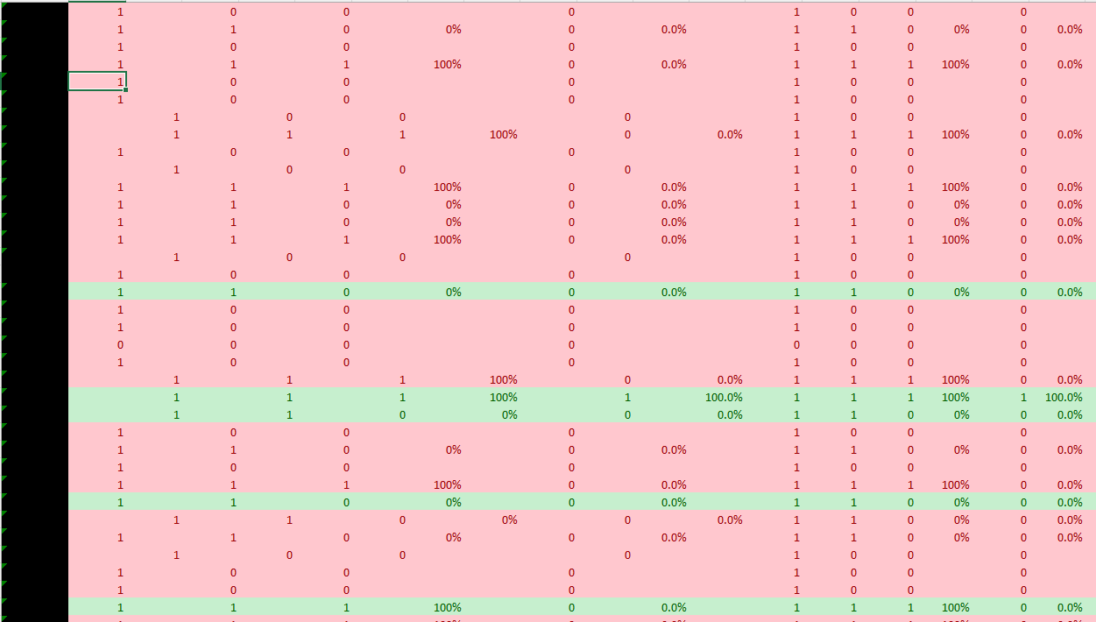
The Issues:
The Tableau reports produced during MAR 2022 - JUN 2023 contained more than 5,000+ patients
The FORTE-CUMC Clinical Research Coordinator would select MRN’s that had the most recent colonoscopies and enter them into our EMR to verify they were eligible for the study
For every patient 50 patients, 1 was found to be eligible for the FORTE study
This was extremely time –consuming process
We went back to the drawing board with our Principal Investigator…
Tableau Report with 5000+ patients

Slide 13
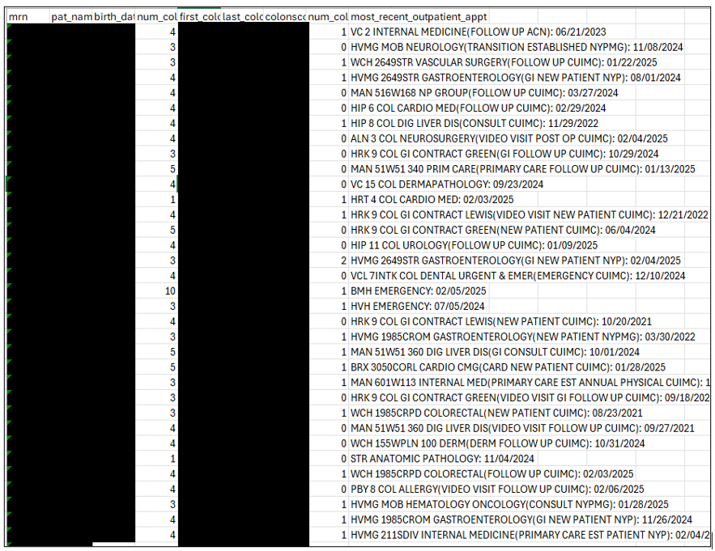
Next Steps:
The FORTE-Columbia study team decided to then query their electronic medical record (EMR) around FORTE eligibility to produce a patient report. The query included:
Patients 45-75 with colonoscopies at Columbia in the last 4 years
Patients with colonoscopy pathology reports available in their chart
No active cancer diagnosis
This patient report continued to produce many patients - about 1200-1,500
Issue with our patient reports can only pick up structured data meanwhile our colonoscopy reports are free text notes, and the 1-2 polyps became a key eligibility point in screening
In speaking with our Cancer Center System Analysts, they recommended a program called EMERSE
FORTE-CUMC Patient Report

Slide 14
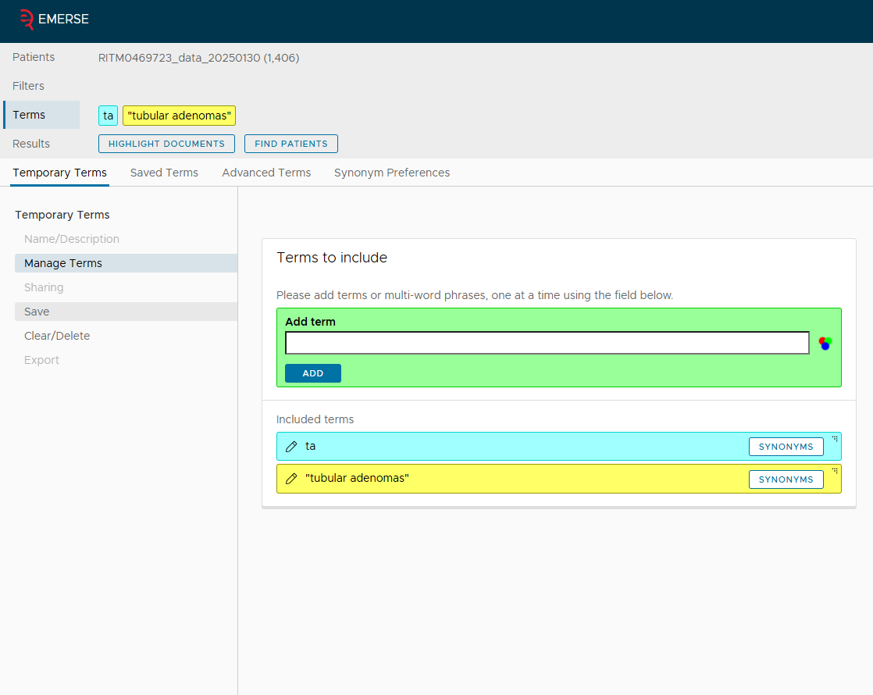
EMERSE Workflow
CUMC Patient Report Uploaded to EMERSE
Around July 2023 CUMC Cancer System Analysts exported our patient reports into EMERSE
As mentioned previously, over the course of screening eligible patients for this trial, we found that 1-2 polyps became the key eligibility point in including or excluding patients to contact for FORTE
The FORTE-CUMC team asked EMERSE to include patient’s whose pathology notes mentioned “tubular adenomas” or “TA”
We asked EMERSE to exclude all patient charts that mentioned “sessile serrated adenoma” and “hyperplastic adenoma”
Could then ask EMERSE to find patients based upon entered criteria
Asking EMERSE to only include patient charts that include the terms “TA” and “Tubular Adenoma”
Prompting EMERSE to look for terms that would narrow down patients truly eligible for FORTE

Slide 15
EMERSE Continued:
Original CUMC Patient Report had 1406 patients
EMERSE was able to narrow list down from 1406 patients to 370 patients

Slide 16
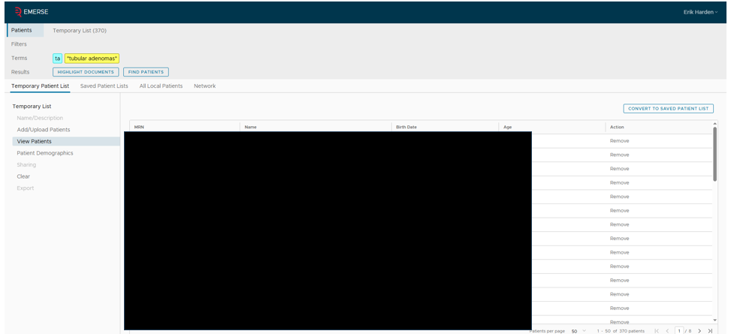
EMERSE Continued:
Exported 370 potentially eligible patients to a separate list

Slide 17
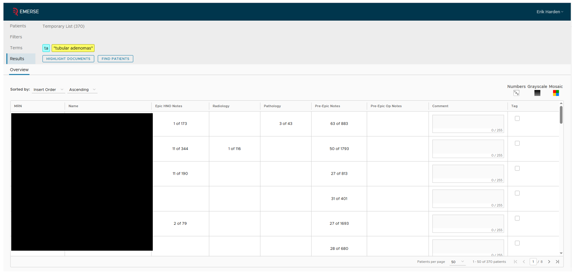
EMERSE Continued:
We could ask EMERSE to “highlight documents” that had the words “TA” and “Tubular Adenoma
For this patient, EMERSE highlighted 3 mentions of the word “TA” and “Tubular Adenoma” in this patient's chart

Slide 18
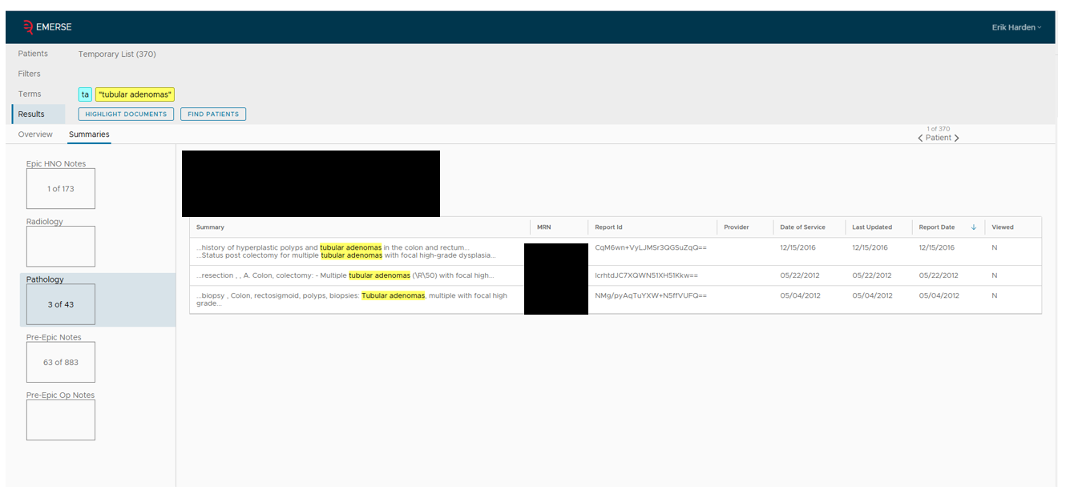
EMERSE Continued:
Could then click on notes that EMERSE flagged mentioning the words“TA” and “Tubular Adenoma” terms
FORTE excludes patients diagnosed with previous polyps so this patient would be ineligible for FORTE

Slide 19
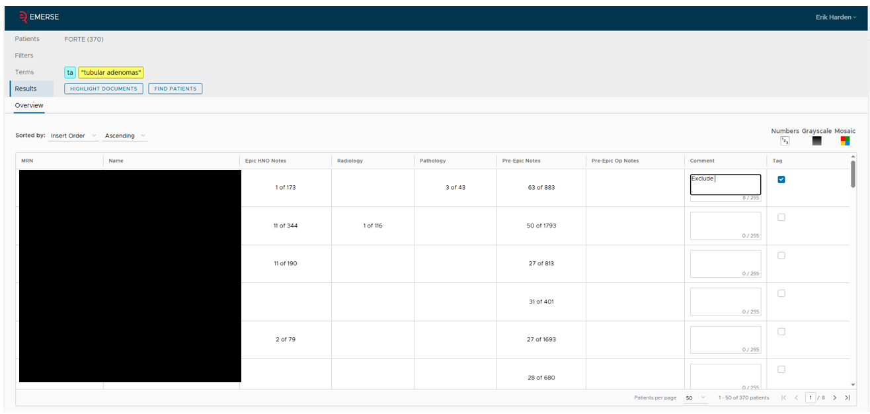
EMERSE Continued:
After renaming the exported 370 list, we could then flag patients as either eligible or ineligible based upon our review in EMERSE
Flagging patient with previous history of polyps as ineligible

Slide 20
EMERSE Continued:
We were able to enroll patients!
Note:
While CUMC rolled out the EMERSE
workflow for FORTE, we were also
simultaneously testing reaching out to
EMERSE identified FORTE patients over
MyChart to introduce the FORTE study to
patients

Slide 21
EMERSE Anecdote from FORTE-CUMC Team
EMERSE has been vital to our teams’ effort to screen patients for the FORTE trial. The sheer volume of patients that the program is able to screen for us drastically increased our efficiency and ability to extend clinical trial opportunities to patients. What is normally a tedious process is significantly less cumbersome when utilizing EMERSE.
- Finn, FORTE-CUMC Coordinator/EMERSE User

Slide 22
FORTE Post EMERSE
Using EMERSE, our team is able to easily identify patients across CUIMC's affiliate hospitals. The tag tool was especially effective in filtering large lists, allowing us to screen records for multiple providers dating back four years. This dramatically reduced screening time and led to a notable increase in eligible candidates across all sites. This allowed us to focus on patient outreach, which has increased engagement in our clinical trial.
- Mariana, FORTE-CUMC Affiliate Coordinator/EMERSE User
Continue to use EMERSE to screen for the FORTE study at CUMC
In the last 2 months we opened the FORTE study at one of CUMC community affiliate, located 1-hour north of CUMC, and rolled out FORTE-CUMC workflow there as well
Have not enrolled a patient at CUMC community affiliate … yet, however, we have reached out to patients identified via EMERSE at CUMC affiliate and have interested patients

Slide 23
EMERSE Conclusions
EMERSE helped narrow down our patient reports to help identify truly eligible patients for FORTE
Decreased staff’s time screening patient eligibility for FORTE
Very easy to use
Combining EMERSE with other electronic methods has helped us (CUMC patient reports + EMERSE + MyChart Outreach) enroll patients to the FORTE study

Slide 24
EMERSE version 7.1
Released internally at U of Michigan in April 2025
Plan for broader release in about a month
New features:
A few bug fixes
Synonyms counting in background
Collapsible navigation panel
Query Writer
Control over Boolean (AND/OR) options
Searches without terms

Slide 25
Demonstration of features in 7.1 release
Demo system is online and available for anyone to test
Contact us for an account
New features are in demo system
Upcoming

Slide 26
Work in progress: UI Framework
Updating backend UI framework
Removing Clarity UI (not Epic Clarity)
Will allow us to update Angular, reduce potential security issues
May speed up the interface
Lots of work, but will be mostly invisible to the users

Slide 27
Work in progress: OCR
Optical character recognition (OCR)
Still testing various technologies
Determine how to store data
Should be able to handle multiple image formats and PDFs
PDFs would be converted to images
Highlighting terms within documents
Looking into pros/cons of spelling correction

Slide 28
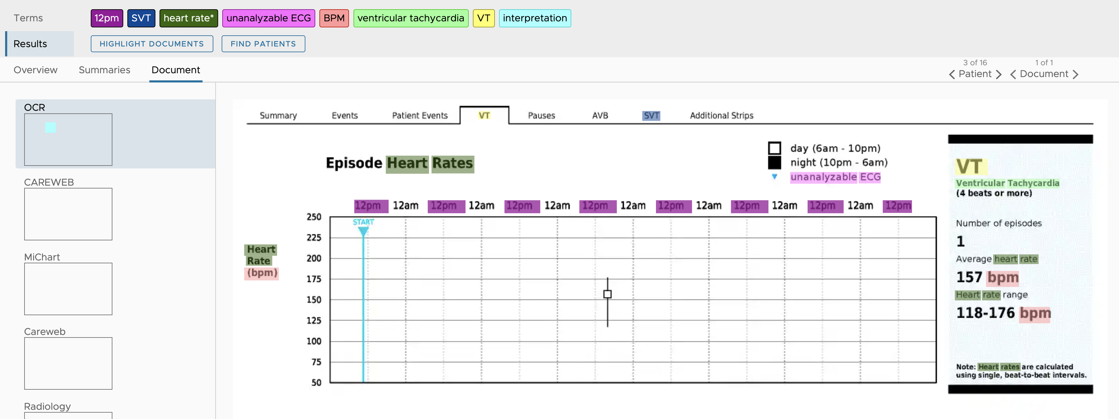
Work in progress: OCR

Slide 29
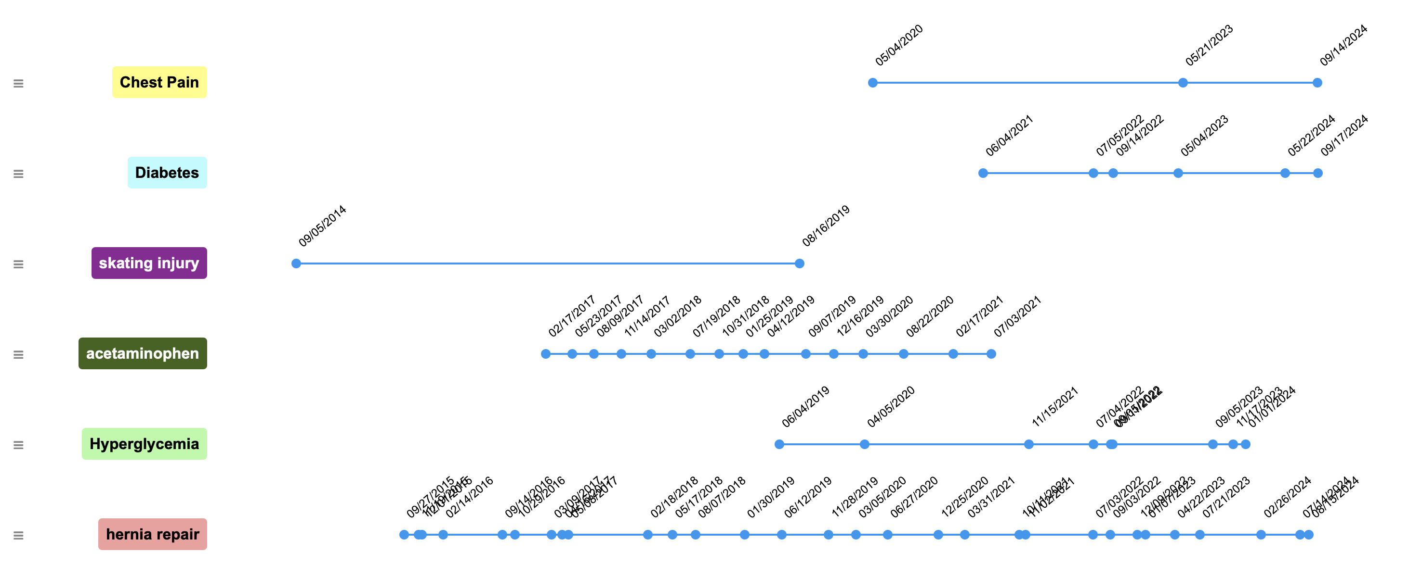
Work in progress: Timelines
Show terms on a timeline, linked to note dates

Slide 30
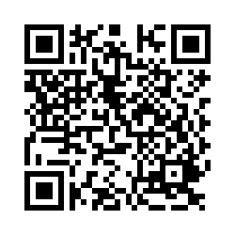
Open Forum & Wrap-up
Questions/Comments/Discussion
Thanks for attending!
Next Meeting: TBD (Fall 2025)
Please complete meeting survey:
https://bit.ly/emerse-may-2025
Upcoming

