Slide 1

An introduction to the EMERSE text searching and natural language processing tool for electronic health record notes
Presentation for Columbia University Herbert Irving Comprehensive Cancer Center
October 29, 2025
Twitter/X: @projectEMERSE
Web: project-emerse.org
Email: hanauer@umich.edu
emerse-team@umich.edu
David Hanauer, MD, MS
Dept of Learning Health Sciences
University of Michigan
http://project-emerse.org/presentations.html

Slide 2

If you want to take notes or visit links
these slides can be found at:
this link will be
on most slides
http://project-emerse.org/presentations.html

Slide 3

Disclosures
Funding: NIH (NCI-ITCR, NCATS-CTSA)
U of Michigan Royalties/Licensing: “Synonyms” dataset–optional “plugin” for EMERSE.
Disclosures
http://project-emerse.org/presentations.html

Slide 4


http://project-emerse.org/presentations.html

Slide 5
2021 study out of UC Irvine: Design, Implementation, and Usability of the Electronic Medical Record Search Engine (EMERSE) Tool https://escholarship.org/uc/item/44p23878
“Users unanimously responded that they would recommend the system to others, and…for a tool they found so useful, they believed that far too few people both within and outside of their network knew about the tool’s existence.”
http://project-emerse.org/presentations.html

Slide 6

EMERSE is available at HICCC
http://project-emerse.org/presentations.html

Slide 7
Unstructured vs Structured Data
EMERSE is for this… | …not this
Unstructured Data (free-text) | Structured Data
Mrs. Jones is a 56 year old female with a history of HTN, hypercholesterolemia, and T2DM who comes to the clinic today with a 3 day h/o dizziness and severe headache on the left side. | WBC: 5.6 Total cholesterol: 182 Weight: 67.4 AST: 30 ALT: 52
http://project-emerse.org/presentations.html

Slide 8


80% of EHR data are in unstructured free-text
structured data
unstructured data/free text
http://project-emerse.org/presentations.html

Slide 9
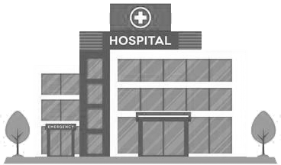

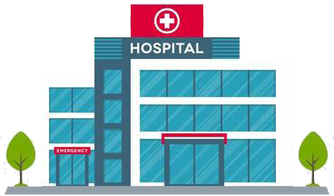
Most medical centers lack tools for free-text
http://project-emerse.org/presentations.html

Slide 10

And the ones that do exist aren’t great
2024 study on EMR usability:
“The same three items (integration into workflow, finding information, and usability of alerts) received the highest number of 'poor' ratings among hospital and practice physicians.”
https://www.nature.com/articles/s41746-025-01657-4
http://project-emerse.org/presentations.html

Slide 11

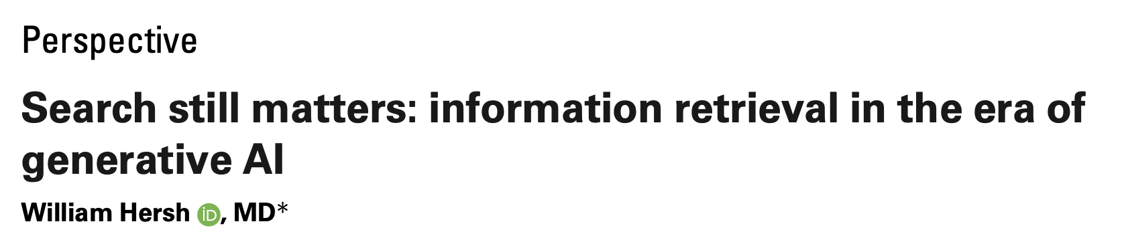
Do we even need search anymore?
Yes!
https://pmc.ncbi.nlm.nih.gov/articles/PMC11339511/pdf/ocae014.pdf
2024
http://project-emerse.org/presentations.html

Slide 12

The EMERSE solution
A system “for the people”
Users search the notes on their own
No need to wait in a queue for an analyst or a data scientist
Easy-to-use for non-technical users
Unlike with some EHRs, EMERSE can search across all notes and all patients at once
Continuous refinements for almost 20 years
http://project-emerse.org/presentations.html

Slide 13

The EMERSE solution
A system “for the admins”
Enterprise grade, easy to support
Configurable with granular roles/privileges to control access (e.g, all patients vs. some patients)
Data are kept secure within a centralized, audited system at your own site
No need to download/store the data elsewhere
http://project-emerse.org/presentations.html

Slide 14


EMERSE is a useful tool
It will be one of many you need to build/support your project(s)
http://project-emerse.org/presentations.html

Slide 15
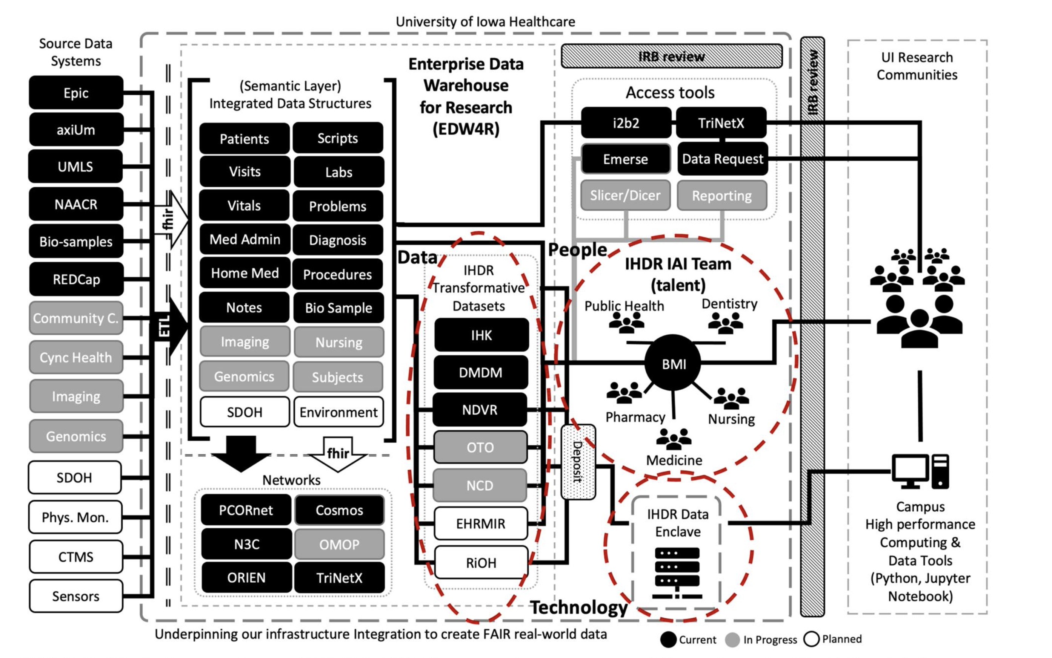
https://doi.org/10.1093/jamia/ocad236
http://project-emerse.org/presentations.html

Slide 16

We think EMERSE is really good
We’re proud of what we created
We think it’s better than other software tools that cost $$$
http://project-emerse.org/presentations.html

Slide 17

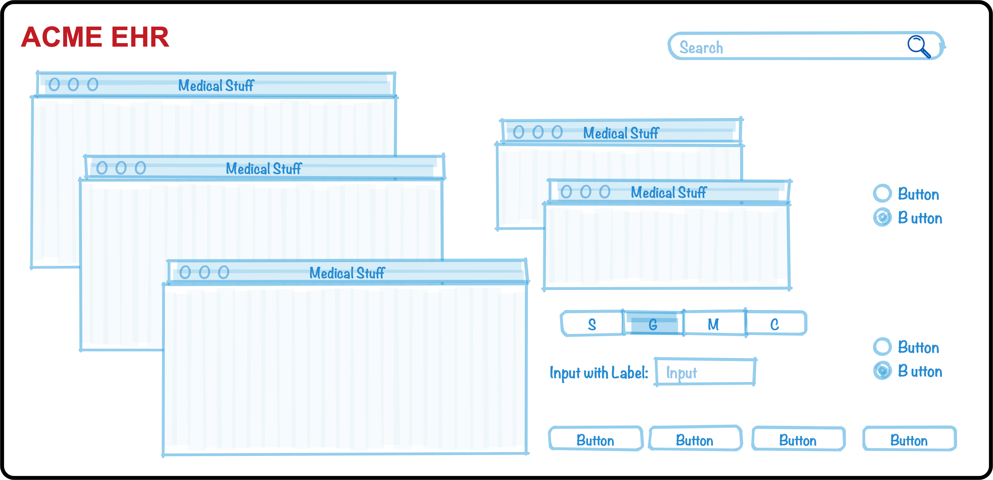
Why do we think it’s better?
We’ve been laser-focused on it
EHRs have thousands of features
The EMERSE team has invested $millions and 20 years on just this one feature (search) because it’s so important
http://project-emerse.org/presentations.html

Slide 18
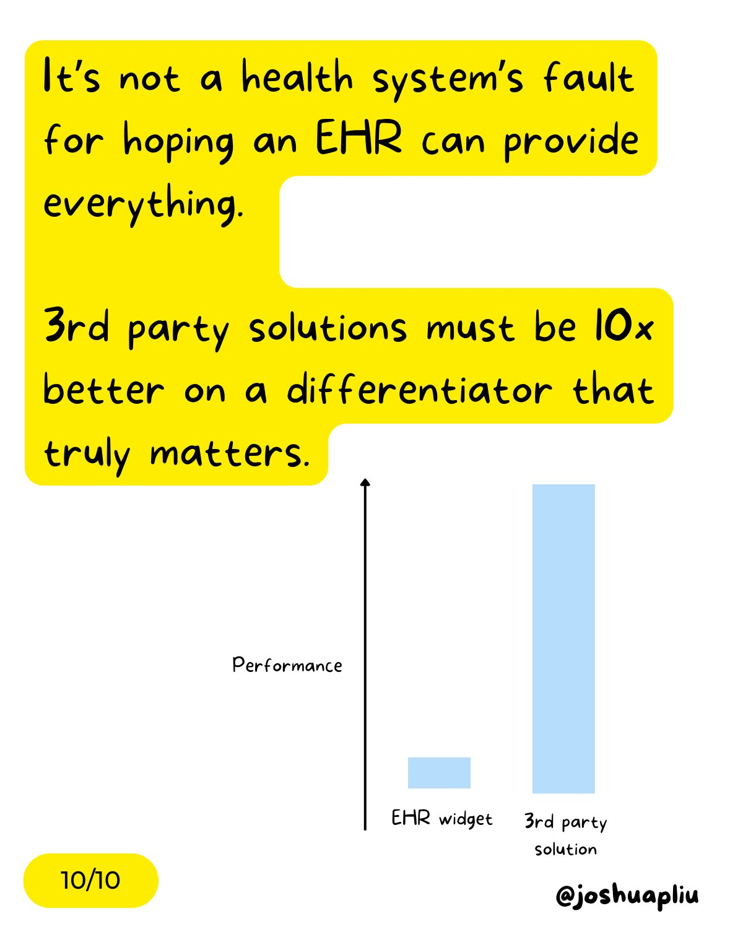
Why do we think it’s better?
It has to be better
EMERSE is a “best of breed” product and must stay ahead of integrated EHR tools to remain relevant
http://project-emerse.org/presentations.html

Slide 19
Why do we think it’s better?
We’ve studied it
“new users of the EMERSE system are able to complete basic but critical workflow tasks in the system with a high rate of success…are highly satisfied with the interface, and have highly positive perceptions of its expected utility in their work.”
“survey results indicate very high ratings of usability and satisfaction with the EMERSE system by new users after only one session of use.”
https://project-emerse.org/documents/reyes_masters_thesis_2021.pdf
http://project-emerse.org/presentations.html

Slide 20
Why do we think it’s better?
Our users tell us
Thank you for…this important tool which is proving extremely valuable in enhancing patient safety and quality of care delivered at Michigan Medicine.
EMERSE is working out great for casefinding...have found quite a bit of cases that we would have missed otherwise. Thank you and everyone on your team!
..continued gratitude for the availability of this powerful research tool. As always, thank you for this innovation!
EMERSE is an absolute gem
@umichmedicine. The functionality is very friendly and it saved hours of time during the data collection process. Thank you to the team that created this powerful research tool!
To say “it is the most useful tool I use in my job” would be an understatement, so thank you for creating and sharing it with others!!
http://project-emerse.org/presentations.html

Slide 21
Why do we think it’s better?
Researchers mention it in their publications
“Reviewers used the EMERSE search tool to ensure thorough review of the available documentation...” [PMID 36119396]
“the tool avoids the pitfalls of diagnostic inaccuracy seen with tools querying on ICD and billing codes…” [PMID 36114099]
“[EMERSE] provides software features to comprehensively scan all clinical documents…for keywords and phrases to ensure that even rarely mentioned events are detected.” [PMID 36550198]
“…information [was] captured via EMERSE…in order to obtain the most accurate and complete information per patient.”[PMID 36752520]
http://project-emerse.org/presentations.html

Slide 22
Why do we think it’s better?
Top-tier medical centers use it
Site | Site
U of Michigan | Case Western Reserve U
Harvard U – Dana Farber Cancer Center | Utrecht University, Netherlands
Columbia U Cancer Center | U of Iowa
U of North Carolina – Chapel Hill | Weill Cornell Medical Center
U of California – San Francisco | U of Virginia
U of Kentucky | Moffitt Cancer Center, Tampa, FL*
U of Cincinnati | Children’s Health Orange County, Calif.*
*Currently installing
http://project-emerse.org/presentations.html

Slide 23
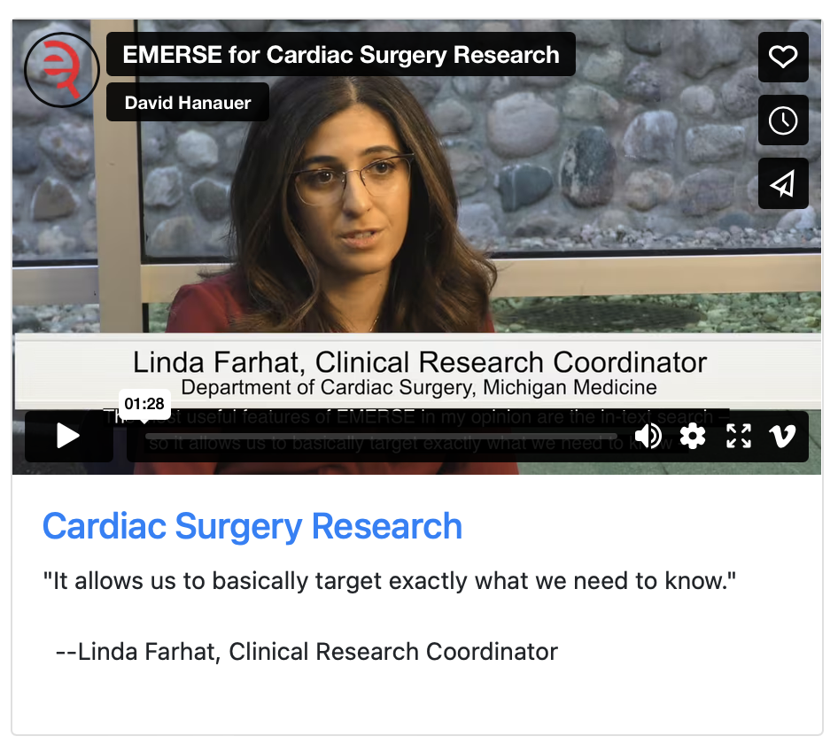
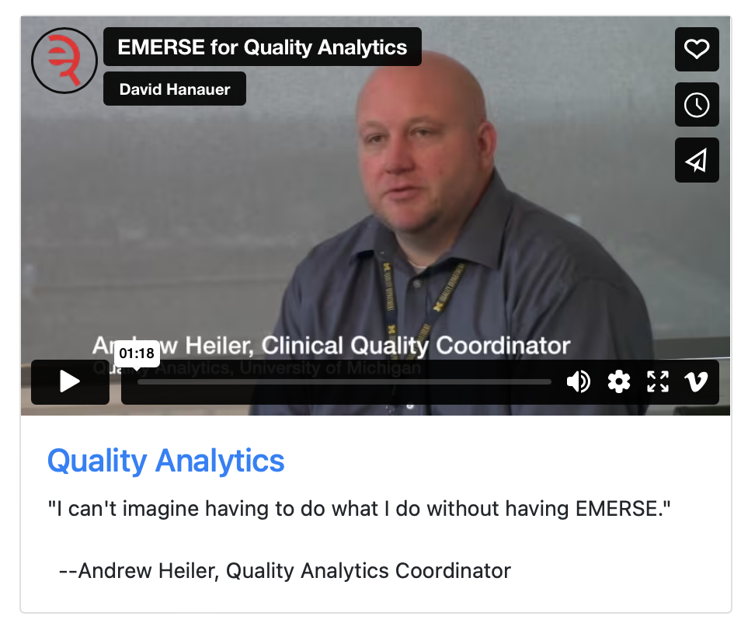
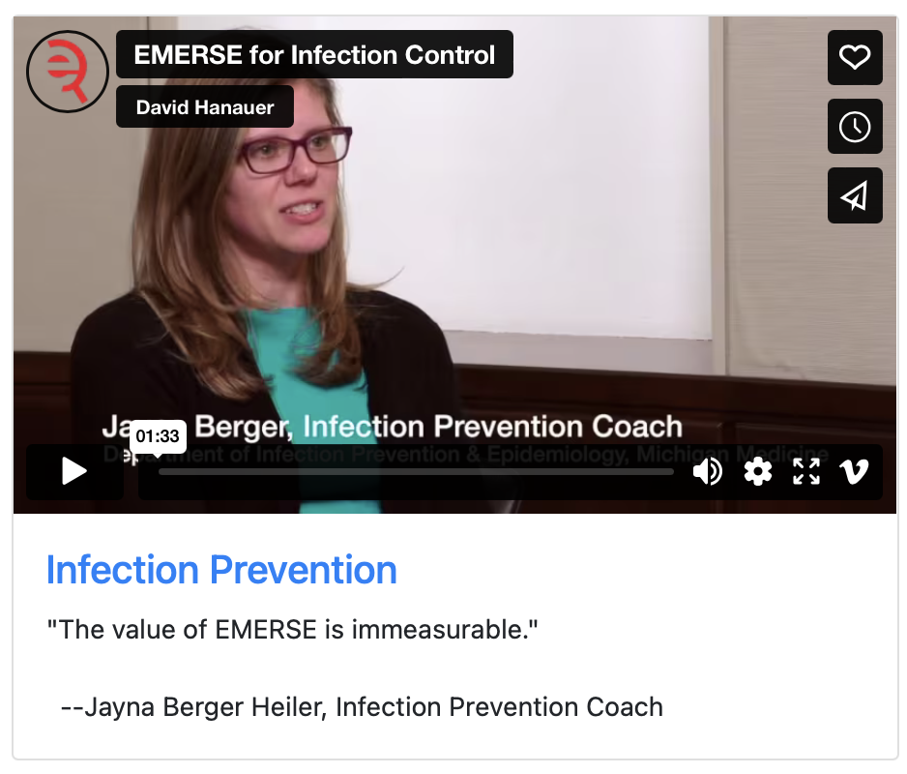
What can EMERSE do?
Lots of things!
Watch our videos: https://project-emerse.org/use_cases.html

Slide 24

Find cohorts
EMERSE allows you to find cohorts based on things mentioned in the notes
diseases
drugs
symptoms
anything*
*if it is mentioned
http://project-emerse.org/presentations.html

Slide 25



Find cohorts
It’s perfect for finding rare things…
…like rare cancers such as
cutaneous leiomyosarcoma
See this talk for more details:
https://vimeo.com/677482835
“Using EMERSE to Improve Research Involving Rare Cancers”
http://project-emerse.org/presentations.html

Slide 26
Highlight documents for chart review
Thoracocentesis confirmed the recurrence of mantle cell lymphoma. Disease restaging work-up revealed multicompartment lymphadenopathy in the neck, mediastinal, retrocrural, retroperitoneal and pelvic regions. Bone marrow was also involved. The patient was treated with a total of six cycles of rituximab, cyclophosphamide, vincristine, doxorubicin and dexamethasone (R-HyperCVAD) completed in January 2007. That treatment led to complete remission that lasted until October 2008, when the disease was found to have recurred in the left pleural space and retroperitoneum without bone marrow involvement.
https://jmedicalcasereports.biomedcentral.com/articles/10.1186/1752-1947-4-329
http://project-emerse.org/presentations.html

Slide 27

EMERSE is fast
Query to identify all patients with the following | Reporting DB time (s) | EMERSE time (s) | EMERSE advantage
cavernous hemangioma | 14,652 | 2 | 7,320x
gray platelet syndrome | 14,940 | 2 | 7,470x
inferior lingular segment of the left upper lobe | 17,784 | 9 | 1,980x
…enabling real-time querying
http://project-emerse.org/presentations.html

Slide 28
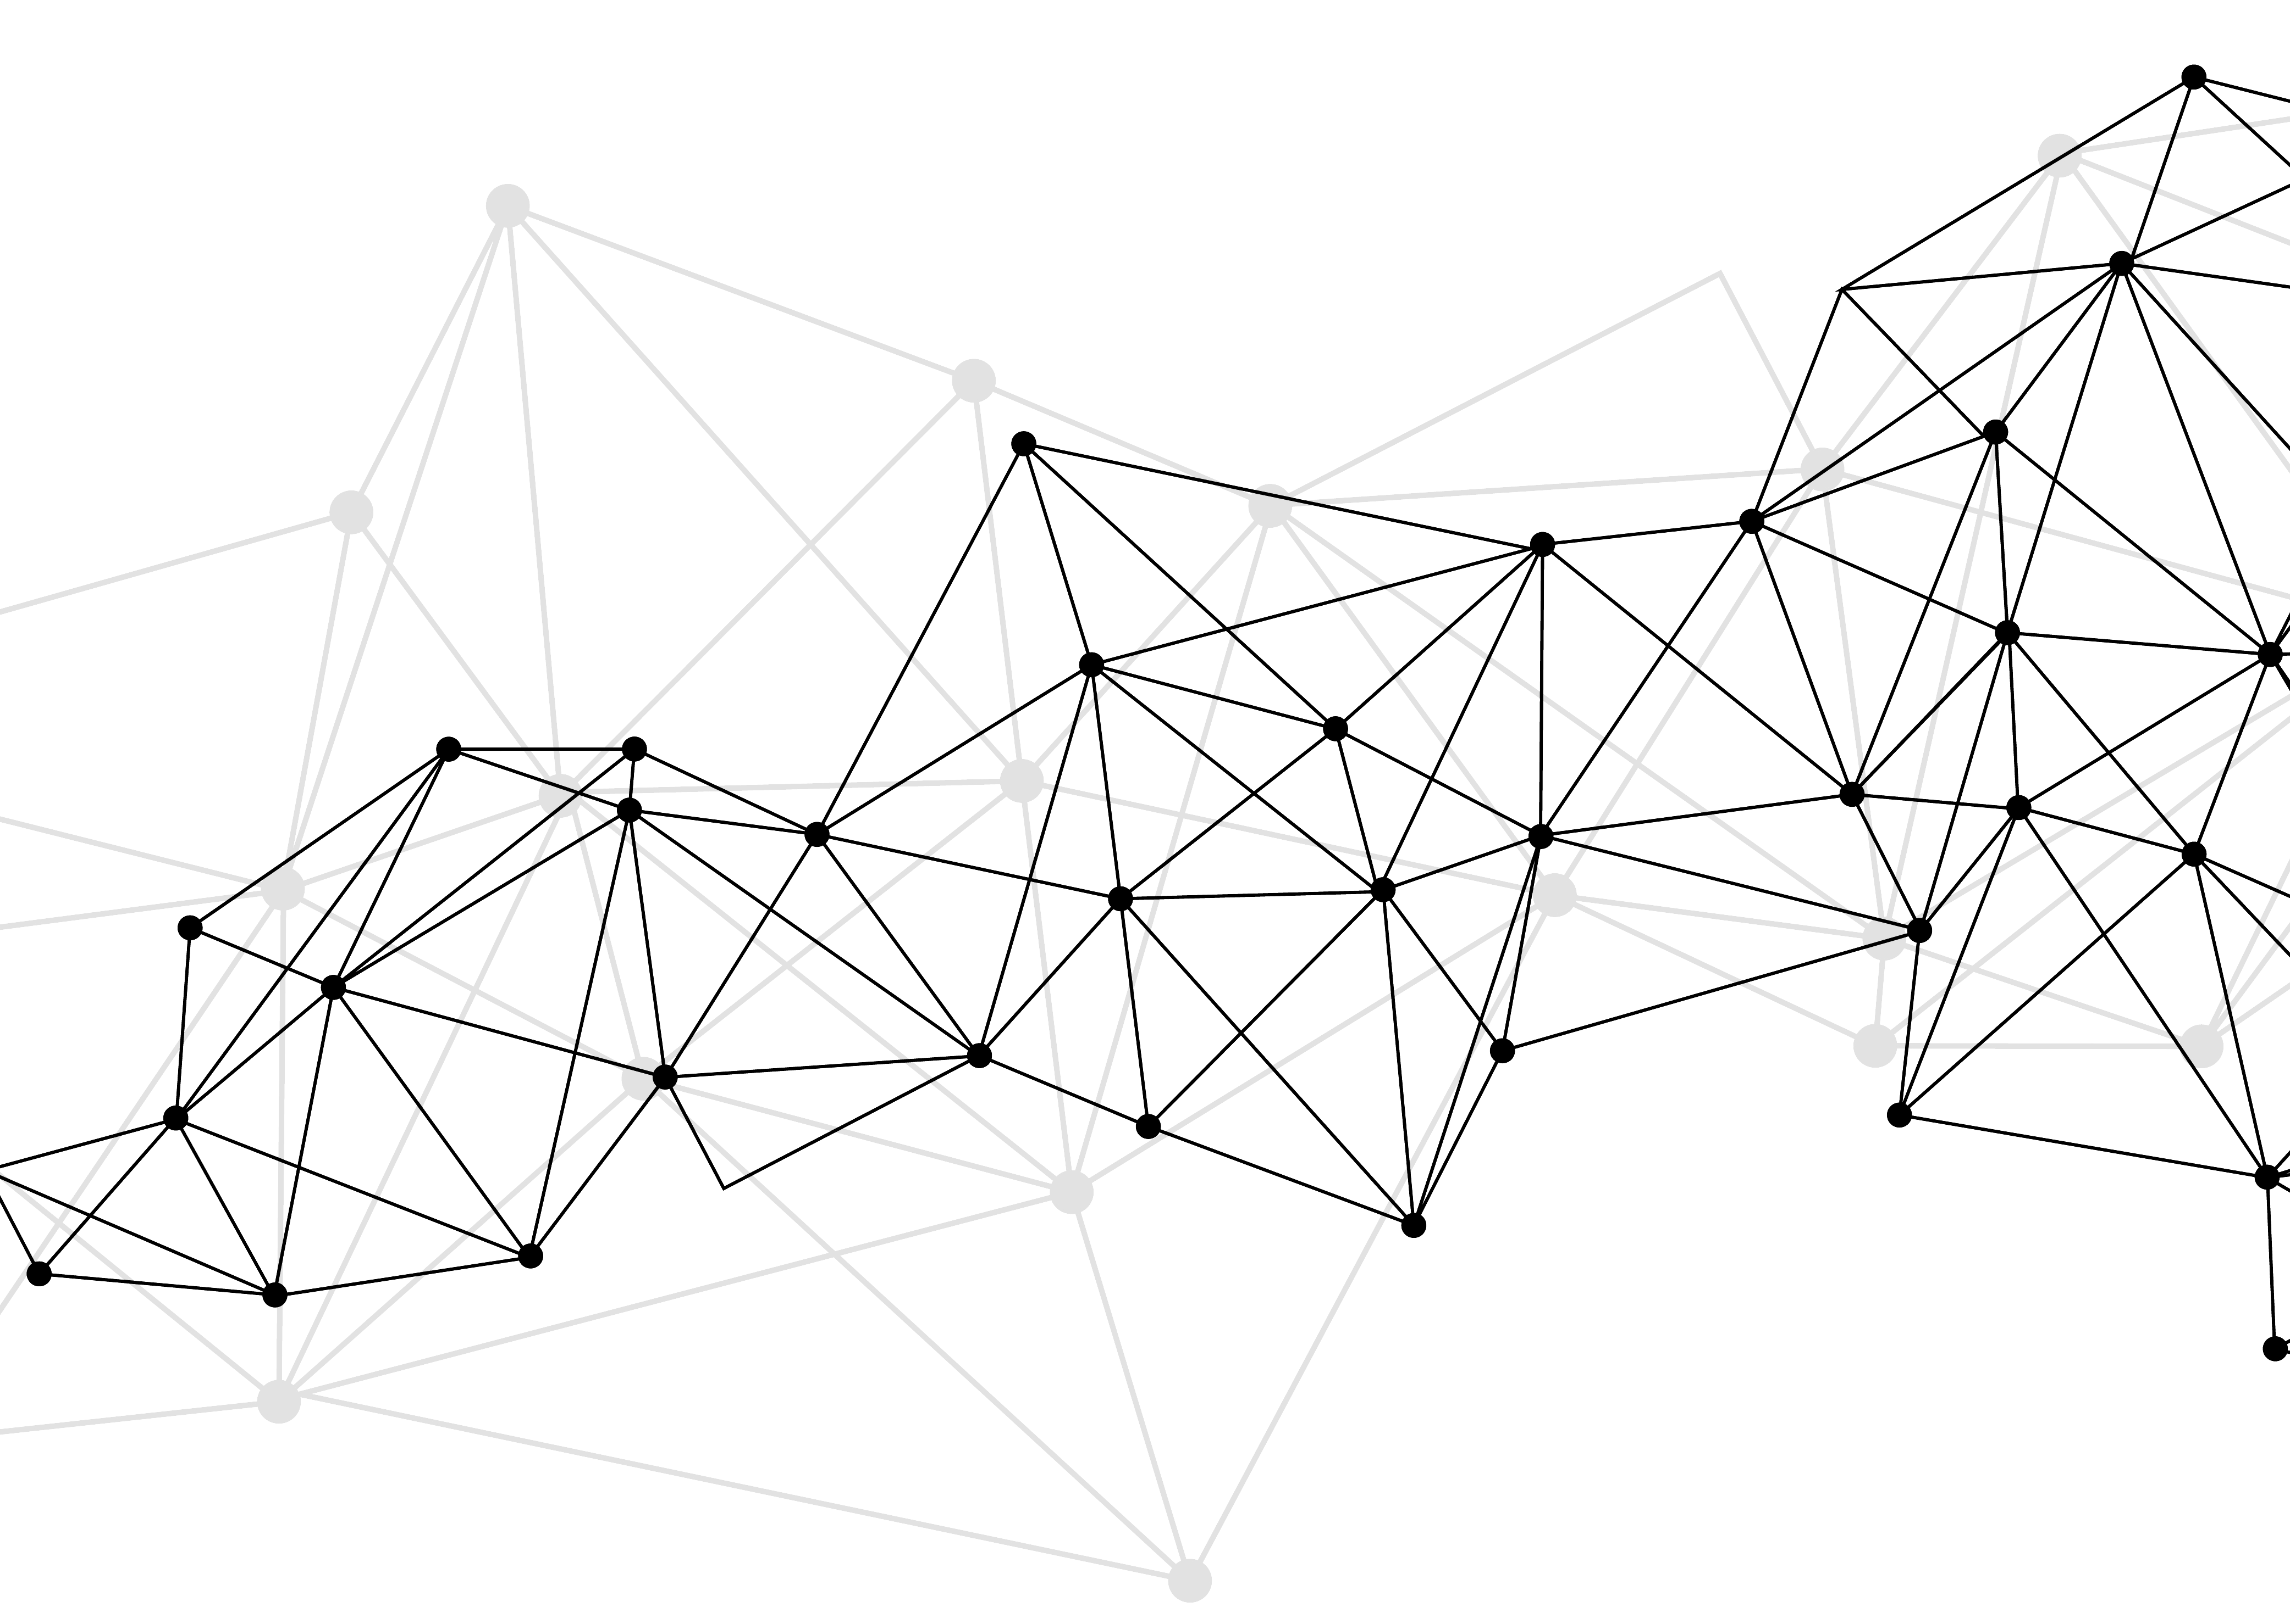
Synonyms
Used for query expansions
User-controlled
Multiple datasets can be included
EMERSE Synonyms
acronyms, abbreviations, professional/consumer terms, misspellings, trade/generic drug names, species, chemo regimens, phrase variations, malapropisms, idioms, neologisms, organizations, companies, & more
2.6 million unique entries
http://project-emerse.org/presentations.html

Slide 29
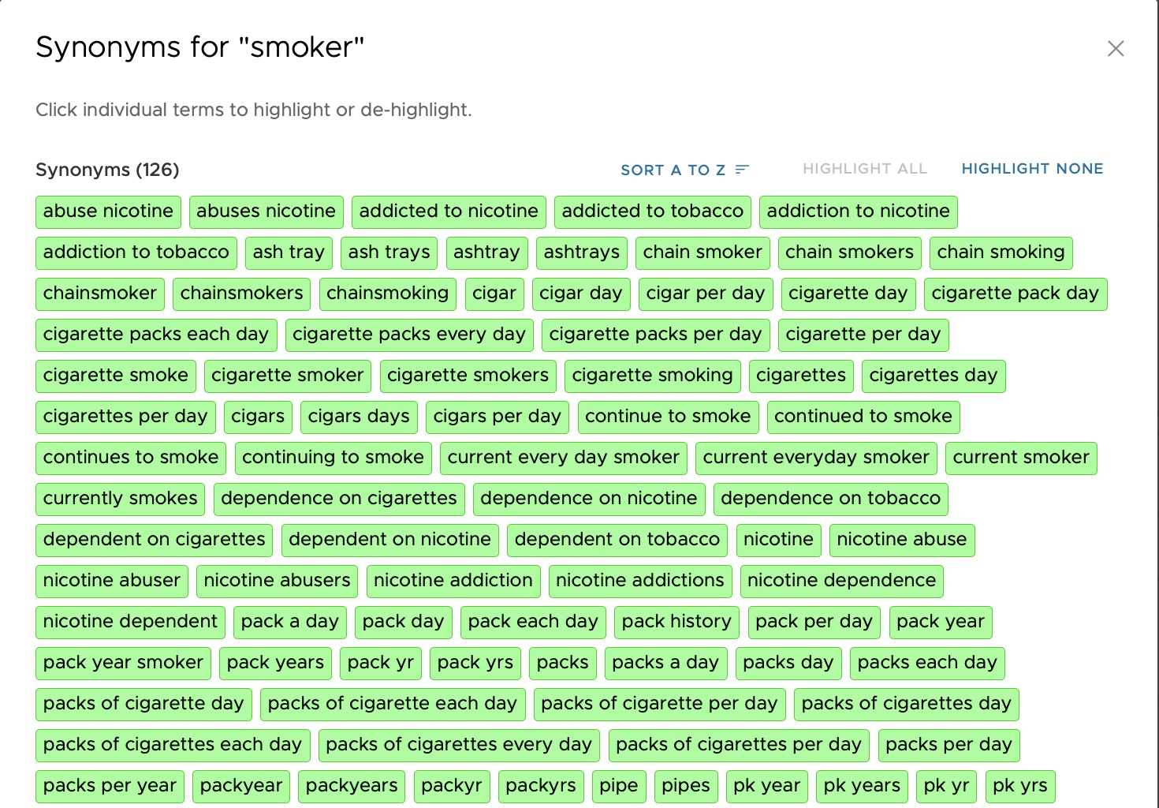

Slide 30
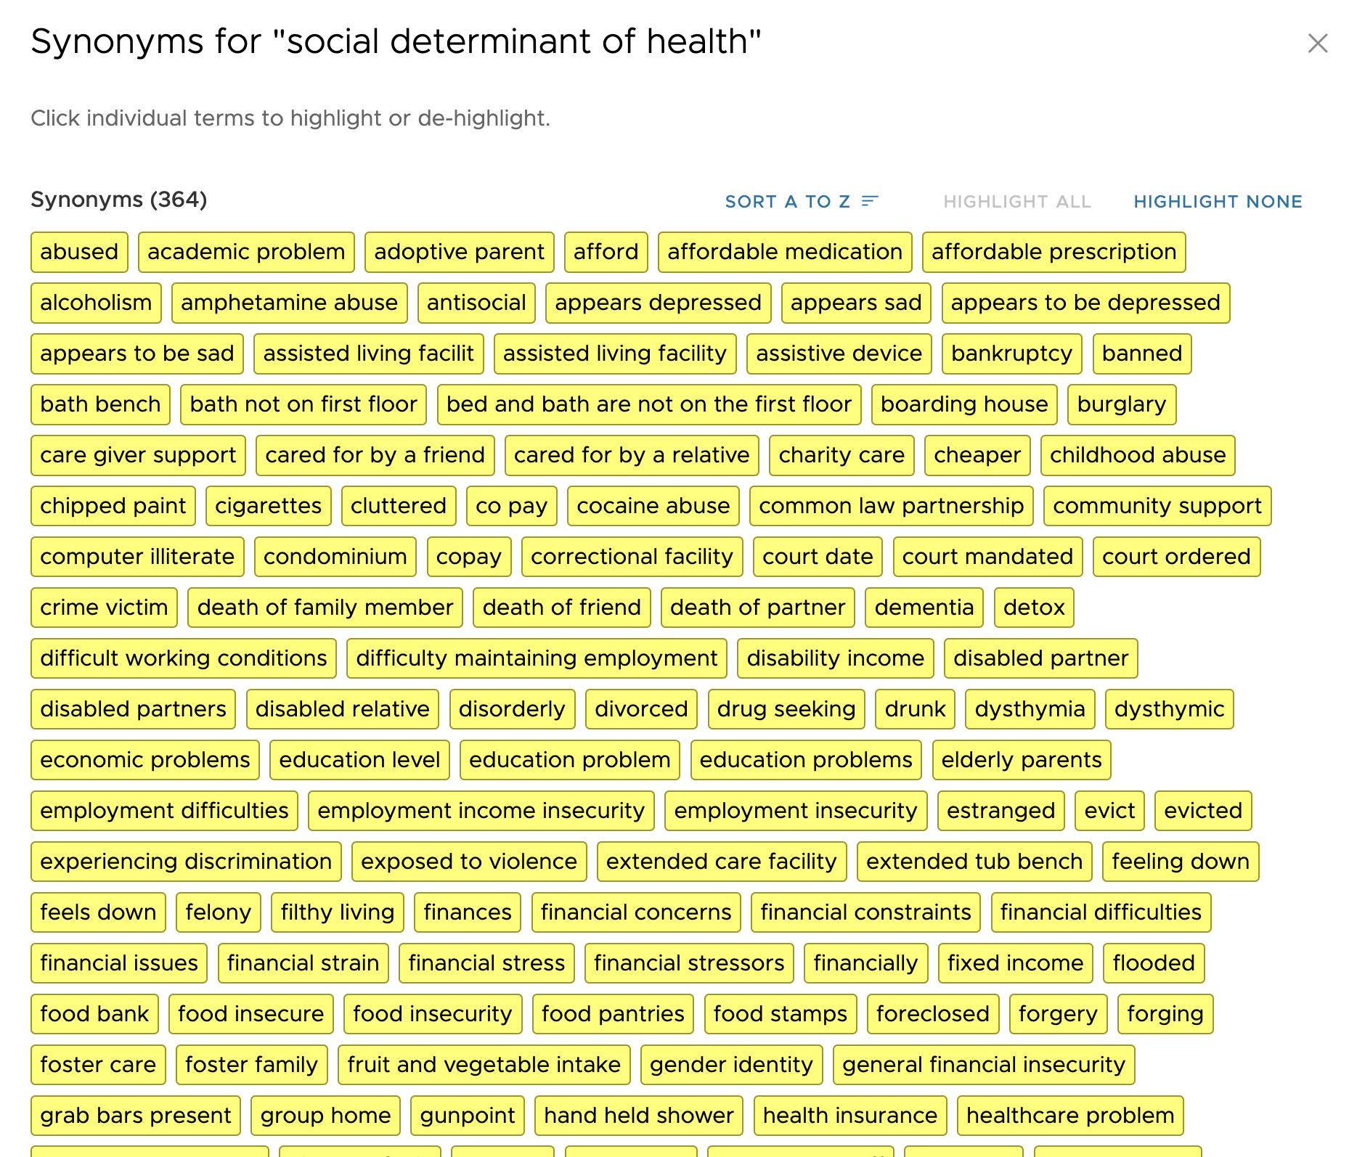
http://project-emerse.org/presentations.html

Slide 31
Typical workflow
initial cohort identified
with a cohort discovery
tool using structured data (or via EMERSE
‘Find Patients’)
Cohort discovery tools:
i2b2/ENACT, Leaf, etc.
http://project-emerse.org/presentations.html

Slide 32
Typical workflow
additional details abstracted from the free text using EMERSE
http://project-emerse.org/presentations.html

Slide 33
Typical workflow
Data recorded in an electronic data capture system (e.g., REDCap)
http://project-emerse.org/presentations.html

Slide 34

Publications using EMERSE
701
papers and abstracts
Full list at:
http://project-emerse.org/publications.html
http://project-emerse.org/presentations.html

Slide 35

Recently released…
Incorporation of NLP features
negation
uncertainty
subject (patient vs other)
history of
named entity recognition/mapping to ontologies
If you don’t like our built-in NLP, use your own
http://project-emerse.org/presentations.html

Slide 36

Future Work
Data extraction from templated notes
Integration with ChatGPT or similar tools
& more…
http://project-emerse.org/presentations.html

Slide 37





project-emerse.org
http://project-emerse.org/presentations.html

Slide 38

Interested in EMERSE?
Contact us to schedule a time with your team for:
Discussions about usage strategies
Training
Live demonstrations (abstractors, IT teams, etc)
http://project-emerse.org/presentations.html

Slide 39

Community Meeting
NEXT WEEK: Wed, November 5, 2024, 1-2 PM ET
Open to everyone, registration link at
http://project-emerse.org/
http://project-emerse.org/presentations.html

Slide 40

EMERSE-team@umich.edu
Lisa Ferguson
David Hanauer
Kellen McClain
Guan Wang
http://project-emerse.org/presentations.html

Slide 41

Live Demo
No real names
No PHI
Publicly available
Abstracts & case reports
http://project-emerse.org/presentations.html

