Slide 1

EMERSE: A user-friendly text searching and natural language processing tool for electronic health record notes
Presentation for
Biomedical & Health Informatics Seminar
University of Iowa
December 11, 2025
Web: project-emerse.org
Email: hanauer@umich.edu
emerse-team@umich.edu
David Hanauer, MD, MS
Dept of Learning Health Sciences
University of Michigan
http://project-emerse.org/presentations.html

Slide 2

If you want to take notes or visit links
these slides can be found at:
this link will be
on most slides
http://project-emerse.org/presentations.html

Slide 3

Disclosures
Funding: NIH (NCI-ITCR, NCATS-CTSA)
U of Michigan Royalties/Licensing: “Synonyms” dataset–optional “plugin” for EMERSE.
Disclosures
http://project-emerse.org/presentations.html

Slide 4


http://project-emerse.org/presentations.html

Slide 5
2021 study out of UC Irvine: Design, Implementation, and Usability of the Electronic Medical Record Search Engine (EMERSE) Tool https://escholarship.org/uc/item/44p23878
“Users unanimously responded that they would recommend the system to others, and…for a tool they found so useful, they believed that far too few people both within and outside of their network knew about the tool’s existence.”
http://project-emerse.org/presentations.html

Slide 6
Unstructured vs Structured Data
EMERSE is for this… | …not this
Unstructured Data (free-text) | Structured Data
Mrs. Jones is a 56 year old female with a history of HTN, hypercholesterolemia, and T2DM who comes to the clinic today with a 3 day h/o dizziness and severe headache on the left side. | WBC: 5.6 Total cholesterol: 182 Weight: 67.4 AST: 30 ALT: 52
http://project-emerse.org/presentations.html

Slide 7


80% of EHR data are in unstructured free-text
structured data
unstructured data/free text
http://project-emerse.org/presentations.html

Slide 8
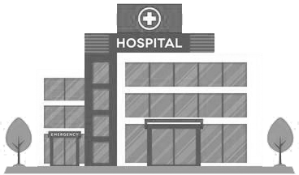

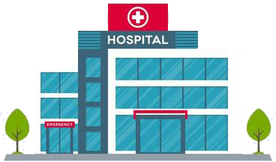
Most medical centers lack tools for free-text
http://project-emerse.org/presentations.html

Slide 9

And the ones that do exist aren’t great
2024 study on EMR usability:
“The same three items (integration into workflow, finding information, and usability of alerts) received the highest number of 'poor' ratings among hospital and practice physicians.”
https://www.nature.com/articles/s41746-025-01657-4
http://project-emerse.org/presentations.html

Slide 10


Do we even need search anymore?
Yes!
https://pmc.ncbi.nlm.nih.gov/articles/PMC11339511/pdf/ocae014.pdf
2024
http://project-emerse.org/presentations.html

Slide 11

The EMERSE solution
A system “for the people”
Users search the notes on their own
  No need to wait in a queue for an analyst or a data scientist
Easy-to-use for non-technical users
Unlike with some EHRs, EMERSE can search across all notes and all patients at once
Continuous refinements for almost 19 years
http://project-emerse.org/presentations.html

Slide 12

The EMERSE solution
A system “for the admins”
Enterprise grade, easy to support
Configurable with granular roles/privileges to control access (e.g, all patients vs. some patients)
Data are kept secure within a centralized, audited system at your own site
  No need to download*/store data elsewhere
http://project-emerse.org/presentations.html

Slide 13


EMERSE is a useful tool
It will be one of many you need to build/support your project(s)
http://project-emerse.org/presentations.html

Slide 14
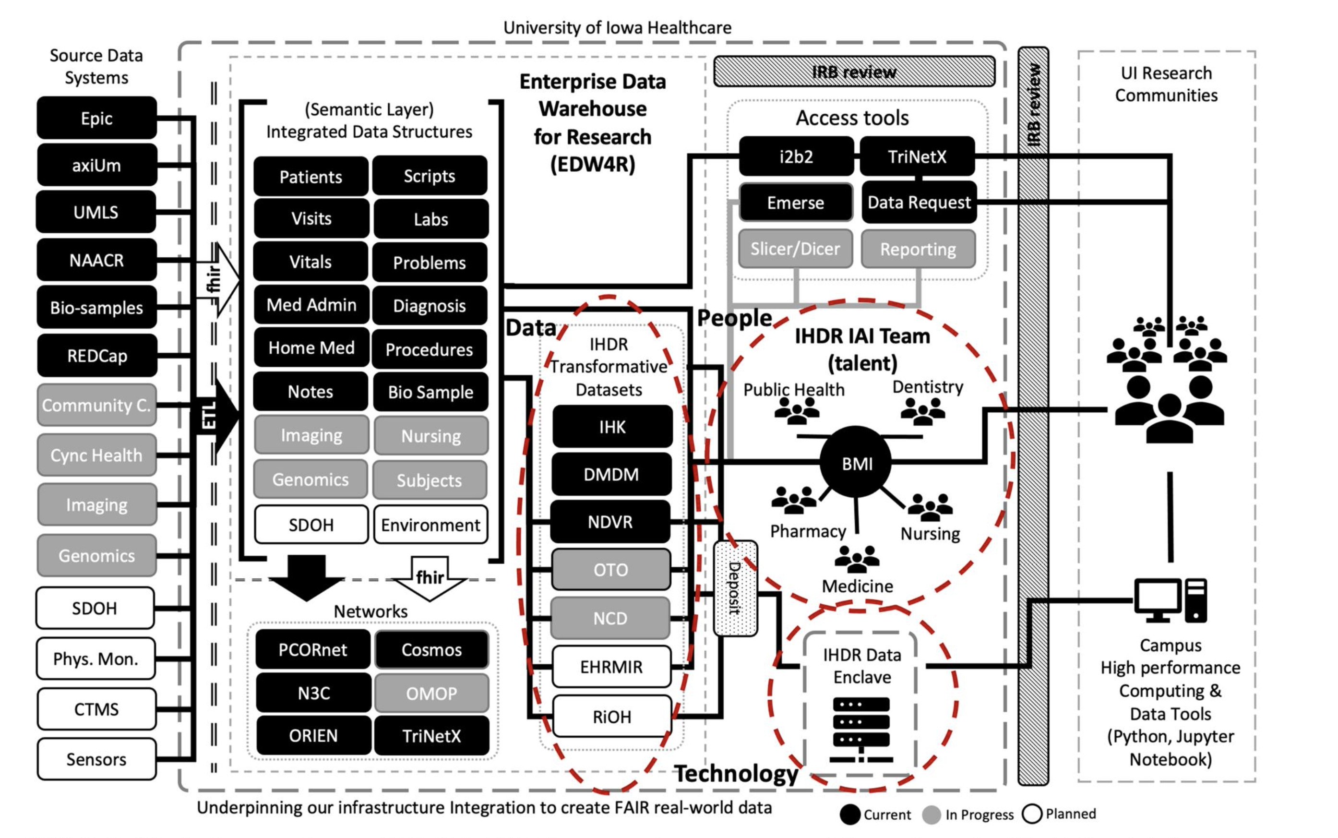
https://doi.org/10.1093/jamia/ocad236
http://project-emerse.org/presentations.html

Slide 15

EMERSE is a mature tool
EMERSE turns 20 tomorrow!
http://project-emerse.org/presentations.html

Slide 16

We think EMERSE is really good
We’re proud of what we created
We think it’s better than other software tools that cost $$$
http://project-emerse.org/presentations.html

Slide 17

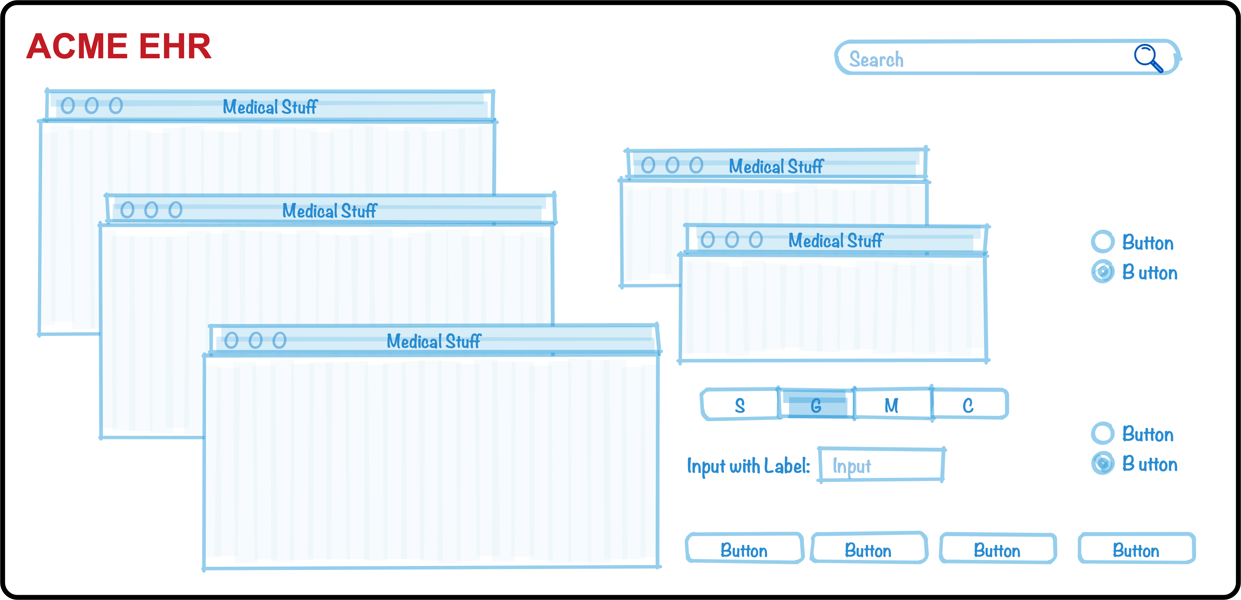
Why do we think it’s better?
We’ve been laser-focused on it
EHRs have thousands of features
The EMERSE team has invested $millions and 19 years on just this one feature (search) because it’s so important
http://project-emerse.org/presentations.html

Slide 18
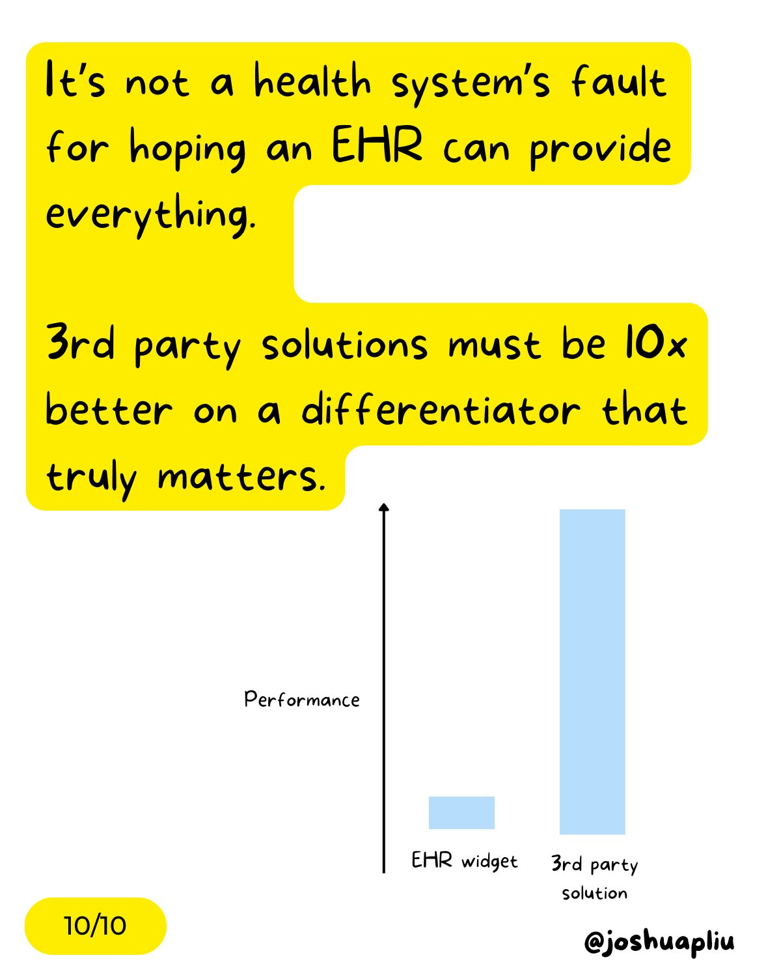
Why do we think it’s better?
It has to be better
EMERSE is a “best of breed” product and must stay ahead of integrated EHR tools to remain relevant
http://project-emerse.org/presentations.html

Slide 19
Why do we think it’s better?
We’ve studied it
“new users of the EMERSE system are able to complete basic but critical workflow tasks in the system with a high rate of success…are highly satisfied with the interface, and have highly positive perceptions of its expected utility in their work.”
“survey results indicate very high ratings of usability and satisfaction with the EMERSE system by new users after only one session of use.”
https://project-emerse.org/documents/reyes_masters_thesis_2021.pdf
http://project-emerse.org/presentations.html

Slide 20
Why do we think it’s better?
Our users tell us
Thank you for…this important tool which is proving extremely valuable in enhancing patient safety and quality of care delivered at Michigan Medicine.
EMERSE is working out great for casefinding...have found quite a bit of cases that we would have missed otherwise. Thank you and everyone on your team!
..continued gratitude for the availability of this powerful research tool. As always, thank you for this innovation!
EMERSE is an absolute gem
@umichmedicine. The functionality is very friendly and it saved hours of time during the data collection process. Thank you to the team that created this powerful research tool!
To say “it is the most useful tool I use in my job” would be an understatement, so thank you for creating and sharing it with others!!
http://project-emerse.org/presentations.html

Slide 21
Why do we think it’s better?
Researchers mention it in their publications
“Reviewers used the EMERSE search tool to ensure thorough review of the available documentation...” [PMID 36119396]
“the tool avoids the pitfalls of diagnostic inaccuracy seen with tools querying on ICD and billing codes…” [PMID 36114099]
“[EMERSE] provides software features to comprehensively scan all clinical documents…for keywords and phrases to ensure that even rarely mentioned events are detected.” [PMID 36550198]
“…information [was] captured via EMERSE…in order to obtain the most accurate and complete information per patient.”[PMID 36752520]
http://project-emerse.org/presentations.html

Slide 22

Why do we think it’s better?
Top-tier medical centers use it
Site | Site
U of Michigan | Case Western Reserve U
Harvard U – Dana Farber Cancer Center | Utrecht University, Netherlands
Columbia U Cancer Center | U of Iowa
U of North Carolina – Chapel Hill | Weill Cornell Medical Center
U of California – San Francisco | U of Virginia
U of Kentucky | Moffitt Cancer Center, Tampa, FL*
U of Cincinnati | Children’s Health Orange County, Calif.*
*Currently installing
http://project-emerse.org/presentations.html

Slide 23
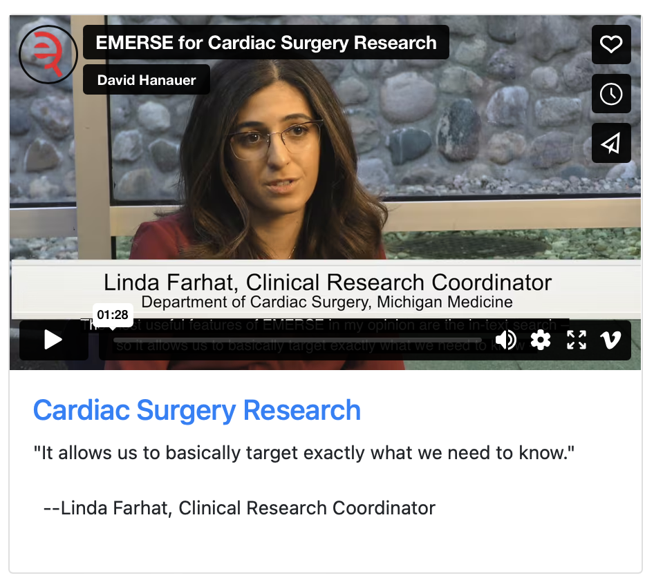
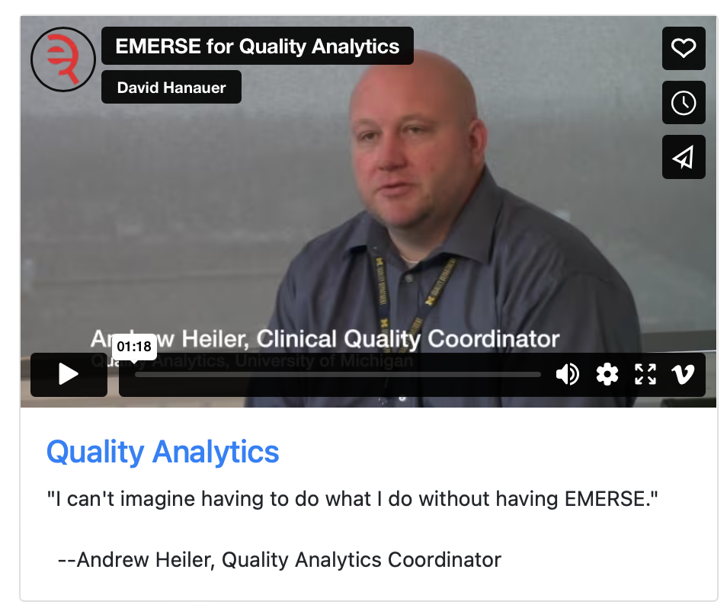
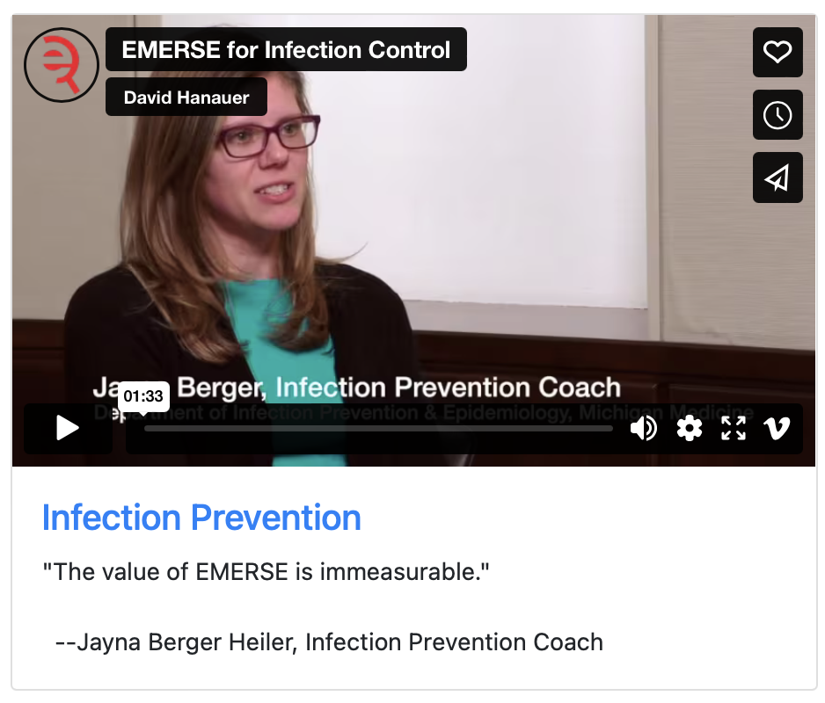
What can EMERSE do?
Lots of things!
Watch our videos: https://project-emerse.org/use_cases.html

Slide 24

Find cohorts
EMERSE allows you to find cohorts based on things mentioned in the notes
  diseases
  drugs
  symptoms
  anything*
*if it is mentioned
http://project-emerse.org/presentations.html

Slide 25



Find cohorts
It’s perfect for finding rare things…
…like rare cancers such as
cutaneous leiomyosarcoma
See this talk for more details:
https://vimeo.com/677482835
“Using EMERSE to Improve Research Involving Rare Cancers”
http://project-emerse.org/presentations.html

Slide 26
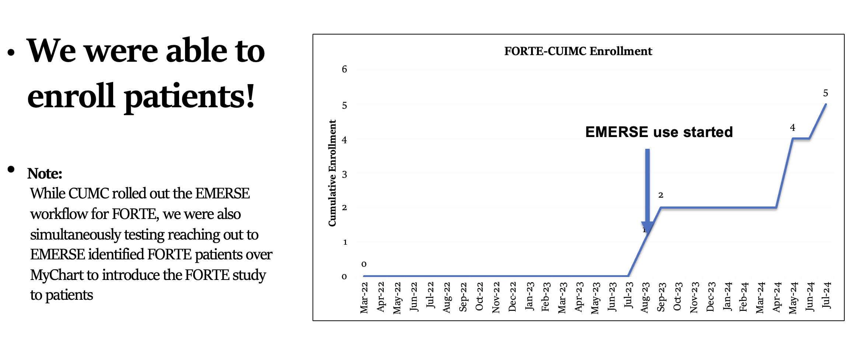
Enroll patients on trials
See this talk for more details:
https://vimeo.com/1084845123/
EMERSE Community Meeting May 2025
http://project-emerse.org/presentations.html

Slide 27
Highlight documents for chart review
Thoracocentesis confirmed the recurrence of mantle cell lymphoma. Disease restaging work-up revealed multicompartment lymphadenopathy in the neck, mediastinal, retrocrural, retroperitoneal and pelvic regions. Bone marrow was also involved. The patient was treated with a total of six cycles of rituximab, cyclophosphamide, vincristine, doxorubicin and dexamethasone (R-HyperCVAD) completed in January 2007. That treatment led to complete remission that lasted until October 2008, when the disease was found to have recurred in the left pleural space and retroperitoneum without bone marrow involvement.
https://jmedicalcasereports.biomedcentral.com/articles/10.1186/1752-1947-4-329
http://project-emerse.org/presentations.html

Slide 28

Our philosophy
It’s important to view the terms/concepts in the context of the original text to truly understand the clinical meaning.
http://project-emerse.org/presentations.html

Slide 29
Meta Mapping (1000):
1000 *^patient (Patients) [Patient or Disabled Group]
Meta Mapping (702):
742 Presented (Presentation) [Idea or Concept]
742 PALPABLE (Palpable) [Qualitative Concept]
784 right Breast mass (Lump in right breast) [Finding]
Meta Mapping (1000):
1000 Clinical Laboratory (Clinical Laboratory Services) [Health Care Activity]
Meta Mapping (1000):
1000 Clinical Laboratory (Laboratories, Clinical) [Health Care Related Organization,Manufactured Object]
Meta Mapping (947):
947 Mammography finding [Finding]
Meta Mapping (743):
715 CARCINOMA OF BREAST (Breast Carcinoma) [Neoplastic Process]
Meta Mapping (1000):
1000 *^patient (Patients) [Patient or Disabled Group]
Meta Mapping (1000):
1000 LUMPECTOMY (Lumpectomy of breast) [Therapeutic or Preventive Procedure]
Meta Mapping (1000):
1000 SENTINEL LYMPH NODE BIOPSY (Sentinel Lymph Node Biopsy) [Diagnostic Procedure]
Meta Mapping (745):
806 Frozen Section (Frozen Sections) [Tissue]
593 Tumour (Neoplasms) [Neoplastic Process]
Meta Mapping (745):
806 Frozen Section (Frozen Sections) [Tissue]
593 Tumor (Tumor tissue sample) [Tissue]
Meta Mapping (745):
806 Frozen Section (Frozen Sections) [Tissue]
593 Tumor (Specimen Source Codes - tumor) [Intellectual Product]
Meta Mapping (745):
806 Frozen Section (Frozen Sections) [Tissue]
593 Tumor (Tumor Mass) [Finding]
Meta Mapping (745):
806 Frozen Section (Cryoultramicrotomy) [Laboratory Procedure]
593 Tumour (Neoplasms) [Neoplastic Process]
Meta Mapping (745):
806 Frozen Section (Cryoultramicrotomy) [Laboratory Procedure]
593 Tumor (Tumor tissue sample) [Tissue]
Meta Mapping (745):
806 Frozen Section (Cryoultramicrotomy) [Laboratory Procedure]
593 Tumor (Specimen Source Codes - tumor) [Intellectual Product]
Meta Mapping (745):
806 Frozen Section (Cryoultramicrotomy) [Laboratory Procedure]
593 Tumor (Tumor Mass) [Finding]
Meta Mapping (1000):
1000 Sentinel node (Sentinel node (disorder)) [Disease or Syndrome]
Meta Mapping (1000):
1000 Sentinel Node (Sentinel Lymph Node) [Body Part, Organ, or Organ Component]
Meta Mapping (1000):
1000 Revealed [Qualitative Concept]
Meta Mapping (1000):
1000 Granulomatous Inflammation (Granulomatous inflammation) [Pathologic Function]
Meta Mapping (1000):
1000 Gross examination (Sample macroscopy) [Laboratory Procedure]
Meta Mapping (1000):
1000 confirmed (Confirmed by) [Qualitative Concept]
Meta Mapping (1000):
1000 Confirmed (Confirmation) [Finding]
Meta Mapping (696):
760 DIAGNOSIS (Diagnosis) [Diagnostic Procedure]
593 Tuberculous (Tuberculosis) [Disease or Syndrome]
593 MASTITIS (Mastitis) [Disease or Syndrome]
Meta Mapping (696):
760 DIAGNOSIS (Diagnosis) [Diagnostic Procedure]
593 Tuberculous (Tuberculosis) [Disease or Syndrome]
593 Mastitis (Inflammatory disorder of breast) [Disease or Syndrome]
Meta Mapping (696):
760 DIAGNOSIS (Diagnosis) [Diagnostic Procedure]
593 Tuberculous (Tuberculosis) [Disease or Syndrome]
593 Mastitis (Inflammation of non-human mammary gland) [Disease or Syndrome]
Meta Mapping (696):
760 Diagnosis (Disease) [Disease or Syndrome]
593 Tuberculous (Tuberculosis) [Disease or Syndrome]
593 MASTITIS (Mastitis) [Disease or Syndrome]
Meta Mapping (696):
760 Diagnosis (Disease) [Disease or Syndrome]
593 Tuberculous (Tuberculosis) [Disease or Syndrome]
593 Mastitis (Inflammatory disorder of breast) [Disease or Syndrome]
Meta Mapping (696):
760 Diagnosis (Disease) [Disease or Syndrome]
593 Tuberculous (Tuberculosis) [Disease or Syndrome]
593 Mastitis (Inflammation of non-human mammary gland) [Disease or Syndrome]
Meta Mapping (696):
760 DIAGNOSIS (Diagnosis Code) [Intellectual Product]
593 Tuberculous (Tuberculosis) [Disease or Syndrome]
593 MASTITIS (Mastitis) [Disease or Syndrome]
Meta Mapping (696):
760 DIAGNOSIS (Diagnosis Code) [Intellectual Product]
593 Tuberculous (Tuberculosis) [Disease or Syndrome]
593 Mastitis (Inflammatory disorder of breast) [Disease or Syndrome]
Meta Mapping (696):
760 DIAGNOSIS (Diagnosis Code) [Intellectual Product]
593 Tuberculous (Tuberculosis) [Disease or Syndrome]
593 Mastitis (Inflammation of non-human mammary gland) [Disease or Syndrome]
Meta Mapping (696):
760 diagnosis (diagnosis aspect) [Functional Concept]
593 Tuberculous (Tuberculosis) [Disease or Syndrome]
593 MASTITIS (Mastitis) [Disease or Syndrome]
Meta Mapping (696):
760 diagnosis (diagnosis aspect) [Functional Concept]
593 Tuberculous (Tuberculosis) [Disease or Syndrome]
593 Mastitis (Inflammatory disorder of breast) [Disease or Syndrome]
Meta Mapping (696):
760 diagnosis (diagnosis aspect) [Functional Concept]
593 Tuberculous (Tuberculosis) [Disease or Syndrome]
593 Mastitis (Inflammation of non-human mammary gland) [Disease or Syndrome]
Meta Mapping (696):
760 DIAGNOSIS (Diagnosis Study) [Research Activity]
593 Tuberculous (Tuberculosis) [Disease or Syndrome]
593 MASTITIS (Mastitis) [Disease or Syndrome]
Meta Mapping (696):
760 DIAGNOSIS (Diagnosis Study) [Research Activity]
593 Tuberculous (Tuberculosis) [Disease or Syndrome]
593 Mastitis (Inflammatory disorder of breast) [Disease or Syndrome]
Meta Mapping (696):
760 DIAGNOSIS (Diagnosis Study) [Research Activity]
593 Tuberculous (Tuberculosis) [Disease or Syndrome]
593 Mastitis (Inflammation of non-human mammary gland) [Disease or Syndrome]
Meta Mapping (696):
760 Diagnosis (Date of diagnosis) [Temporal Concept]
593 Tuberculous (Tuberculosis) [Disease or Syndrome]
593 MASTITIS (Mastitis) [Disease or Syndrome]
Meta Mapping (696):
760 Diagnosis (Date of diagnosis) [Temporal Concept]
593 Tuberculous (Tuberculosis) [Disease or Syndrome]
593 Mastitis (Inflammatory disorder of breast) [Disease or Syndrome]
Meta Mapping (696):
760 Diagnosis (Date of diagnosis) [Temporal Concept]
593 Tuberculous (Tuberculosis) [Disease or Syndrome]
593 Mastitis (Inflammation of non-human mammary gland) [Disease or Syndrome]
Meta Mapping (1000):
1000 *^patient (Patients) [Patient or Disabled Group]
Meta Mapping (1000):
1000 RECEIVED (Receive) [Qualitative Concept]
Meta Mapping (719):
753 TUBERCULOSIS (Tuberculosis) [Disease or Syndrome]
753 therapy (therapeutic aspects) [Functional Concept]
623 Six months [Temporal Concept]
Meta Mapping (719):
753 TUBERCULOSIS (Tuberculosis) [Disease or Syndrome]
753 Therapy (Therapeutic procedure) [Therapeutic or Preventive Procedure]
623 Six months [Temporal Concept]
Meta Mapping (719):
753 TUBERCULOSIS (Tuberculosis) [Disease or Syndrome]
753 Therapy (Therapy Object (animal model)) [Finding]
623 Six months [Temporal Concept]
Meta Mapping (1000):
1000 side effects (aspects of adverse effects) [Functional Concept]
Meta Mapping (1000):
1000 N side effects (Adverse event) [Pathologic Function]
Meta Mapping (1000):
1000 N Side effects (Adverse effects) [Pathologic Function]
Meta Mapping (888):
694 Further [Spatial Concept]
861 N Complications (Complication) [Pathologic Function]
Meta Mapping (888):
694 Further [Spatial Concept]
861 complications (Complication Aspects) [Functional Concept]
MetaMap output
http://project-emerse.org/presentations.html

Slide 30
Location_Start | Location_End | Semantic | Entity
28 | 63 | problem | a palpable mass of the right breast
51 | 63 | bodyloc | right breast
130 | 136 | bodyloc | breast
130 | 146 | problem | breast carcinoma
170 | 180 | treatment | lumpectomy
185 | 211 | test | sentinel lymph node biopsy
213 | 240 | treatment | Frozen section of the tumor
249 | 262 | bodyloc | sentinel node
273 | 299 | problem | granulomatous inflammation
308 | 325 | test | gross examination
353 | 373 | problem | tuberculous mastitis
396 | 421 | treatment | anti-tuberculosis therapy
426 | 436 | temporal | six months
442 | 444 | negation | no
445 | 457 | problem | side effects
461 | 486 | problem | any further complications
http://project-emerse.org/presentations.html

Slide 31
CASE PRESENTATION
The patient presented with a palpable mass of the right breast with clinical, laboratory and mammographic findings indicative of breast carcinoma. The patient underwent lumpectomy and sentinel lymph node biopsy. Frozen section of the tumor and the sentinel node revealed "granulomatous inflammation", while gross examination confirmed the diagnosis of tuberculous mastitis. The patient received anti-tuberculosis therapy for six months with no side effects or any further complications.
https://jmedicalcasereports.biomedcentral.com/articles/10.1186/1752-1947-2-34
http://project-emerse.org/presentations.html

Slide 32

EMERSE is fast
Query to identify all patients with the following | Reporting DB time (s) | EMERSE time (s) | EMERSE advantage
cavernous hemangioma | 14,652 | 2 | 7,320x
gray platelet syndrome | 14,940 | 2 | 7,470x
inferior lingular segment of the left upper lobe | 17,784 | 9 | 1,980x
…enabling real-time querying
http://project-emerse.org/presentations.html

Slide 33
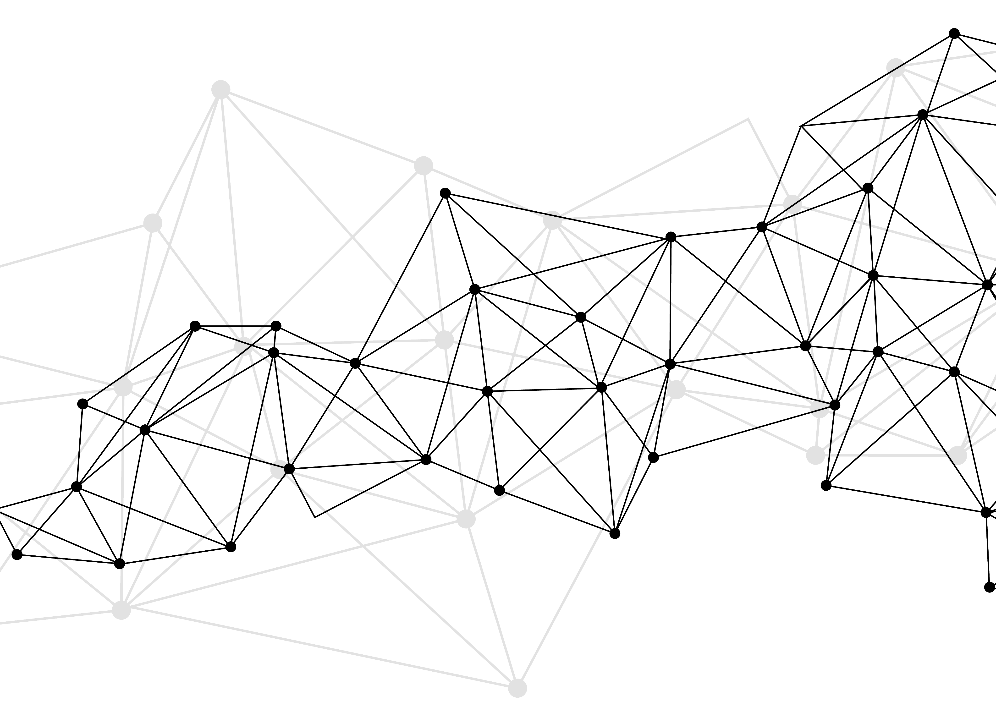
Synonyms
Used for query expansions
User-controlled
Multiple datasets can be included
EMERSE Synonyms
  acronyms, abbreviations, professional/consumer terms, misspellings, trade/generic drug names, species, chemo regimens, phrase variations, malapropisms, idioms, neologisms, organizations, companies, & more
  3 million unique entries
http://project-emerse.org/presentations.html

Slide 34
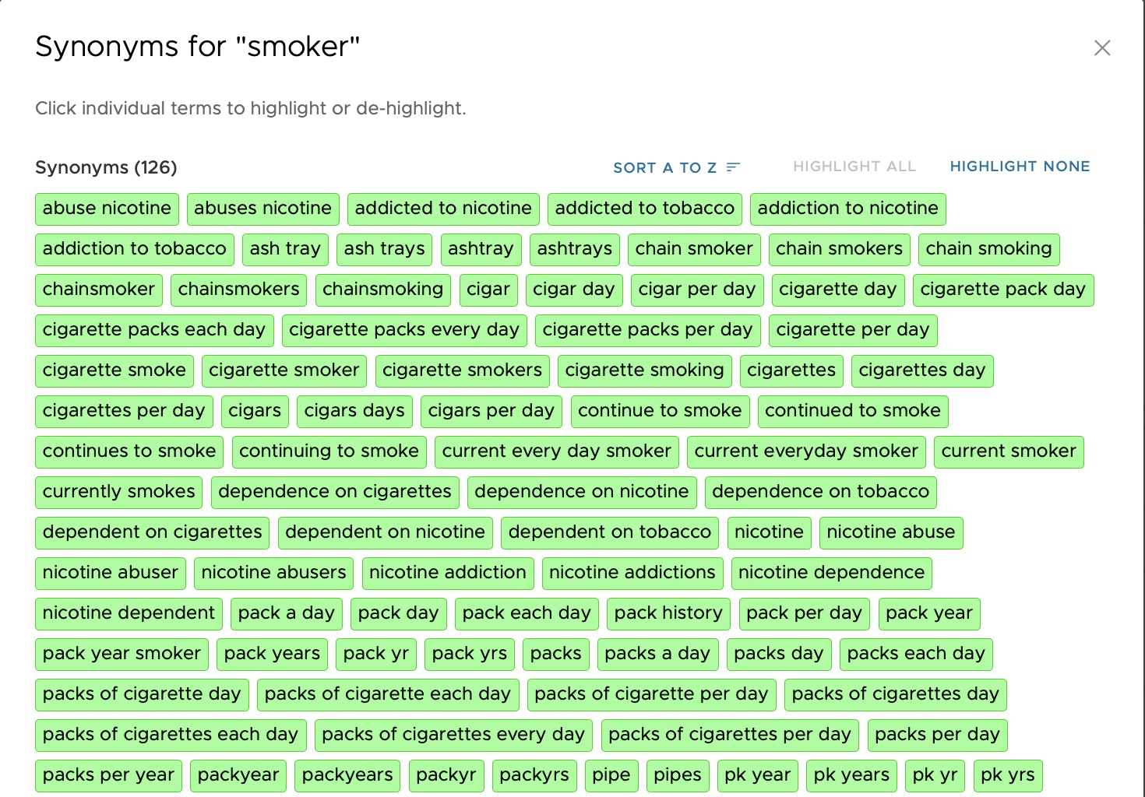

Slide 35
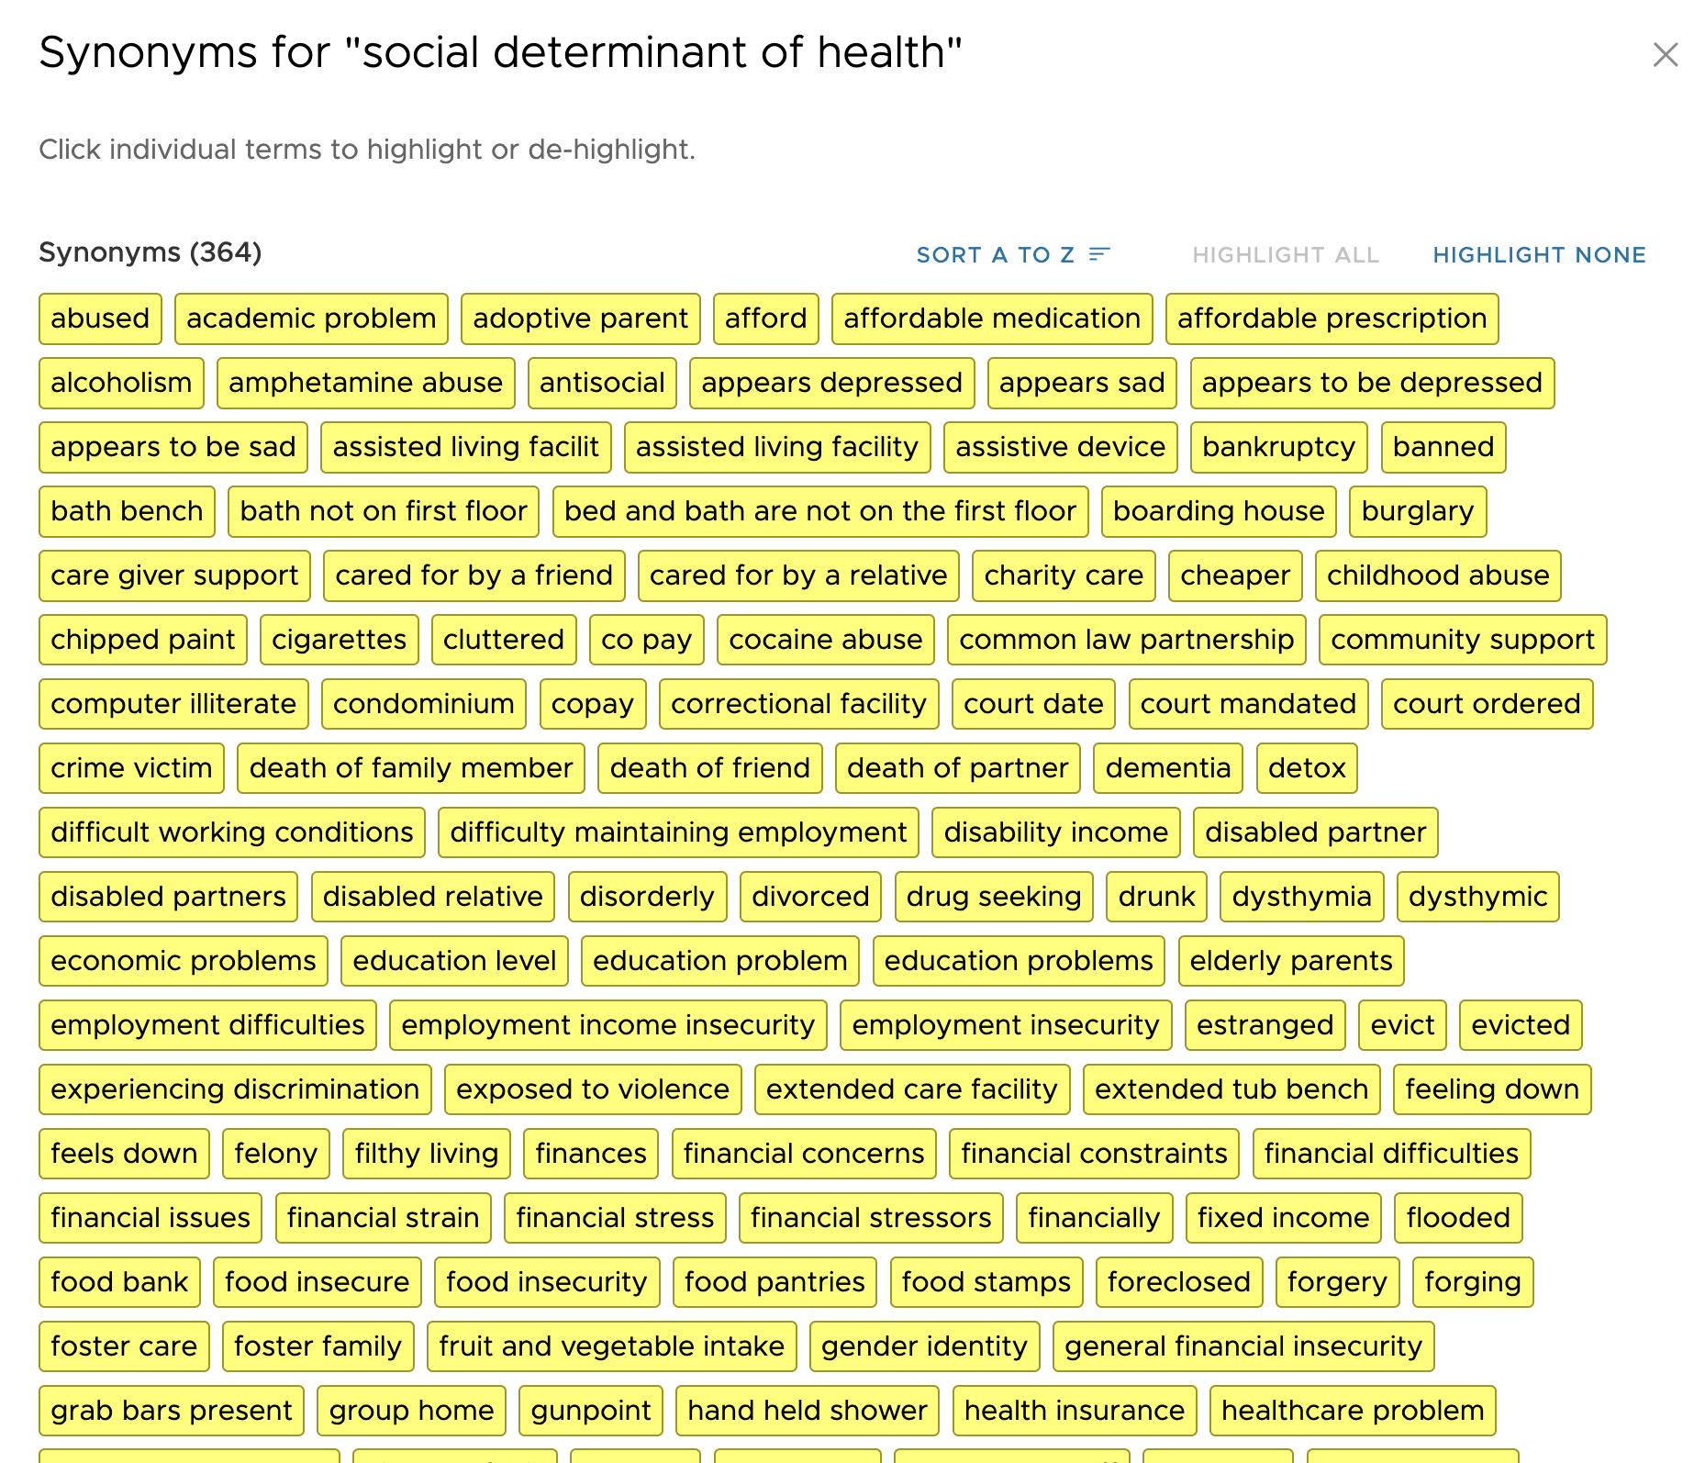
http://project-emerse.org/presentations.html

Slide 36
Typical workflow
initial cohort identified
with a cohort discovery
tool using structured data (or via EMERSE
‘Find Patients’)
Cohort discovery tools:
i2b2/ENACT, Leaf, etc.
http://project-emerse.org/presentations.html

Slide 37
Typical workflow
additional details abstracted from the free text using EMERSE
http://project-emerse.org/presentations.html

Slide 38
Typical workflow
Data recorded in an electronic data capture system (e.g., REDCap)
http://project-emerse.org/presentations.html

Slide 39

Publications using EMERSE
737
papers, abstracts,
theses, etc.
Full list at:
http://project-emerse.org/publications.html
http://project-emerse.org/presentations.html

Slide 40

Recently released…
Incorporation of NLP features
  negation
  uncertainty
  subject (patient vs other)
  history of
  named entity recognition/mapping to ontologies
If you don’t like our built-in NLP, use your own
http://project-emerse.org/presentations.html

Slide 41

Future Work
Data extraction from templated notes
Integration with ChatGPT or similar tools
& more…
http://project-emerse.org/presentations.html

Slide 42





project-emerse.org
http://project-emerse.org/presentations.html

Slide 43

Interested in EMERSE?
Contact us to schedule a time with your team for:
Discussions about usage strategies
Training
Live demonstrations (abstractors, IT teams, etc)
http://project-emerse.org/presentations.html

Slide 44

Community Meetings
Twice per year
Last meeting November 2025
Next meeting May 2026
http://project-emerse.org/presentations.html

Slide 45

EMERSE-team@umich.edu
Lisa Ferguson
David Hanauer
Kellen McClain
Guan Wang
http://project-emerse.org/presentations.html

Slide 46

Live Demo
No real names
No PHI
Publicly available
Abstracts & case reports
http://project-emerse.org/presentations.html

