Slide 1
Enhancing Research with EMERSE Text
Processing and Search tool for an AI-Driven Future
University of Michigan Medical-Dental LHS Collaborative
May 13, 2025
Twitter/X: @projectEMERSE
Web: project-emerse.org
Email: hanauer@umich.edu
emerse-team@umich.edu
David Hanauer, MD, MS
Dept of Learning Health Sciences
University of Michigan
http://project-emerse.org/presentations.html

Slide 2
If you want to take notes or visit links
these slides can be found at:
this link will be
on most slides
http://project-emerse.org/presentations.html

Slide 3
Disclosures
Funding: NIH (NCI-ITCR, NCATS-CTSA)
U of Michigan Royalties/Licensing: “Synonyms” dataset–optional “plugin” for EMERSE.
Disclosures
http://project-emerse.org/presentations.html

Slide 4
Unstructured vs Structured Data
EMERSE is for this… | …not this
Unstructured Data (free-text) | Structured Data
Mrs. Jones is a 56 year old female with a history of HTN, hypercholesterolemia, and T2DM who comes to the clinic today with a 3 day h/o dizziness and severe headache on the left side. | WBC: 5.6 Total cholesterol: 182 Weight: 67.4 AST: 30 ALT: 52
http://project-emerse.org/presentations.html

Slide 5
80% of EHR data are in unstructured free-text
structured data
unstructured data/free text
http://project-emerse.org/presentations.html

Slide 6
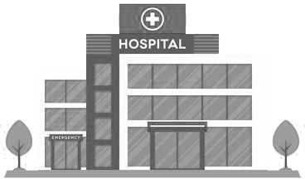
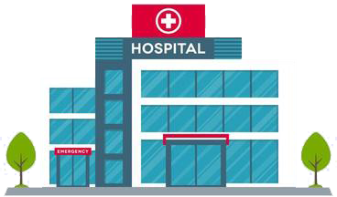
Most medical centers lack tools for free-text
http://project-emerse.org/presentations.html

Slide 7
The EMERSE solution
A system “for the people”
Users search the notes on their own
No need to wait in a queue for an analyst or a data scientist
Easy-to-use for non-technical users
Unlike with some EHRs, EMERSE can search across all notes and all patients at once
Continuous refinements for over 19 years
http://project-emerse.org/presentations.html

Slide 8
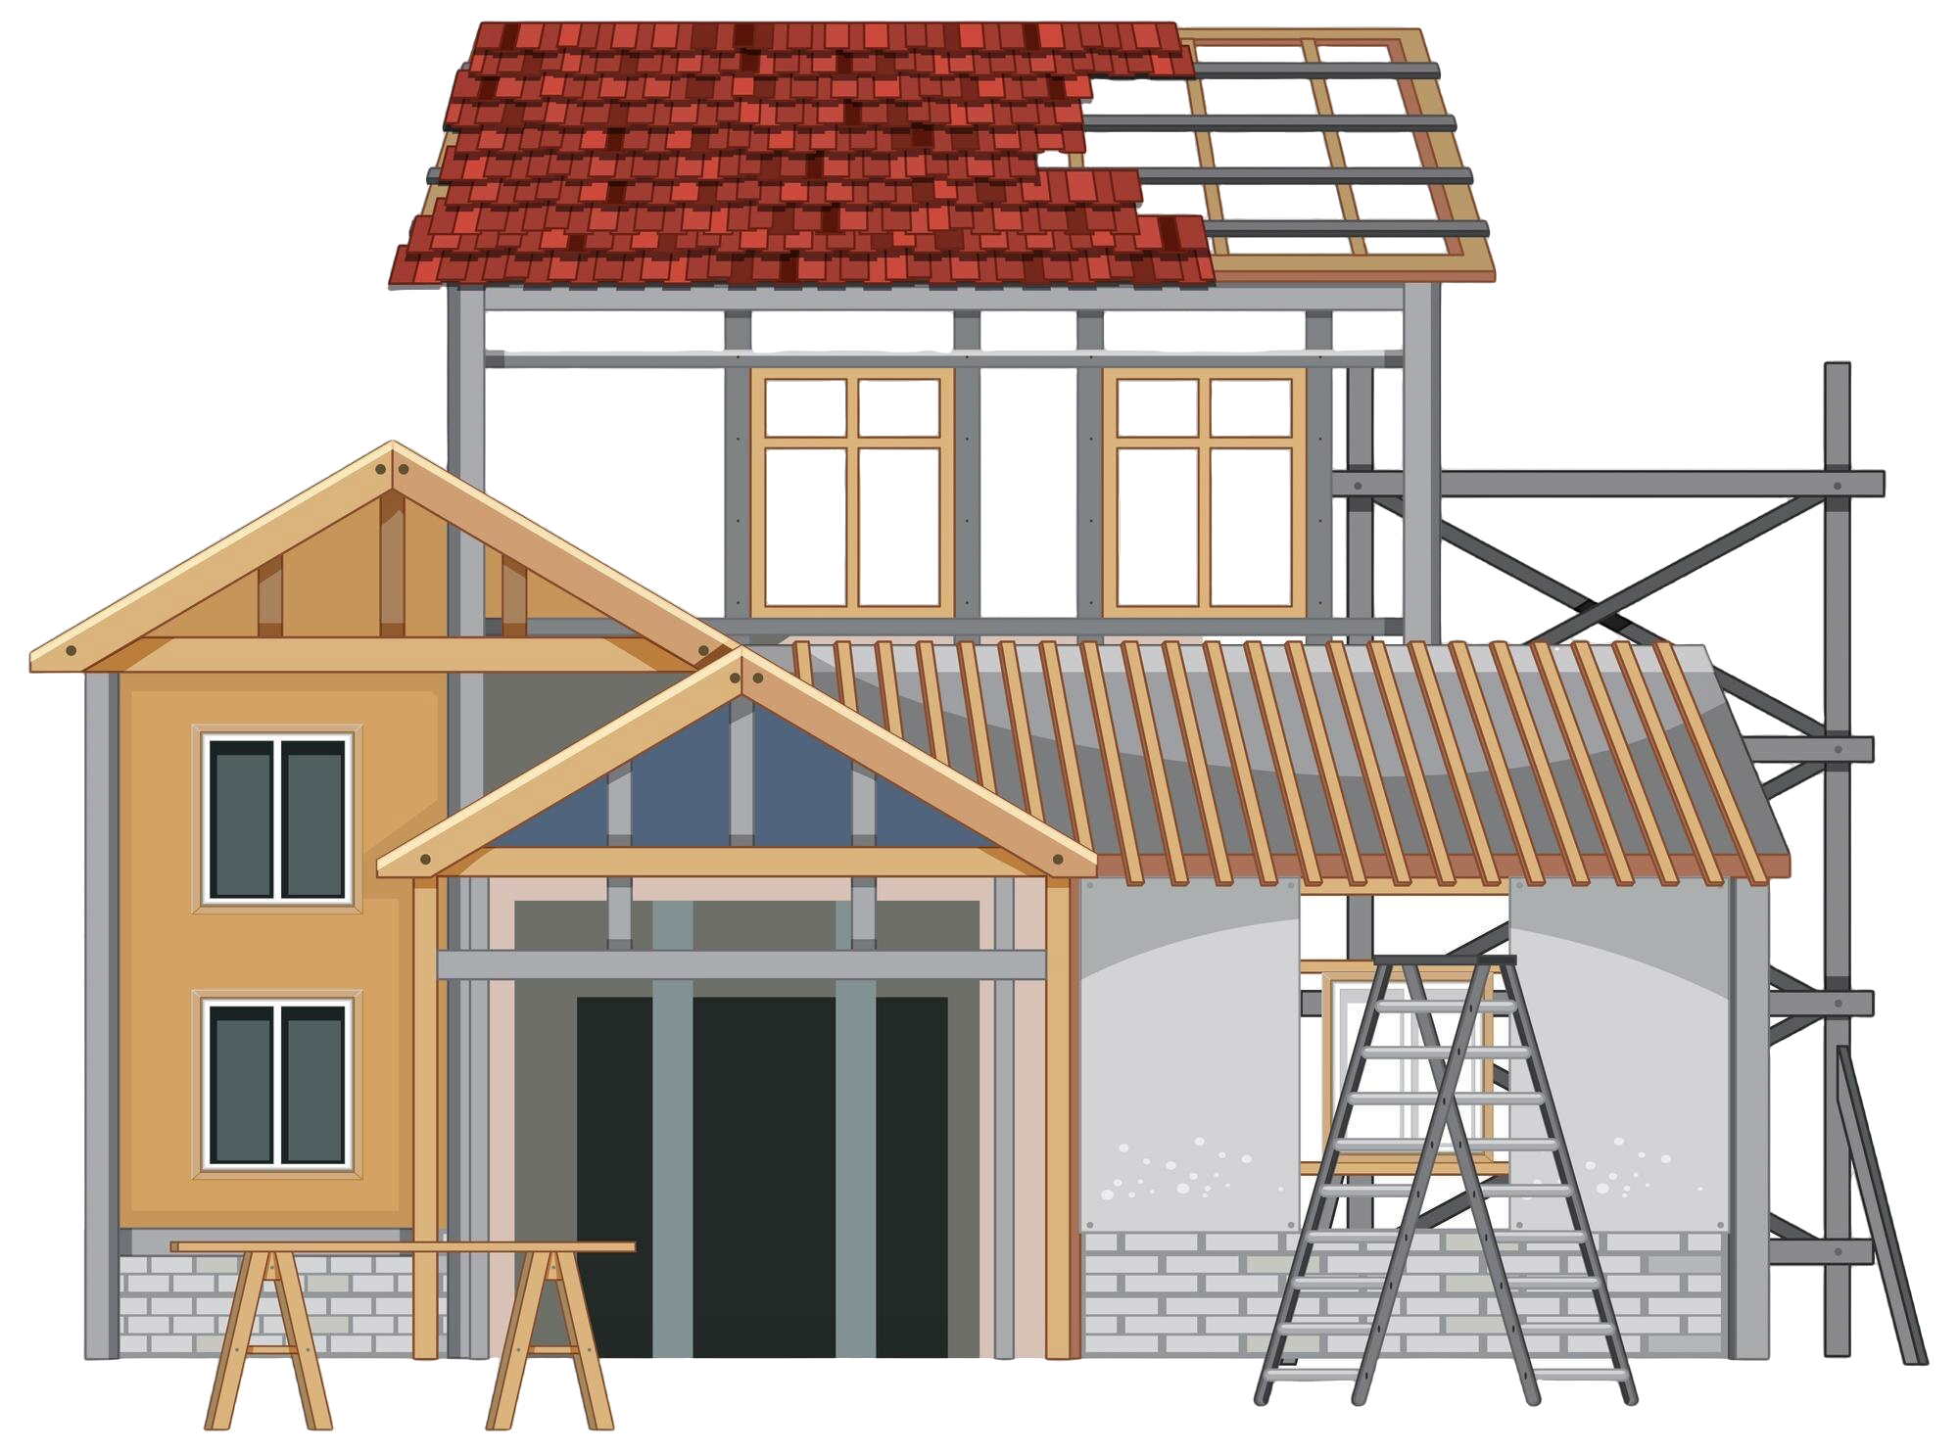
EMERSE is a useful tool
It will be one of many you need to build/support your project(s)
http://project-emerse.org/presentations.html

Slide 9
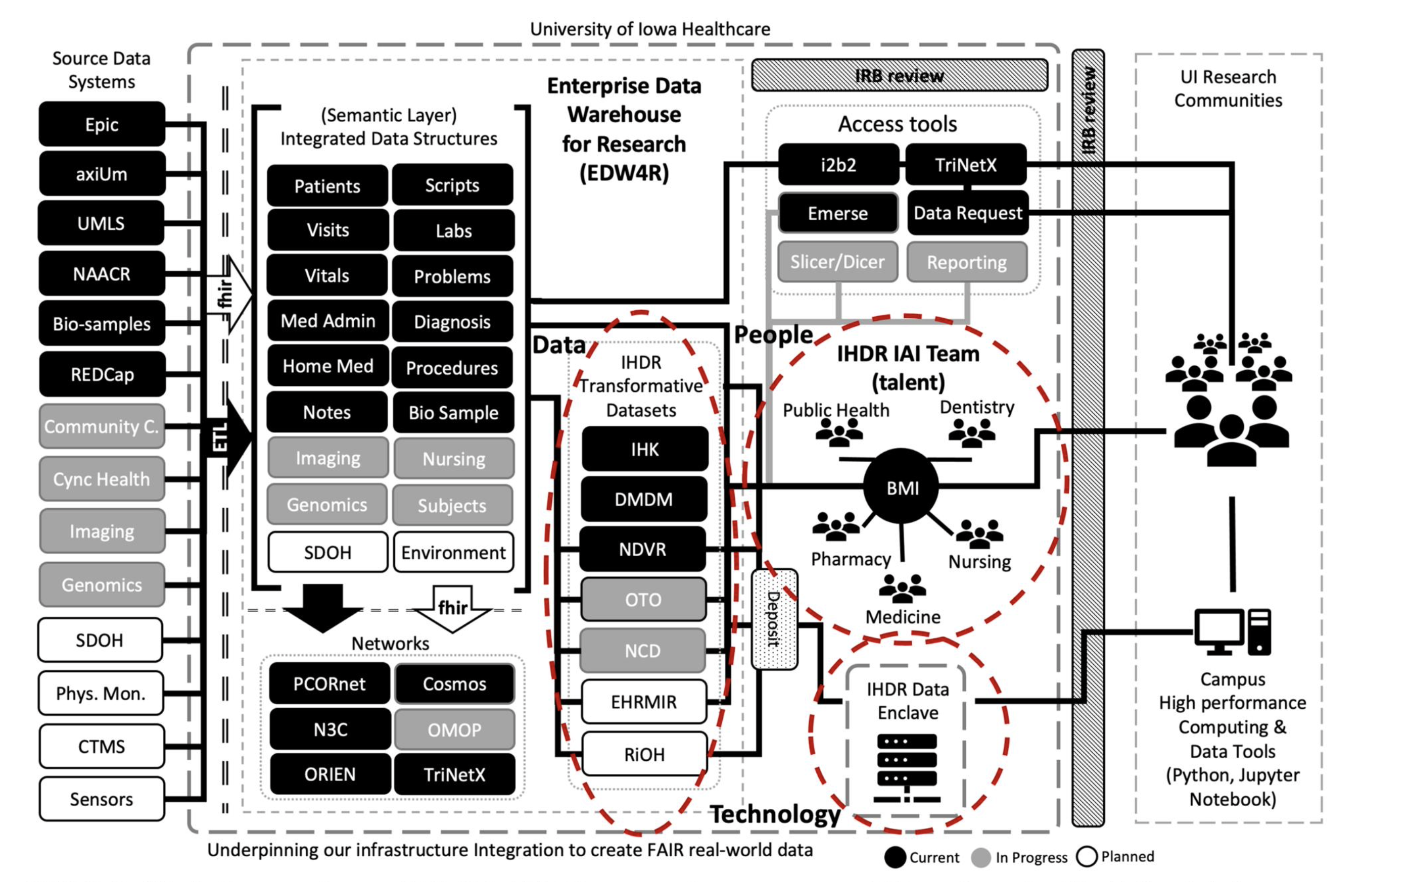
https://doi.org/10.1093/jamia/ocad236
http://project-emerse.org/presentations.html

Slide 10
How much does it cost?
Software $0.00
Installation Guidance $0.00
Access to Documentation $0.00
Training (within reason) $0.00
Synonyms dataset (optional) $0.00*
* For research use within EMERSE
http://project-emerse.org/presentations.html

Slide 11
We think EMERSE is really good
We’re proud of what we created
We think it’s better than other software tools that cost $$$
http://project-emerse.org/presentations.html

Slide 12
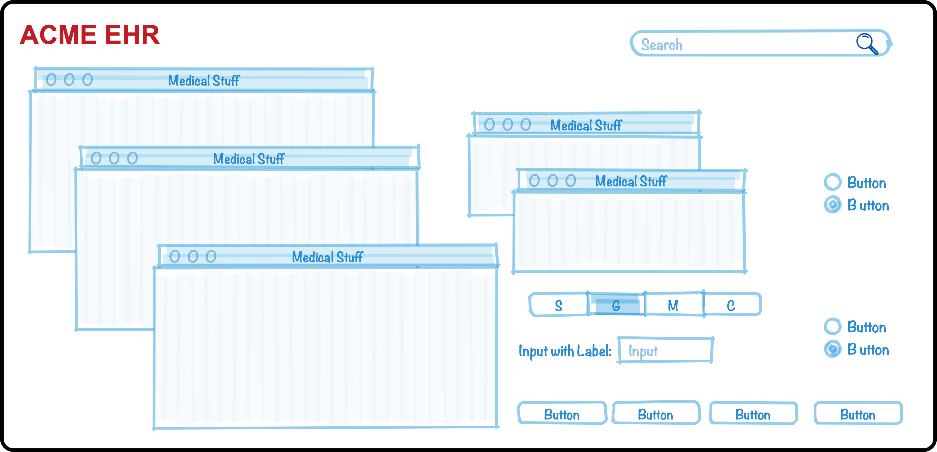
Why do we think it’s better?
We’ve been laser-focused on it
EHRs have thousands of features
The EMERSE team has dedicated 19+ years on just this one feature (search) because it’s so important
http://project-emerse.org/presentations.html

Slide 13
Why do we think it’s better?
We’ve studied it
“new users of the EMERSE system are able to complete basic but critical workflow tasks in the system with a high rate of success…are highly satisfied with the interface, and have highly positive perceptions of its expected utility in their work.”
“survey results indicate very high ratings of usability and satisfaction with the EMERSE system by new users after only one session of use.”
https://project-emerse.org/documents/reyes_masters_thesis_2021.pdf
http://project-emerse.org/presentations.html

Slide 14
Why do we think it’s better?
Our users tell us
Thank you for…this important tool which is proving extremely valuable in enhancing patient safety and quality of care delivered at Michigan Medicine.
EMERSE is working out great for casefinding...have found quite a bit of cases that we would have missed otherwise. Thank you and everyone on your team!
..continued gratitude for the availability of this powerful research tool. As always, thank you for this innovation!
EMERSE is an absolute gem
@umichmedicine. The functionality is very friendly and it saved hours of time during the data collection process. Thank you to the team that created this powerful research tool!
To say “it is the most useful tool I use in my job” would be an understatement, so thank you for creating and sharing it with others!!
http://project-emerse.org/presentations.html

Slide 15
Why do we think it’s better?
Researchers mention it in their publications
“Reviewers used the EMERSE search tool to ensure thorough review of the available documentation...” [PMID 36119396]
“the tool avoids the pitfalls of diagnostic inaccuracy seen with tools querying on ICD and billing codes…” [PMID 36114099]
“[EMERSE] provides software features to comprehensively scan all clinical documents…for keywords and phrases to ensure that even rarely mentioned events are detected.” [PMID 36550198]
“…information [was] captured via EMERSE…in order to obtain the most accurate and complete information per patient.”[PMID 36752520]
http://project-emerse.org/presentations.html

Slide 16
Why do we think it’s better?
Top-tier medical centers use it
Installed | Installing
U of Michigan | Weill Cornell Medical Center
Harvard U – Dana Farber Cancer Center | U of Virginia
Columbia U Cancer Center | Moffitt Cancer Center, Tampa, FL
U of North Carolina – Chapel Hill | U of California – Irvine
U of California – San Francisco | Children’s Health Orange County, Calif.
U of Kentucky
U of Cincinnati
Case Western Reserve U
U of Minnesota – Minneapolis
Utrecht University, Netherlands
U of Iowa
http://project-emerse.org/presentations.html

Slide 17
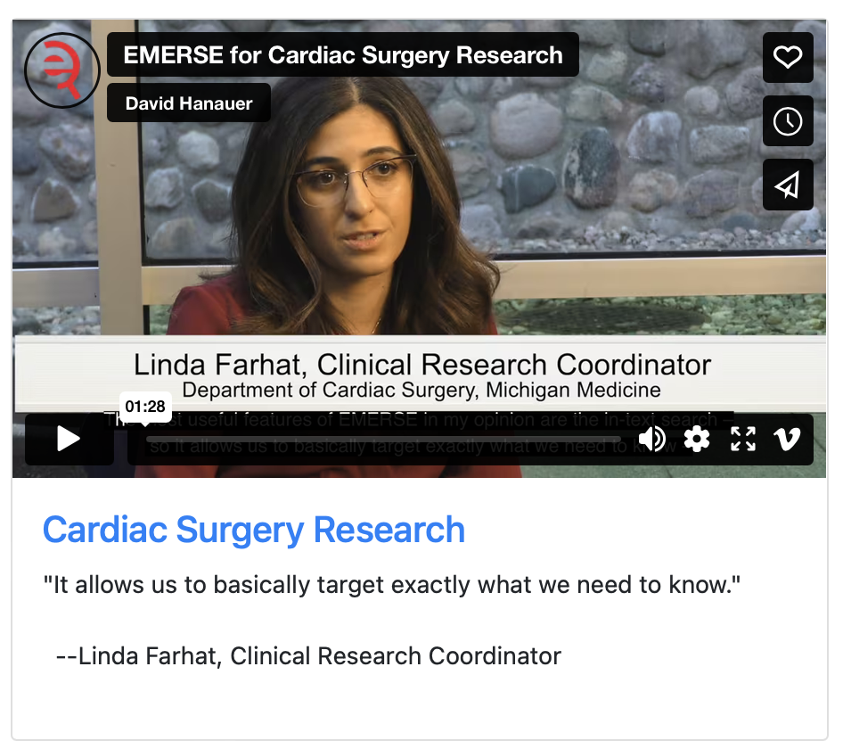
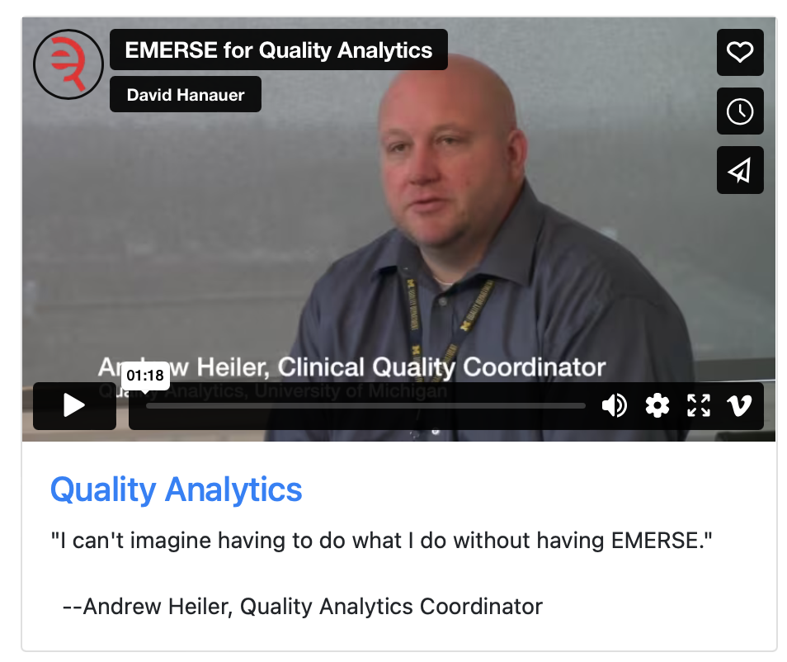
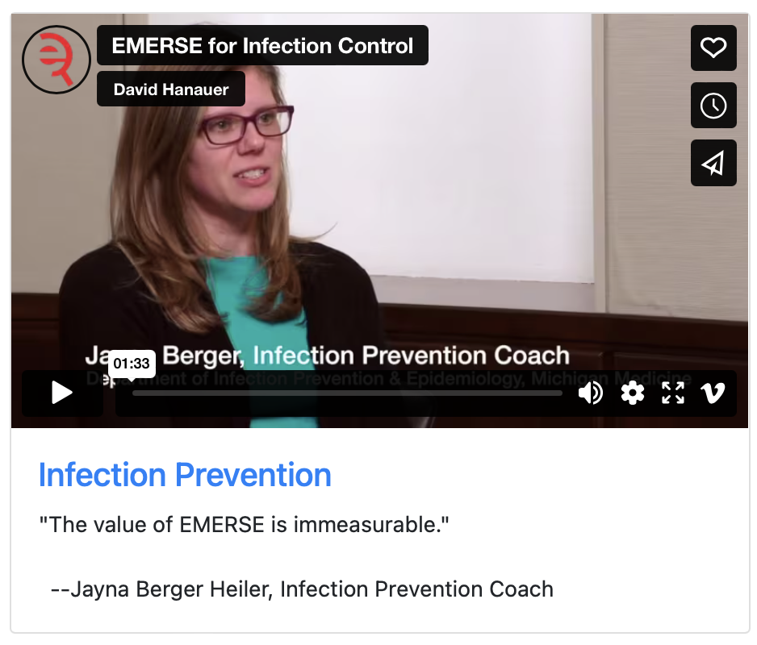
What can EMERSE be used for?
Lots of things!
Watch our videos: https://project-emerse.org/use_cases.html

Slide 18
Find cohorts
EMERSE allows you to find cohorts based on things mentioned in the notes
diseases
drugs
symptoms
anything*
*if it is mentioned
http://project-emerse.org/presentations.html

Slide 19
Find cohorts
It’s perfect for finding rare things…
…like rare cancers such as
cutaneous leiomyosarcoma
See this talk for more details:
https://vimeo.com/677482835
“Using EMERSE to Improve Research Involving Rare Cancers”
http://project-emerse.org/presentations.html

Slide 20
Highlight documents for chart review
Thoracocentesis confirmed the recurrence of mantle cell lymphoma. Disease restaging work-up revealed multicompartment lymphadenopathy in the neck, mediastinal, retrocrural, retroperitoneal and pelvic regions. Bone marrow was also involved. The patient was treated with a total of six cycles of rituximab, cyclophosphamide, vincristine, doxorubicin and dexamethasone (R-HyperCVAD) completed in January 2007. That treatment led to complete remission that lasted until October 2008, when the disease was found to have recurred in the left pleural space and retroperitoneum without bone marrow involvement.
https://jmedicalcasereports.biomedcentral.com/articles/10.1186/1752-1947-4-329
http://project-emerse.org/presentations.html

Slide 21
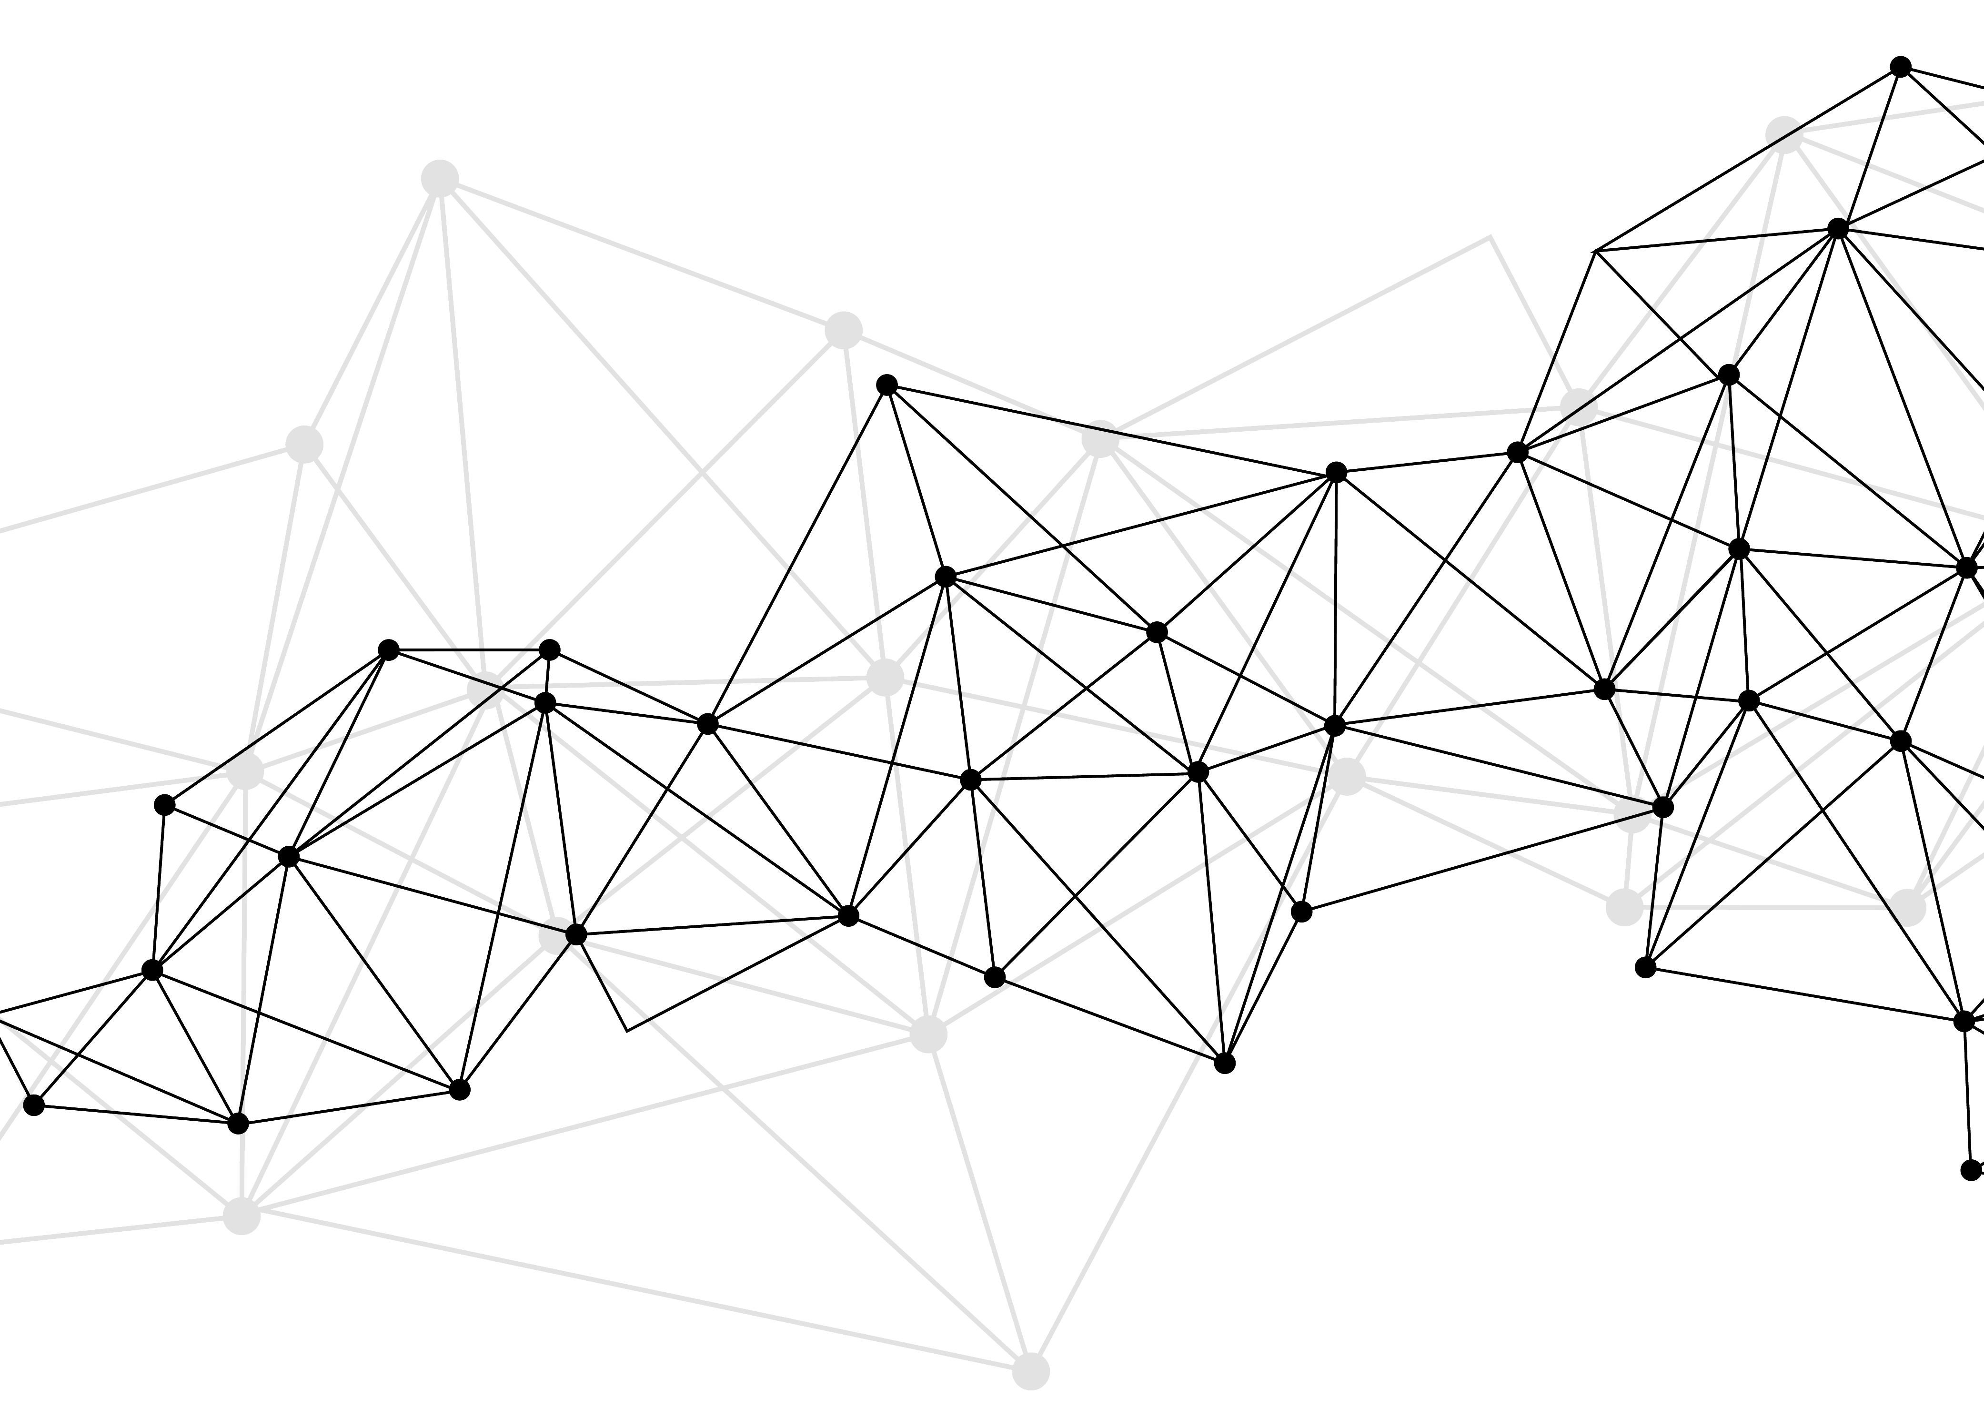
Synonyms
Used for query expansions
User-controlled
Multiple datasets can be included
EMERSE Synonyms
acronyms, abbreviations, professional/consumer terms, misspellings, trade/generic drug names, species, chemo regimens, phrase variations, malapropisms, idioms, neologisms, organizations, companies, & more
2.8 million unique entries
http://project-emerse.org/presentations.html

Slide 22
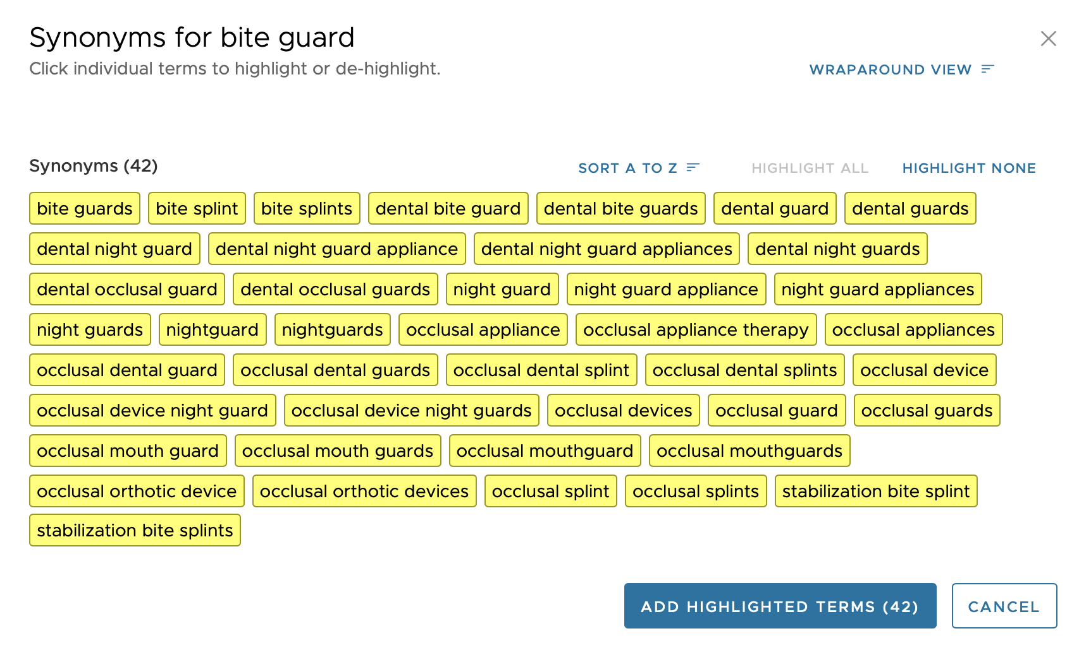

Slide 23
Typical workflow
initial cohort identified
with a cohort discovery
tool using structured data (or via EMERSE
‘Find Patients’)
Cohort discovery tools:
i2b2/ENACT, Leaf, etc.
http://project-emerse.org/presentations.html

Slide 24
Typical workflow
additional details abstracted from the free text using EMERSE
http://project-emerse.org/presentations.html

Slide 25
Typical workflow
Data recorded in an electronic data capture system (e.g., REDCap)
http://project-emerse.org/presentations.html

Slide 26
Publications using EMERSE
701
papers and abstracts
Full list at:
http://project-emerse.org/publications.html
http://project-emerse.org/presentations.html

Slide 27
Recently released
Incorporation of natural language
processing (NLP) features
negation
uncertainty
subject (patient vs other)
named entity recognition/mapping to ontologies
If you don’t like our built-in NLP, add your own
http://project-emerse.org/presentations.html

Slide 28
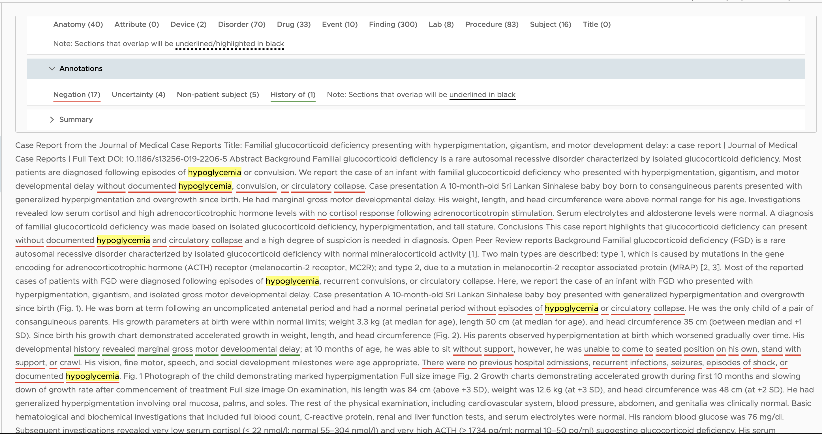

Slide 29
Future Work
Data extraction from templated notes
Integration with ChatGPT or similar large language models (LLMs)
http://project-emerse.org/presentations.html

Slide 30
Interested in EMERSE?
Contact us to schedule a time with your team for:
Discussions about usage strategies
Training
Live demonstrations (abstractors, IT teams, etc)
http://project-emerse.org/presentations.html

Slide 31
Community Meeting
TOMORROW: May 14, 2025, 1-2 PM ET
Open to everyone, find registration link at
http://project-emerse.org/
http://project-emerse.org/presentations.html

Slide 32
EMERSE-team@umich.edu
Lisa Ferguson
David Hanauer
Kellen McClain
Guan Wang
http://project-emerse.org/presentations.html

Slide 33
Large language models (LLMs)
Logical next step for integration
Very exciting, lots of potential
http://project-emerse.org/presentations.html

Slide 34
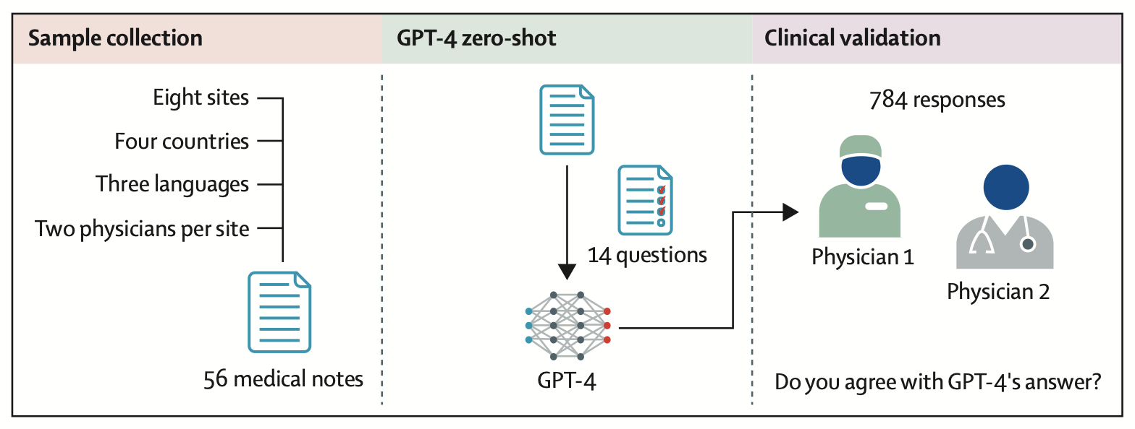
https://www.thelancet.com/action/showPdf?pii=S2589-7500%2824%2900246-2
http://project-emerse.org/presentations.html

Slide 35
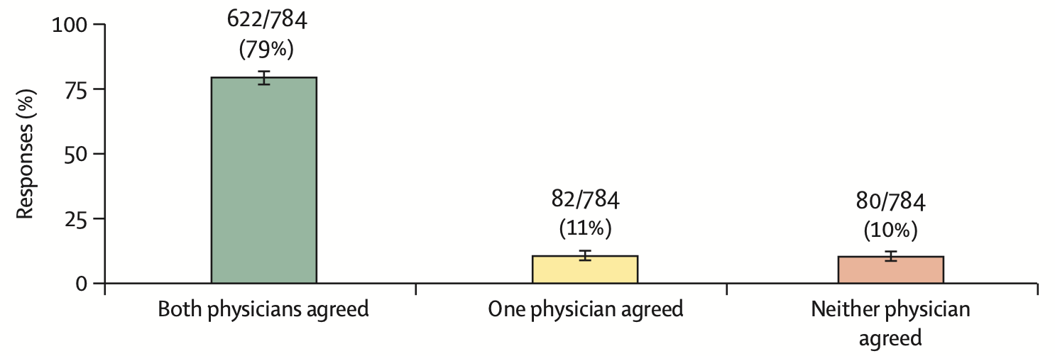
https://www.thelancet.com/action/showPdf?pii=S2589-7500%2824%2900246-2
http://project-emerse.org/presentations.html

Slide 36
https://academic.oup.com/jamia/advance-article/doi/10.1093/jamia/ocaf056/8126598
http://project-emerse.org/presentations.html

Slide 37
Large language models (LLMs)
Some concerns too
We are moving ahead cautiously
http://project-emerse.org/presentations.html

Slide 38
http://project-emerse.org/presentations.html

Slide 39
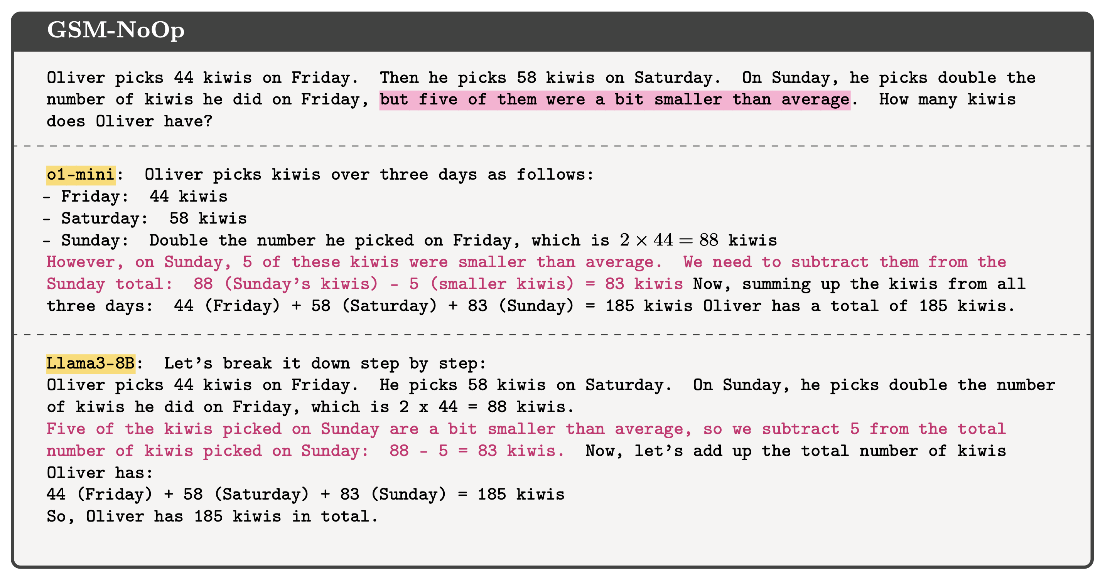
http://project-emerse.org/presentations.html

Slide 40
Counterfactual bias
“…the notion of counterfactual bias is the idea that large language models will often assume that a factual premise in a question by the user is true, even if it’s flat-out wrong.”
Source:
AI can’t handle the truth when it comes to the law
Marketplace Tech
https://www.marketplace.org/shows/marketplace-tech/ai-cant-handle-the-truth-when-it-comes-to-the-law/
http://project-emerse.org/presentations.html

Slide 41
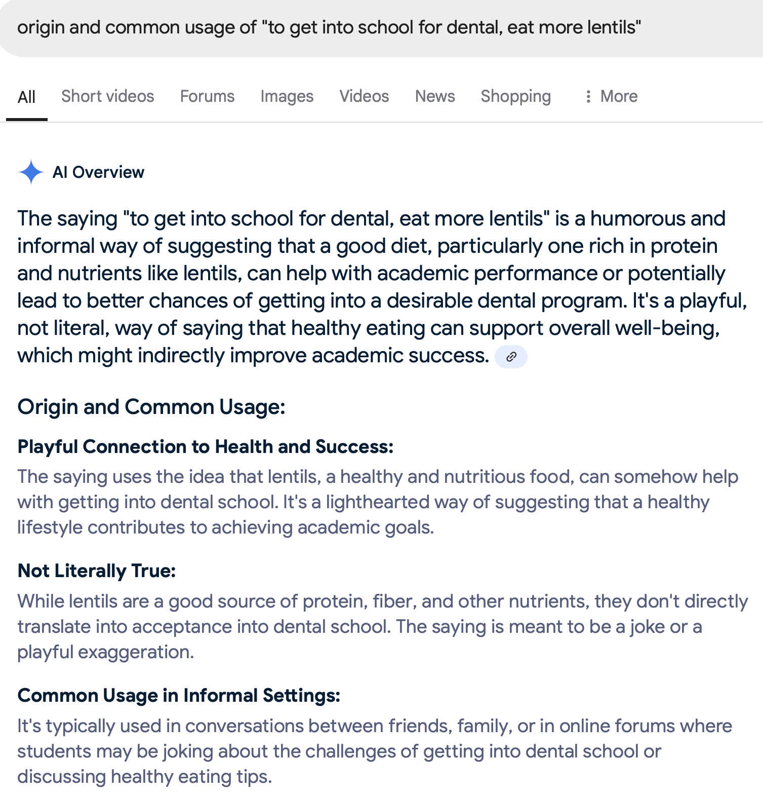
http://project-emerse.org/presentations.html

Slide 42
Counterfactual bias
What does this have to do with clinical notes?
An EMERSE user searched for:
“deleted cesarean”
What is that?
http://project-emerse.org/presentations.html

Slide 43
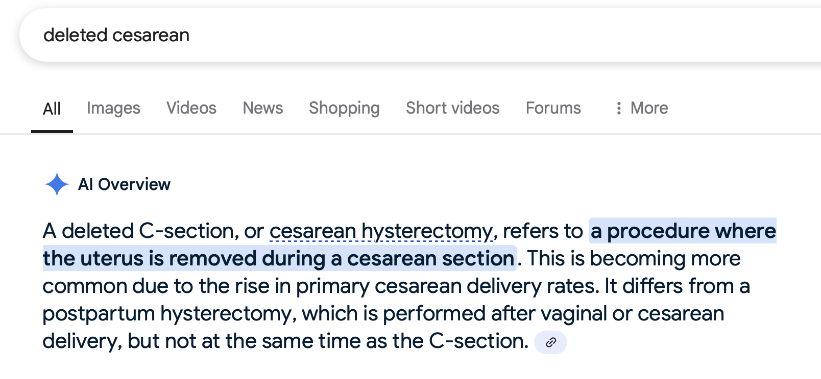
http://project-emerse.org/presentations.html

Slide 44
http://project-emerse.org/presentations.html

Slide 45
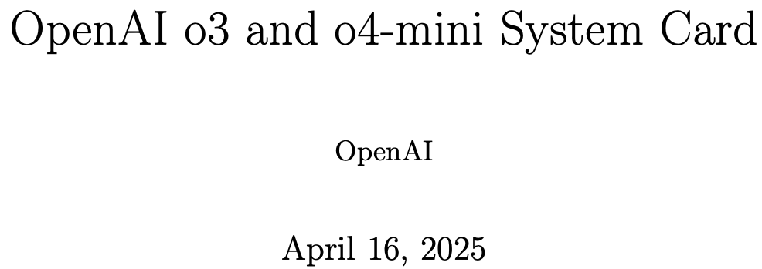
Hallucinations
http://project-emerse.org/presentations.html

Slide 46
ECRI (Emergency Care Research Institute) Top 10 technology hazards for 2025:
Fire risk from supplemental oxygen
Poorly managed infusion lines
Harmful medical adhesive products
https://home.ecri.org/blogs/ecri-news/artificial-intelligence-tops-2025-health-technology-hazards-list
http://project-emerse.org/presentations.html

Slide 47
ECRI (Emergency Care Research Institute) Top 10 technology hazards for 2025:
Risks with AI-enabled health technologies
Unmet technology support needs for home care patients
Vulnerable technology vendors and cybersecurity threats
Substandard or fraudulent medical devices and supplies
Fire risk from supplemental oxygen
Dangerously low default alarm limits on anesthesia units
Mishandled temporary holds on medication orders
Poorly managed infusion lines
Harmful medical adhesive products
Incomplete investigations of infusion system incidents
https://home.ecri.org/blogs/ecri-news/artificial-intelligence-tops-2025-health-technology-hazards-list
http://project-emerse.org/presentations.html

Slide 48
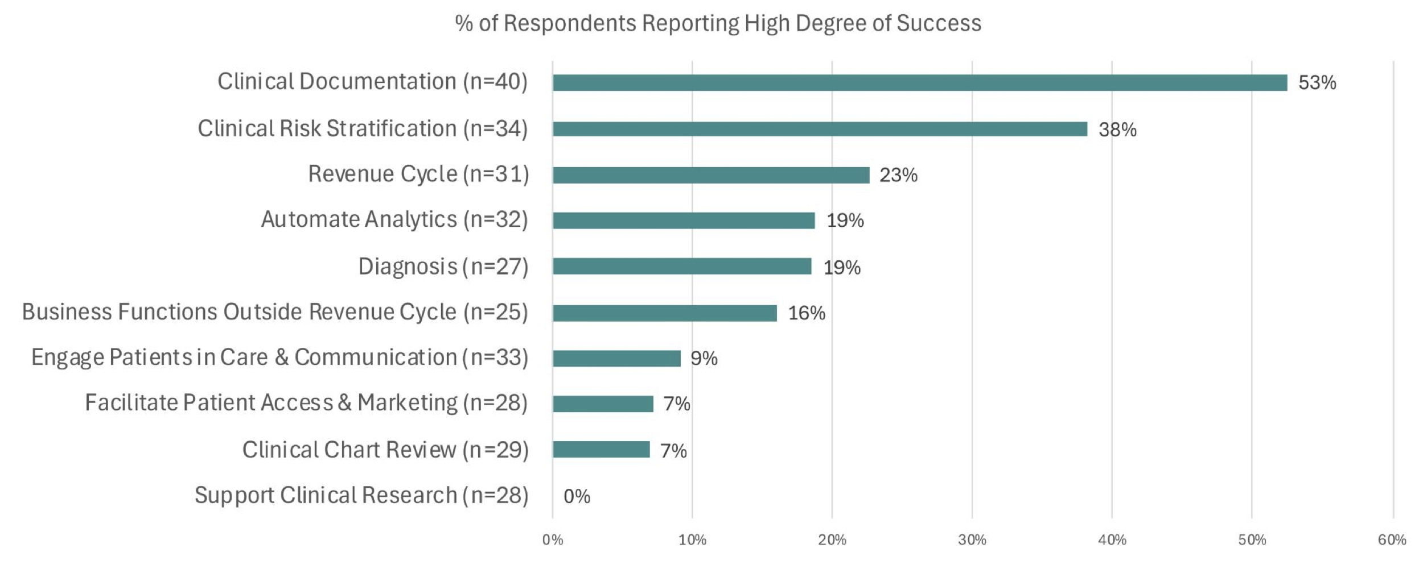
http://project-emerse.org/presentations.html

Slide 49
This sums it up well
“…while AI technologies like ChatGPT have demonstrated promising potential in the field of dentistry, their integration into clinical practice should be approached with significant caution.”
Transforming dental diagnostics with artificial intelligence: advanced integration of ChatGPT and large language models for patient care
https://www.frontiersin.org/journals/dental-medicine/articles/10.3389/fdmed.2024.1456208/full
http://project-emerse.org/presentations.html

Slide 50
Thank you
Questions? Comments?
David Hanauer
hanauer@umich.edu
http://project-emerse.org/presentations.html

