Slide 1

EMERSE: an easy-to-use, researcher-approved tool for cohort identification and chart review with EHR notes
Presentation for the CTSA Program Webinar
January 28, 2026
Web: project-emerse.org
Email: hanauer@umich.edu
emerse-team@umich.edu
David Hanauer, MD, MS
Dept of Learning Health Sciences
University of Michigan
http://project-emerse.org/presentations.html

Slide 2

If you want to take notes or visit links
these slides can be found at:
this link will be
on most slides
http://project-emerse.org/presentations.html

Slide 3

Disclosures
Funding: NIH
NCI-ITCR: U24CA269315
NCATS-CTSA: UM1TR004404
U of Michigan Royalties/Licensing:
“Synonyms” dataset–optional “plugin” for
EMERSE
→ Free for use within EMERSE for
research
Disclosures
http://project-emerse.org/presentations.html

Slide 4


http://project-emerse.org/presentations.html

Slide 5
2021 study out of UC Irvine: Design, Implementation, and Usability of the Electronic Medical Record Search Engine (EMERSE) Tool https://escholarship.org/uc/item/44p23878
“Users unanimously responded that they would recommend the system to others, and…for a tool they found so useful, they believed that far too few people both within and outside of their network knew about the tool’s existence.”
http://project-emerse.org/presentations.html

Slide 6


We want to close the researcher-leadership gap on software selection
We have a major need for a tool like EMERSE
Our researchers don’t need a tool like this
This is exactly the tool we have been looking for
We already have something that does the same thing.
We have nothing like it
http://project-emerse.org/presentations.html

Slide 7
Unstructured vs Structured Data
EMERSE is for this… | …not this
Unstructured Data (free-text) | Structured Data
Mrs. Jones is a 56 year old female with a history of HTN, hypercholesterolemia, and T2DM who comes to the clinic today with a 3 day h/o dizziness and severe headache on the left side. | WBC: 5.6 Total cholesterol: 182 Weight: 67.4 AST: 30 ALT: 52
http://project-emerse.org/presentations.html

Slide 8


80% of EHR data are in unstructured free-text
structured data
unstructured data/free text
http://project-emerse.org/presentations.html

Slide 9
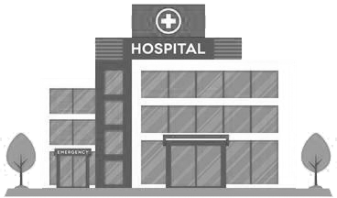

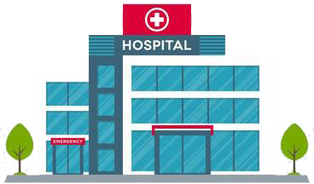
Most medical centers lack tools for free-text
http://project-emerse.org/presentations.html

Slide 10

And many options that exist aren’t great
2024 study on EMR usability:
“The same three items (integration into workflow, finding information, and usability of alerts) received the highest number of 'poor' ratings among hospital and practice physicians.”
https://www.nature.com/articles/s41746-025-01657-4
http://project-emerse.org/presentations.html

Slide 11

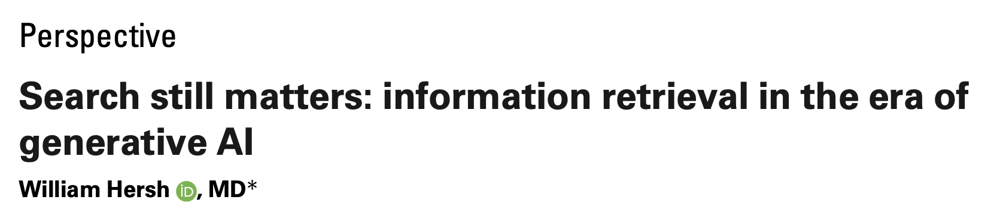
Do we even need search anymore?
Yes!
https://pmc.ncbi.nlm.nih.gov/articles/PMC11339511/pdf/ocae014.pdf
2024
http://project-emerse.org/presentations.html

Slide 12

The EMERSE solution
A system “for the people”
Users search the notes on their own
  No need to wait in a queue for an analyst or a data scientist
Easy-to-use for non-technical users
Unlike with some EHRs, EMERSE can search across all notes and all patients at once
Continuous refinements for > 20 years
http://project-emerse.org/presentations.html

Slide 13

The EMERSE solution
A system “for the admins”
Enterprise grade, easy to support
Configurable with granular roles/privileges to control access (e.g, all patients vs. some patients)
Data are kept secure within a centralized, audited system at your own site
  No need to copy the data elsewhere
http://project-emerse.org/presentations.html

Slide 14


EMERSE is a super useful tool
but it will likely be one of several you need to support your project(s)
http://project-emerse.org/presentations.html

Slide 15
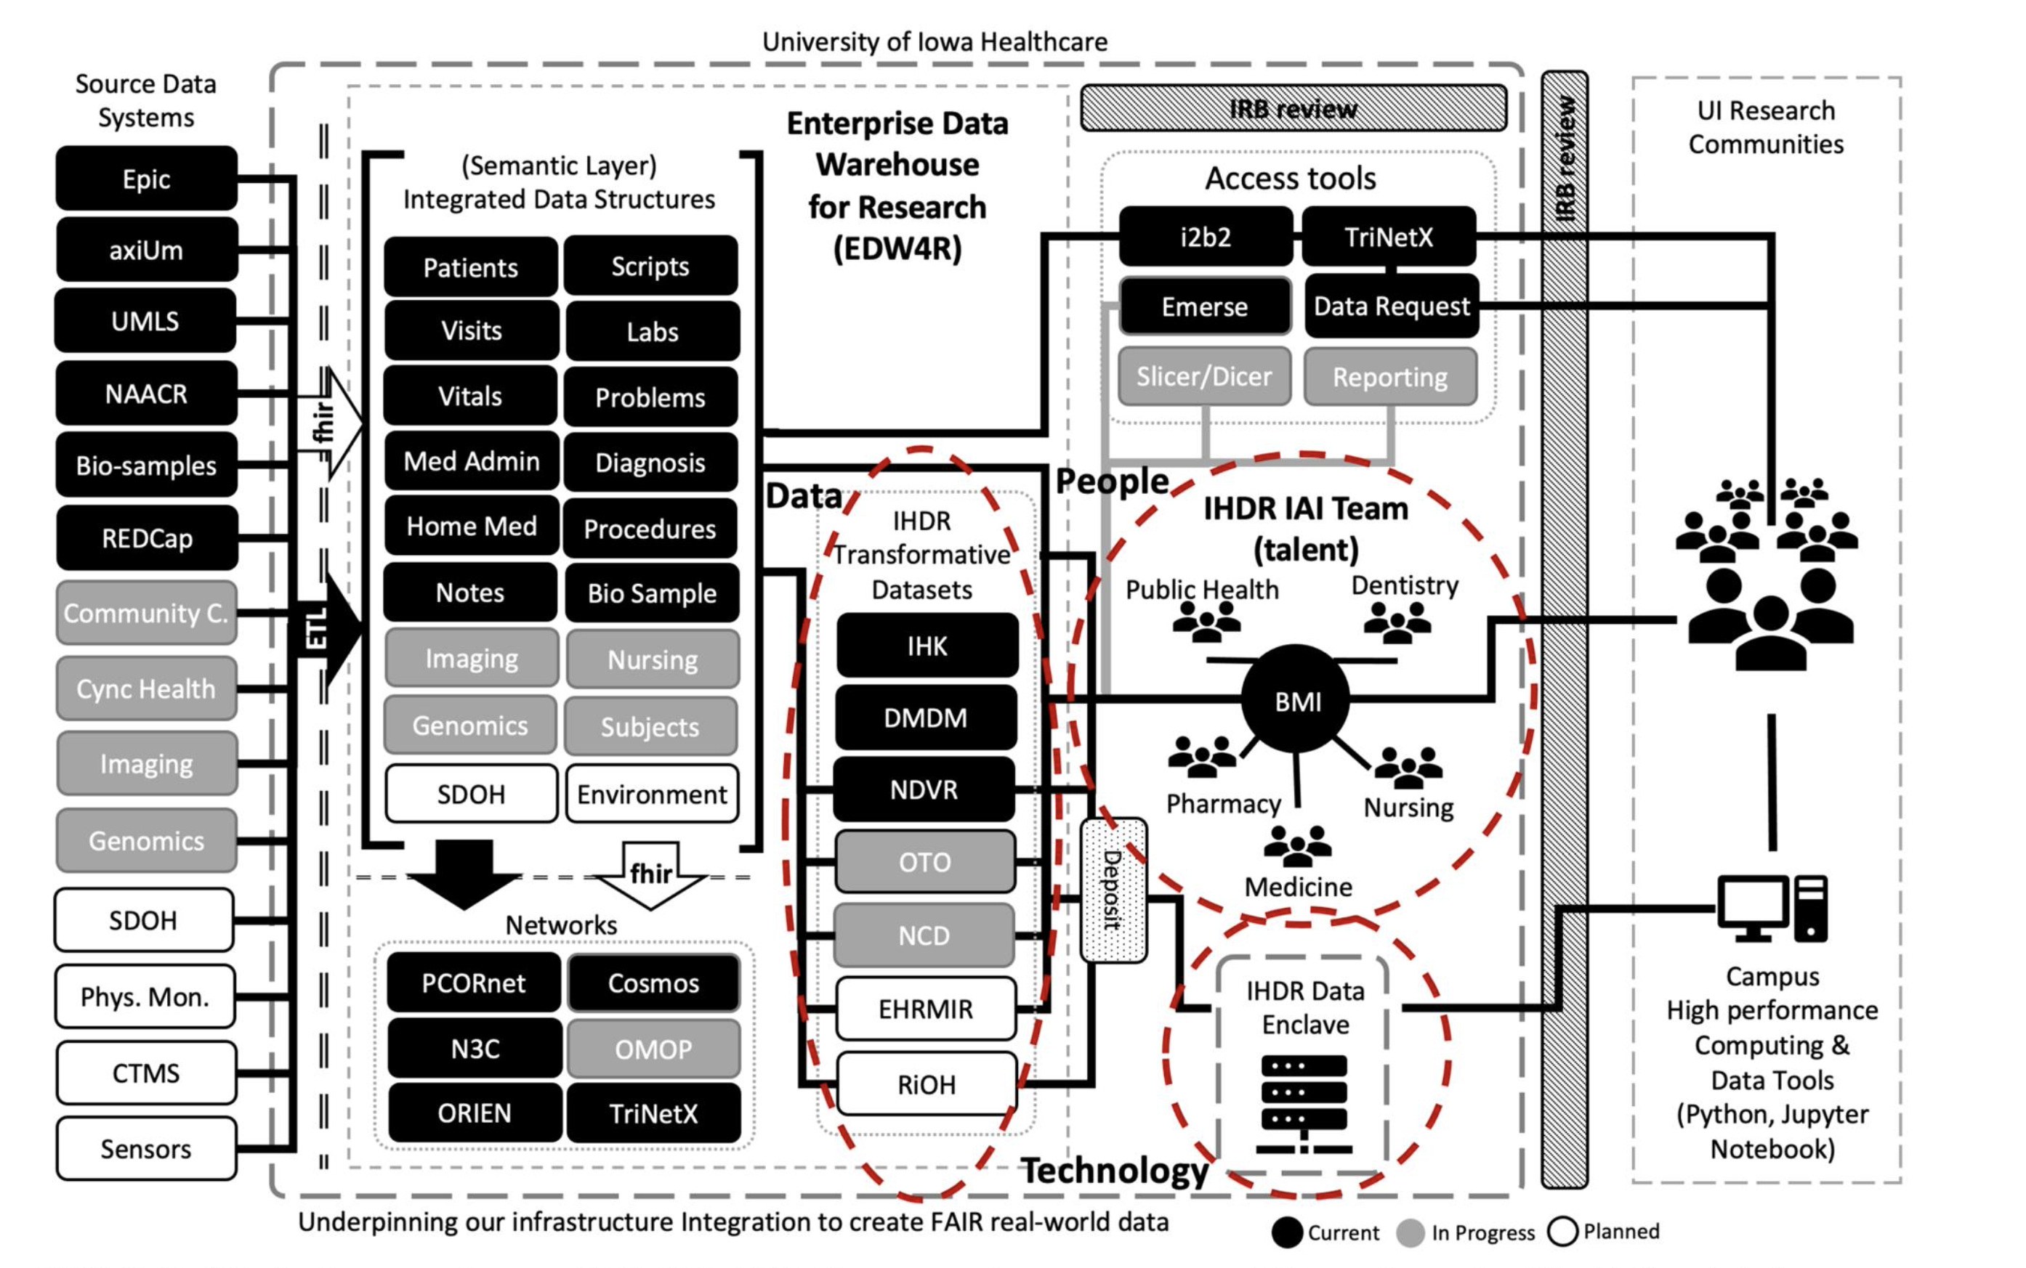
https://doi.org/10.1093/jamia/ocad236
http://project-emerse.org/presentations.html

Slide 16

We think EMERSE is fff-ing good

Slide 17
We think EMERSE is fff-ing good
“fast free-text finding” good
http://project-emerse.org/presentations.html

Slide 18
We think EMERSE is fff-ing good
“fast free-text finding” good
it’s also flexible, free, and fun
http://project-emerse.org/presentations.html

Slide 19
We think EMERSE is fff-ing good
We’re proud of what we’ve created
We think it’s better than other options
http://project-emerse.org/presentations.html

Slide 20

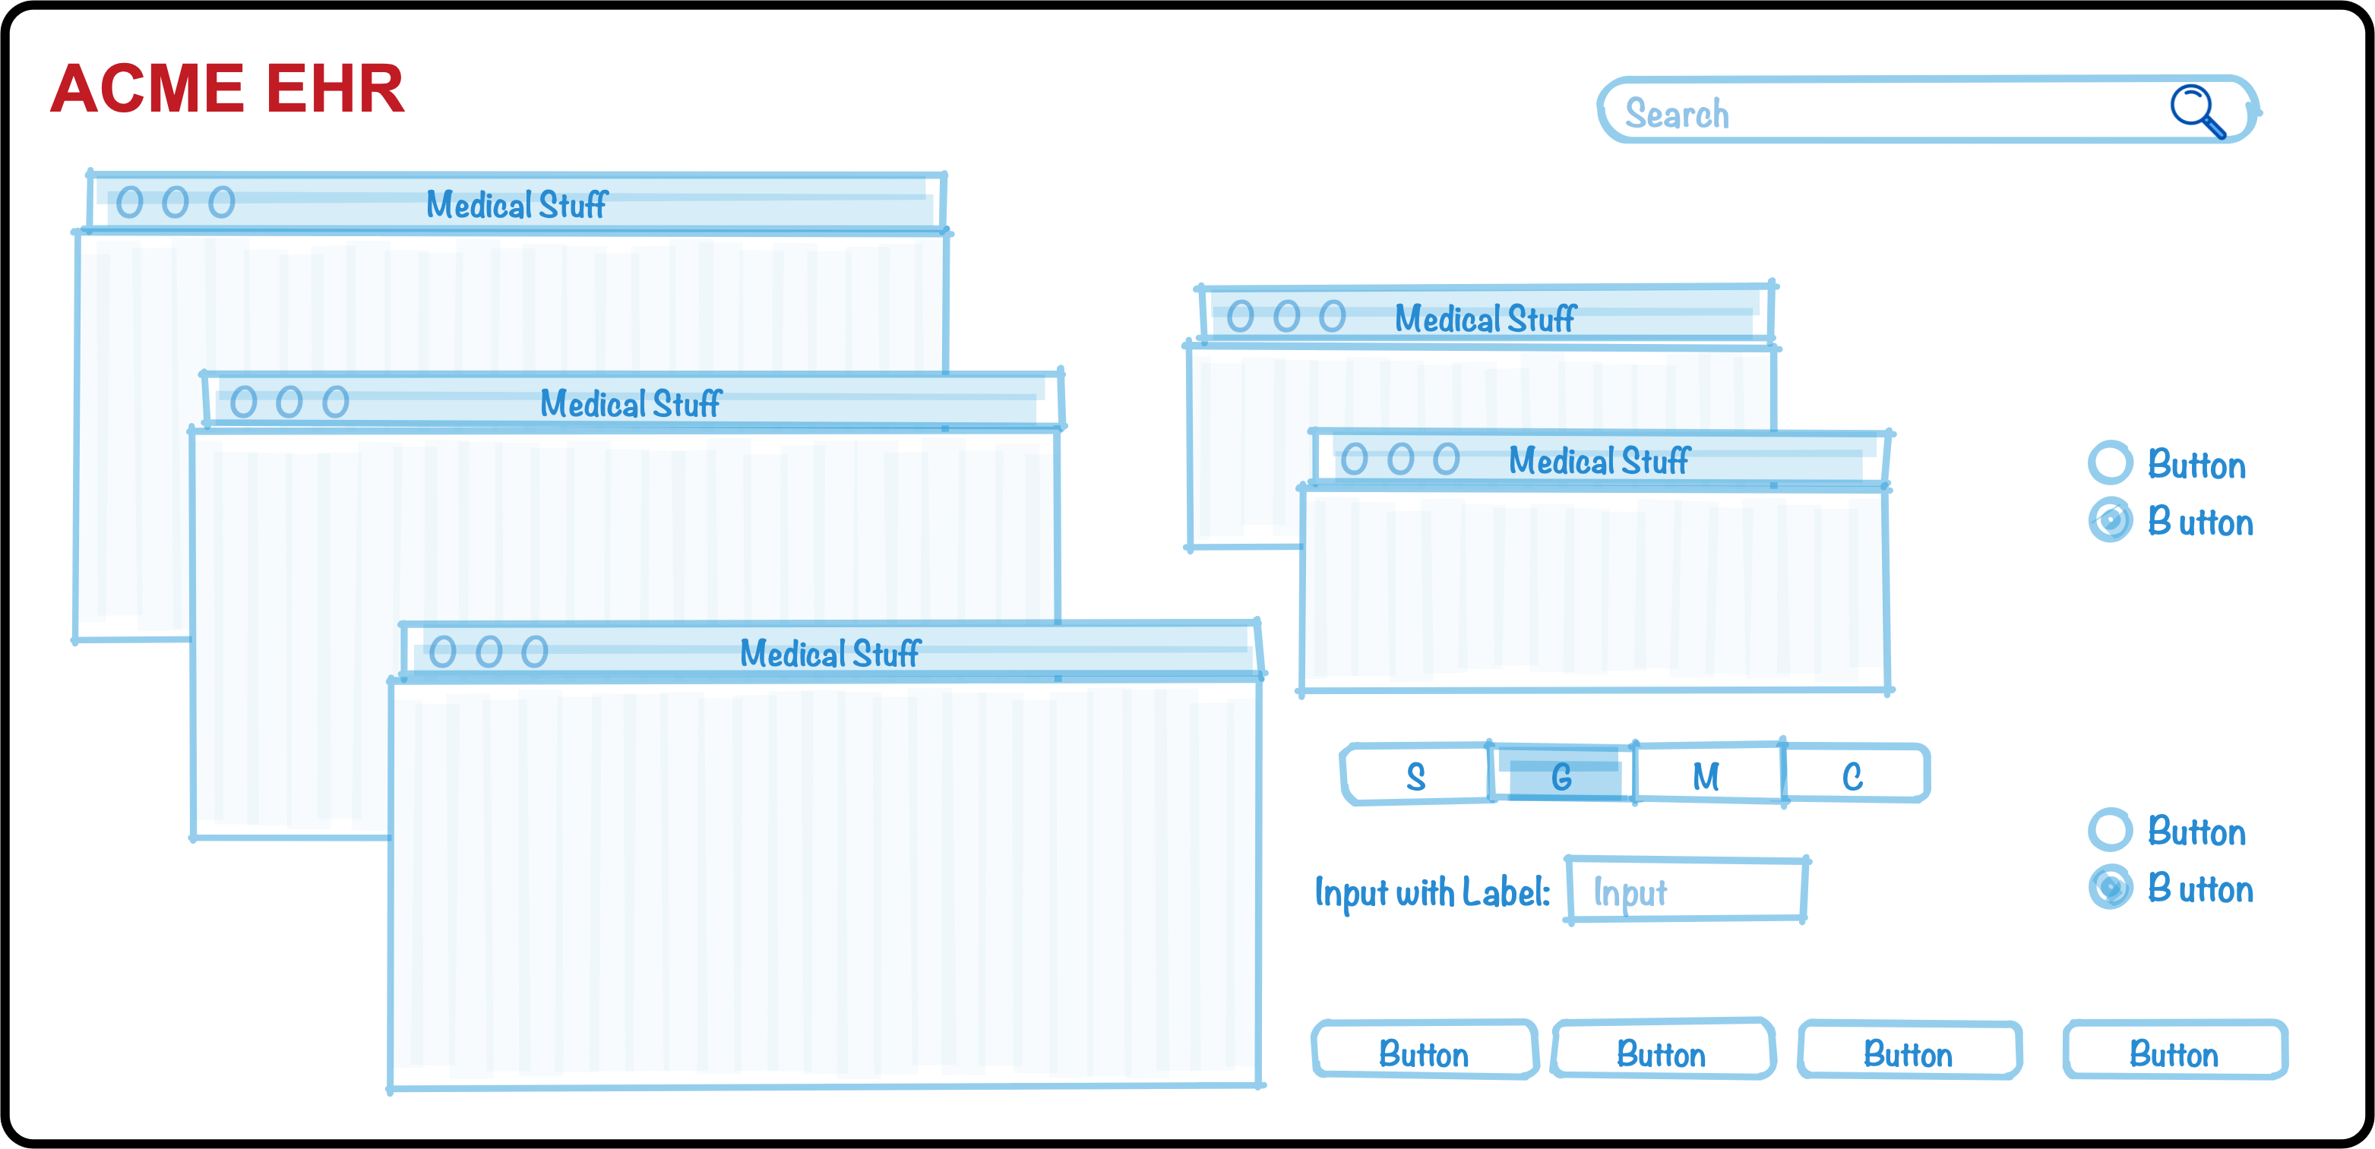
Why do we think it’s better?
We’ve been laser-focused on it
EHRs have thousands of features
The EMERSE team has invested 20+ years on just this one feature (search) because it’s so important
http://project-emerse.org/presentations.html

Slide 21
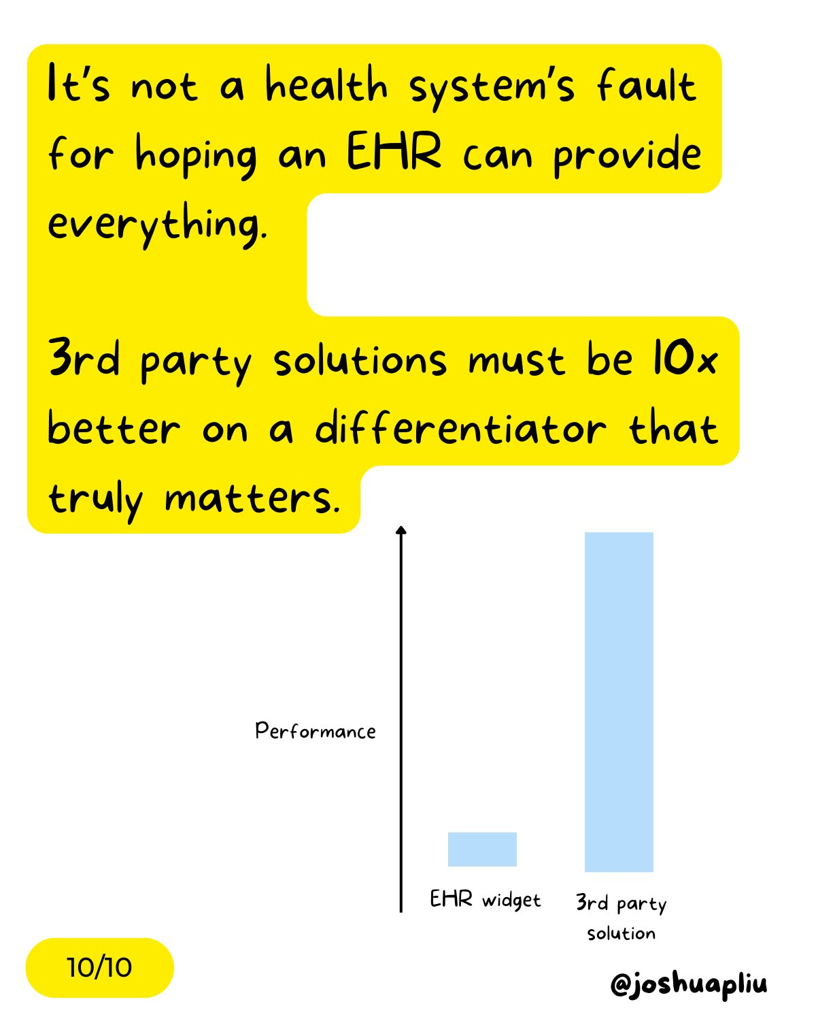
Why do we think it’s better?
It has to be better
EMERSE is a “best of breed” product and must stay ahead of integrated EHR tools to remain relevant
http://project-emerse.org/presentations.html

Slide 22
Why do we think it’s better?
We’ve studied it
“new users of the EMERSE system are able to complete basic but critical workflow tasks in the system with a high rate of success…are highly satisfied with the interface, and have highly positive perceptions of its expected utility in their work.”
“survey results indicate very high ratings of usability and satisfaction with the EMERSE system by new users after only one session of use.”
https://project-emerse.org/documents/reyes_masters_thesis_2021.pdf
http://project-emerse.org/presentations.html

Slide 23
Why do we think it’s better?
Our users tell us
Thank you for…this important tool which is proving extremely valuable in enhancing patient safety and quality of care delivered at Michigan Medicine.
EMERSE is working out great for casefinding...have found quite a bit of cases that we would have missed otherwise. Thank you and everyone on your team!
..continued gratitude for the availability of this powerful research tool. As always, thank you for this innovation!
EMERSE is an absolute gem
@umichmedicine. The functionality is very friendly and it saved hours of time during the data collection process. Thank you to the team that created this powerful research tool!
To say “it is the most useful tool I use in my job” would be an understatement, so thank you for creating and sharing it with others!!
http://project-emerse.org/presentations.html

Slide 24
Why do we think it’s better?
Researchers mention its strengths in their publications
“Reviewers used the EMERSE search tool to ensure thorough review of the available documentation...” [PMID 36119396]
“the tool avoids the pitfalls of diagnostic inaccuracy seen with tools querying on ICD and billing codes…” [PMID 36114099]
“[EMERSE] provides software features to comprehensively scan all clinical documents…for keywords and phrases to ensure that even rarely mentioned events are detected.” [PMID 36550198]
“…information [was] captured via EMERSE…in order to obtain the most accurate and complete information per patient.”[PMID 36752520]
http://project-emerse.org/presentations.html

Slide 25
Why do we think it’s better?
Top-tier medical centers use it
Site | Site
U of Michigan | Case Western Reserve U
Harvard U – Dana Farber Cancer Center | Utrecht University, Netherlands
Columbia U Cancer Center | U of Iowa
U of North Carolina – Chapel Hill | Weill Cornell Medical Center
U of California – San Francisco | U of Virginia
U of Kentucky | Moffitt Cancer Center, Tampa, FL*
U of Cincinnati | Children’s Health Orange County, Calif.*
*Currently installing
http://project-emerse.org/presentations.html

Slide 26

Why do we think it’s better?
Real people use it
2025 stats
682 users
412 IRB-approved studies
Learn more in our annual report:
https://project-emerse.org/reports/EMERSE-annual-report-2025.pdf
http://project-emerse.org/presentations.html

Slide 27
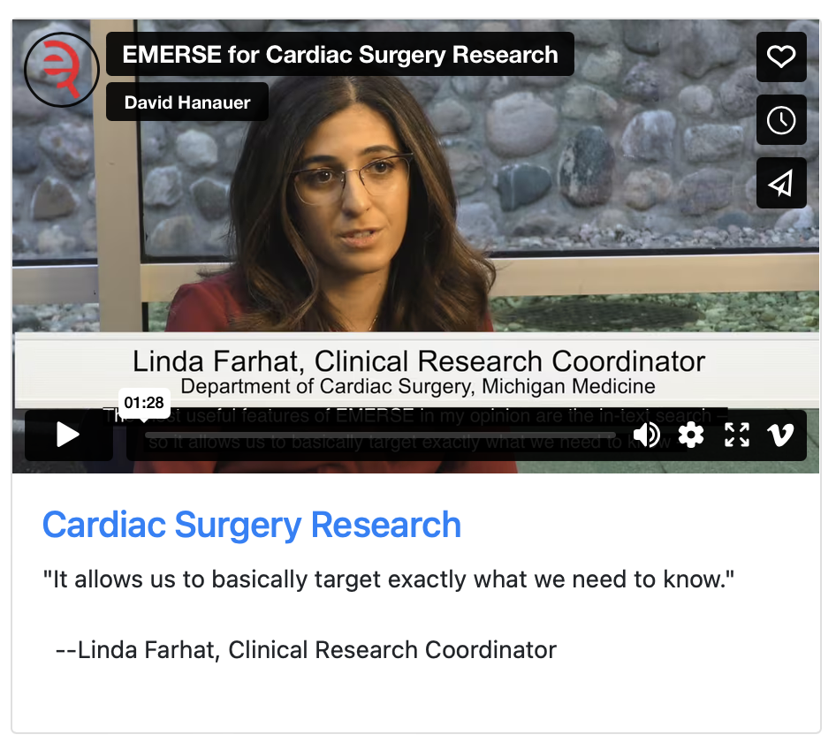
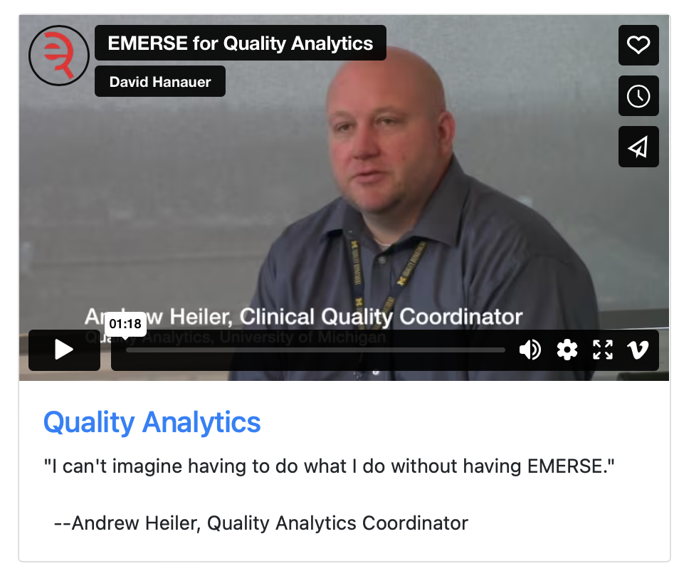
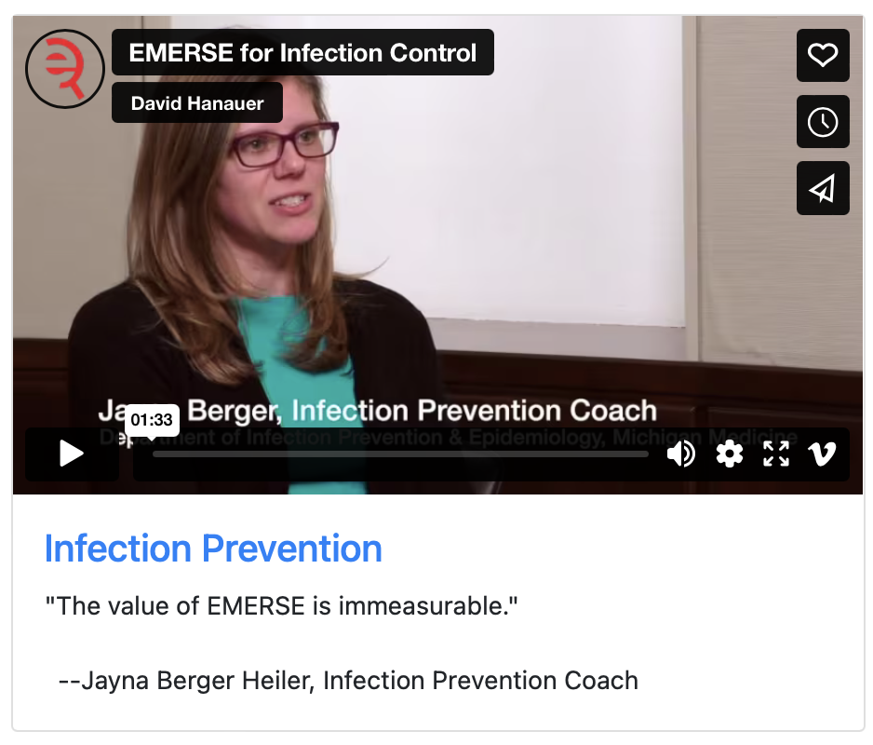
What can EMERSE do?
Lots of things!
Watch our videos: https://project-emerse.org/use_cases.html

Slide 28

Find cohorts
EMERSE allows you to find cohorts based on things mentioned in the notes
  diseases
  drugs
  symptoms
  anything*
*if it is mentioned
http://project-emerse.org/presentations.html

Slide 29



Find cohorts
It’s perfect for finding rare things…
…like rare cancers such as
cutaneous leiomyosarcoma
See this talk for more details:
https://vimeo.com/677482835
“Using EMERSE to Improve Research Involving Rare Cancers”
http://project-emerse.org/presentations.html

Slide 30
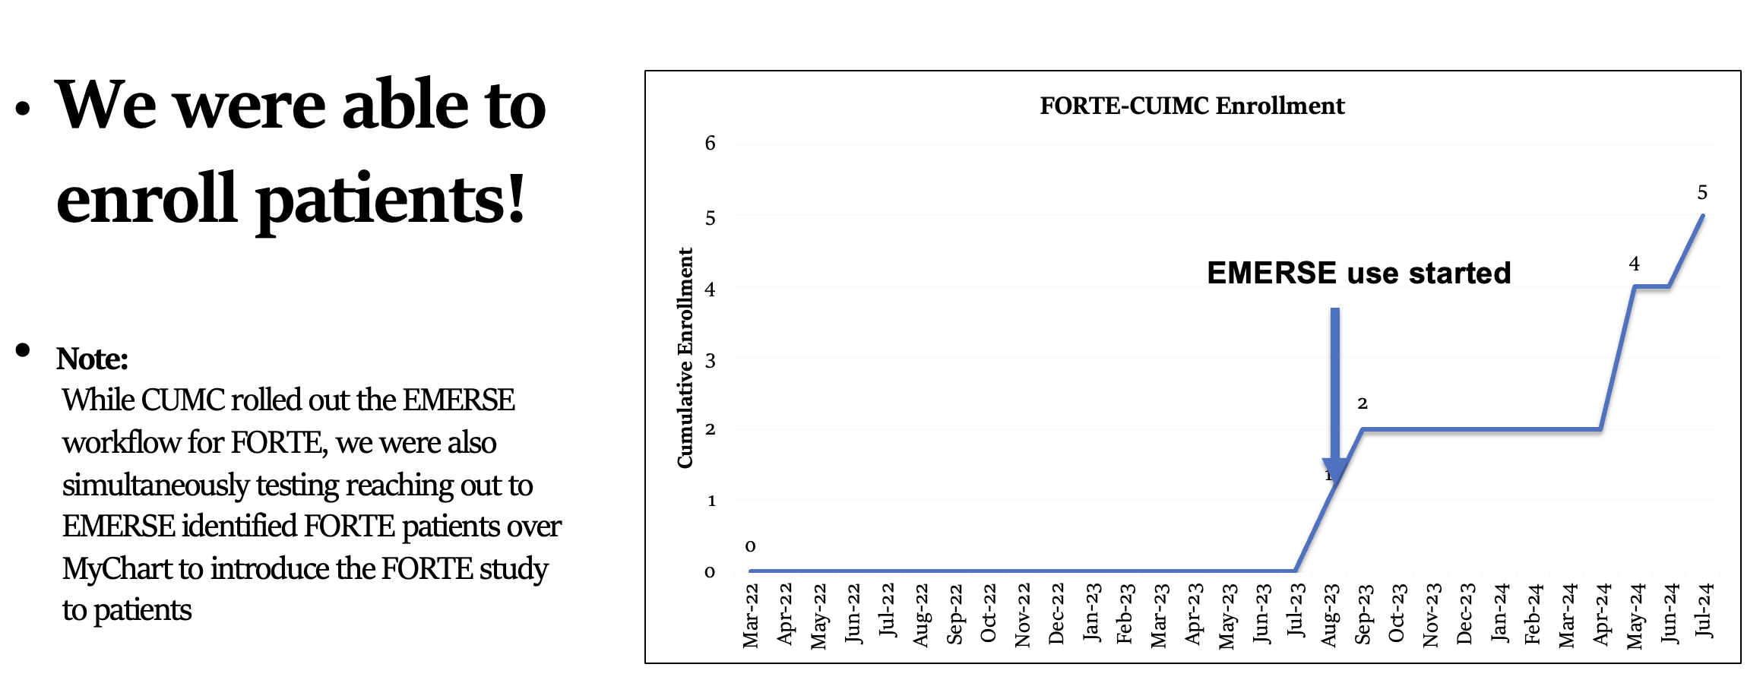
Enroll patients on trials
See this talk for more details:
https://vimeo.com/1084845123/
EMERSE Community Meeting May 2025
http://project-emerse.org/presentations.html

Slide 31

We keep the human-in-the-loop
http://project-emerse.org/presentations.html

Slide 32
Highlight documents for chart review
Thoracocentesis confirmed the recurrence of mantle cell lymphoma. Disease restaging work-up revealed multicompartment lymphadenopathy in the neck, mediastinal, retrocrural, retroperitoneal and pelvic regions. Bone marrow was also involved. The patient was treated with a total of six cycles of rituximab, cyclophosphamide, vincristine, doxorubicin and dexamethasone (R-HyperCVAD) completed in January 2007. That treatment led to complete remission that lasted until October 2008, when the disease was found to have recurred in the left pleural space and retroperitoneum without bone marrow involvement.
https://jmedicalcasereports.biomedcentral.com/articles/10.1186/1752-1947-4-329
http://project-emerse.org/presentations.html

Slide 33

EMERSE is fast
Query to identify all patients with the following | Reporting DB time (s) | EMERSE time (s) | EMERSE advantage
cavernous hemangioma | 14,652 | 2 | 7,320x
gray platelet syndrome | 14,940 | 2 | 7,470x
inferior lingular segment of the left upper lobe | 17,784 | 9 | 1,980x
…enabling real-time querying
http://project-emerse.org/presentations.html

Slide 34
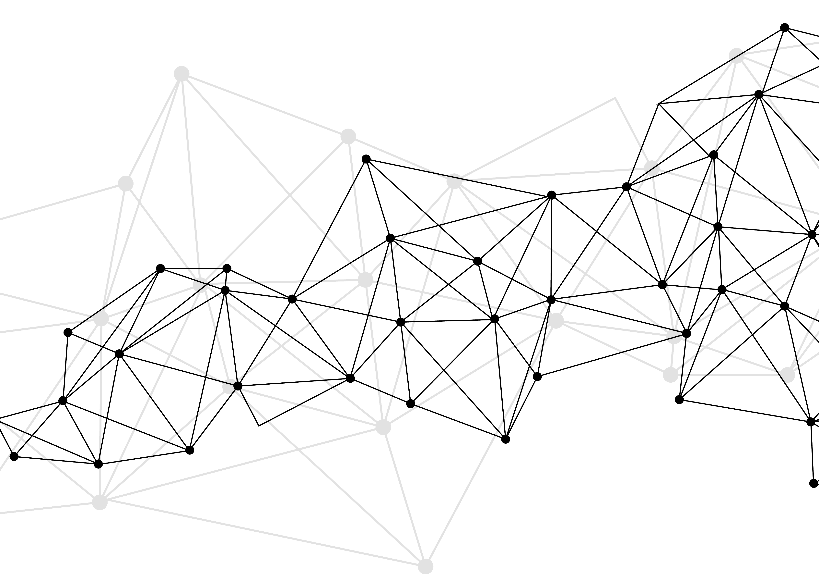
Synonyms
Used for query expansions
User-controlled
Multiple datasets can be included
EMERSE Synonyms
  acronyms, abbreviations, professional/consumer terms, misspellings, trade/generic drug names, species, chemo regimens, phrase variations, malapropisms, idioms, neologisms, organizations, companies, & more
  3 million unique entries
http://project-emerse.org/presentations.html

Slide 35
Typical workflow
initial cohort identified
with a cohort discovery
tool using structured data (or via EMERSE
‘Find Patients’)
Cohort discovery tools:
i2b2/ENACT, Leaf, etc.
http://project-emerse.org/presentations.html

Slide 36
Typical workflow
additional details abstracted from the free text using EMERSE
http://project-emerse.org/presentations.html

Slide 37
Typical workflow
Data recorded in an electronic data capture system (e.g., REDCap)
http://project-emerse.org/presentations.html

Slide 38

Publications using EMERSE
723
papers and abstracts
Full list at:
http://project-emerse.org/publications.html
http://project-emerse.org/presentations.html

Slide 39

Recently released…
Incorporation of NLP features
  negation
  uncertainty
  subject (patient vs other)
  history of
  named entity recognition/mapping to ontologies
If you don’t like our built-in NLP, use your own
http://project-emerse.org/presentations.html

Slide 40

Ongoing Work
• Automated data extraction from templated notes
• Optical Character Recognition of scanned documents
• Integration with ChatGPT or similar tools
http://project-emerse.org/presentations.html

Slide 41

ChatGPT/LLM integration
• Interactive chat about a patient’s notes
• Human-in-the-loop with data verification
http://project-emerse.org/presentations.html

Slide 42

How much does it cost?
Software (w/ source code) $0.00
Installation Guidance $0.00
Access to Documentation $0.00
Training (within reason) $0.00
Synonyms dataset (optional) $0.00*
* For research use within EMERSE
http://project-emerse.org/presentations.html

Slide 43



Fine Print
Free
Kitten
There will be local operational costs
  free kitten < free pony
Sites need to determine how to extract their data to get it into EMERSE
  We can provide recommendations
Sites install EMERSE themselves
  on premise or in the cloud
Our team does not have access to anyone’s data other than U of Michigan
http://project-emerse.org/presentations.html

Slide 44

Community Meetings
Twice per year – recordings available online
Last meeting November 2025
Next meeting May 2026
http://project-emerse.org/presentations.html

Slide 45

Demo
No real names
No PHI
Publicly available
Abstracts & case reports
http://project-emerse.org/presentations.html

Slide 46
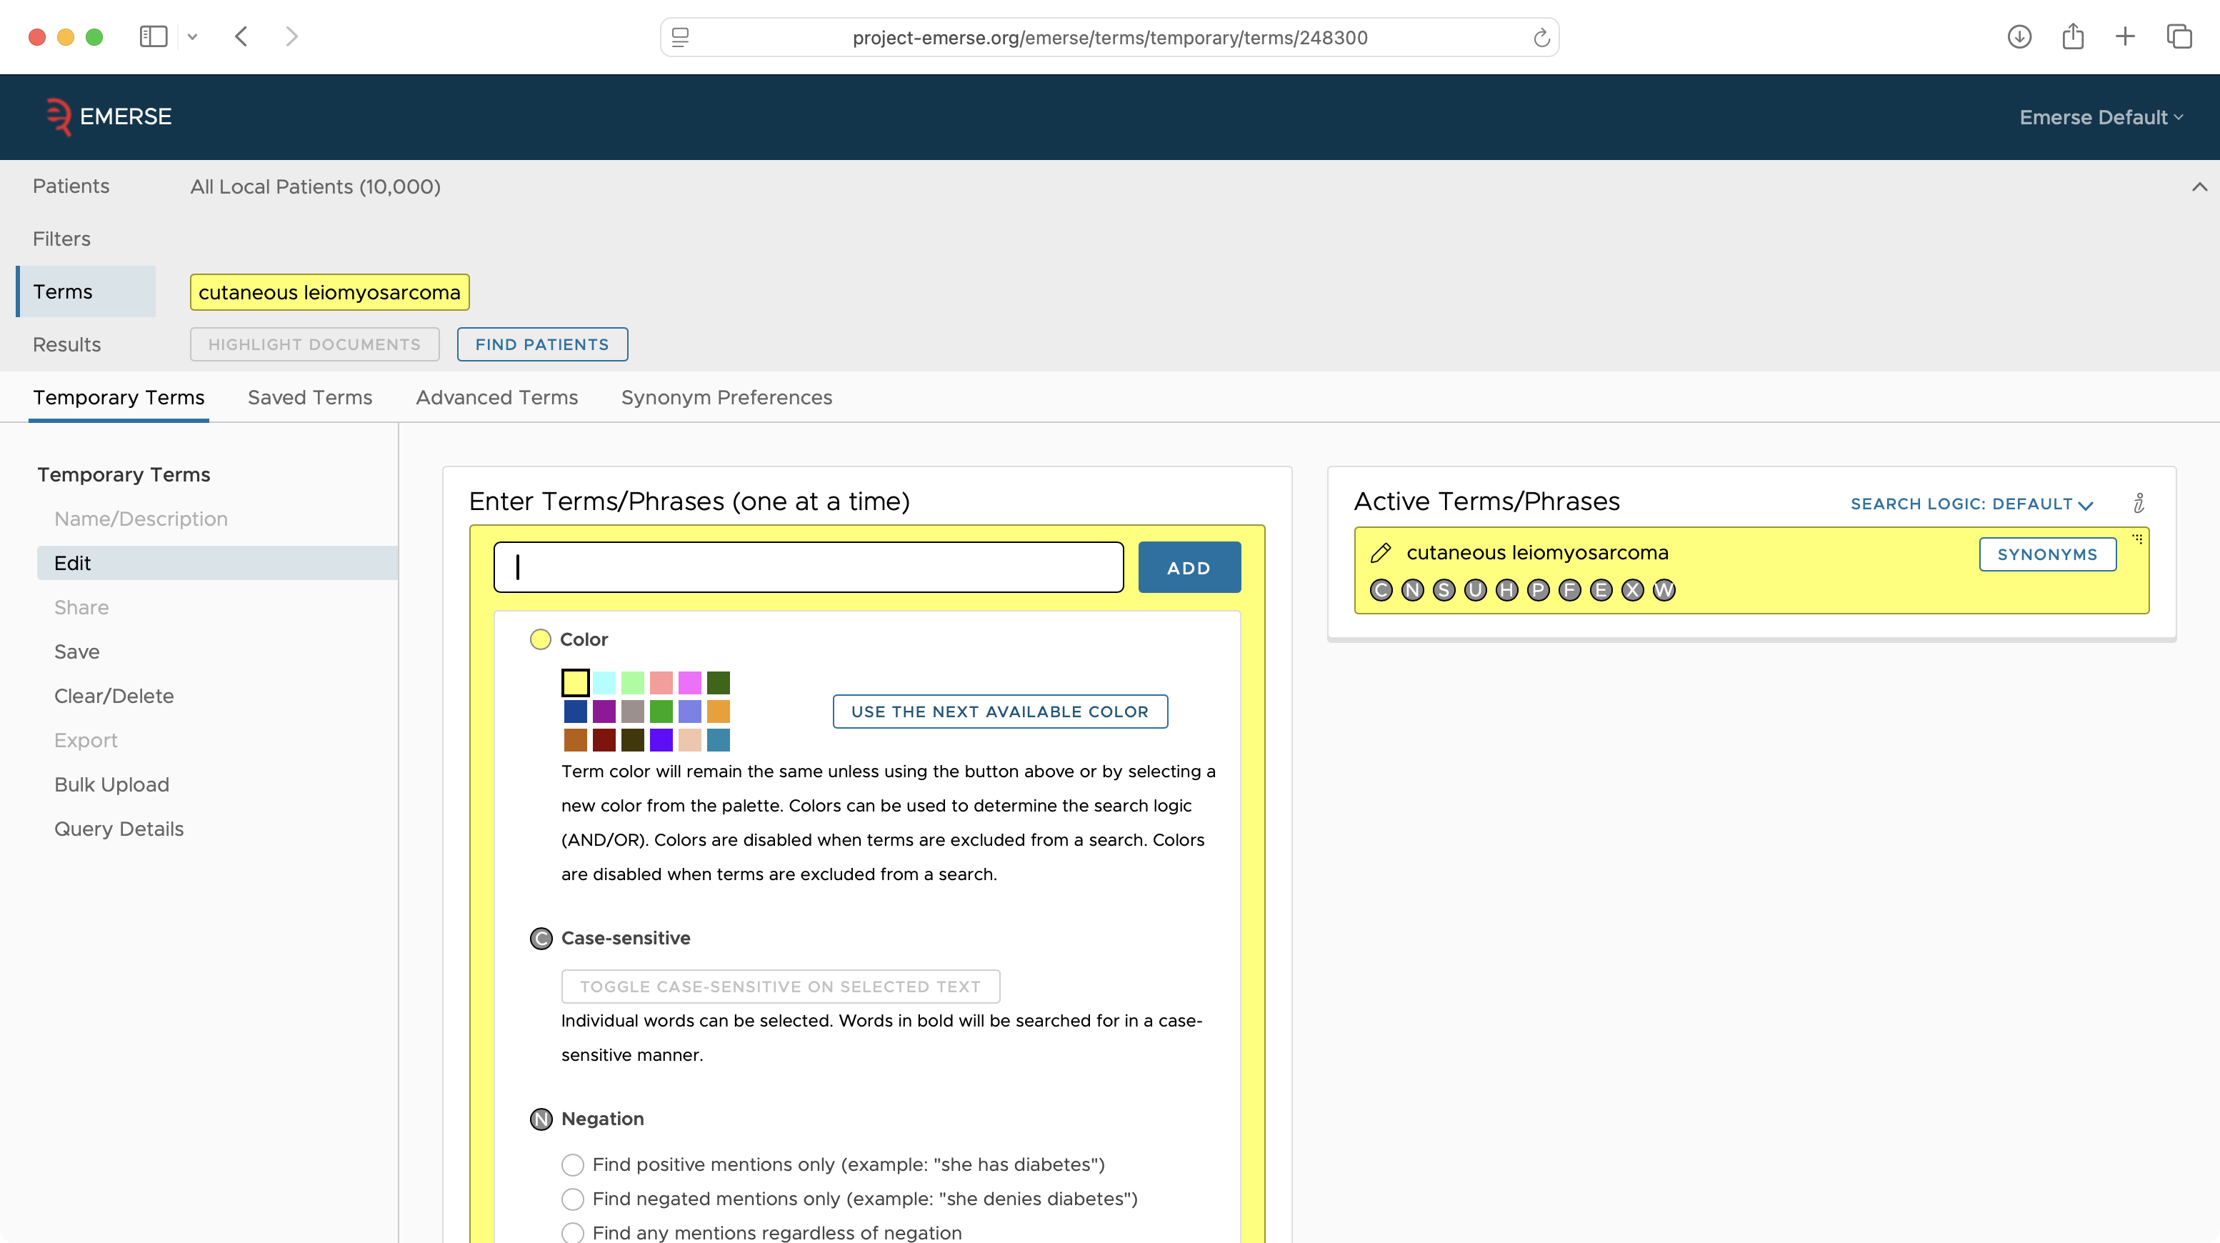

Slide 47
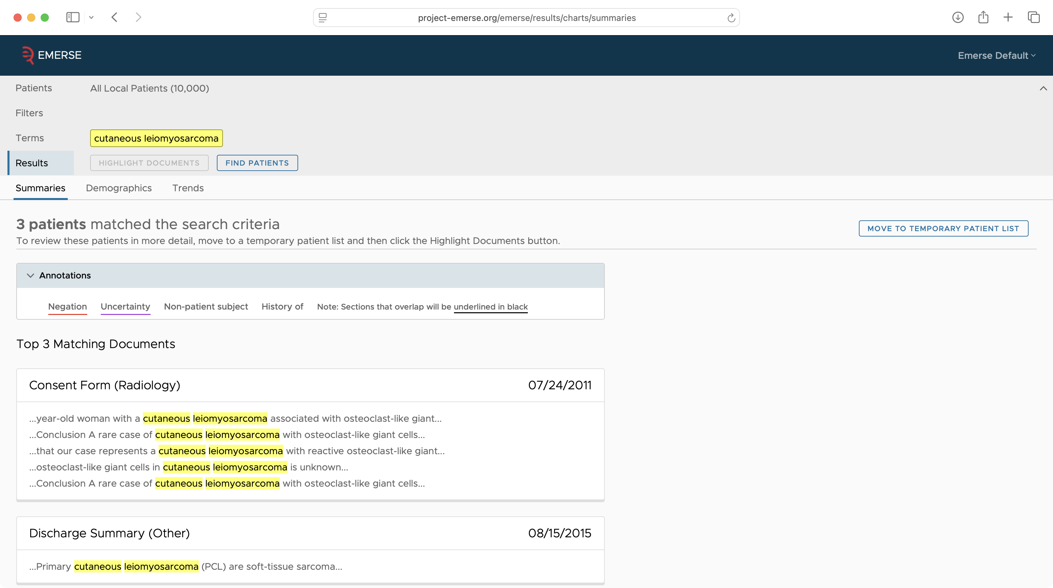

Slide 48
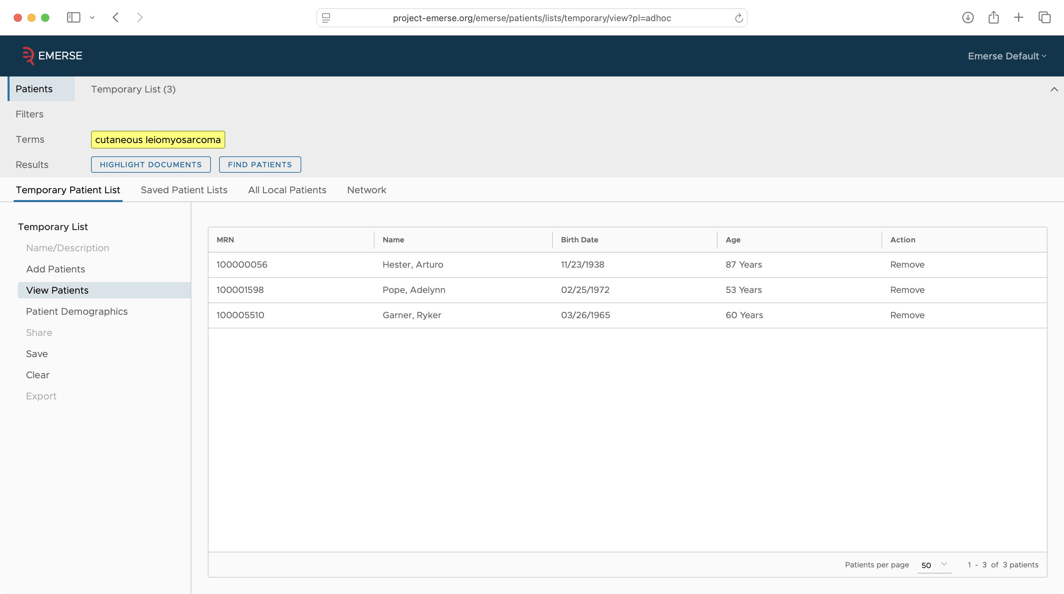

Slide 49
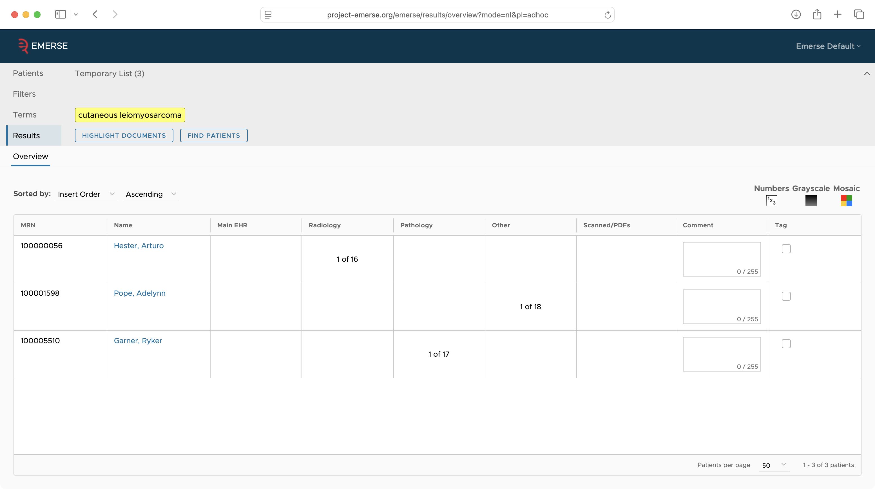

Slide 50
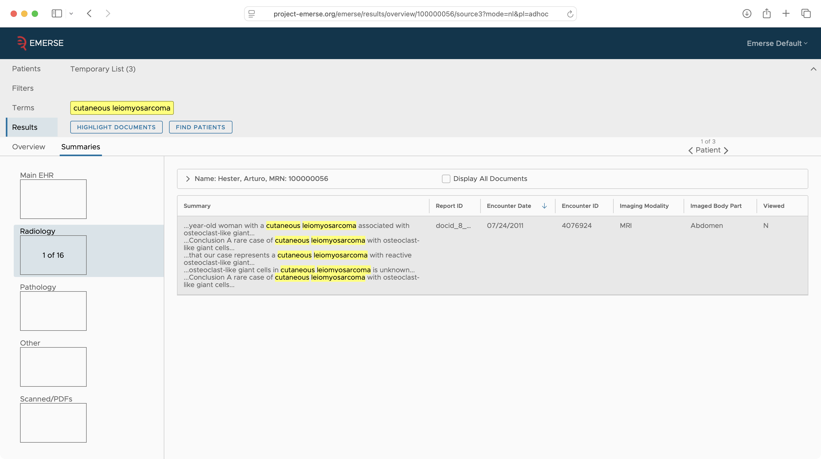

Slide 51
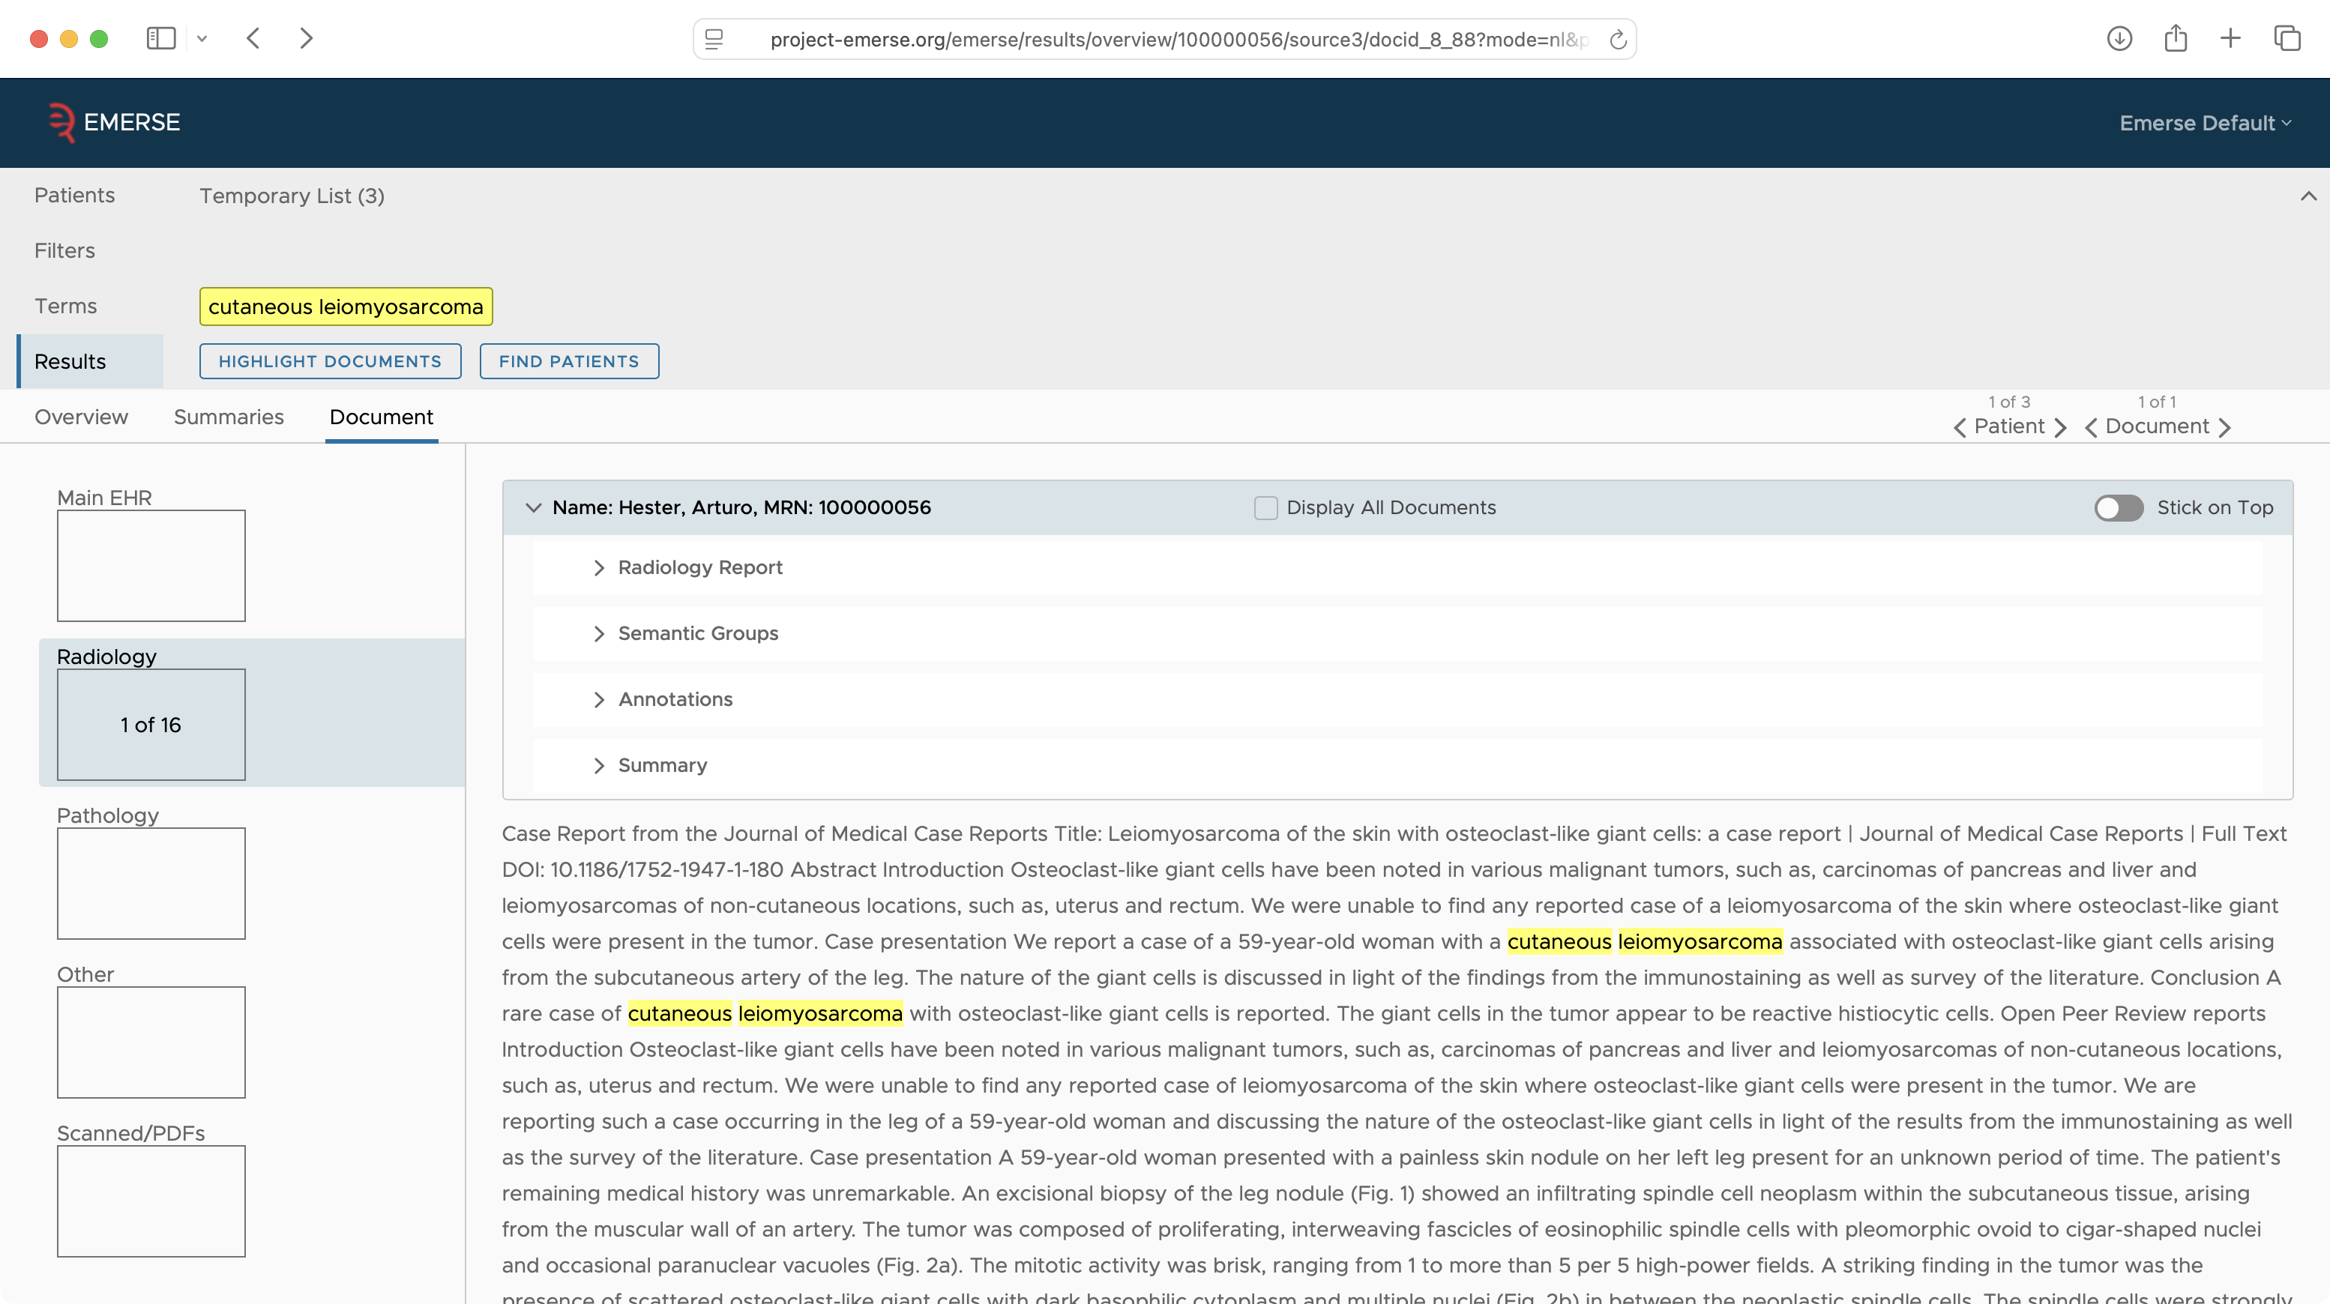

Slide 52
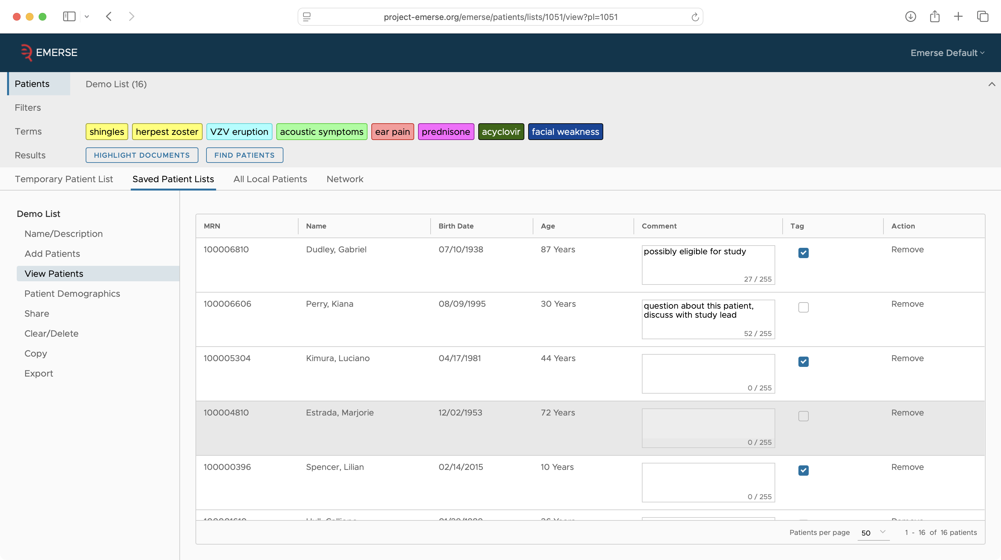

Slide 53
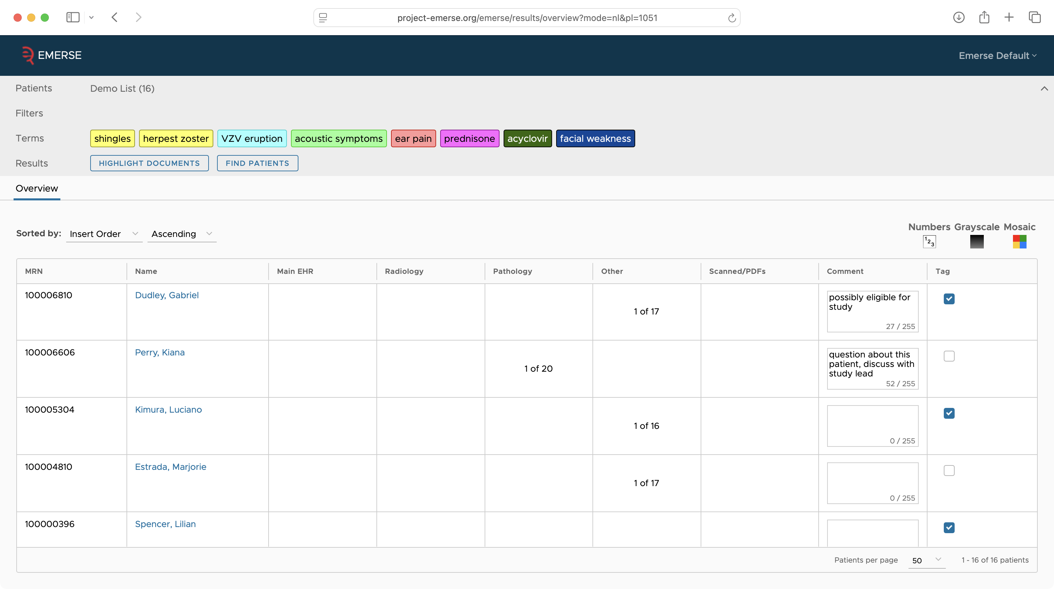

Slide 54
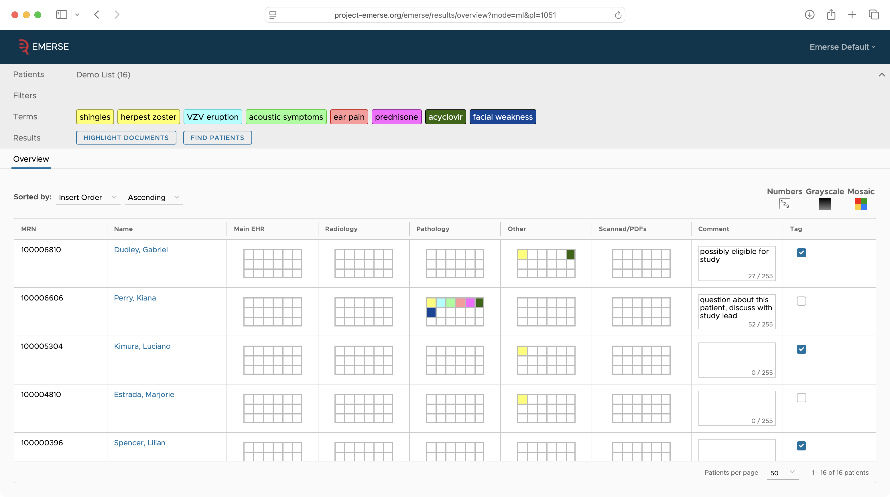

Slide 55
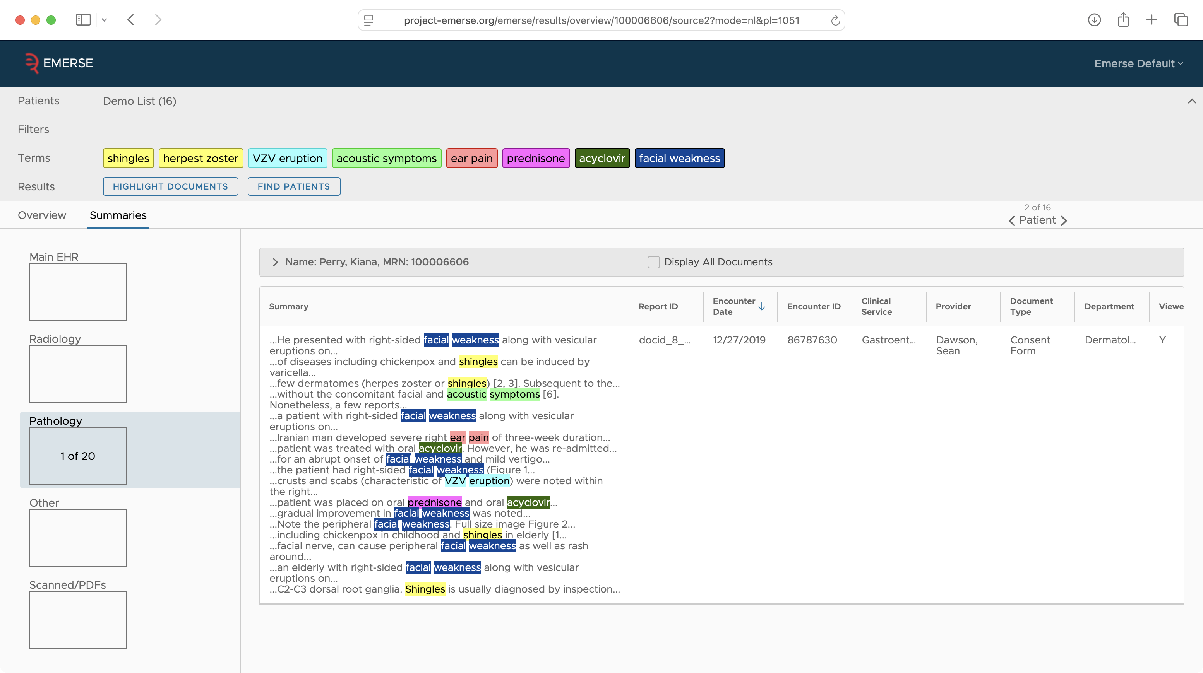

Slide 56
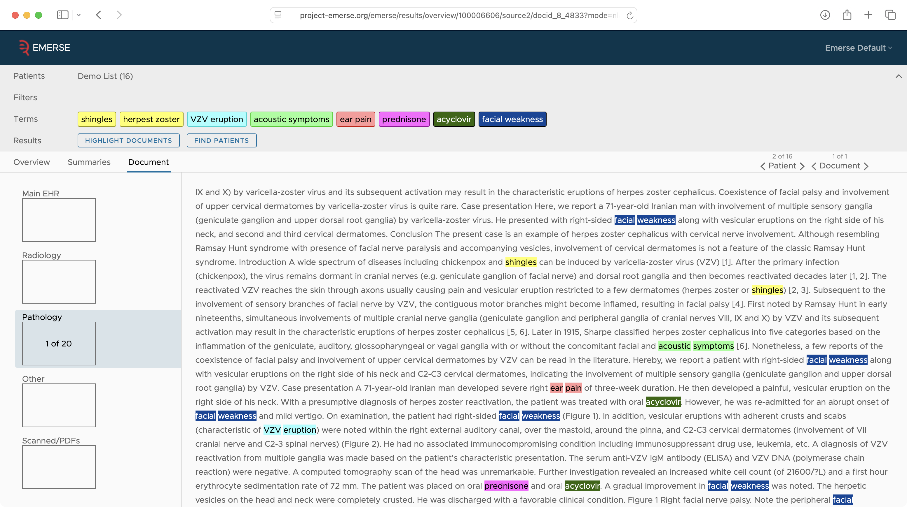

Slide 57
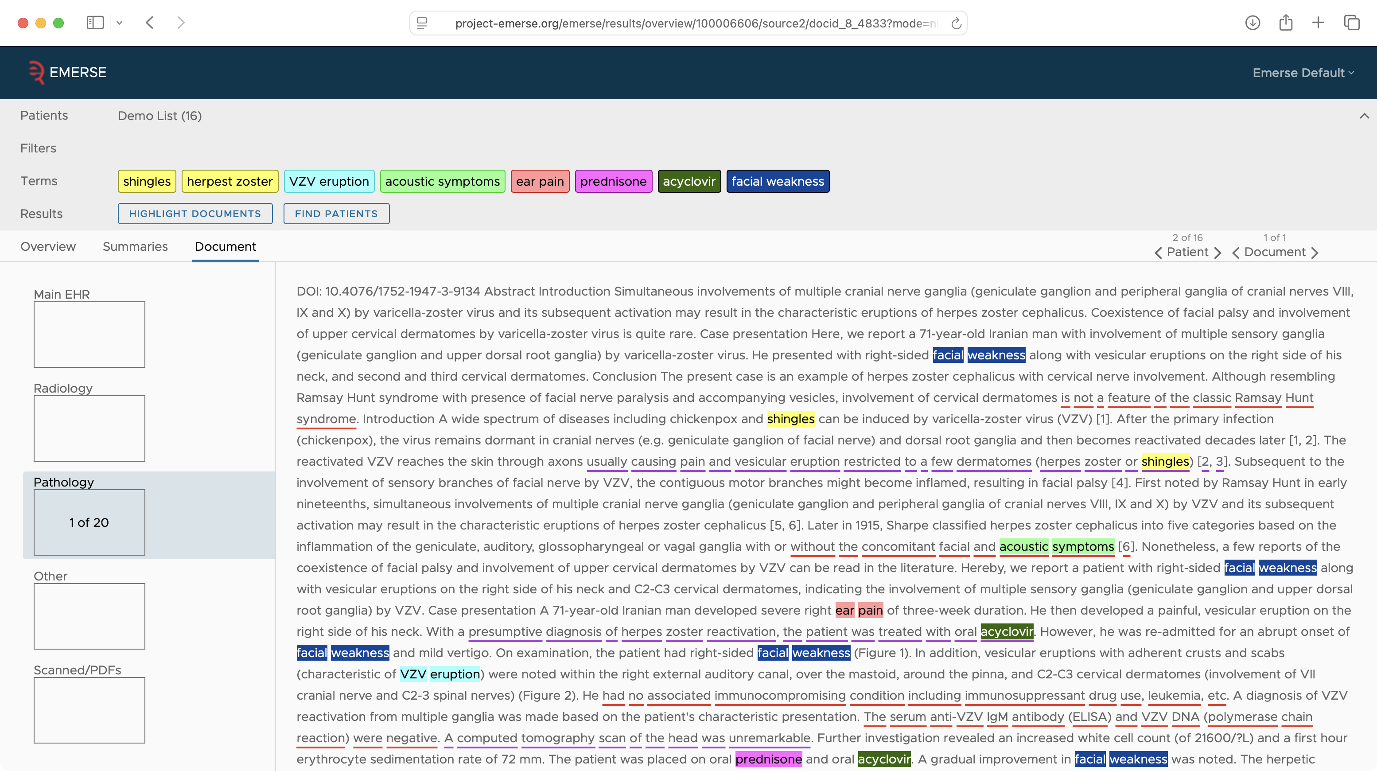

Slide 58
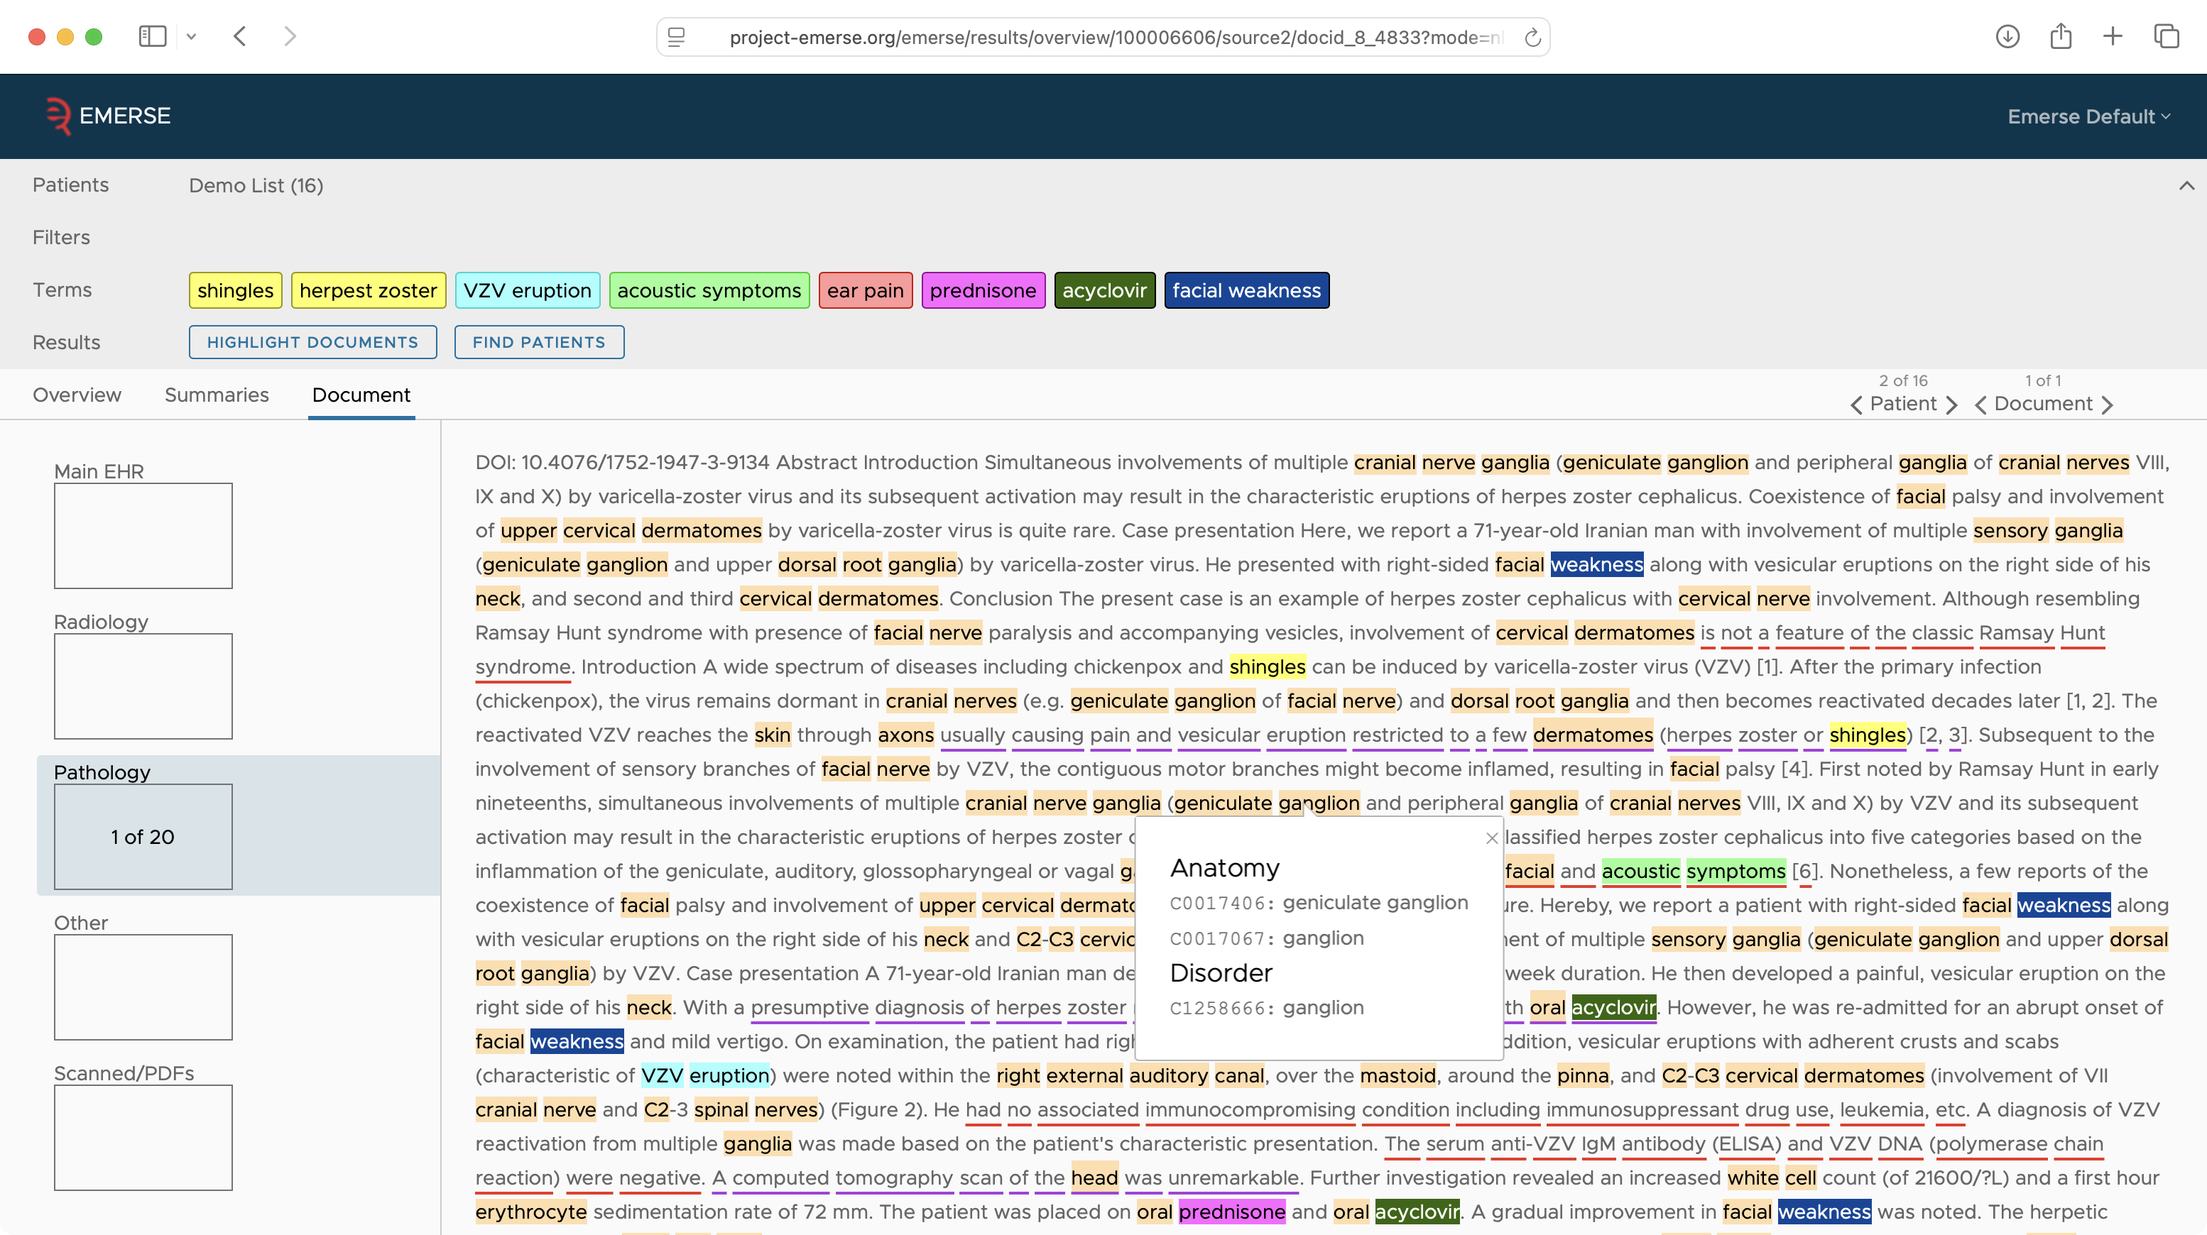

Slide 59
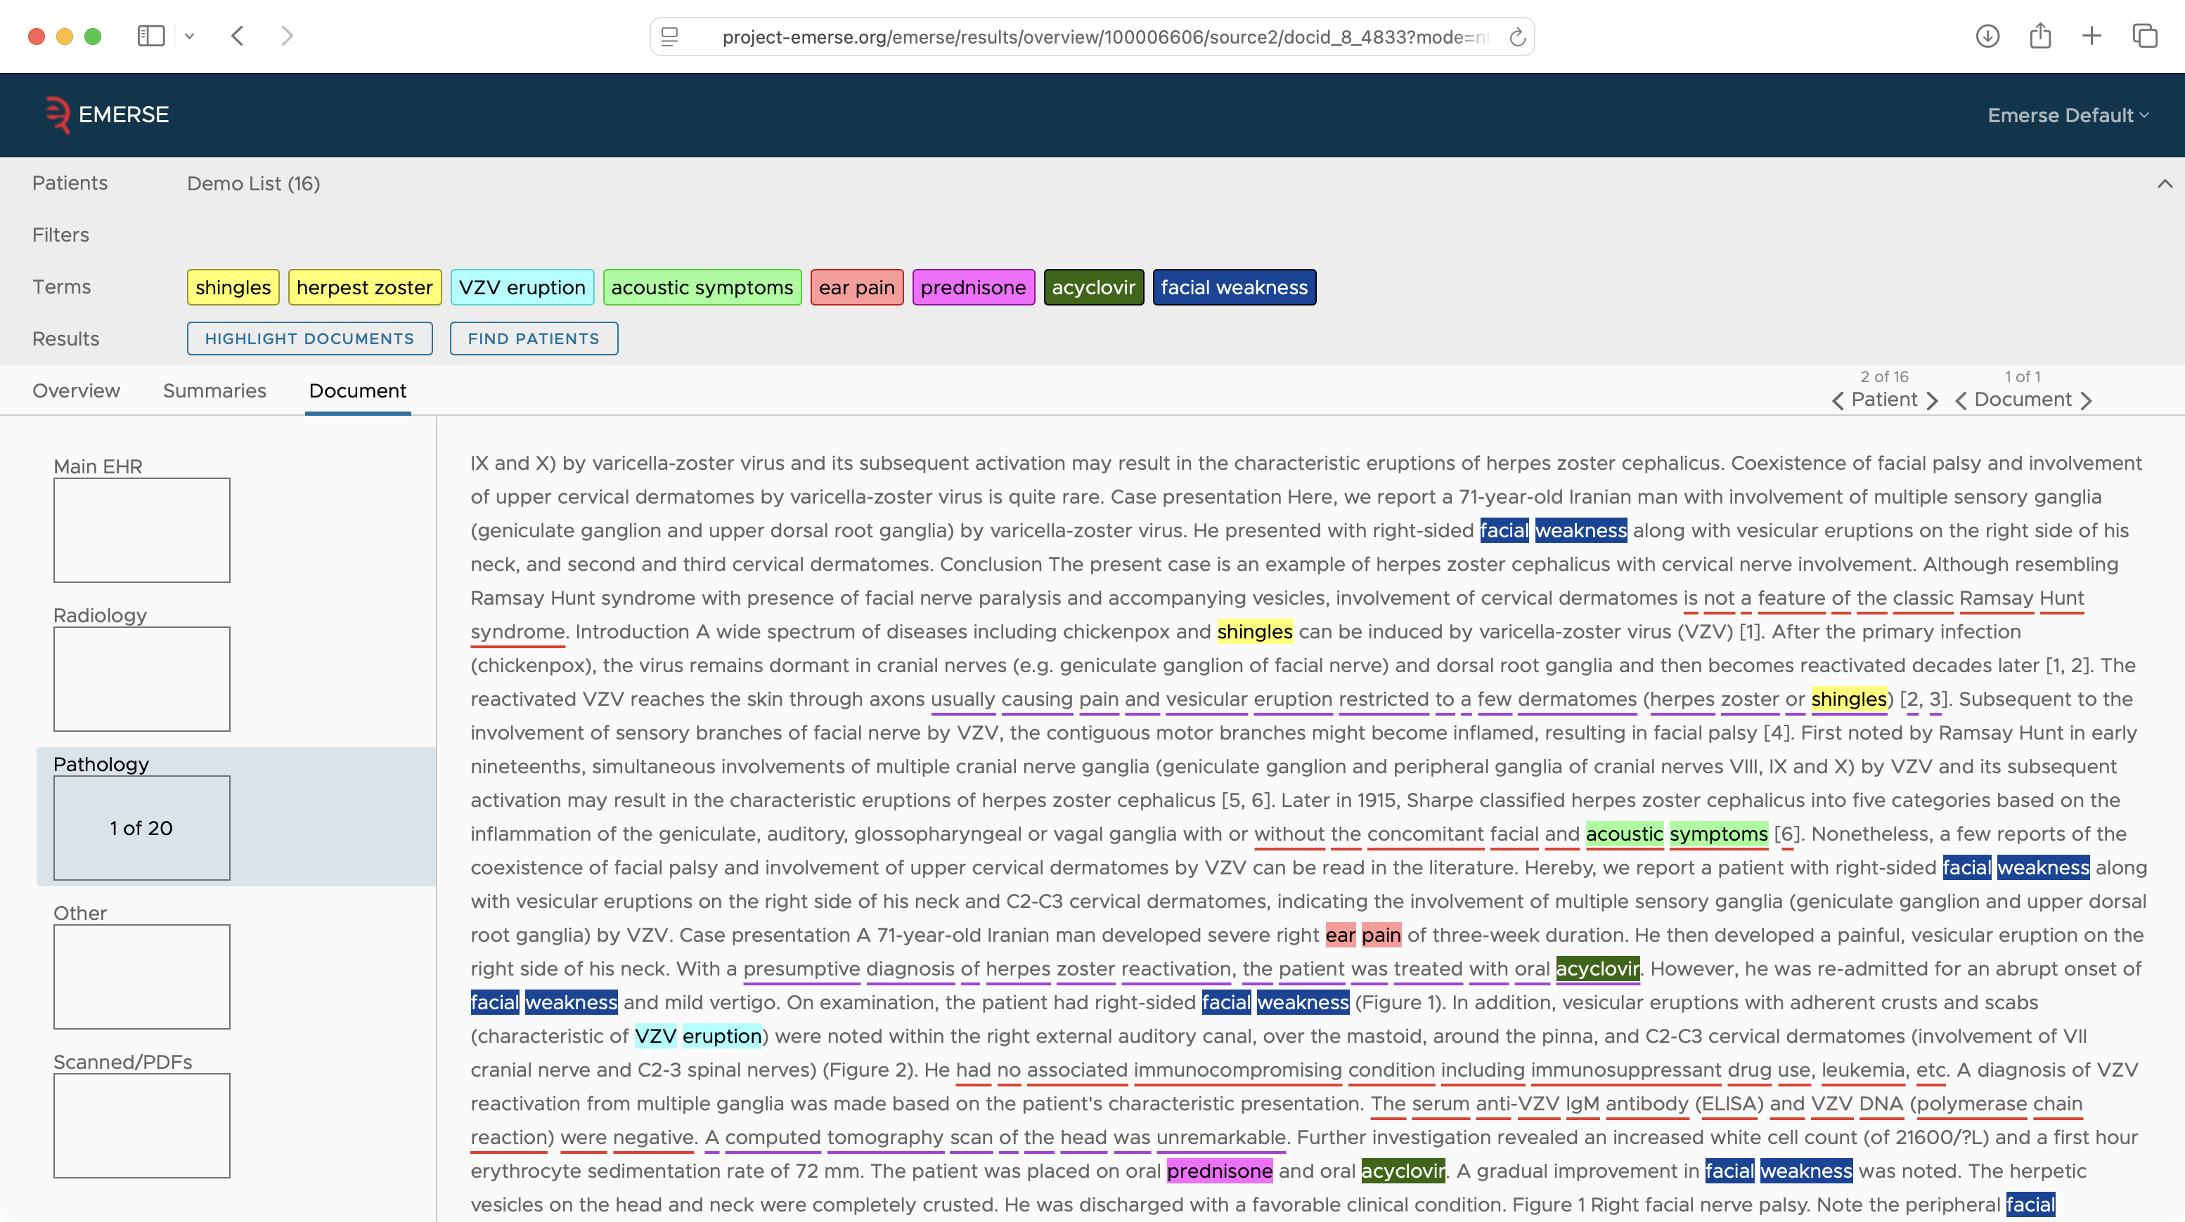

Slide 60
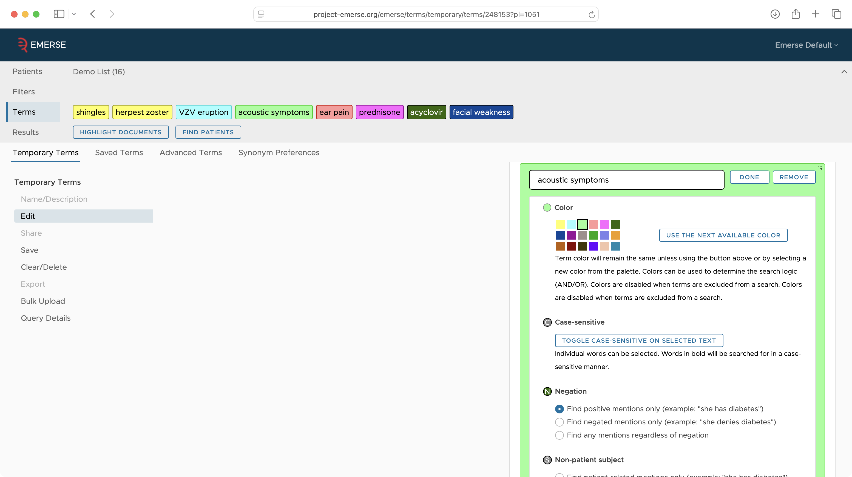

Slide 61
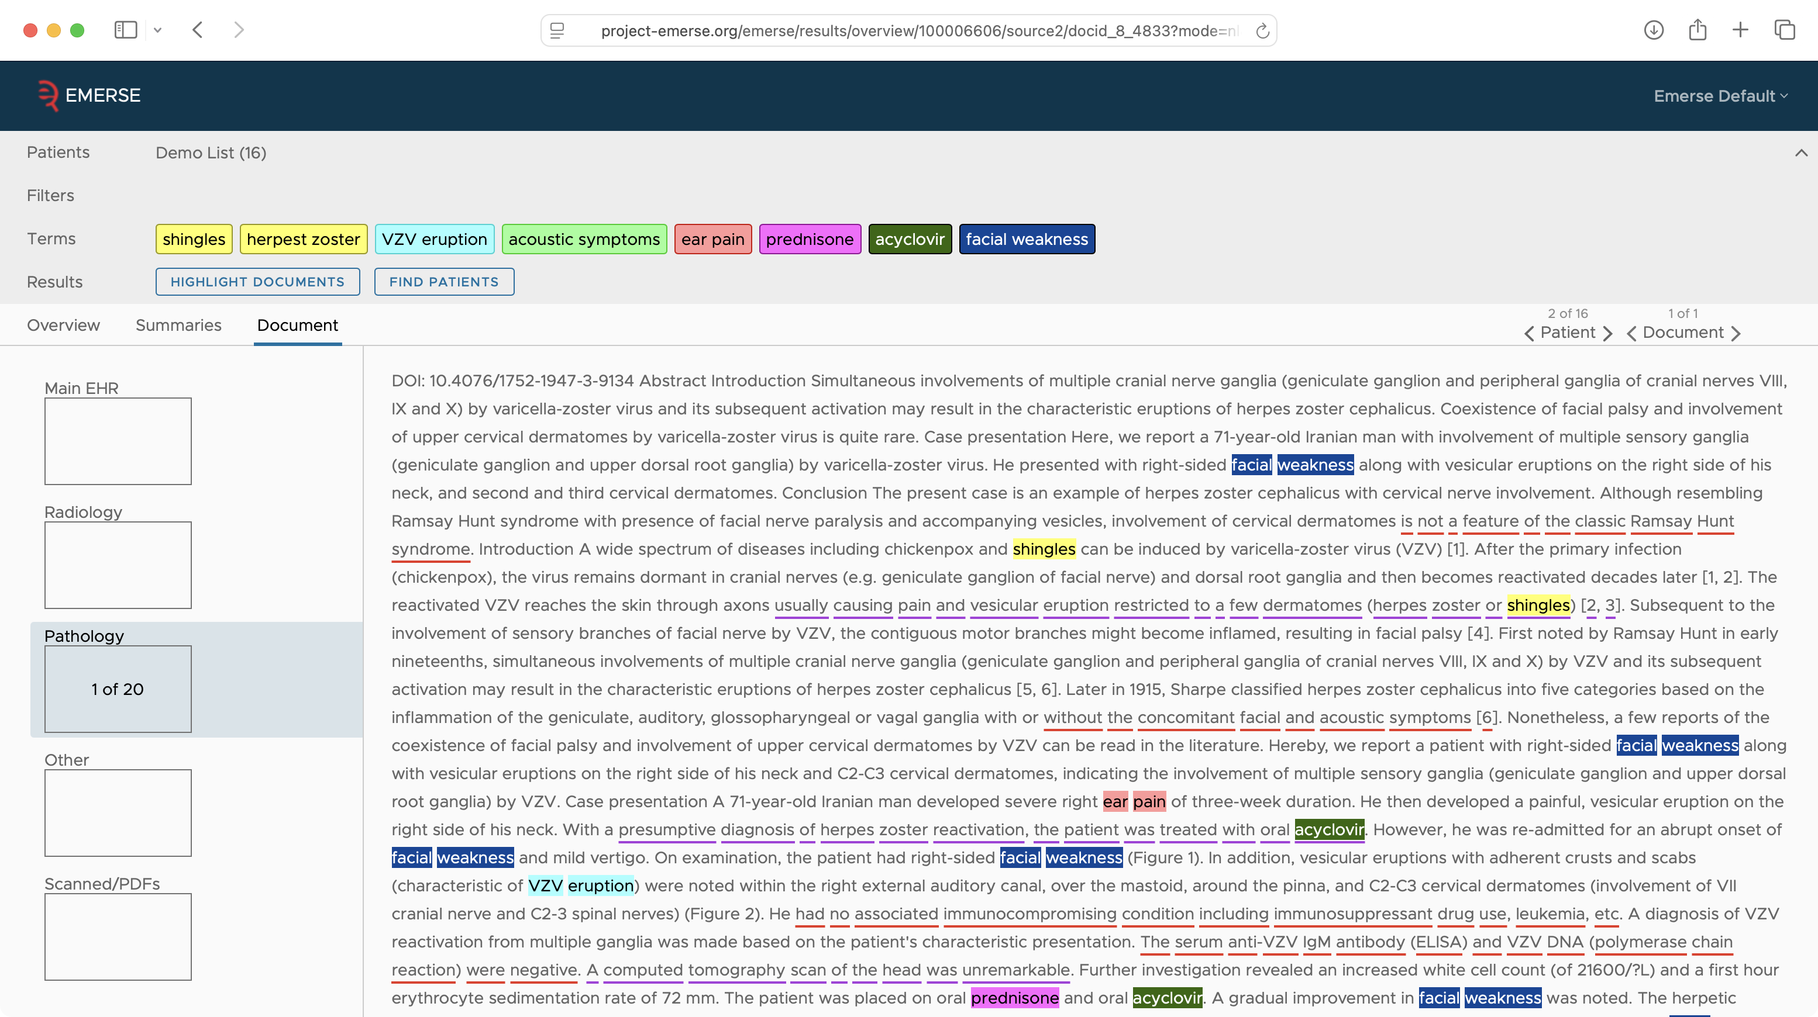

Slide 62
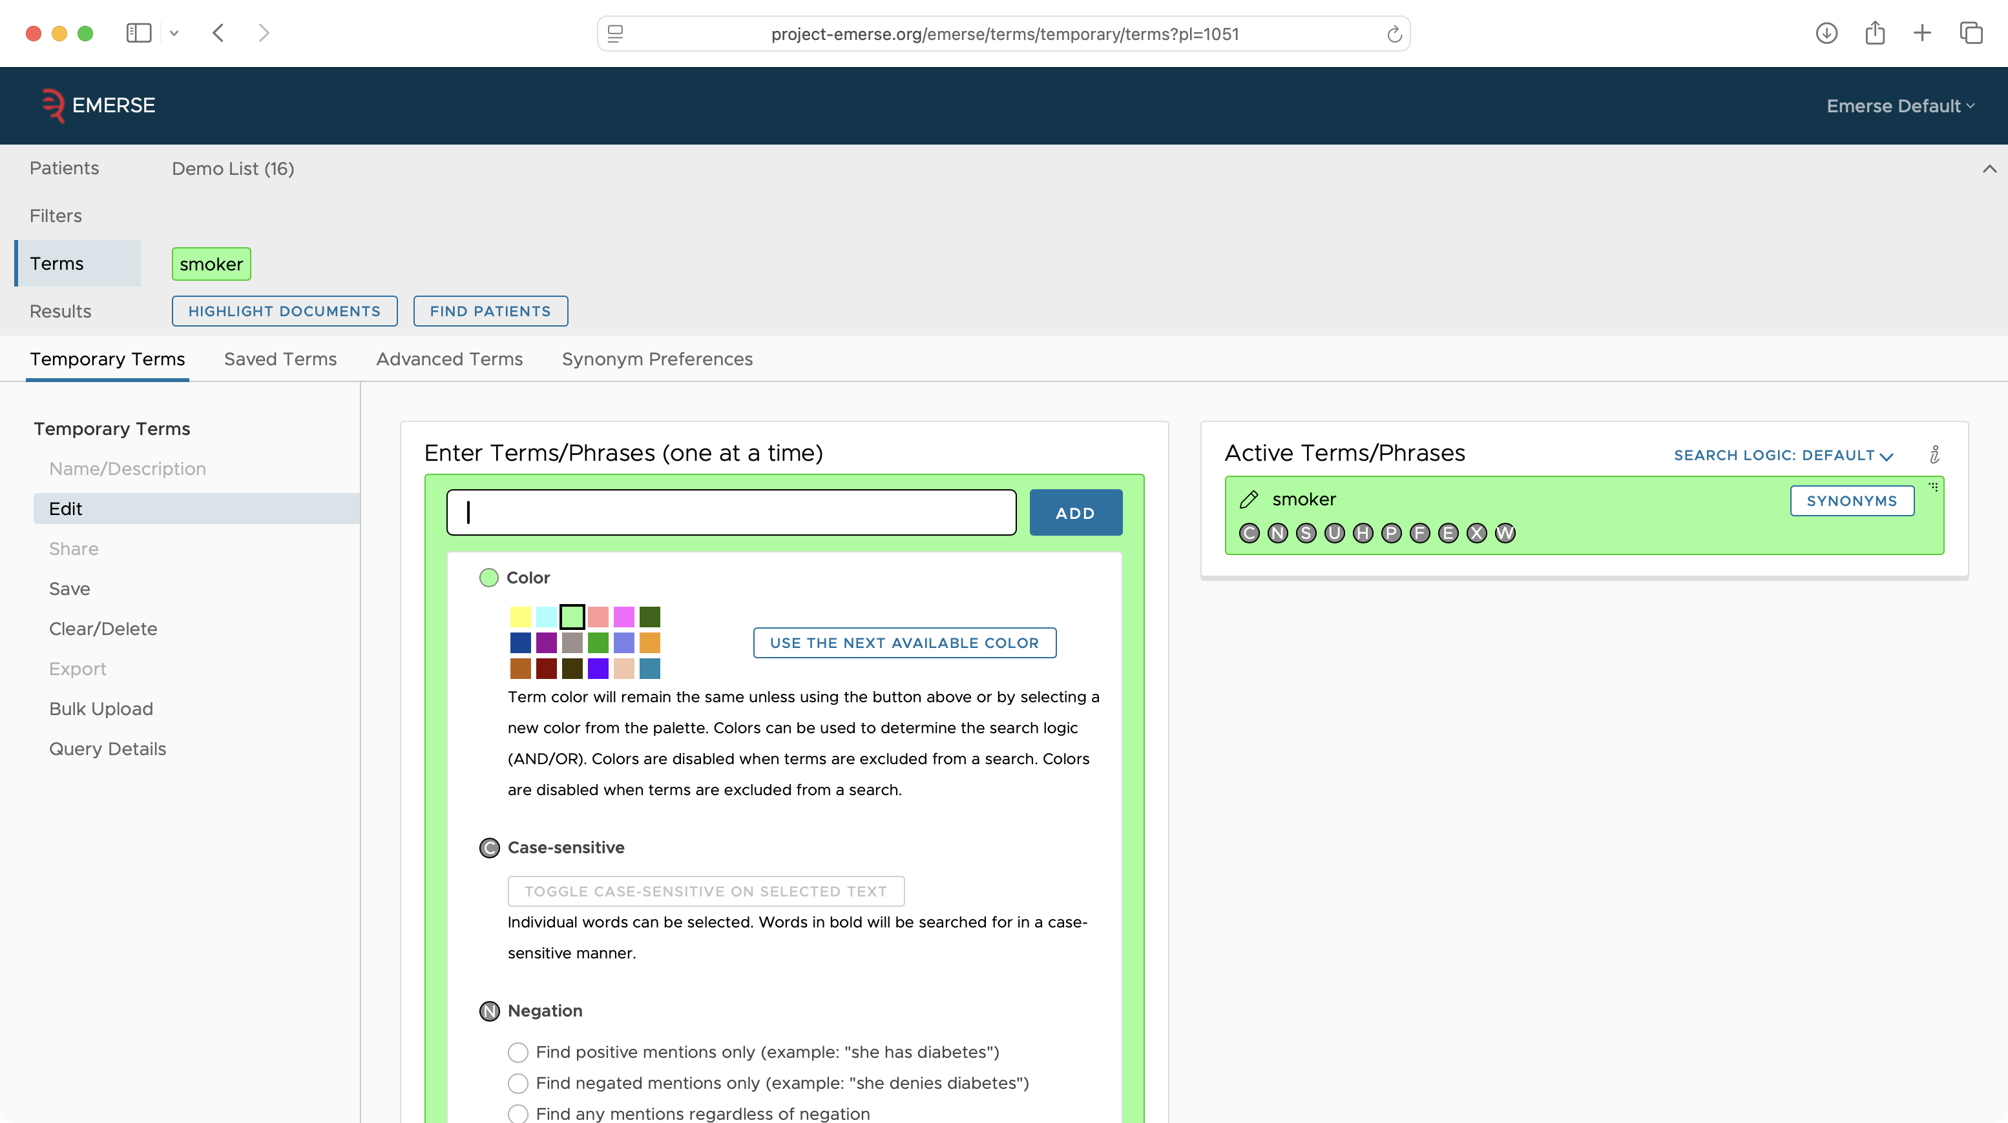

Slide 63
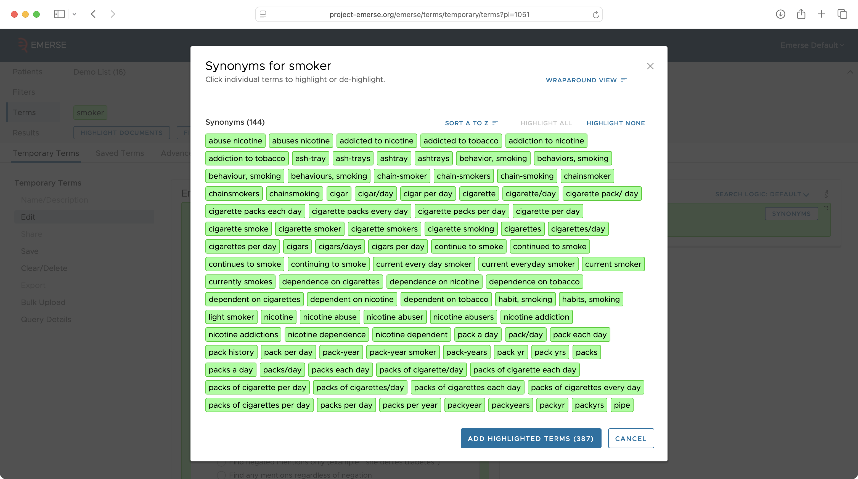

Slide 64
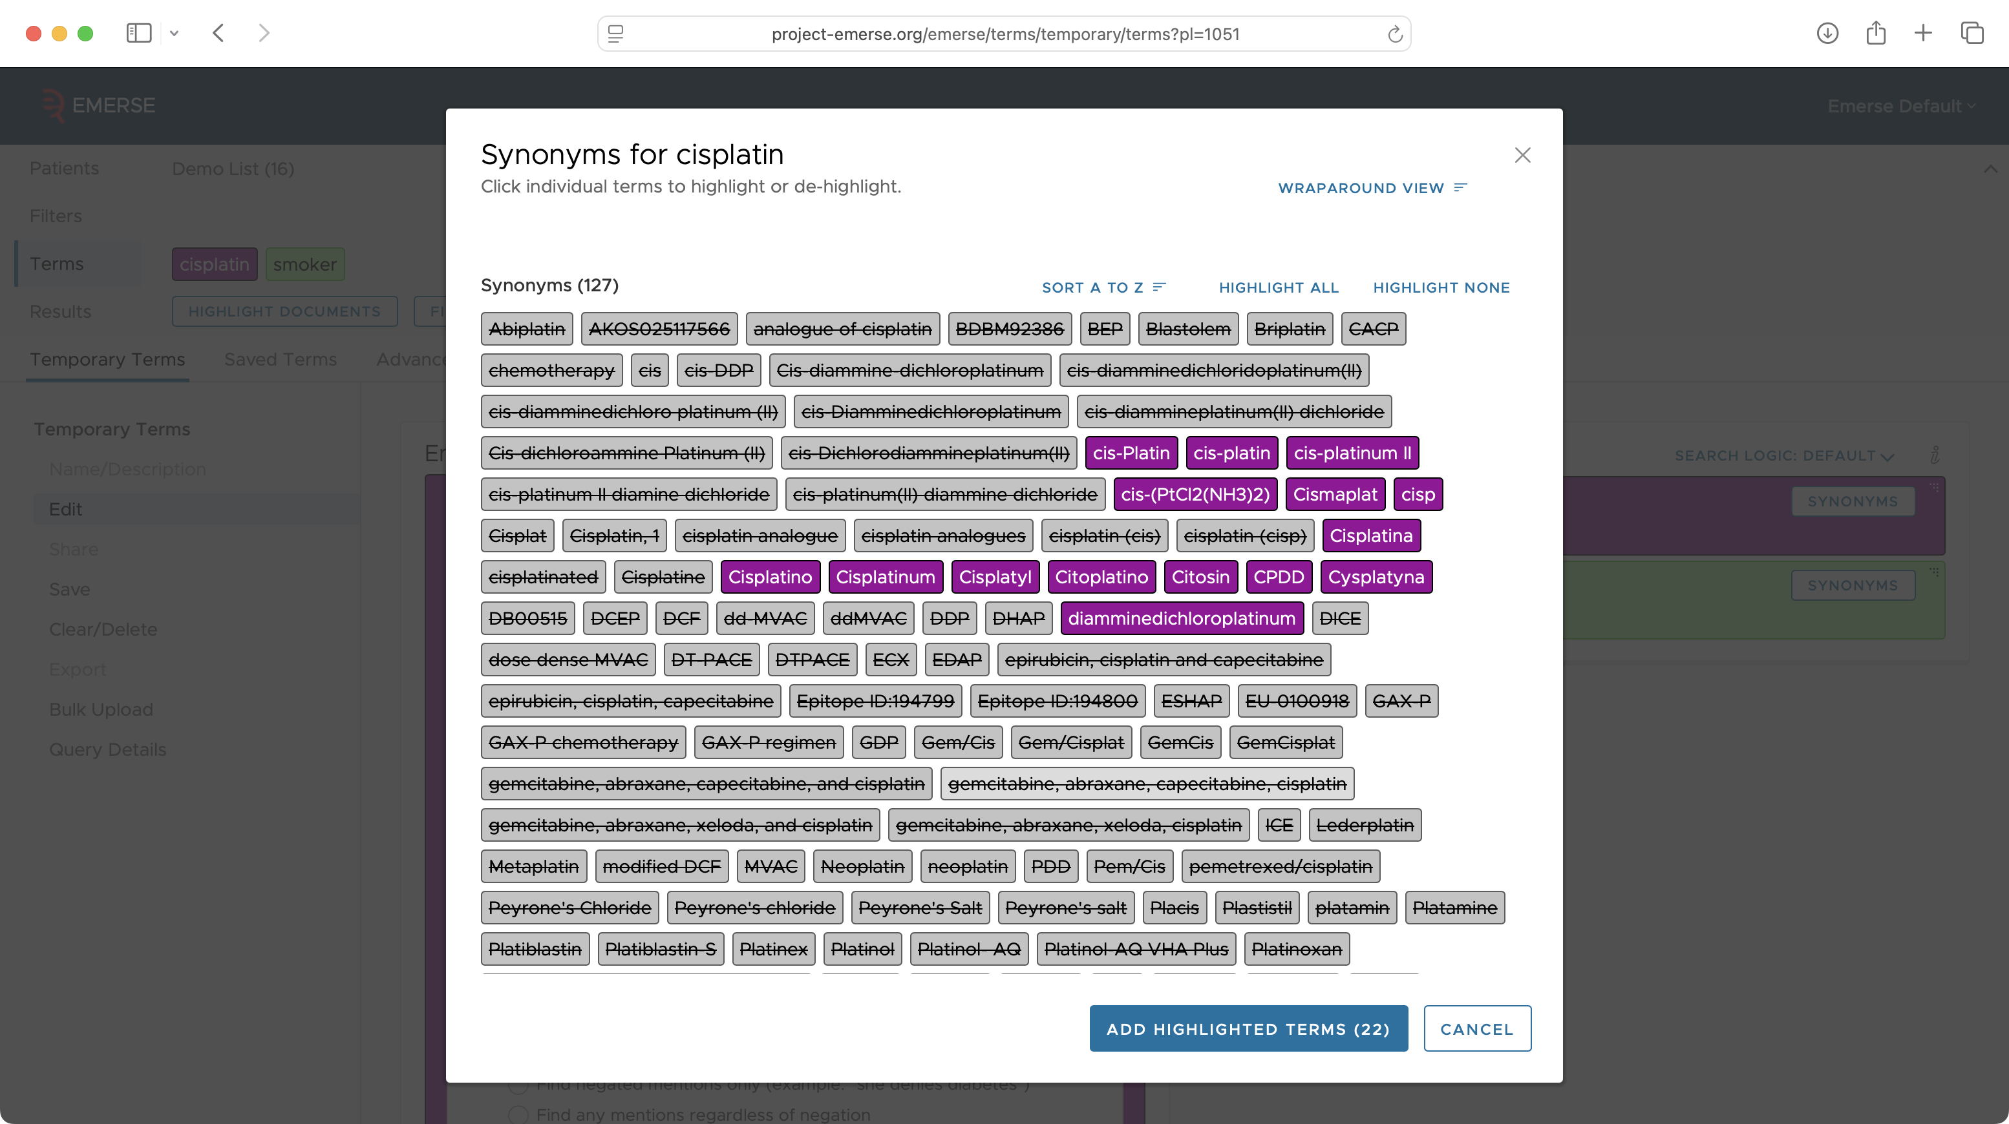

Slide 65
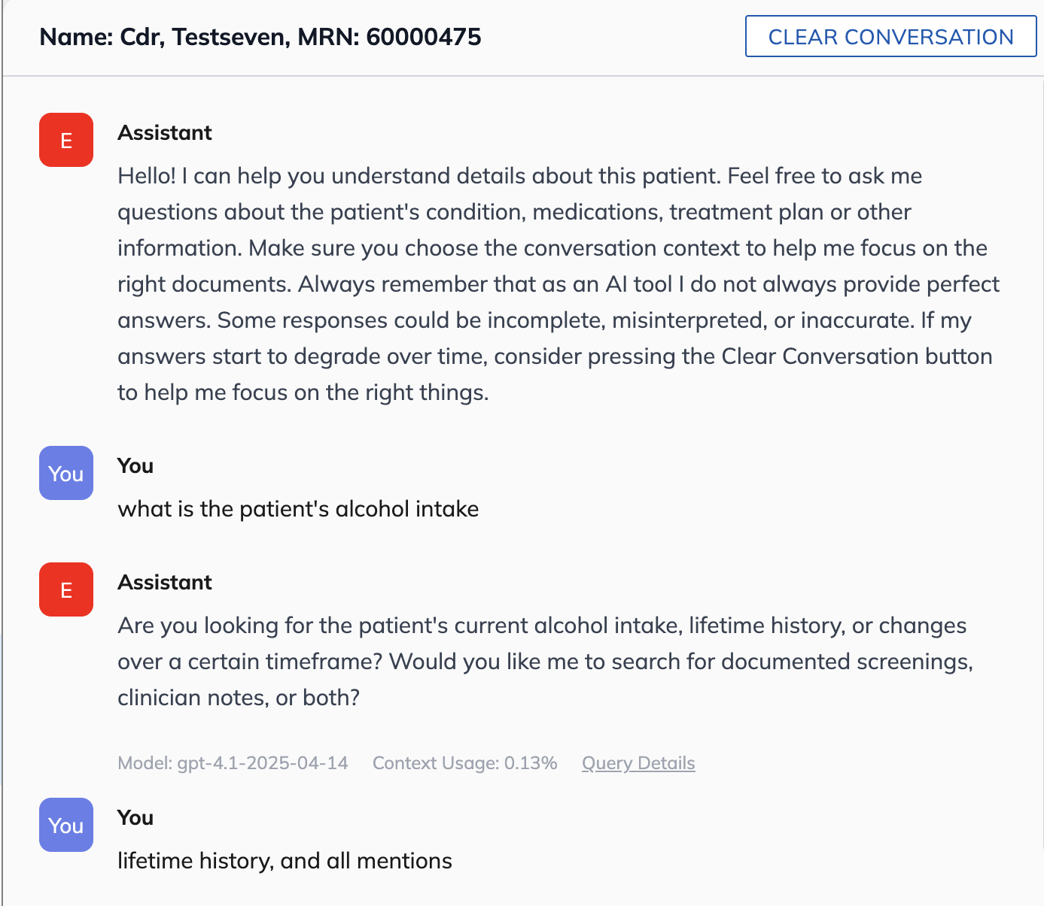
User enters
AI clarifies
User enters

Slide 66
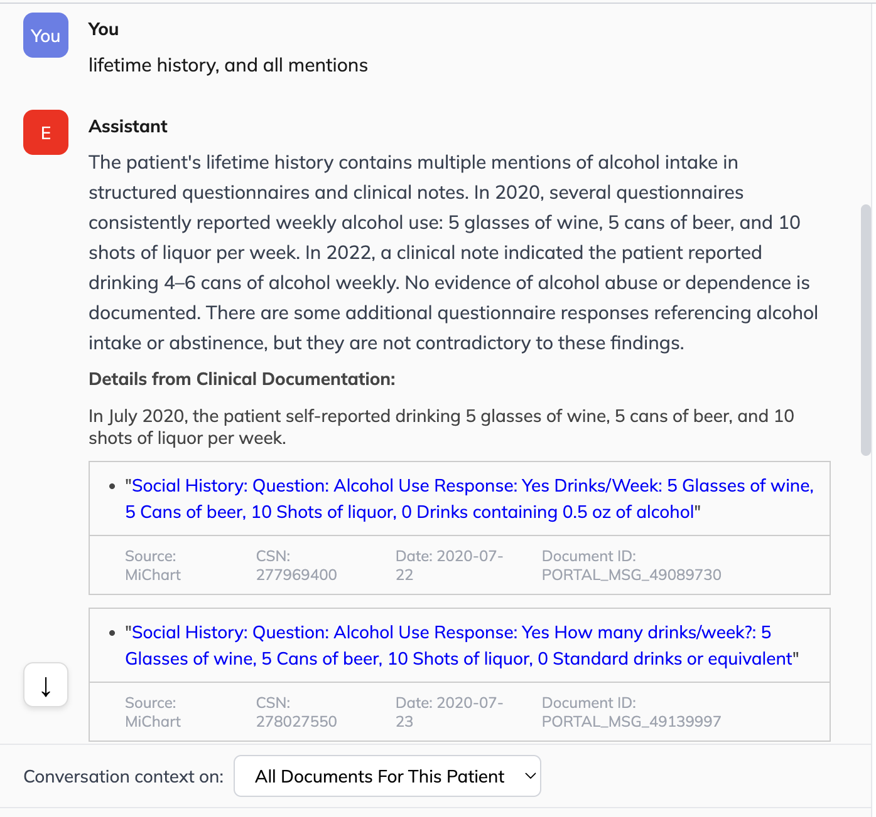

Slide 67
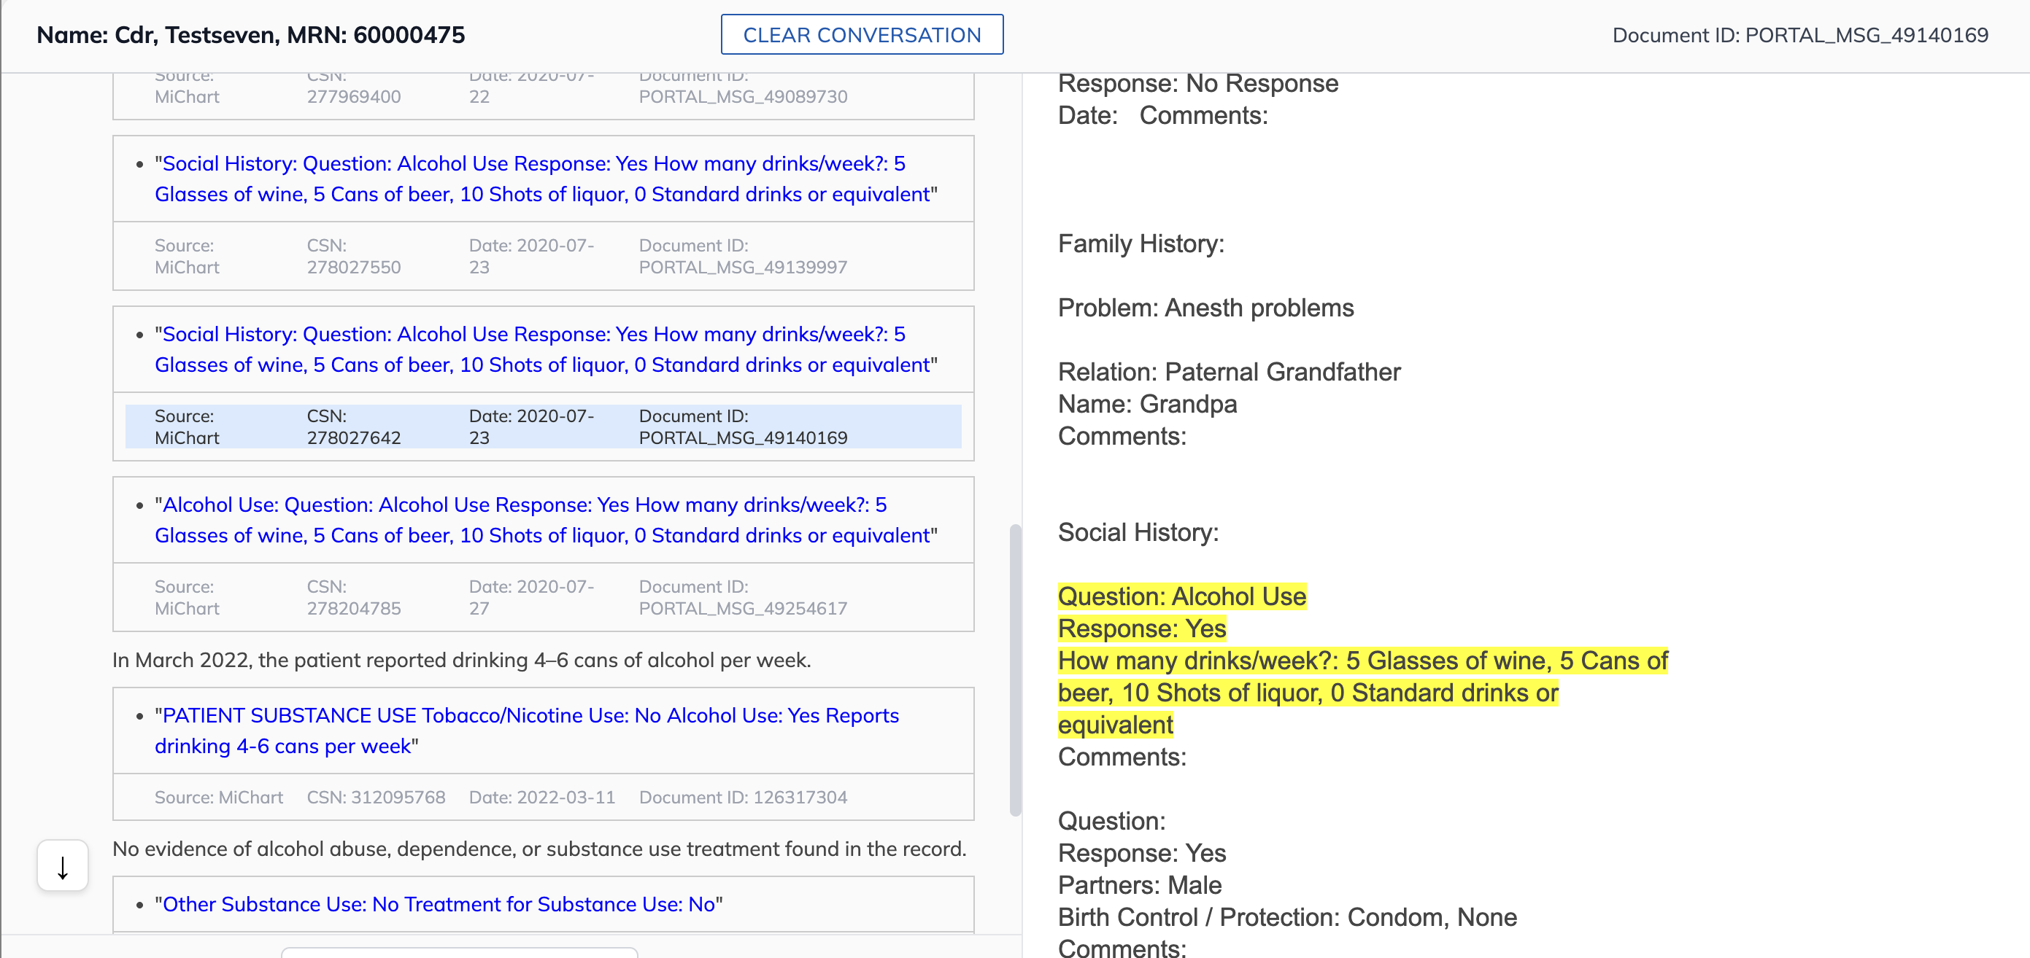

Slide 68
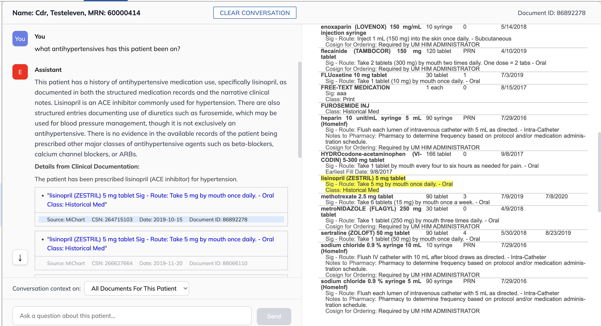

Slide 69

Interested in EMERSE?
Contact us to schedule a time with your team for:
Implementation planning
Discussions about usage strategies
Training
Live demonstrations (abstractors, IT teams, etc)
http://project-emerse.org/presentations.html

Slide 70


EMERSE-team@umich.edu
Lisa Ferguson
David Hanauer
Kellen McClain
Guan Wang
http://project-emerse.org/presentations.html

Slide 71




project-emerse.org
THANK
YOU!
http://project-emerse.org/presentations.html

