Slide 1

EMERSE Community Meeting
2026-May-06
https://project-emerse.org
https://project-emerse.org

Slide 2
Plan for today
Welcome and Housekeeping
Announcements
Guest Speakers: Tyler G. James, PhD, MCHES & Logan Roberts, MS, CHES
“Reducing Chart Review Burden with EMERSE: Lessons from CHARGE Syndrome Computable Phenotyping”
Software Updates
Open Forum
Adjourn

Slide 3
Housekeeping
Zoom Meeting
More opportunities for interaction
Please stay muted, unless you would like to ask a question or make a comment
Feel free to use the chat function to type questions or provide comments
We will answer questions throughout
We will record this meeting; it will be available where prior recordings are located:
https://project-emerse.org/presentations.html
https://project-emerse.org/community.html

Slide 4
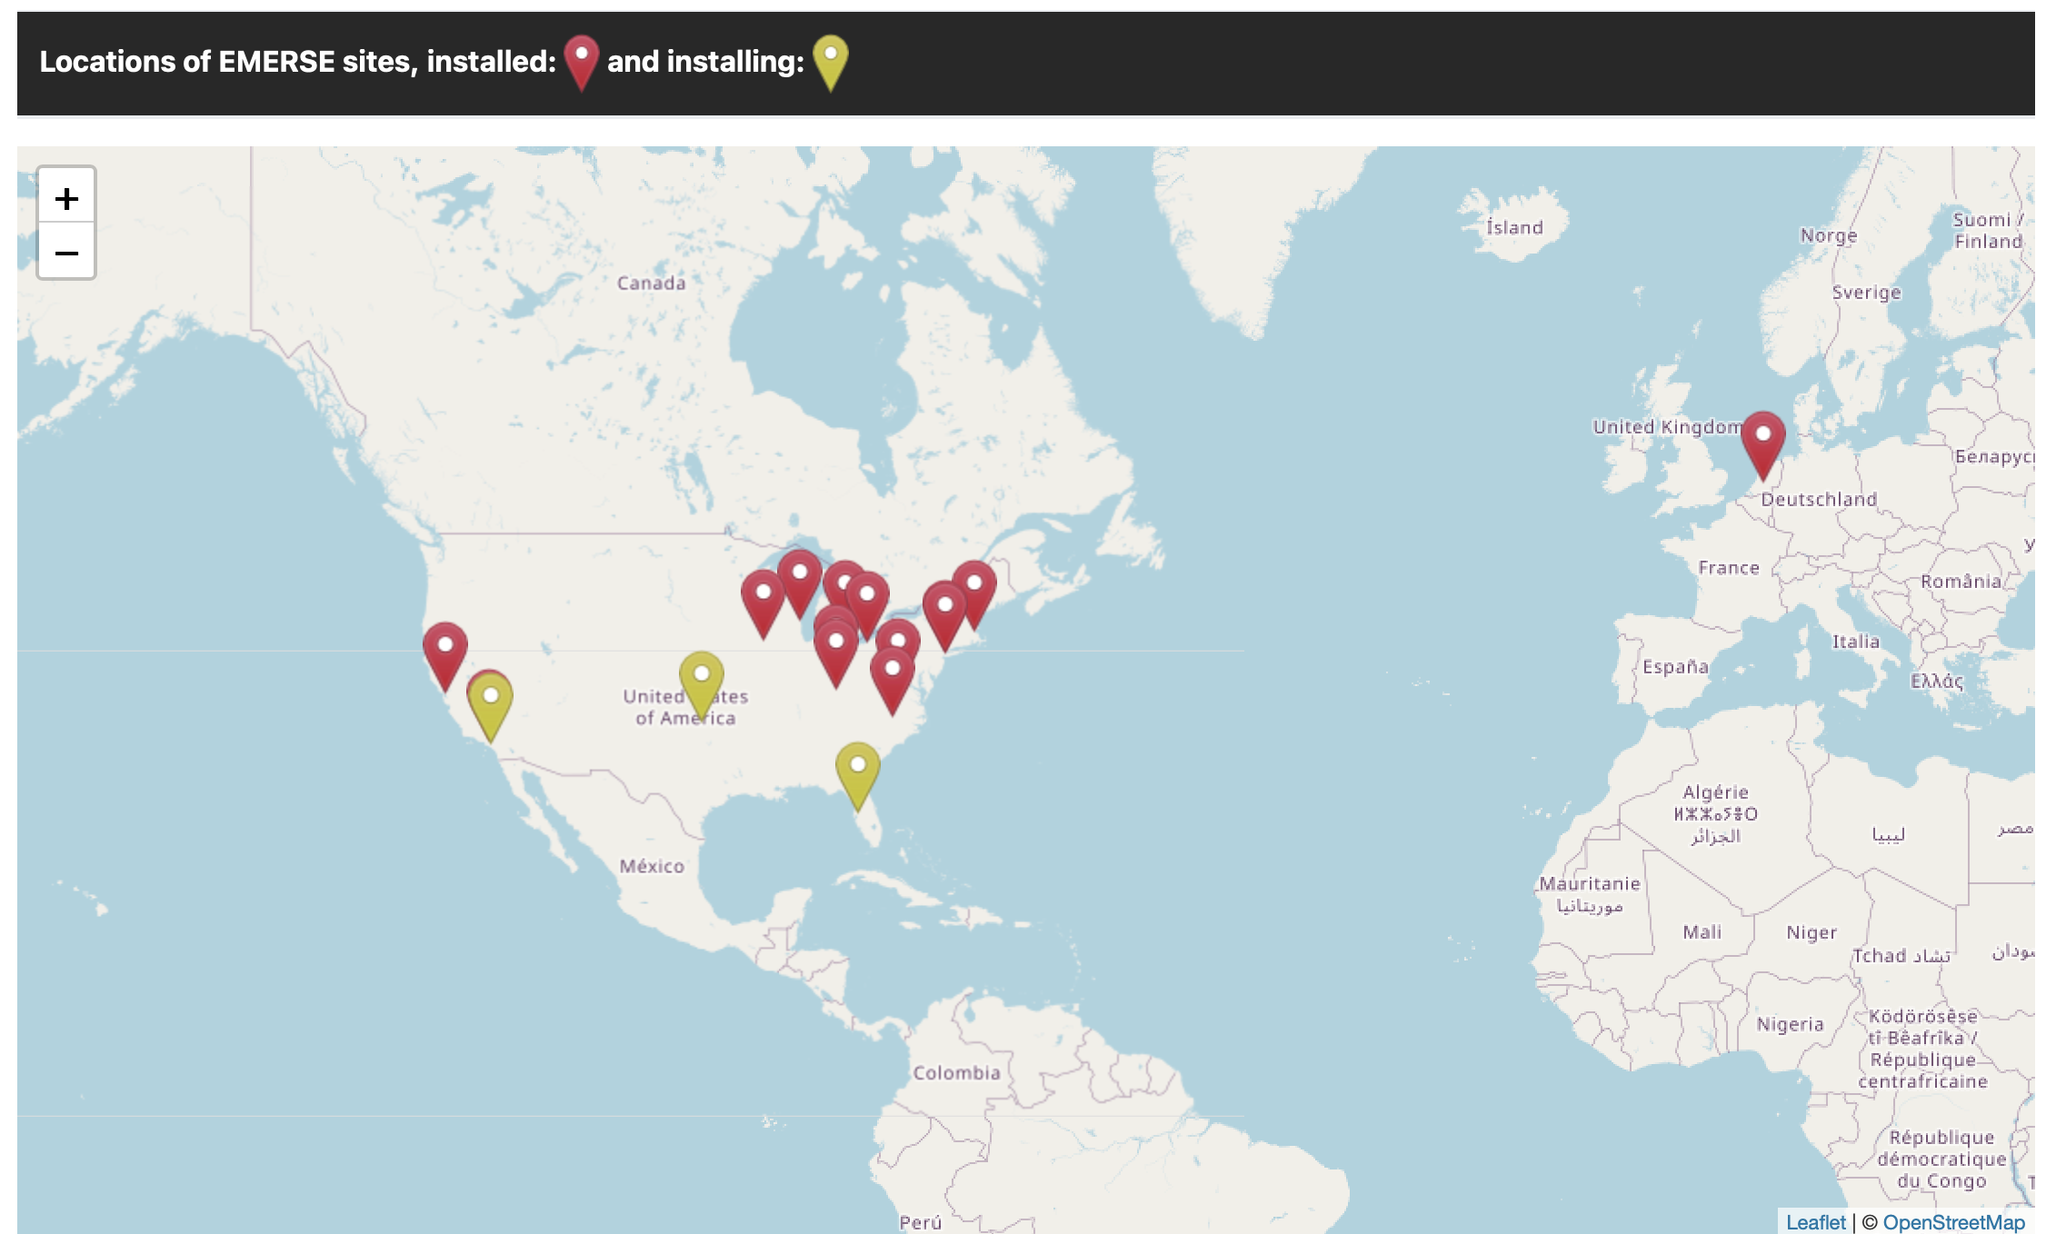
Community
https://project-emerse.org/community.html

Slide 5
Acknowledgements
EMERSE has been supported by:
NCI ITCR program
NCATS via MICHR CTSA
Michigan Medicine
Department of Learning Health Sciences
Office of Research
Health Information Technology & Services
Rogel Cancer Center

Slide 6

Publications Using EMERSE
since our last community meeting in Nov 2025
30
papers
5
abstracts
Full list here: https://project-emerse.org/publications.html

Slide 7
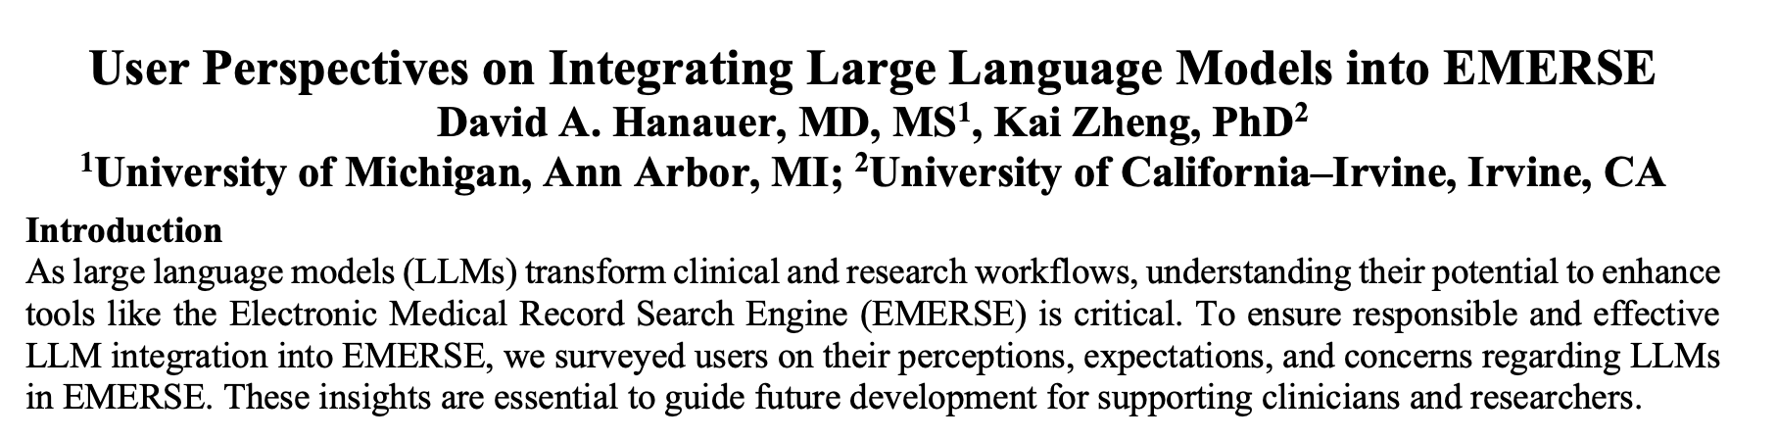
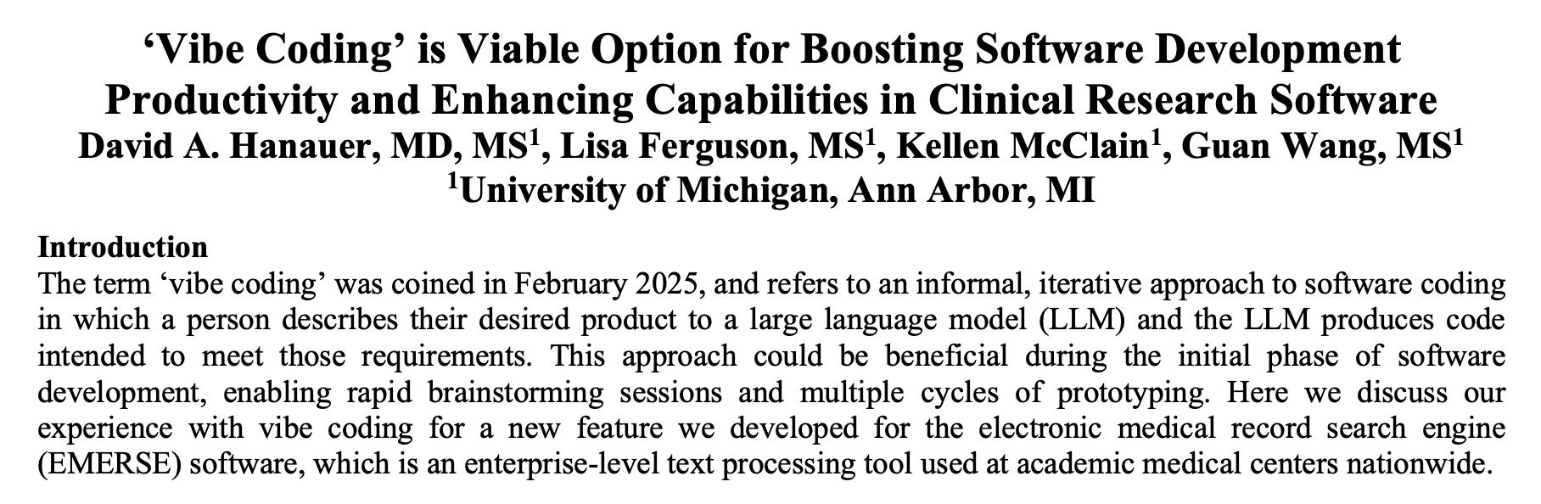
AMIA Amplify Meeting May 19-20, 2026

Slide 8
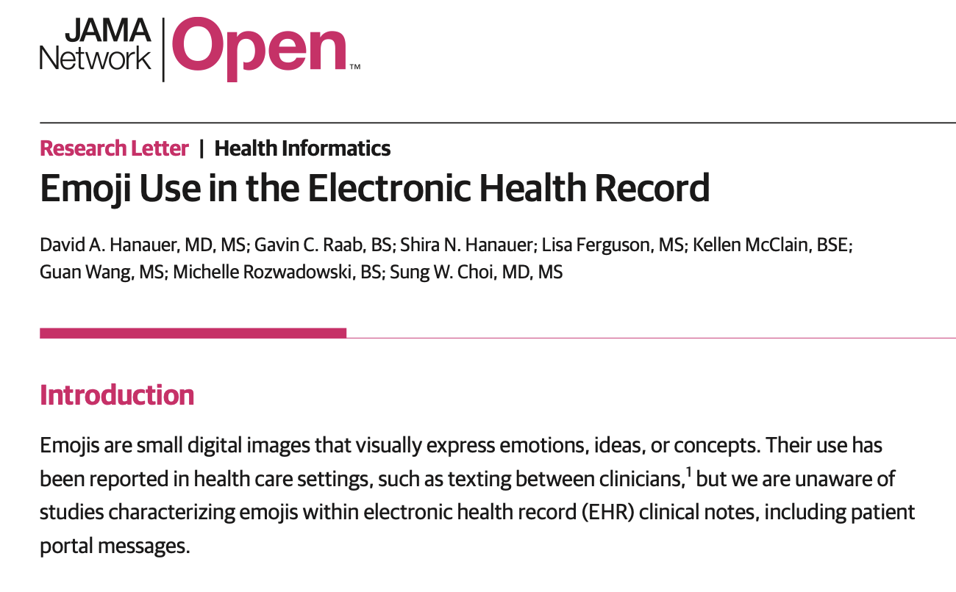
EMERSE-enabled
😀

Slide 9
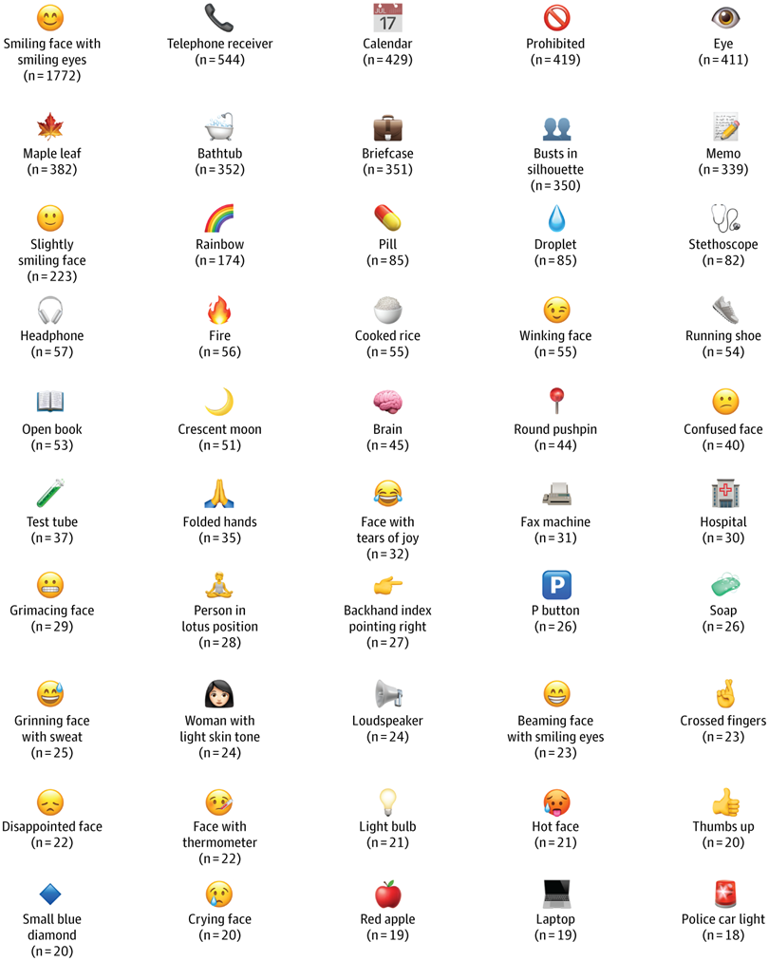
EMERSE-enabled
😀

Slide 10
Pause for Questions/Comments
🙋
Next up: Community member presentation
(followed by EMERSE v7.2 discussion)

Slide 11
Reducing Chart Review Burden with EMERSE: Lessons from CHARGE Syndrome Computable Phenotyping
Tyler G. James, PhD, MCHES & Logan Roberts, MS, CHES

Slide 12
Acknowledgements
And disclosures
Collaborators:
Brianna Marzolf, DO
Kim Blake, MD
Donna Martin, MD
MEL-STaR mentors:
Vinod Vydiswaran, PhD
Tiffany Veinot, PhD
Michael McKee, MD, MPH
Symone Griffin

Slide 13
Our Context
Chart review is a resource intensive task
Resources
Outcome complexity
Chart length
Data element type
Double abstraction
Notes:
[Logan]
The context of this presentation is conducting retrospective medical record, or chart, reviews.
The retrospective chart review is one of the most common methods in clinical and health research: going into existing medical records and pulling out the data you need to answer a research question. It’s widely used because the data already exist, but it comes with its own challenges and is commonly seen as complicated, time-consuming, and resource intensive.
As this figure highlights, several factors drive the cost of chart review.
First, outcome complexity plays a major role—more nuanced or subjective outcomes require additional interpretation, which increases both time and expertise needed.
Second, chart length matters. Longer records naturally take more time to review, especially when relevant information is buried within unstructured notes.
Third, the type of data elements being abstracted also impacts cost. Structured data can often be captured more efficiently, while unstructured or narrative data requires careful manual review.
And finally, double abstraction, while important for ensuring data quality and reliability, effectively doubles the effort required.
Because of all these factors, chart review is often described by many teams as both time consuming and expensive.

Slide 14
Rare Disease Clinical Trial Readiness
A priority for patient-centered research
Natural History
Clinical Trial Readiness
Patient and Family Engagement
Biomarker identification
Epidemiologic studies
Disease progression
Therapeutics
Psychological and medical treatments
Notes:
[Logan]
The resource demands we just discussed are even more pronounced in certain research contexts—particularly in rare diseases.
A rare disease is typically defined, in the United States, as a condition affecting fewer than 200,000 individuals. While each condition is uncommon, collectively rare diseases impact millions of patients, often with limited existing data and fragmented clinical knowledge.
Because of this, retrospective chart review becomes a critical tool—it’s often one of the few feasible ways to gather real-world evidence on disease progression, treatment patterns, and outcomes. At the same time, the costs and complexities we talked about can be amplified due to small sample sizes, variability in documentation, and the need for detailed data abstraction.
This brings us to the broader concept of clinical trial readiness in rare disease, which is really a foundation for advancing patient-centered research.
As shown in this figure, clinical trial readiness is supported by several interconnected components:
Understanding natural history, including how the disease progresses over time
Identifying and evaluating therapeutics, both psychological and medical
Developing biomarkers, which are essential for measuring outcomes and enabling trials
And critically, engaging patients and families, often through epidemiologic studies, to ensure research reflects real-world needs and experiences
Importantly, all of these components rely heavily on the underlying clinical data infrastructure—and in rare diseases, that infrastructure is often built from information captured in the medical record. Whether it’s reconstructing natural history, identifying potential biomarkers, or characterizing treatment patterns, much of the foundational work depends on extracting detailed, high-quality data from charts.
So while chart review is resource intensive, it also plays a central role in enabling the very pieces of infrastructure needed to make rare disease clinical research possible.

Slide 15
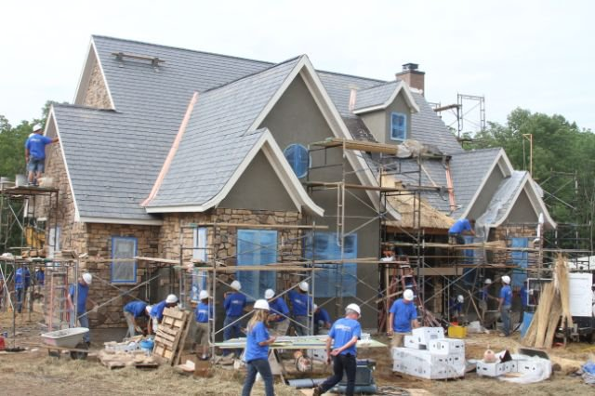
CHD7
Chromodomain helicase DNA binding protein 7
CHD7 regulates the function of other genes that influence fetal development.
Insufficient CHD7 protein increases risk of impact to heart, eye, ear, kidney, etc.
Adapted from Hitzert & van Ravenswaaij-Arts (2023)
Notes:
[Tyler]
One rare disease is CHD7 disorder. CHD7 – or chromodomain helicase DNA binding protein 7 – is a gene that regulates the function of other genes early in fetal development.
I once heard an example from geneticists that CHD7 essentially plays the role of a project manager for a construction project – making sure that tasks are completed in the correct order, by the correct people.
Insufficient CHD7 protein – which happens with some pathogenic variants of CHD7 – increases risk of impacts across all major organ systems.

Slide 16
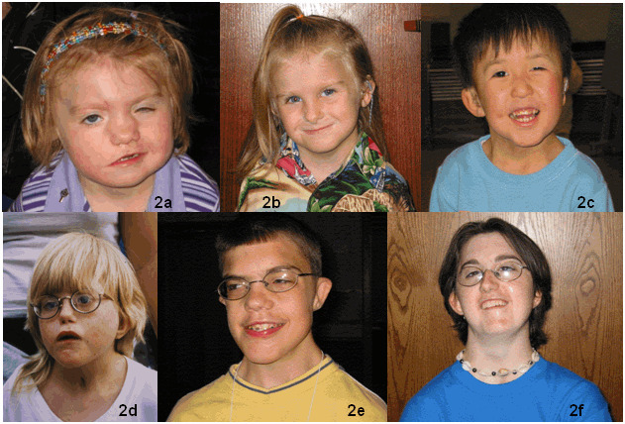
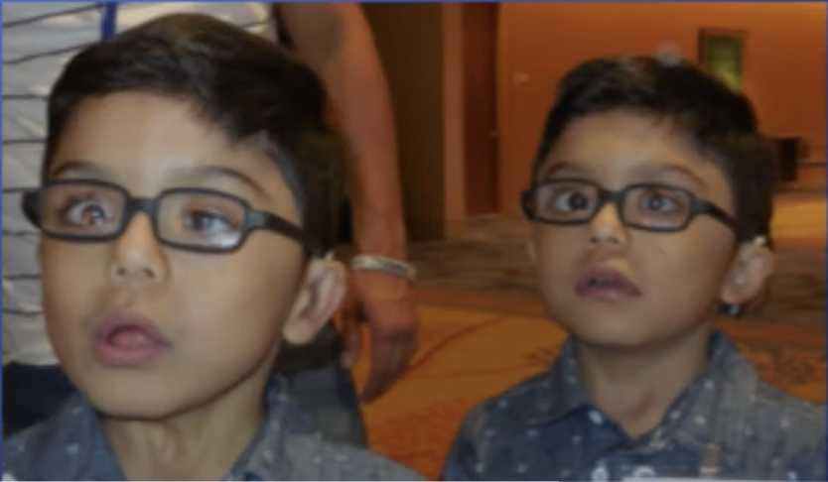
The Phenotypic Spectrum
If you know one person with CHARGE…
Source: Ravenswaaij-Arts, Hefner, Blake, & Martin (2022)
Notes:
[Tyler]
CHD7 pathogenic variants have been identified as a cause of CHARGE syndrome. First identified in 1979, CHARGE syndrome was named using the major features: coloboma [causing blindness], heart defect, choanal atresia, restriction of growth and development, genital differences, and ear differences.
CHARGE syndrome is characterized by significant impacts to the cranial nerves, and is the leading genetic etiology of congenital DeafBlindness in the U.S.
Unlike some congenital conditions which have clear genotype-phenotype relations (like Down syndrome), CHARGE syndrome is complicated by a wide phenotypic spectrum – the way CHARGE syndrome manifests can be quite different across individuals / even among twins (right). For this reason, if you know one person with CHARGE syndrome, you know one person with CHARGE syndrome.

Slide 17
Understanding CHARGE Syndrome
The phenotypic spectrum
Vision
Coloboma*
Microphthalmos
Choanal atresia*
Cranial nerve*
Facial palsy
Swallowing problems / gut motility
CHARGE ear*
Semicircular canals
Cochlea
Ossicular malformations
Short, wide ear
Bony or membranous
Atresia or stenosis
Unilateral or bilateral
Cleft palate
Sensorineural hearing loss
Anosmia
Other
Congenital heart defect
Genital differences
Language
Insomnia
Autistic-like behavior
Notes:
[Tyler]
This figure shows some of the major manifestations or features of CHARGE syndrome, and can be used as ways to think of spectrums within the spectrum.

Slide 18
Major Diagnostic Criteria for CHARGE
Primarily a clinical diagnosis
Criteria | Blake et al. (1998) | Verloes (2005) | Hale et al. (2016)
Coloboma | ✔ | ✔ | ✔
Choanal atresia | ✔ | ✔ | ✔ (inc. cleft palate)
Characteristic ear abnormalities | ✔ | ✔ (semicircular canals) | ✔
Cranial nerve dysfunction | ✔ | (minor) | (minor)
Pathogenic CHD7 | N/A | N/A | ✔
Notes:
[Tyler]
The phenotypic spectrum and variance in patients is also paired with varied diagnostic definitions for CHARGE syndrome – spanning from the Blake criteria of the late 90s to the more recent Hale criteria which aims to be more inclusive in trying to identify less ‘typical’ cases of CHARGE syndrome. Of course, these definitions do share similarities on the major features of CHARGE syndrome.

Slide 19
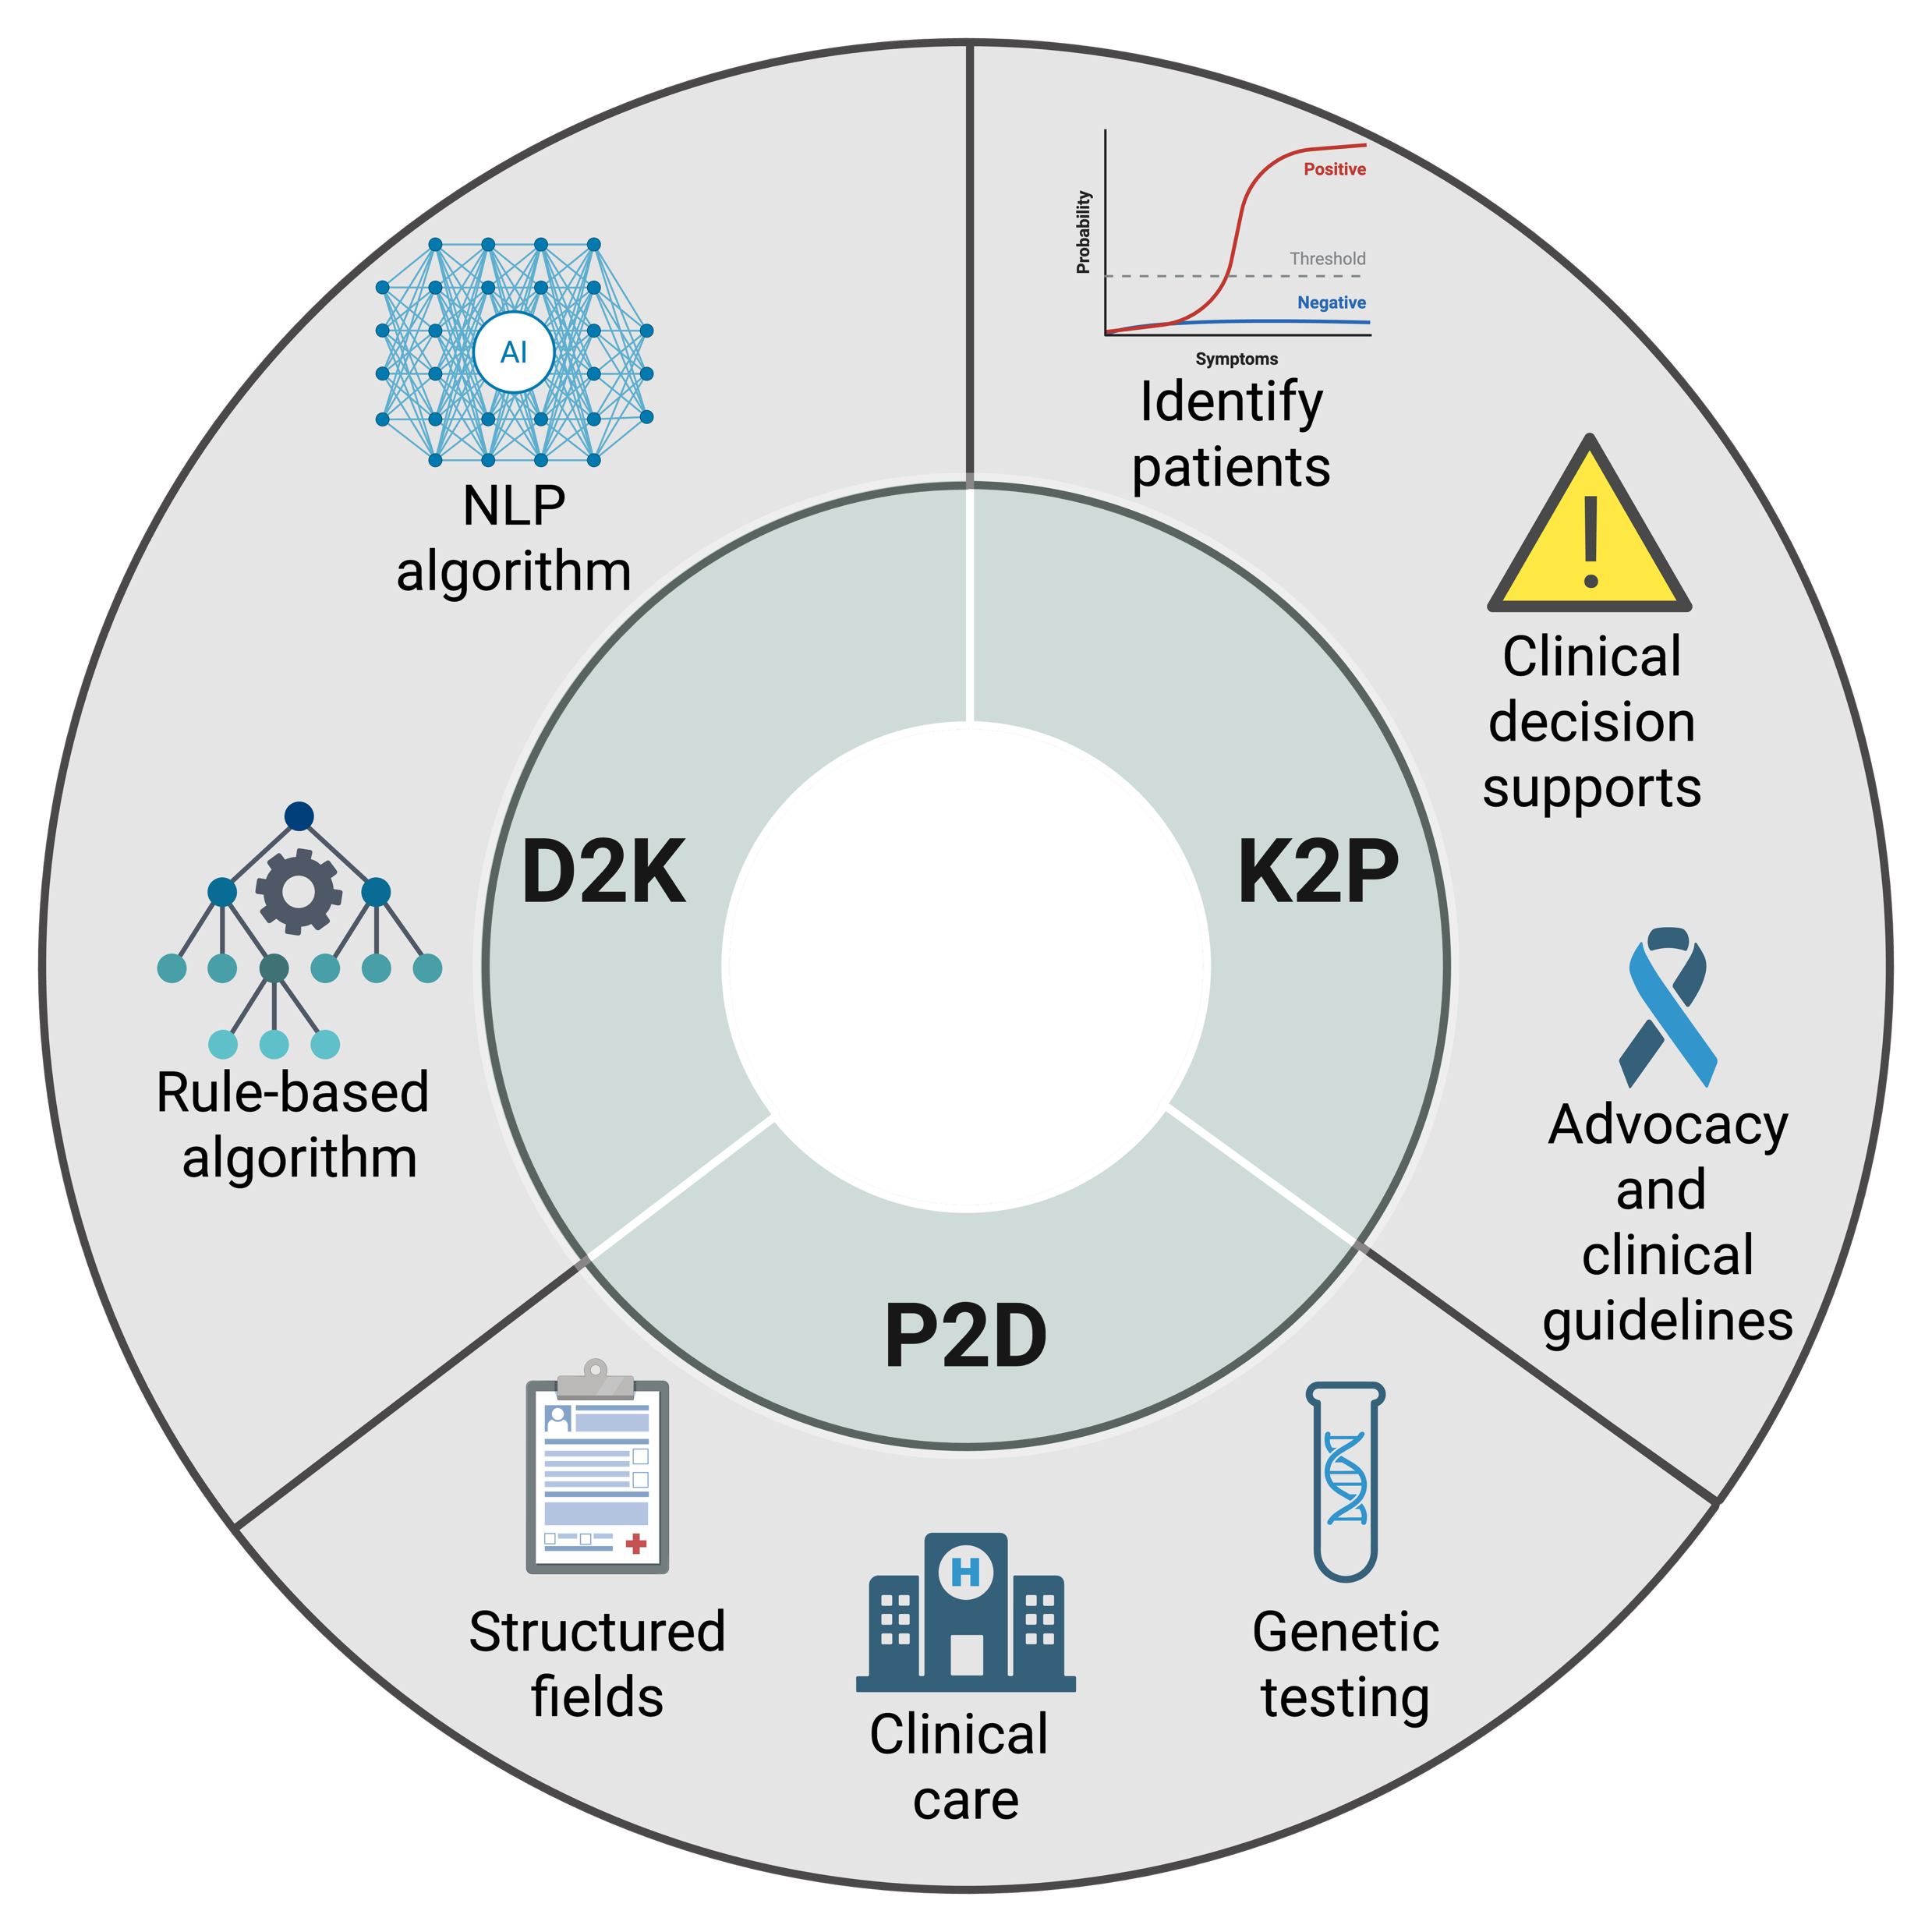
Learning Cycle Informatics
Requires infrastructure
Notes:
[Tyler]
Identifying patients with CHARGE syndrome is a priority so that we can conduct better/more clinical research, Learning Cycle Informatics, or Learning Health Systems reseach.
Without being able to identify patients, we cannot implement clinical decision supports, improving clinical practice → more data collection → more knowledge generation.
In short, without being able to identify patients with CHARGE syndrome – we cannot improve care coordination for this population.

Slide 20
Identifying Patients with CHARGE
A priority and challenge
ICD-9-CM | ICD-10-CM | ICD-11 | SNOMED
759.89 | Q87.8 | 5A61.0 | 47535005
Other specified congenital anomalies | Other specified congenital malformation syndromes, not elsewhere classified | Hypopituitarism | CHARGE syndrome
Notes:
[Tyler]
This should be easy though – right? In clinical research, we frequently use diagnostic and procedure codes to identify patient populations and create outcome variables.
But, there is not a diagnostic code unique to CHARGE syndrome.
This table shows the different ways CHARGE Syndrome may be classified using diagnostic codes.
The lack of a diagnostic code may change with the revision to ICD-11, but the World Health Organization is suggesting a change to classify CHARGE syndrome with pituitary hormone system disorders.
If we want to conduct more robust research in CHARGE syndrome, we need to do a better job at identifying people with CHARGE…

Slide 21
Development of a Rule-based Phenotype
Methods
Identify the phenotype.
Diagnostic criteria.
Define the algorithm.
Do those identified as having CHARGE have CHARGE?
Validate the algorithm.
Features of CHARGE based on ICD-9-CM, ICD-10-CM, and CPT codes.
Notes:
[Logan]
This led to the primary project, which we will discuss as a use-case for EMERSE.
Our goal was to develop and evaluate a rule-based computable phenotype, which could be used to identify patients with CHARGE syndrome.
This figure shows the overview of our procedure: first, we used diagnostic guidelines, then mapped the features of CHARGE syndrome to diagnostic and procedure codes, and then attempted to validate the algorithm.

Slide 22
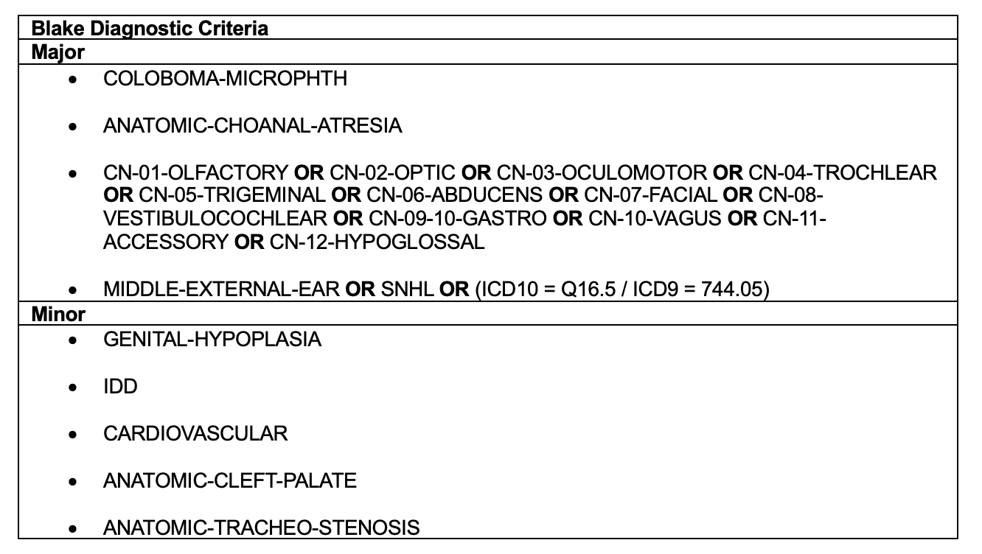
Rule-based Phenotype for the Blake Criteria
If 4 major OR 3 major + at least 3 minor THEN “Definite” (code as 2)
If 1 or 2 major + at least 3 minor THEN “Probable” (code as 1)
Else: “None” (code as 0)
Notes:
[Logan]
Tyler mentioned three major diagnostic criteria for CHARGE syndrome a few slides ago. This slide shows an example of how this was operationalized for the rule-based phenotype.
The Blake criteria identifies ‘Definite’ CHARGE syndrome as the presence of 4 major or 3 major and 3 minor criteria.
Major and minor criteria are defined in the diagnostic guidelines. For example, coloboma, choanal atresia, cranial nerve dysfunction, and ear differences or hearing loss are all major criteria.
We started by identifying the different criteria for each diagnostic guideline.

Slide 23
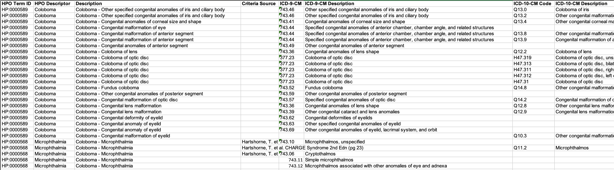
Defining the Rule-based Phenotype
Example of our spreadsheets
Notes:
[Logan]
We then developed spreadsheets mapping phenotypes to ICD codes and CPT codes.
This spreadsheet (although it is a little small) is for the Coloboma manifestation. We mapped each manifestation of CHARGE syndrome to the ICD9CM, ICD10CM, and CPT codes.
This spreadsheet is one of the early versions – we have actually been working to improve this as a ready-to-use computable biomedical knowledge resource for CHARGE syndrome, linking to UMLS concepts and Human Phenotype Ontology terms.

Slide 24
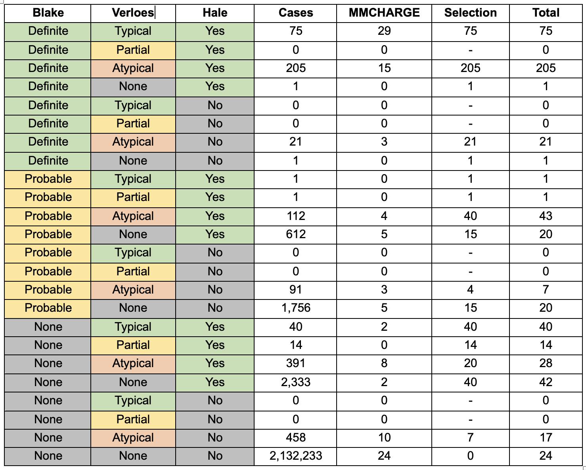
Notes:
[Tyler]
This table shows the classification of 2.1 million patients at Michigan Medicine, under age 50 – based on each of the three diagnostic criteria.
For example, the top row is for ‘Definite’ on the Blake Criteria, ‘Typical’ on the Verloes criteria, and ‘Yes’ on the Hale criteria. -- For this, 75 patients were identified.
29 patients in that top row were identified as having the SNOMED term for CHARGE Syndrome in their problem list.
We then needed to go through and do gold-standard chart review for these patients.
~6100 were identified as possible on at least one algorithm. This was too much for manual chart review.
We took a purposeful stratified sample, based on proportions, and sampling all with the SNOMED term for CHARGE Syndrome → a sample of 560 patients.

Slide 25
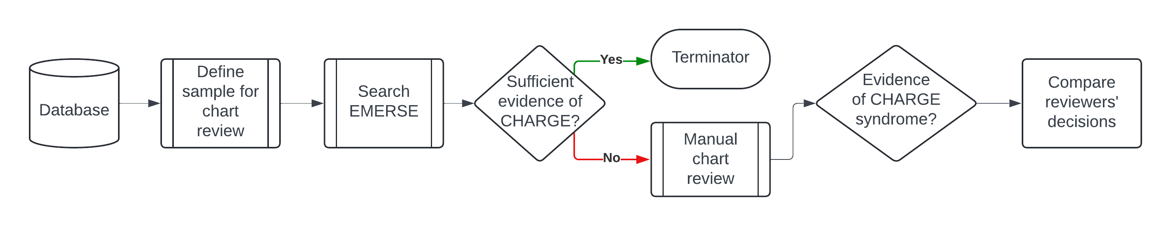
The Chart Review Process
Simplified
Notes:
[Logan]
This slide shows the chart review process used for our study.
Essentially, we started with the database of 2.1 million patients. This was narrowed down to 560 patients for manual chart review.
Initially, we had not planned to use EMERSE. But, when starting chart reviews, we realized that it was taking a significant amount of time.
We integrated EMERSE into the workflow, searching EMERSE first.
A research coordinator familiar with CHARGE syndrome identified if there was sufficient evidence of CHARGE Syndrome in the medical record, and if so – the record in REDCap was appropriately flagged. Otherwise, manual chart review was necessary.

Slide 26
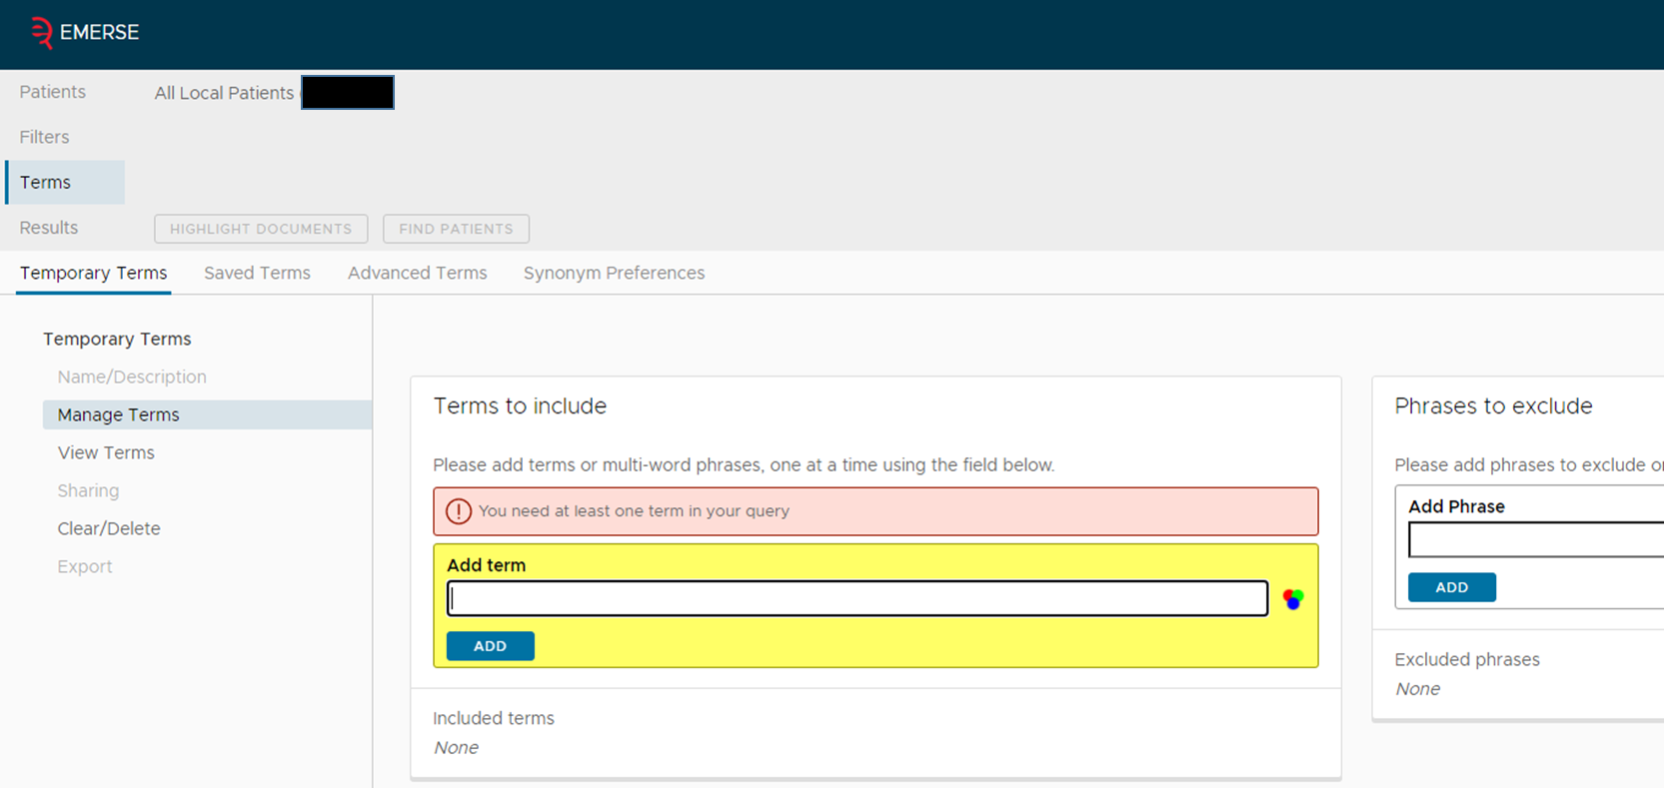
Using EMERSE to Search Records
EMERSE main screen
Source: Project EMERSE
Notes:
[Tyler]
- This slide just shows the main screen of EMERSE.
- Essentially, we uploaded the 560 patients’ MRNs to EMERSE as a ‘Saved patients’ list and then entered terms related to CHARGE syndrome.

Slide 27
Using EMERSE to Search Records
Inputting search terms
CHD7
CHD7
Deletions of CHD7 gene
CHARGE syndrome
CHARGE syndrome
CHARGE association
Semicircular canals
Semicircular canal
Pathogenic CHD7 variant
Coloboma
Dysplasia of semi-circular canal
Notes:
[Tyler]
For terms related to CHARGE Syndrome, we created three topical categories – which were color coded.
The first was related to the causal gene for CHARGE syndrome: CHD7. We highlighted terms related to CHD7 deletion, pathogenic variants, etc.
CHARGE syndrome included terms related to CHARGE Syndrome, the older name of CHARGE association, and coloboma.
Semicircular canal dysplasia is pathognomonic in CHARGE syndrome and can be seen on temporal bone CTs. We also developed a term set related to semicircular canals.

Slide 28
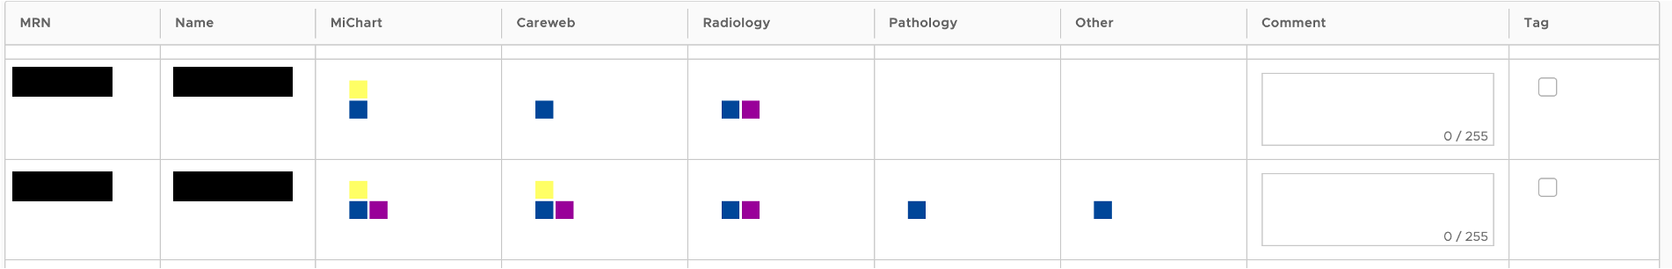
Using EMERSE to Search Records
Example screenshot from EMERSE
Notes:
[Tyler]
This screenshot shows what the feature looks like with the mosaic option turned on, and the color coding for each of the patients.
This second patient, for example has yellow (CHD7), blue (charge syndrome), and purple (semicircular canals). – This was one way that we identified patients with CHARGE syndrome, prepared the research coordinator for extraction, and identified relevant segments.

Slide 29
Benefits of Using EMERSE
For this study
True Financial Costs
$31,360 for chart review without EMERSE.
Data Quality
Project Management
Fewer charts needed to be manually reviewed.
Reduced variability.
Better for time restraints.
Easier to find data.
Reproducible.
Notes:
[Logan]
Our study greatly benefited from integrating EMERSE into the pipeline.
In true financial costs, we found that reviewing one medical record – with two reviewers – cost approximately $56/chart. In total, that would have been over $30k. – This is incredibly expensive for an unfunded study.
We also had improvements in data quality. By using EMERSE – we were able to reduce variability in what reviewers were looking for; it was easier to identify and extract data; and also created a more reproducible pipeline.
From a project management standpoint, we found that fewer charts needed to be manually reviewed → less time needed to complete the project.

Slide 30
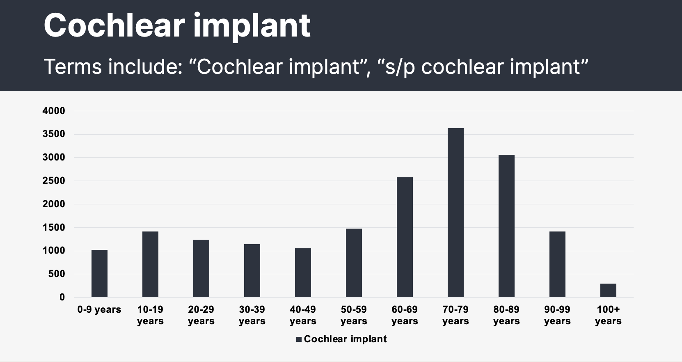
Other Uses of EMERSE
In our research group

Slide 31
Questions?
Thank you!

Slide 32
EMERSE version 7.2
Testing (in production) underway at U of Michigan
Preparing for wider release
User interface framework updated – improved security
Timeline
Customizable table columns in Summaries
OCR-ready (e.g., thumbnail views, highlighting within documents)
Flowsheet-ready (search within flowsheets)
More compact user interface
Minor user interface updates (e.g., descriptions no longer required for Saved Patient Lists/Terms)

Slide 33
EMERSE version 7.2
Quick Demonstration

Slide 34
Work in progress
User guide for version 7.2
Solr Cloud
to scale up resources for improved performance
Download data
Almost done, need to make a few more changes
AI Integration
Short demonstration today

Slide 35

Wrap-up
Thanks for attending!
Next Meeting: TBD (Fall 2026)
Please complete meeting survey:
https://bit.ly/emerse-may-2026
Upcoming

