Slide 1

From Search to Synthesis: EMERSE, LLMs, and the Future of AI-Augmented Clinical Discovery
Presentation for the Weill Cornell Medical Center
July 15, 2026
Web: project-emerse.org
Email: hanauer@umich.edu
David Hanauer, MD, MS
Dept of Learning Health Sciences
University of Michigan
http://project-emerse.org/presentations.html

Slide 2

Disclosures
Funding: U.S National Institutes of Health
NCI-ITCR: U24CA269315
NCATS-CTSA: UM1TR004404
U of Michigan Royalties/Licensing:
“Synonyms” dataset–optional “plugin” for
EMERSE
→ Free for use within EMERSE for
research
Disclosures
http://project-emerse.org/presentations.html

Slide 3
Unstructured vs Structured Data
EMERSE is for this… | …not this
Unstructured Data (free-text) | Structured Data
Mrs. Jones is a 56 year old female with a history of HTN, hypercholesterolemia, and T2DM who comes to the clinic today with a 3 day h/o dizziness and severe headache on the left side. | WBC: 5.6 Total cholesterol: 182 Weight: 67.4 AST: 30 ALT: 52
http://project-emerse.org/presentations.html

Slide 4
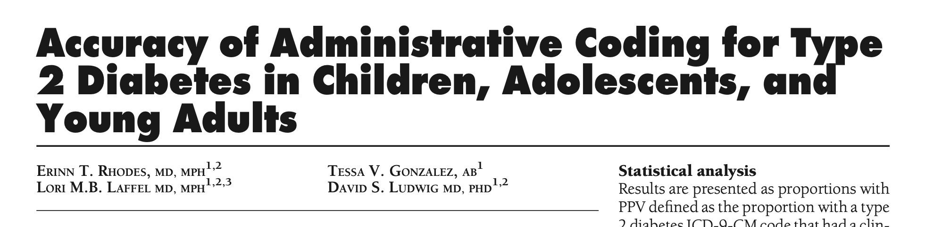
2007
Among 432 patients with an ICD-9 code for type 2 diabetes:
  251 (58%) had type 1 diabetes
  112 (26%) had neither type 1 nor type 2 diabetes
  69 (16%) had type 2 diabetes
https://pubmed.ncbi.nlm.nih.gov/17192348/
http://project-emerse.org/presentations.html

Slide 5
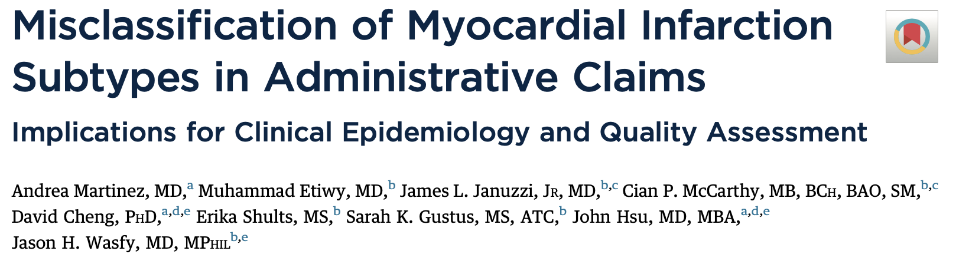
2025
Among 350 patients with an ICD-10 code for type 1 myocardial infarction (MI):
  138 (39%) had type 1 MI
  159 (45%) had type 2 MI
  35 (10%) had other myocardial injuries
https://pubmed.ncbi.nlm.nih.gov/40701673/
http://project-emerse.org/presentations.html

Slide 6



80% of EHR data are in unstructured free-text
structured data
unstructured data/free text
http://project-emerse.org/presentations.html

Slide 7
Free-text is really important
“The use of EHRs to create disease registers or assess quality of care will be misleading if free text information is not taken into account.”
“Structured data is best used for first pass filtering of EHR data...prior to a more nuanced second pass using unstructured data”
https://link.springer.com/article/10.1186/1471-2288-13-105
https://pmc.ncbi.nlm.nih.gov/articles/PMC4333685/
http://project-emerse.org/presentations.html

Slide 8
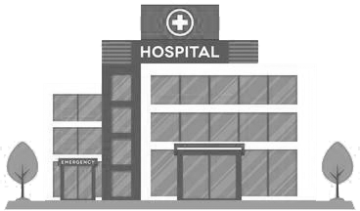

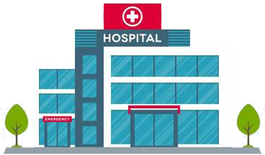
Most medical centers lack tools for free-text
http://project-emerse.org/presentations.html

Slide 9

And options that exist aren’t great
2025 study on EMR usability:
“The same three items (integration into workflow, finding information, and usability of alerts) received the highest number of 'poor' ratings among hospital and practice physicians.”
https://www.nature.com/articles/s41746-025-01657-4
http://project-emerse.org/presentations.html

Slide 10
The EMERSE solution
Software tool designed for searching electronic health record notes
Users search the notes on their own
  No need to wait in a queue for an analyst or a data scientist
Made for non-technical researchers
Search across all notes and all patients at once
Continuously updated for > 20 years
http://project-emerse.org/presentations.html

Slide 11
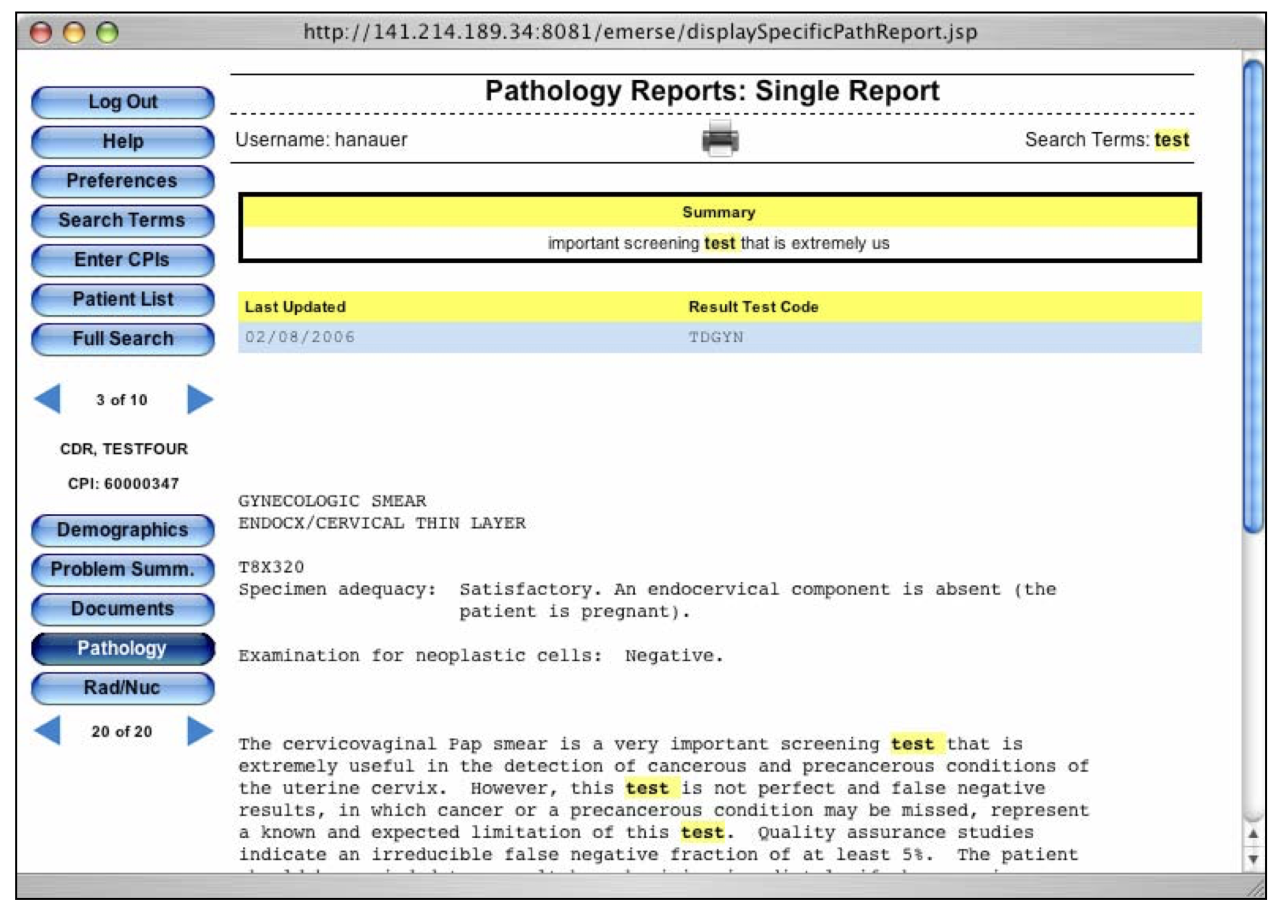

Slide 12

The EMERSE solution
Initially made for researchers at University of Michigan Cancer Center
Adopted by about 20 academic health centers including
Open source software
  Each site installs locally
  Our EMERSE team provides implementation support
http://project-emerse.org/presentations.html

Slide 13


EMERSE is a useful tool…
…but it will likely be one of several you need to support your project(s)
http://project-emerse.org/presentations.html

Slide 14
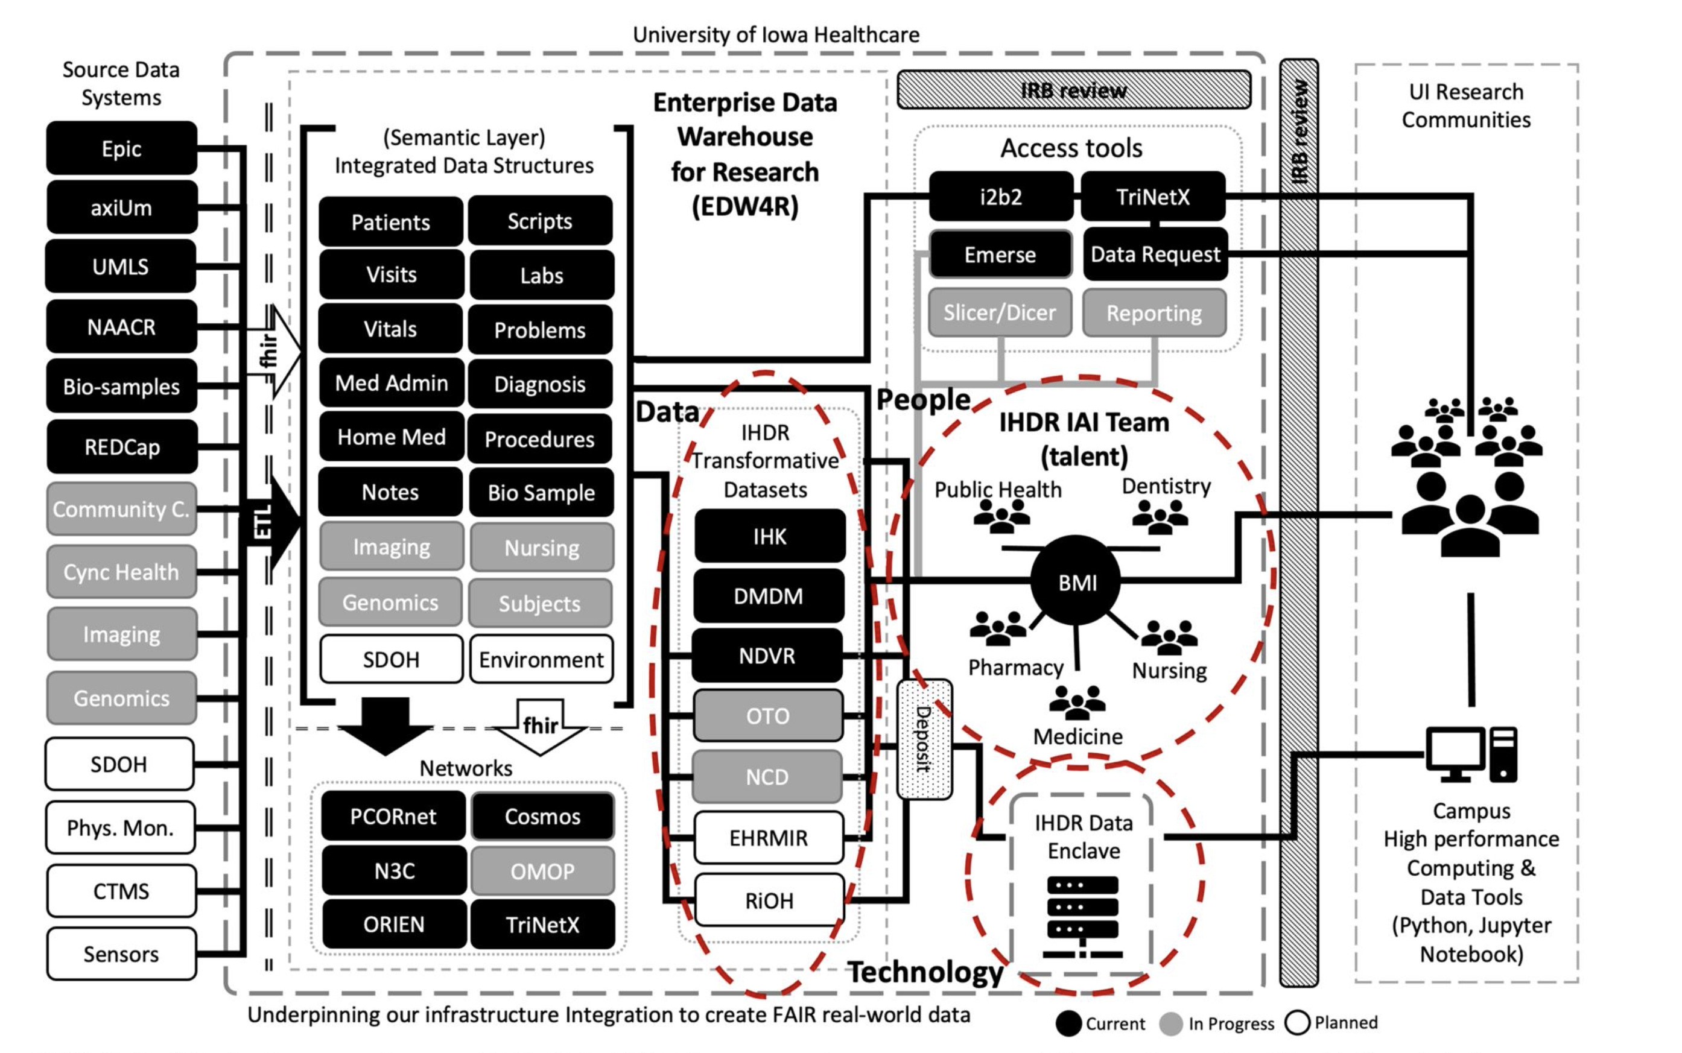
https://doi.org/10.1093/jamia/ocad236
http://project-emerse.org/presentations.html

Slide 15
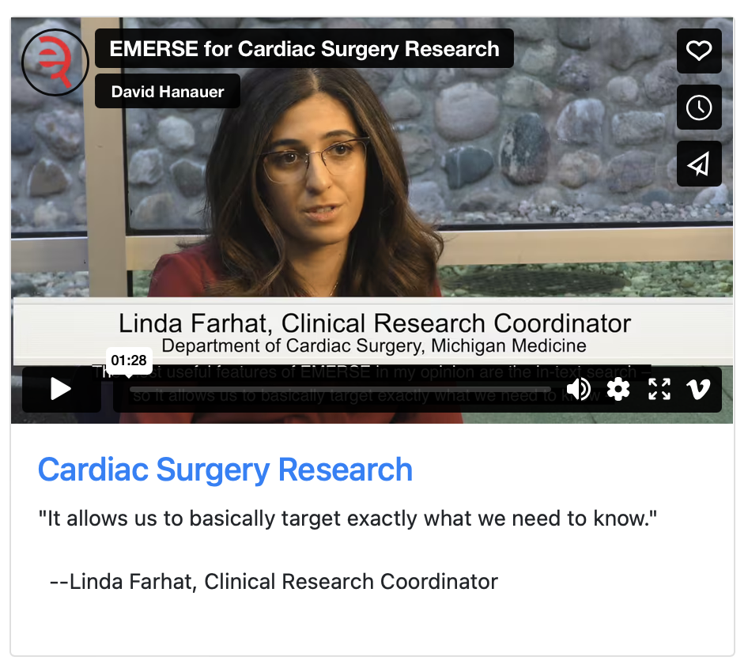
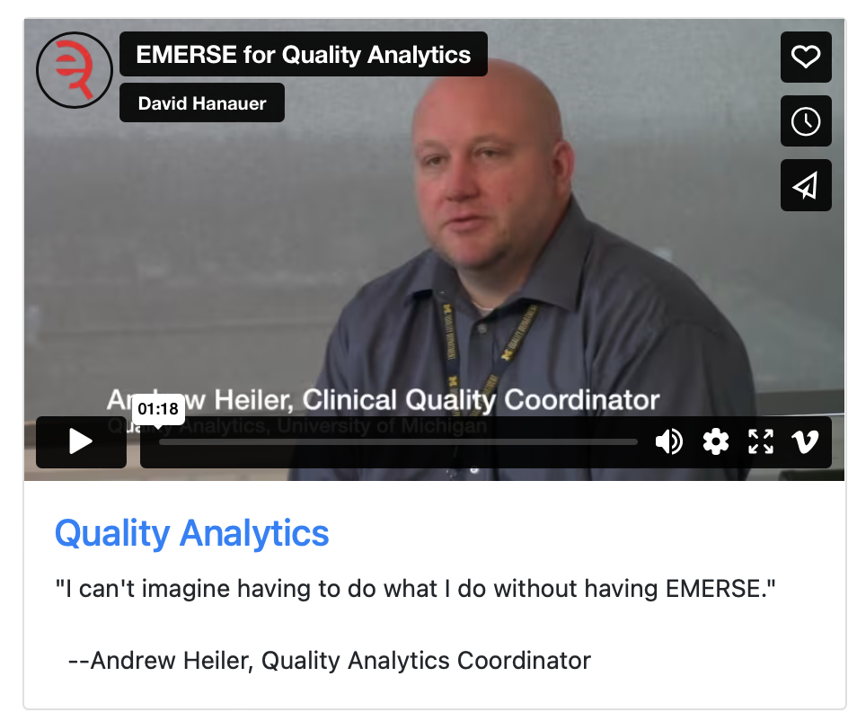
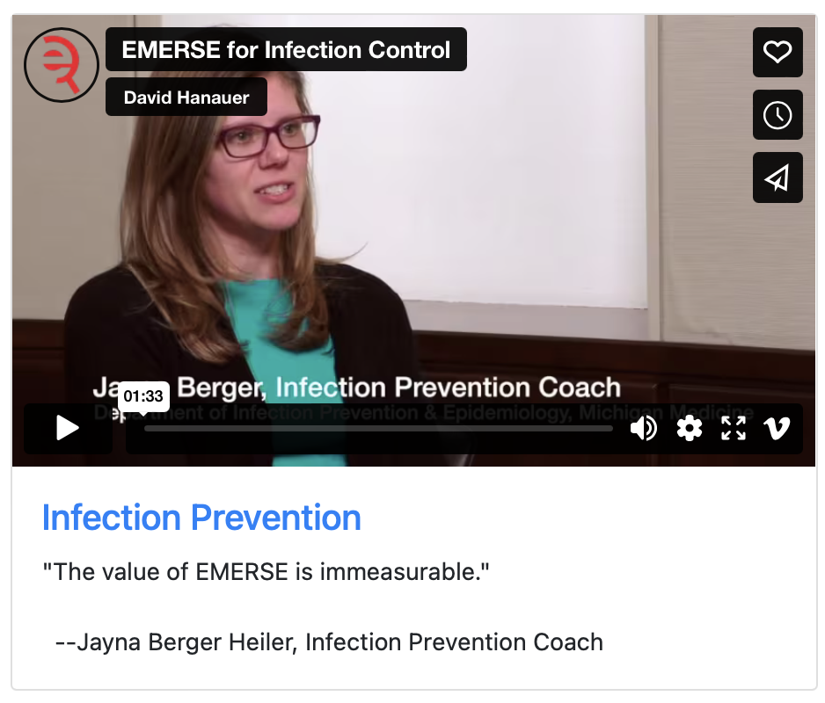
What can EMERSE do?
Lots of things!
Watch our videos: https://project-emerse.org/use_cases.html

Slide 16

Find cohorts
EMERSE allows you to find cohorts based on things mentioned in the notes
  diseases
  drugs
  symptoms
  anything*
*if it is mentioned
http://project-emerse.org/presentations.html

Slide 17



Find cohorts
It’s perfect for finding rare things…
…like rare cancers such as
cutaneous leiomyosarcoma
See this talk for more details:
https://vimeo.com/677482835
“Using EMERSE to Improve Research Involving Rare Cancers”
http://project-emerse.org/presentations.html

Slide 18
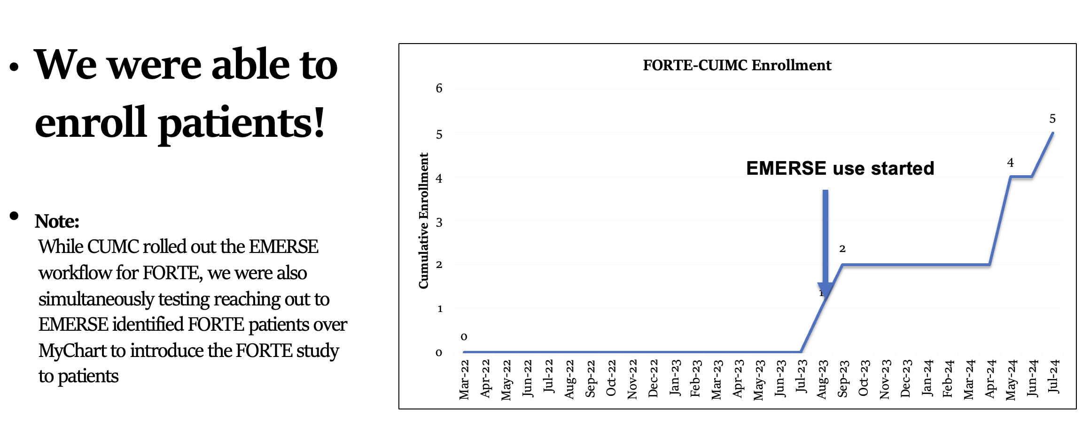
Enroll patients on trials
See this talk for more details:
https://vimeo.com/1084845123/
EMERSE Community Meeting May 2025
http://project-emerse.org/presentations.html

Slide 19
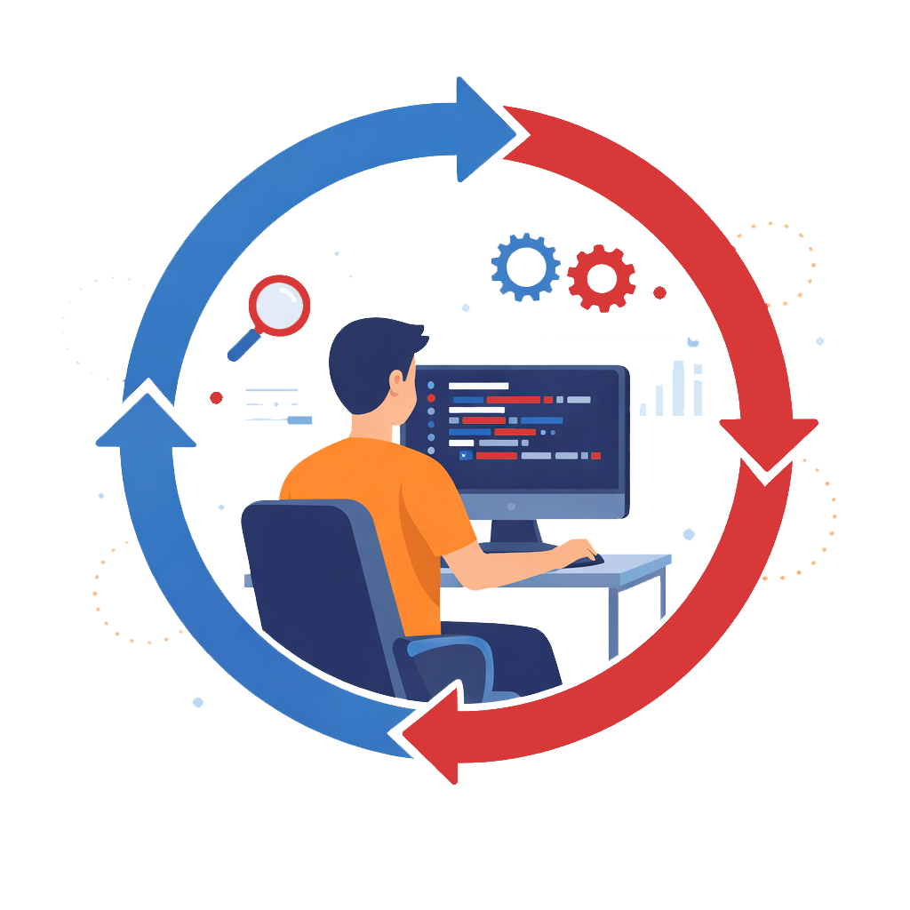
EMERSE keeps the human-in-the-loop
http://project-emerse.org/presentations.html

Slide 20
Highlight terms in documents for chart review
Thoracocentesis confirmed the recurrence of mantle cell lymphoma. Disease restaging work-up revealed multicompartment lymphadenopathy in the neck, mediastinal, retrocrural, retroperitoneal and pelvic regions. Bone marrow was also involved. The patient was treated with a total of six cycles of rituximab, cyclophosphamide, vincristine, doxorubicin and dexamethasone (R-HyperCVAD) completed in January 2007. That treatment led to complete remission that lasted until October 2008, when the disease was found to have recurred in the left pleural space and retroperitoneum without bone marrow involvement.
https://jmedicalcasereports.biomedcentral.com/articles/10.1186/1752-1947-4-329
http://project-emerse.org/presentations.html

Slide 21

EMERSE is fast
Query to identify all patients with the following | Reporting DB time (s) | EMERSE time (s) | EMERSE advantage
inferior lingular segment of the left upper lobe | 17,784 | 9 | 1,980x
cavernous hemangioma | 14,652 | 2 | 7,320x
gray platelet syndrome | 14,940 | 2 | 7,470x
…enabling real-time querying
http://project-emerse.org/presentations.html

Slide 22
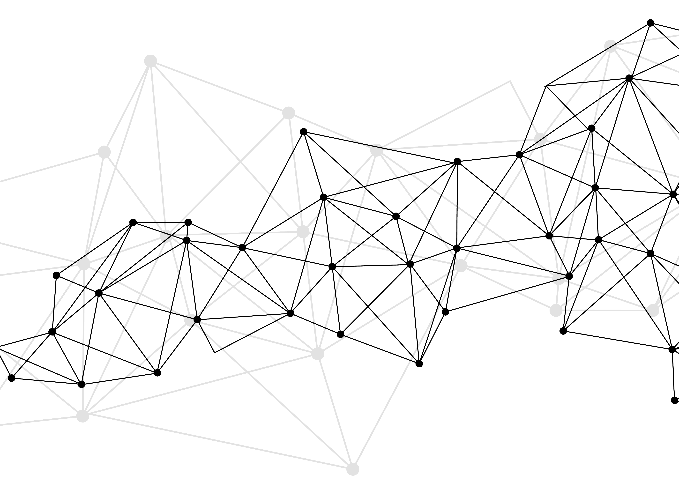
Synonyms
Used for query expansions
User-controlled
Multiple datasets can be included
EMERSE Synonyms
  acronyms, abbreviations, professional/consumer terms, misspellings, trade/generic drug names, species, chemo regimens, phrase variations, malapropisms, idioms, neologisms, organizations, companies, & more
  3 million unique entries
http://project-emerse.org/presentations.html

Slide 23
Typical workflow
initial cohort identified
with a cohort discovery
tool using structured data (or via EMERSE
‘Find Patients’)
Cohort discovery tools:
i2b2/ENACT, TriNetX, Leaf, etc.
http://project-emerse.org/presentations.html

Slide 24
Typical workflow
additional details abstracted from the free text using EMERSE
http://project-emerse.org/presentations.html

Slide 25
Typical workflow
Data recorded in an electronic data capture system (e.g., REDCap)
http://project-emerse.org/presentations.html

Slide 26

Publications using EMERSE
730+
papers and abstracts
Full list at:
http://project-emerse.org/publications.html
http://project-emerse.org/presentations.html

Slide 27

Brief Demo
no real names
no PHI
publicly available
“notes” are mainly abstracts & case reports
http://project-emerse.org/presentations.html

Slide 28
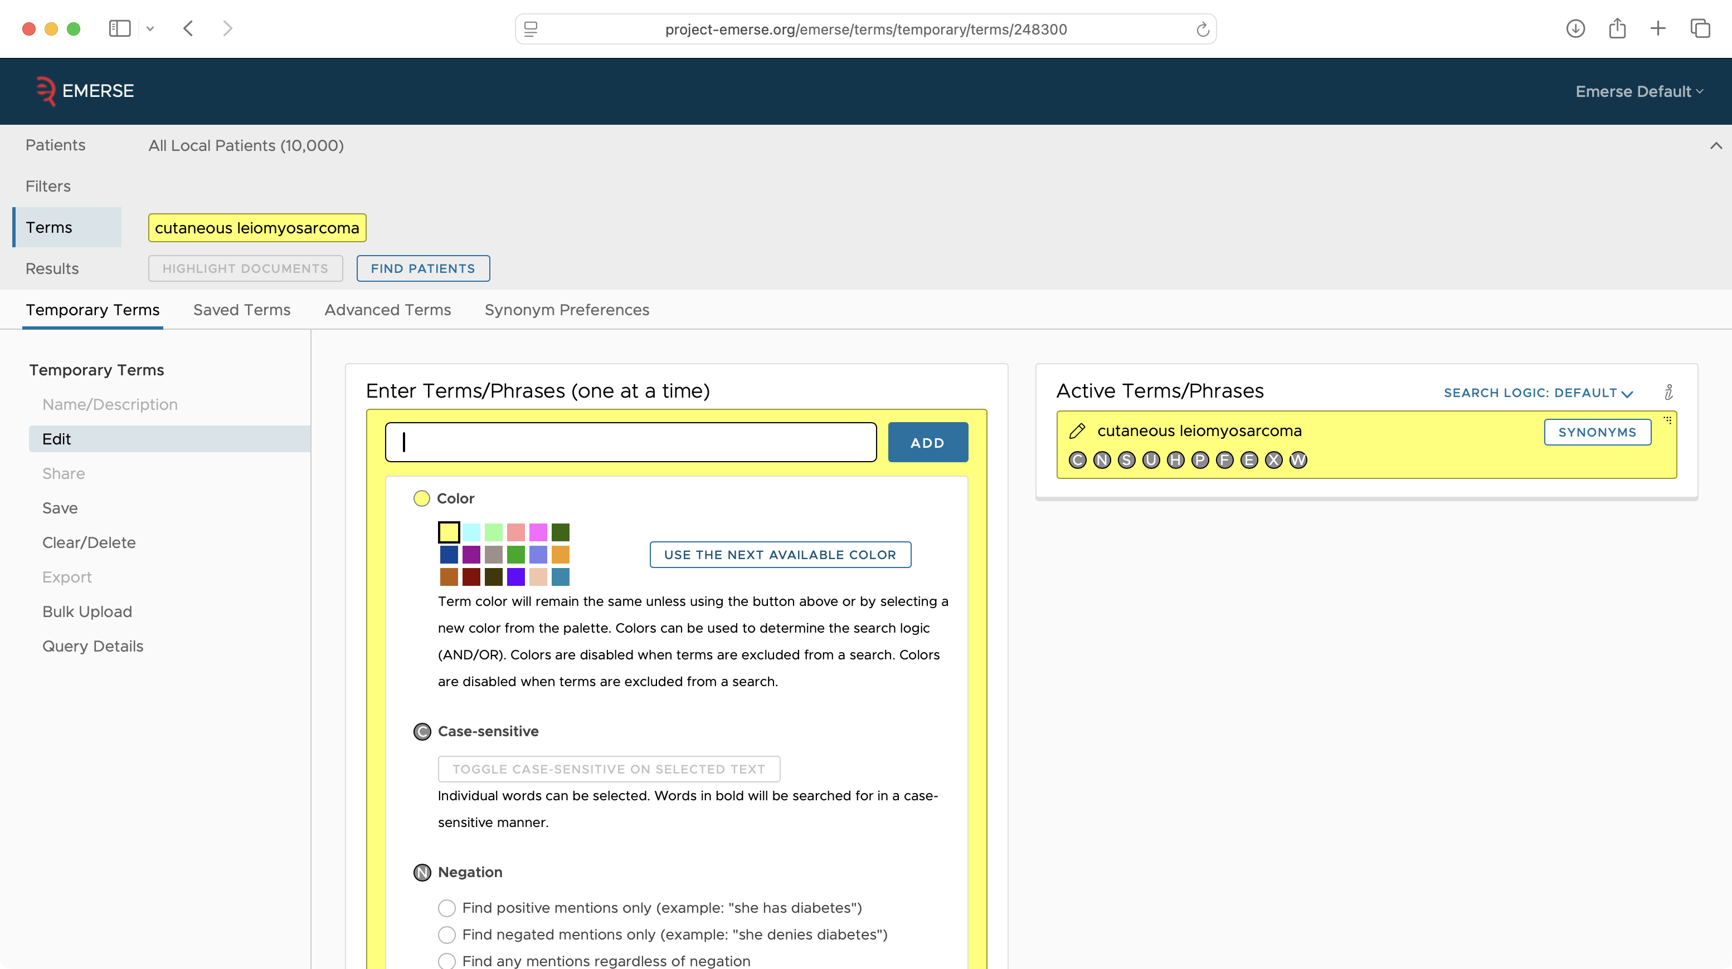

Slide 29
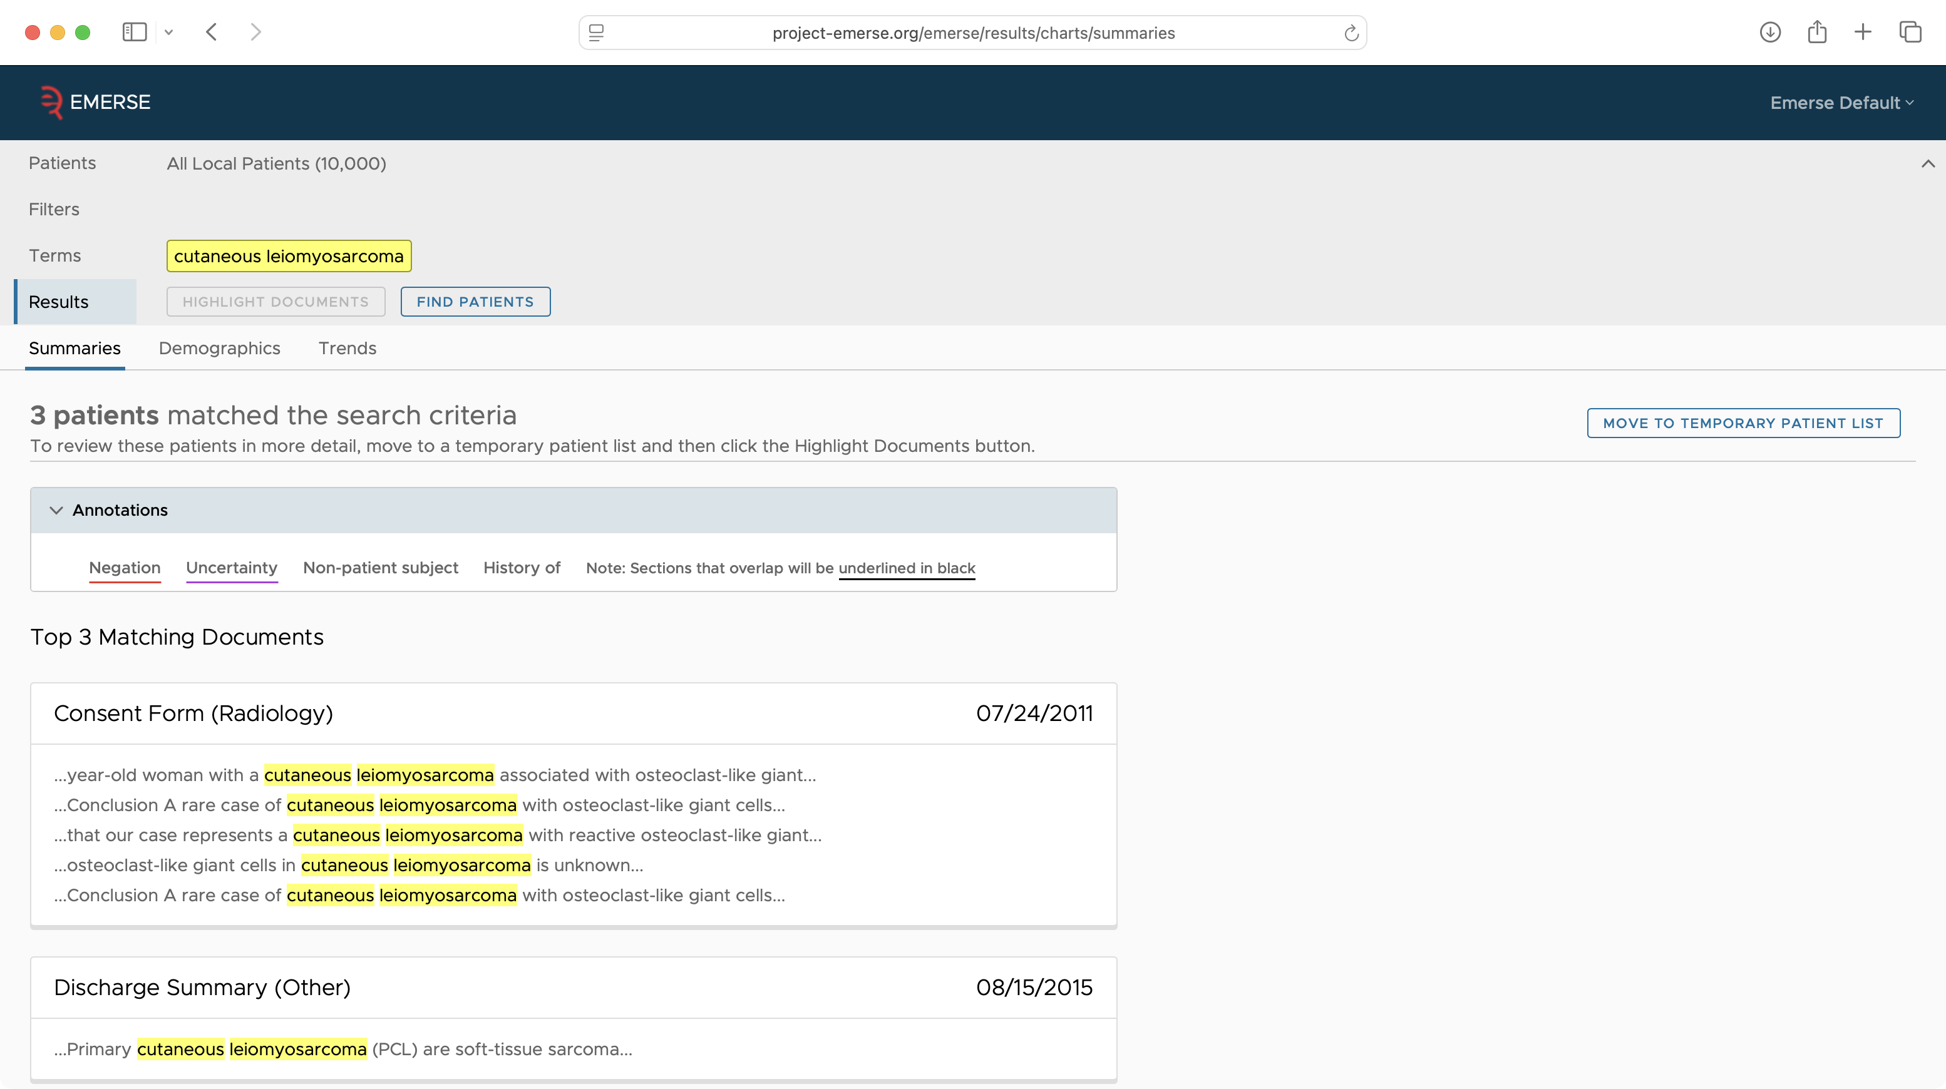

Slide 30
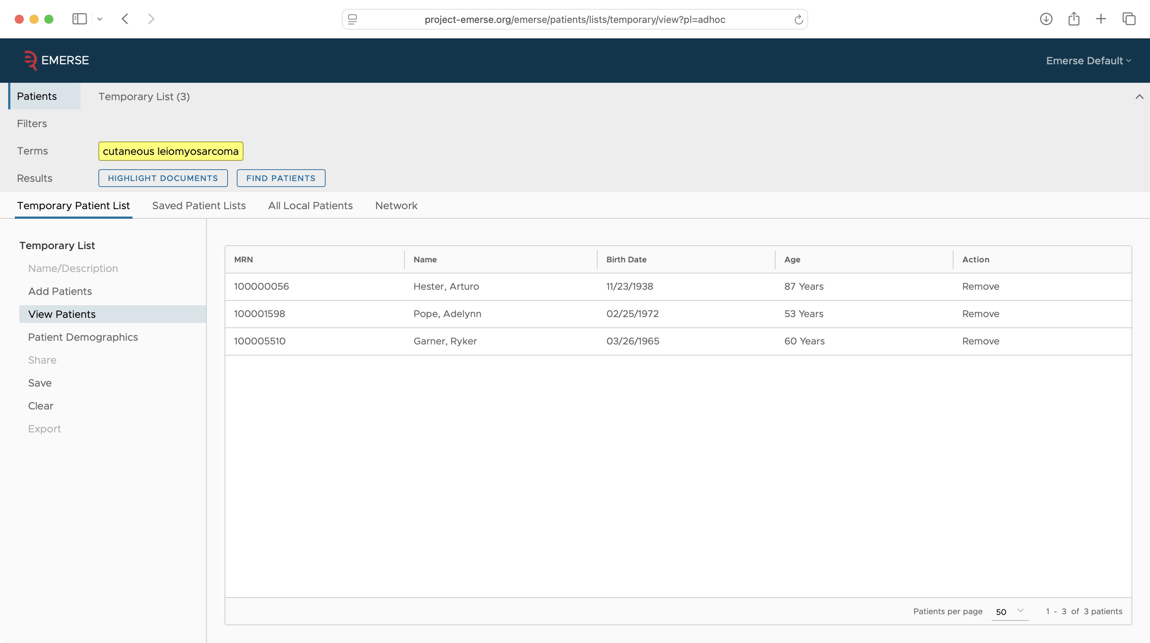

Slide 31
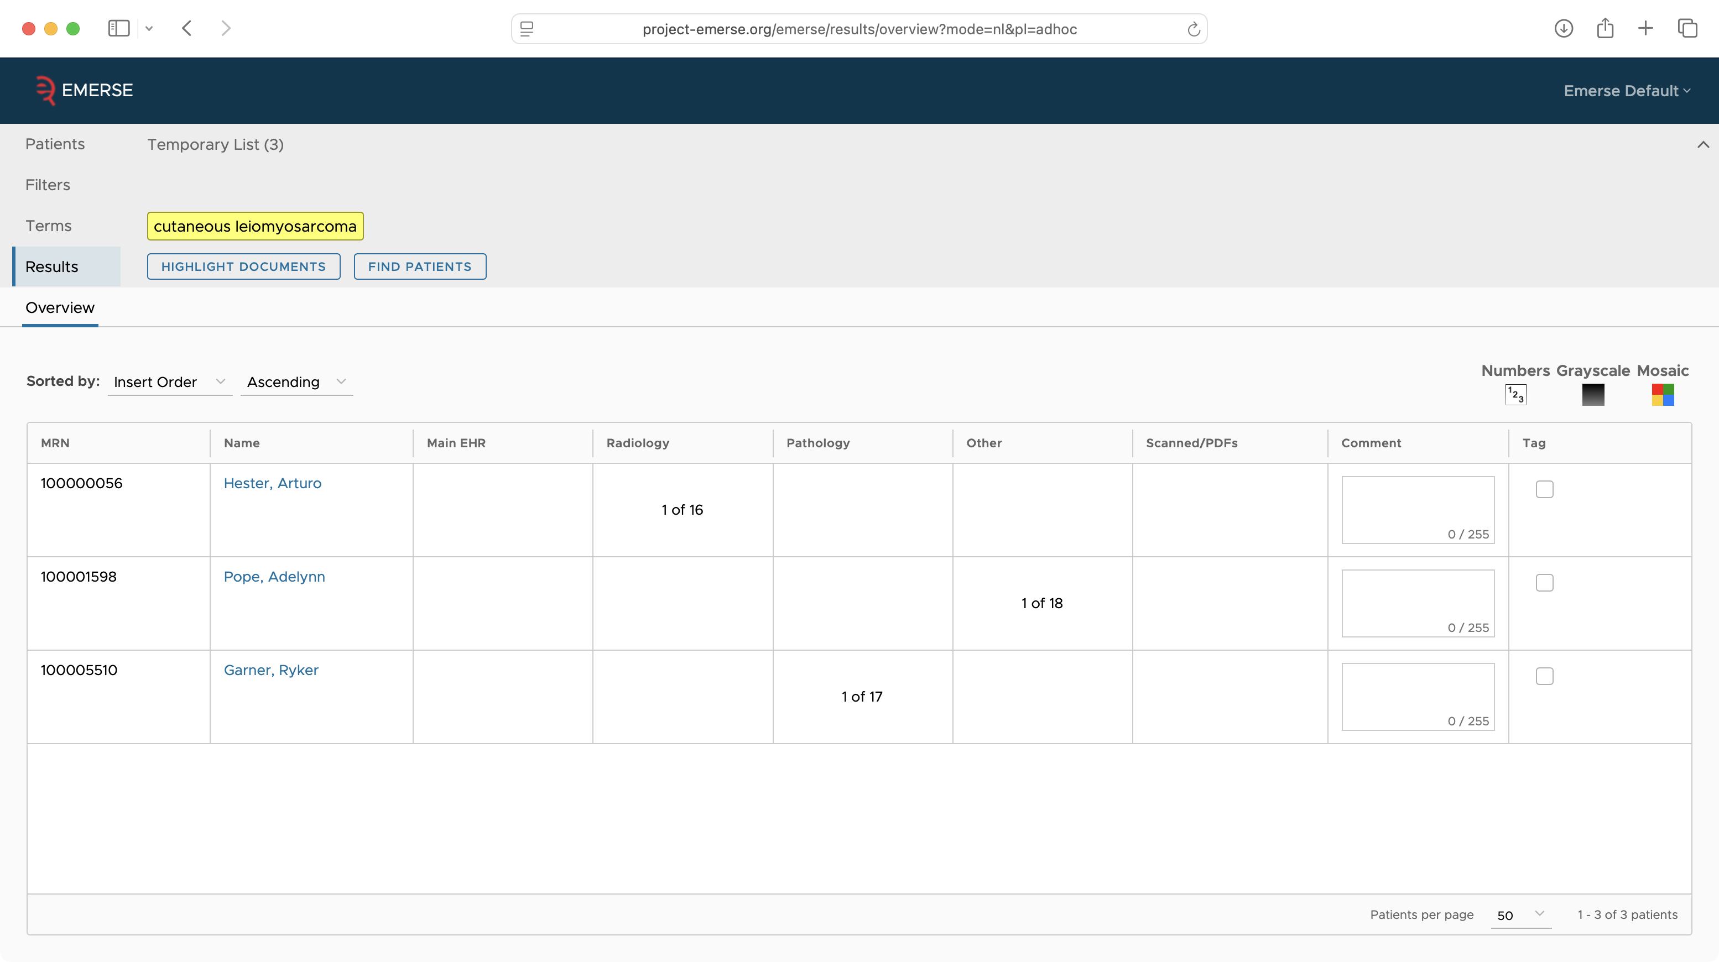

Slide 32
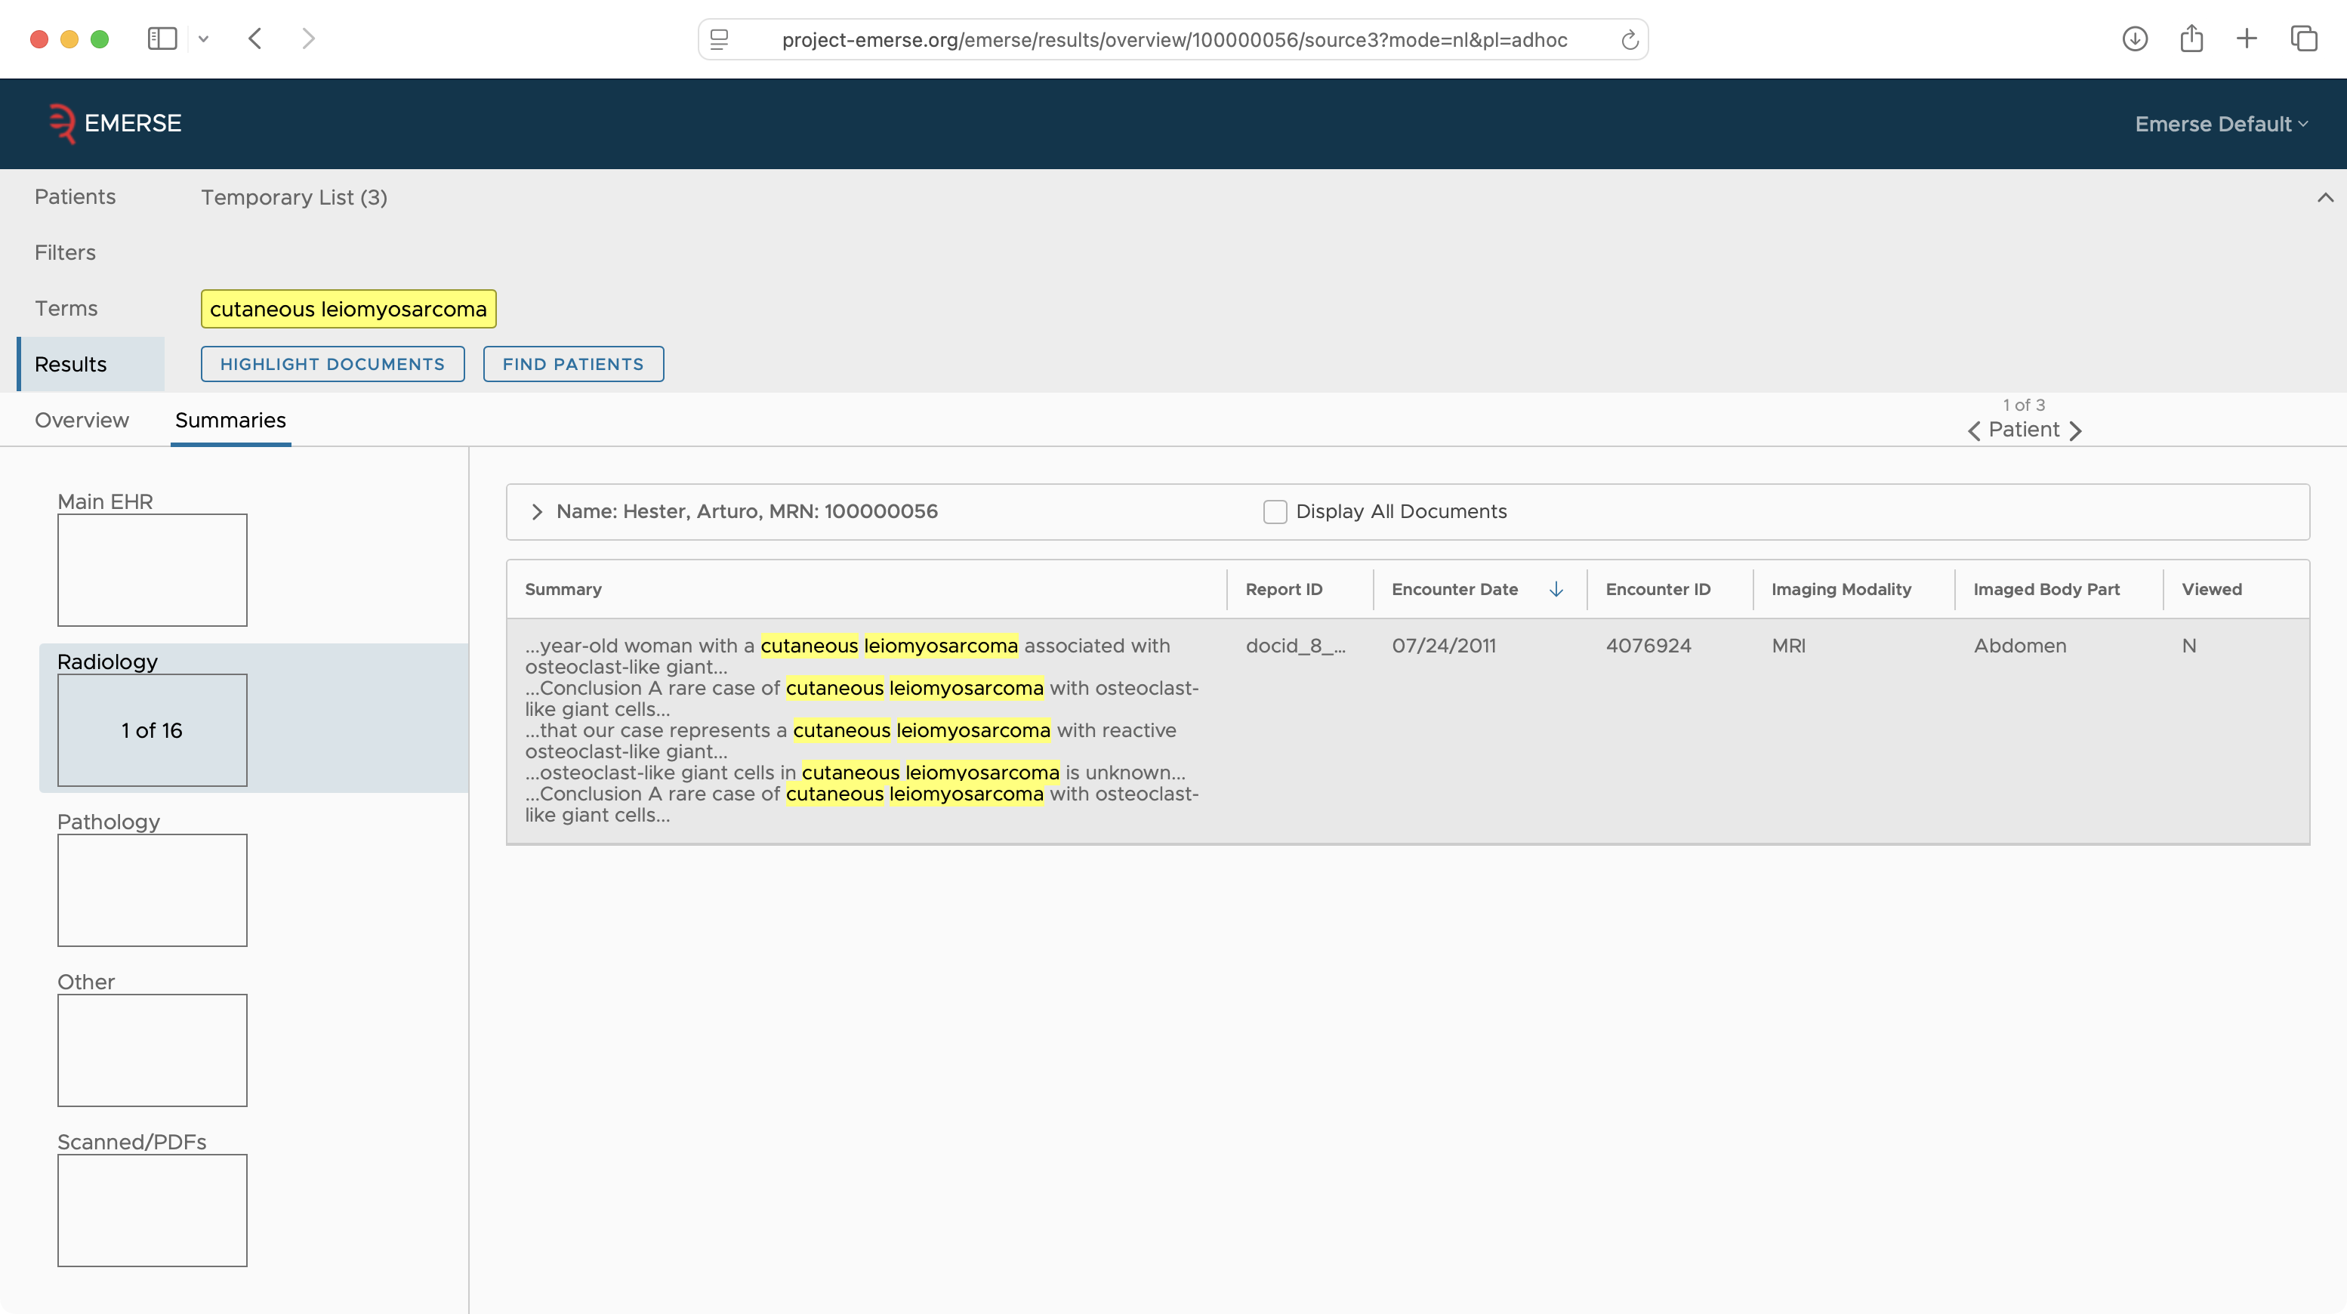

Slide 33
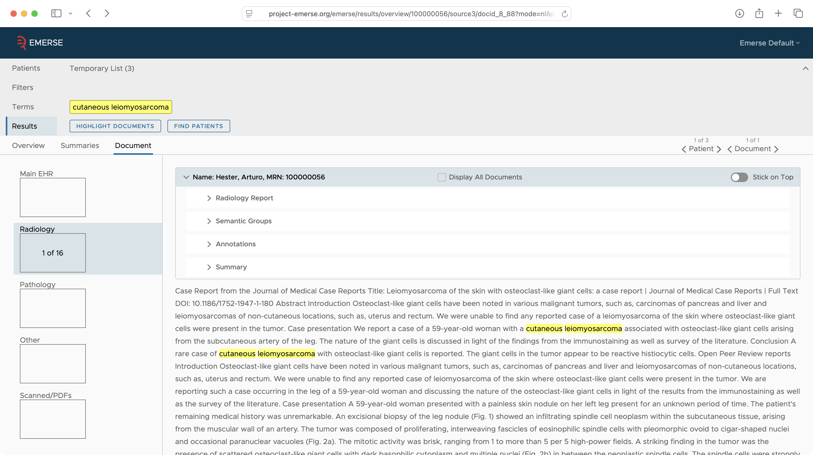

Slide 34
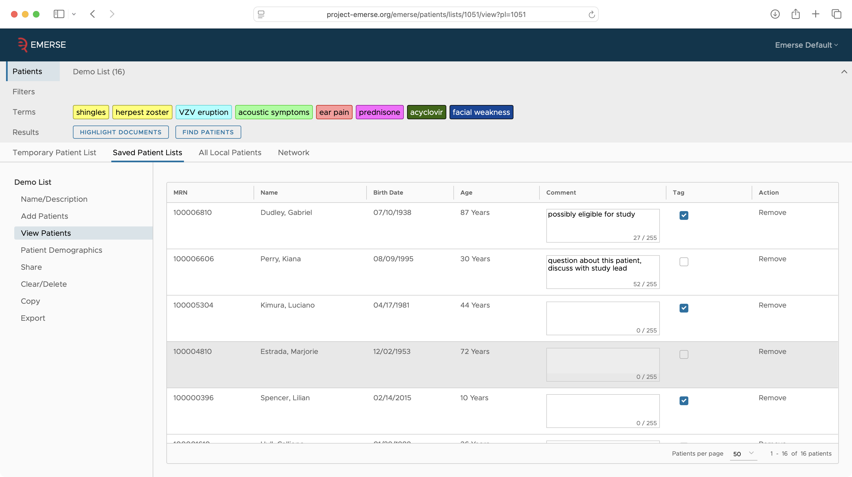

Slide 35
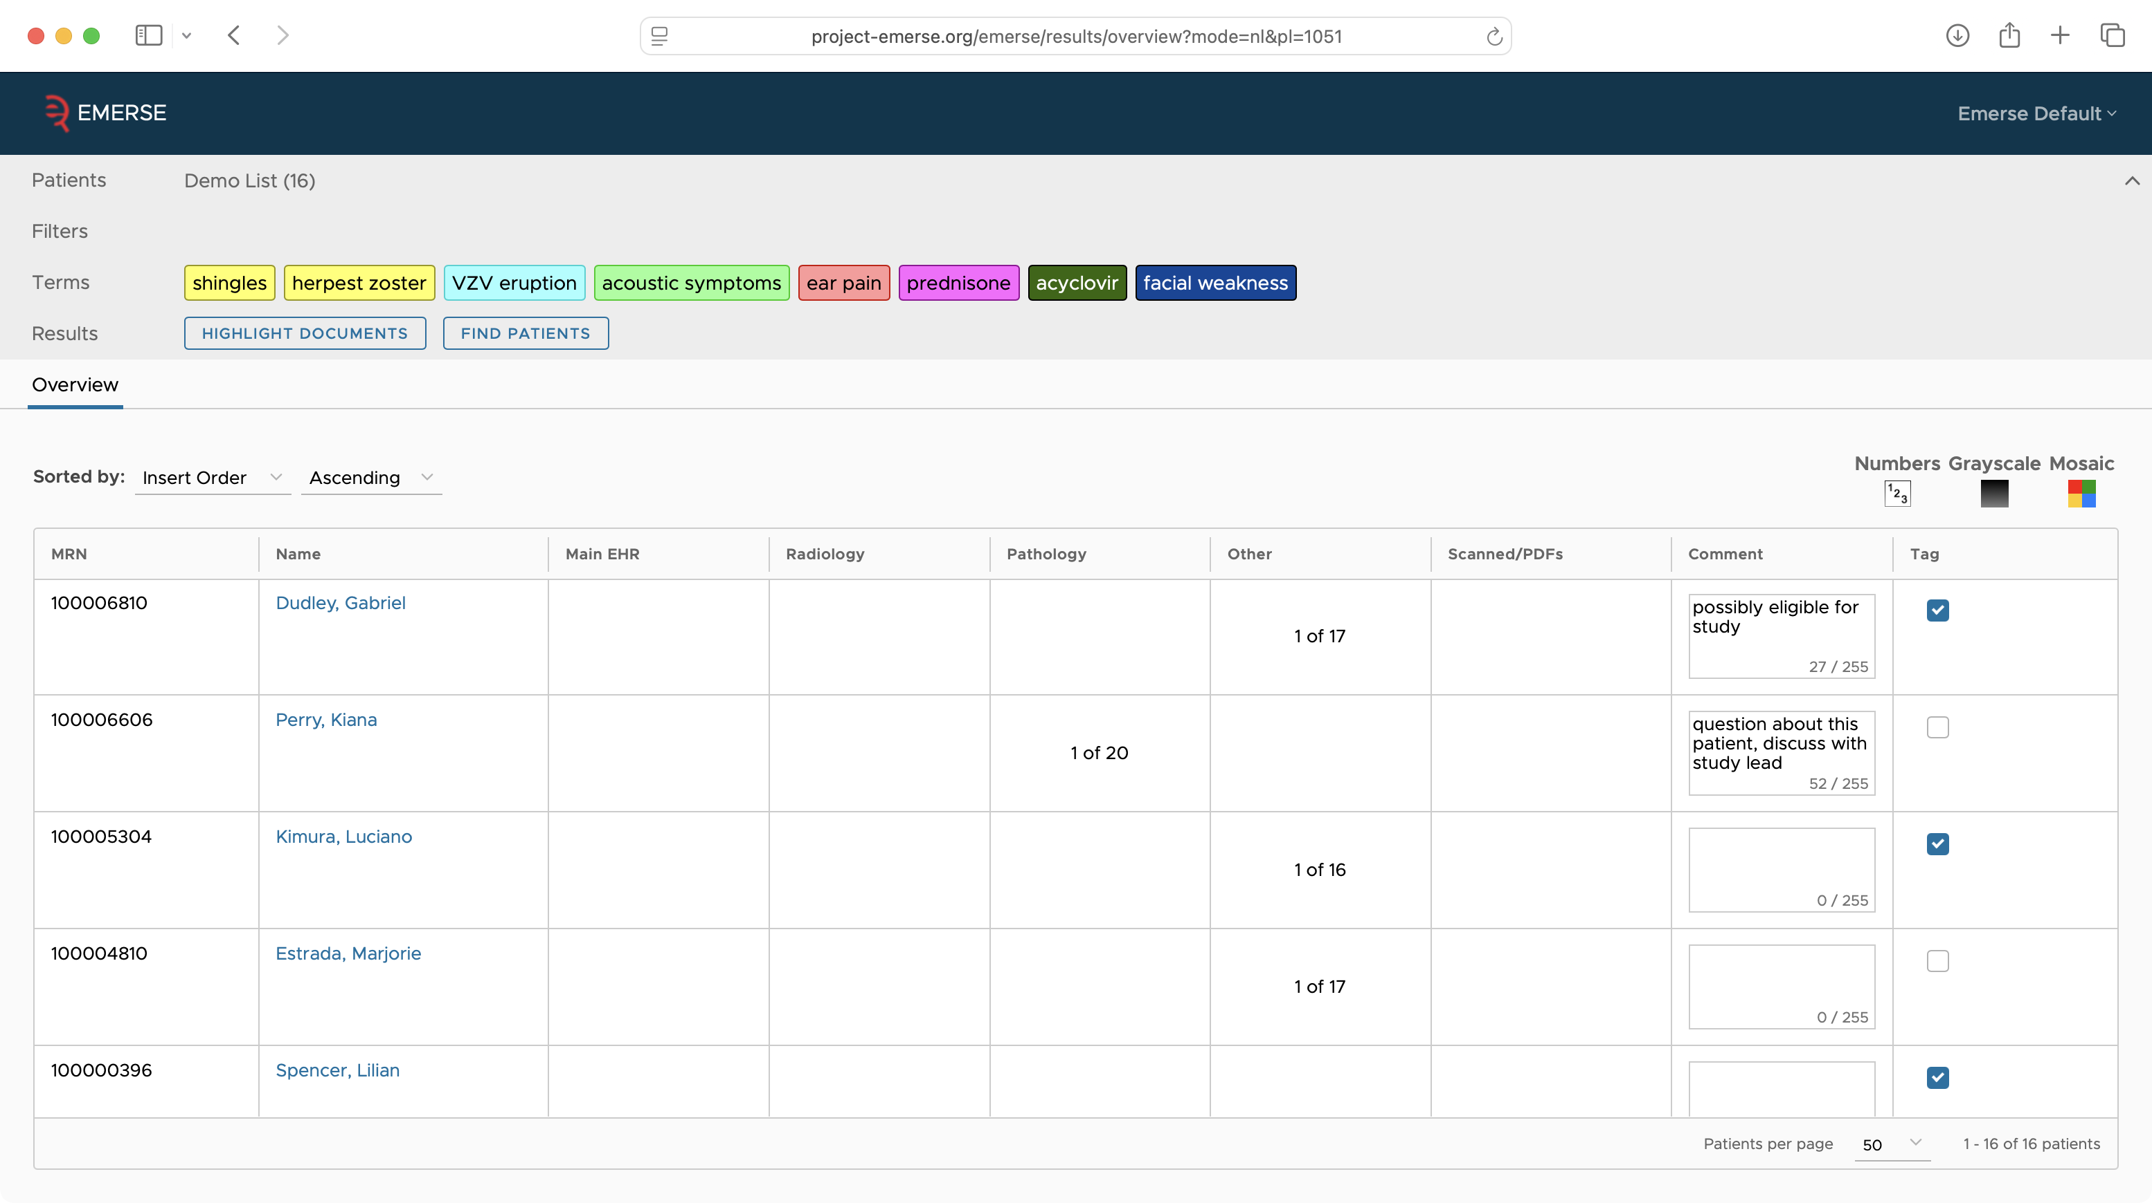

Slide 36
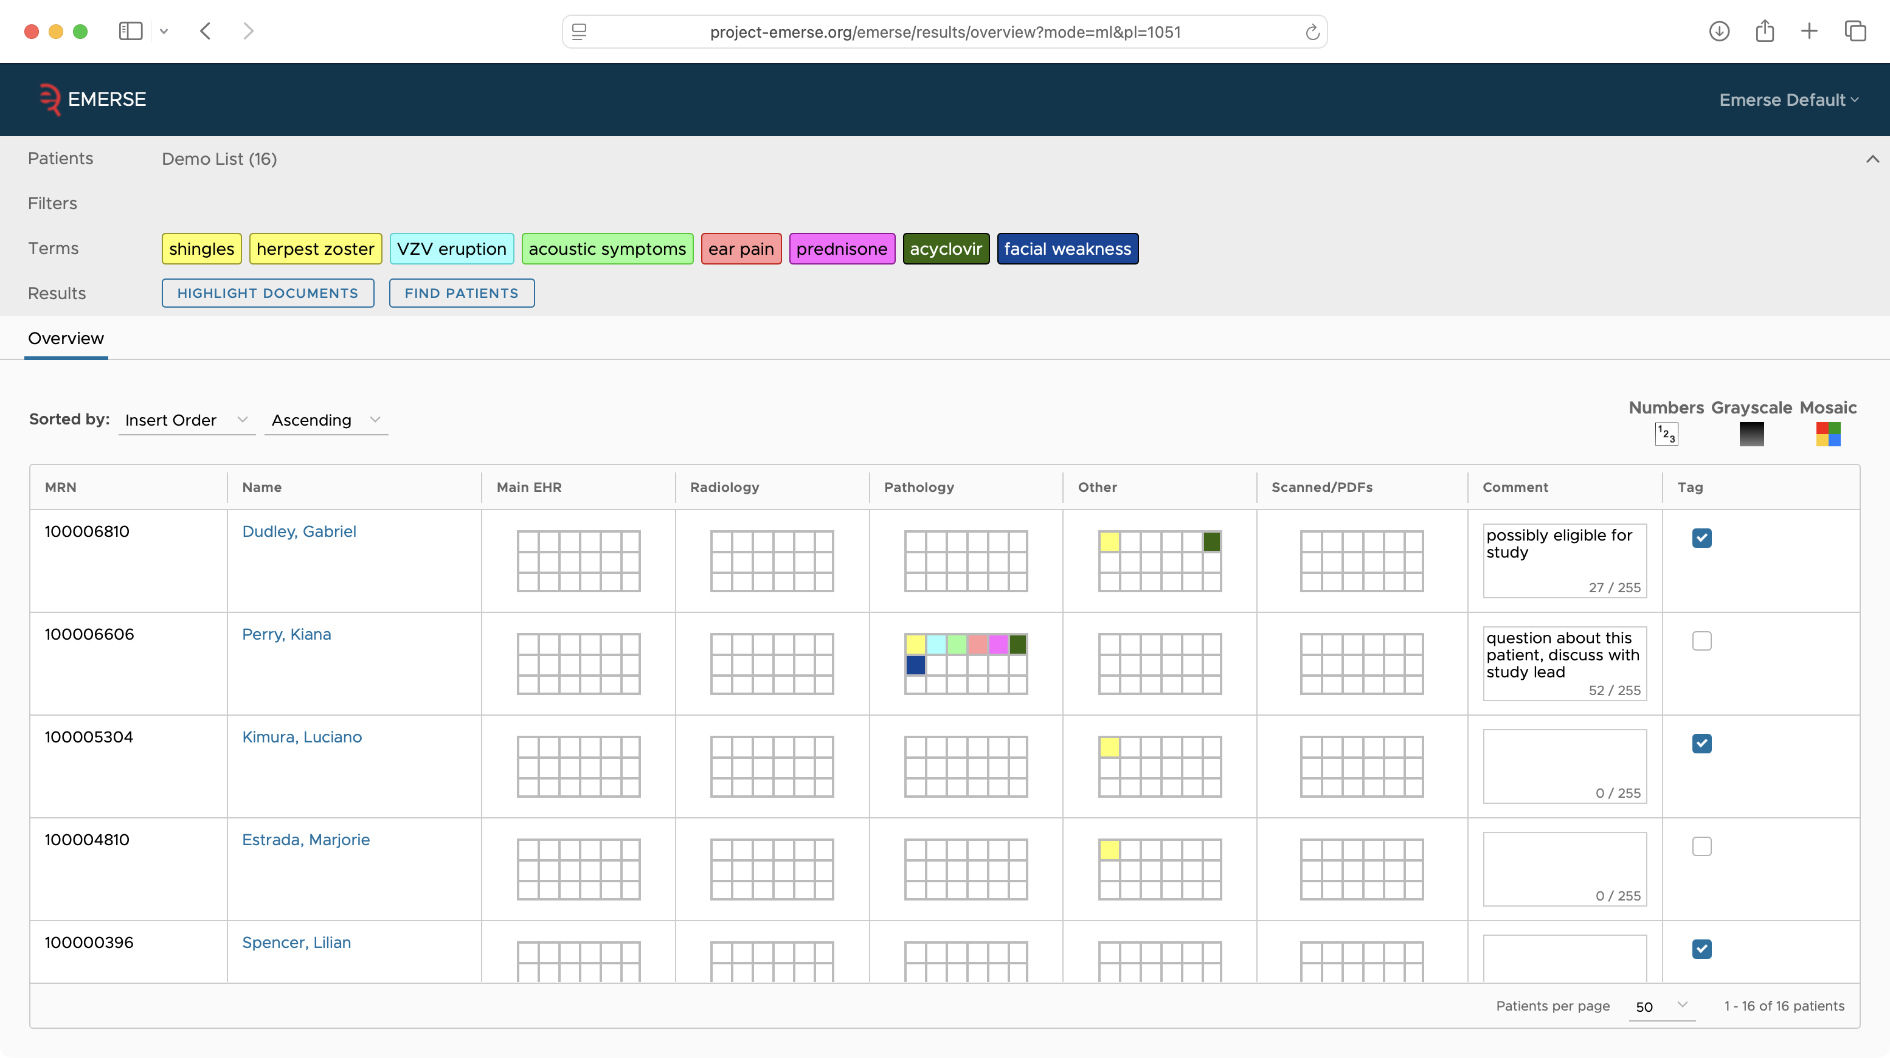

Slide 37
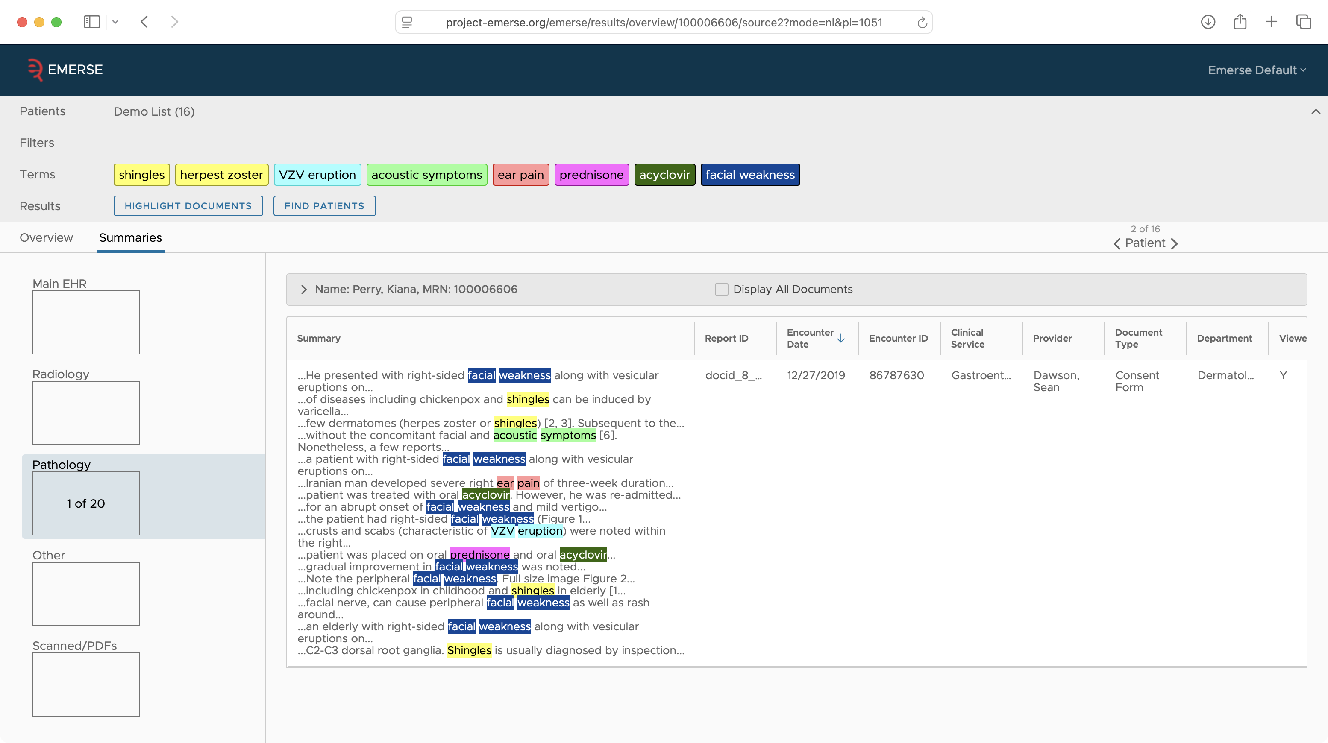

Slide 38
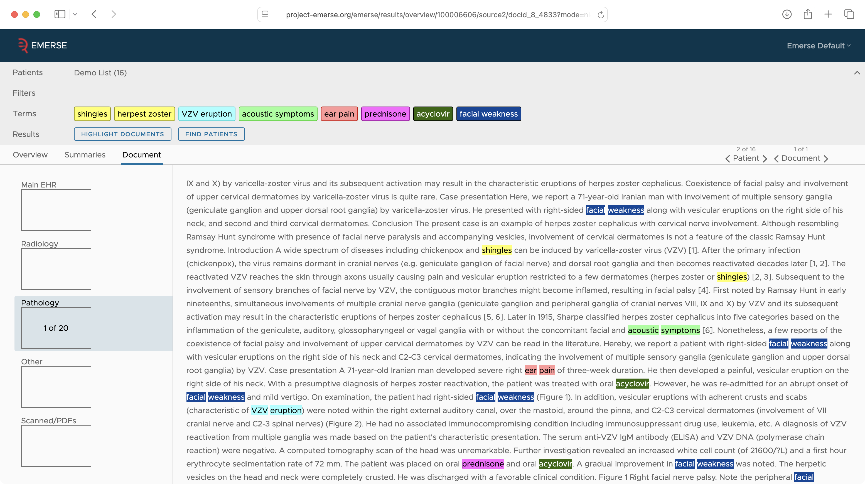

Slide 39
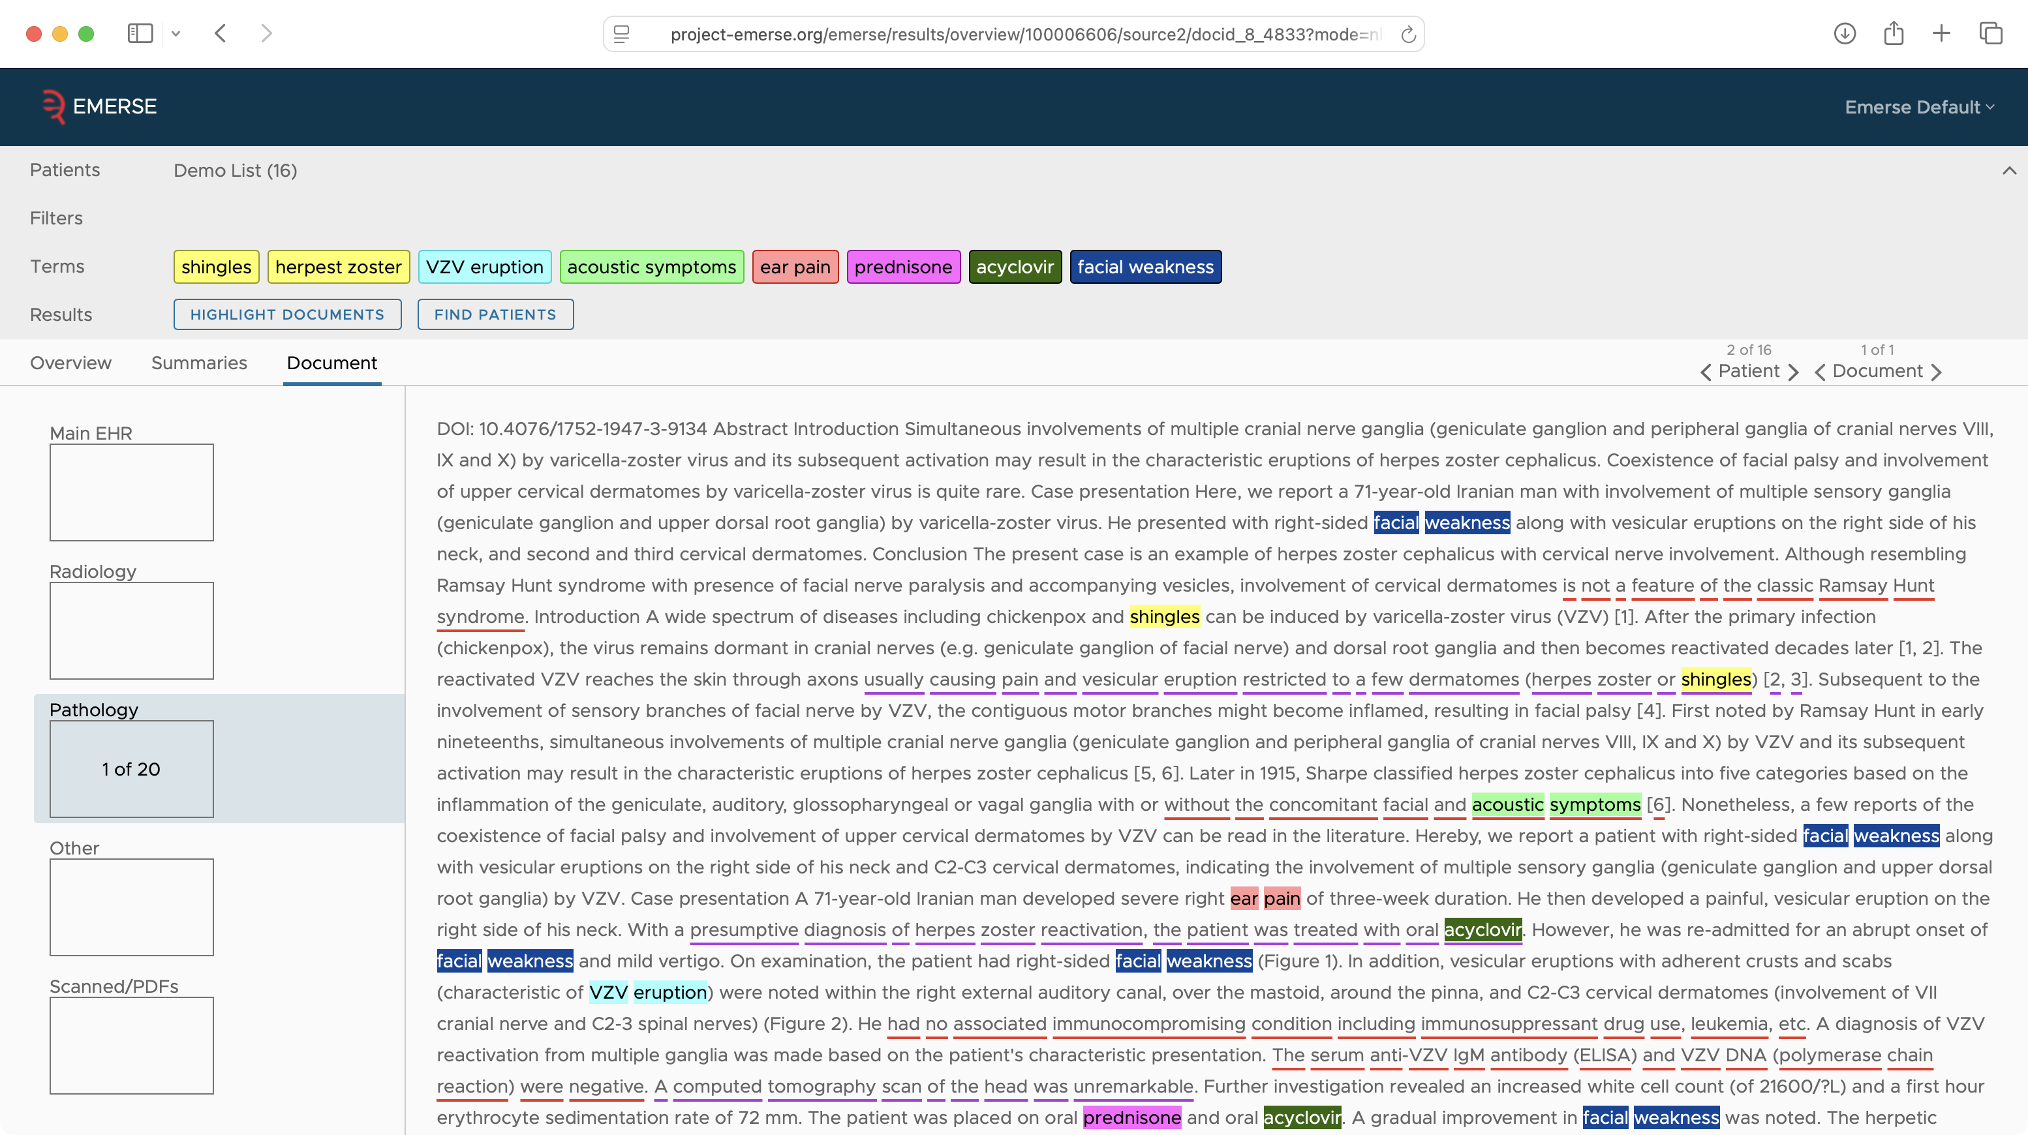

Slide 40
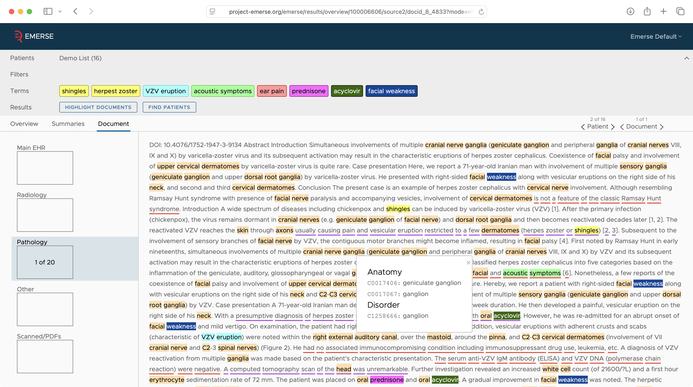

Slide 41
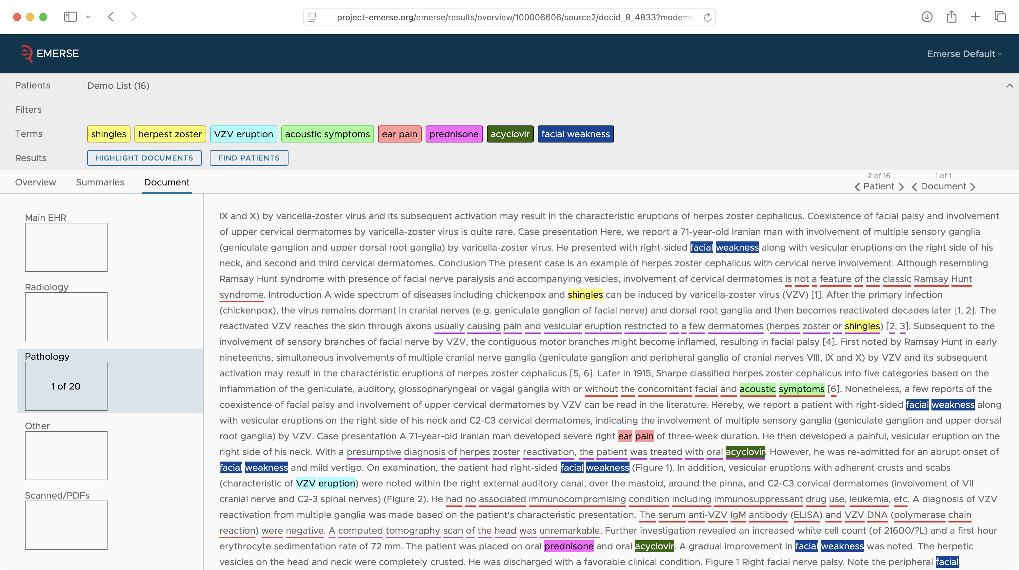

Slide 42
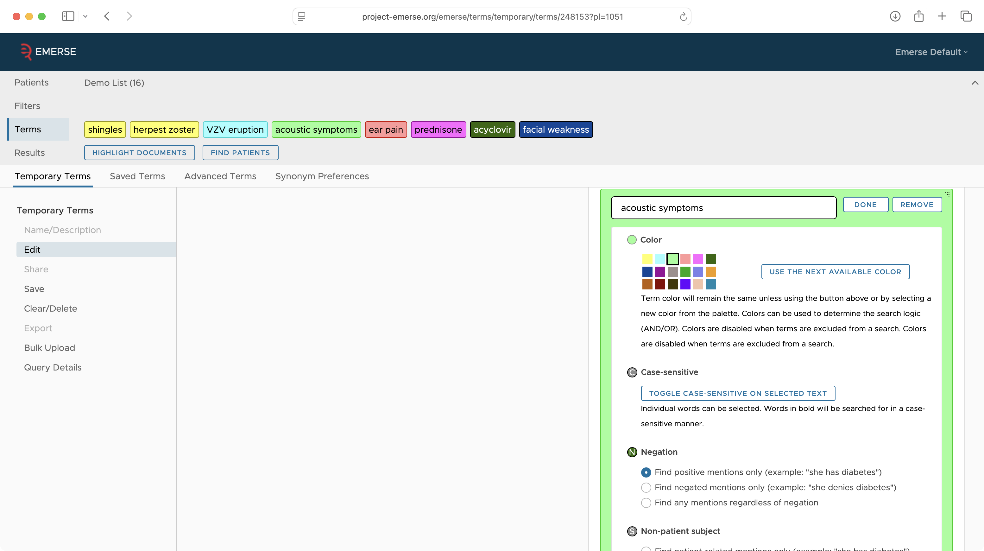

Slide 43
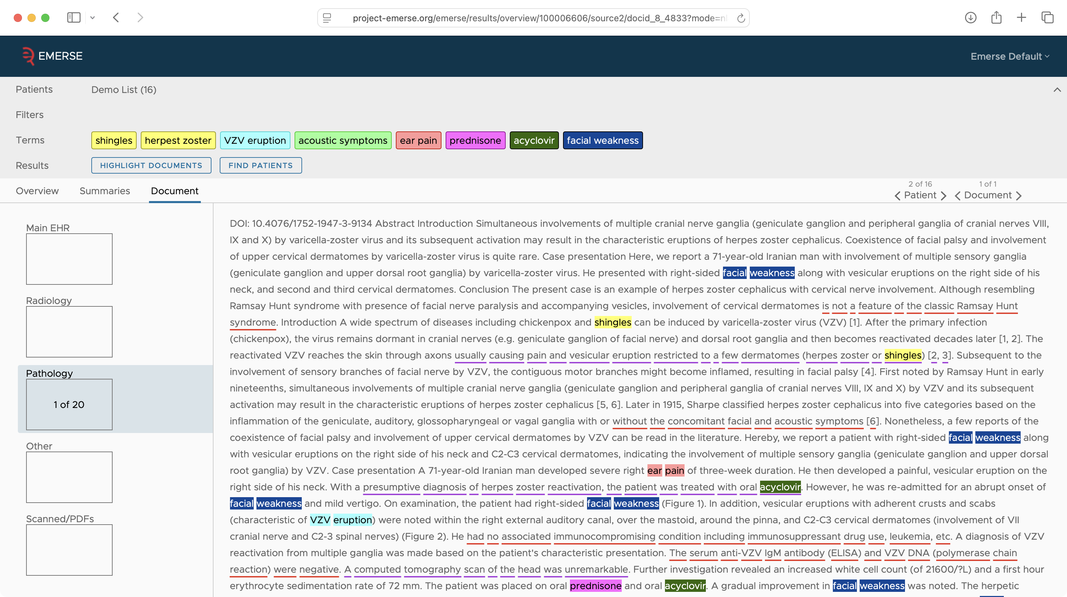

Slide 44
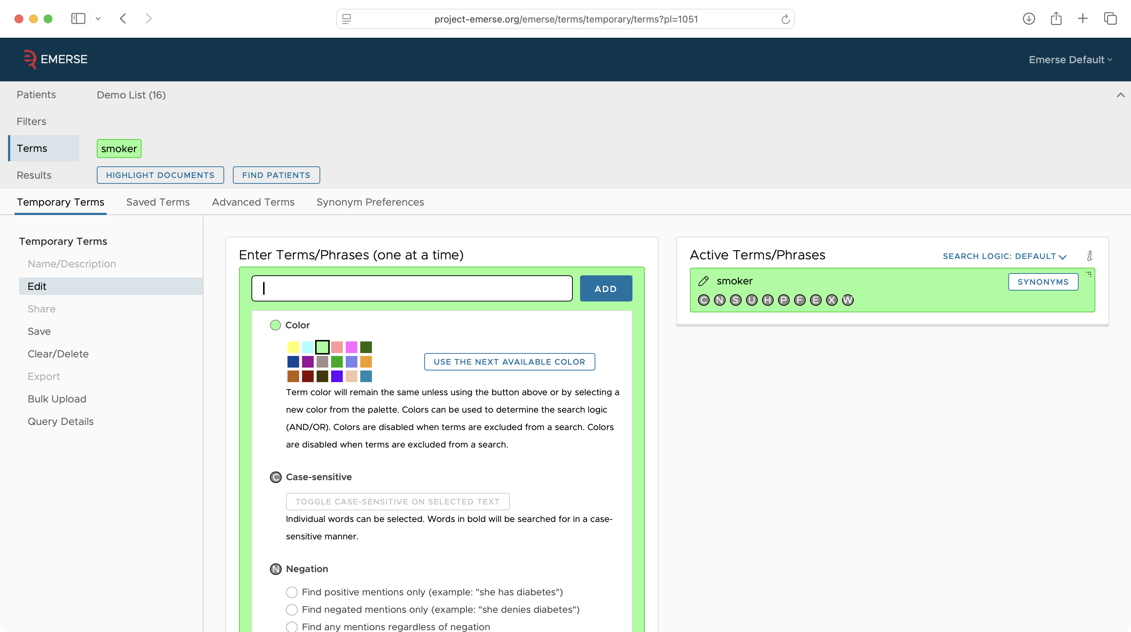

Slide 45
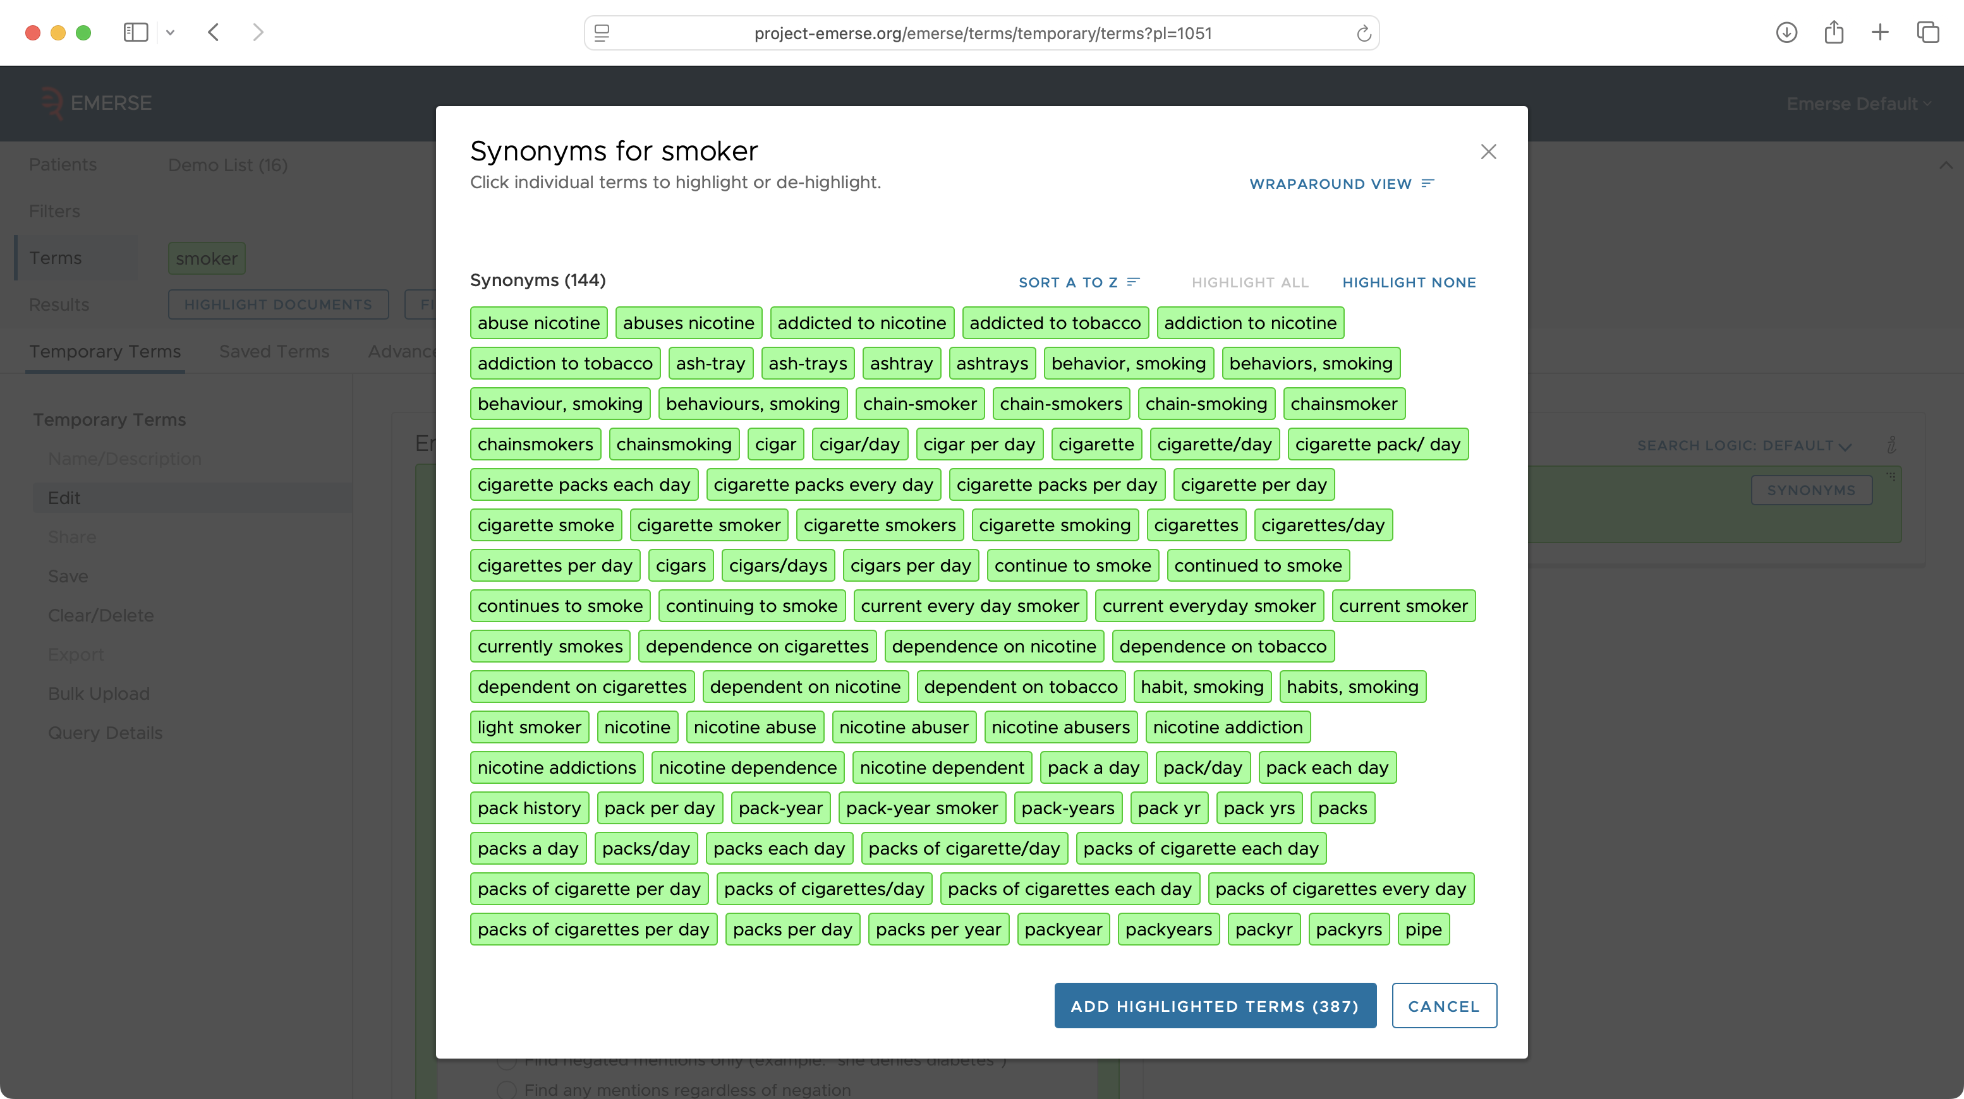

Slide 46
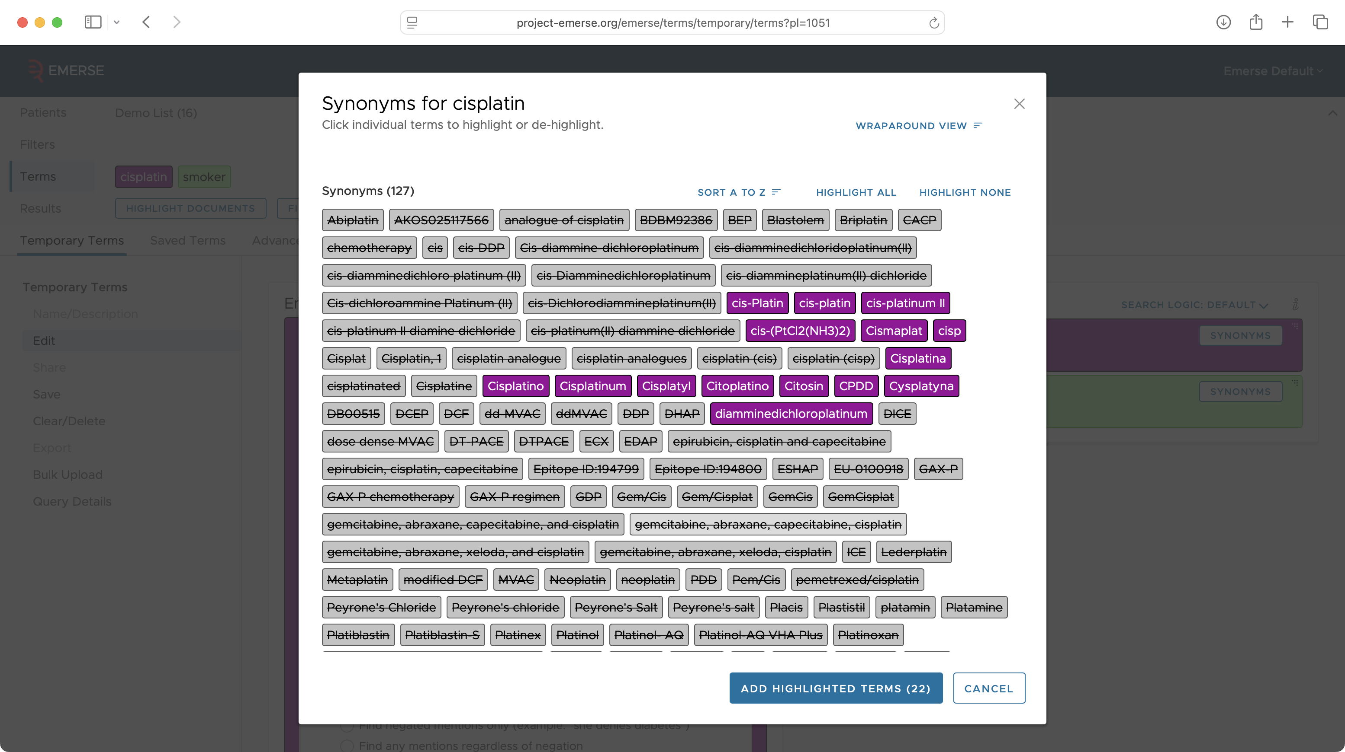

Slide 47
EMERSE has served the community for 20+ years
How do we ensure its future?
http://project-emerse.org/presentations.html

Slide 48


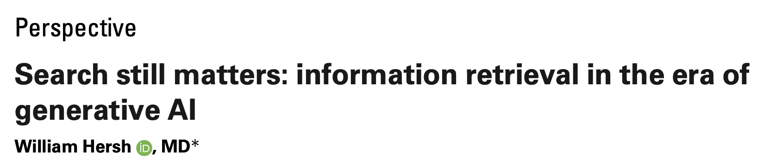
LLMs are changing how we work with text…do we even need search anymore?
https://pmc.ncbi.nlm.nih.gov/articles/PMC11339511/pdf/ocae014.pdf
2024
http://project-emerse.org/presentations.html

Slide 49
Current EMERSE efforts
Leverage the platform we have already built
  security model (roles, privileges, auditing)
  rapid retrieval of clinical notes
  simple user interface for researchers
Extend the capabilities with LLMs in various areas of the application
http://project-emerse.org/presentations.html

Slide 50
LLM agnostic
We are not building our own LLM
EMERSE should be flexible to connect to any LLM using APIs
http://project-emerse.org/presentations.html

Slide 51

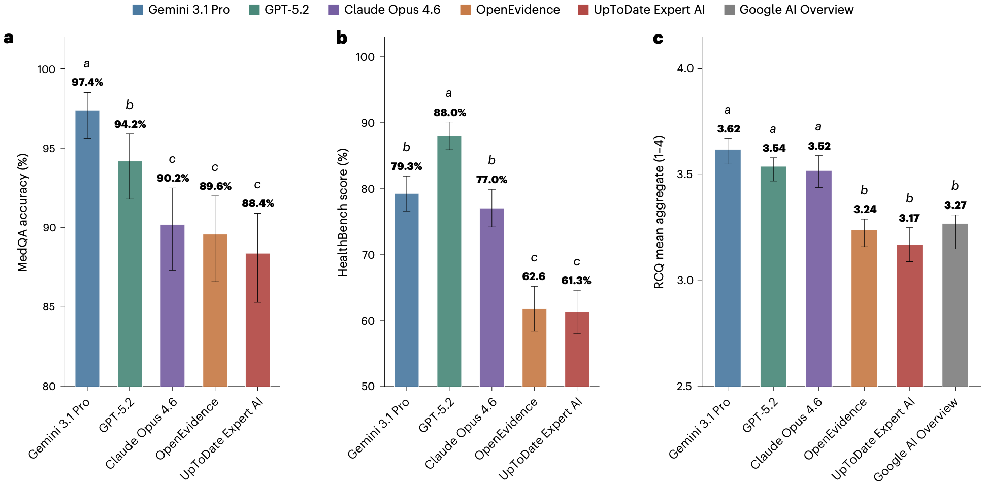
http://project-emerse.org/presentations.html

Slide 52
Initial thoughts: This should be easy
LLMs are good at reading text
Clinical notes are text
Typical LLM paradigm:
  paste note → ask question → get answer
http://project-emerse.org/presentations.html

Slide 53
The reality: it’s not so easy
Patients have many notes over time
Users ask multiple follow-up questions
Clinical context matters
Answers must be grounded in source documentation
Need to track costs
Need to control costs
http://project-emerse.org/presentations.html

Slide 54
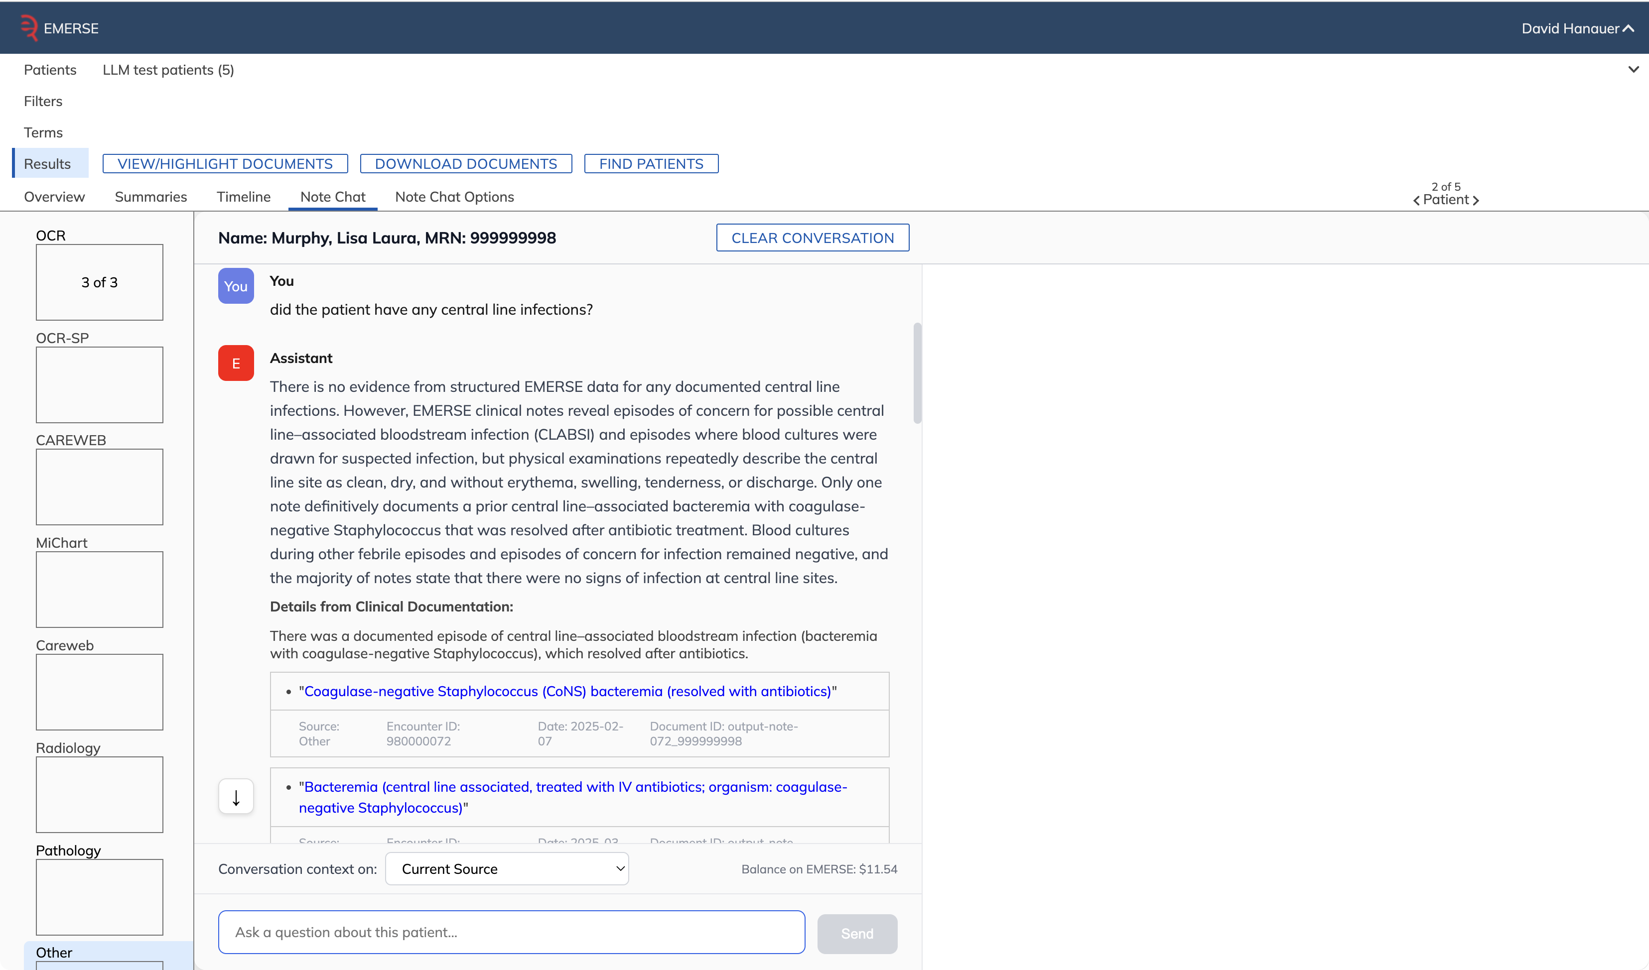
Note Chat
user-entered question

Slide 55
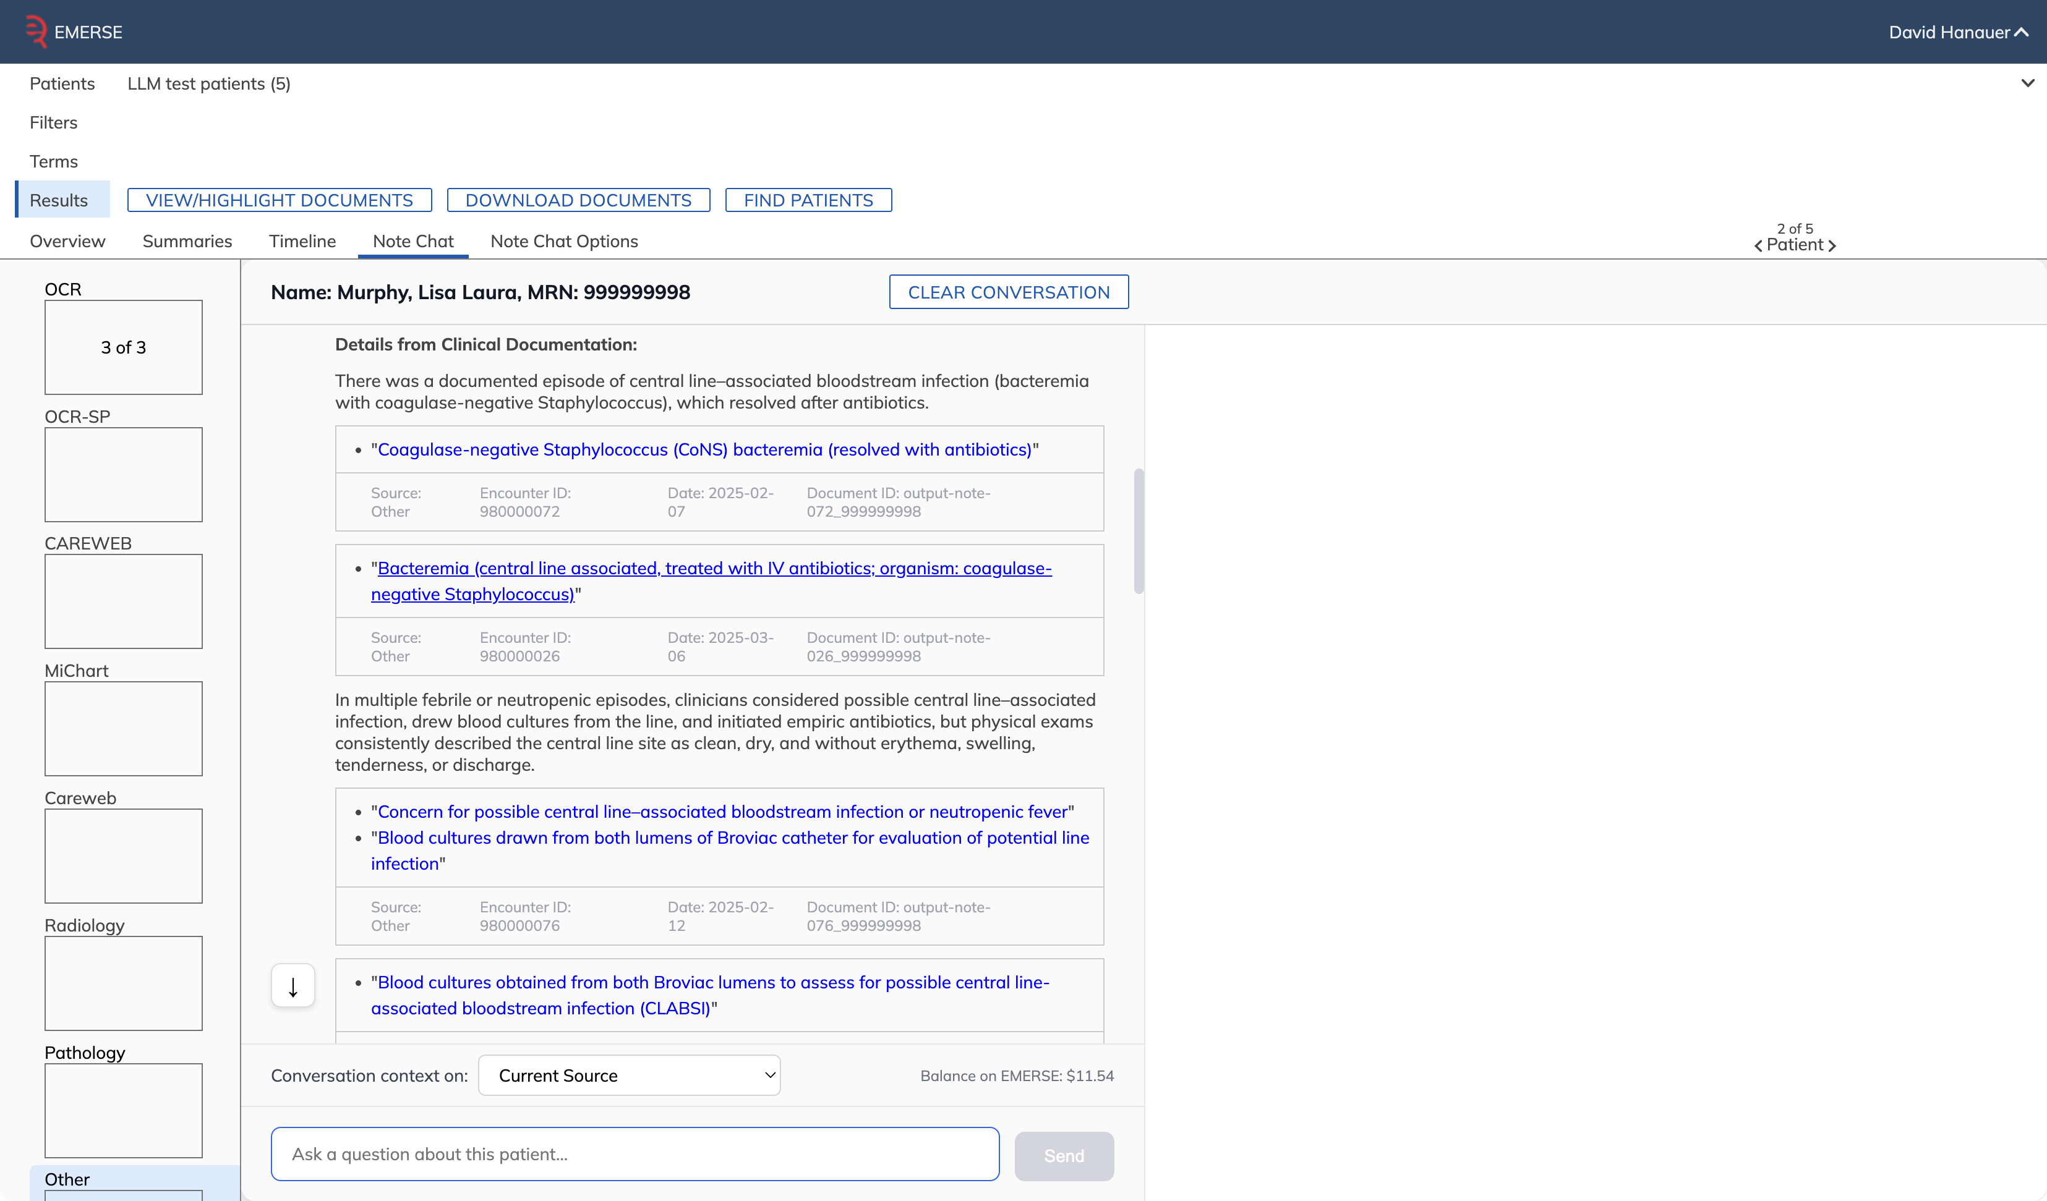
direct quote from note

Slide 56
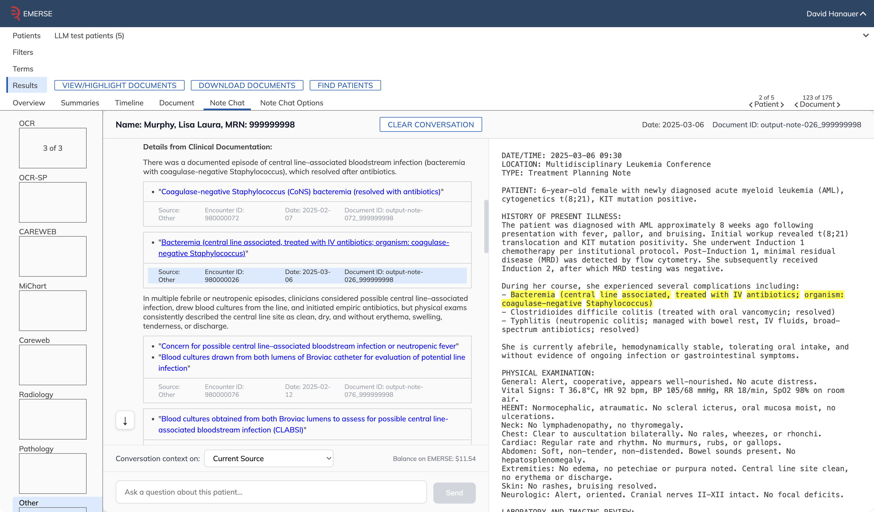
direct quote from note

Slide 57
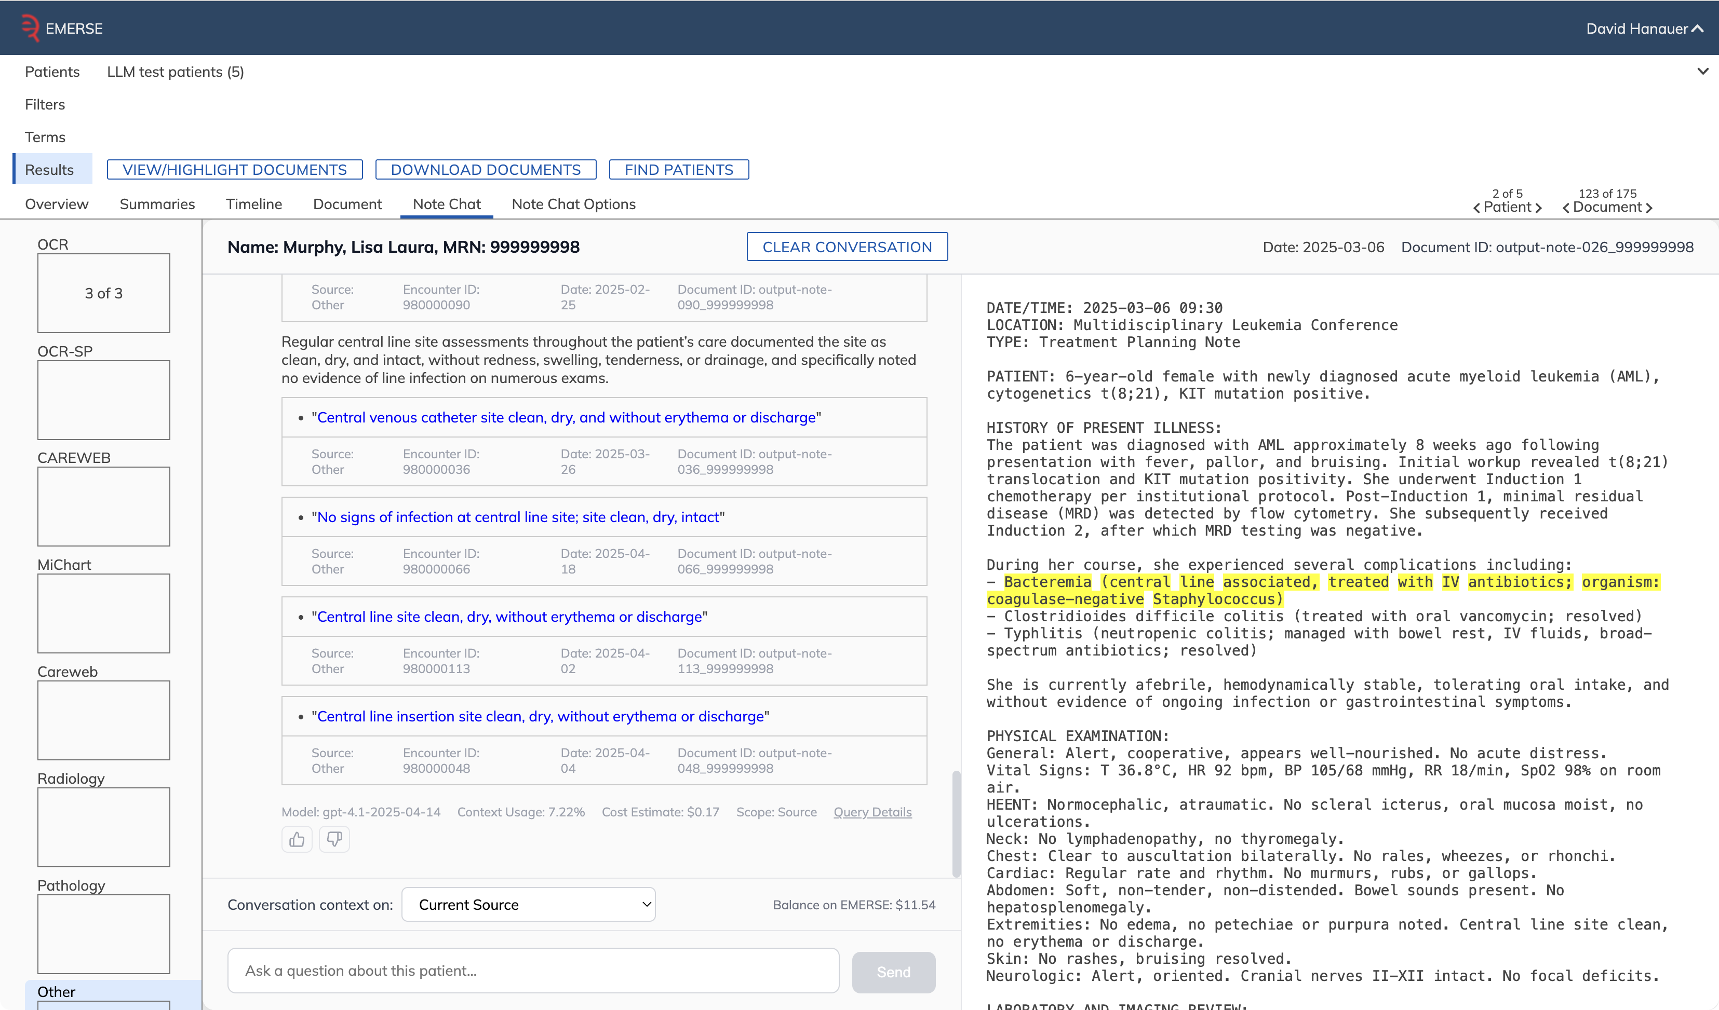
query details
model
cost

Slide 58
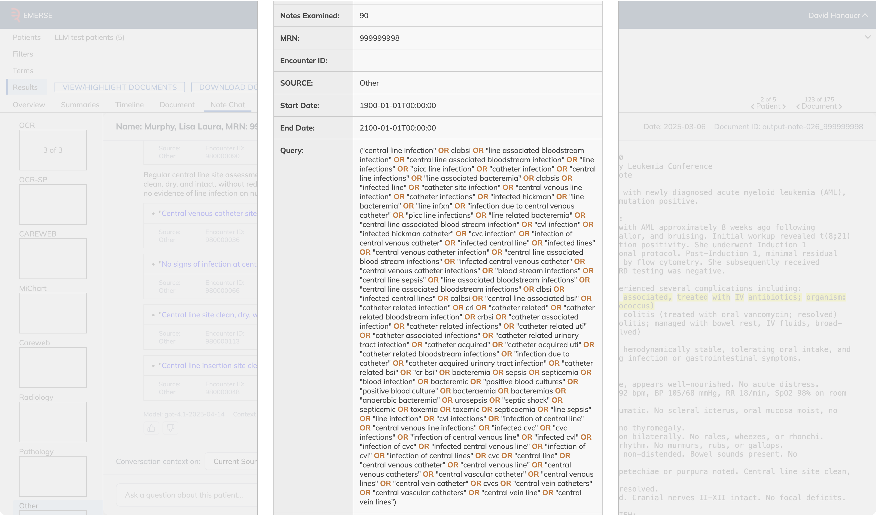
90 notes examined
query written by LLM

Slide 59
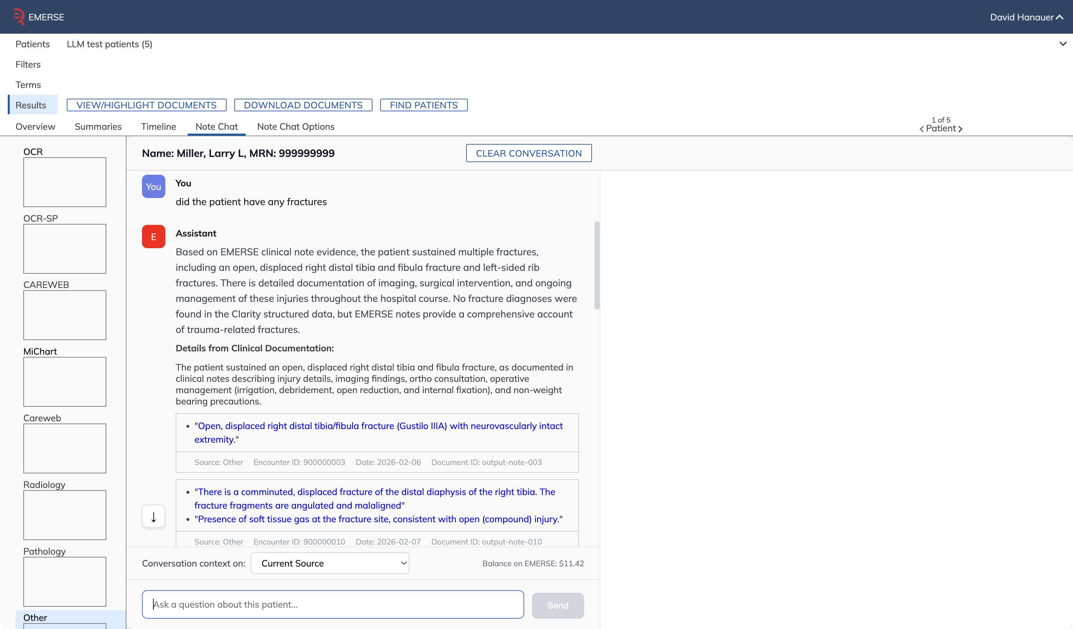
One more patient
straightforward question
straightforward answer

Slide 60
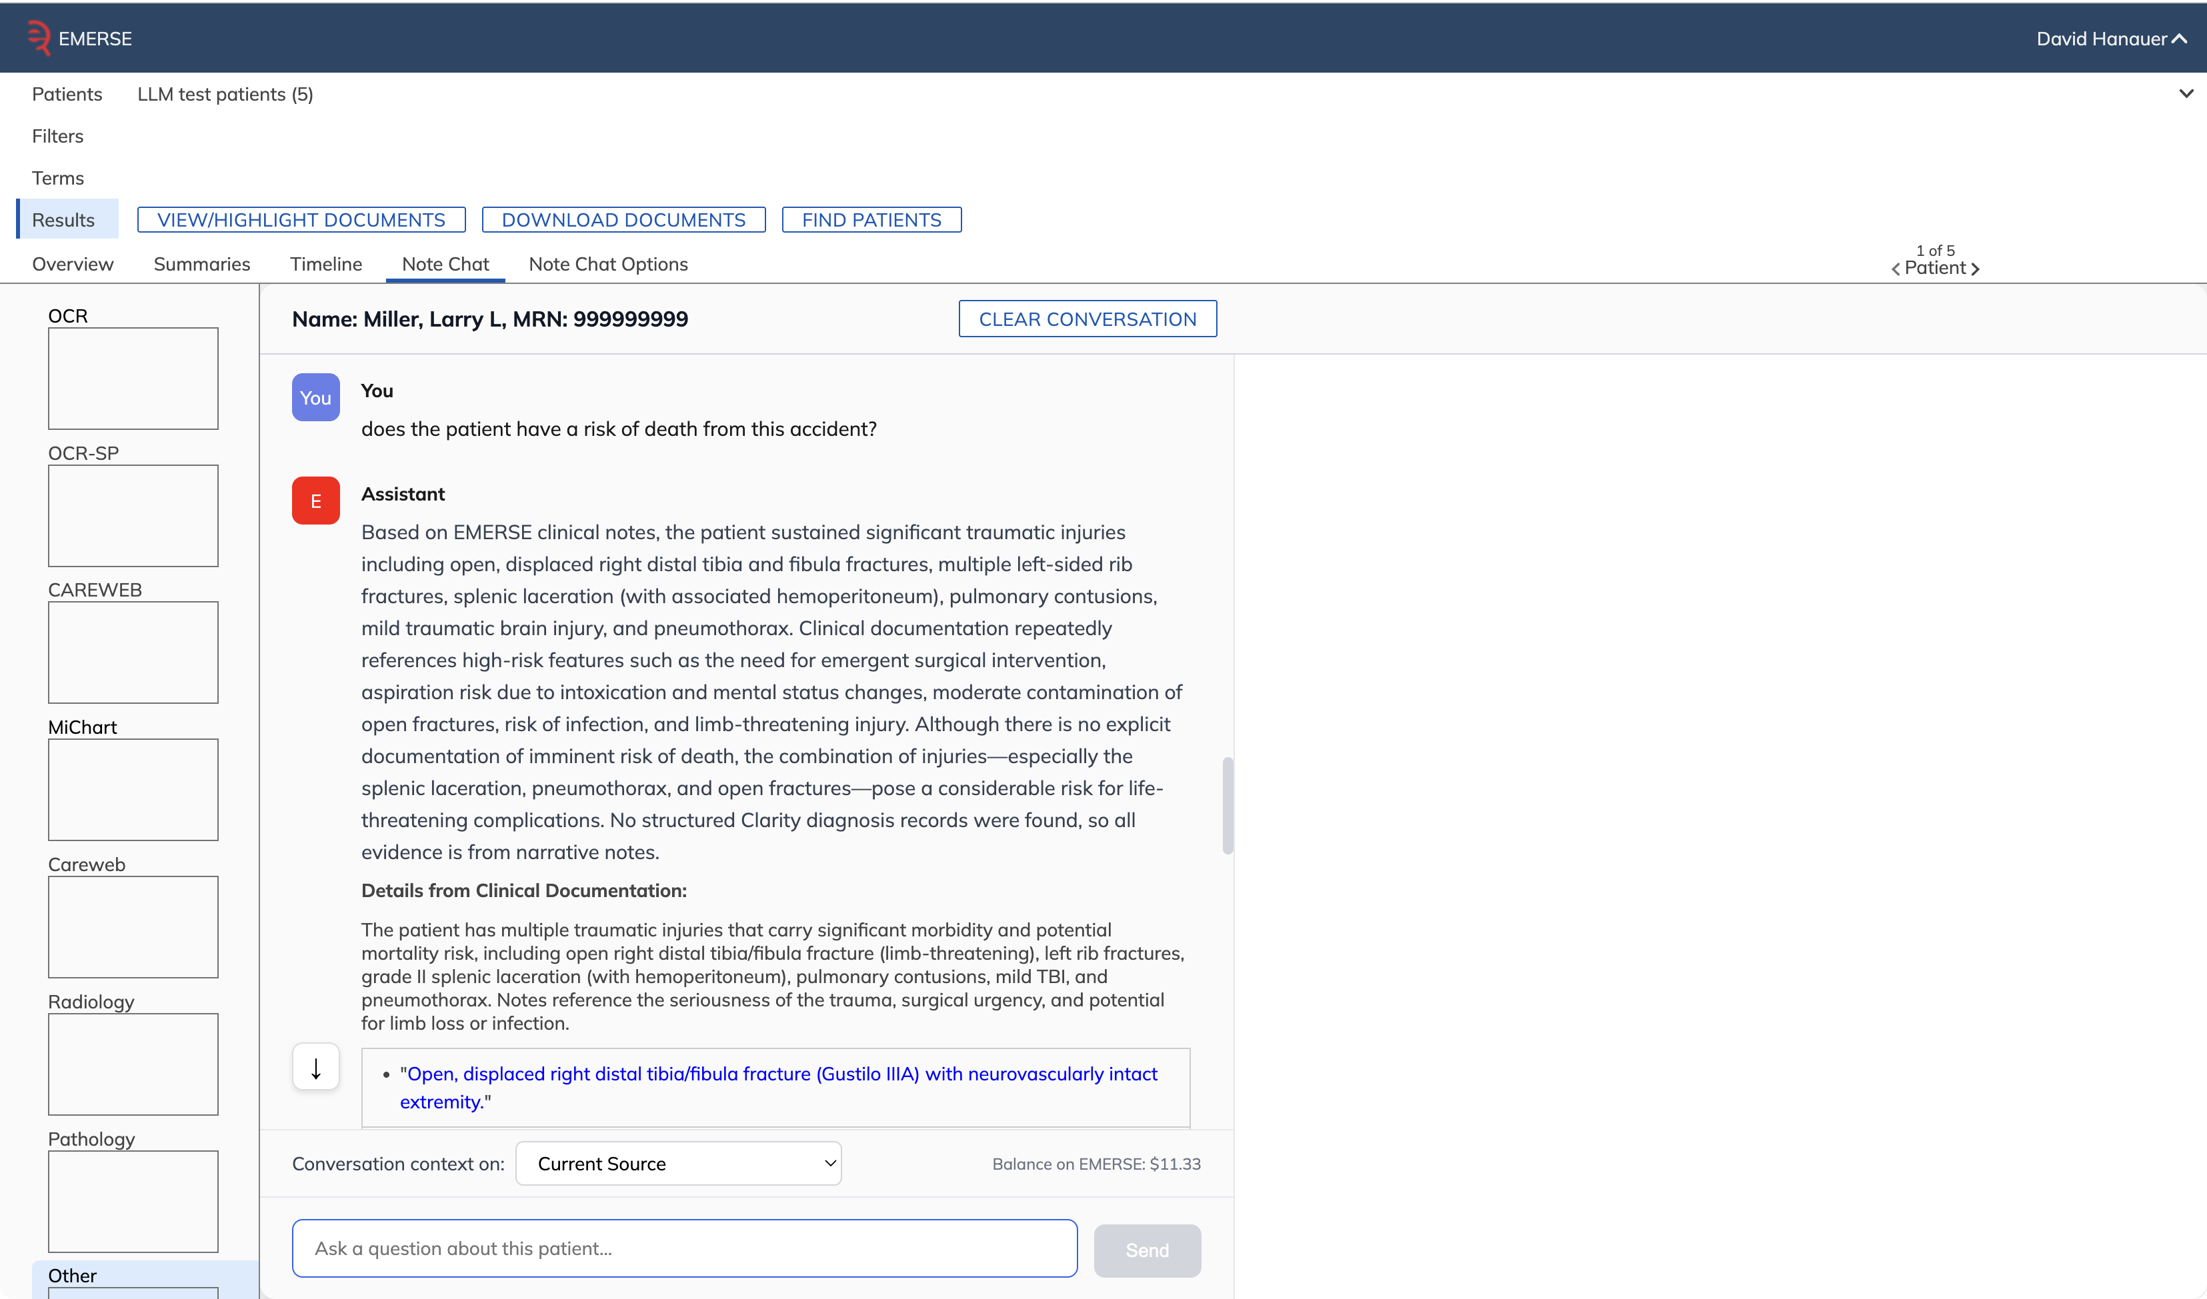
more abstract question
answer based on
synthesis and
inference from 26
notes

Slide 61
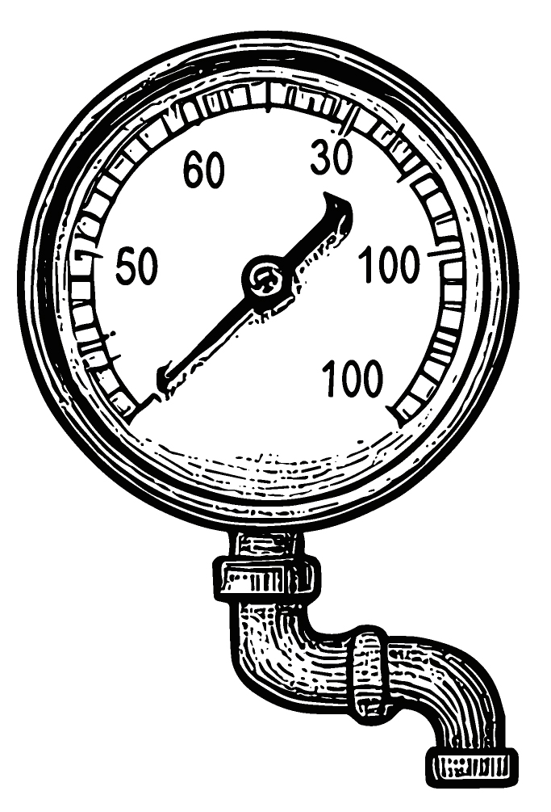
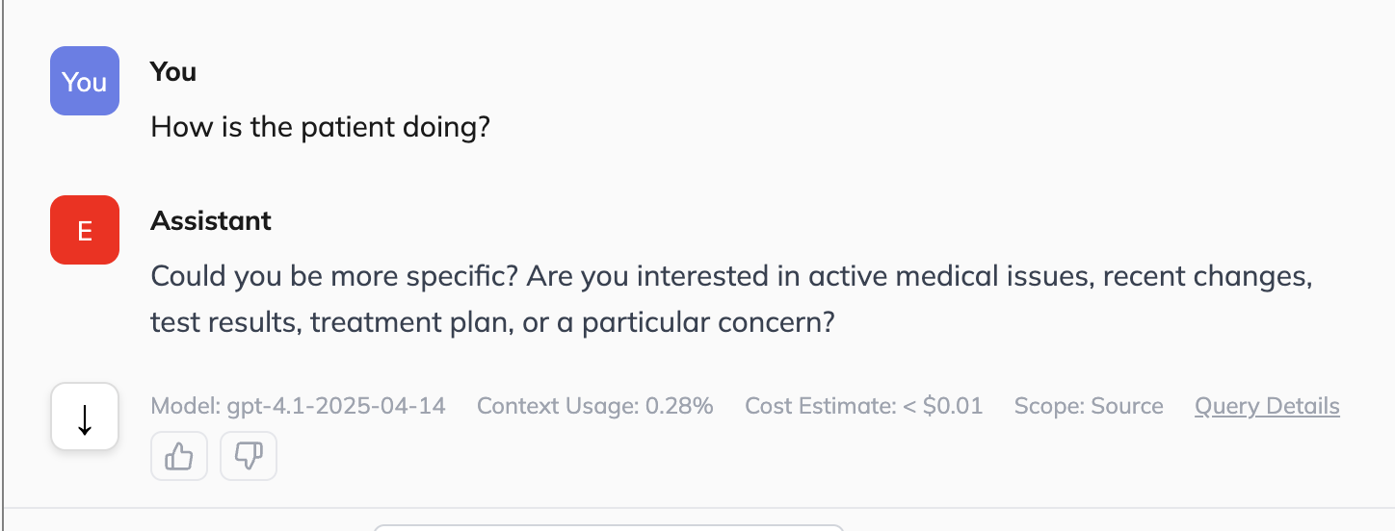
How does it all work?
1. User asks a question
2. LLM evaluates question for specificity
  If too vague, it will ask for more details
http://project-emerse.org/presentations.html

Slide 62

How does it all work?
3. LLM decides if reporting database (e.g., Epic Clarity) should be queried for any known details about the patient
  demographics, diagnoses, medications, etc.
  usually not enough to answer the question, but used to help the LLM focus on the right details.
4. LLM writes an initial free text search query (no RAG/embeddings), using the structured data as a guide, if available
http://project-emerse.org/presentations.html

Slide 63
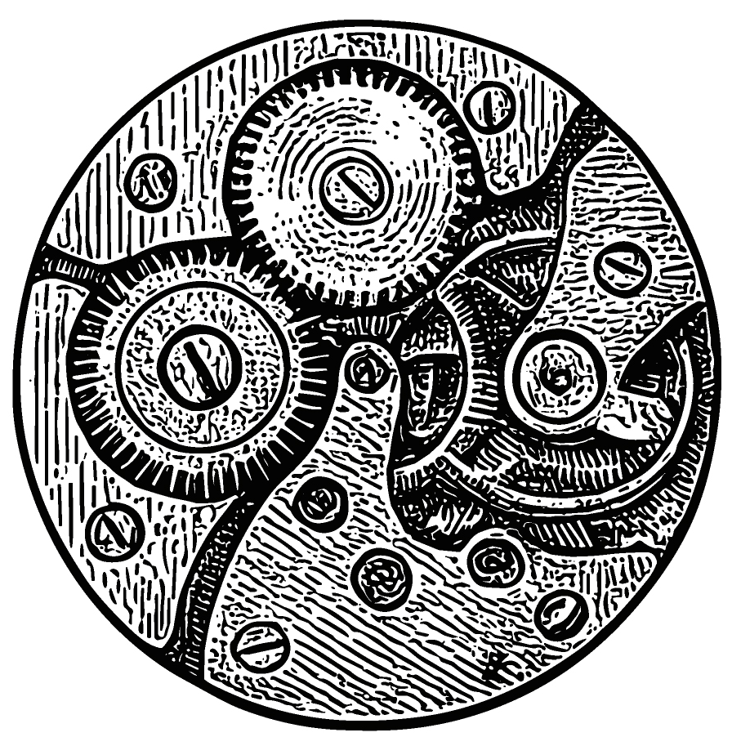
How does it all work?
5. LLM will then use available Synonyms to expand the query with additional terms
6. LLM evaluates the expanded query to remove terms likely to be vague, which could lead to excess false positives/noise
e.g., ‘ca’ could be cancer, calcium, catheter-associated, etc
http://project-emerse.org/presentations.html

Slide 64
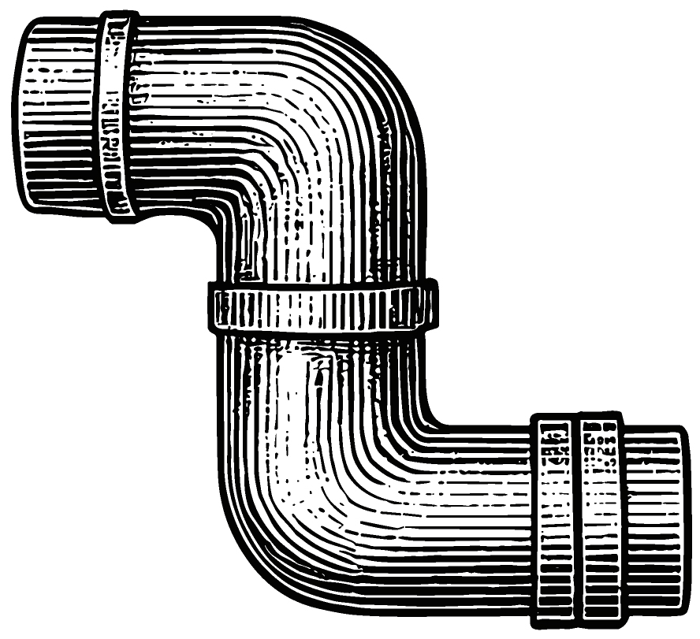
How does it all work?
7. LLM queries EMERSE notes (stored in Solr) to retrieve up to 800 notes (controlled by user preferences)
8. Snippets from each note are extracted with 1,000 characters on each end of the search terms
http://project-emerse.org/presentations.html

Slide 65

How does it all work?
9. Snippets, along with note metadata, are sent back to the LLM for synthesis and answering the question
LLM is instructed to extract exact quotes from notes as supporting evidence
10. Results are returned in a structured (JSON) format and presented to the user in a consistent manner
http://project-emerse.org/presentations.html

Slide 66

How does it all work?
11. User can click on supporting quotes to review the text in the original note
  The quoted text is highlighted with deterministic highlighter
  If text cannot be highlighted deterministically, the LLM may have paraphrased, so text and note is sent to LLM to try to highlight
  If text still cannot be highlighted it could represent a hallucination and user is warned
http://project-emerse.org/presentations.html

Slide 67
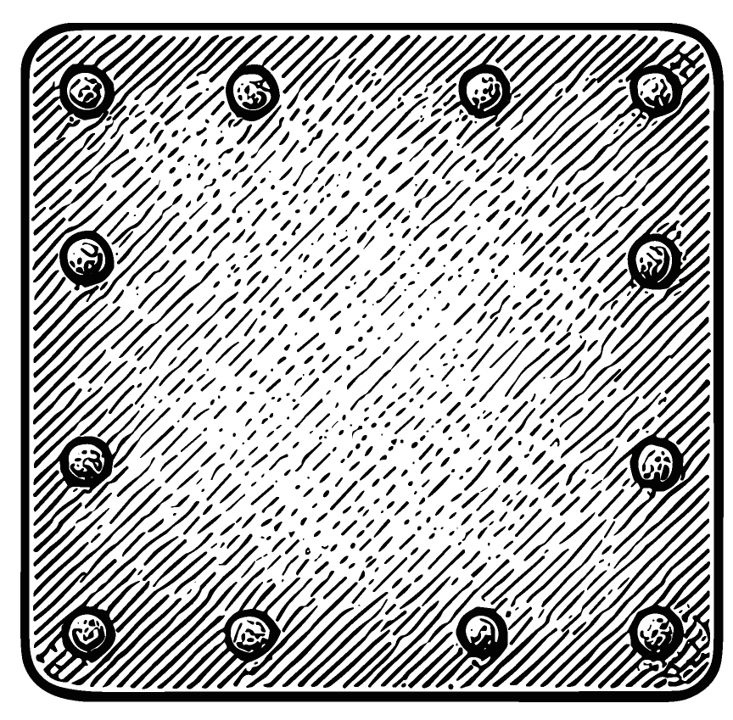
Additional details
Workflow engine ties distinct LLM calls together
Conversational memory is maintained, but only within a patient, and only per-conversation
To encourage reproducibility a temperature of 0 is initially used
  If LLM returns invalid JSON, and it cannot be repaired, the system will retry at higher temperatures to obtain a valid response
http://project-emerse.org/presentations.html

Slide 68

Additional details
System maintains detailed accounting of input/output tokens, with estimated costs available for each answer and as a running ledger per user
http://project-emerse.org/presentations.html

Slide 69
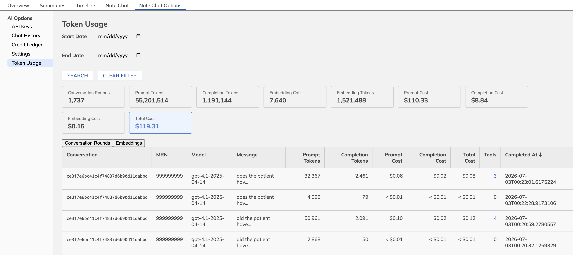

Slide 70
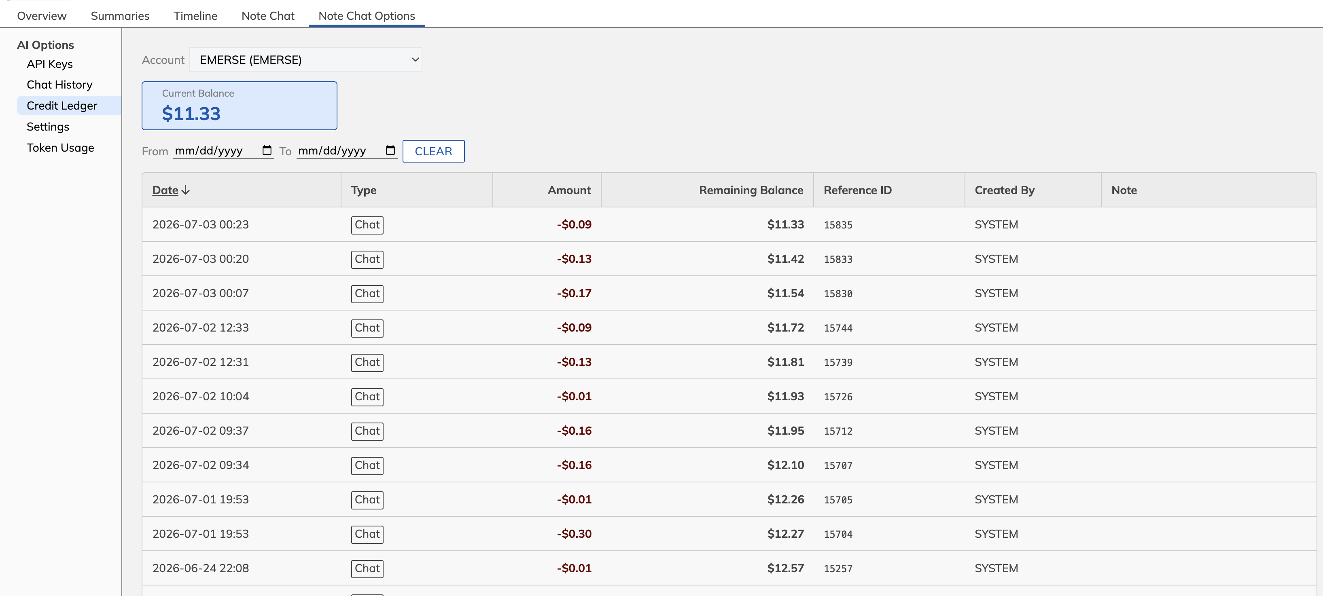

Slide 71
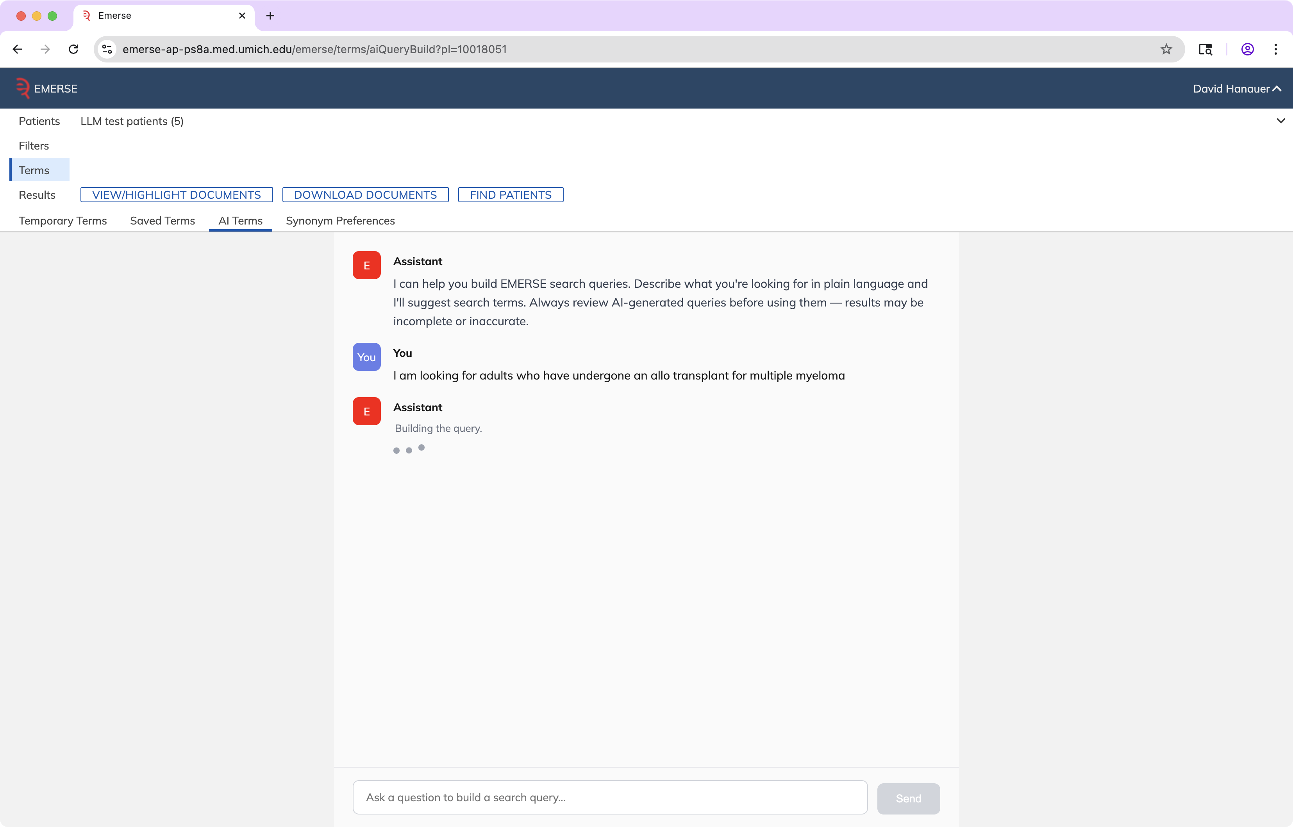
Query Generation

Slide 72
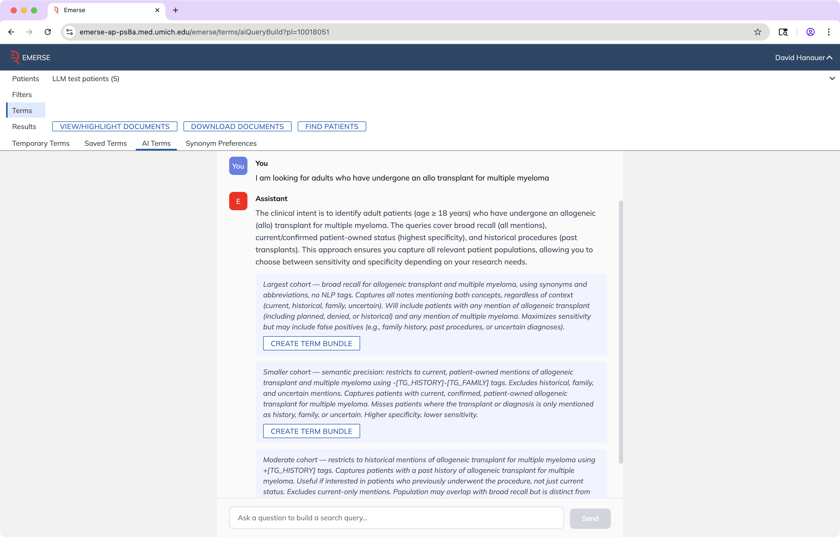

Slide 73
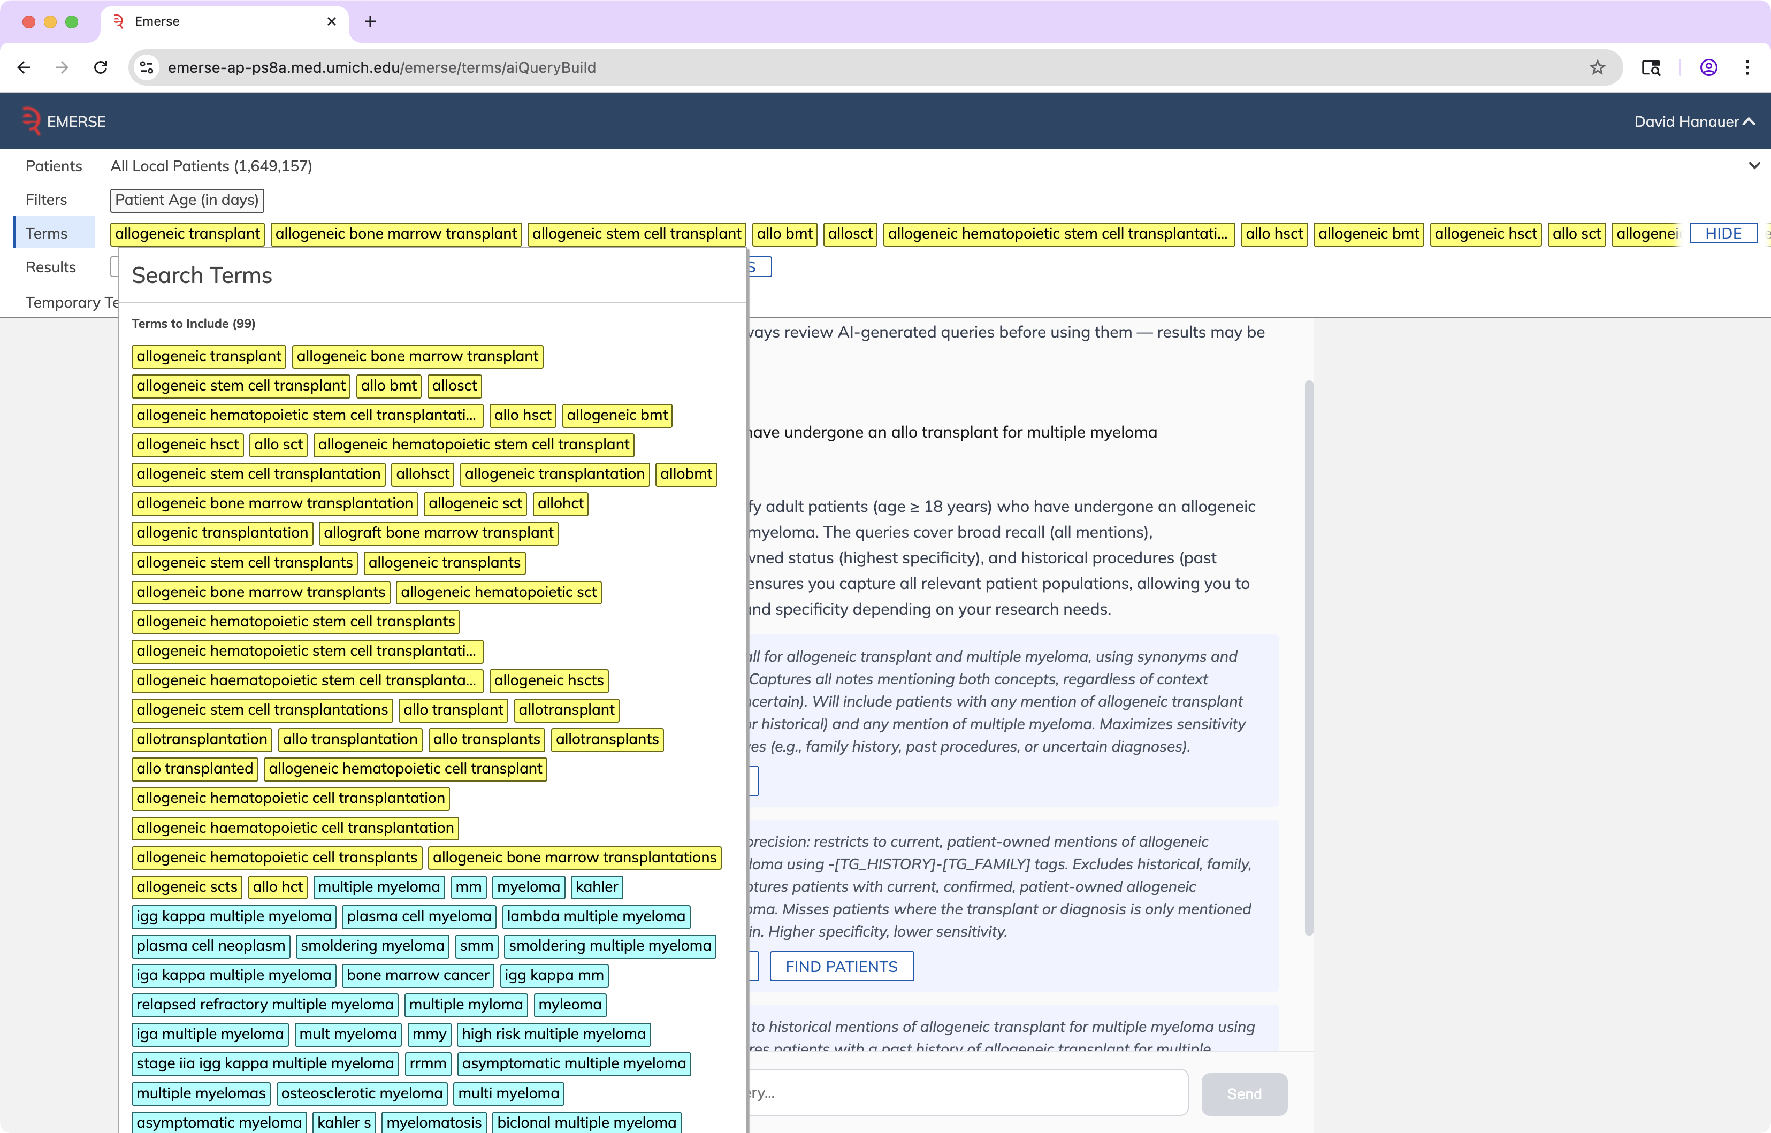

Slide 74


Slide 75
Initial Experiences
• LLMs are powerful but multiple challenges remain
  Cost
  Speed
  Completeness
  Accuracy
    Invalid JSON
    Paraphrasing instead of direct quotes
  Hallucinations – rare
http://project-emerse.org/presentations.html

Slide 76

Quoting too much text

Slide 77
Invalid JSON question: why did the patient get a transplant?
[
{
"answer": "Treatment for acute myeloid leukemia (AML) via an allogeneic hematopoietic stem cell/bone marrow transplant.",
"quote": "status post allogeneic hematopoietic stem cell transplantation for AML"
},
{
"answer": "The transplant indication was AML (acute myeloid leukemia).",
"quote": "Day +220 post-allogeneic BMT for AML",
}
]
http://project-emerse.org/presentations.html

Slide 78
Context window limitations
1 million token limit for context window
A quick check of our EHR identifies:
  Patient with 9377 notes, 4.6 million tokens
  Patient with 8675 notes, 7.5 million tokens
Need to sample, no guarantee it can be “complete”
http://project-emerse.org/presentations.html

Slide 79

LLM work remains in progress
We are excited and optimistic about what will be possible
Users are eager to test the upcoming capabilities
http://project-emerse.org/presentations.html

Slide 80


EMERSE-team@umich.edu
Lisa Ferguson
David Hanauer
Kellen McClain
Guan Wang
http://project-emerse.org/presentations.html

Slide 81




project-emerse.org
THANK
YOU!
http://project-emerse.org/presentations.html

