Slide 1

Chatting with Clinical Notes: Incorporating LLM-Based Question-and-Answer Capabilities into the EMERSE Search Engine and Text Processing Tool
Presentation for the ITCR Annual Meeting
Cold Spring Harbor Laboratory
July 16, 2026
Web: project-emerse.org
Email: hanauer@umich.edu
David Hanauer, MD, MS
Dept of Learning Health Sciences
University of Michigan
http://project-emerse.org/presentations.html

Slide 2

Acknowledgements
NCI-ITCR: U24CA269315
NCATS-CTSA: UM1TR004404
http://project-emerse.org/presentations.html

Slide 3
What is EMERSE?
Free text search and review platform designed to help clinical researchers find and abstract information found within electronic health records efficiently and securely
http://project-emerse.org/presentations.html

Slide 4
What is EMERSE?
Quickly searches large volumes of unstructured clinical text including notes, radiology & pathology reports, and more
Supports discovery of cohorts, phenotypes, treatments, outcomes, adverse events, and related clinical details
Designed for usability, auditability, and privacy-aware access to sensitive clinical data
http://project-emerse.org/presentations.html

Slide 5
Value for Researchers
Reduces manual chart review burden
Supports iterative search strategies using query expansion and natural language processing (NLP)
Facilitates reproducible patient chart reviews for translational and clinical cancer research
http://project-emerse.org/presentations.html

Slide 6



80% of EHR data are in unstructured free-text
structured data
unstructured data/free text
http://project-emerse.org/presentations.html

Slide 7


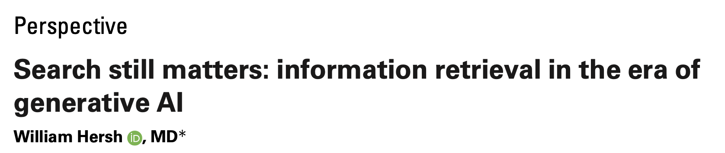
LLMs are changing how we work with text…do we even need search anymore?
https://pmc.ncbi.nlm.nih.gov/articles/PMC11339511/pdf/ocae014.pdf
2024
http://project-emerse.org/presentations.html

Slide 8
Current EMERSE efforts
Leverage the existing platform
  security model (roles, privileges, auditing)
  rapid retrieval of clinical notes
  simple user interface for researchers
Extend the capabilities with LLMs in various areas of the application
Supported with ITCR set-aside funds, collab with UCSF
http://project-emerse.org/presentations.html

Slide 9
LLM agnostic
We are not building our own LLM
EMERSE should be flexible to connect to any LLM using APIs
http://project-emerse.org/presentations.html

Slide 10
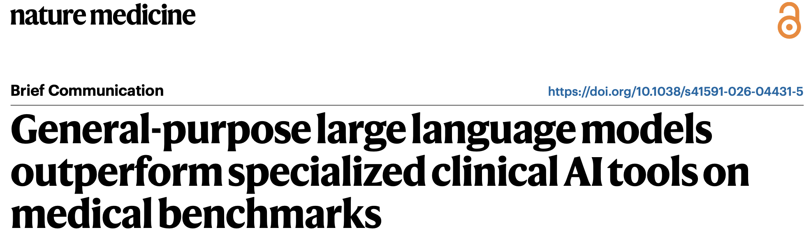
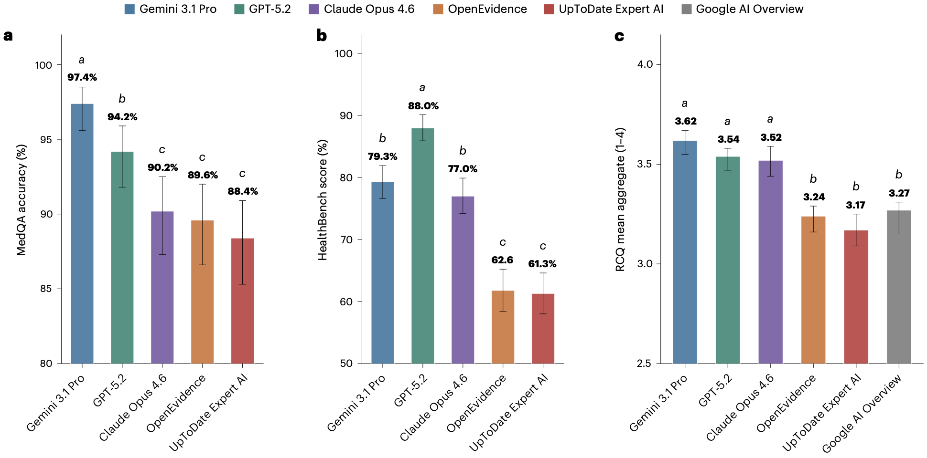
http://project-emerse.org/presentations.html

Slide 11
Initial thoughts: This should be easy
LLMs are good at reading text
Clinical notes are text
Typical LLM paradigm:
  paste note → ask question → get answer
http://project-emerse.org/presentations.html

Slide 12
The reality: it’s not so easy
Patients have many notes over time
Users ask multiple follow-up questions
Clinical context matters
Answers must be grounded in source documentation
Need to track costs
Need to control costs
http://project-emerse.org/presentations.html

Slide 13
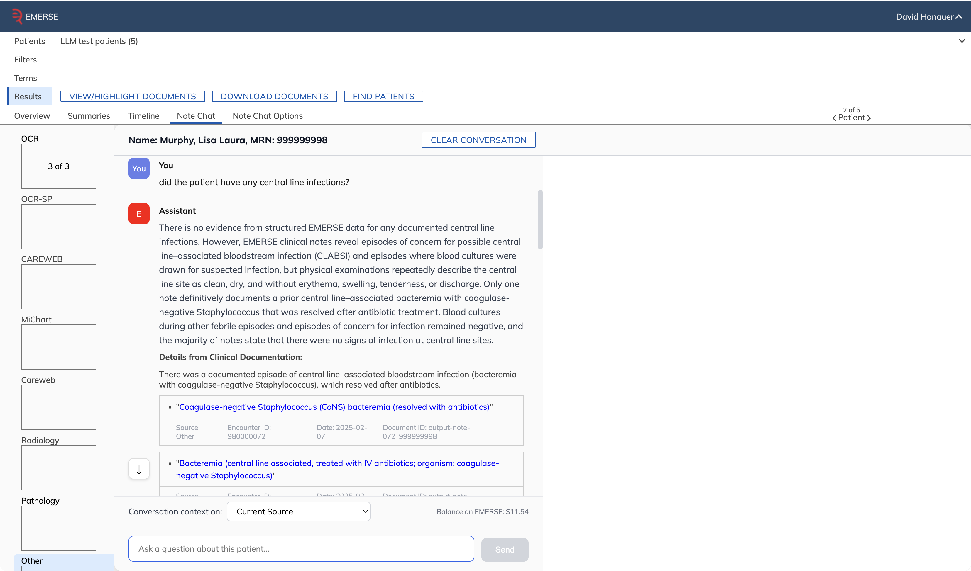
Note Chat
user-entered question

Slide 14
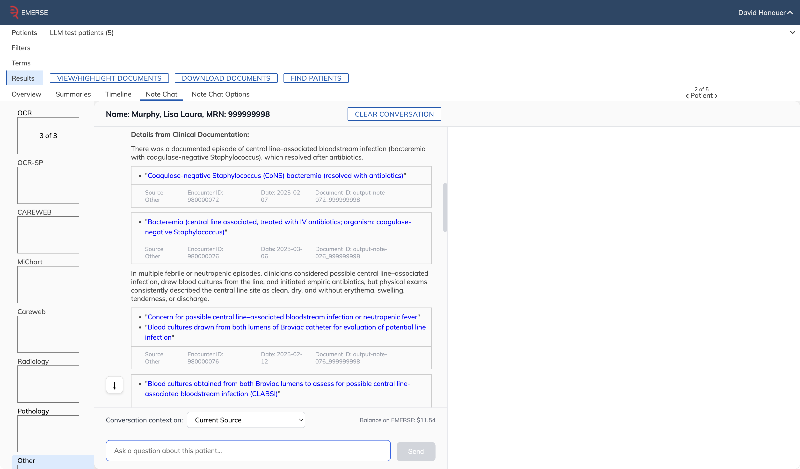
direct quote from note

Slide 15
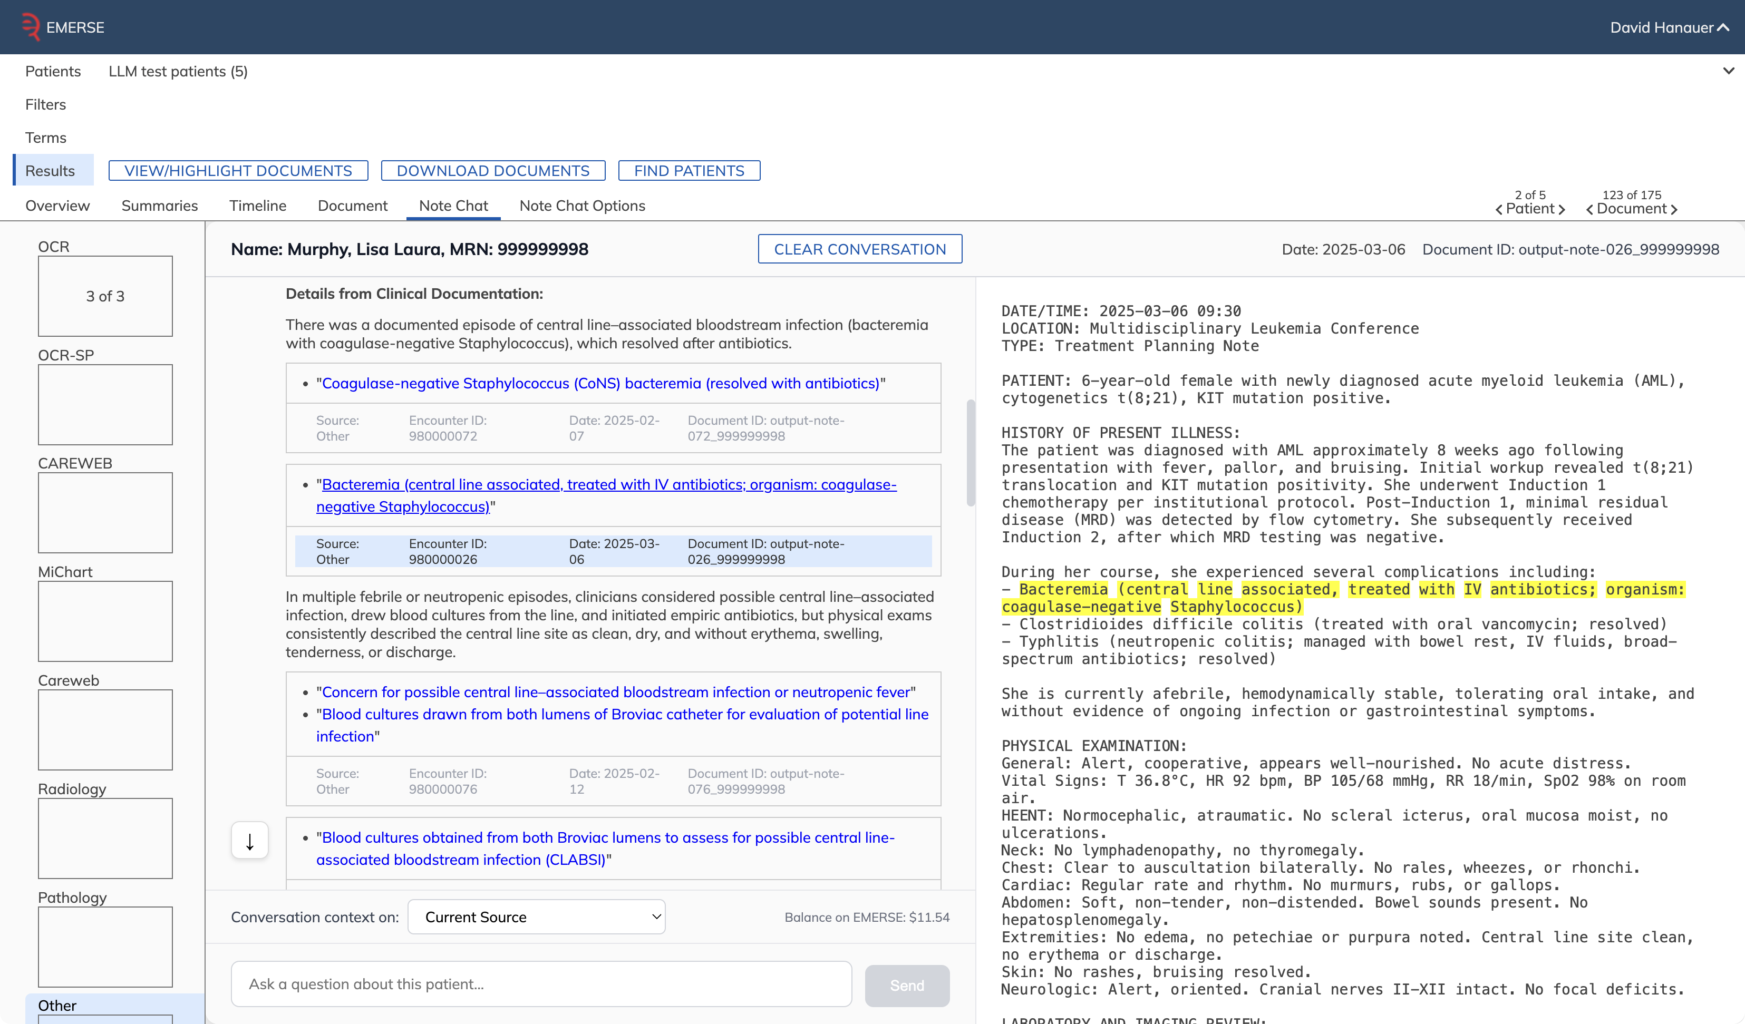
direct quote from note

Slide 16
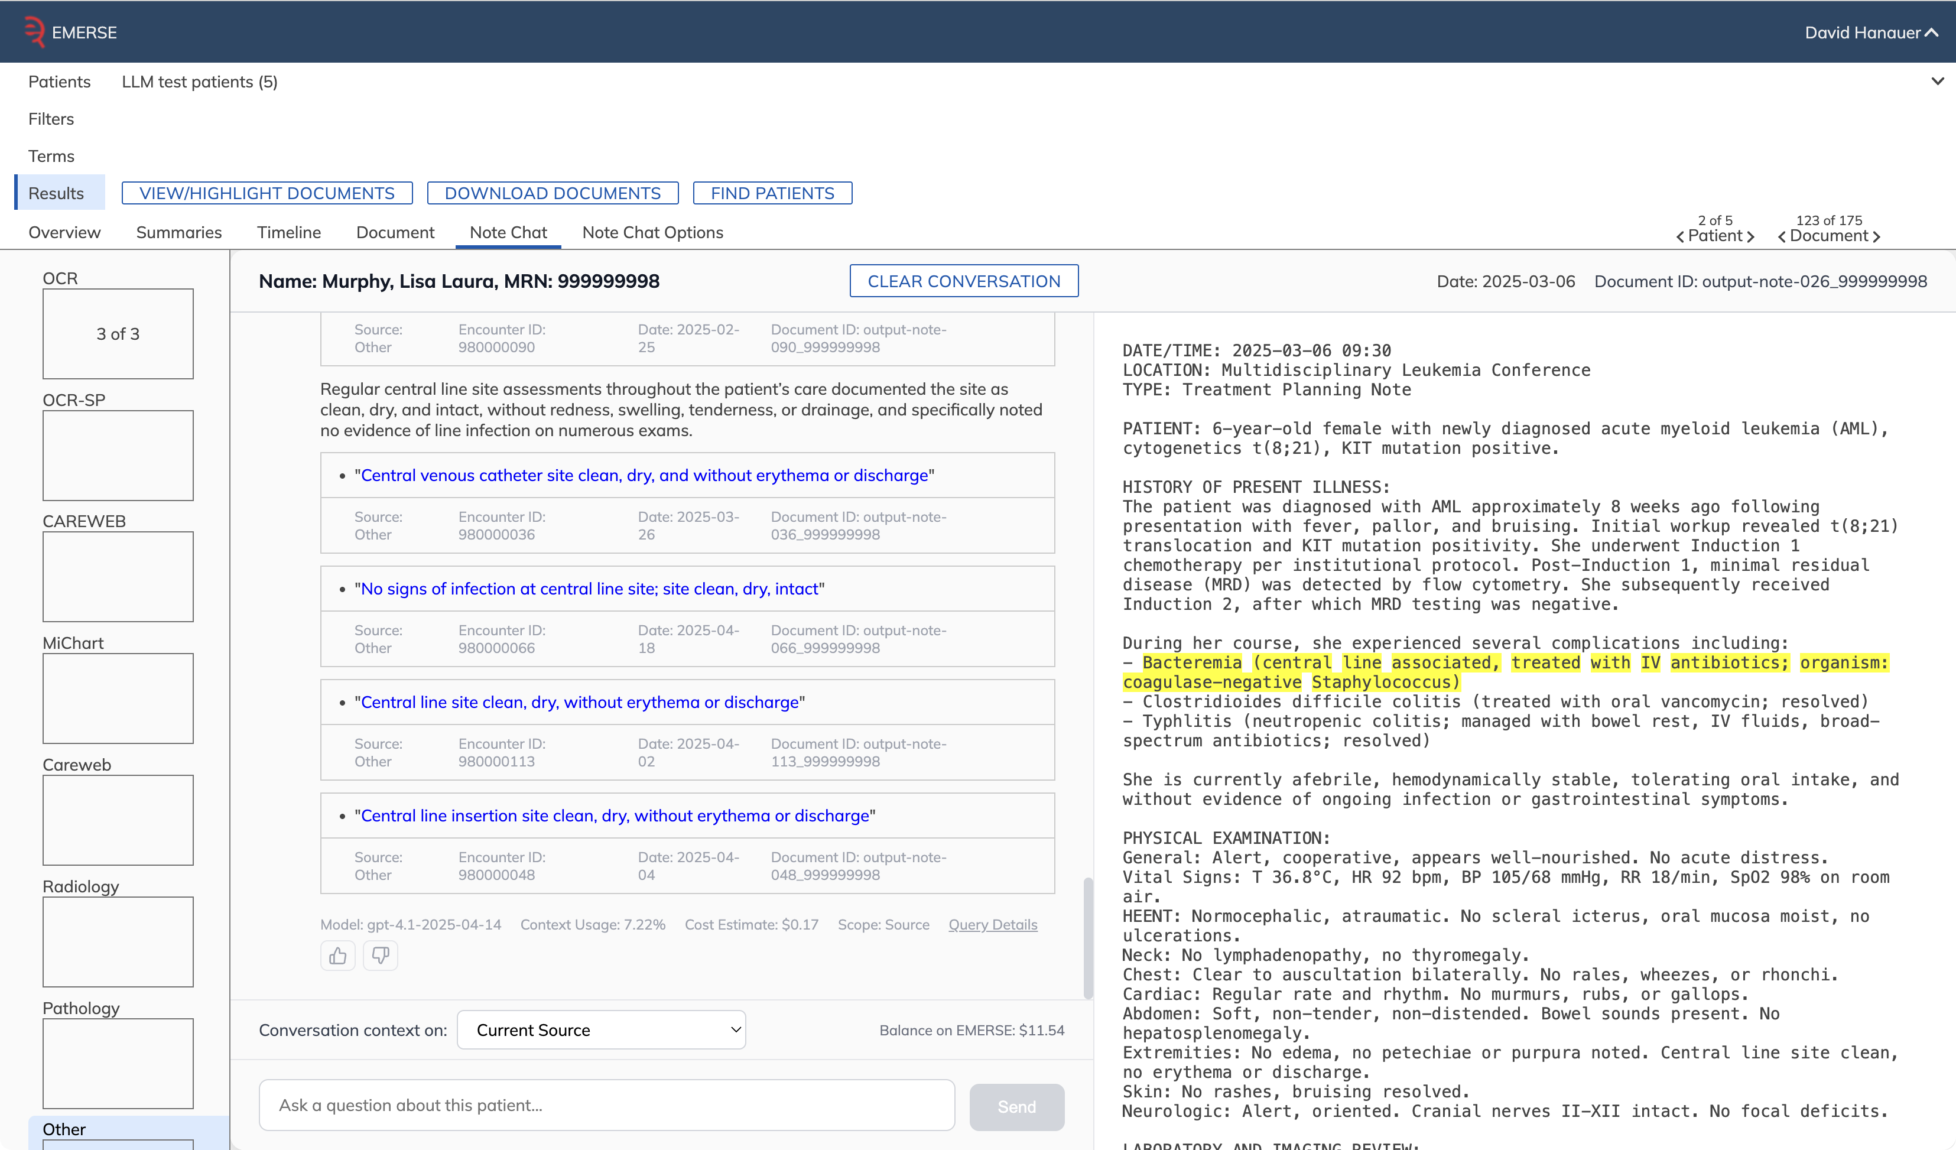
query details
model
cost

Slide 17
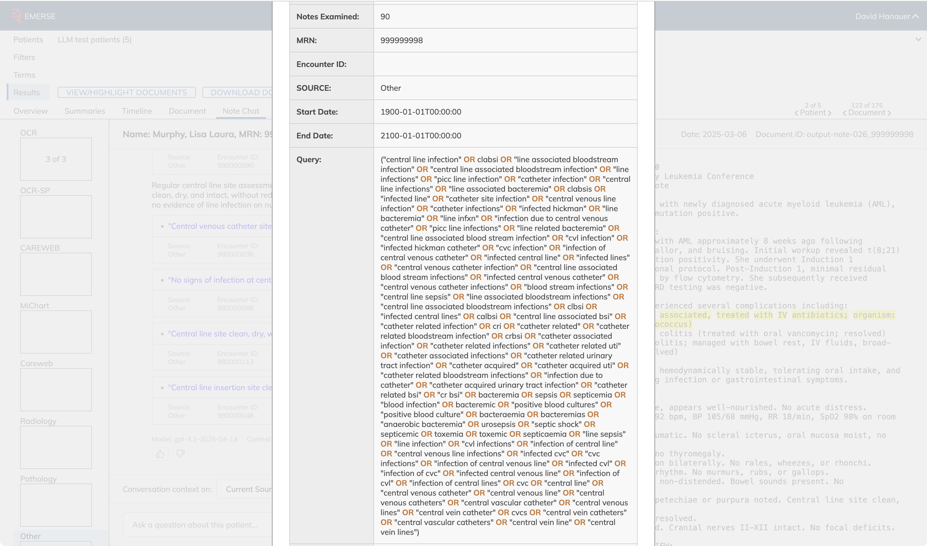
90 notes examined
query written by LLM

Slide 18
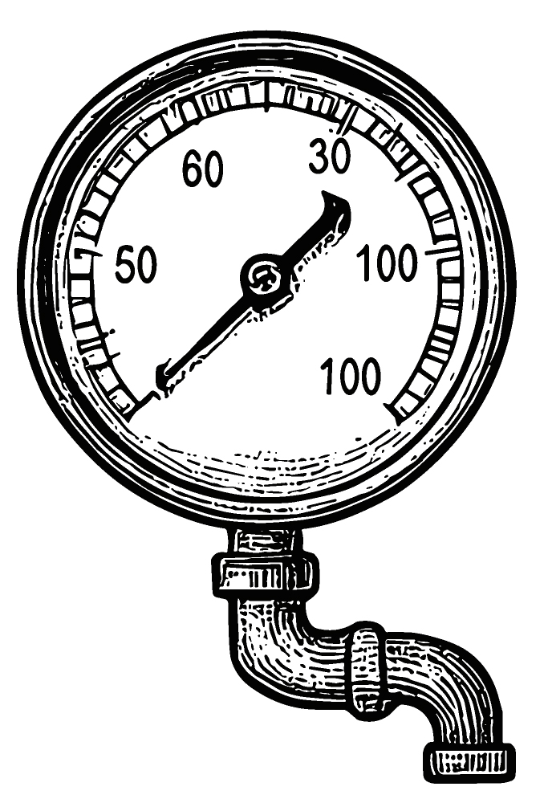
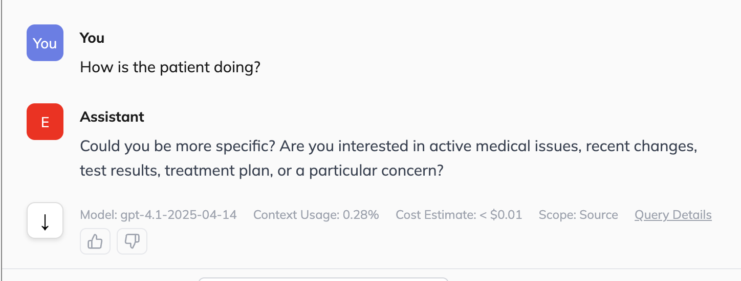
How does it all work?
1. User asks a question
2. LLM evaluates question for specificity
  If too vague, it will ask for more details
http://project-emerse.org/presentations.html

Slide 19

How does it all work?
3. LLM decides if reporting database (e.g., Epic Clarity) should be queried for any known details about the patient
  demographics, diagnoses, medications, etc.
  usually not enough to answer the question, but will be used to help the LLM focus on the right details.
4. LLM writes an initial free text search query (no RAG/embeddings), using the structured data as a guide, if available
http://project-emerse.org/presentations.html

Slide 20
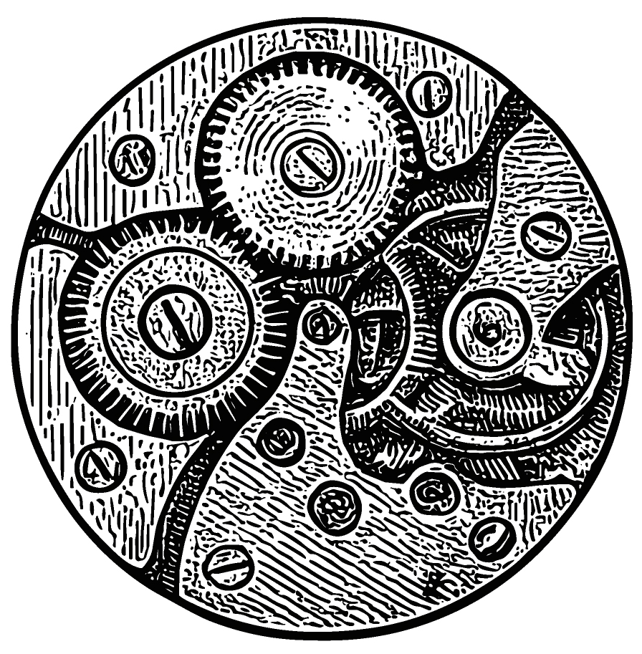
How does it all work?
5. LLM will then use available Synonyms to expand the query with additional terms
6. LLM evaluates the expanded query to remove terms likely to be vague, which could lead to excess false positives/noise
e.g., ‘ca’ could be cancer, calcium, catheter-associated, etc
http://project-emerse.org/presentations.html

Slide 21
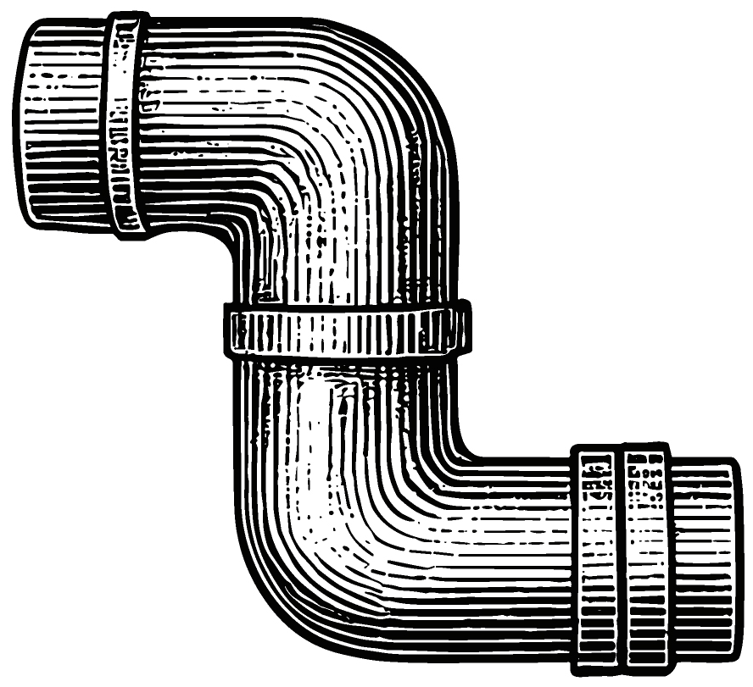
How does it all work?
7. LLM queries EMERSE notes (stored in Solr) to retrieve up to 800 notes (controlled by user preferences)
8. Snippets from each note are extracted with 1,000 characters on each end of the search terms
http://project-emerse.org/presentations.html

Slide 22

How does it all work?
9. Snippets, along with note metadata, are sent back to the LLM for synthesis and answering the question
LLM is instructed to extract exact quotes from notes as supporting evidence
10. Results are returned in a structured (JSON) format and presented to the user in a consistent manner
http://project-emerse.org/presentations.html

Slide 23

How does it all work?
11. User can click on supporting quotes to review the text in the original note
  The quoted text is highlighted with deterministic highlighter
  If text cannot be highlighted deterministically, the LLM may have paraphrased, so text and note is sent to LLM to try to highlight
  If text still cannot be highlighted it could represent a hallucination and user is warned
http://project-emerse.org/presentations.html

Slide 24
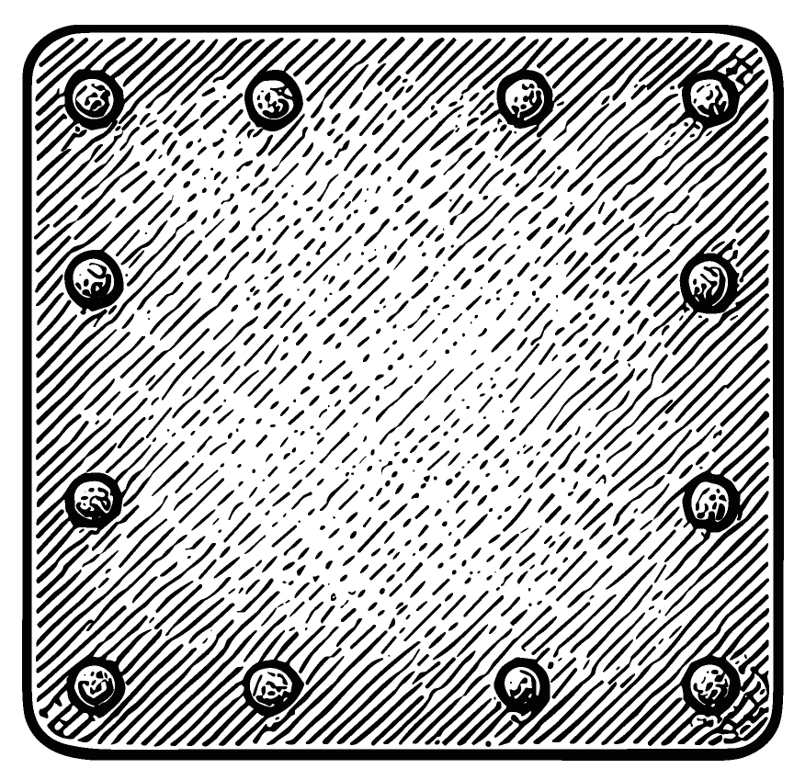
Additional details
Workflow engine ties distinct LLM calls together
Conversational memory is maintained, but only within a patient, and only per-conversation
To encourage reproducibility a temperature of 0 is initially used
  If LLM returns invalid JSON, and it cannot be repaired, the system will retry at higher temperatures to obtain a valid response
http://project-emerse.org/presentations.html

Slide 25

Additional details
System maintains detailed accounting of input/output tokens, with estimated costs available for each answer and as a running ledger per user
http://project-emerse.org/presentations.html

Slide 26
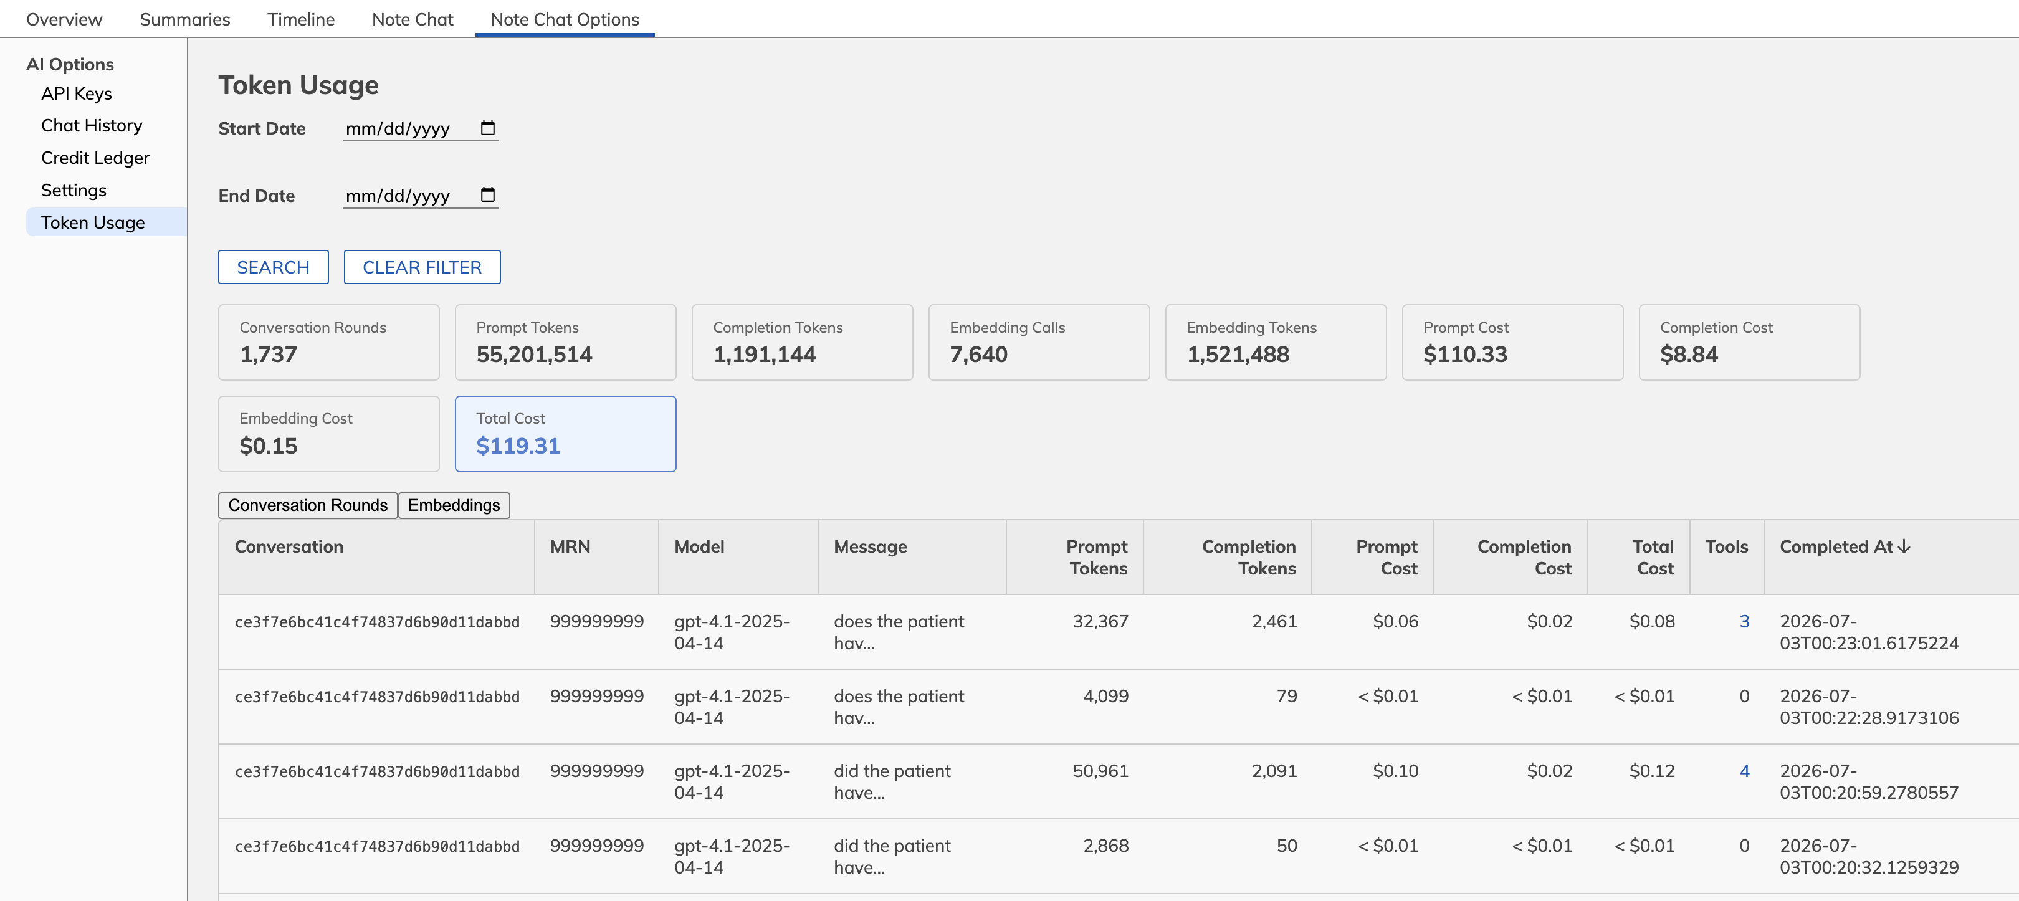

Slide 27
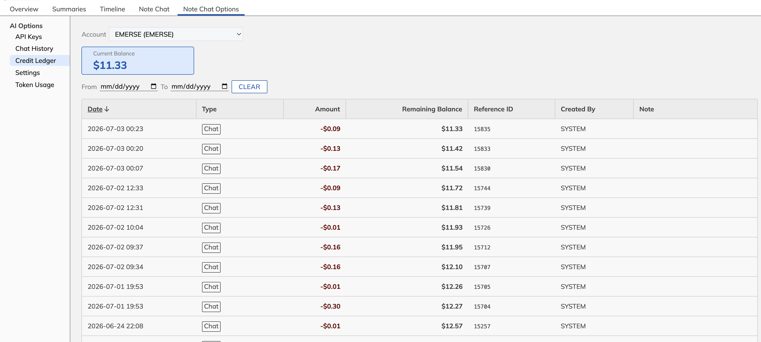

Slide 28
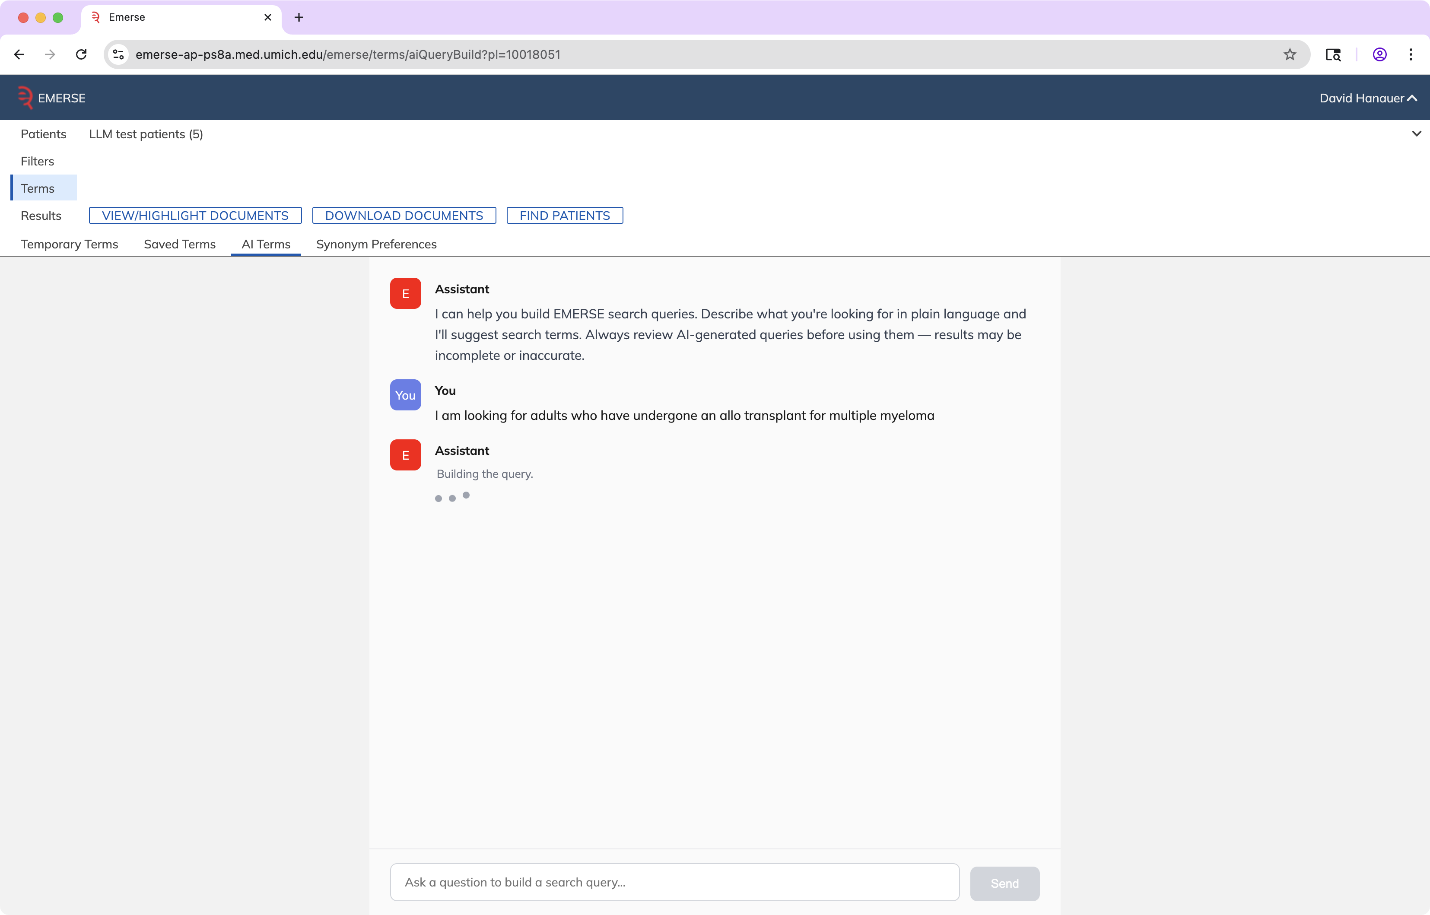
Query Generation

Slide 29
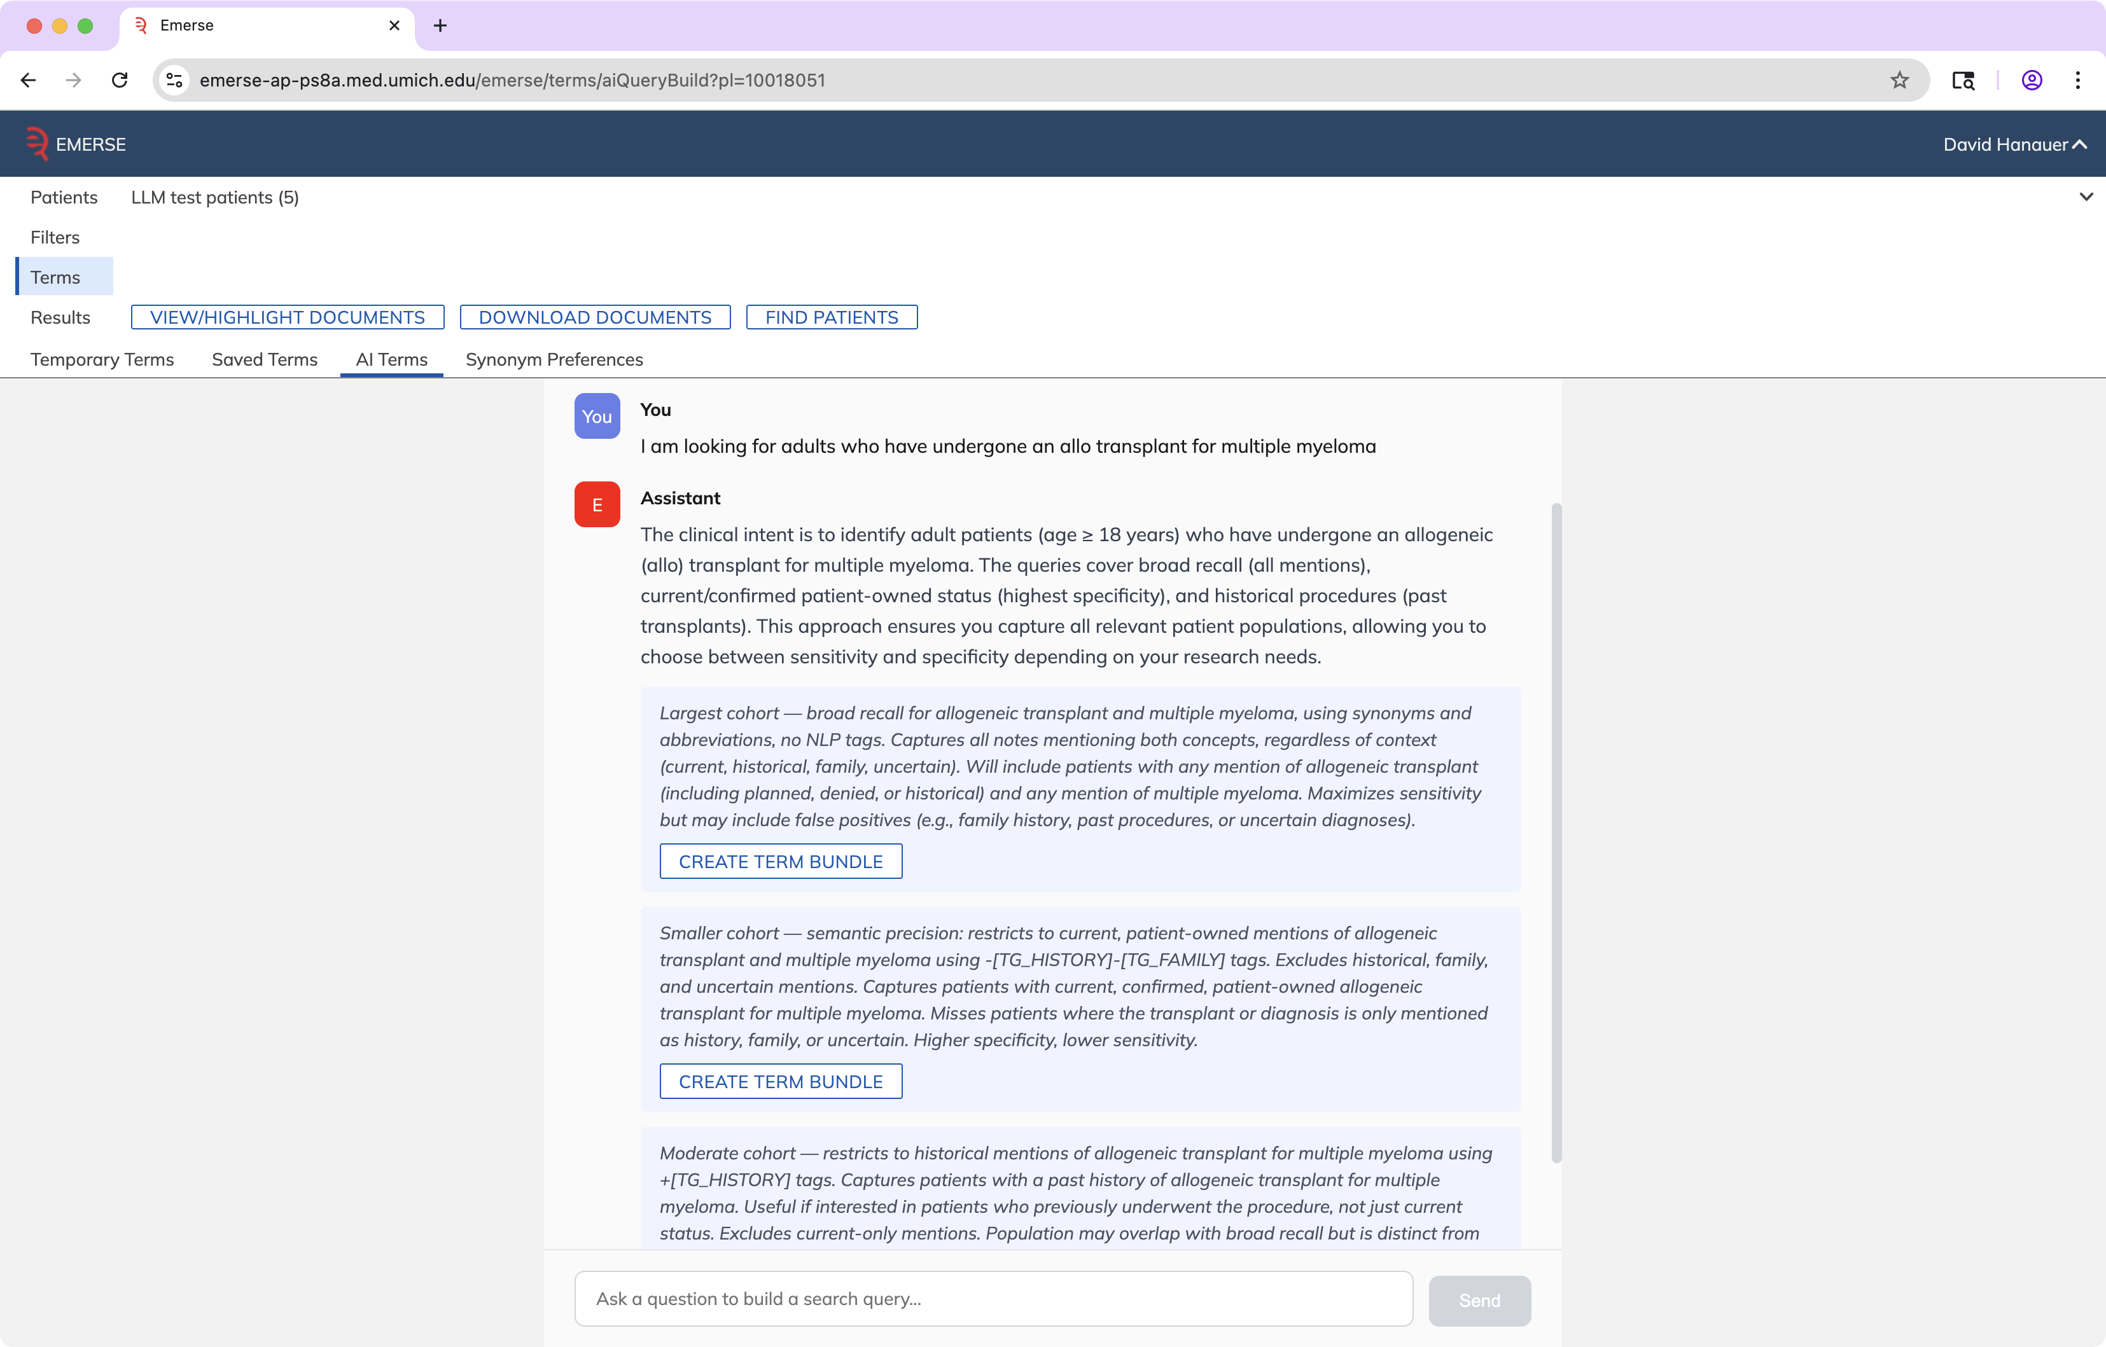

Slide 30
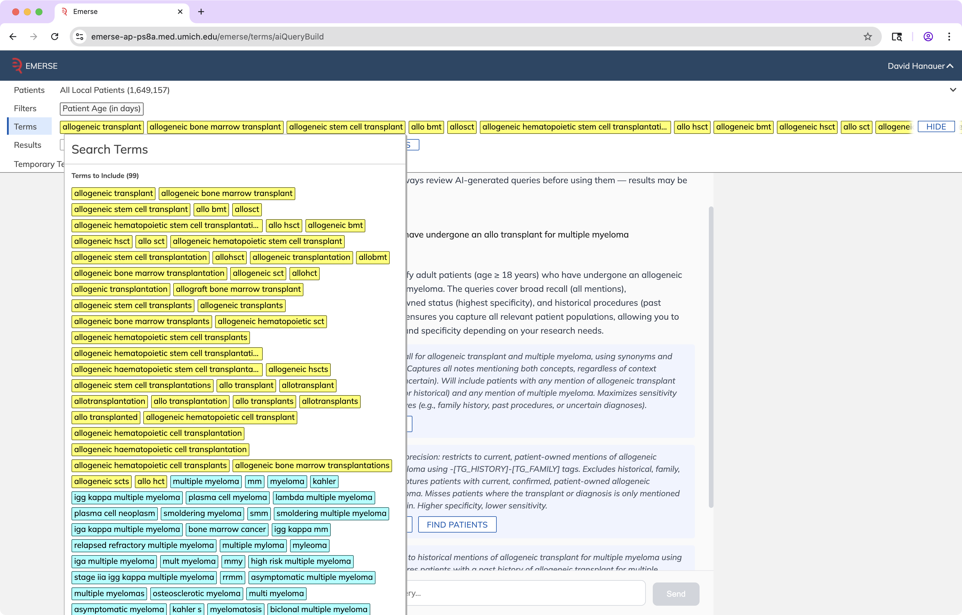

Slide 31
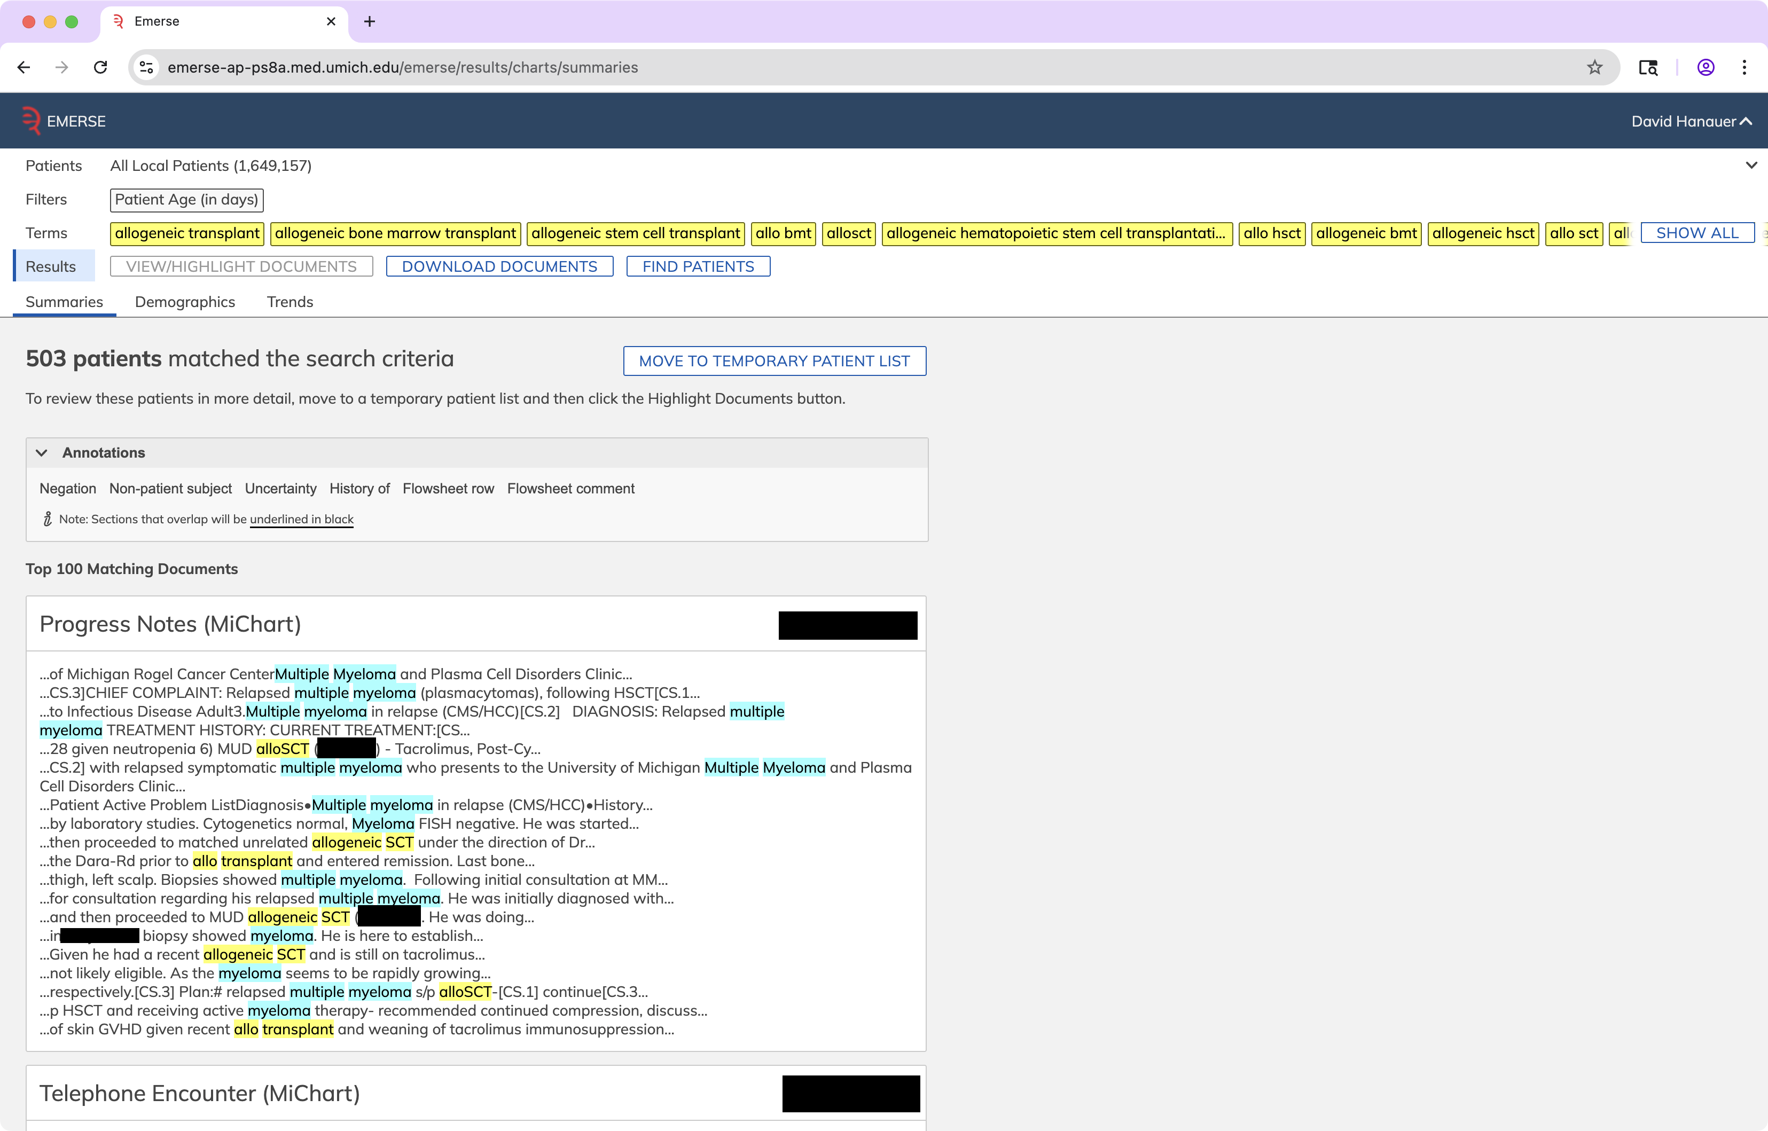

Slide 32
Initial Experiences
• LLMs are powerful but multiple challenges remain
  Cost
  Speed
  Completeness
  Accuracy
    Invalid JSON
    Paraphrasing instead of direct quotes
  Hallucinations – rare
http://project-emerse.org/presentations.html

Slide 33
Context window limitations
1 million token limit for context window
A quick check of our EHR identifies:
  Patient with 9377 notes, 4.6 million tokens
  Patient with 8675 notes, 7.5 million tokens
Need to sample, no guarantee it can be “complete”
http://project-emerse.org/presentations.html

Slide 34

LLM work remains in progress
We are excited and optimistic about what will be possible
Users are eager to test the upcoming capabilities
http://project-emerse.org/presentations.html

Slide 35


EMERSE-team@umich.edu
Lisa Ferguson
David Hanauer
Kellen McClain
Guan Wang
http://project-emerse.org/presentations.html

Slide 36




project-emerse.org
THANK
YOU!
http://project-emerse.org/presentations.html

