Slide 1

Reimagining EMERSE in the Age of
Large Language Models
Presentation for the Pan Pacific Symposium on Stem Cells and Cancer Research
May 2026
Web: project-emerse.org
Email: hanauer@umich.edu
David Hanauer, MD, MS
Dept of Learning Health Sciences
University of Michigan
http://project-emerse.org/presentations.html

Slide 2

Disclosures
Funding: U.S National Institutes of Health
NCI-ITCR: U24CA269315
NCATS-CTSA: UM1TR004404
U of Michigan Royalties/Licensing:
“Synonyms” dataset–optional “plugin” for
EMERSE
→ Free for use within EMERSE for
research
Disclosures
http://project-emerse.org/presentations.html

Slide 3
Unstructured vs Structured Data
EMERSE is for this… | …not this
Unstructured Data (free-text) | Structured Data
Mrs. Jones is a 56 year old female with a history of HTN, hypercholesterolemia, and T2DM who comes to the clinic today with a 3 day h/o dizziness and severe headache on the left side. | WBC: 5.6 Total cholesterol: 182 Weight: 67.4 AST: 30 ALT: 52
http://project-emerse.org/presentations.html

Slide 4



80% of EHR data are in unstructured free-text
structured data
unstructured data/free text
http://project-emerse.org/presentations.html

Slide 5
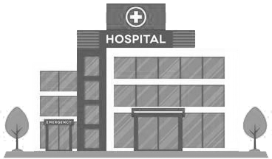

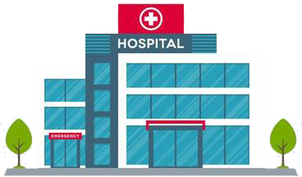
Most medical centers lack tools for free-text
http://project-emerse.org/presentations.html

Slide 6

And many options that exist aren’t great
2024 study on EMR usability:
“The same three items (integration into workflow, finding information, and usability of alerts) received the highest number of 'poor' ratings among hospital and practice physicians.”
https://www.nature.com/articles/s41746-025-01657-4
http://project-emerse.org/presentations.html

Slide 7
The EMERSE solution
Software tool designed for searching electronic health record notes
Users search the notes on their own
No need to wait in a queue for an analyst or a data scientist
Made for non-technical users
Search across all notes and all patients at once
Continuous refinements for > 20 years
http://project-emerse.org/presentations.html

Slide 8
The EMERSE solution
Created initially for researchers at University of Michigan Cancer Center
Adopted by about 20 other academic health centers
Open source software
Each site installs locally
Our EMERSE team provides implementation support
http://project-emerse.org/presentations.html

Slide 9


EMERSE is a very useful tool
but it will likely be one of several you need to support your project(s)
http://project-emerse.org/presentations.html

Slide 10
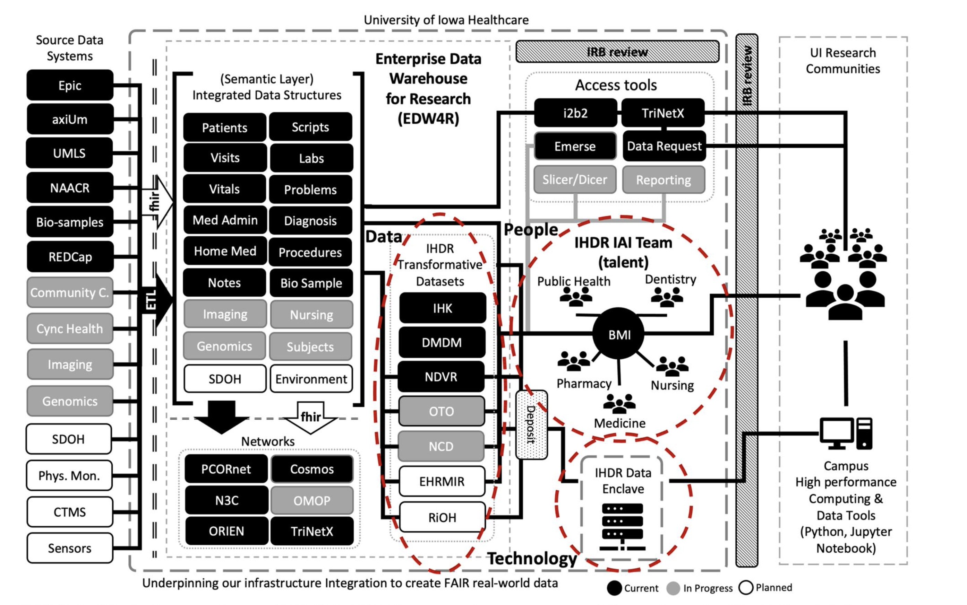
https://doi.org/10.1093/jamia/ocad236
http://project-emerse.org/presentations.html

Slide 11
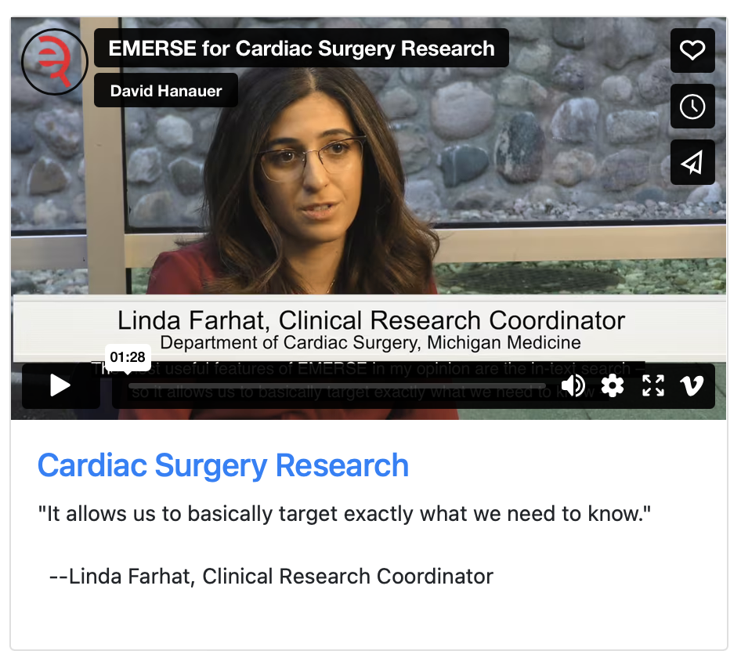
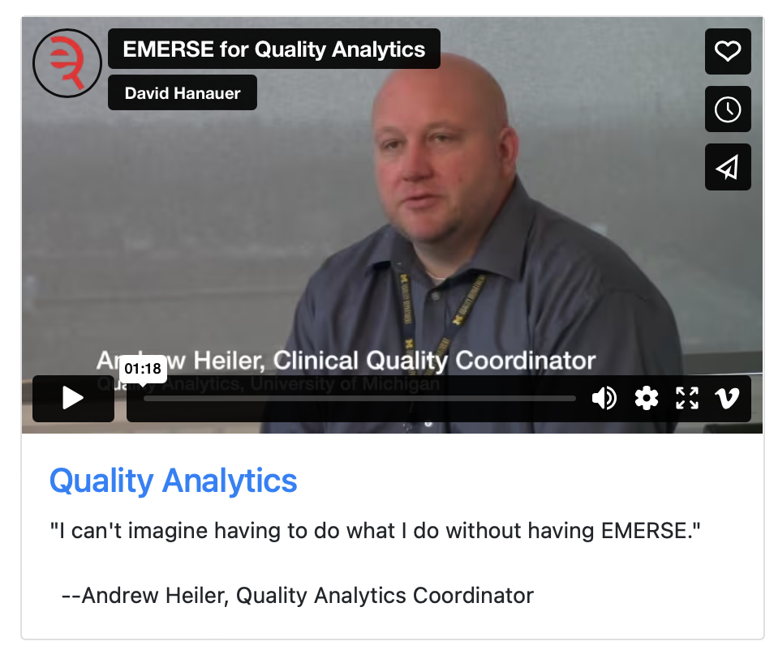
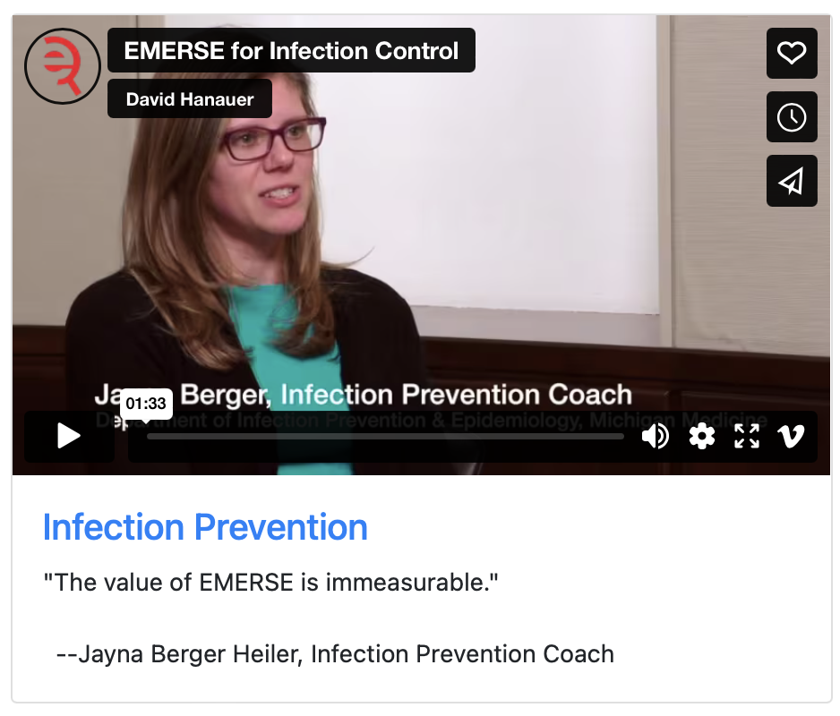
What can EMERSE do?
Lots of things!
Watch our videos: https://project-emerse.org/use_cases.html

Slide 12

Find cohorts
EMERSE allows you to find cohorts based on things mentioned in the notes
diseases
drugs
symptoms
anything*
*if it is mentioned
http://project-emerse.org/presentations.html

Slide 13



Find cohorts
It’s perfect for finding rare things…
…like rare cancers such as
cutaneous leiomyosarcoma
See this talk for more details:
https://vimeo.com/677482835
“Using EMERSE to Improve Research Involving Rare Cancers”
http://project-emerse.org/presentations.html

Slide 14
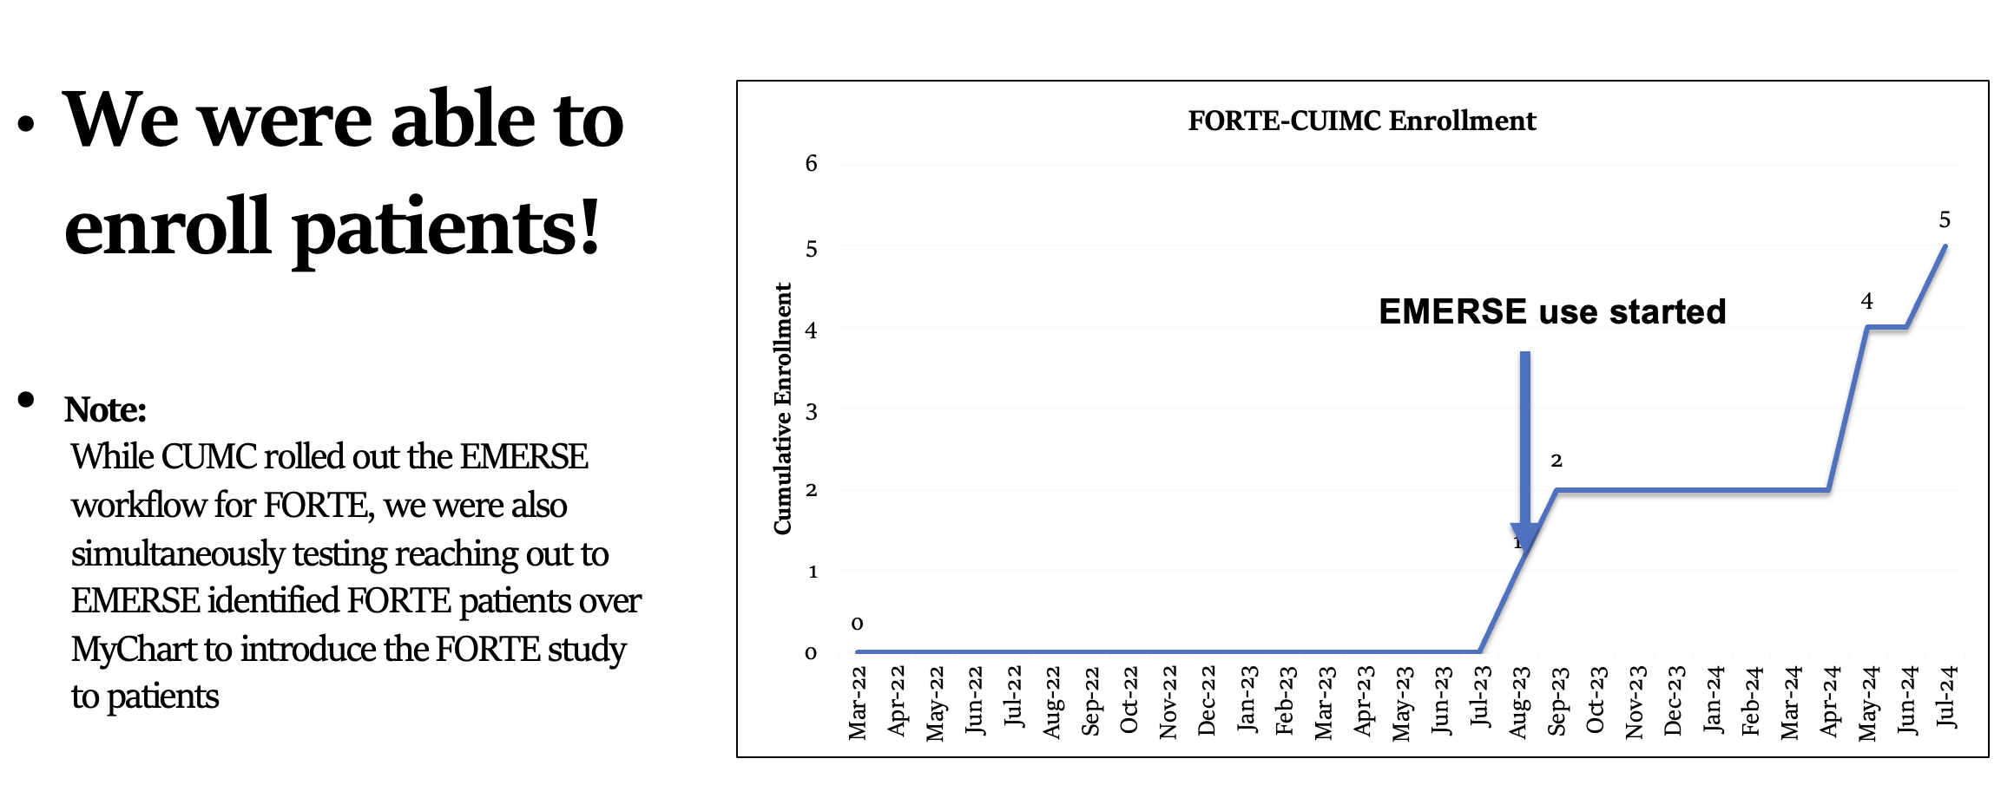
Enroll patients on trials
See this talk for more details:
https://vimeo.com/1084845123/
EMERSE Community Meeting May 2025
http://project-emerse.org/presentations.html

Slide 15
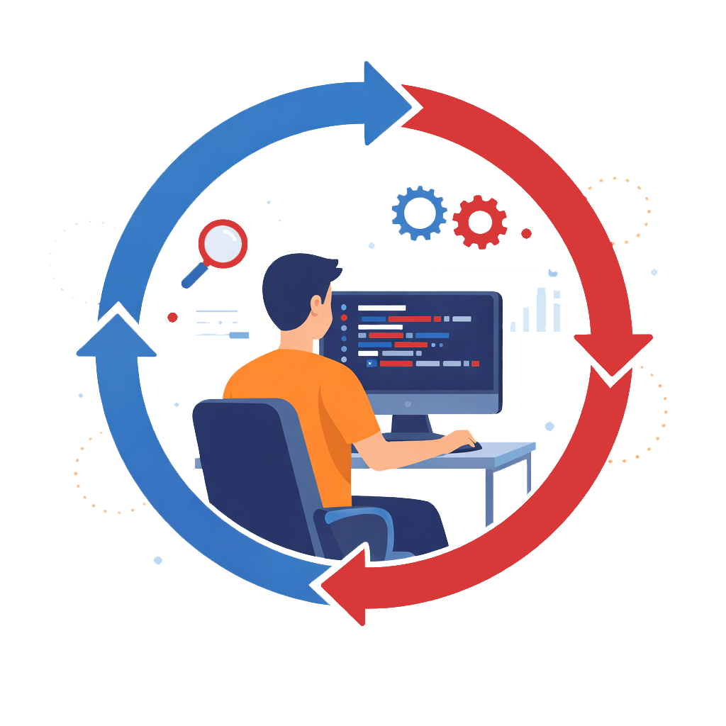
We keep the human-in-the-loop
http://project-emerse.org/presentations.html

Slide 16
Highlight documents for chart review
Thoracocentesis confirmed the recurrence of mantle cell lymphoma. Disease restaging work-up revealed multicompartment lymphadenopathy in the neck, mediastinal, retrocrural, retroperitoneal and pelvic regions. Bone marrow was also involved. The patient was treated with a total of six cycles of rituximab, cyclophosphamide, vincristine, doxorubicin and dexamethasone (R-HyperCVAD) completed in January 2007. That treatment led to complete remission that lasted until October 2008, when the disease was found to have recurred in the left pleural space and retroperitoneum without bone marrow involvement.
https://jmedicalcasereports.biomedcentral.com/articles/10.1186/1752-1947-4-329
http://project-emerse.org/presentations.html

Slide 17

EMERSE is fast
Query to identify all patients with the following | Reporting DB time (s) | EMERSE time (s) | EMERSE advantage
cavernous hemangioma | 14,652 | 2 | 7,320x
gray platelet syndrome | 14,940 | 2 | 7,470x
inferior lingular segment of the left upper lobe | 17,784 | 9 | 1,980x
…enabling real-time querying
http://project-emerse.org/presentations.html

Slide 18
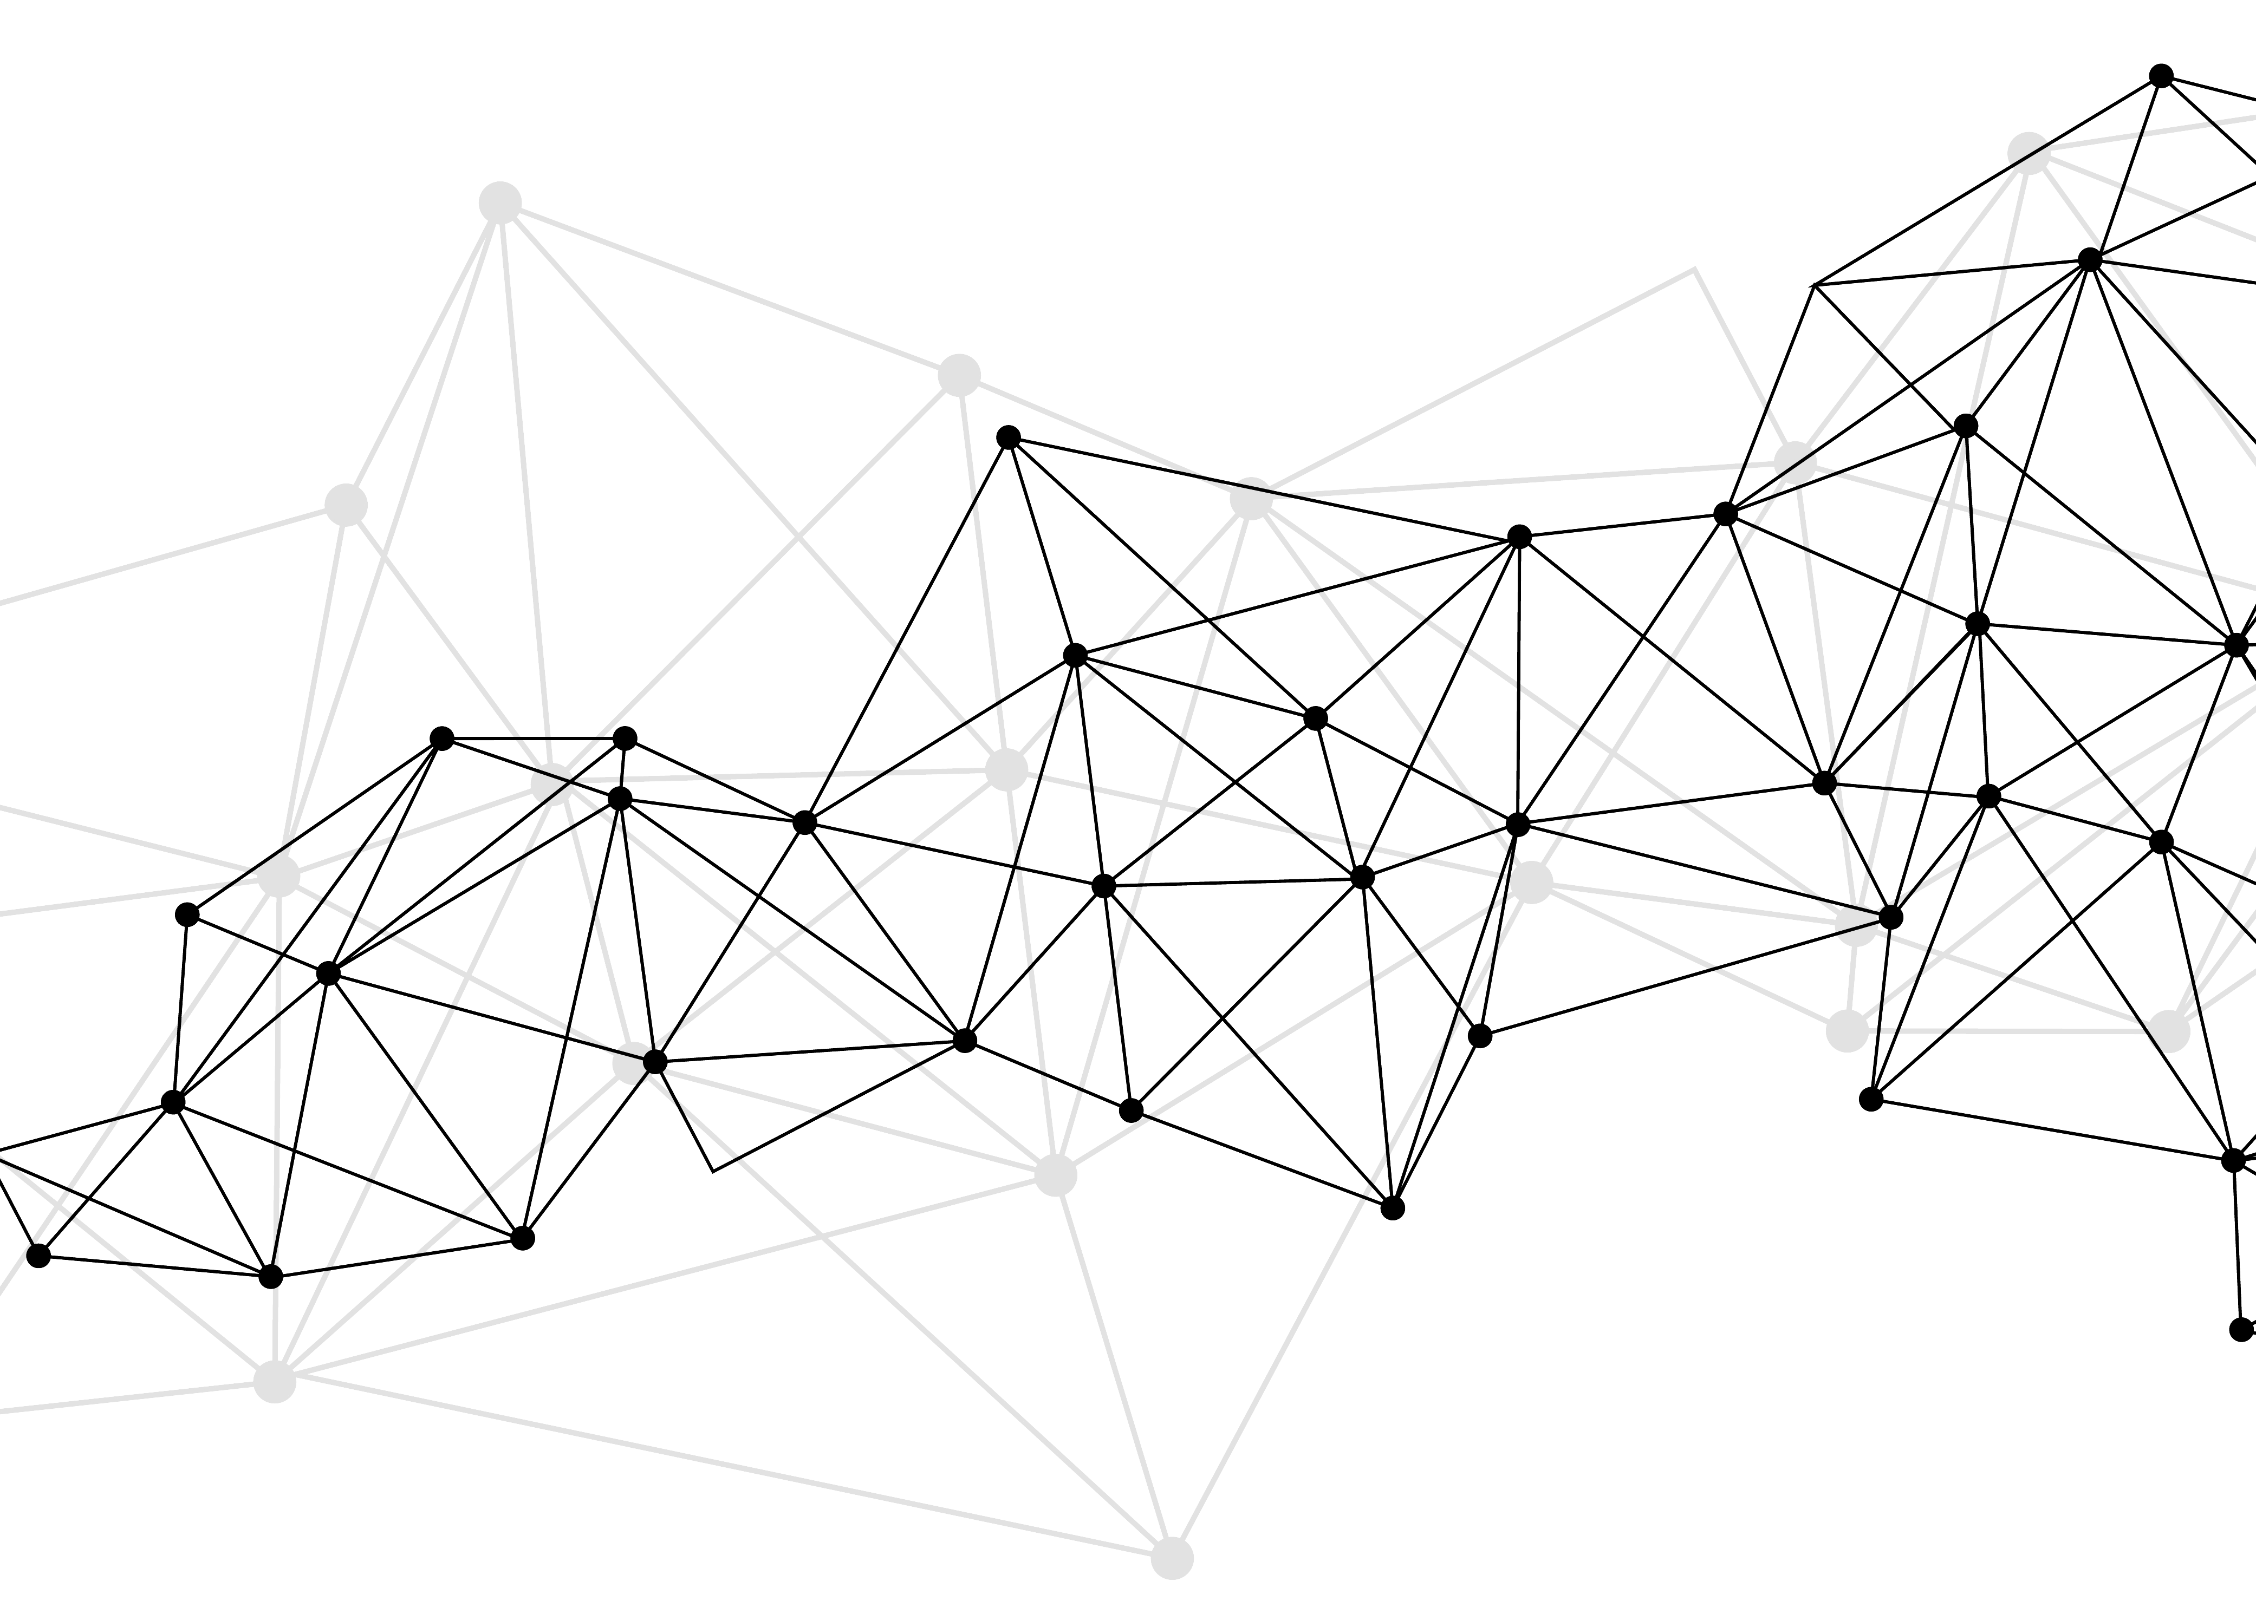
Synonyms
Used for query expansions
User-controlled
Multiple datasets can be included
EMERSE Synonyms
acronyms, abbreviations, professional/consumer terms, misspellings, trade/generic drug names, species, chemo regimens, phrase variations, malapropisms, idioms, neologisms, organizations, companies, & more
3 million unique entries
http://project-emerse.org/presentations.html

Slide 19
Typical workflow
initial cohort identified
with a cohort discovery
tool using structured data (or via EMERSE
‘Find Patients’)
Cohort discovery tools:
i2b2/ENACT, Leaf, etc.
http://project-emerse.org/presentations.html

Slide 20
Typical workflow
additional details abstracted from the free text using EMERSE
http://project-emerse.org/presentations.html

Slide 21
Typical workflow
Data recorded in an electronic data capture system (e.g., REDCap)
http://project-emerse.org/presentations.html

Slide 22

Publications using EMERSE
745
papers and abstracts
Full list at:
http://project-emerse.org/publications.html
http://project-emerse.org/presentations.html

Slide 23

Demo
No real names
No PHI
Publicly available
Abstracts & case reports
http://project-emerse.org/presentations.html

Slide 24
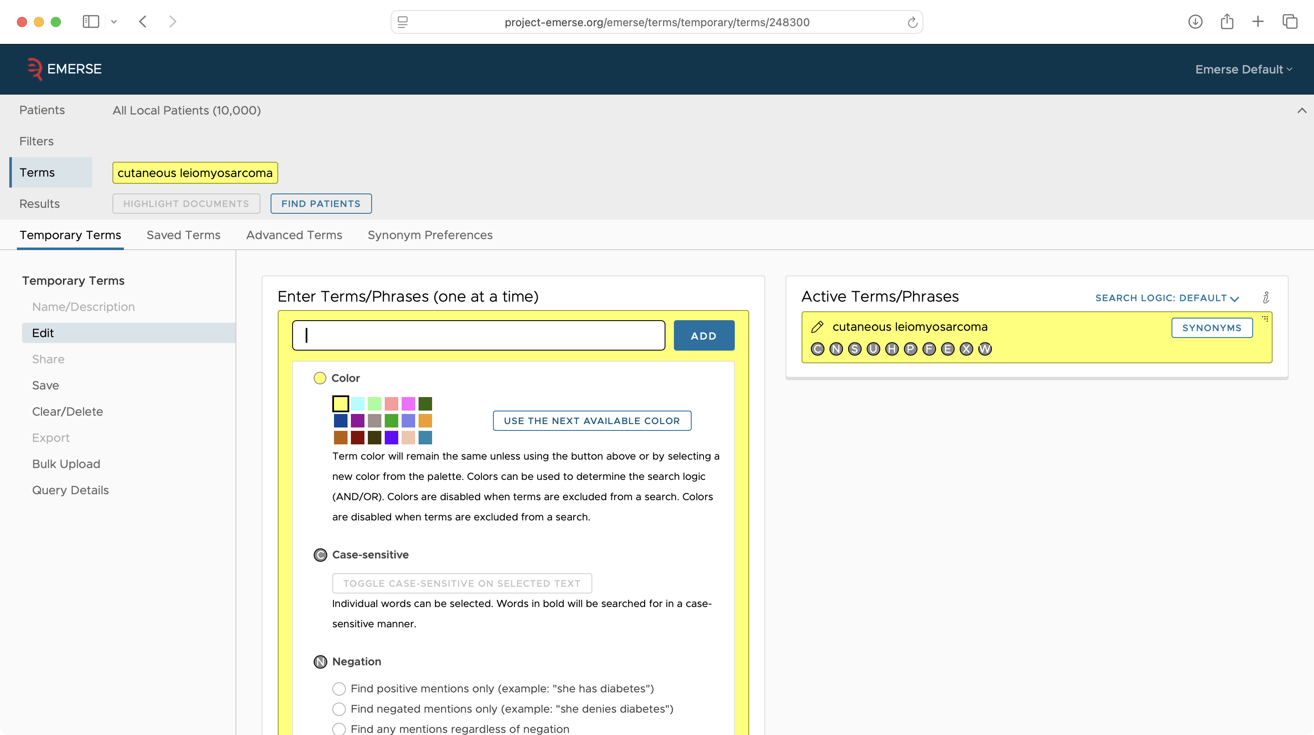

Slide 25
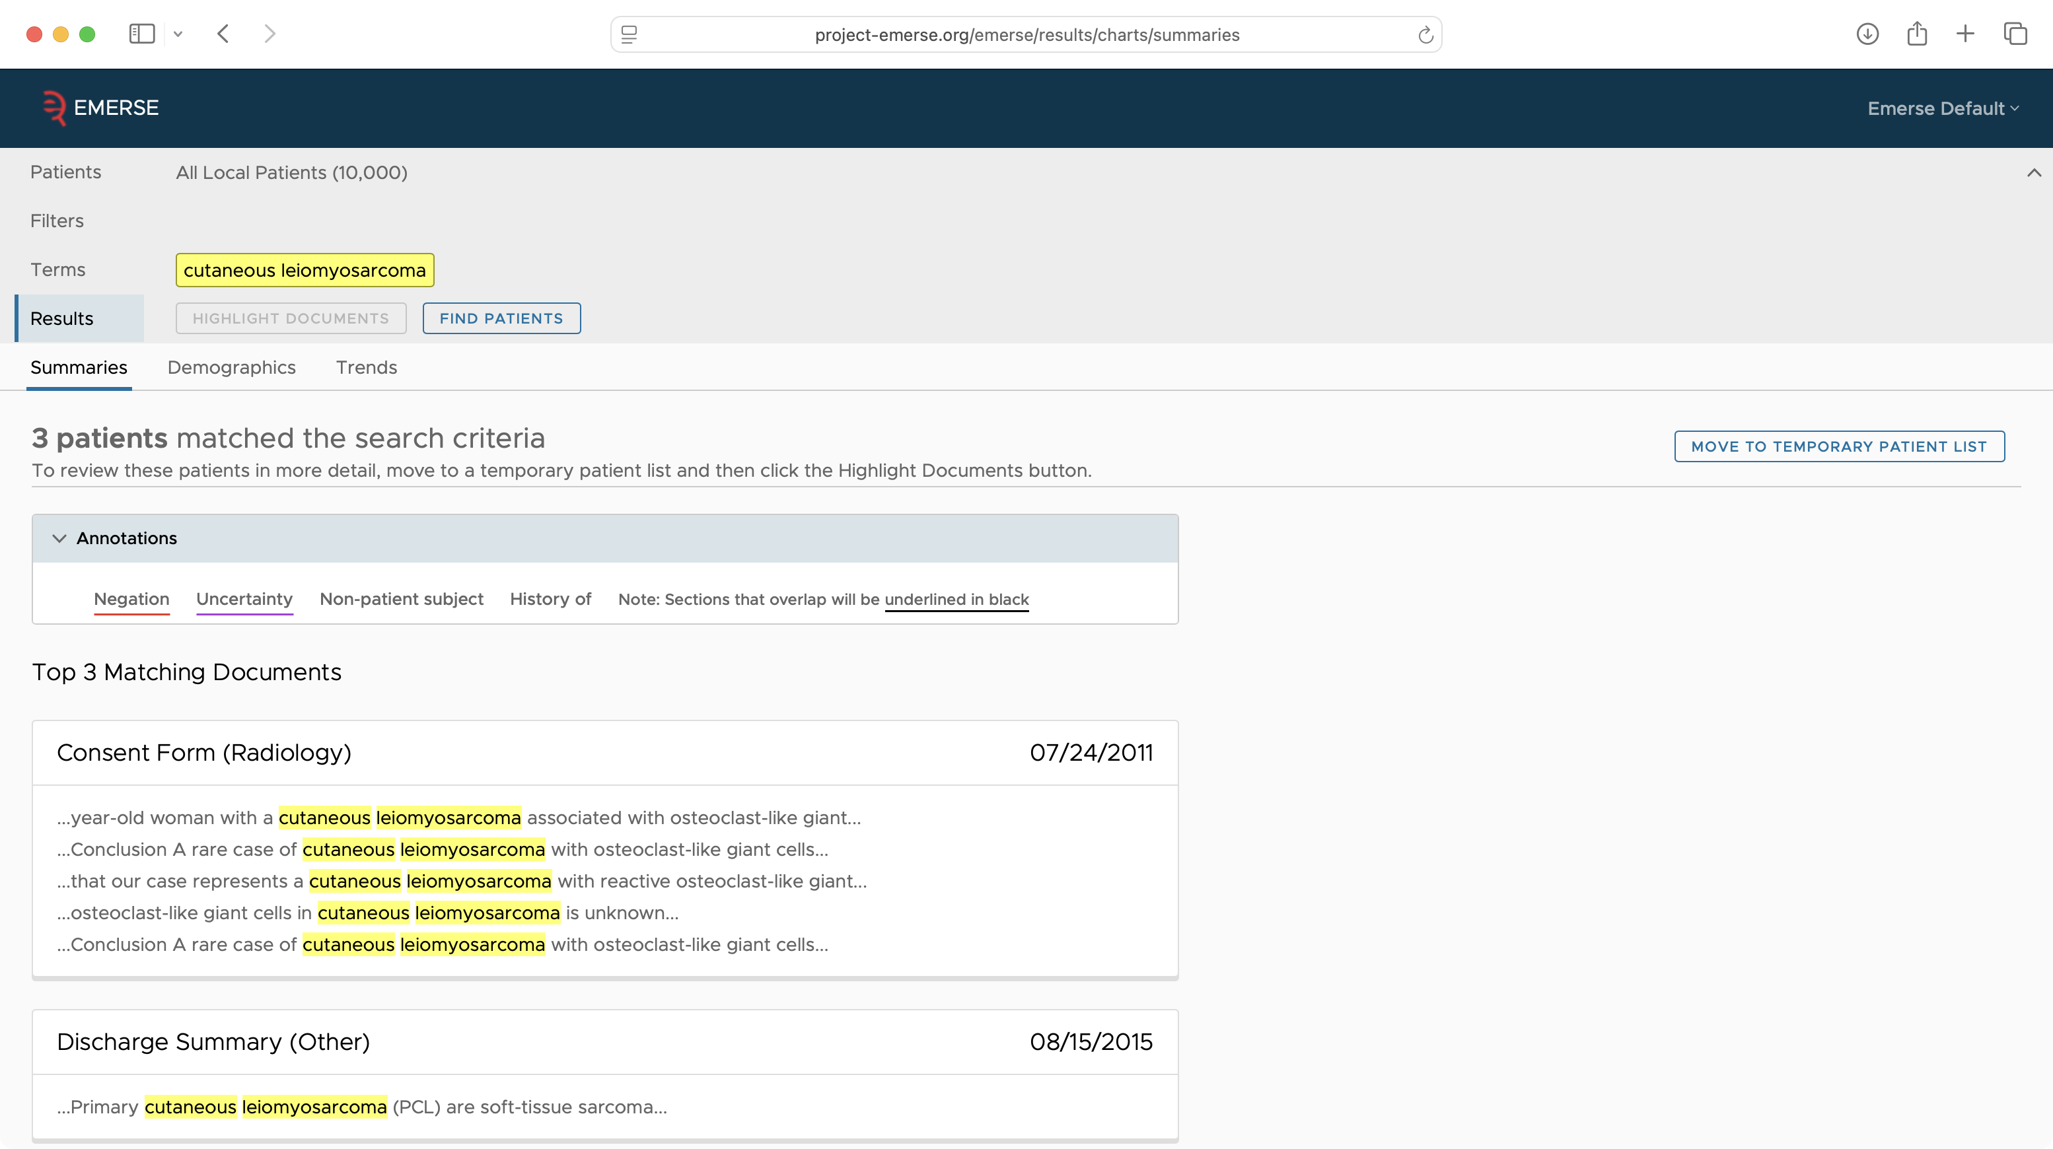

Slide 26
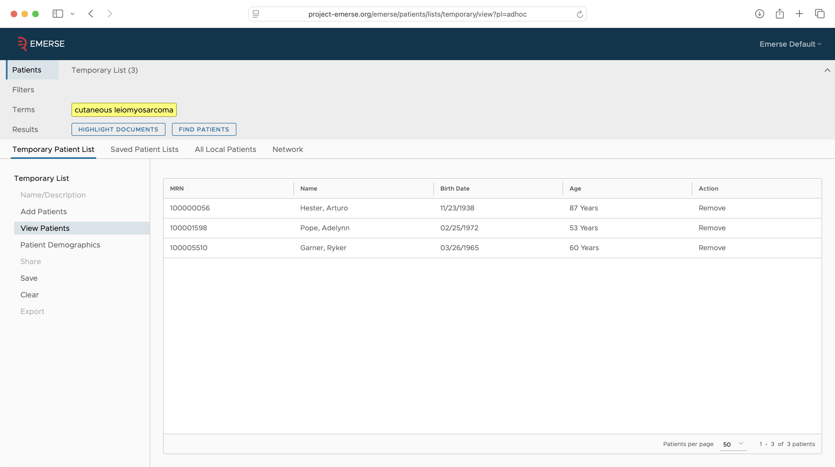

Slide 27
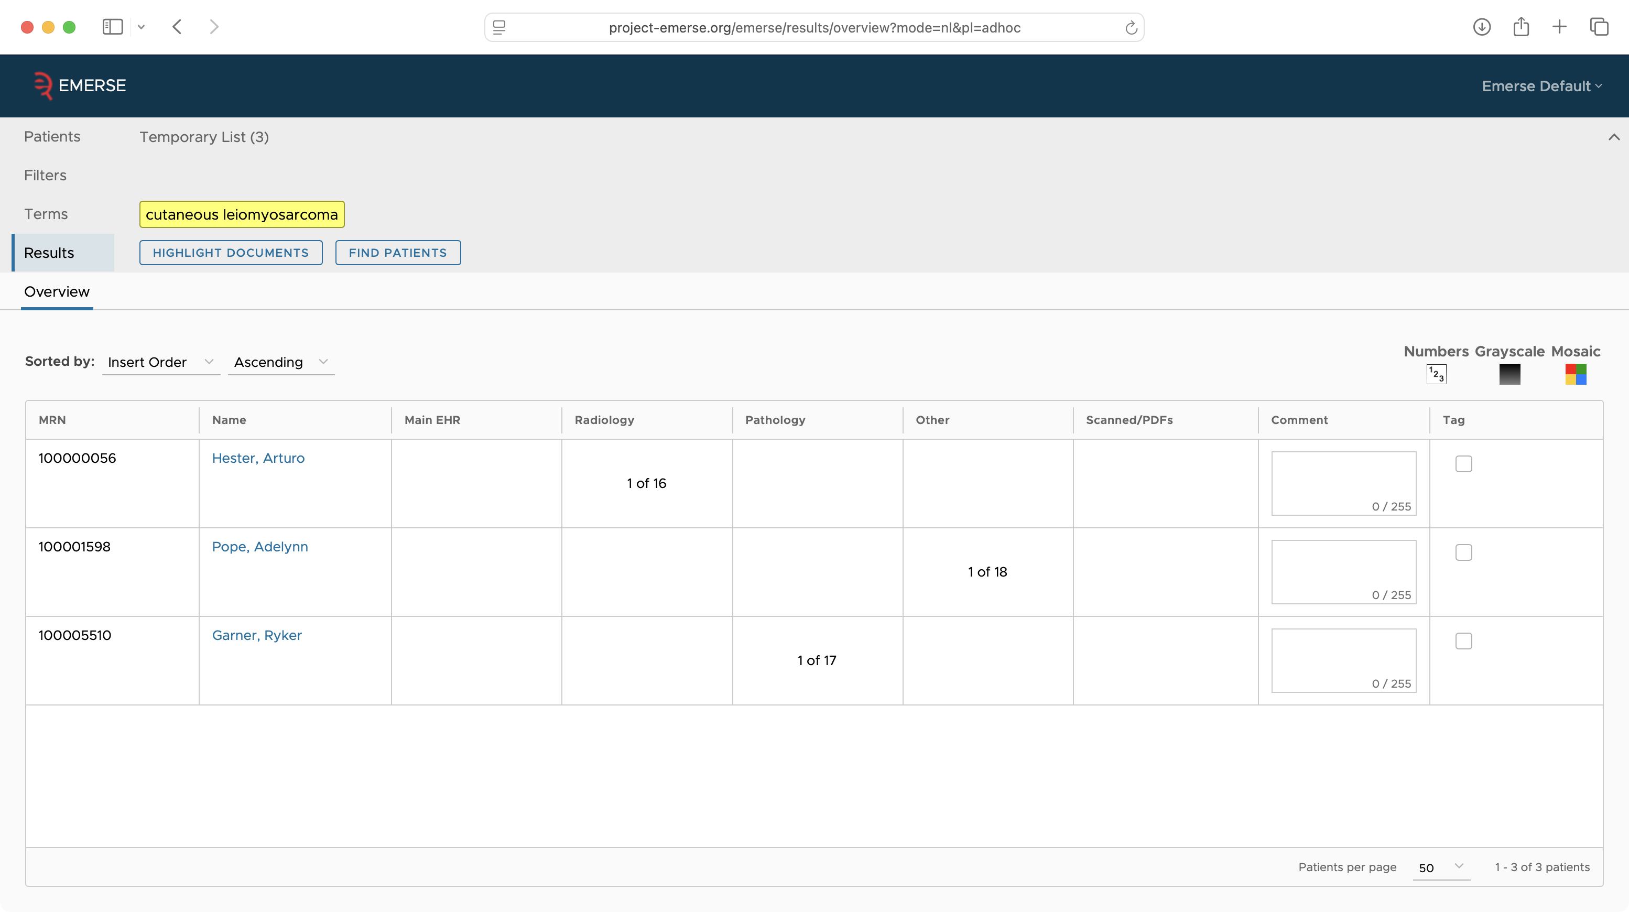

Slide 28
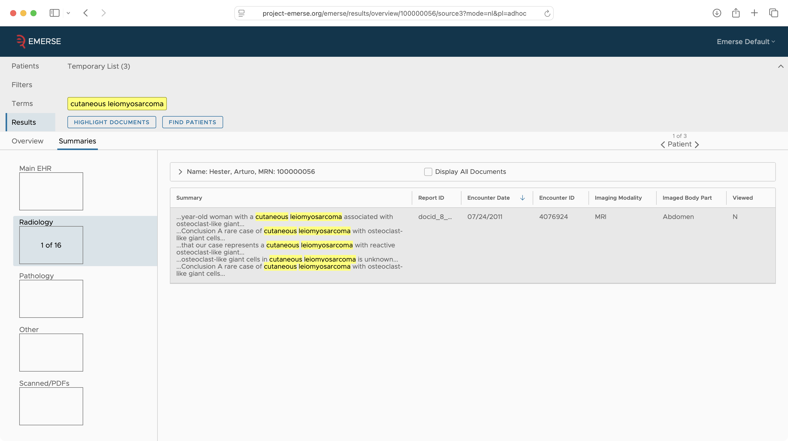

Slide 29
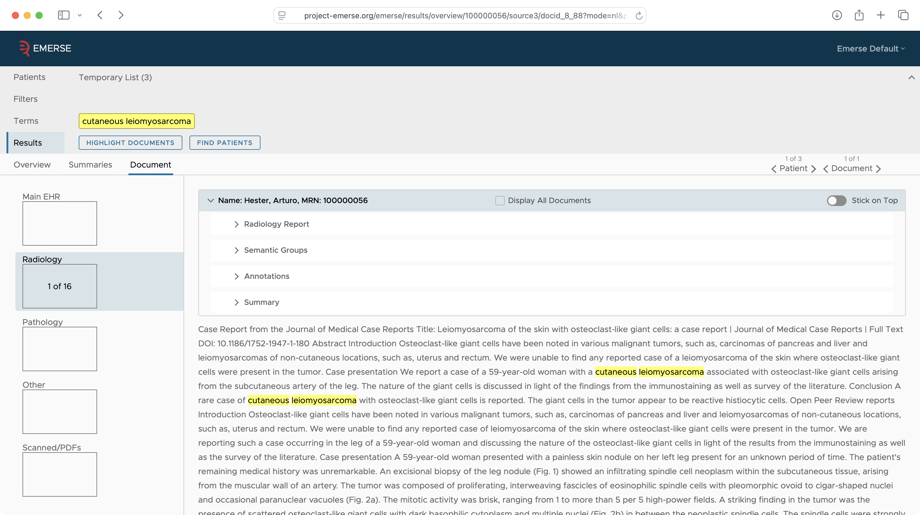

Slide 30
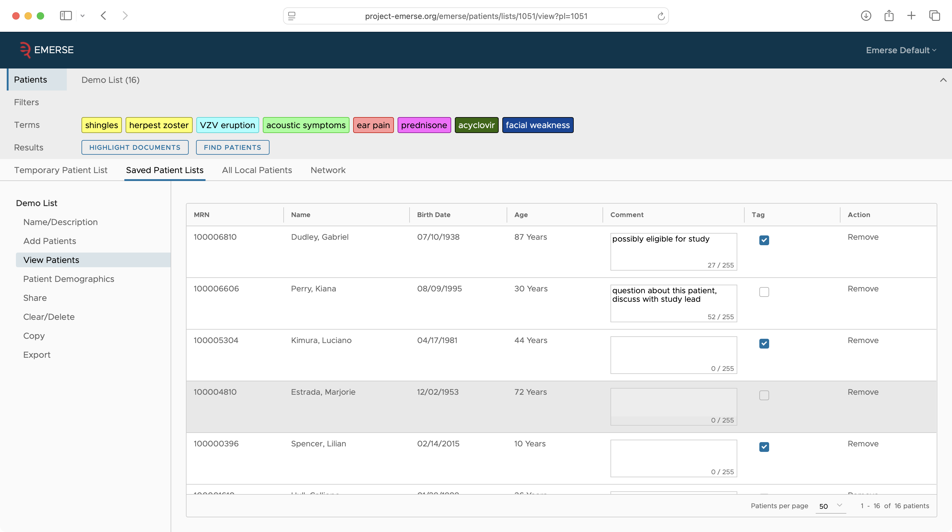

Slide 31
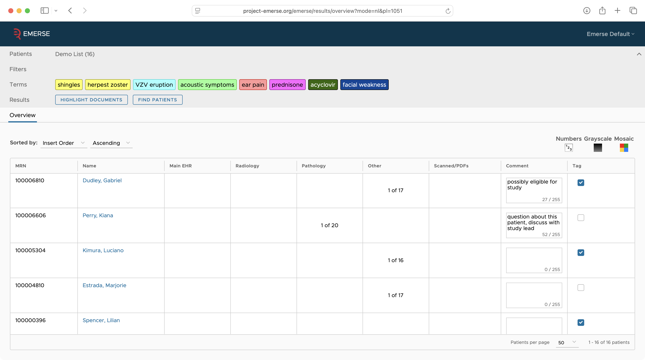

Slide 32
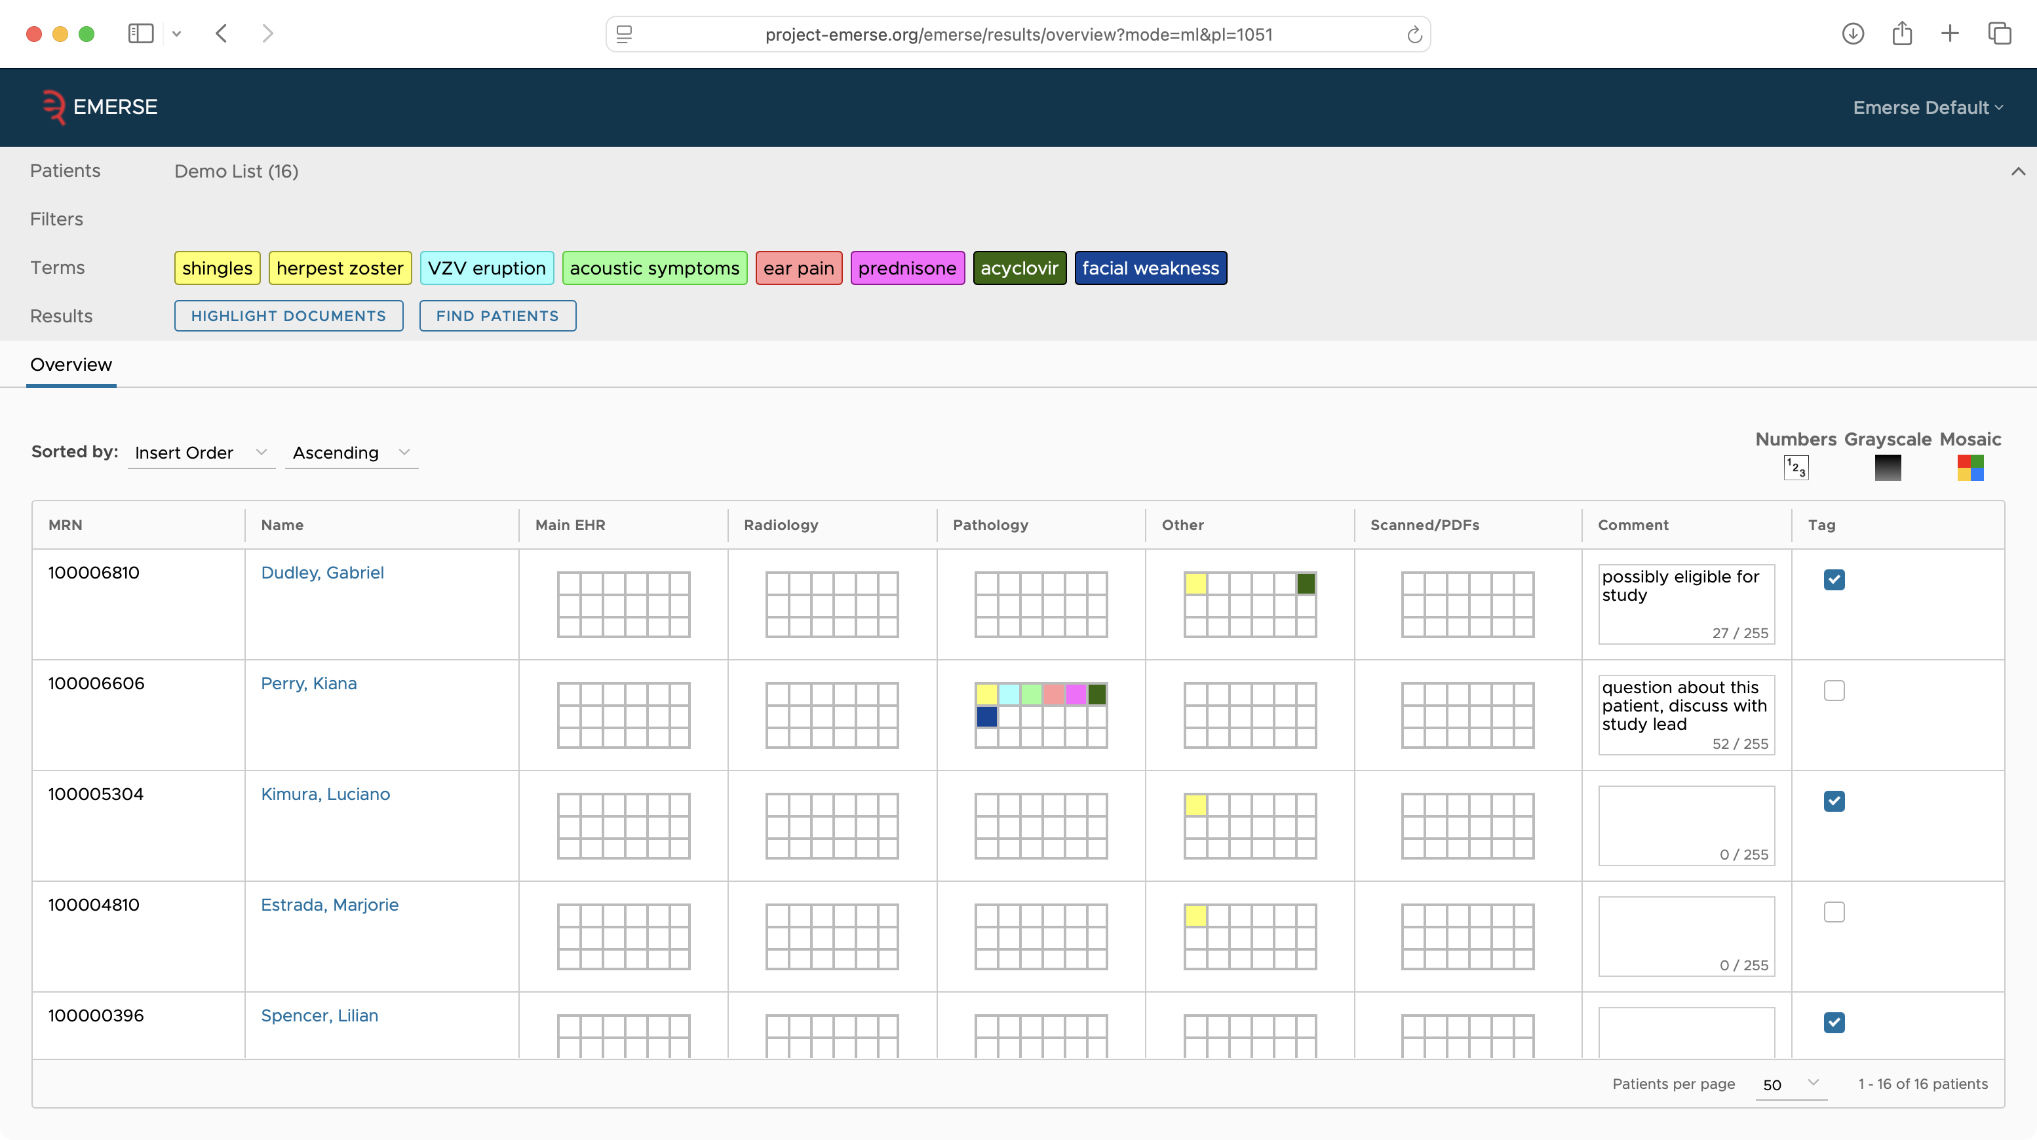

Slide 33
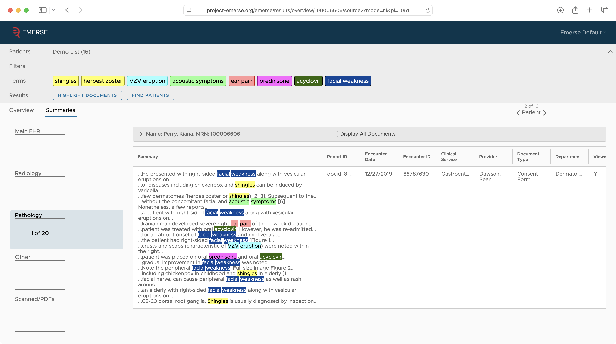

Slide 34
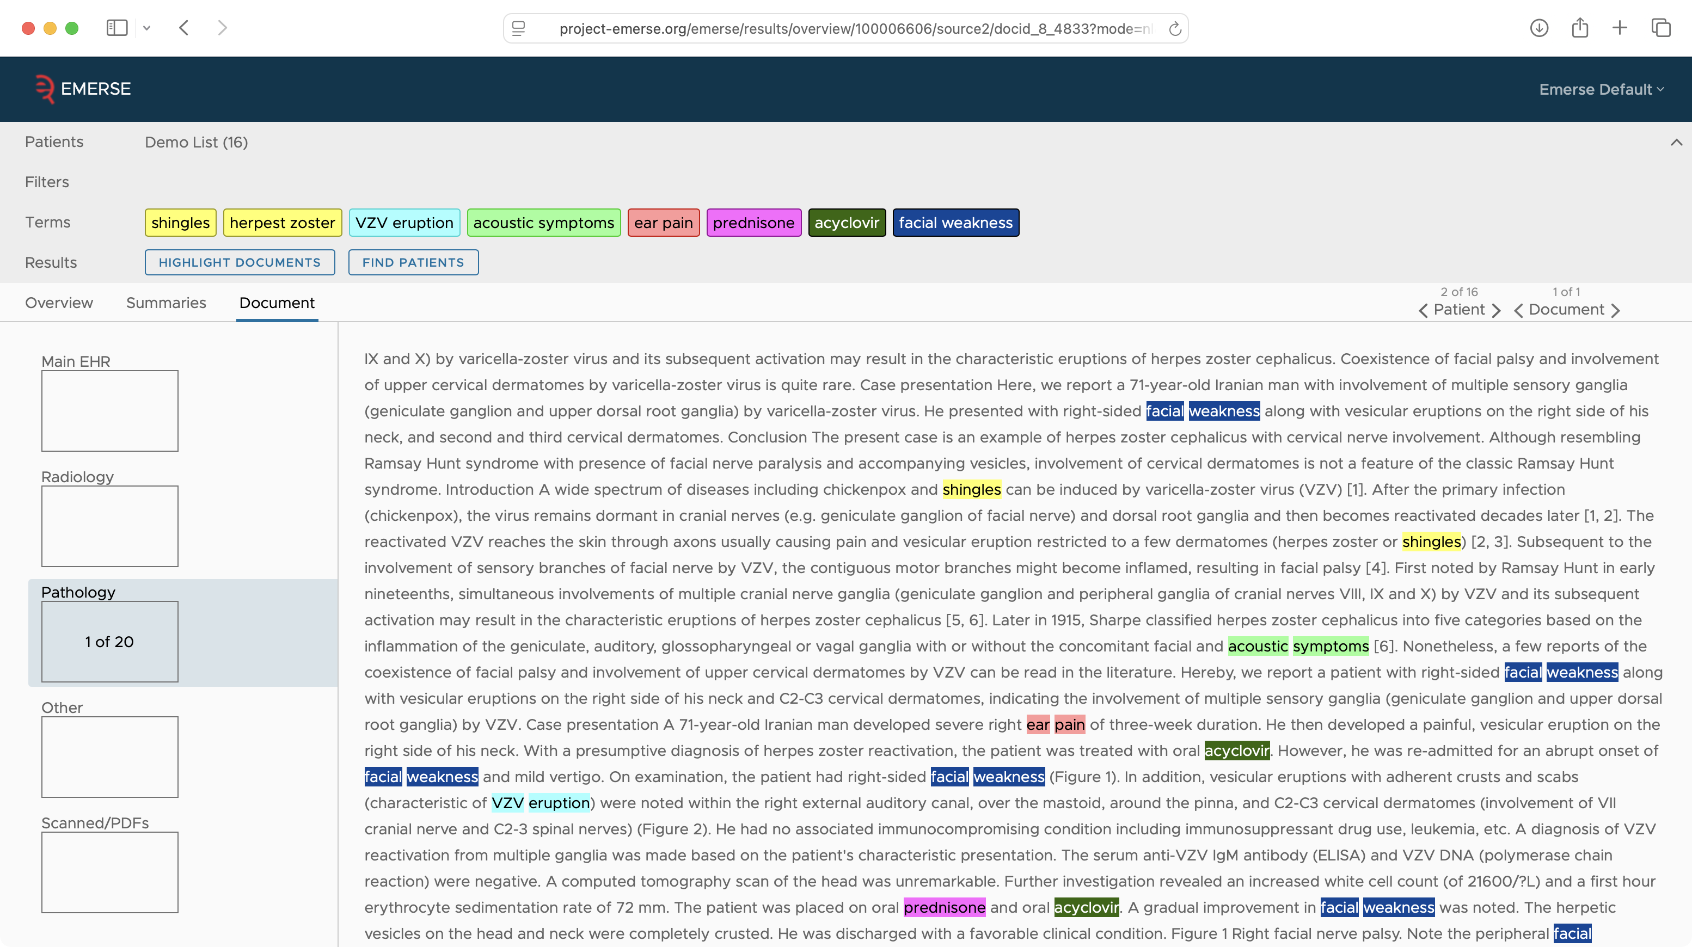

Slide 35
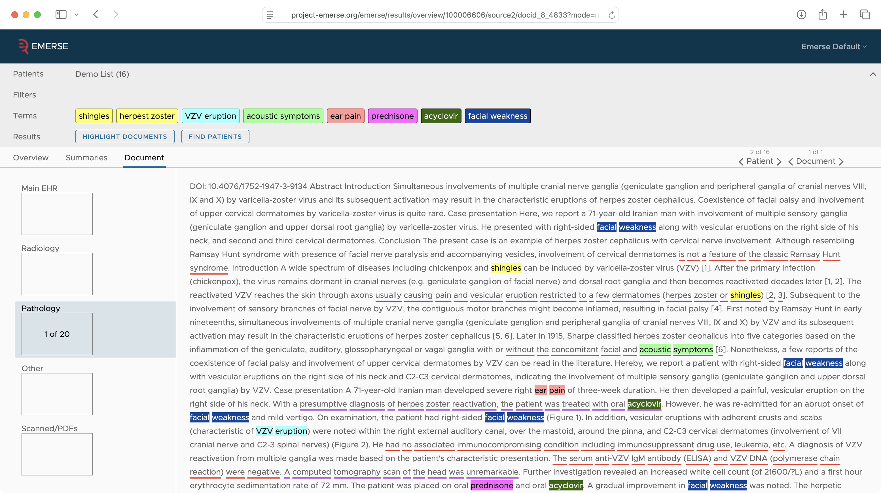

Slide 36
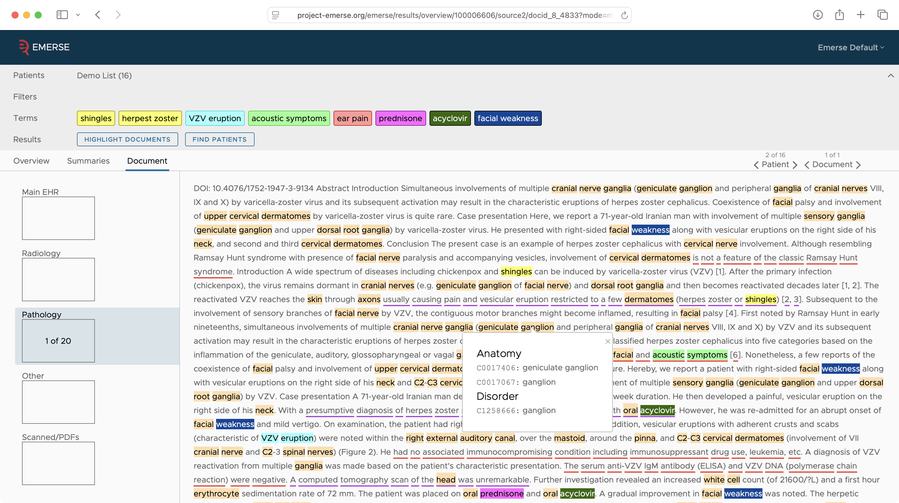

Slide 37
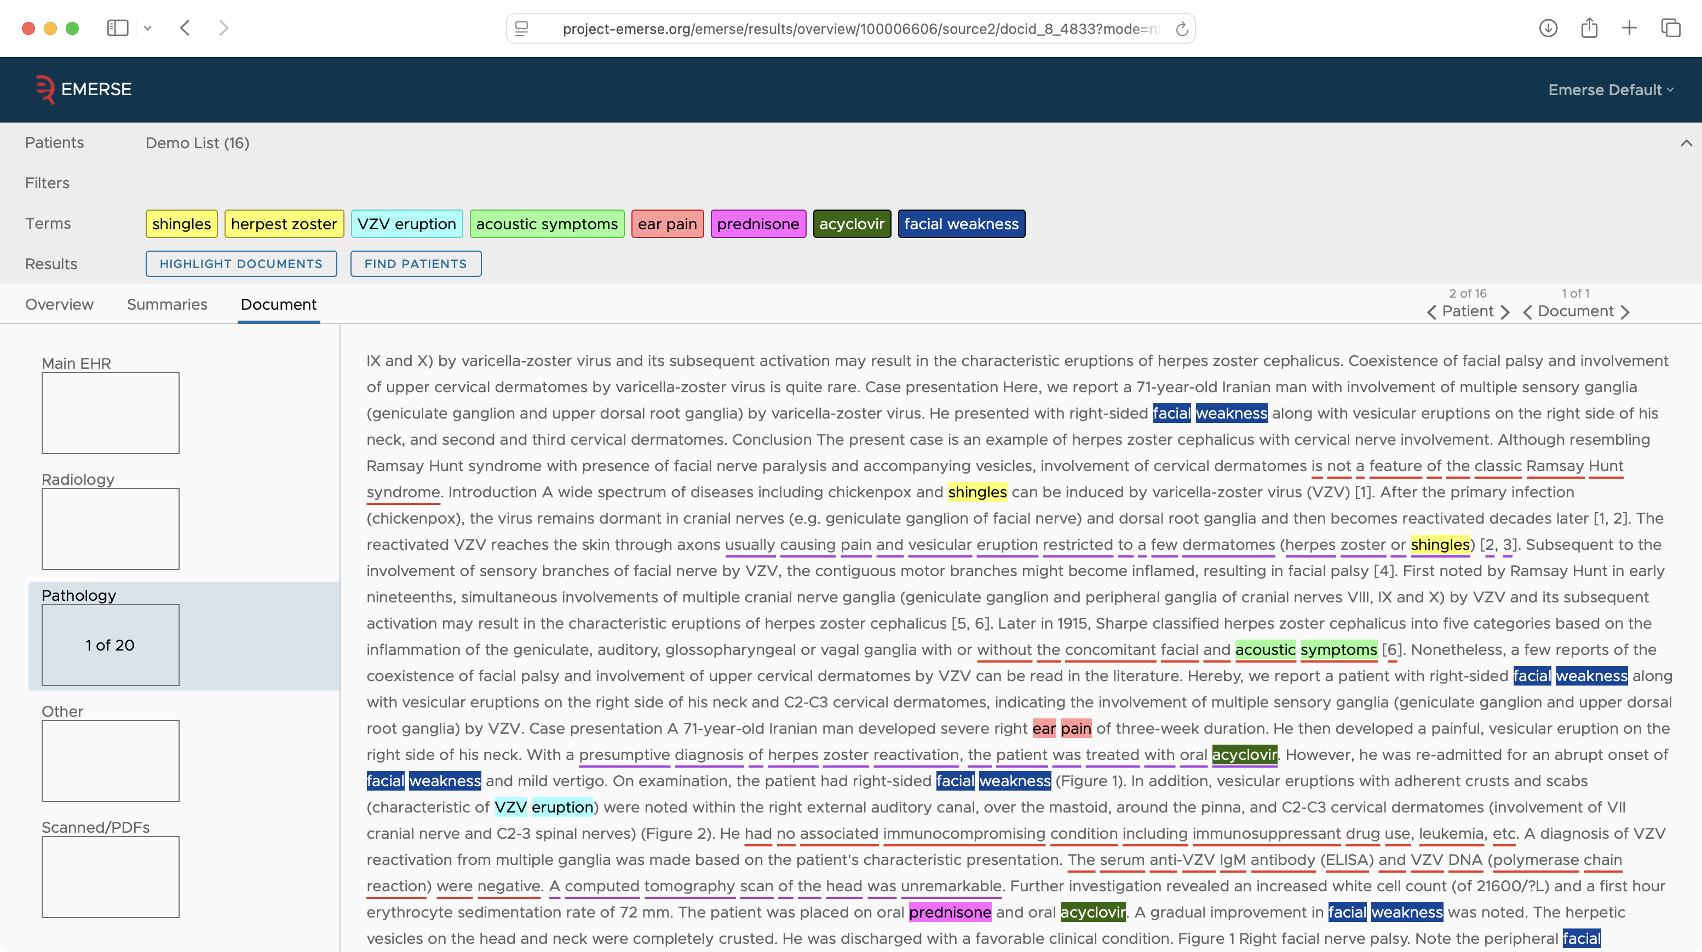

Slide 38
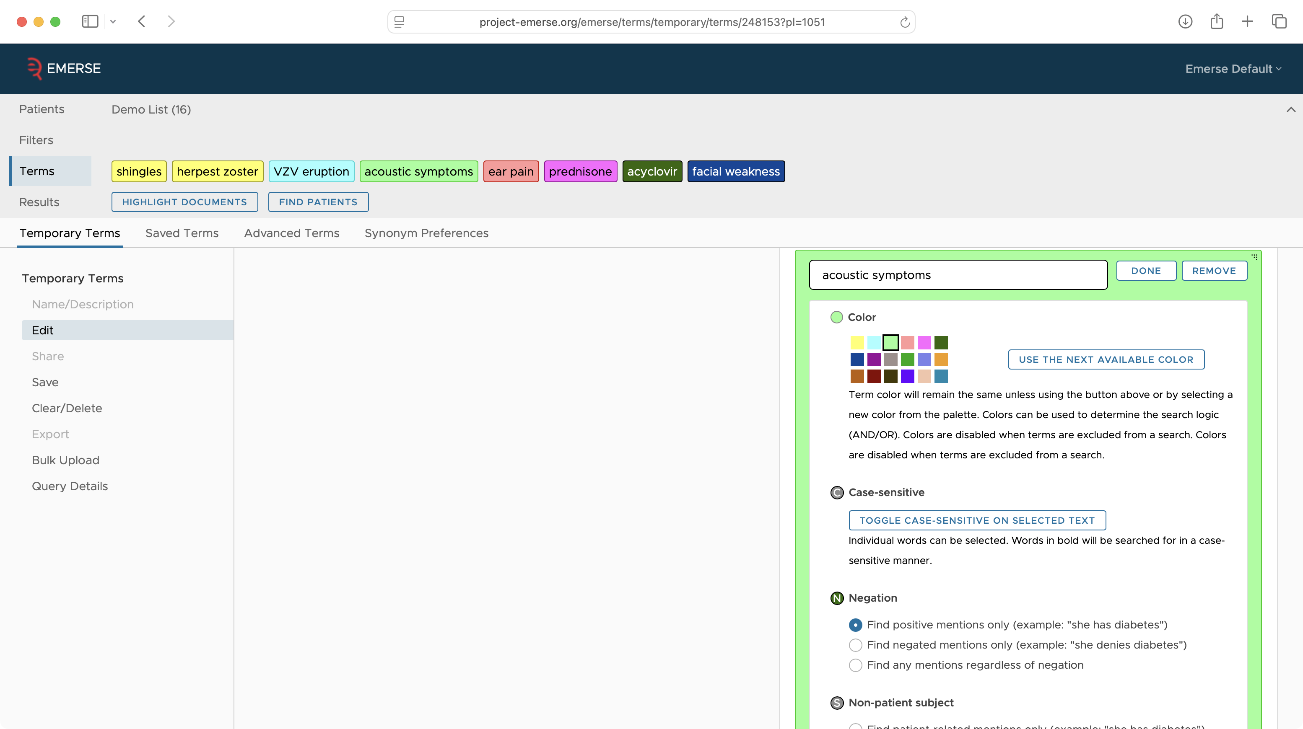

Slide 39
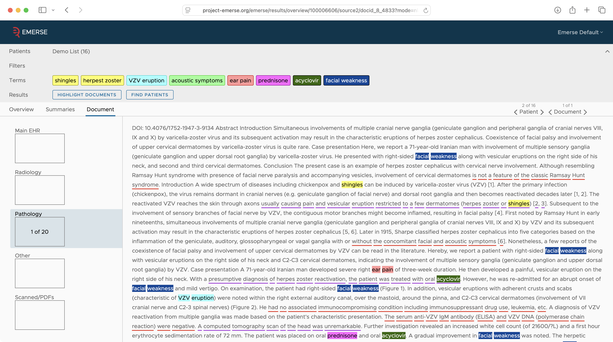

Slide 40
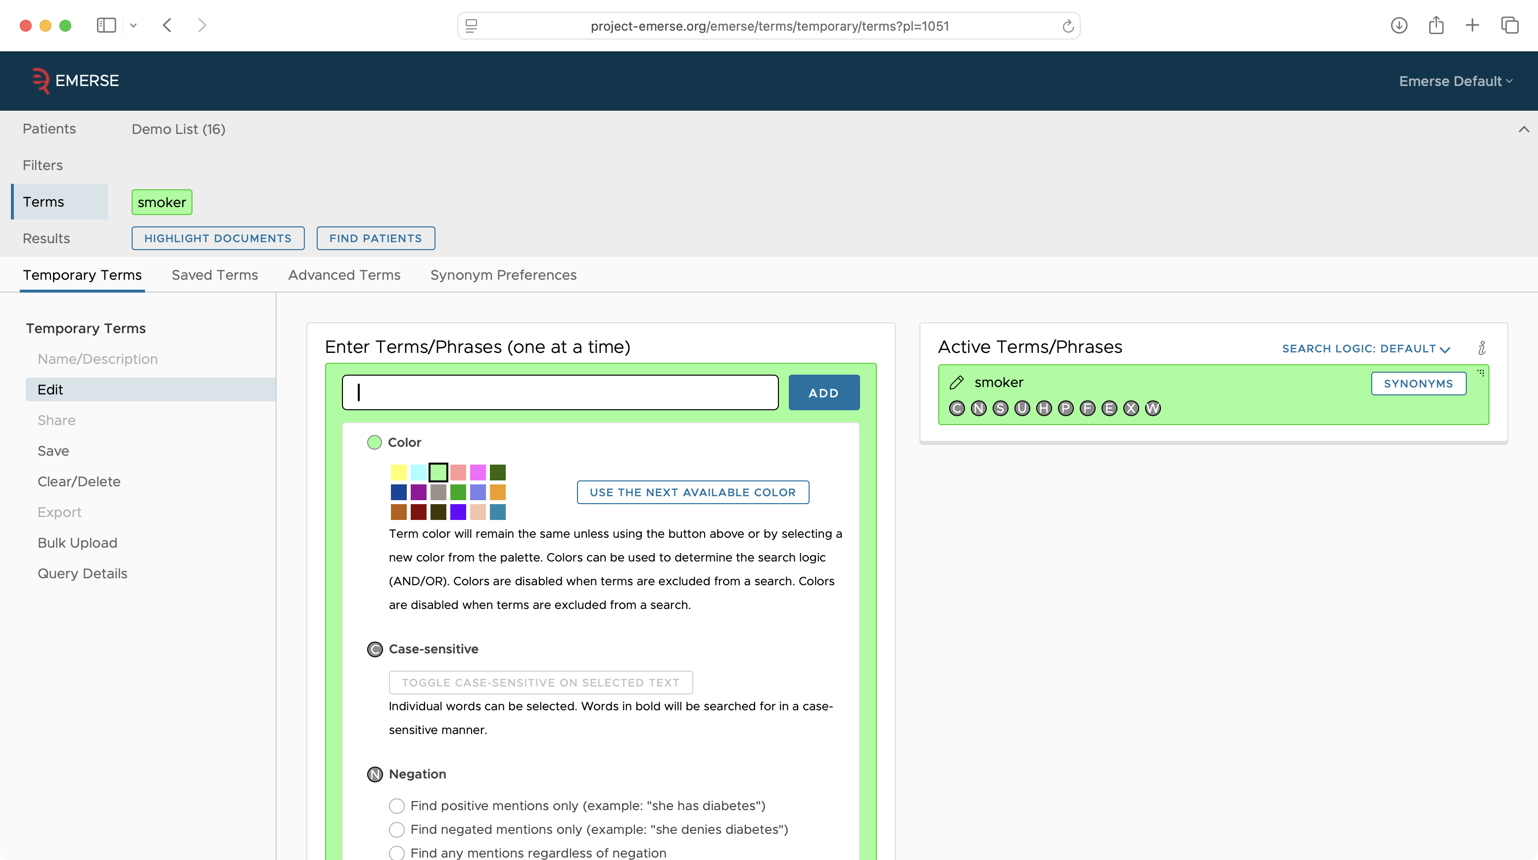

Slide 41
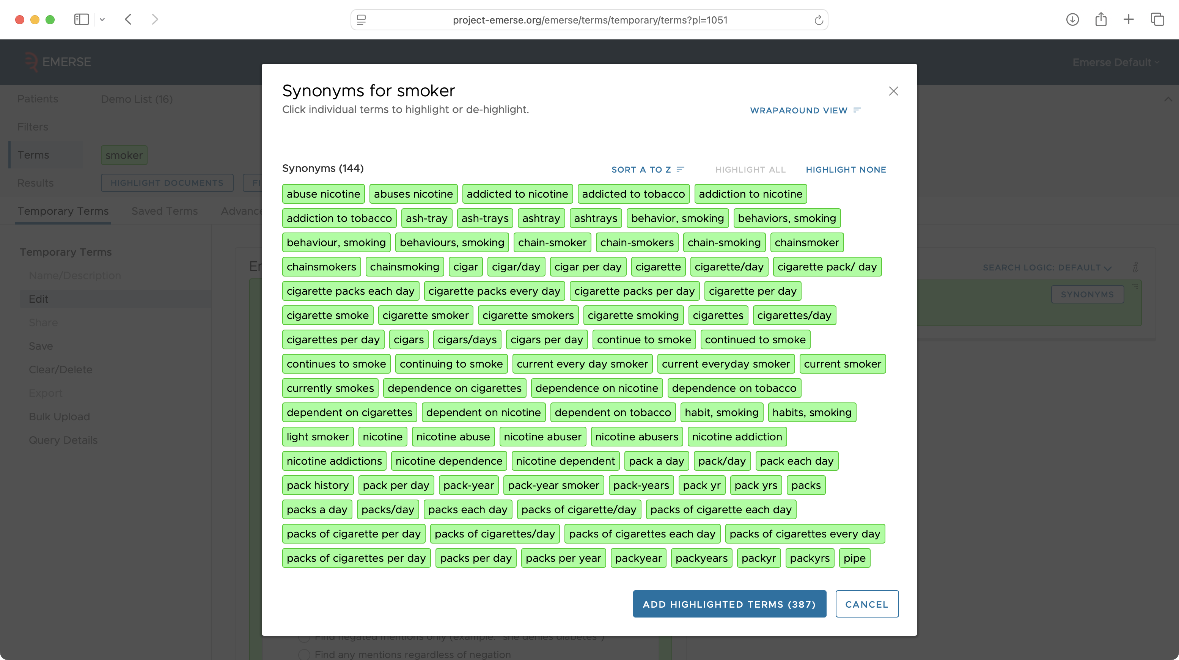

Slide 42
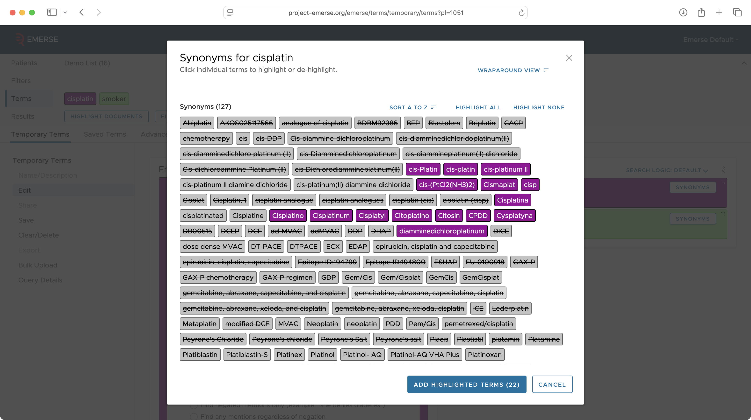

Slide 43
EMERSE has served the community for 20+ years–how do we ensure its future?
http://project-emerse.org/presentations.html

Slide 44

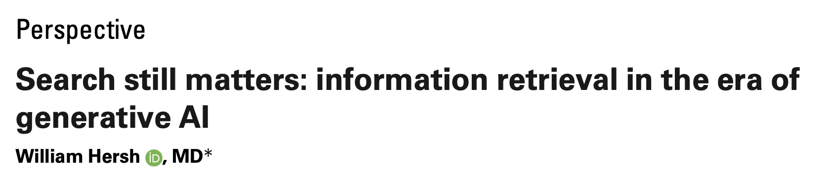
LLMs are changing how we work with text…do we even need search anymore?
Yes!
https://pmc.ncbi.nlm.nih.gov/articles/PMC11339511/pdf/ocae014.pdf
2024
http://project-emerse.org/presentations.html

Slide 45
Our plans
Leverage the platform we have already built
security model (roles, privileges, auditing)
simple review of medical records
existing rapid retrieval index of clinical notes
simple user interface for researchers
Extend the capabilities with LLMs in various areas of the application
Securely integrate with LLMs
http://project-emerse.org/presentations.html

Slide 46
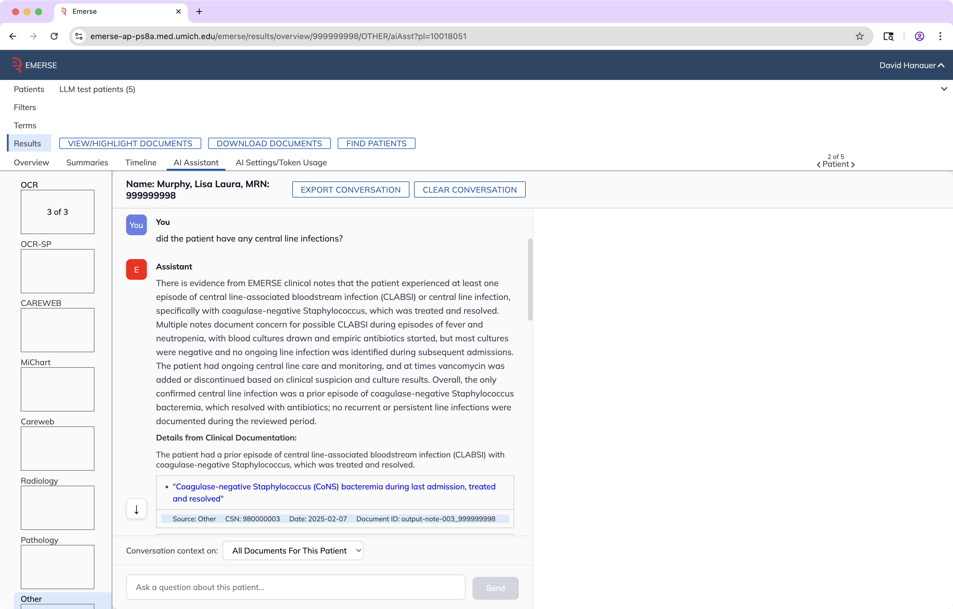
Chat with the notes

Slide 47
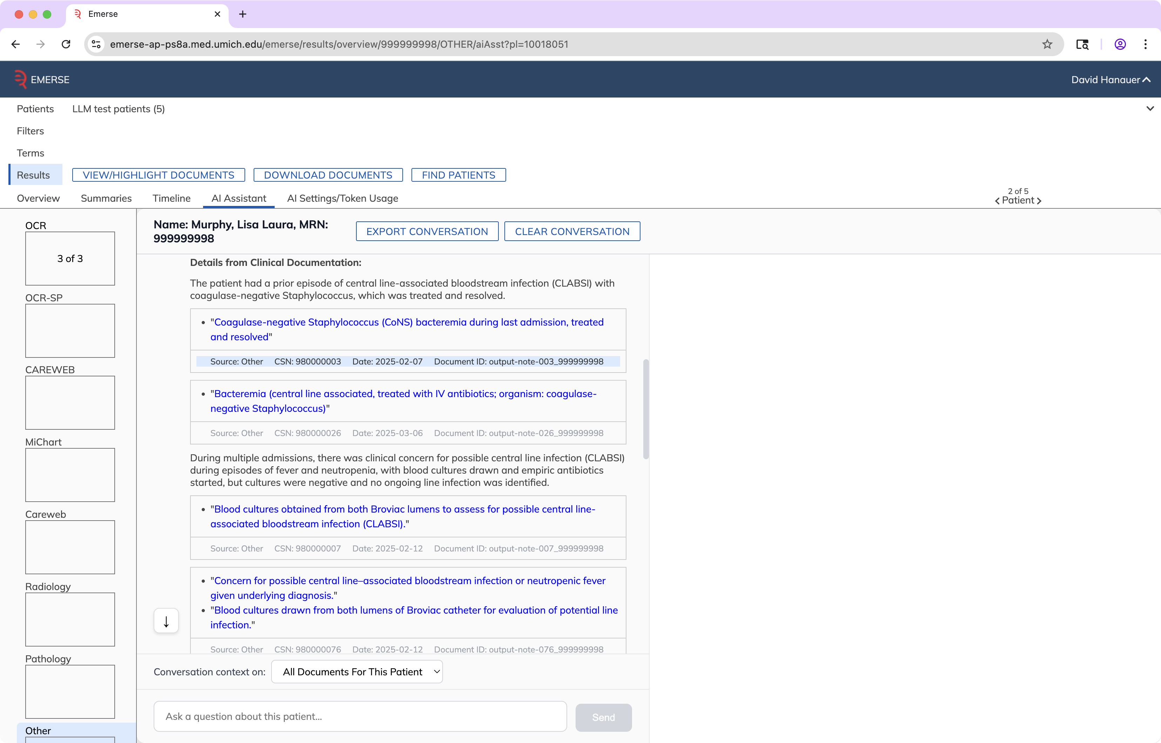

Slide 48
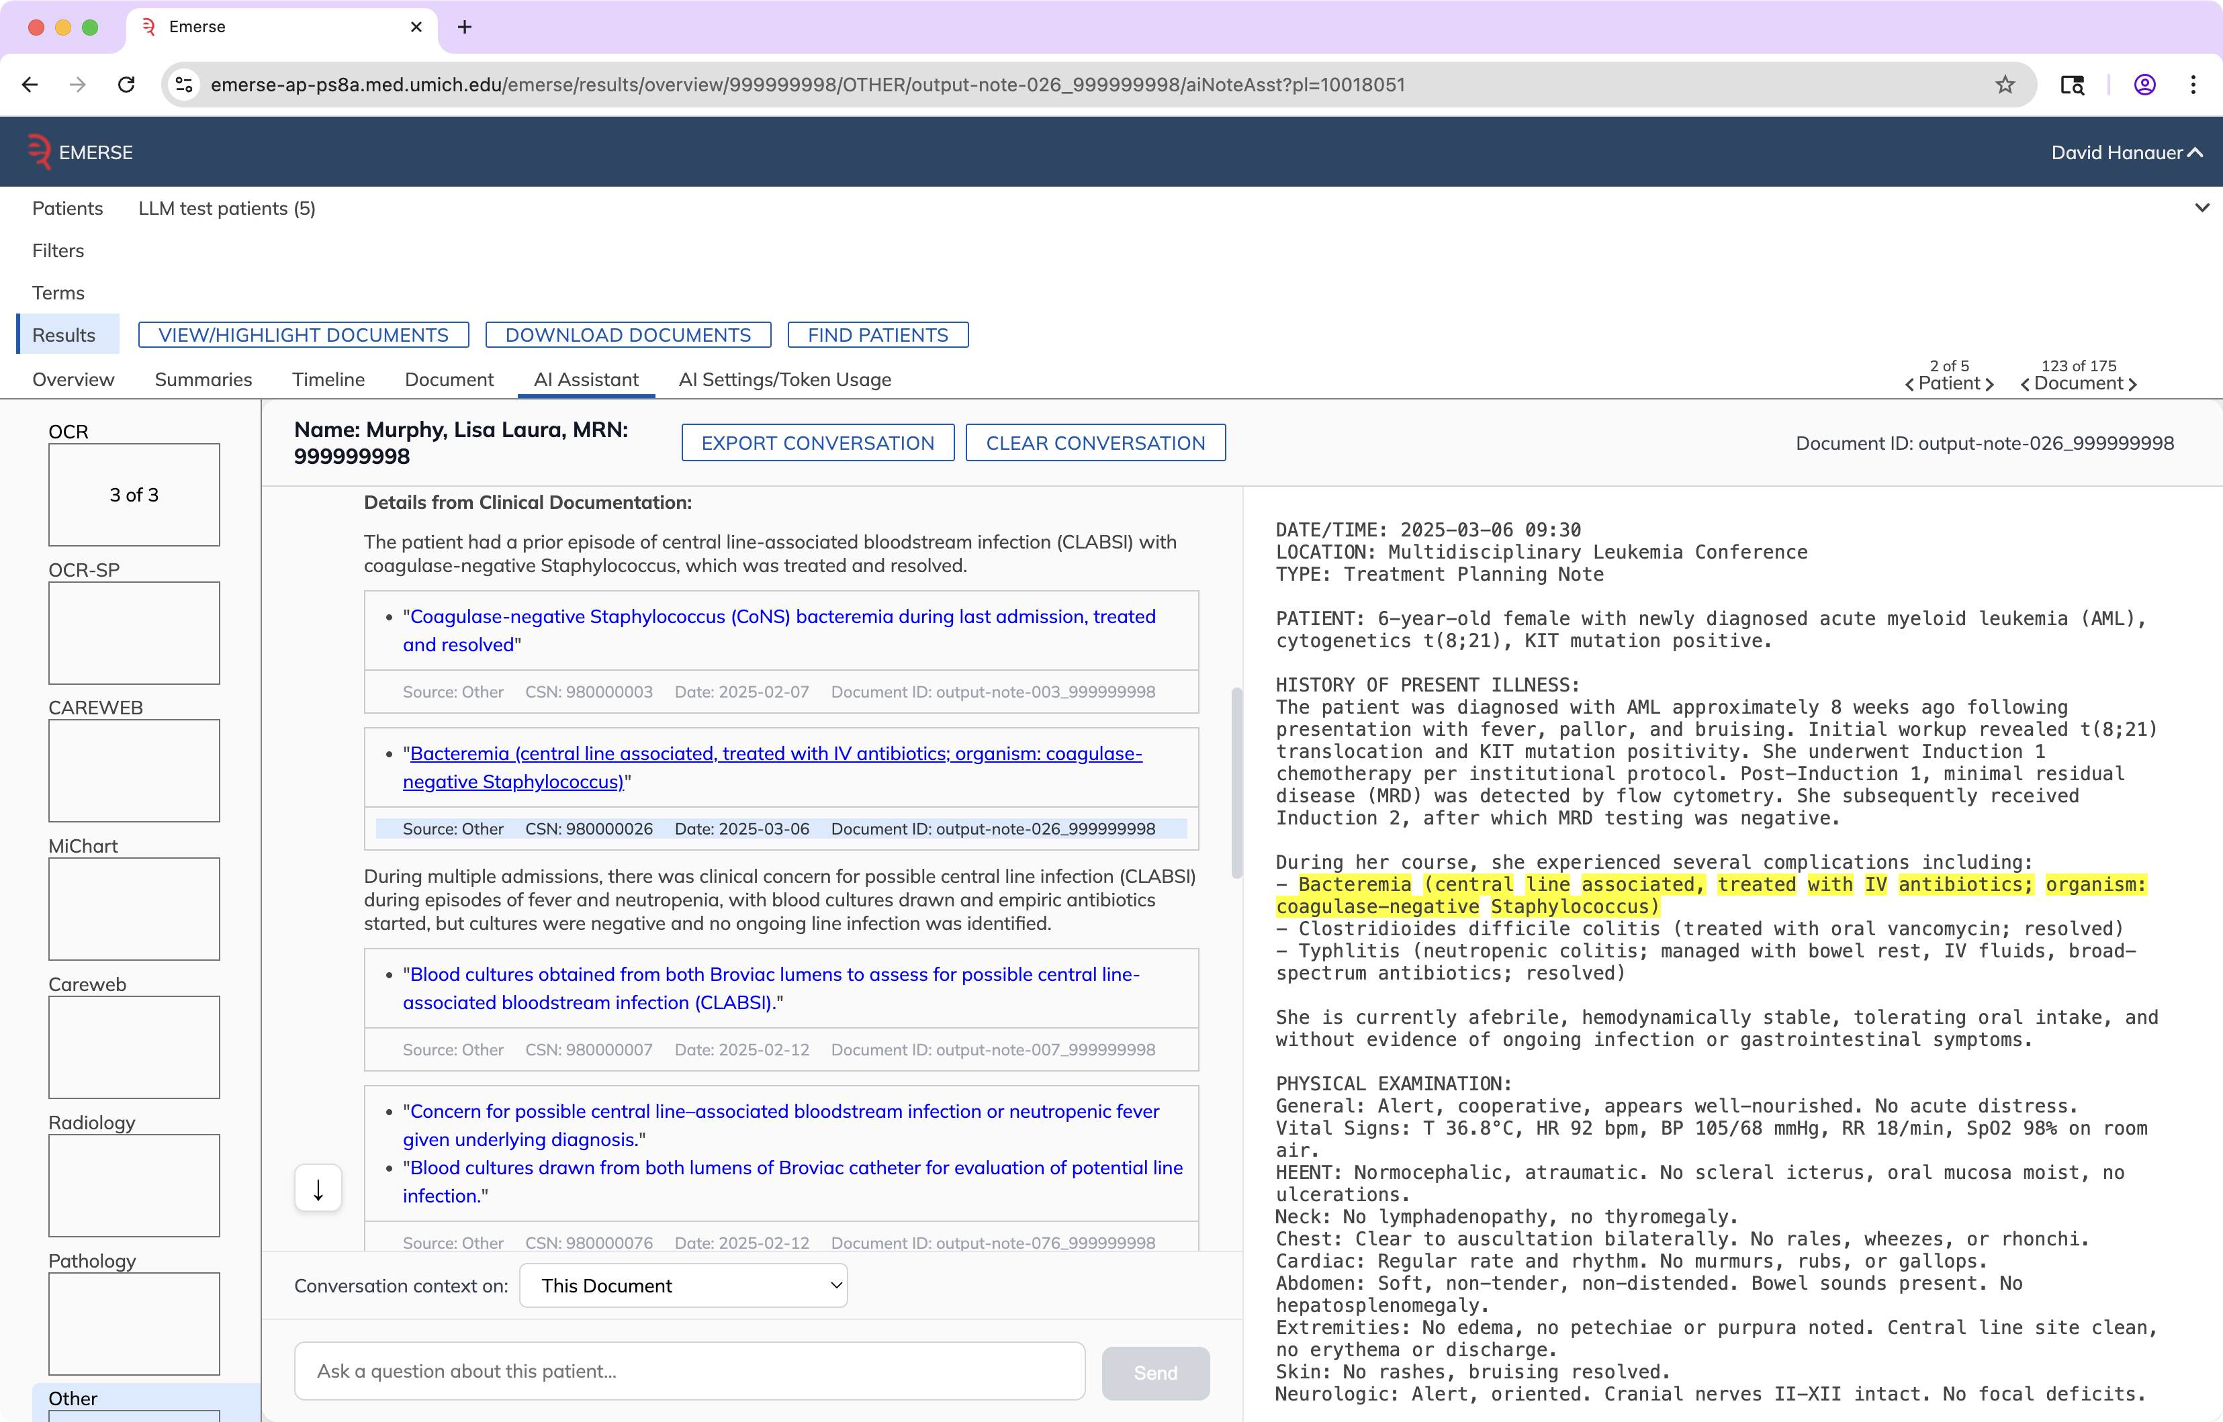

Slide 49
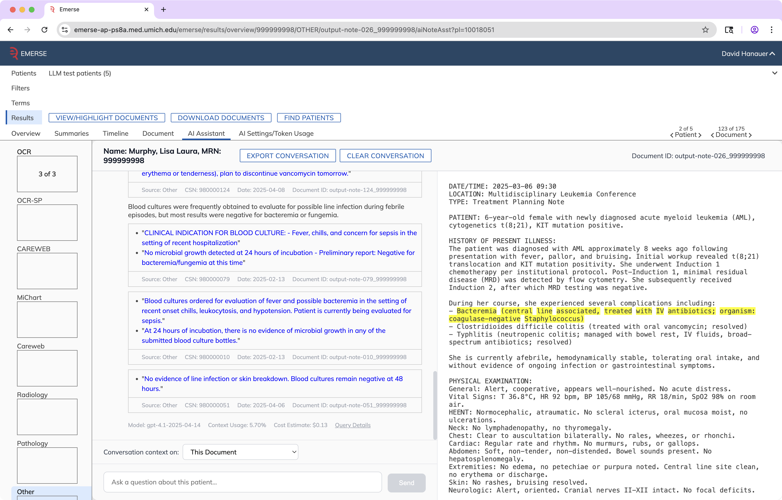

Slide 50
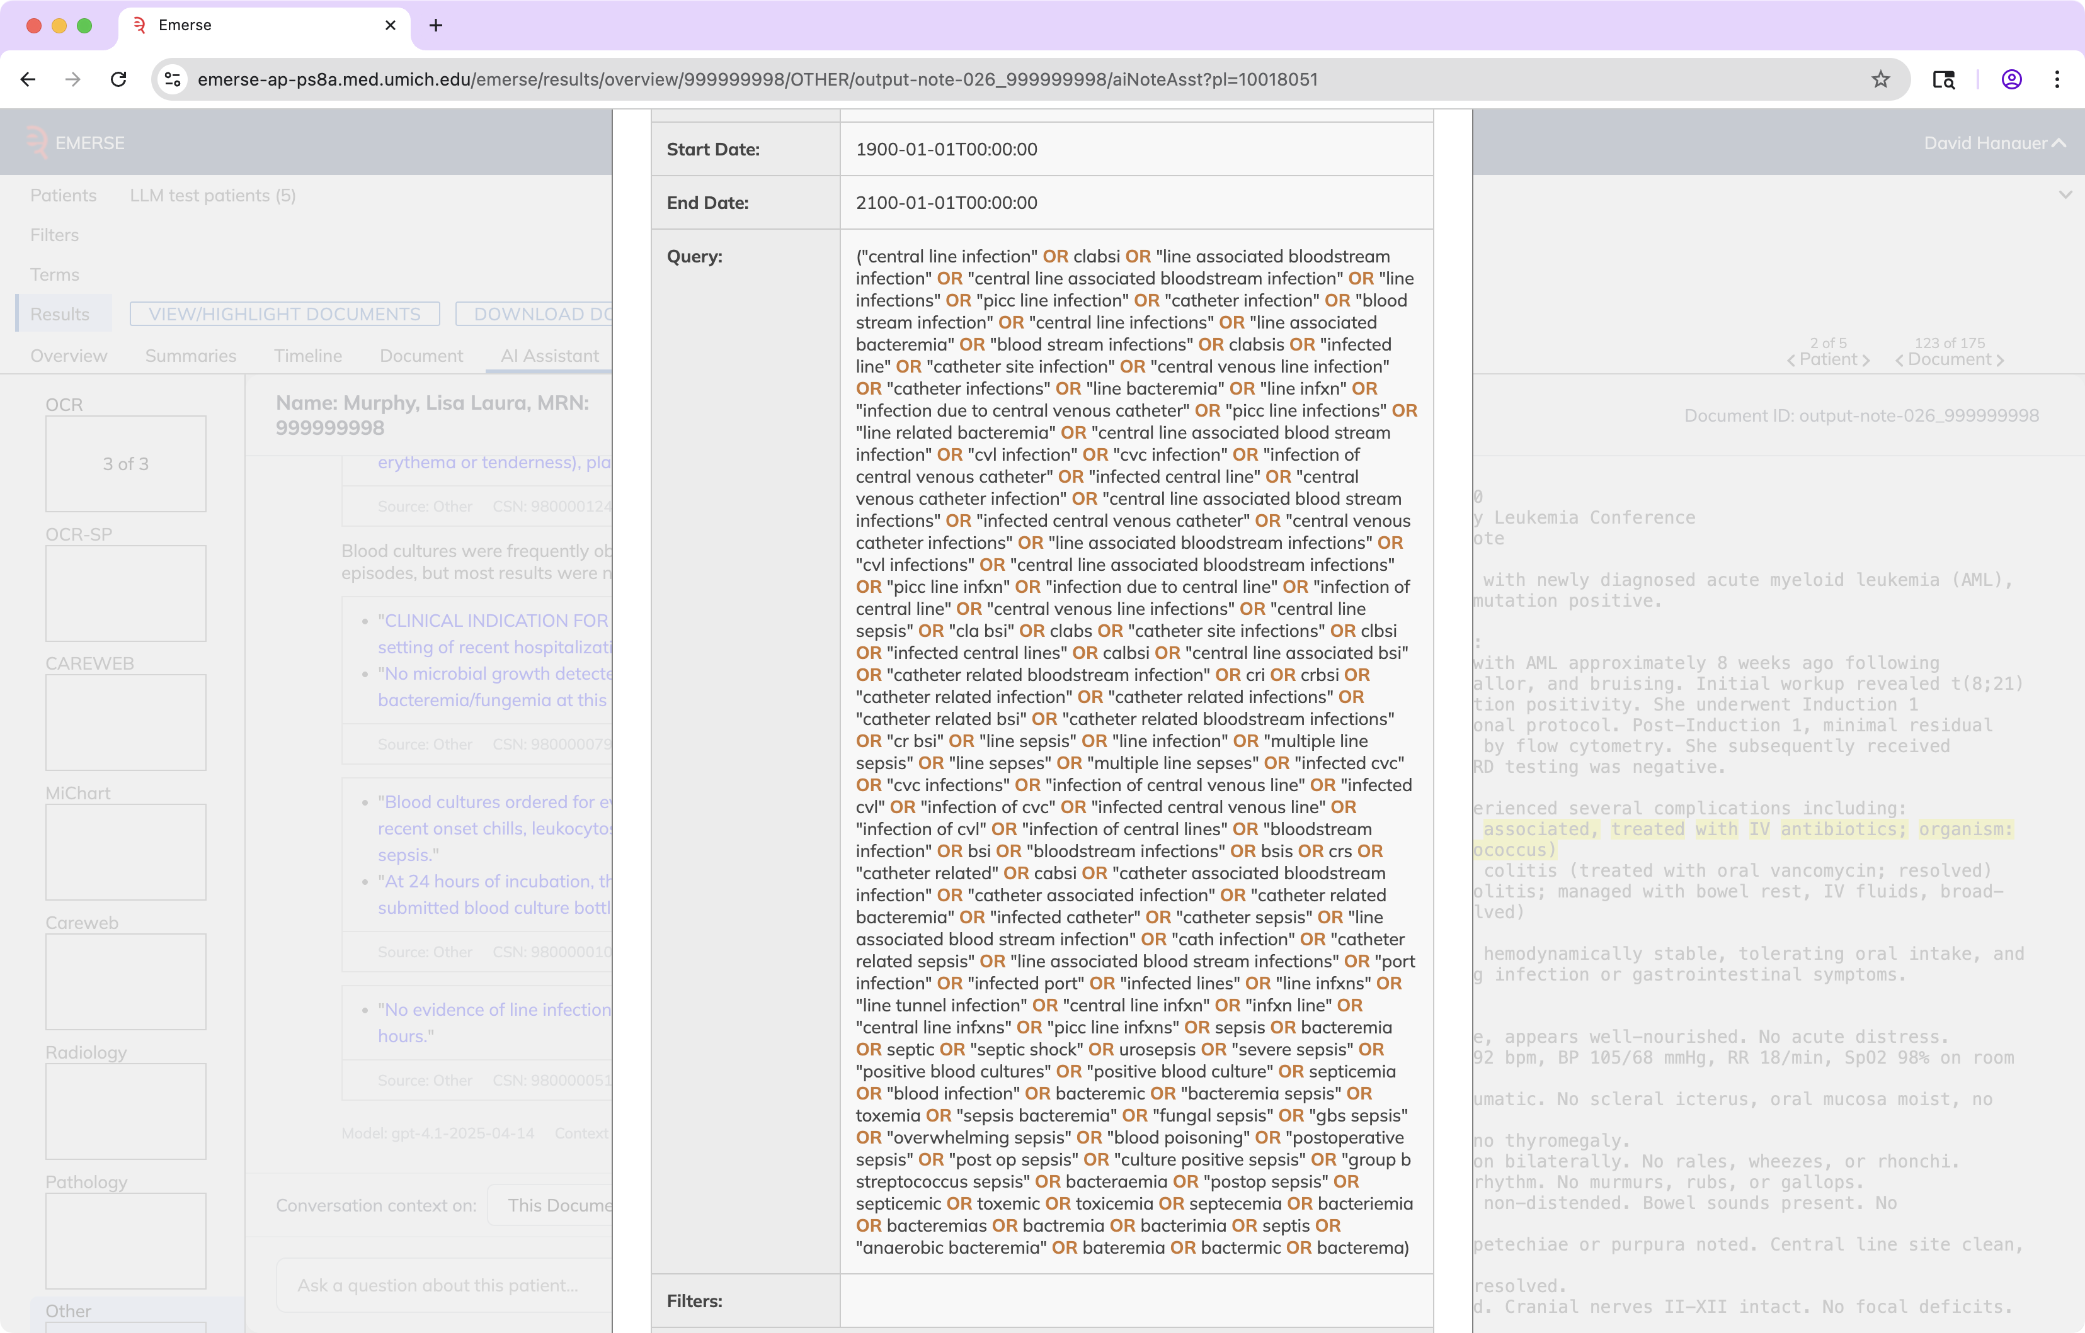

Slide 51
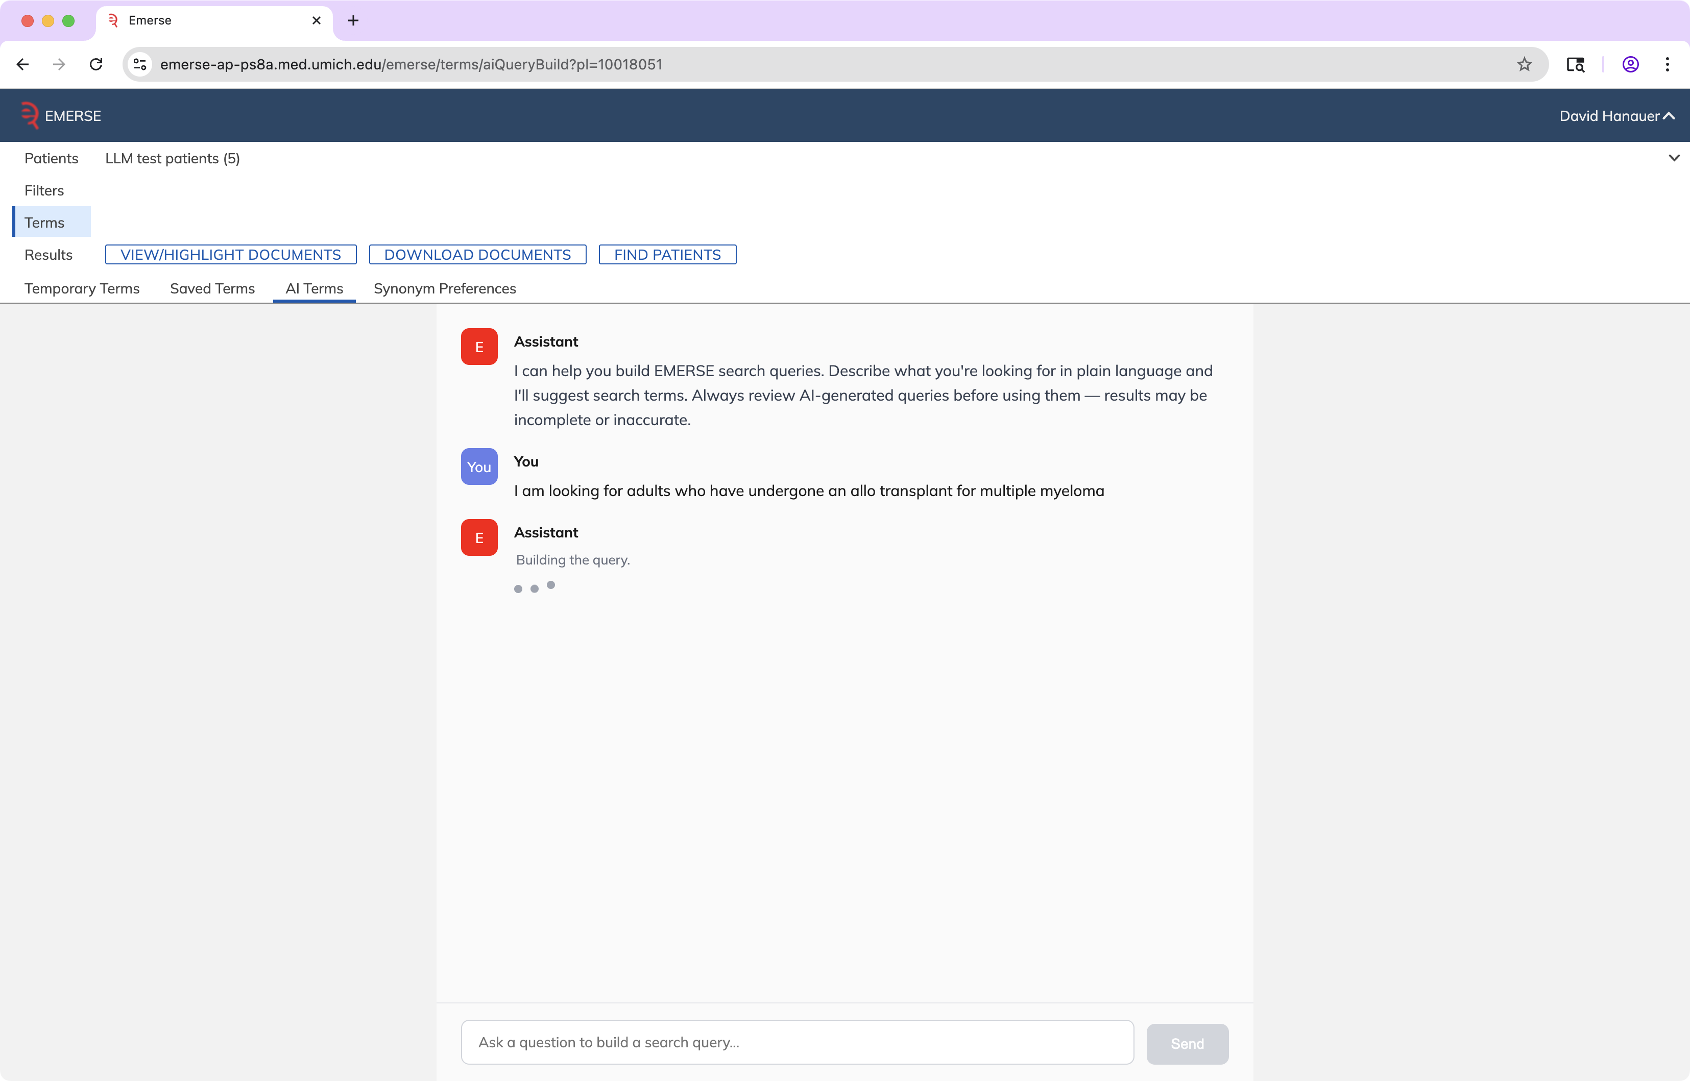
Query Generation

Slide 52
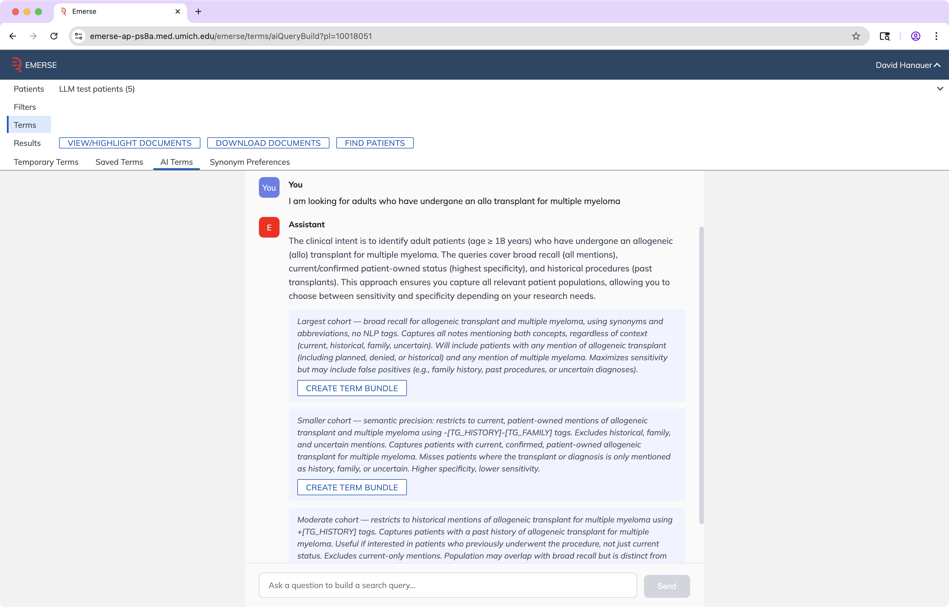

Slide 53
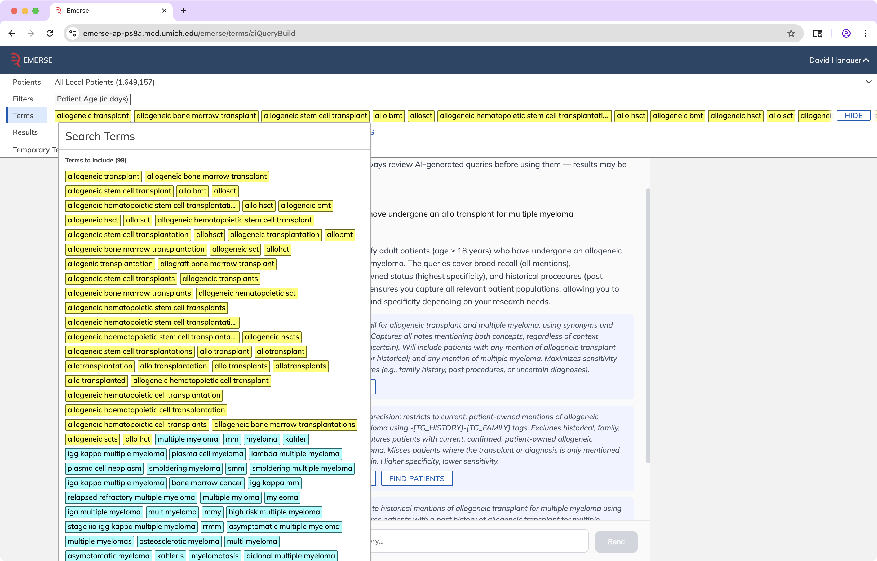

Slide 54
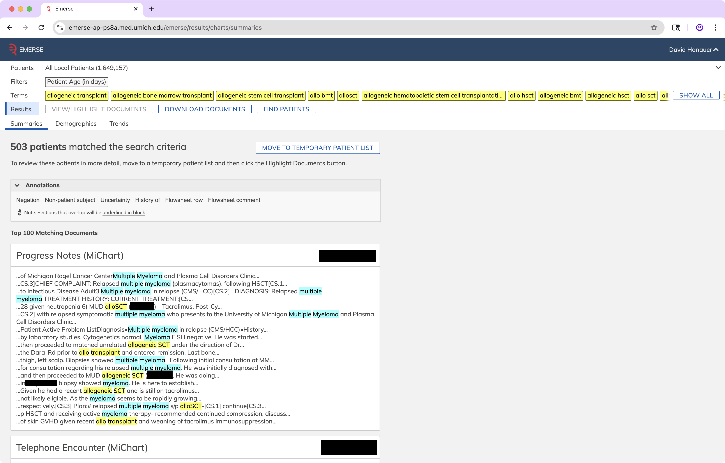

Slide 55
Initial Experiences
• LLMs are very powerful but multiple challenges remain
Cost
Speed
Completeness
Accuracy
Invalid JSON
Paraphrasing instead of direct quotes
Hallucinations – seems rare
http://project-emerse.org/presentations.html

Slide 56
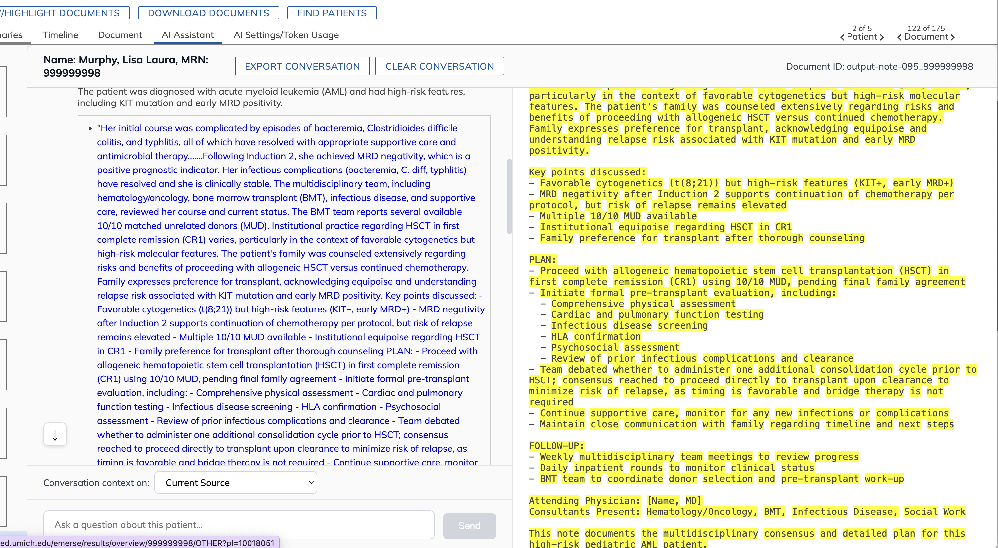
Quoting too much text

Slide 57
Invalid JSON question: why did the patient get a transplant?
[
{
"answer": "Treatment for acute myeloid leukemia (AML) via an allogeneic hematopoietic stem cell/bone marrow transplant.",
"quote": "status post allogeneic hematopoietic stem cell transplantation for AML"
},
{
"answer": "The transplant indication was AML (acute myeloid leukemia).",
"quote": "Day +220 post-allogeneic BMT for AML”,
}
]
http://project-emerse.org/presentations.html

Slide 58
Context window limitations
1 million token limit for context window
A quick check of our EHR identifies:
Patient with 9377 notes, 4.6 million tokens
Patient with 8675 notes, 7.5 million tokens
Need to sample, no guarantee can be “complete”
http://project-emerse.org/presentations.html

Slide 59

LLM work remains in progress
We are excited and optimistic about what will be possible
Users are eager to try out the upcoming capabilities
http://project-emerse.org/presentations.html

Slide 60


EMERSE-team@umich.edu
Lisa Ferguson
David Hanauer
Kellen McClain
Guan Wang
http://project-emerse.org/presentations.html

Slide 61




project-emerse.org
THANK
YOU!
http://project-emerse.org/presentations.html

